Slide 1
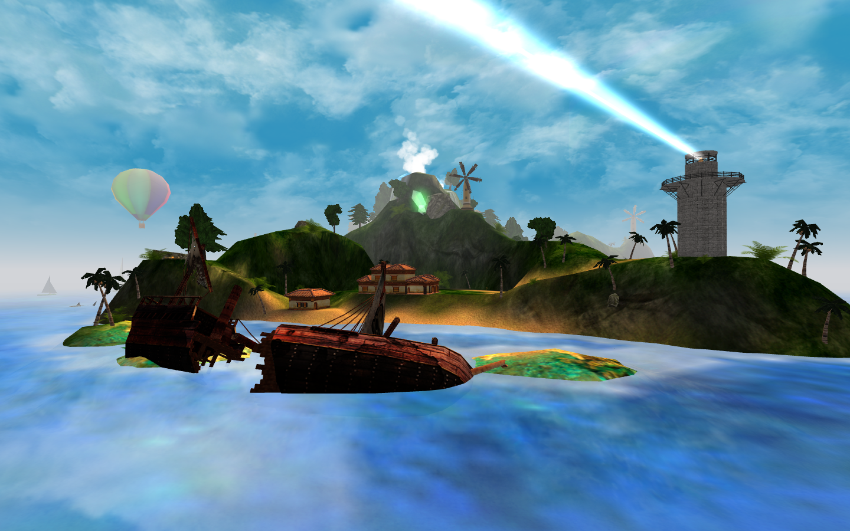
VIRTUAL WORLD
U4L3 Virtual Reality
作者：刘雅婷
单位：华南师范大学
We're living such a modern dream

Slide 2
We need this goal

Slide 3
Or so it seems
To find another kind of life

Slide 4
That shines

Slide 5
We're able to project our thoughts

Slide 6
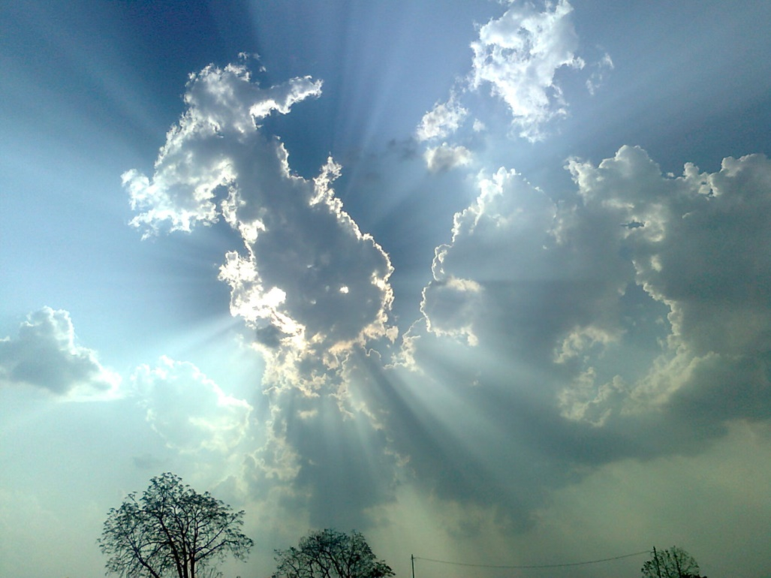
And paint our world with silver clouds

Slide 7
We're sketching lines up in the sky

Slide 8
To pass the time

Slide 9
There's life and love straight above

Slide 10
We're growing up inside

Slide 11
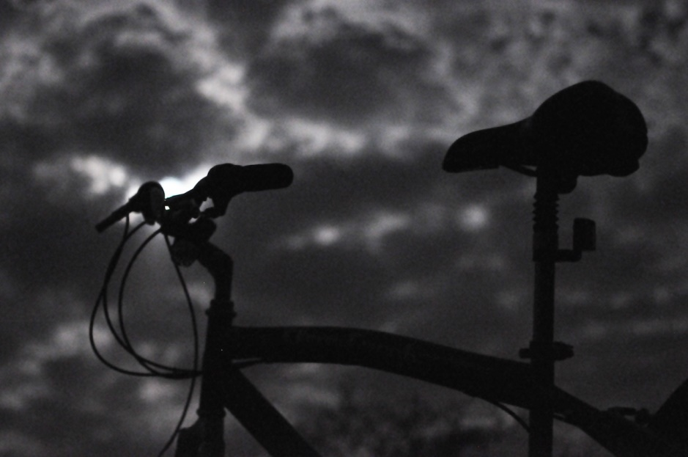
Let's get upon this moonlight ride

Slide 12
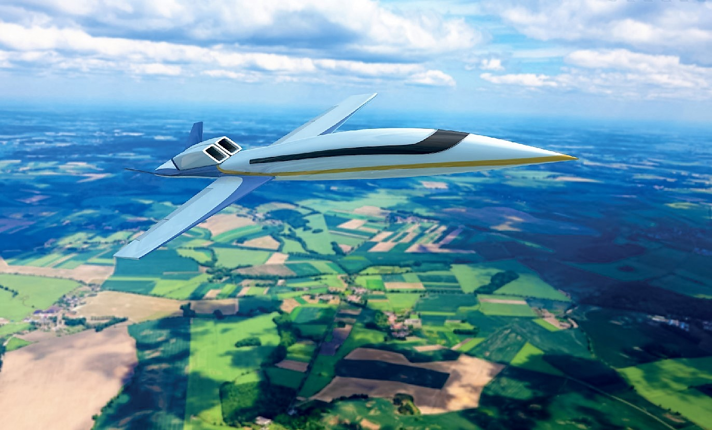
It's such a supersonic feeling

Slide 13
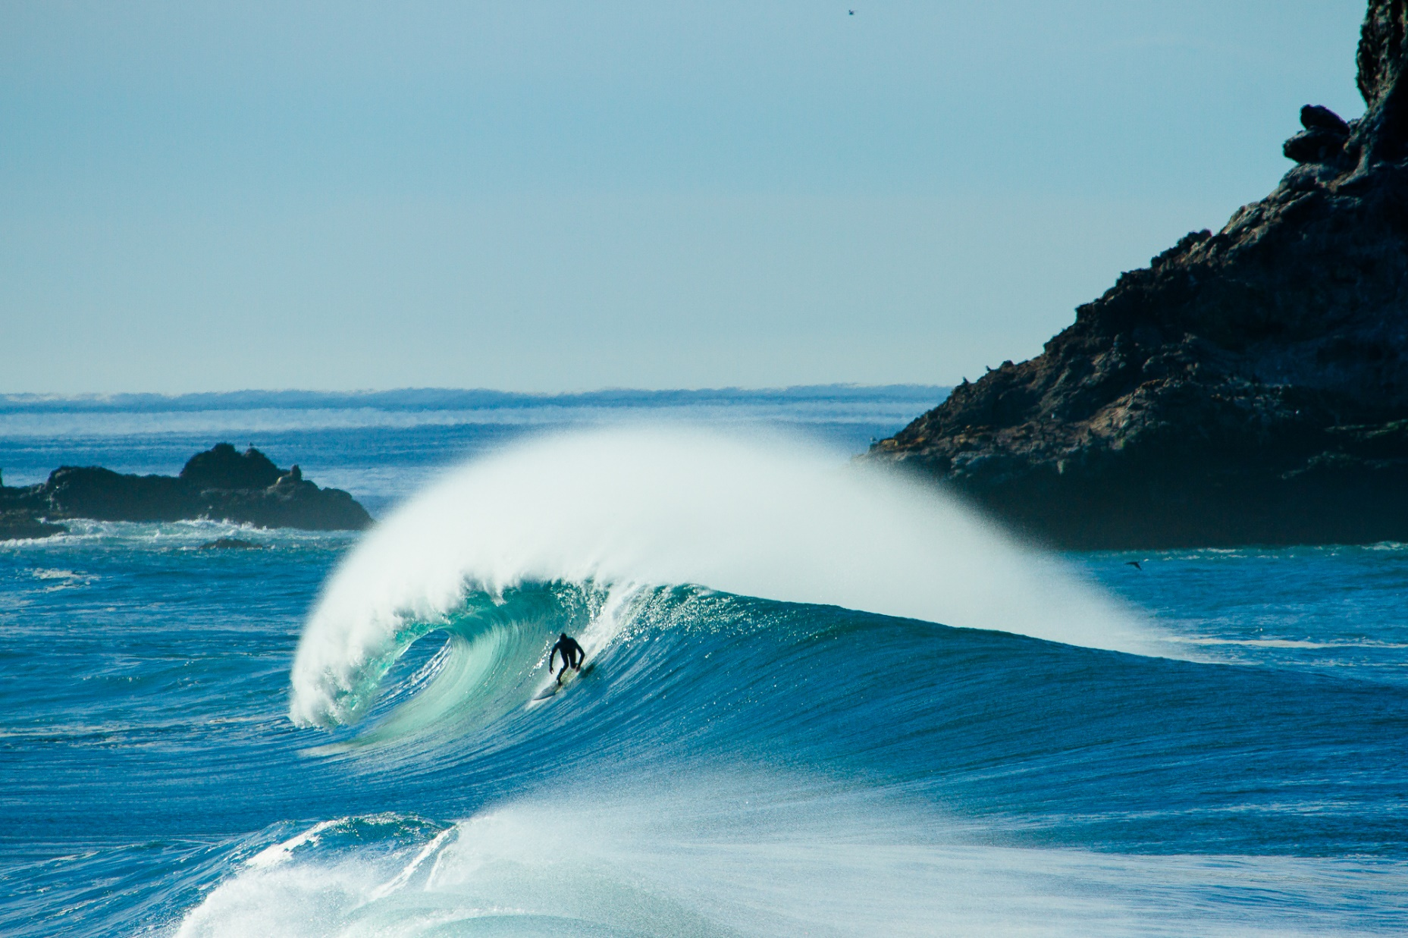
We're surfing through time

Slide 14
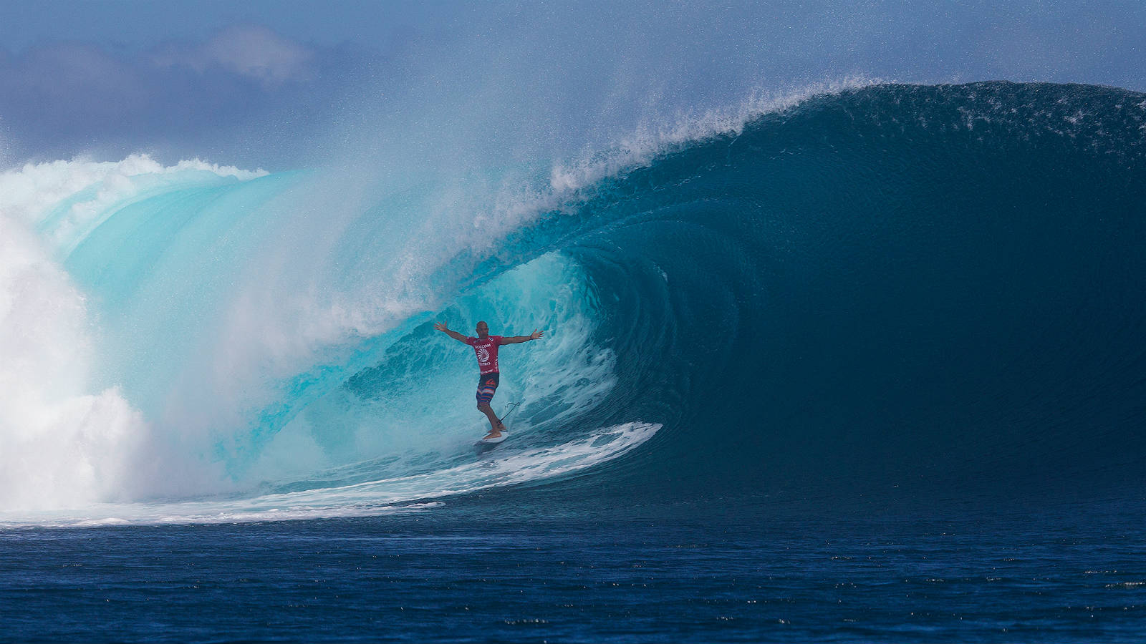
We can feel we're really moving

Slide 15
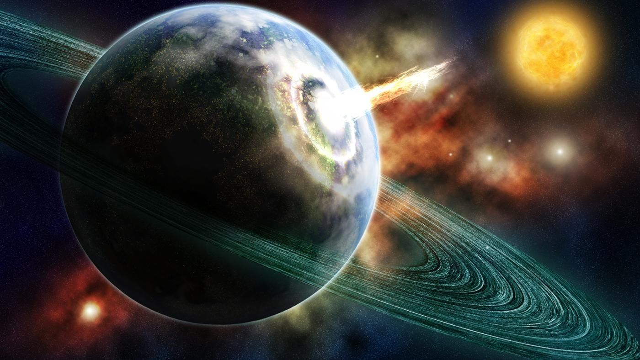
From the Earth to the light

Slide 16
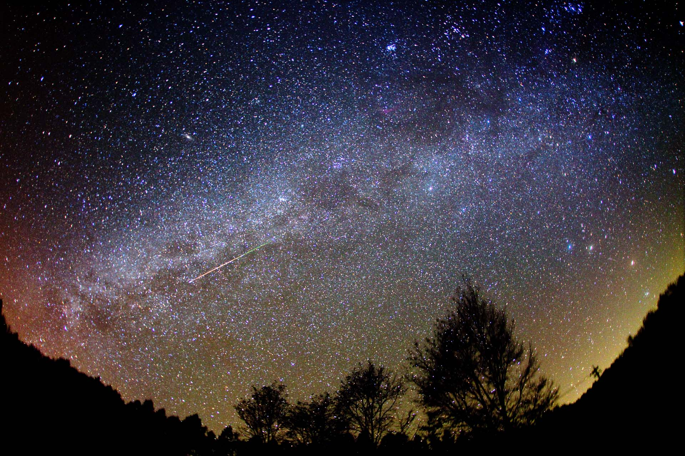
There are stars racing past

Slide 17
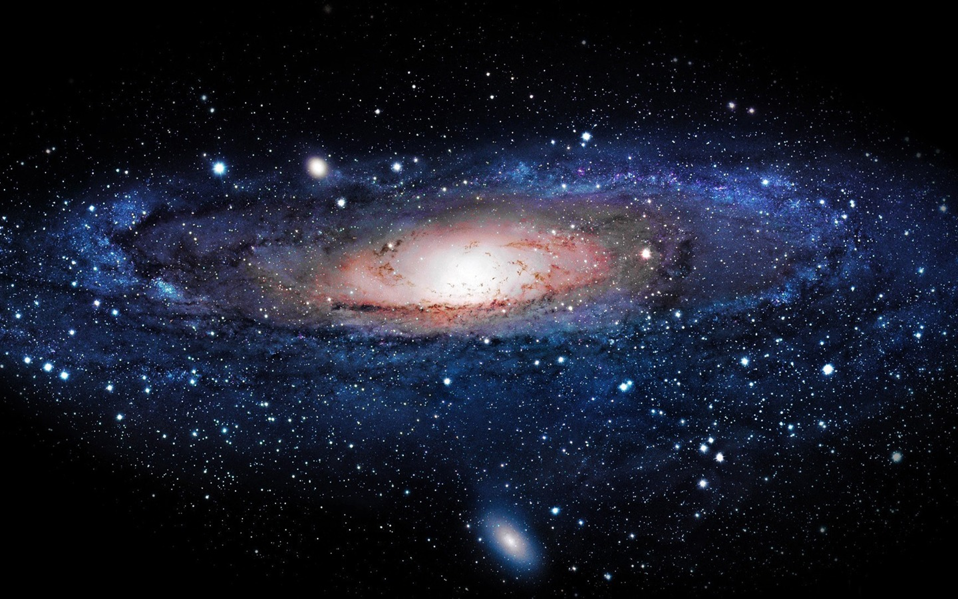
Zooming through the Milky Way

Slide 18
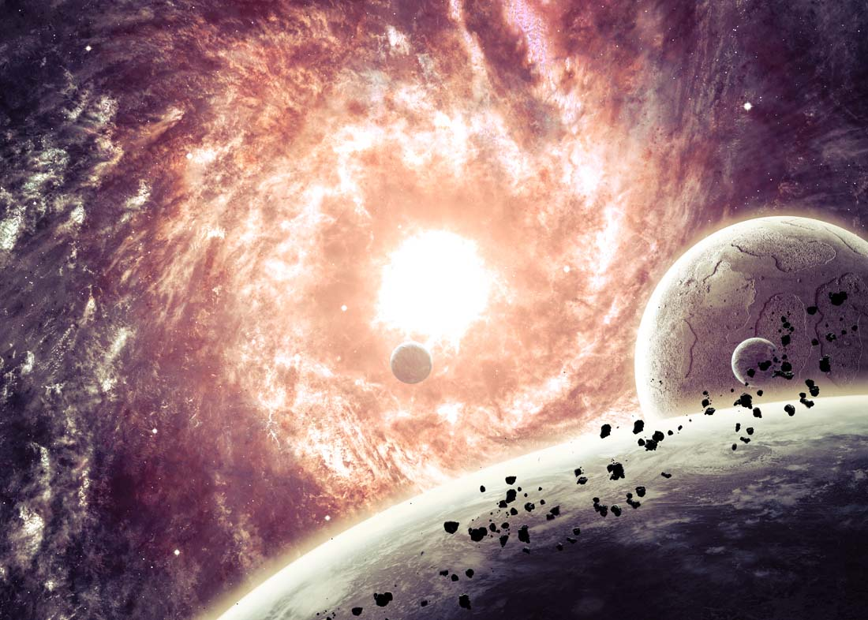
We have found a way to play

Slide 19
We are way up high

Slide 20
Flying out

Slide 21
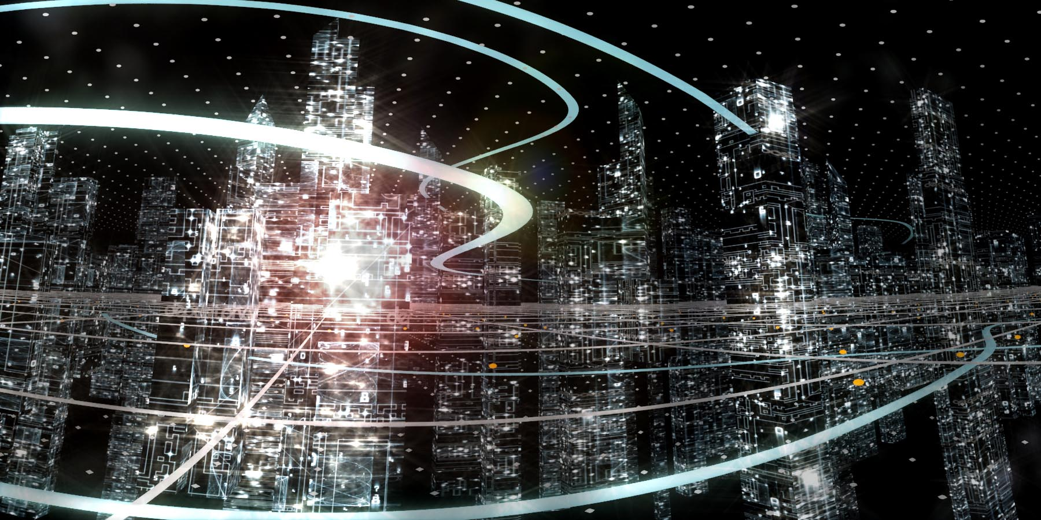
In this virtual world

Slide 22
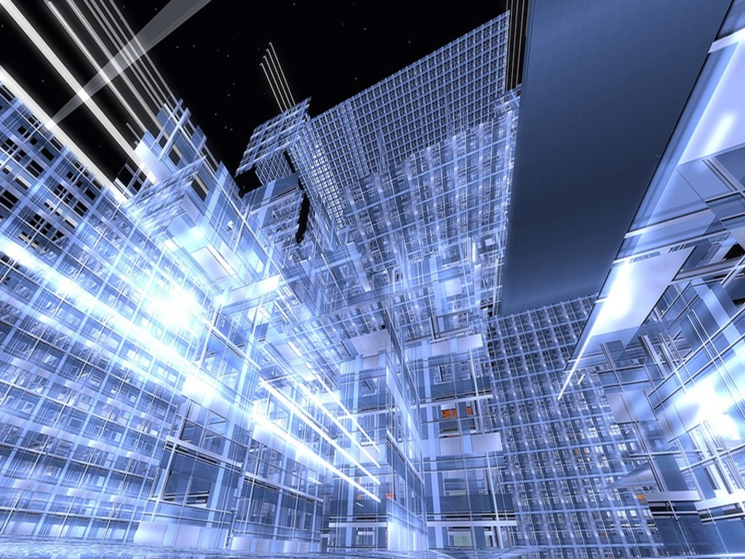
In this virtual world

Slide 23
Where is this song

Slide 24
Where is this light

Slide 25
Where are the limits of our minds?

Slide 26
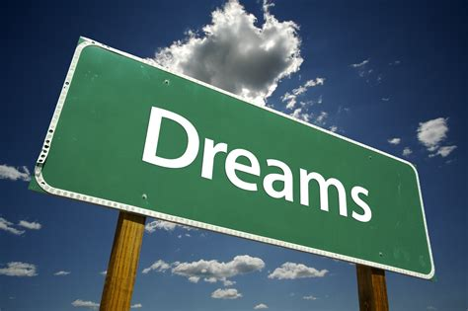
How do we get inside our dreams?

Slide 27
To analyze
What makes us fly out everyday?

Slide 28
We never really plan to stay

Slide 29
We do our work and go back home

Slide 30
This is our way

Slide 31
There's life and love
Straight above

Slide 32
We're growing up inside

Slide 33
Let's get upon this moonlight ride

Slide 34
It's such a supersonic feeling

Slide 35
We're surfing through time

Slide 36
We can feel we're really moving

Slide 37
From the Earth to the light

Slide 38
There are stars racing past

Slide 39
Zooming through the Milky Way

Slide 40
We have found a way to play

Slide 41
We are way up high

Slide 42
Flying out

Slide 43
In this virtual world

Slide 44
In this virtual world

Slide 45
Let's get upon this moonlight ride

Slide 46
It's such a supersonic feeling

Slide 47
We're surfing through time

Slide 48
We can feel we're really moving

Slide 49
From the Earth to the light

Slide 50
There are stars racing past

Slide 51
Zooming through the Milky Way

Slide 52
We have found a way to play

Slide 53
Let's get upon this moonlight ride

Slide 54
Let's get upon this moonlight ride

