Slide 1
When Christmas come to town
教材: 高中英语北师大版
单元: U3L4
主题：Christmas
作者：苏素琅 20160121051
单位：华南师范大学

Slide 2
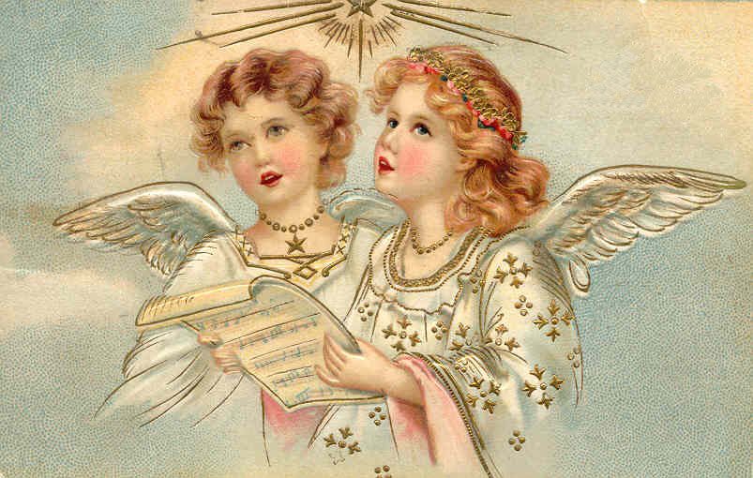

Slide 4
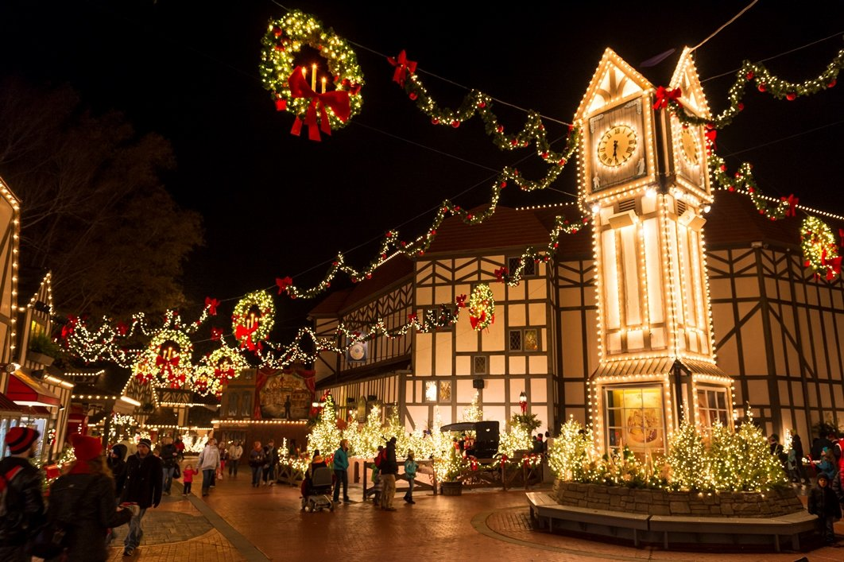

Slide 7
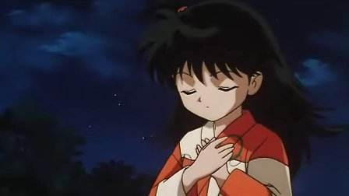
I'm wishing on a star

Slide 8
And trying to believe

Slide 9
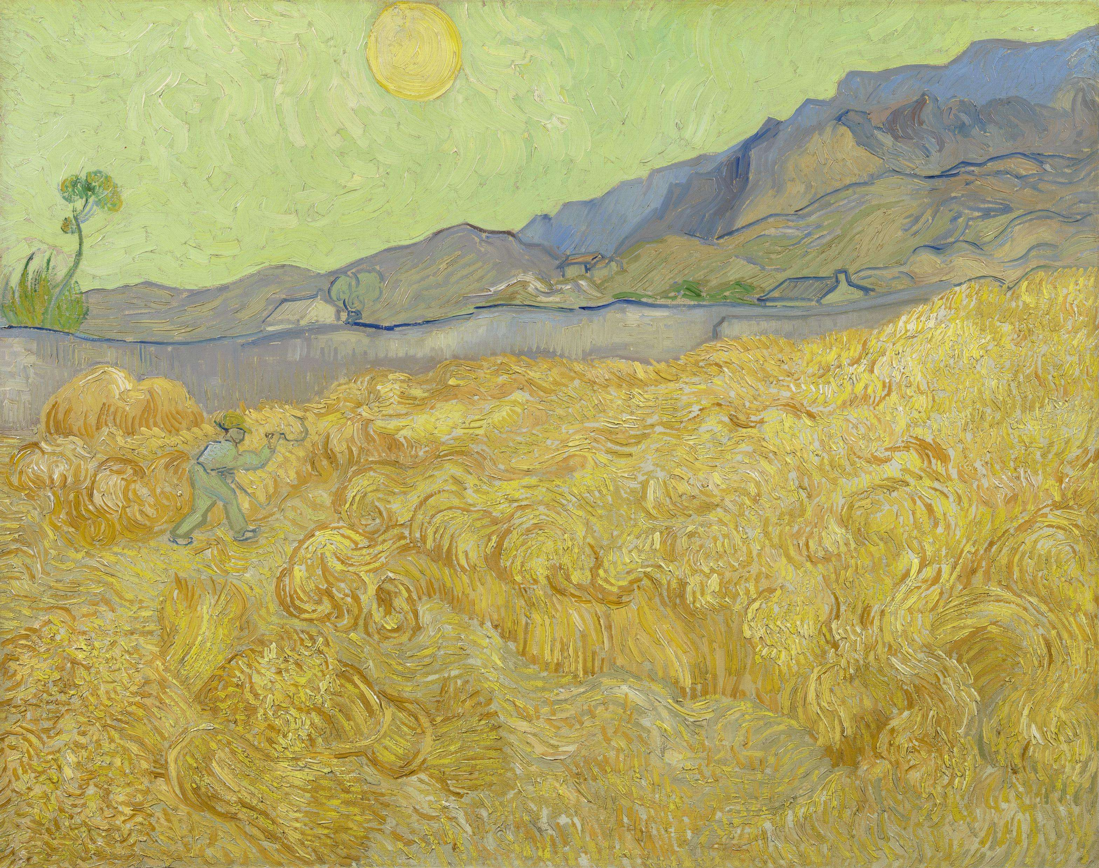
That even though it's far

Slide 10
He'll find me Christmas Eve

Slide 11
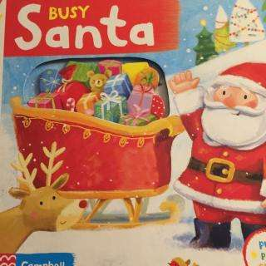
I guess that Santa's busy

Slide 12
Cause he's never come around

Slide 13
I think of him

Slide 14
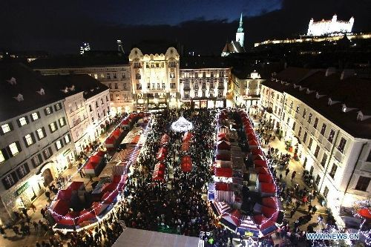
When Christmas Comes to Town

Slide 17
The best time of the year

Slide 18
When everyone comes home

Slide 19
With all this Christmas cheer

Slide 20
It's hard to be alone

Slide 21
Putting up the Christmas tree

Slide 22
With friends who come around

Slide 23
It's so much fun

Slide 24
When Christmas Comes to Town

Slide 25
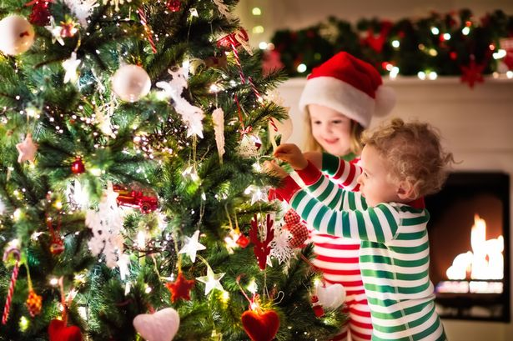
Presents for the children

Slide 26
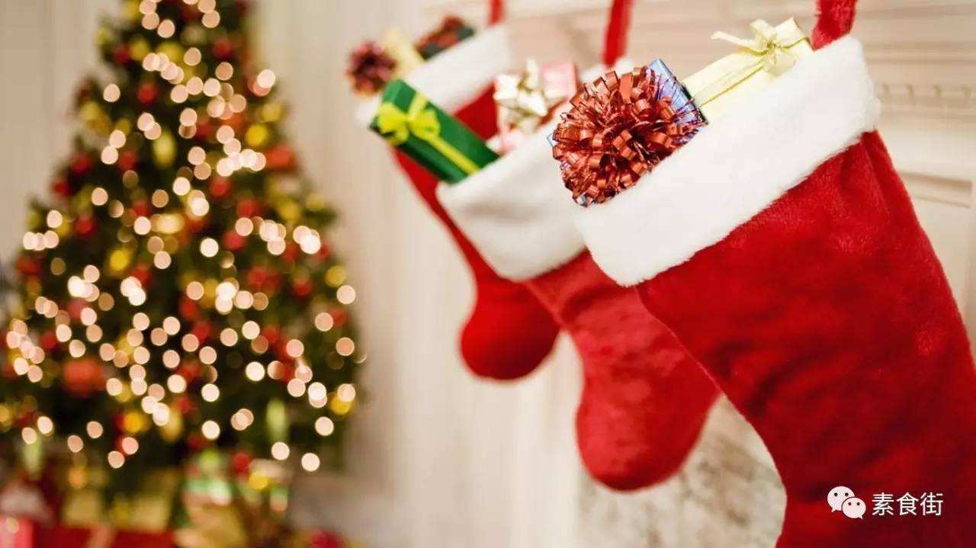
Wrapped in red and green

Slide 27
All the things I've heard about

Slide 28
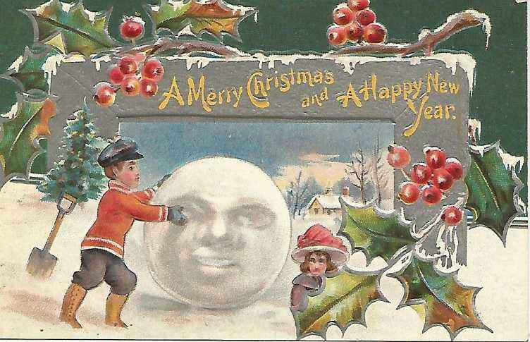
But never really seen

Slide 29
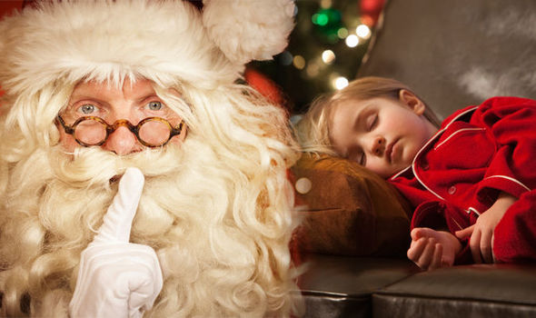
No one will be sleeping on

Slide 30
The night of Christmas Eve

Slide 31
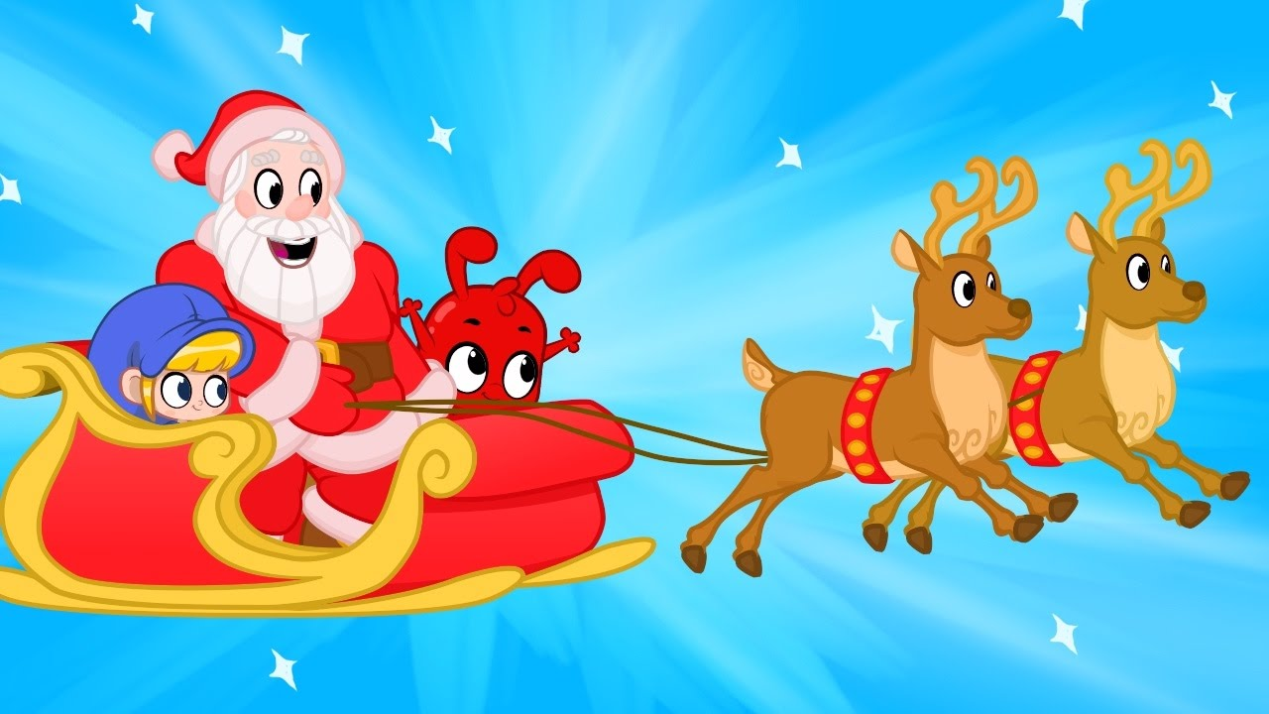
Hoping Santa's on his way

Slide 38
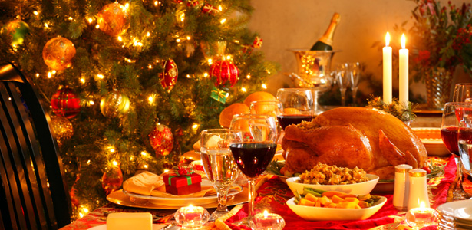
Presents for the children

Slide 39
Wrapped in red and green

Slide 40
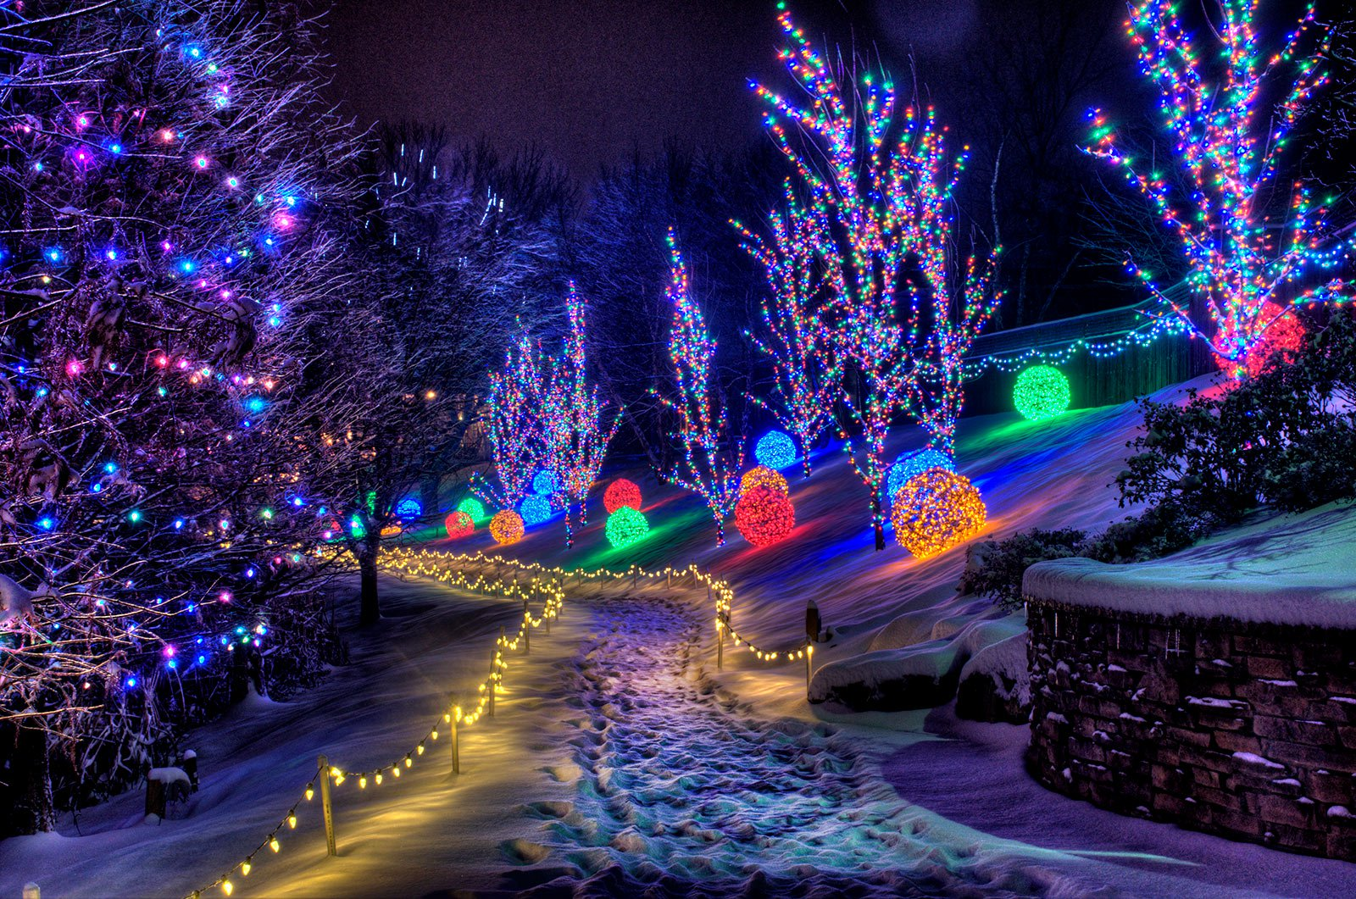
All the things I've heard about

Slide 41
But never really seen

Slide 42
No one will be sleeping on

Slide 43
The night of Christmas Eve

Slide 44
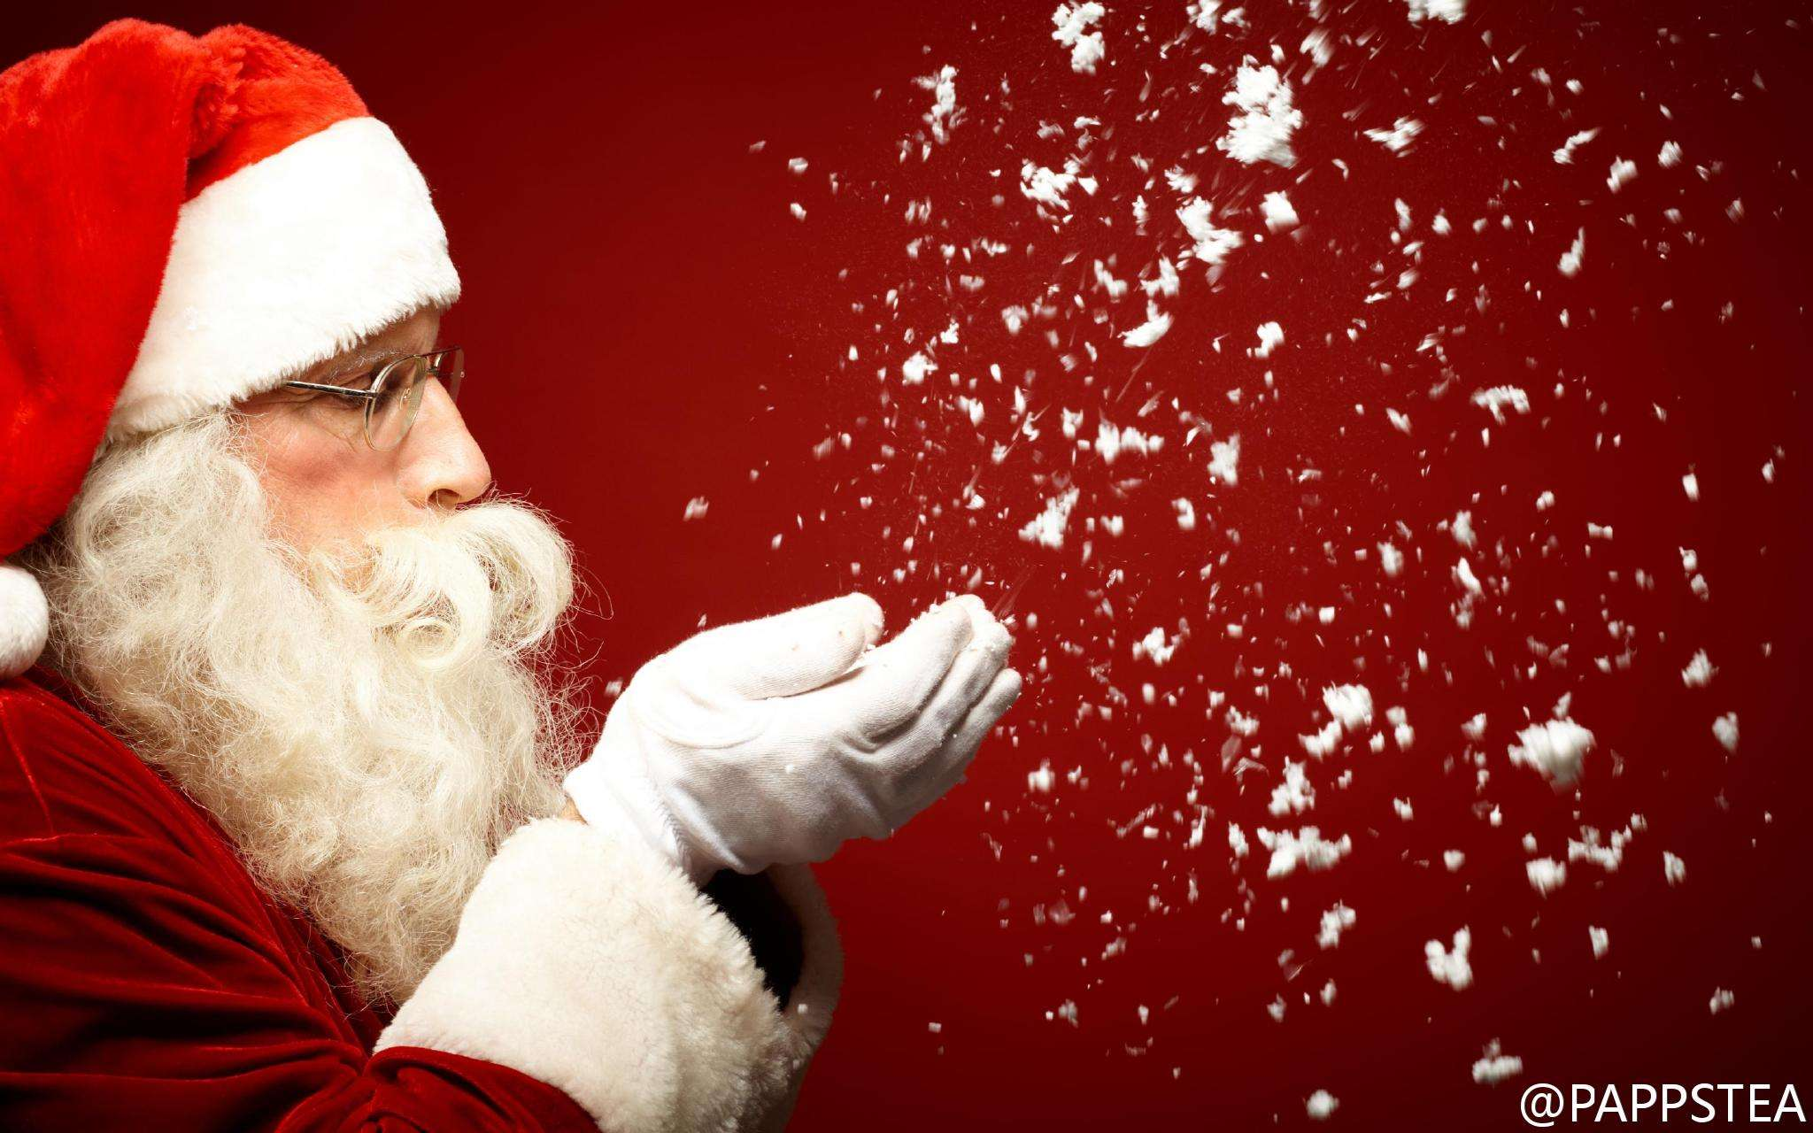
Hoping Santa's on his way

Slide 45
When Santa's sleigh bells ring

Slide 46
I listen all around

Slide 47
The herald angels sing

Slide 48
I never hear a sound

Slide 49
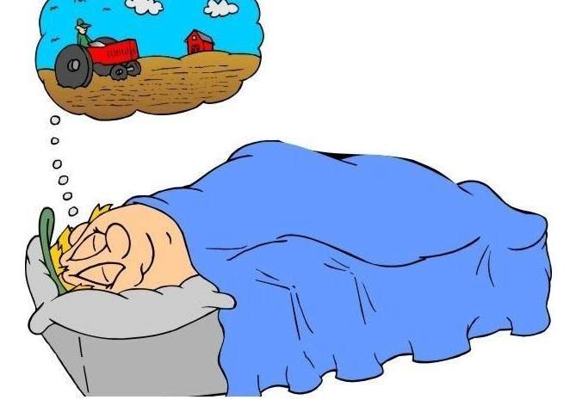
When all the dreams of children

Slide 50
Once lost will all be found

Slide 51
That's all I want

Slide 52
When Christmas Comes to Town

Slide 54
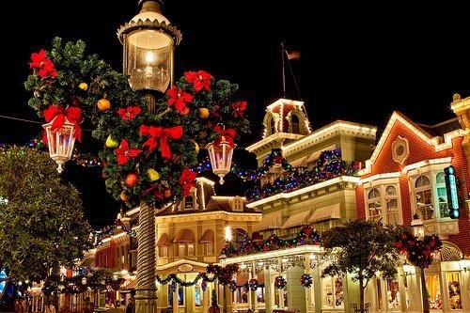
That's all I want

Slide 55
When Christmas Comes to Town

Slide 58
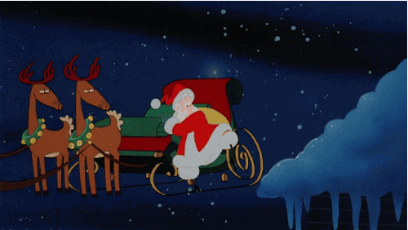

Slide 60
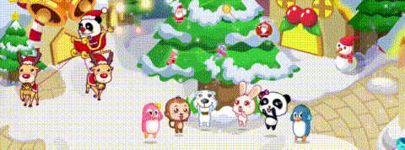

Slide 62
