Slide 1
PEP U3L2 Party Song：Good time Singer: Carly Rae Jepsen
作者：邓益花
单位：华南师范大学

Slide 2
It's always a good time

Slide 3
Woke up on the right side of the bed

Slide 4
What's up with this Prince song inside my head?

Slide 5
Hands up if you're down to get down tonight

Slide 6
Cuz it's always a good time.

Slide 7
Slept in all my clothes like I didn't care

Slide 8
Hopped into a cab, take me anywhere

Slide 9
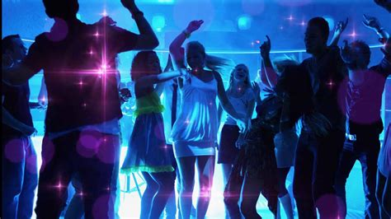
I'm in if you're down
to get down tonight

Slide 10
Cuz it's always a good time

Slide 11
Cuz it's always a good time
Good morning and good night

Slide 12
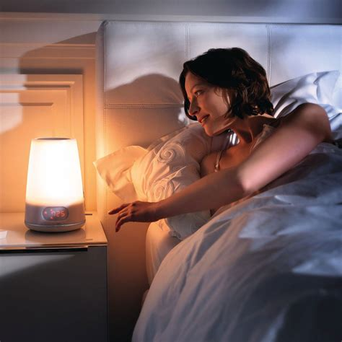
I wake up at twilight

Slide 13
It's go be alright

Slide 14
We don't even have to try
It's always a good time

Slide 15
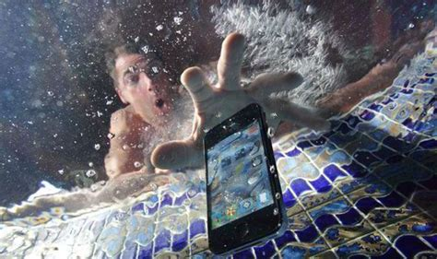
Feet down dropped my phone in the pool again

Slide 16
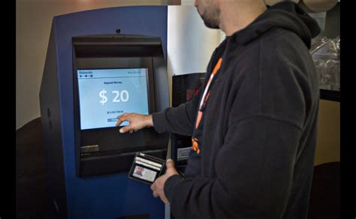
Checked out of my room
hit the ATM

Slide 17
Let's hang out if you're down
to get down tonight
Cuz it's always a good time

Slide 18
Good morning and good night
、

Slide 19
I wake up at twilight

Slide 20
It's go be alright we don't even have to try
It's always a good time.
We don't even have to try, it's always a good time.
It's always a good time
We don't even have to try, it's always a good time.

Slide 21
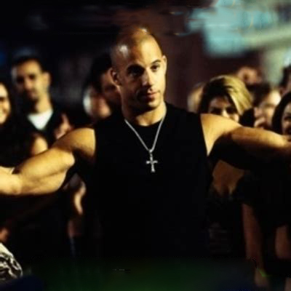
Doesn't matter when

Slide 22
It's always a good time then
It's always a good time
We don't even have to try, it's always a good time
It's always a good time
We don't even have to try, it's always a good time

