Slide 1
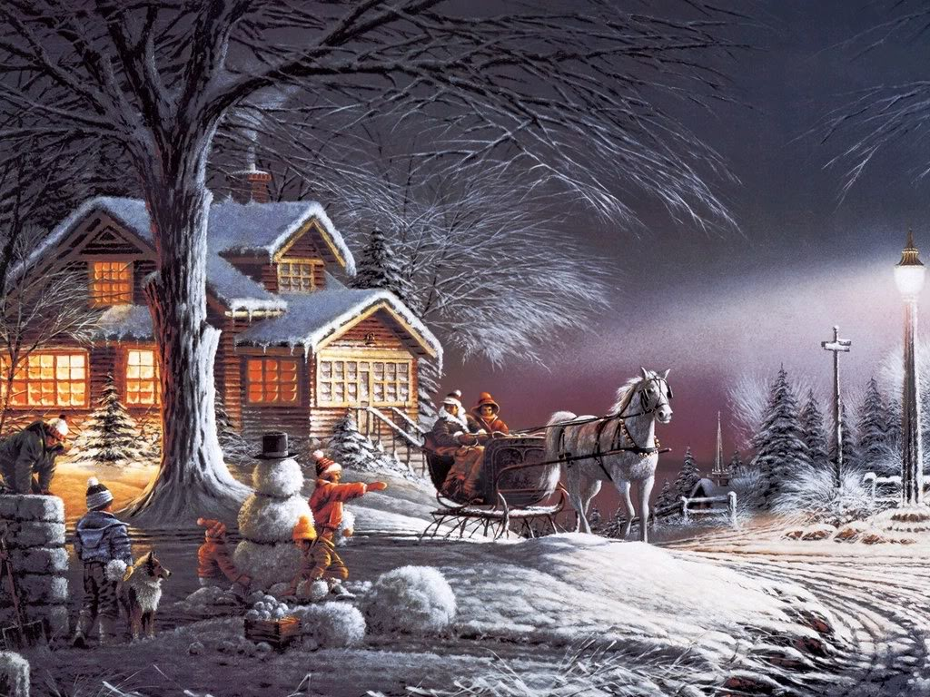
北师大, U3L1, Festival
Song：Silent night
Editor: 柳丽莉
单位：华南师范大学

Slide 2
Silent night, holy night

Slide 3
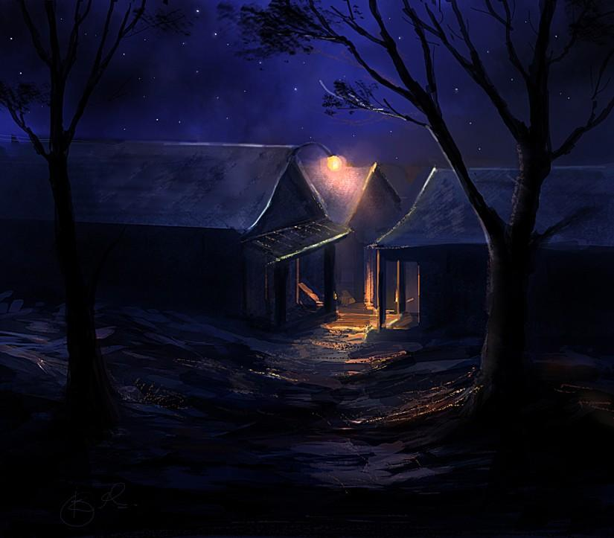
All is calm

Slide 4
All is bright

Slide 5
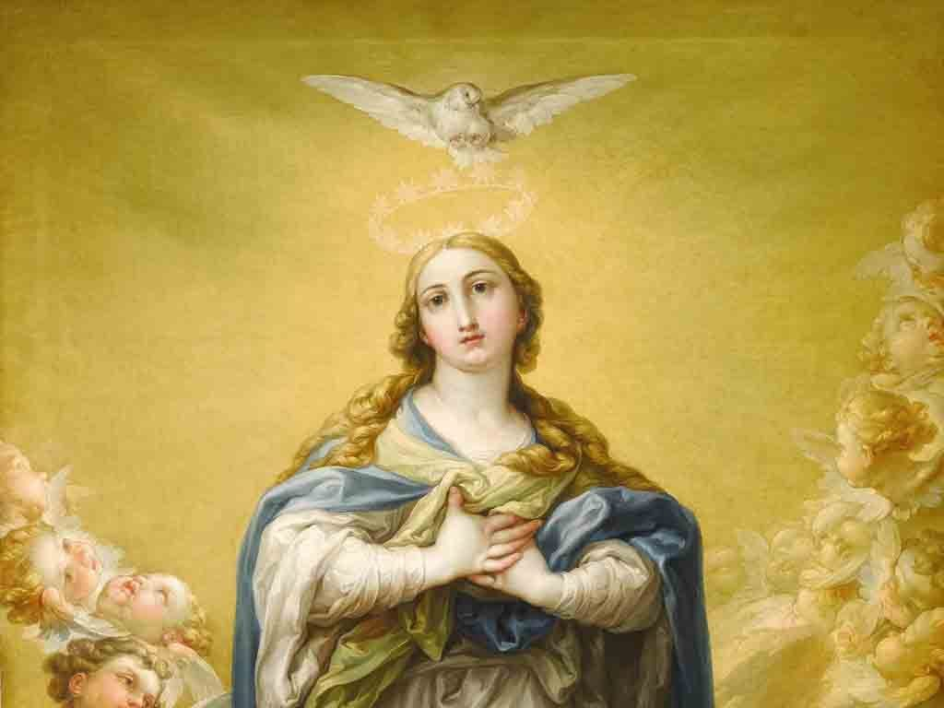
Round yon virgin mother and child

Slide 6
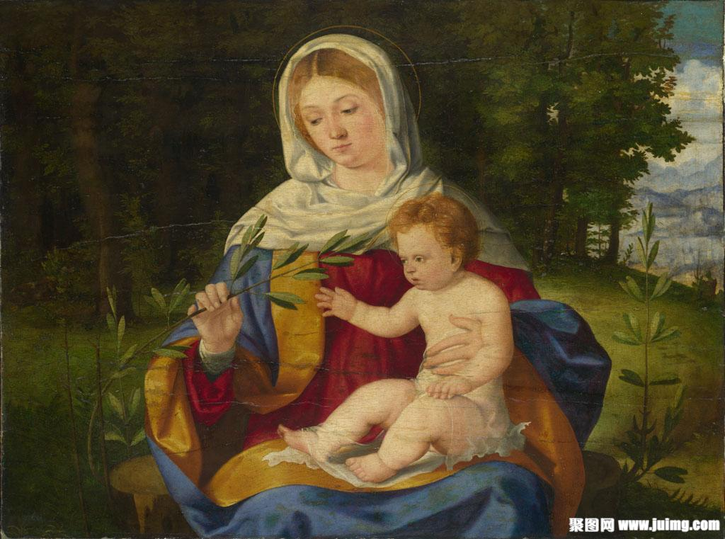
Holy infant so tender and mild

Slide 7
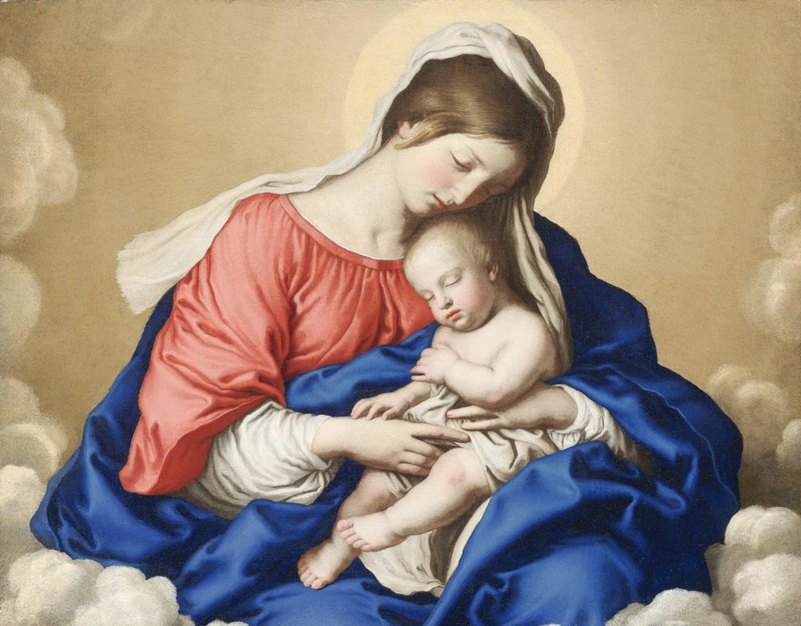
Sleep in heavenly peace

Slide 8
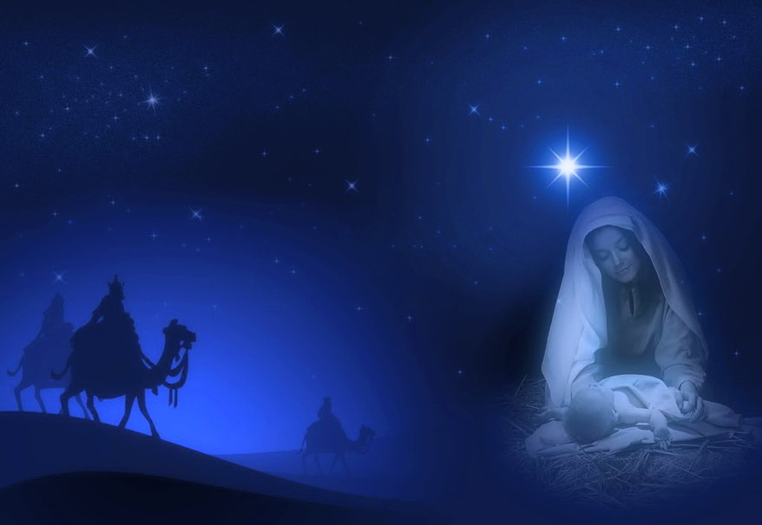
Sleep in heavenly peace

Slide 9
Silent night, holy night

Slide 10
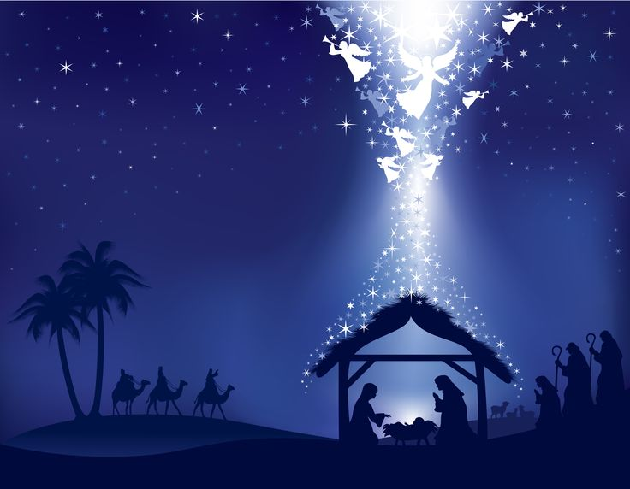
Son of God

Slide 11
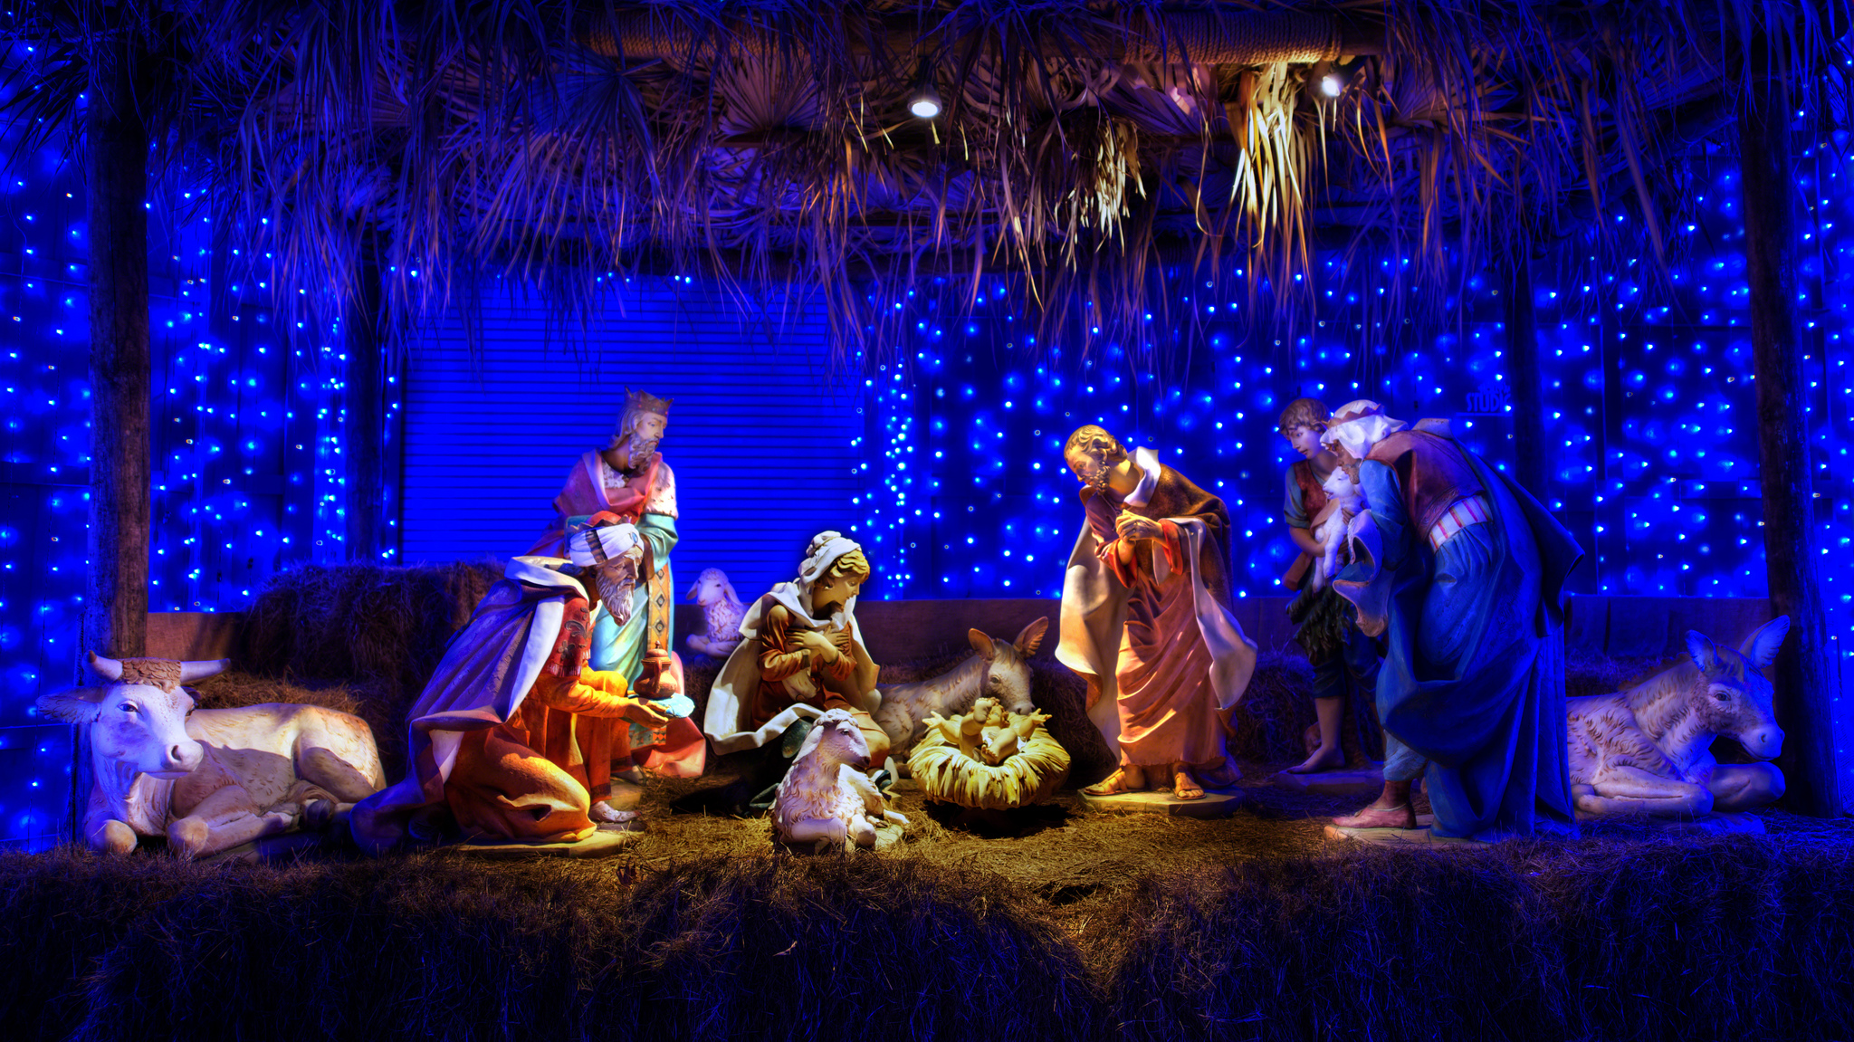
love's pure light

Slide 12
Radiant beams from thy holy face

Slide 13
With the dawn of redeeming grace

Slide 14
Christ, the Savior is born

Slide 15
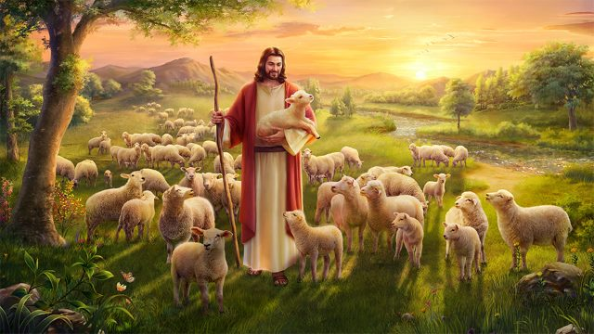
Christ, the Savior is born

Slide 16
Christ, the Savior is born

Slide 17
Thank you

