Slide 1
U2L4：Superhero
Song： Superhero
Singer： Simon Curtis
作者：章宇熙
单位：华南师范大学

Slide 2
Oops——

Slide 3
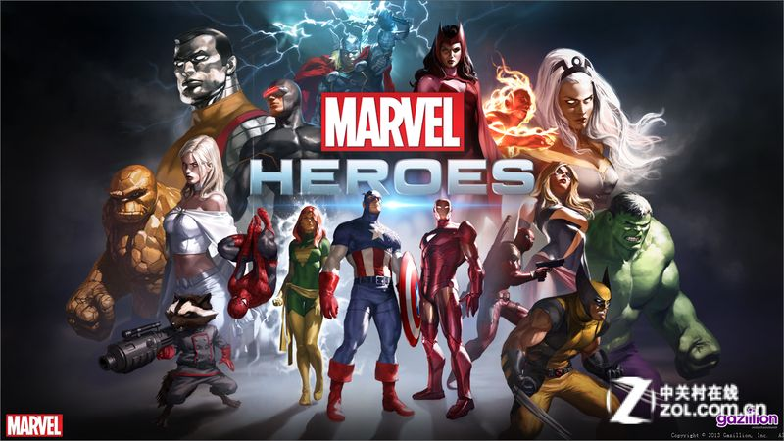
Stand up' everybody's lookin' love
Say c'mon' c'mon' c'mon we're gonna get it now

Slide 4
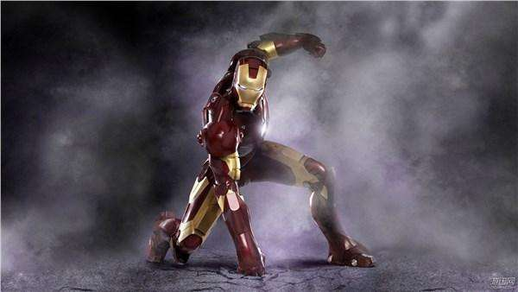
Hands up if you're ready for a fight' say
C'mon' c'mon' c'mon we're gonna win it now

Slide 5
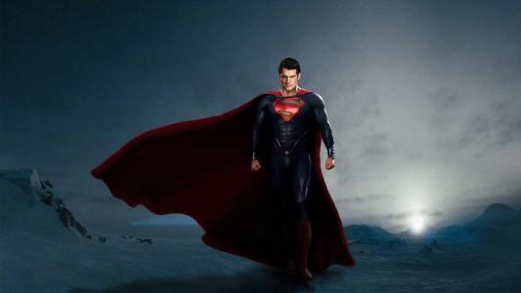
I don't need you to believe in me
I know how to change my destiny

Slide 6
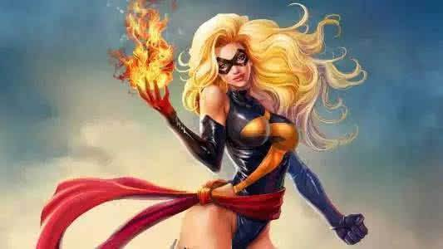
Same down but we are the hisotry'
we are the history' we are the history...

Slide 7
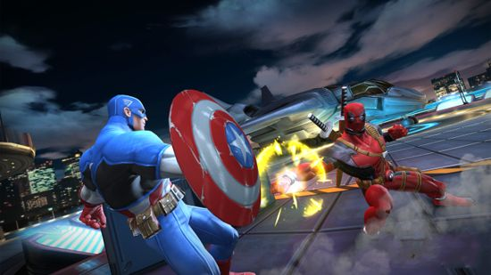
We can change the whole world'
gonna take it over' gonna start it over
Don't you know that we could be

Slide 8
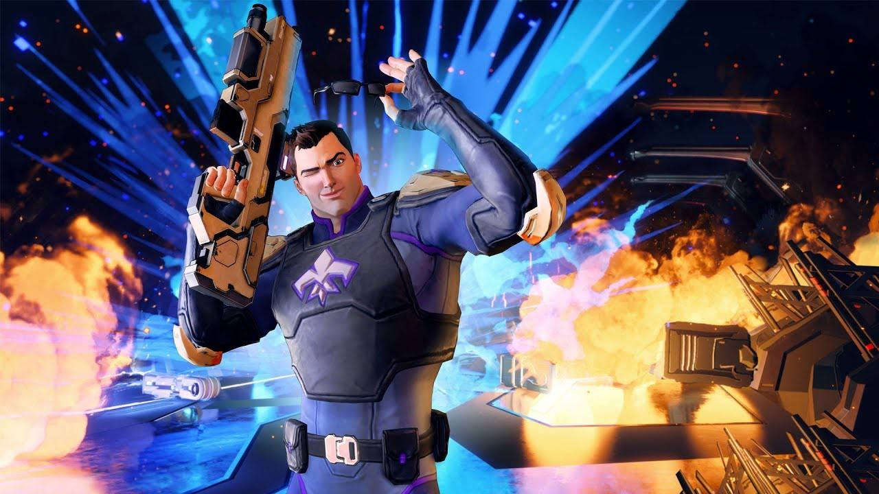
A new beginning' fighting 'til the winning
Tell me that you're in it
Don't you wanna be

Slide 9
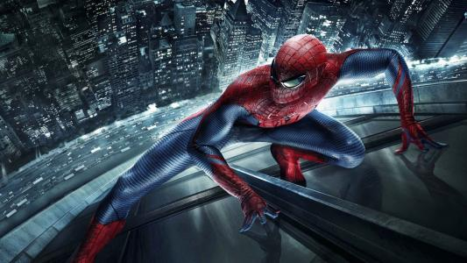
A superhero' superhero' superhero
Don't you wanna be

Slide 10
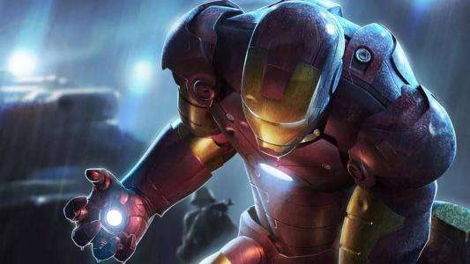
A superhero' superhero' superhero
Anybody could be ······

Slide 11
Rip it off' show the symbol on your chest
Say c'mon and show the world who you really are

Slide 12
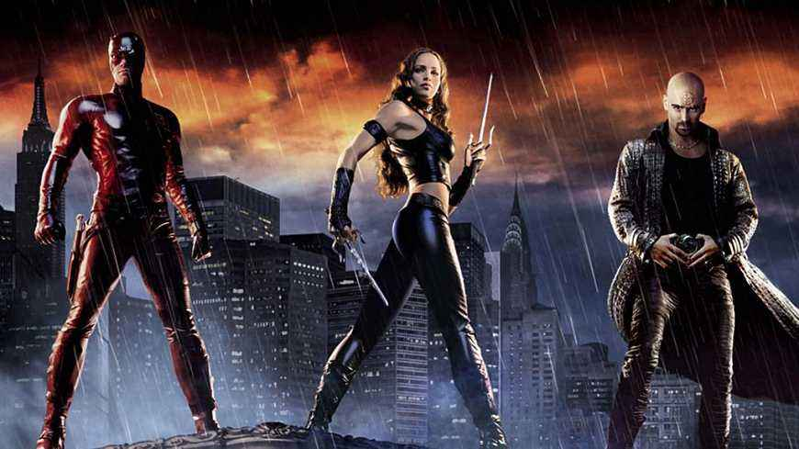
It's not enough to be better than the rest
Gotta take it to the top'
Make yourself a superstar

Slide 13
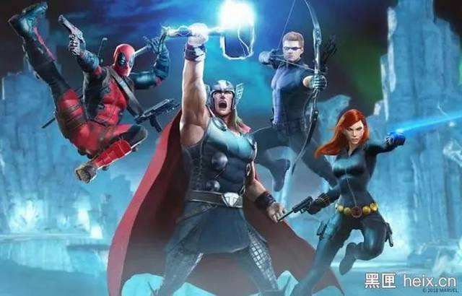
You don't need them to believe in you
Get your mission on lock and see 'em through

Slide 14
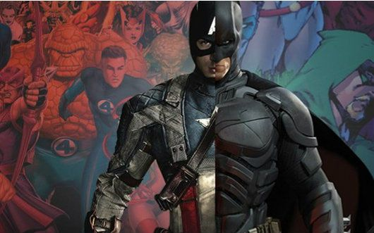
You've got all the power you need in you'
power you need in you' power you need in you

Slide 15
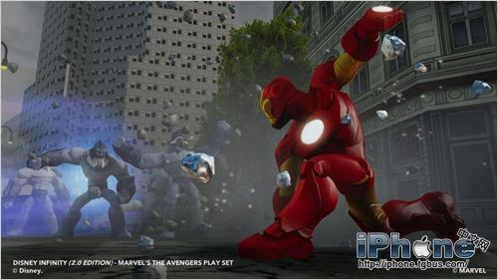
We can change the whole world'
gonna take it over' gonna start it over
Don't you know that we could be

Slide 16
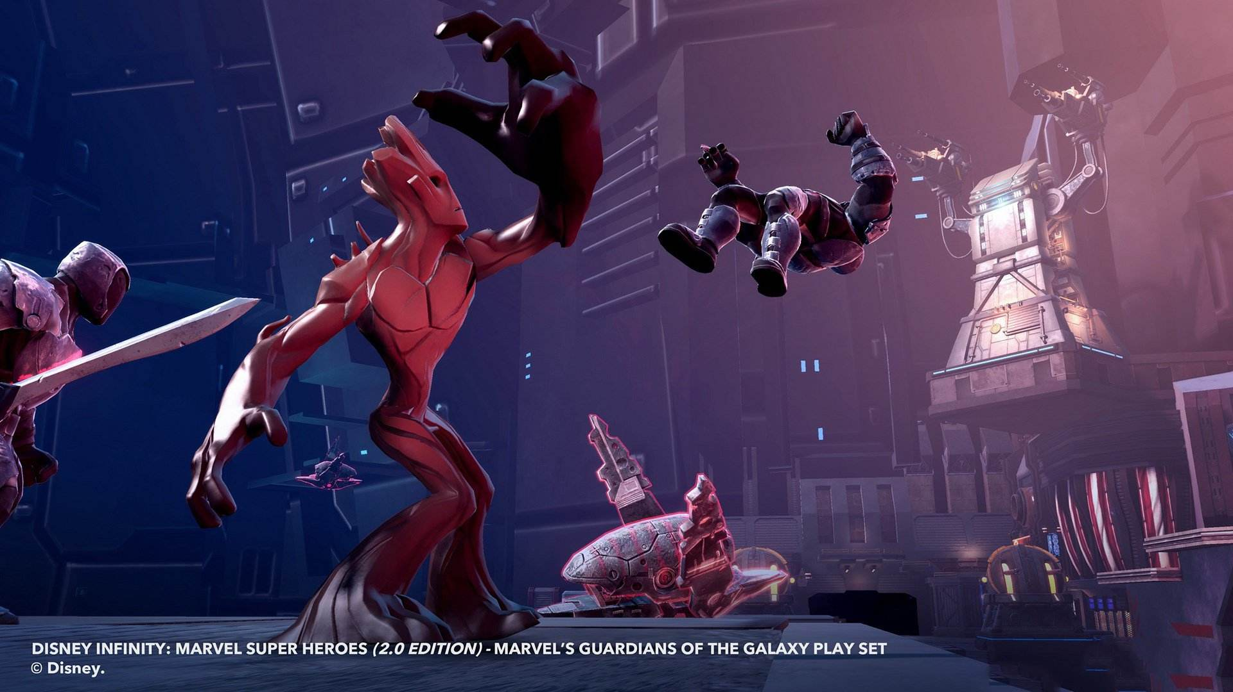
A new beginning' fighting 'til the winning
Tell me that you're in it
Don't you wanna be

Slide 17
A superhero' superhero' superhero
Don't you wanna be

Slide 18
A superhero' superhero' superhero
Anybody could be

Slide 22
We can change the whole world'
gonna take it over' gonna start it over
Don't you know that we could be

Slide 23
A new beginning' fighting 'til the winning
Tell me that you're in it
Don't you wanna be

Slide 24
A superhero' superhero' superhero
Don't you wanna be

Slide 25
A superhero' superhero' superhero
Anybody could be

Slide 26
We can change the whole world'
gonna take it over' gonna start it over
Don't you know that we could be

Slide 27
A new beginning' fighting 'til the winning
Tell me that you're in it
Don't you wanna be

Slide 28
A superhero' superhero' superhero
Don't you wanna be

Slide 29
A superhero' superhero' superhero
Anybody could be ··· ···

