Slide 1
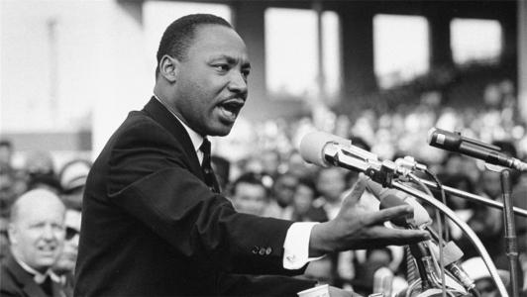
高中英语北师大版 U2L2 “History Maker”
Song: I have a dream
Singer：westlife
Editor: 刘晶 Stella
单位：华南师范大学

Slide 2
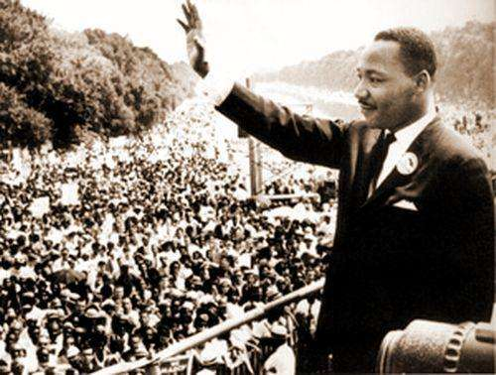
I have a dream
a song to sing

Slide 3
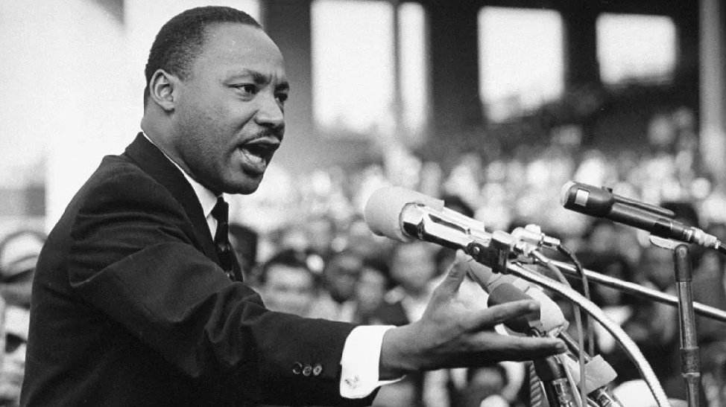
To help me cope
with anything

Slide 4
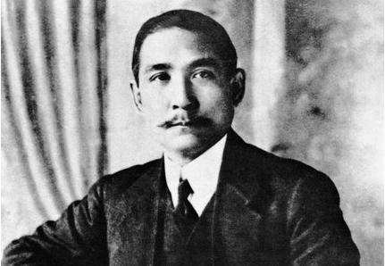
If you see the wonder of a fairy tale

Slide 5
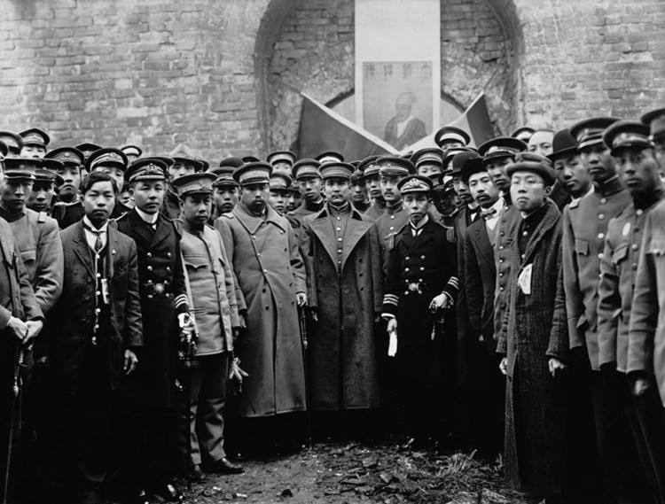
You can take the future even if you fail

Slide 6
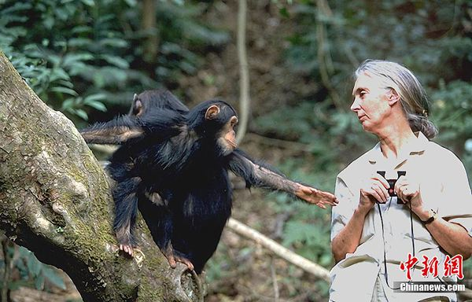
I believe in angels

Slide 7
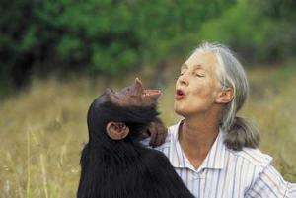
Something good in
everything I see

Slide 8
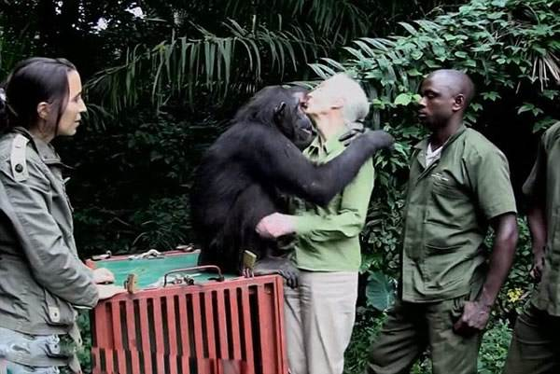
I believe in angels

Slide 9
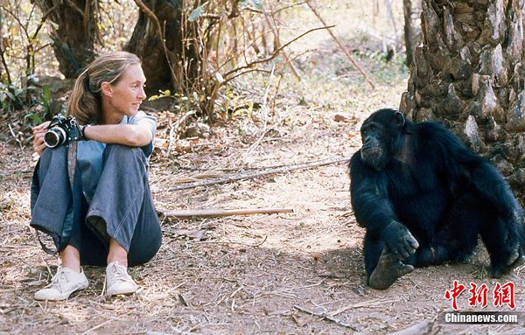
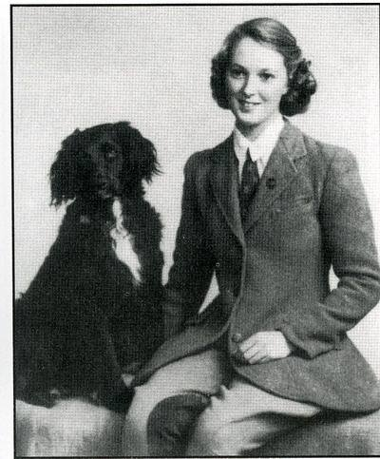
When I know the time is right for me

Slide 10
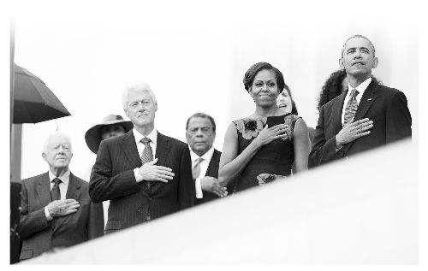
I cross the stream
I have a dream

Slide 11
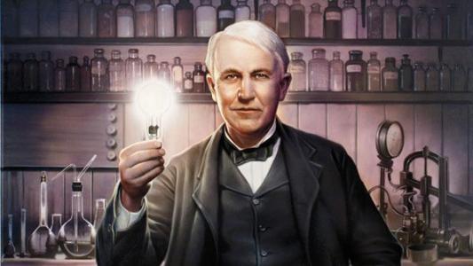
I have a dream a fantasy
To help me through reality

Slide 12
And my destination
makes it worth
the while

Slide 13
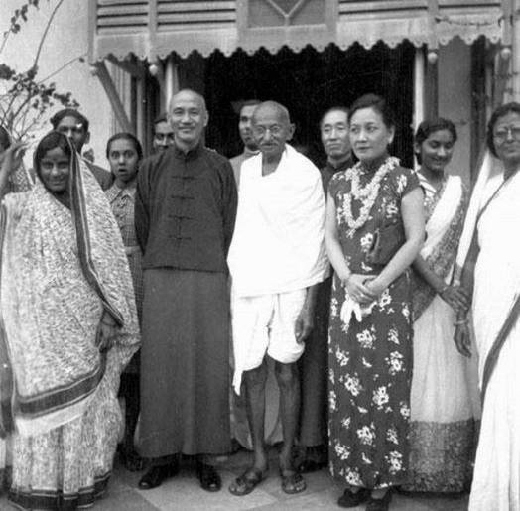
Pushing through the darkness still another mile

Slide 14
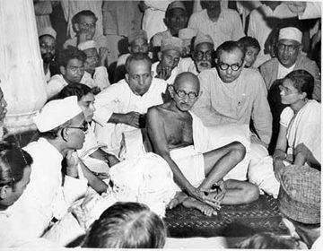
I believe in angels Something good in everything I see

Slide 15
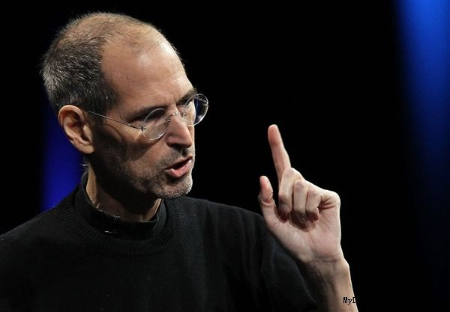
I believe in angels When I know the time is right for me

Slide 16
I cross the stream
I have a dream

Slide 17
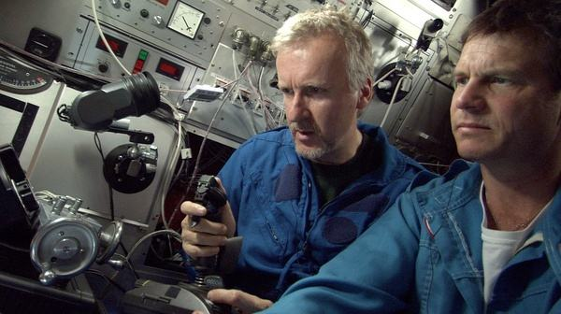
I have a dream
a song to sing

Slide 18
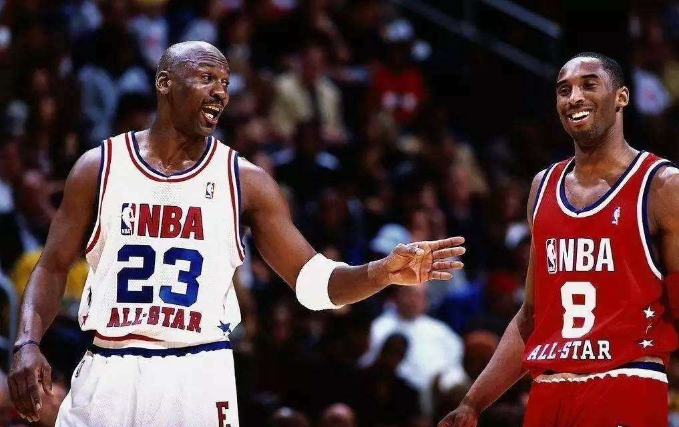
To help me cope
with anything

Slide 19
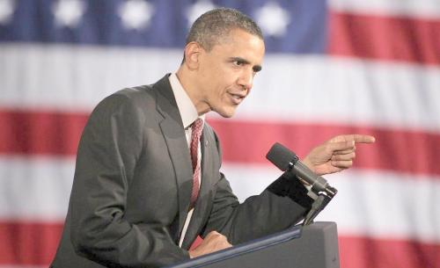
If you see the wonder of a fairy tale

Slide 20
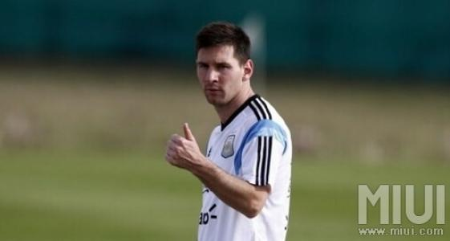
You can take the future even if you fail

Slide 21
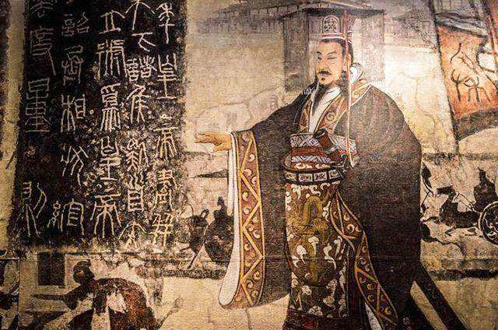
I believe in angels

Slide 22
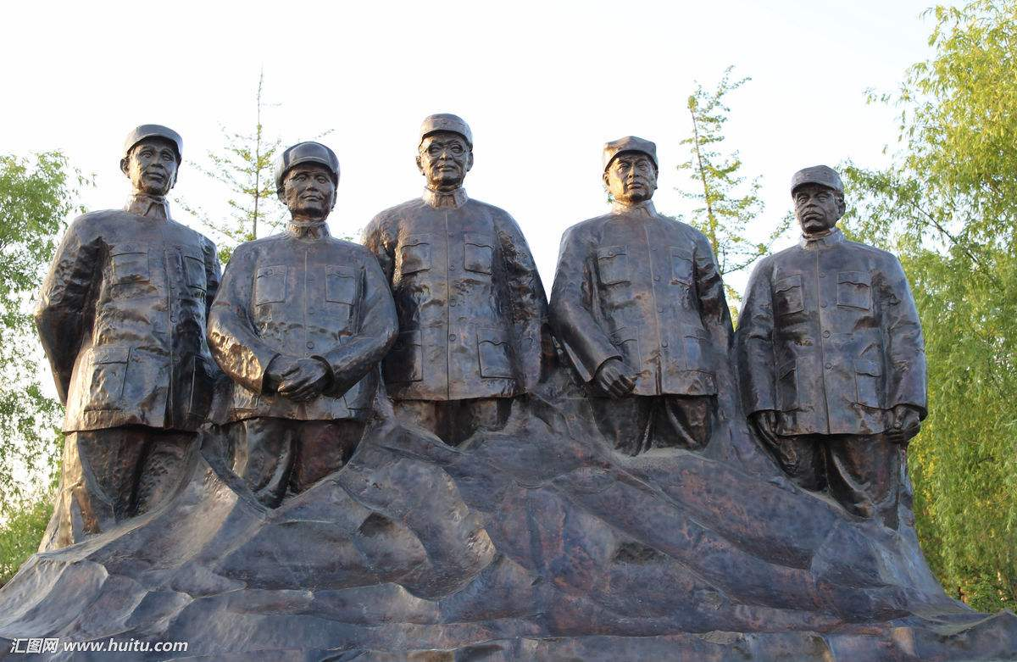
Something good in
everything I see

Slide 23
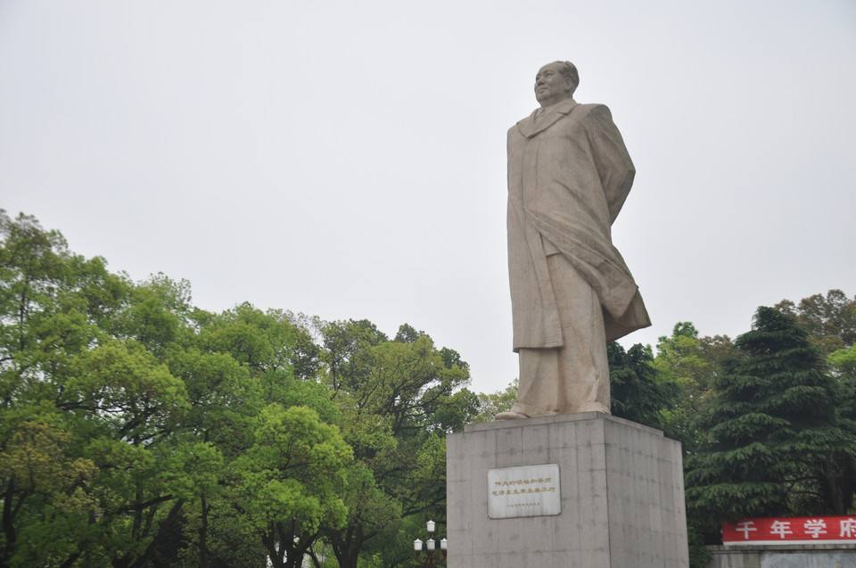
I believe in angels

Slide 24
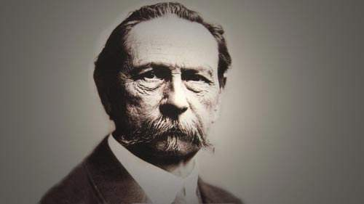
When I know the time is right for me

Slide 25
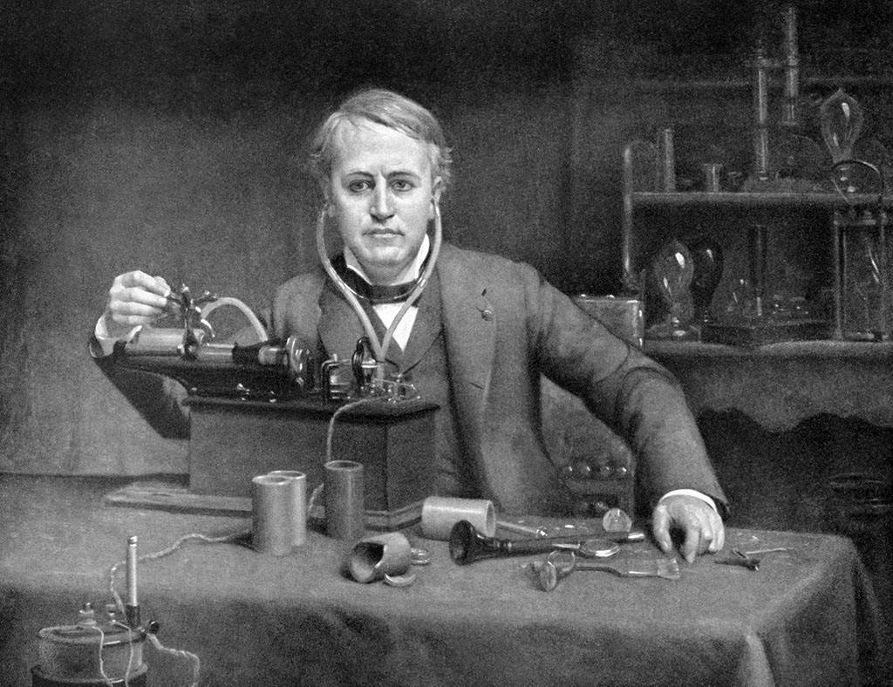
I cross the stream
I have a dream

