Slide 1
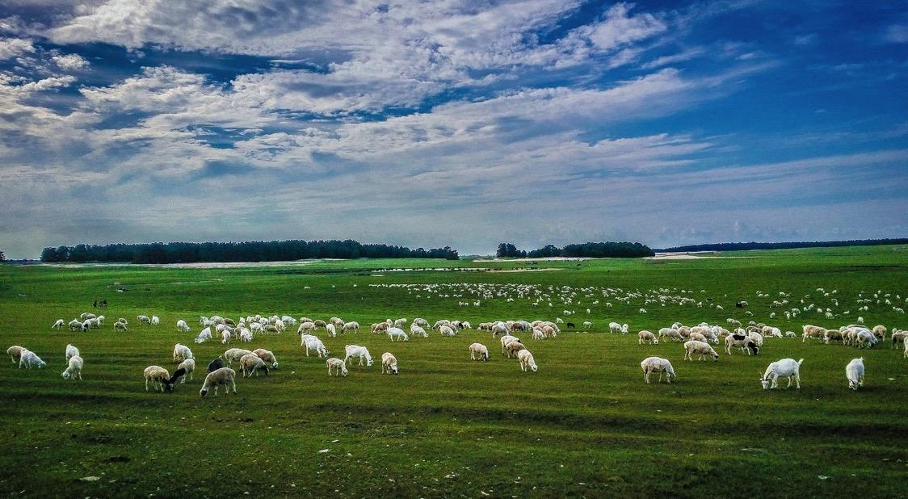
PEP, U1L3, A Volunteer Teacher
Song: We Will Get There
Singer: Stefanie Sun
Editor: Alicia 阮碧仪
单位：华南师范大学外文学院

Slide 2
We remember the days, We sat out together with faith?

Slide 3
Remember the times, so fine, When we thought that nothing could stand in our way?

Slide 4
Then things weren't the same, The life that we knew had to change
Then things weren't

Slide 5
We've struggled through the darkest storms,
We thought we couldn't tame

Slide 6
Together we've tried,
As we stood side by side

Slide 7
I knew we'd build a new world,
A world of hope forever after

Slide 8
Deep in my heart I just know,
right from the start we will grow

Slide 9
Look where we are,
we've come so far and there's still a long long way to go

Slide 10
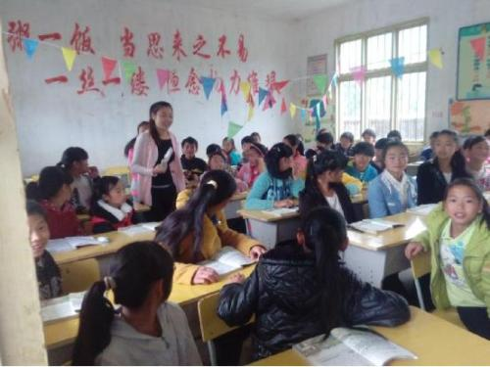
All of my heart, I will care.
I'll play my part, I will share

Slide 11
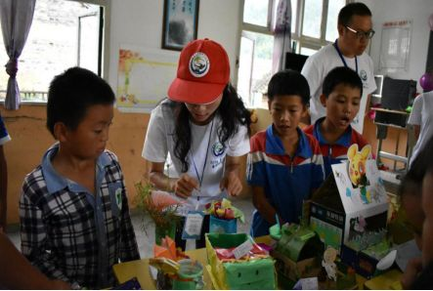
With family and friends together
we'll stand And in the end, hand in hand,

Slide 12
We will get there

Slide 13
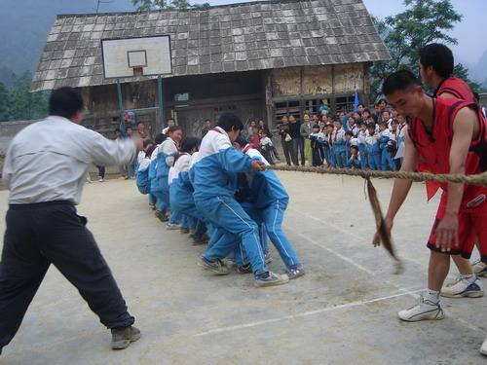
So now we begin,
working together to win

Slide 14
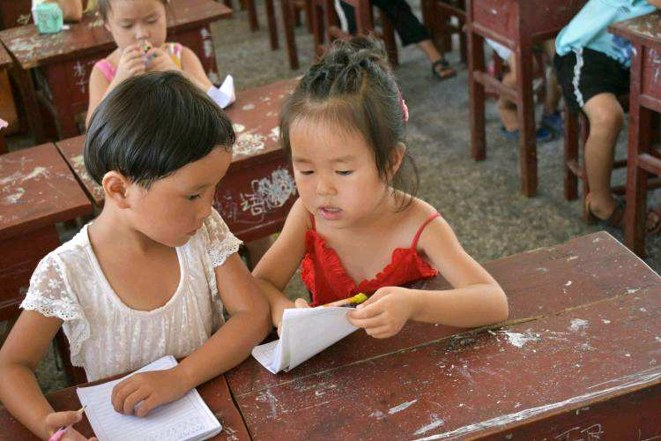
Believing in trust, it must be possible to overcome anything.

Slide 15
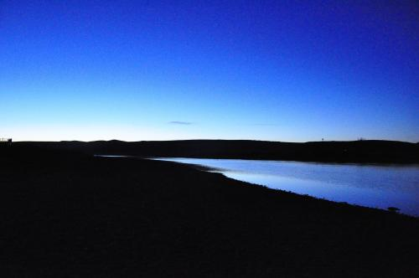
There‘s so much to do, There's so much we can contribute

Slide 16
By sharing just a little love, We will start again a new

Slide 17
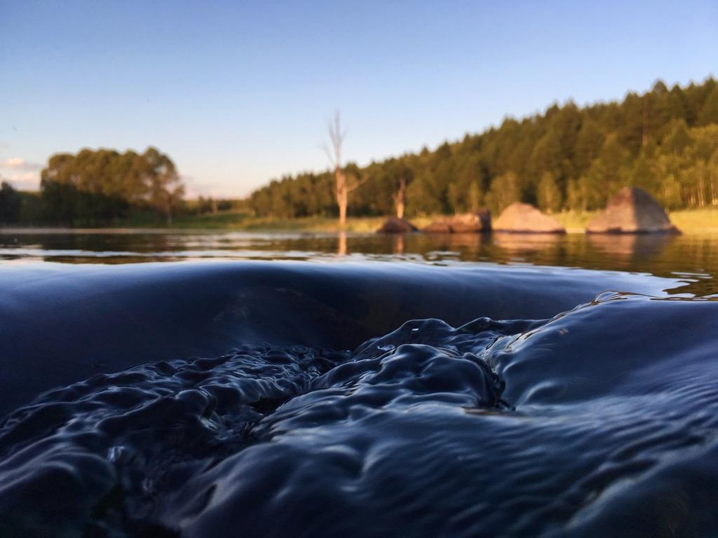
So why don't we try?
If we stand side by side

Slide 18
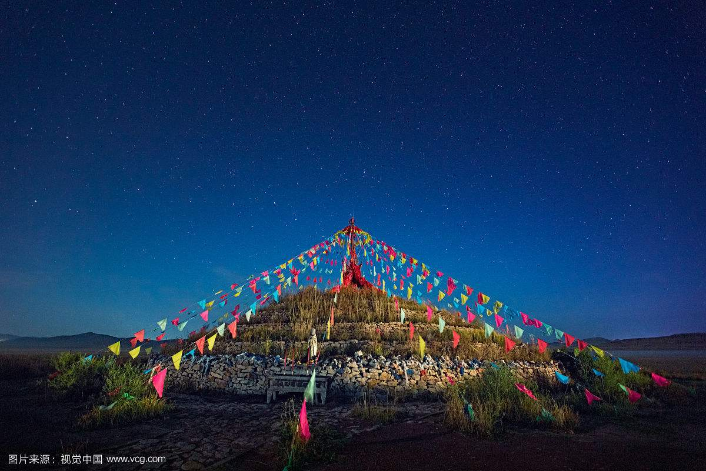
I know we'll build a new world,
A world of hope for ever after

Slide 19
Deep in my heart I just know,
right from the start we will grow
Look where we are
we've come so far and there's still a long long way to go

Slide 20
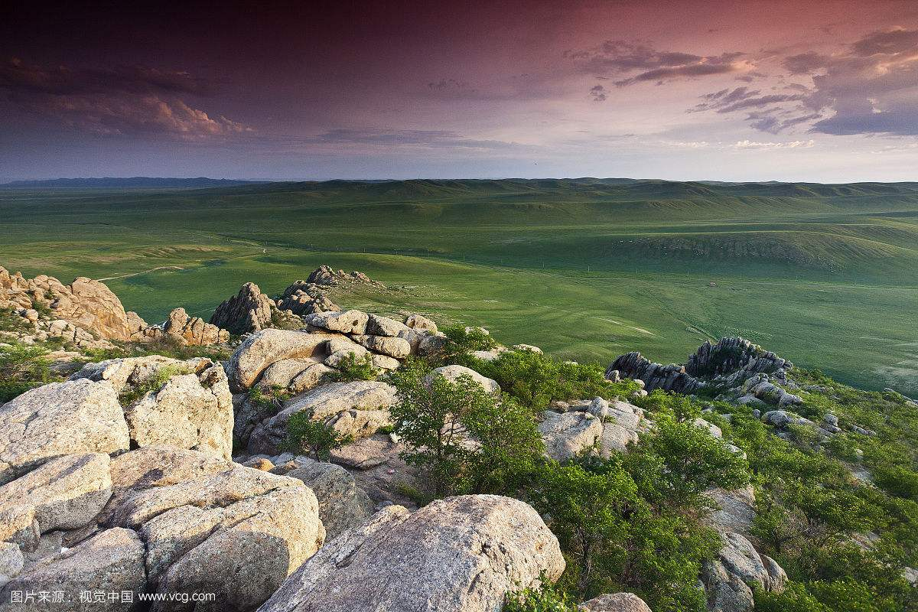
All of my heart, I will care
I'll play my part, I will share
With family and friends together we'll stand
And in the end, hand in hand,

Slide 21
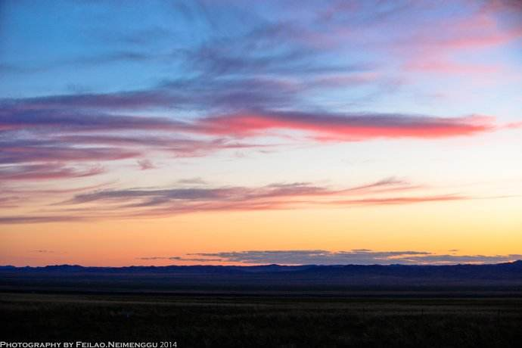
We will get there

