Slide 1
How are you doing?
Situational Communication--Greetings
华南师范大学外国语言文化学院 佘苑莹
广东省河源市东源县黄村中学 程燕妮

Slide 2
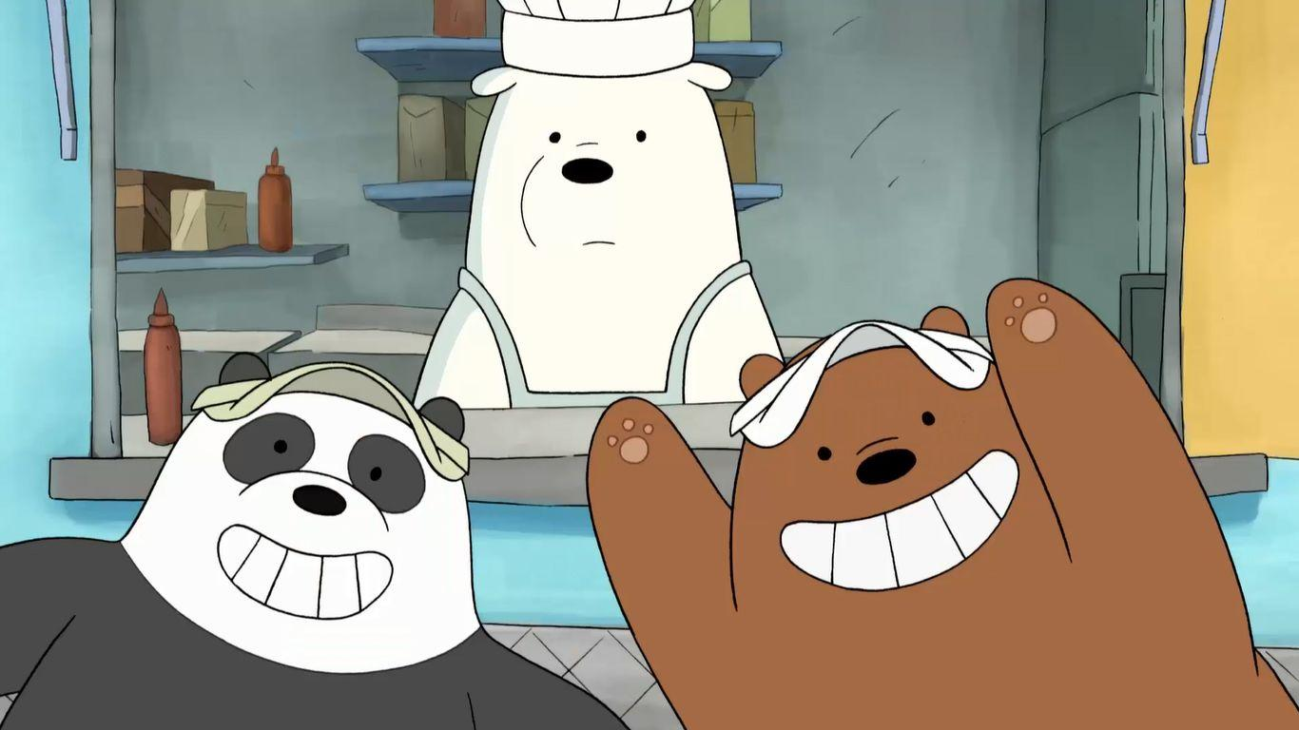

Slide 3
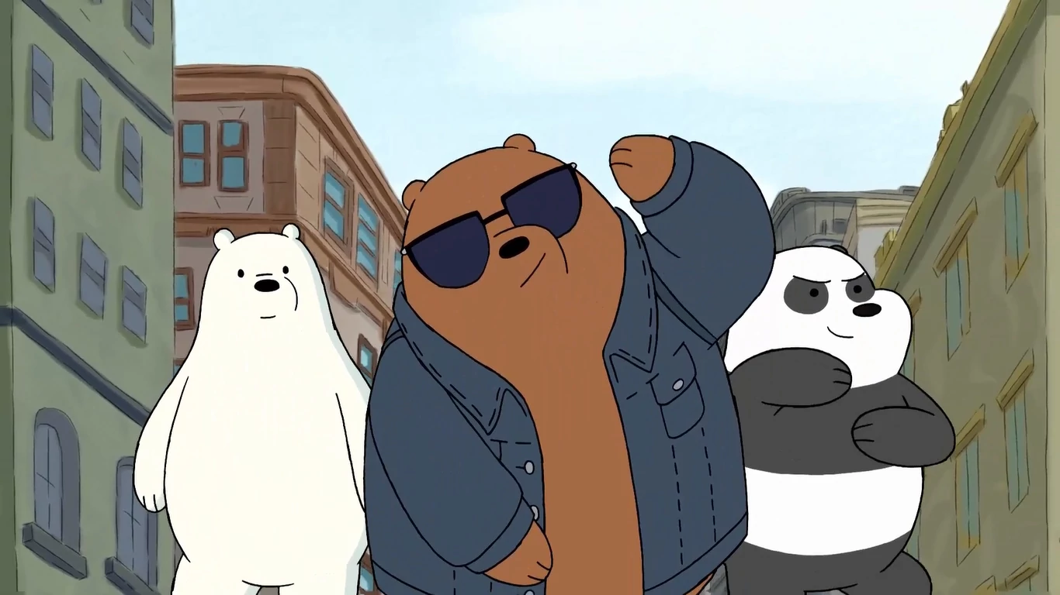

Slide 4
How are you doing?
What about you?
I’m fine.
I’m fine, too.
Notes:
How are you doing?
How are you doing?
I'll be fine, how about you?
I'm fine too

Slide 5
Yes, it goes.
What about you?
How is it going?
It goes for me too.
Notes:
How is it going?
How is it going?
Yes it goes, what about you?
It goes for me too.

Slide 6
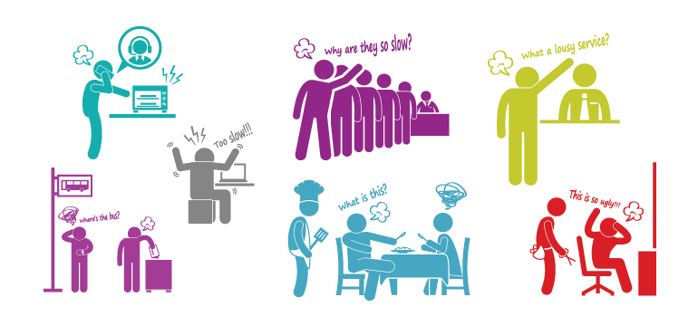
Nothing new, can't complain
Notes:
Nothing new, can't complain
Skies are blue, sunshine or rain
Something to eat, watch a show
After that, I'll sleep like a baby

Slide 7
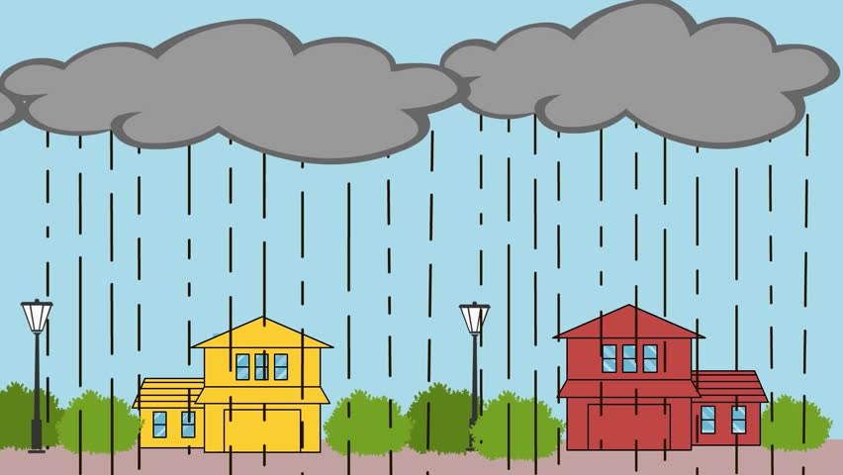
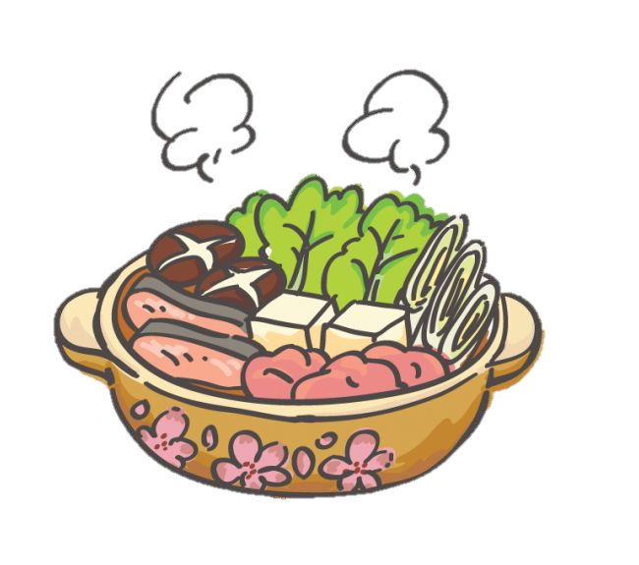
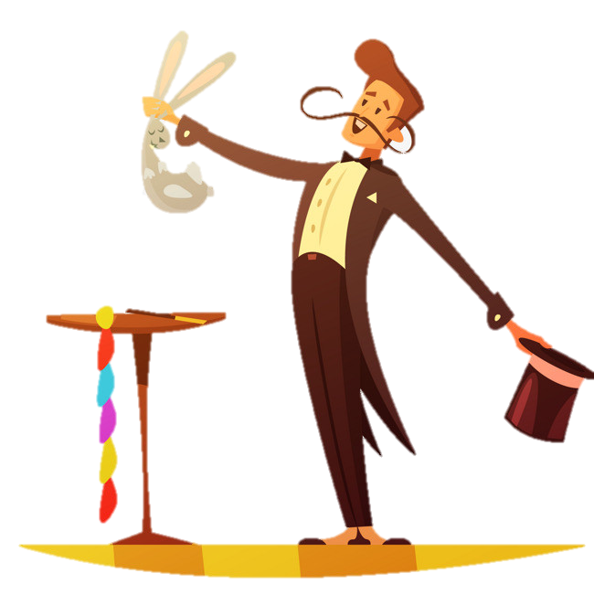
Skies are blue
sunshine or rain
Something to eat
watch a show
Notes:
Nothing new, can't complain

Slide 8
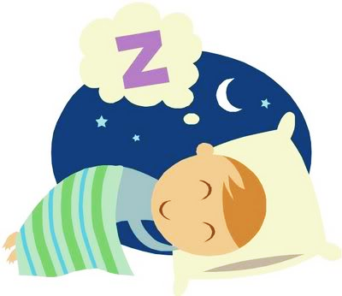
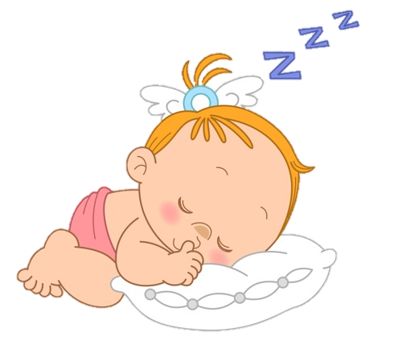
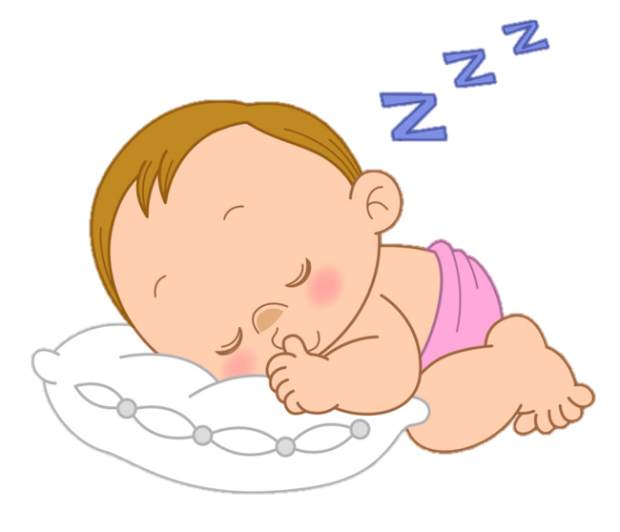
After that, I'll sleep like a baby
Notes:
After that, I'll sleep like a baby

Slide 9
What are you up to?
What about you?
Not much, nothing to do.
Me too.
Notes:
What are you up to?
What are you up to?
Not much, nothing to do
What about you?
What about you?
Me too

Slide 10
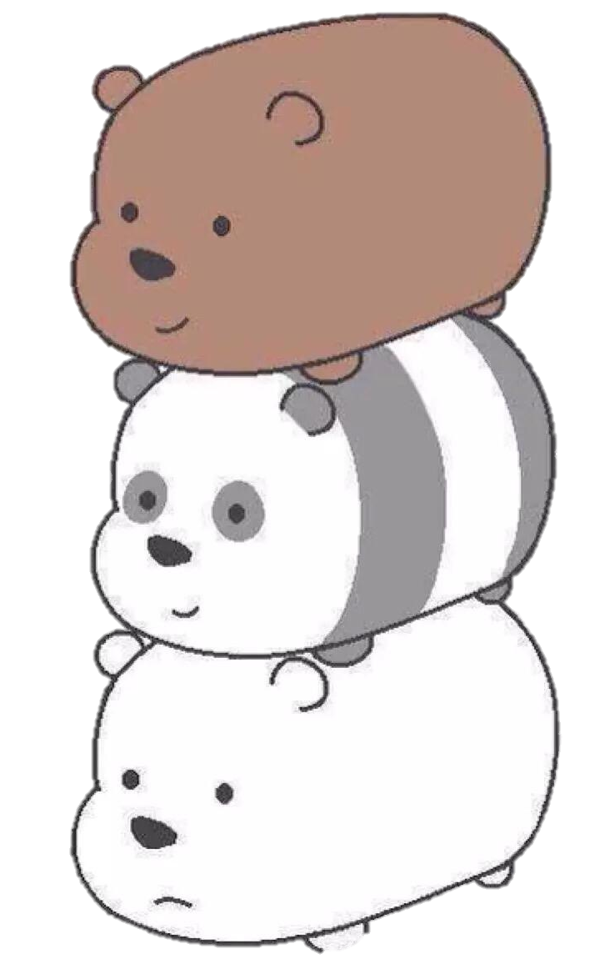
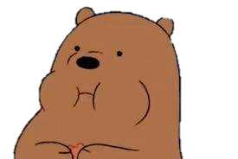
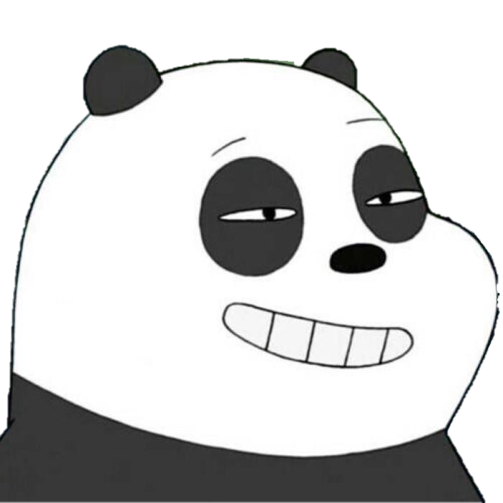

Slide 11
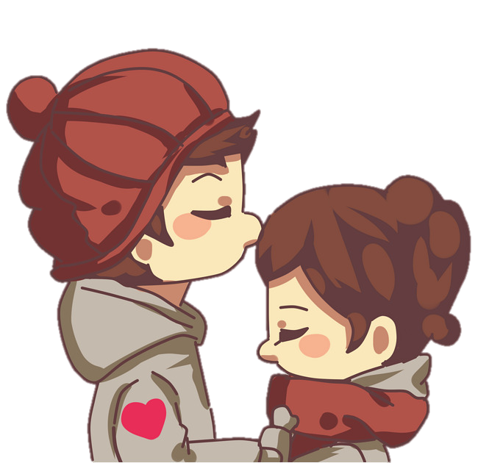
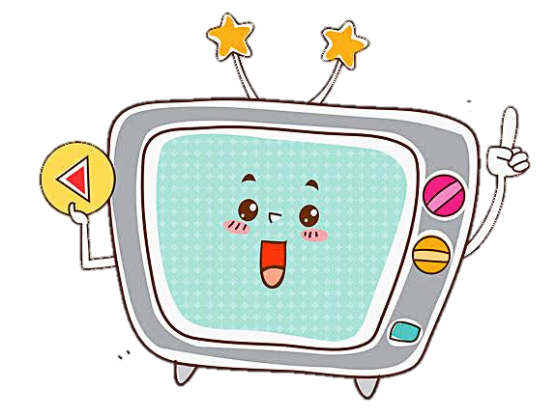
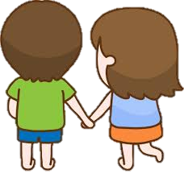
holding hands
watching TV
After hours, kisses are sweet.
Notes:
After hours, kisses are sweet
Holding hands, watching TV
Nothing to say, nowhere to go
After that, I'll sleep like a baby

Slide 12
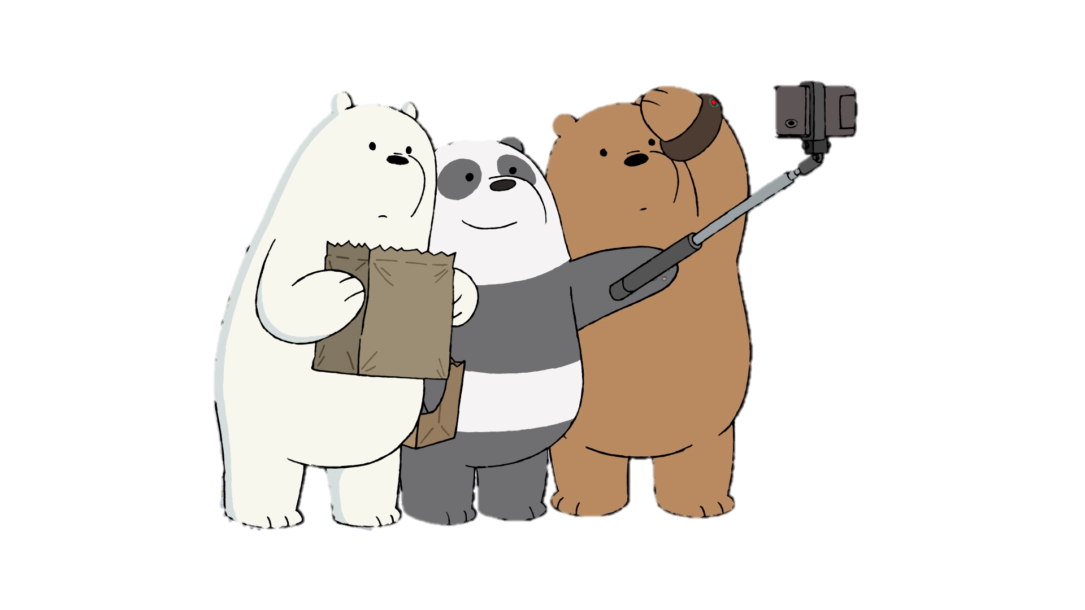
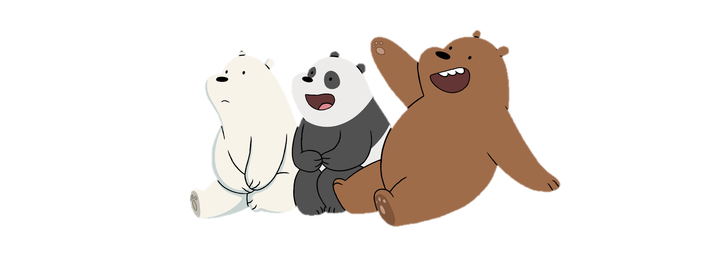
Nowhere to go
Nothing to say
Notes:
Nothing to say, nowhere to go

Slide 13
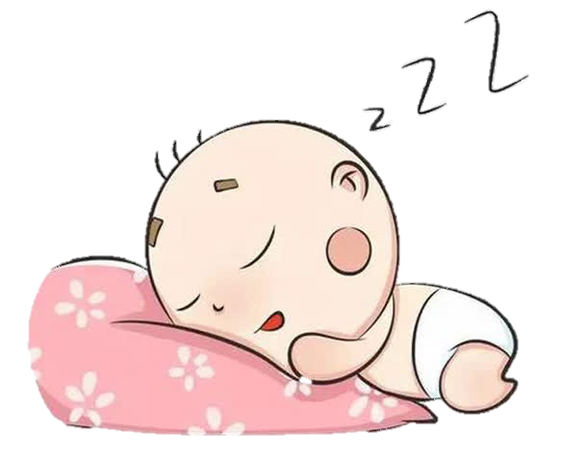
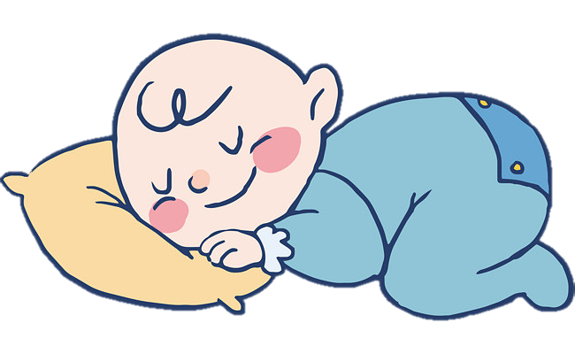
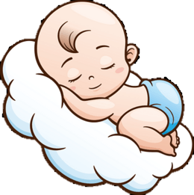
After that, I'll sleep like a baby
Notes:
After that, I'll sleep like a baby

Slide 14
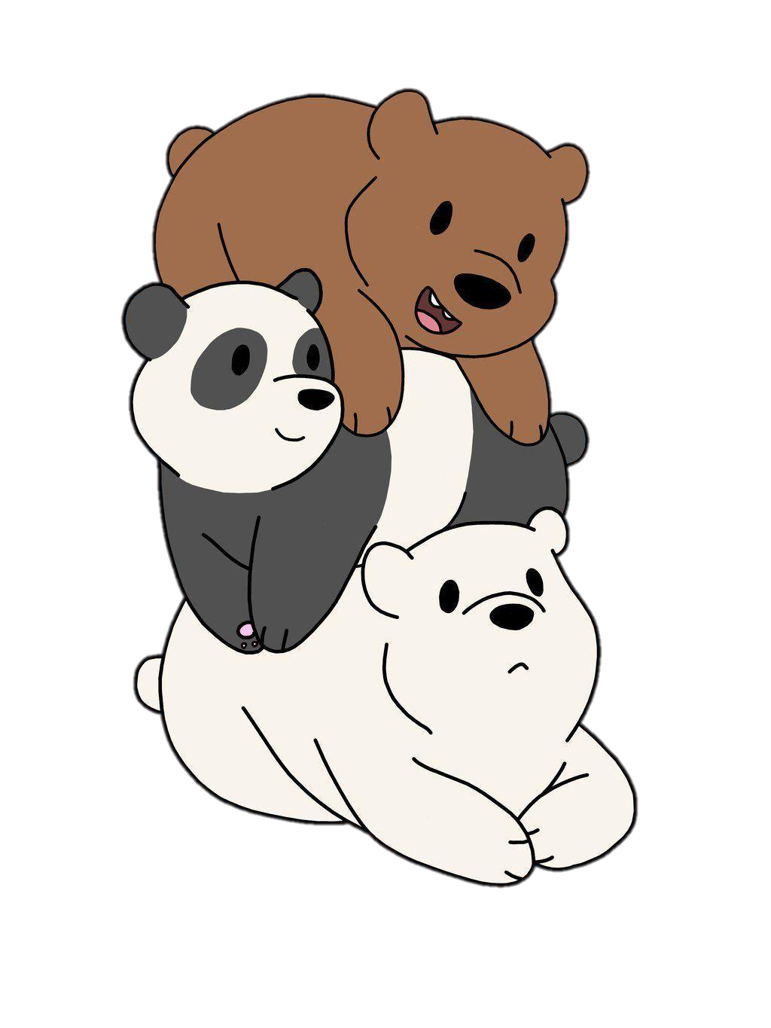
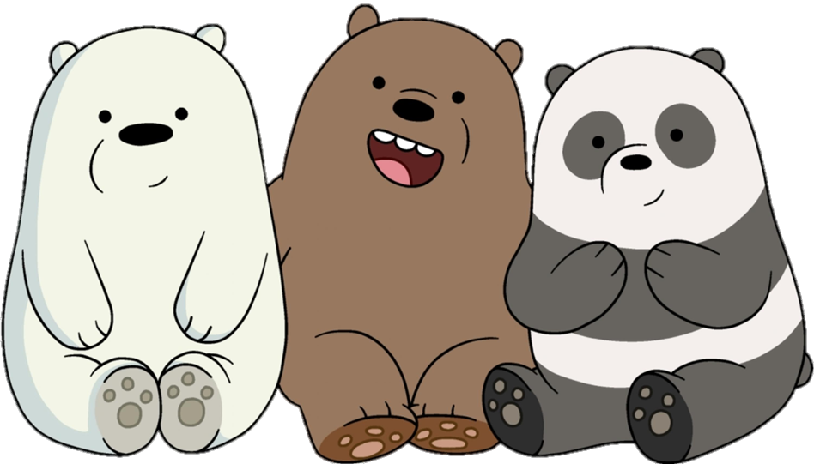
How are you doing?
How are you doing?
Notes:
How are you doing?
How are you doing?
I'm fine, what about you?
I'm fine, what about you?
I'm fine, what about you?
I'm fine, what about you?
Me too
Me too
Me too

Slide 15
I’m fine. What about you?
I’m fine. What about you?
Notes:
How are you doing?
How are you doing?
I'm fine, what about you?
I'm fine, what about you?
I'm fine, what about you?
I'm fine, what about you?
Me too
Me too
Me too

Slide 16
Me too!
Me too!
Me too!

Slide 17
