Slide 1
Seasons in the sun ———简单句
设计制作：
华南师范大学外文学院 吴嘉莹
广东省河源市东源县义合中学 谢杰华
指导老师：谢杰华、刘晓斌

Slide 2
Goodbye to you, my trusted friend

Slide 3
We've known each other since we were nine or ten

Slide 4
Together we've climbed hills and trees

Slide 5
Learned of love and ABC’s

Slide 6
Skinned our hearts and skinned our knees

Slide 7
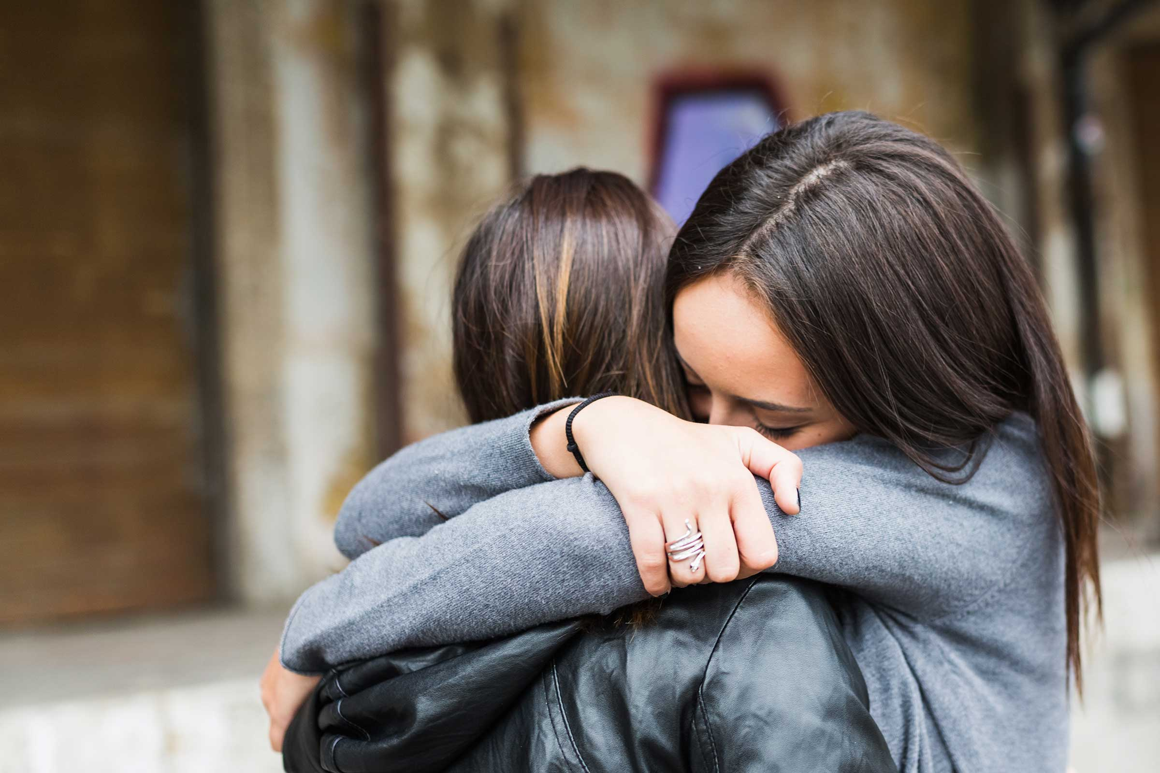
Goodbye my friend, it's hard to die

Slide 8
When all the birds are singing in the sky

Slide 9
Now that spring is in the air

Slide 10
Pretty girls are everywhere

Slide 11
Think of me and I'll be there

Slide 12
We had joy, we had fun

Slide 13
We had seasons in the sun

Slide 14
But the hills that we climbed

Slide 15
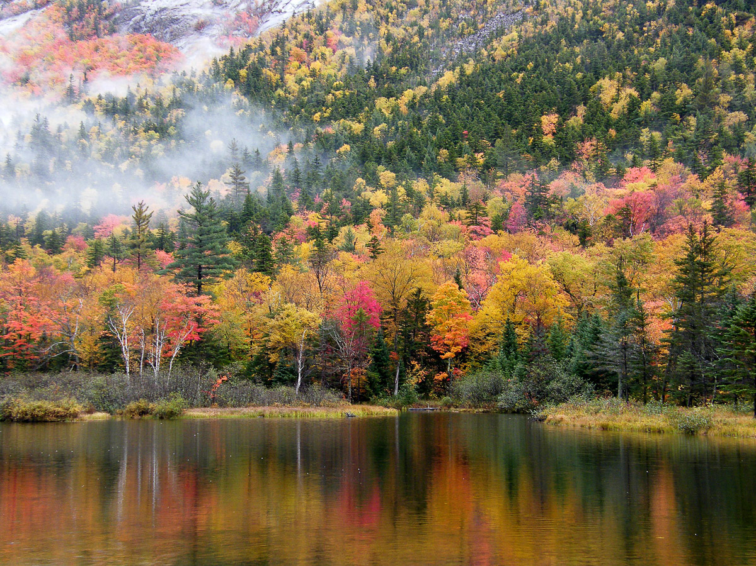
Were just seasons out of time

Slide 16
Goodbye papa, please pray for me

Slide 17
I was the black sheep of the family

Slide 18
You tried to teach me right from wrong

Slide 19
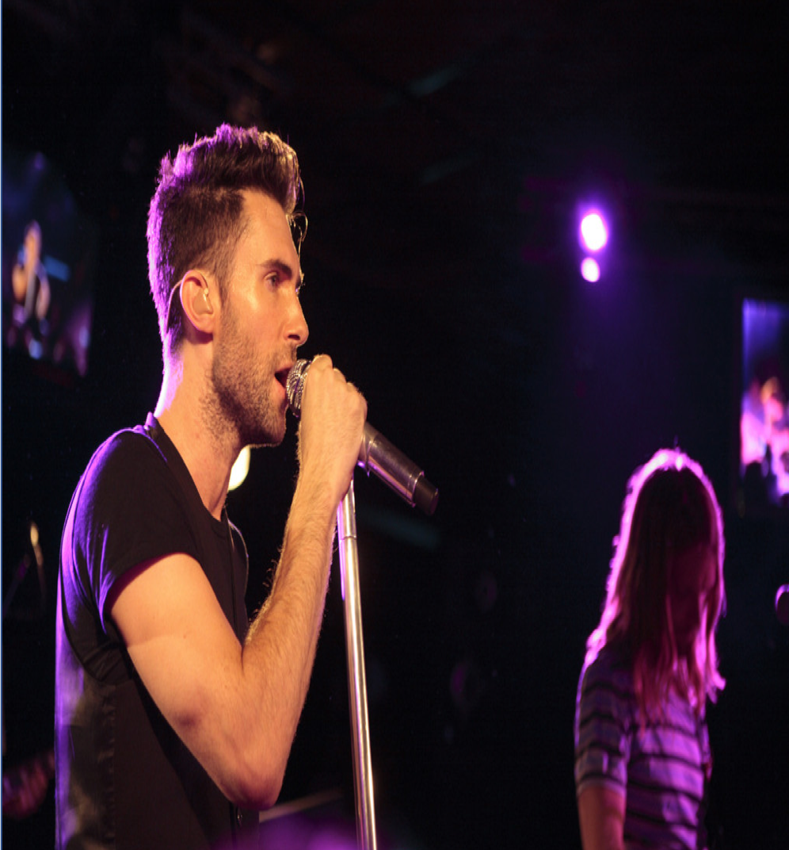
Too much wine and too much song

Slide 20
Wonder how I got along

Slide 21
Goodbye papa it's hard to die

Slide 22
When all the birds are singing in the sky.
Now that the spring is in the air

Slide 23
Little children everywhere

Slide 24
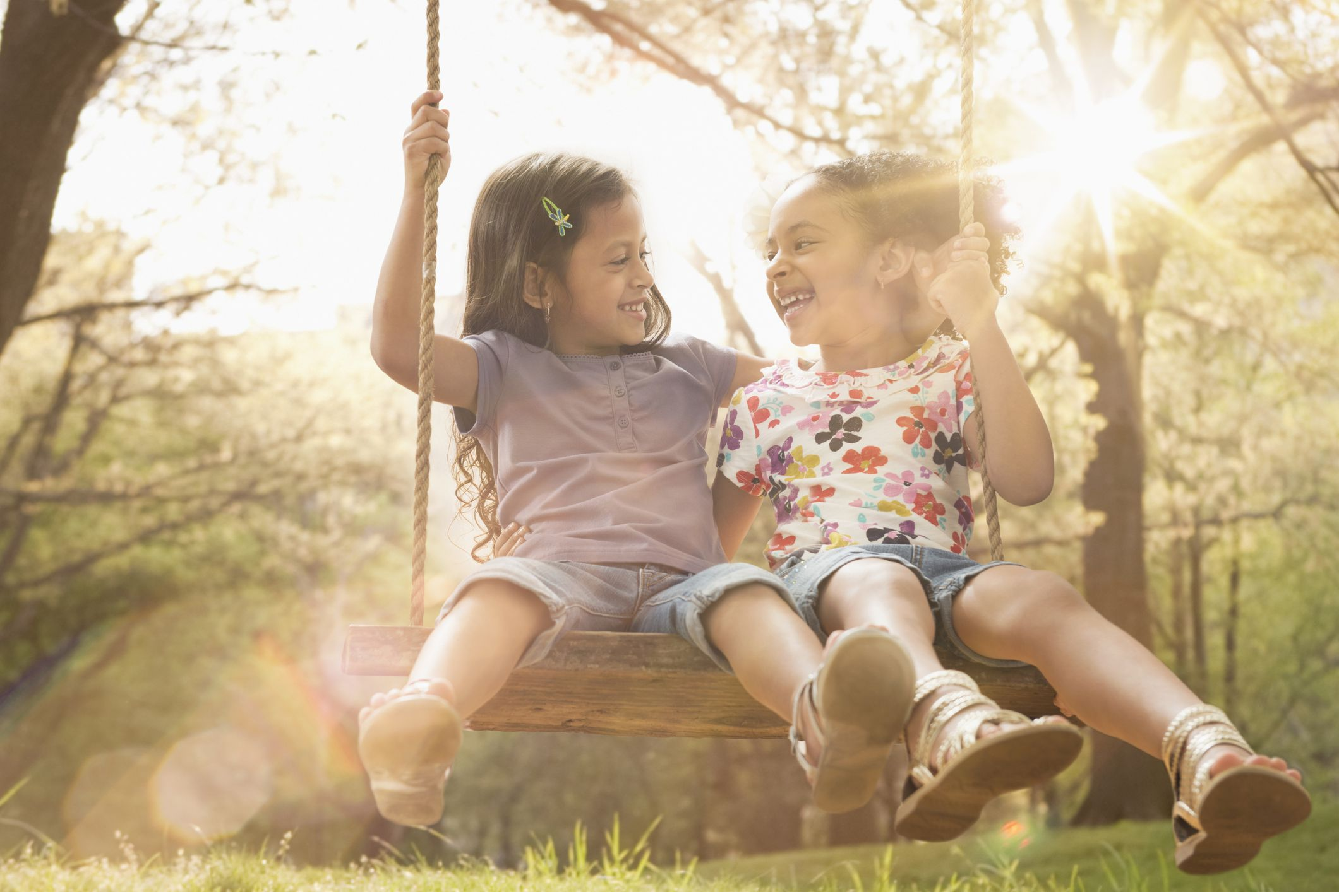
When you see them, I'll be there

Slide 25
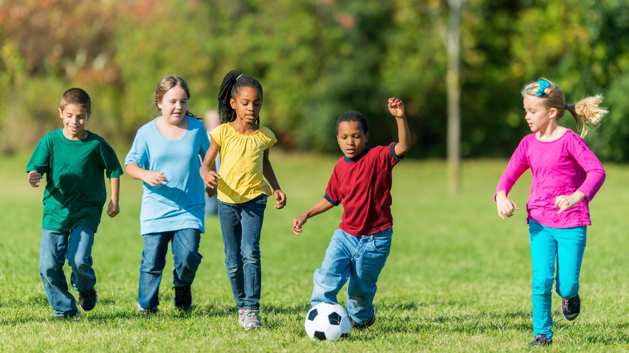
We had joy, we had fun

Slide 26
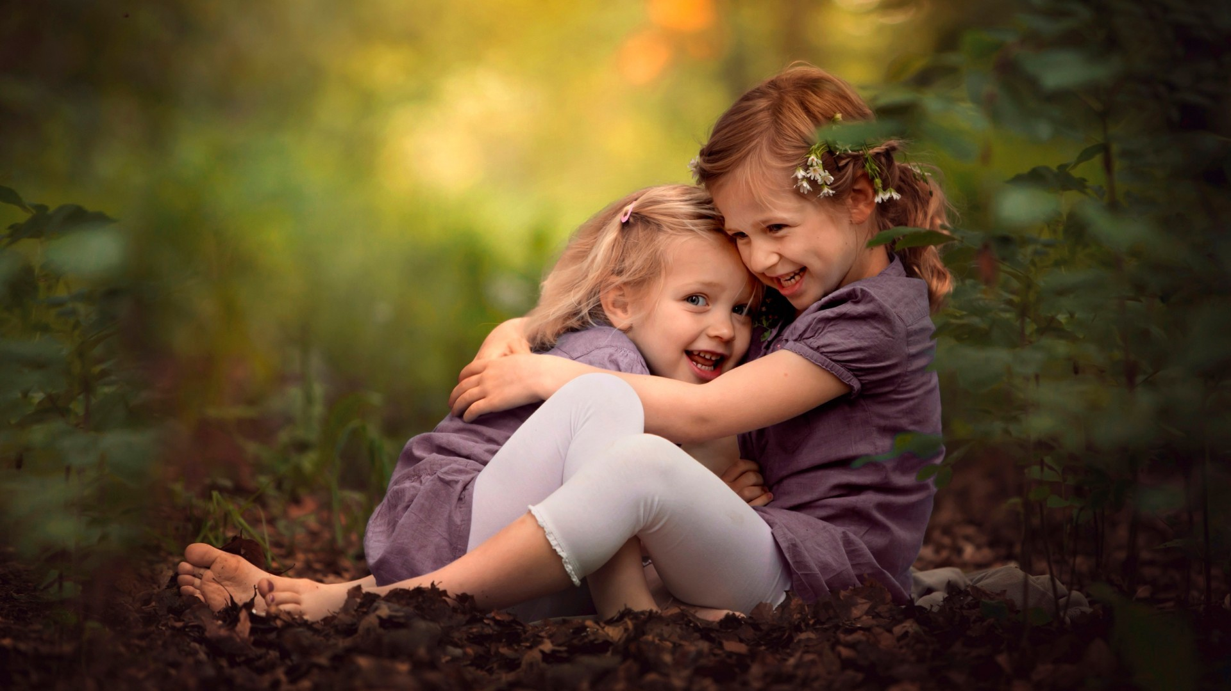
We had seasons in the sun

Slide 27
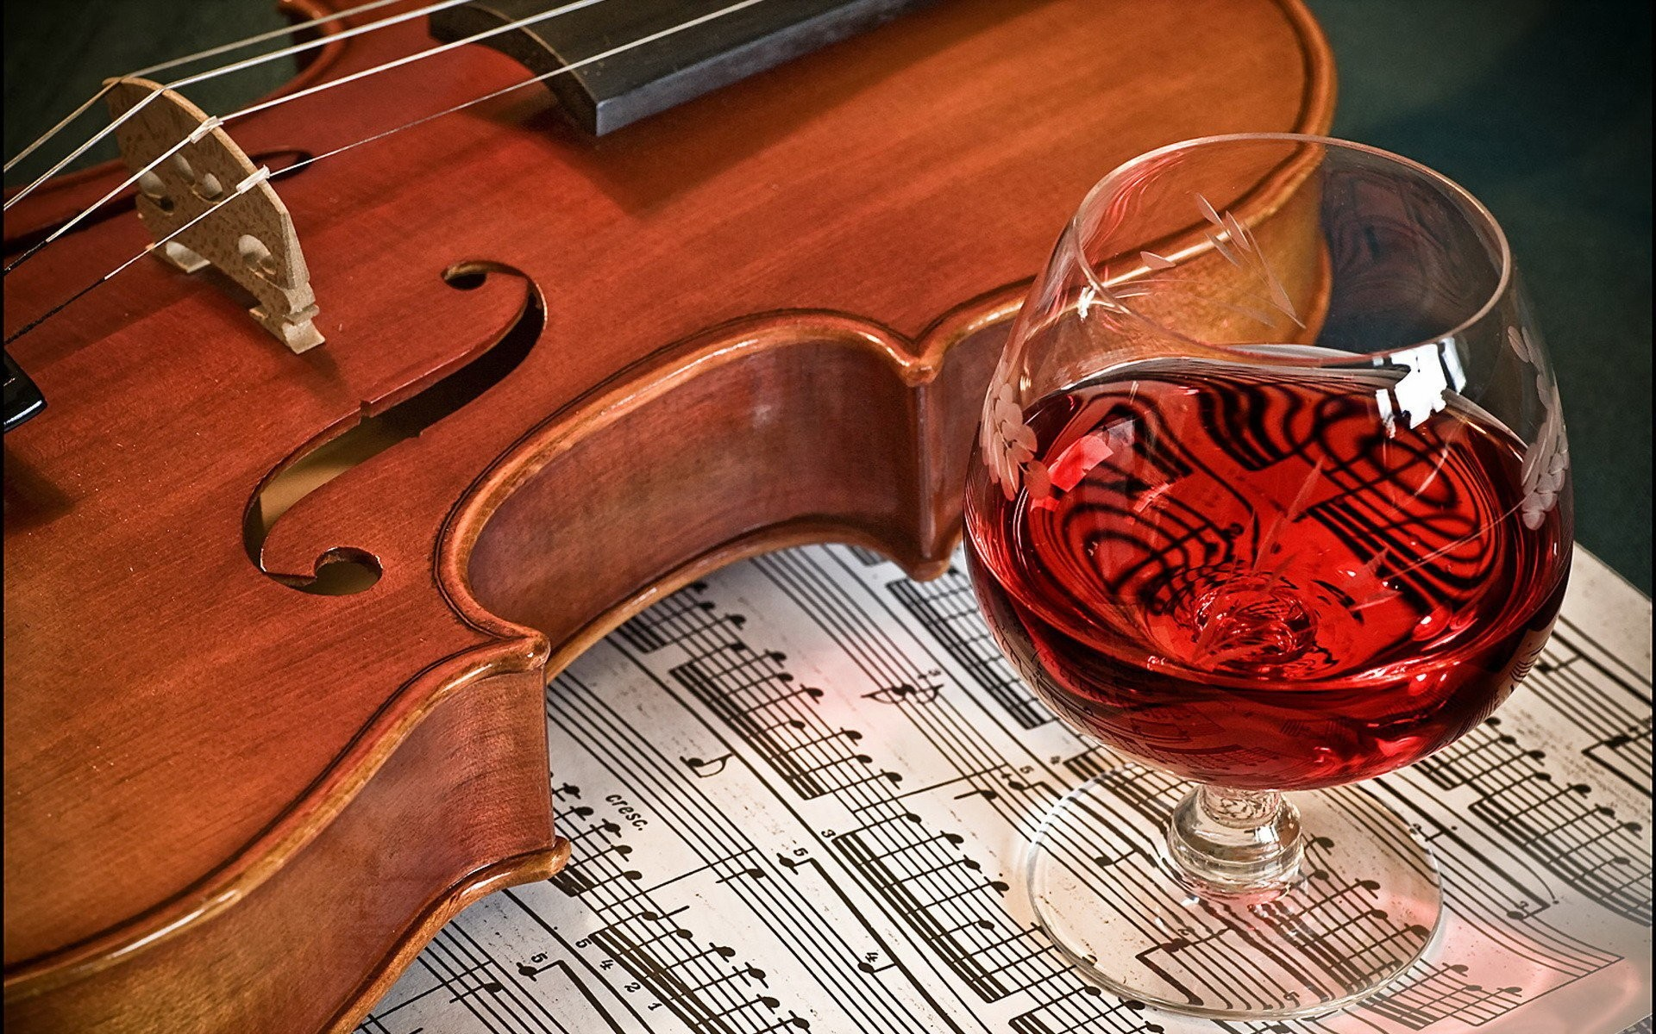
But the wine and the song

Slide 28
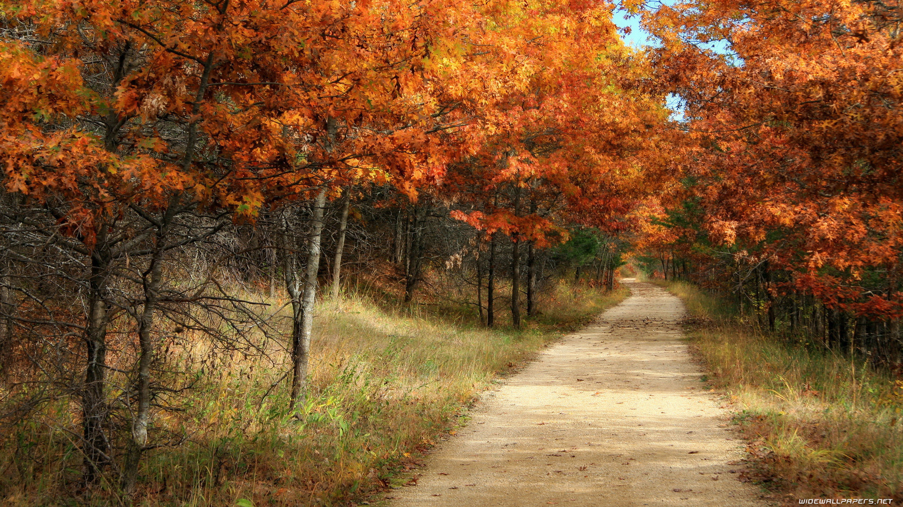
Like the seasons have all gone

Slide 29
We had joy, we had fun

Slide 30
We had seasons in the sun

Slide 31
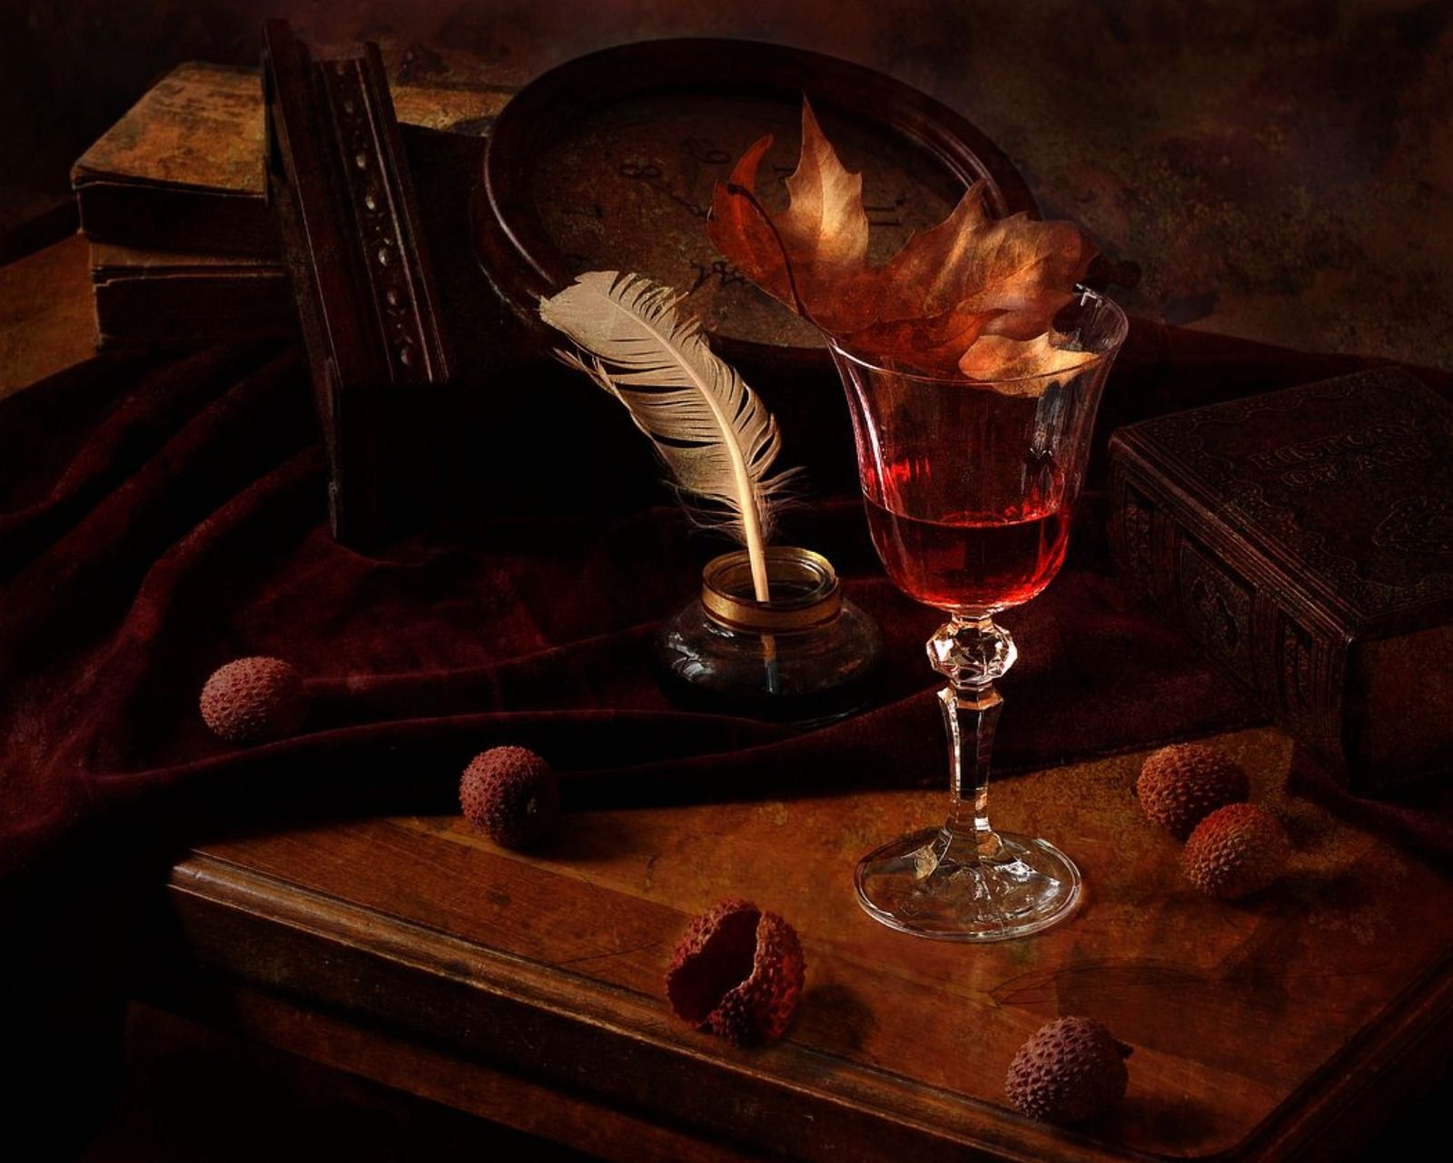
But the wine and the song

Slide 32
Like the seasons have all gone

Slide 33
Goodbye Michelle my little one

Slide 34
You gave me love and help me find the sun

Slide 35
And every time that I was down.

Slide 36
You would always come around

Slide 37
And get my feet back on the ground

Slide 38
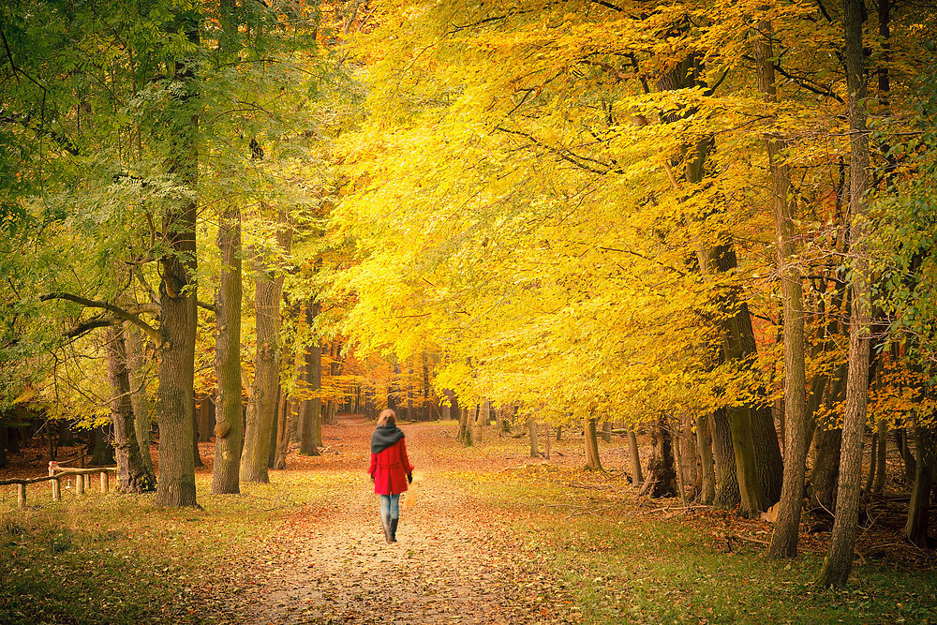
Goodbye Michelle it's hard to die

Slide 39
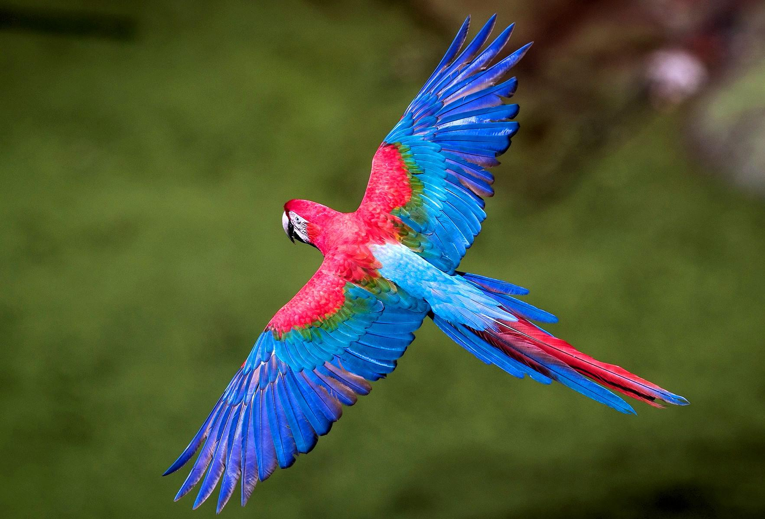
When all the birds are singing in the sky

Slide 40
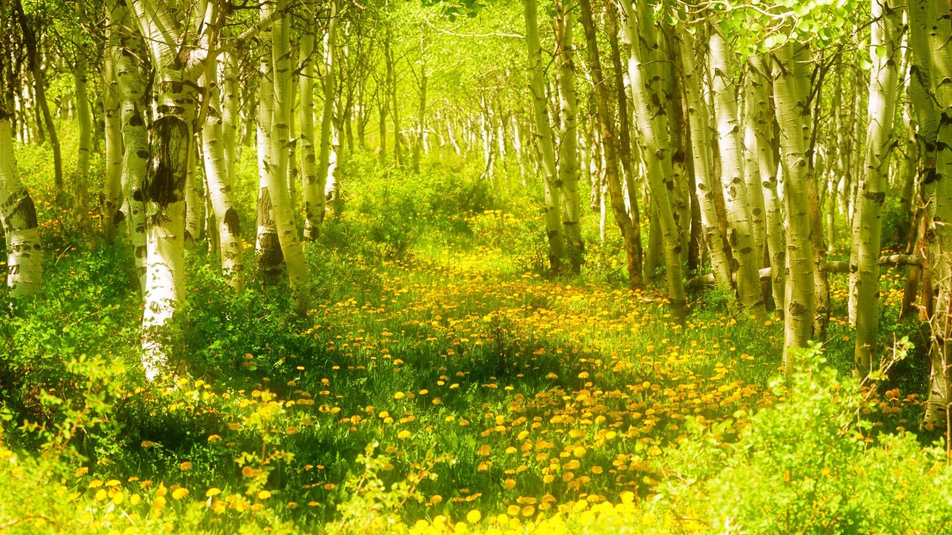
Now that spring is in the air

Slide 41
With the flowers everywhere

Slide 42
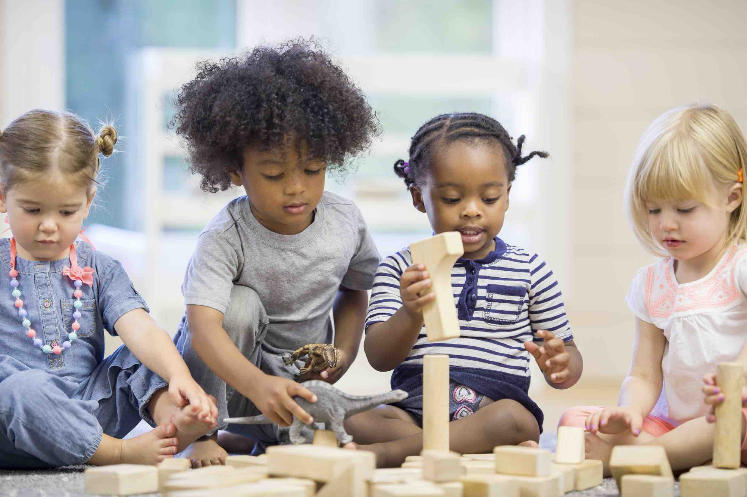
I wish that we could both be there

Slide 43
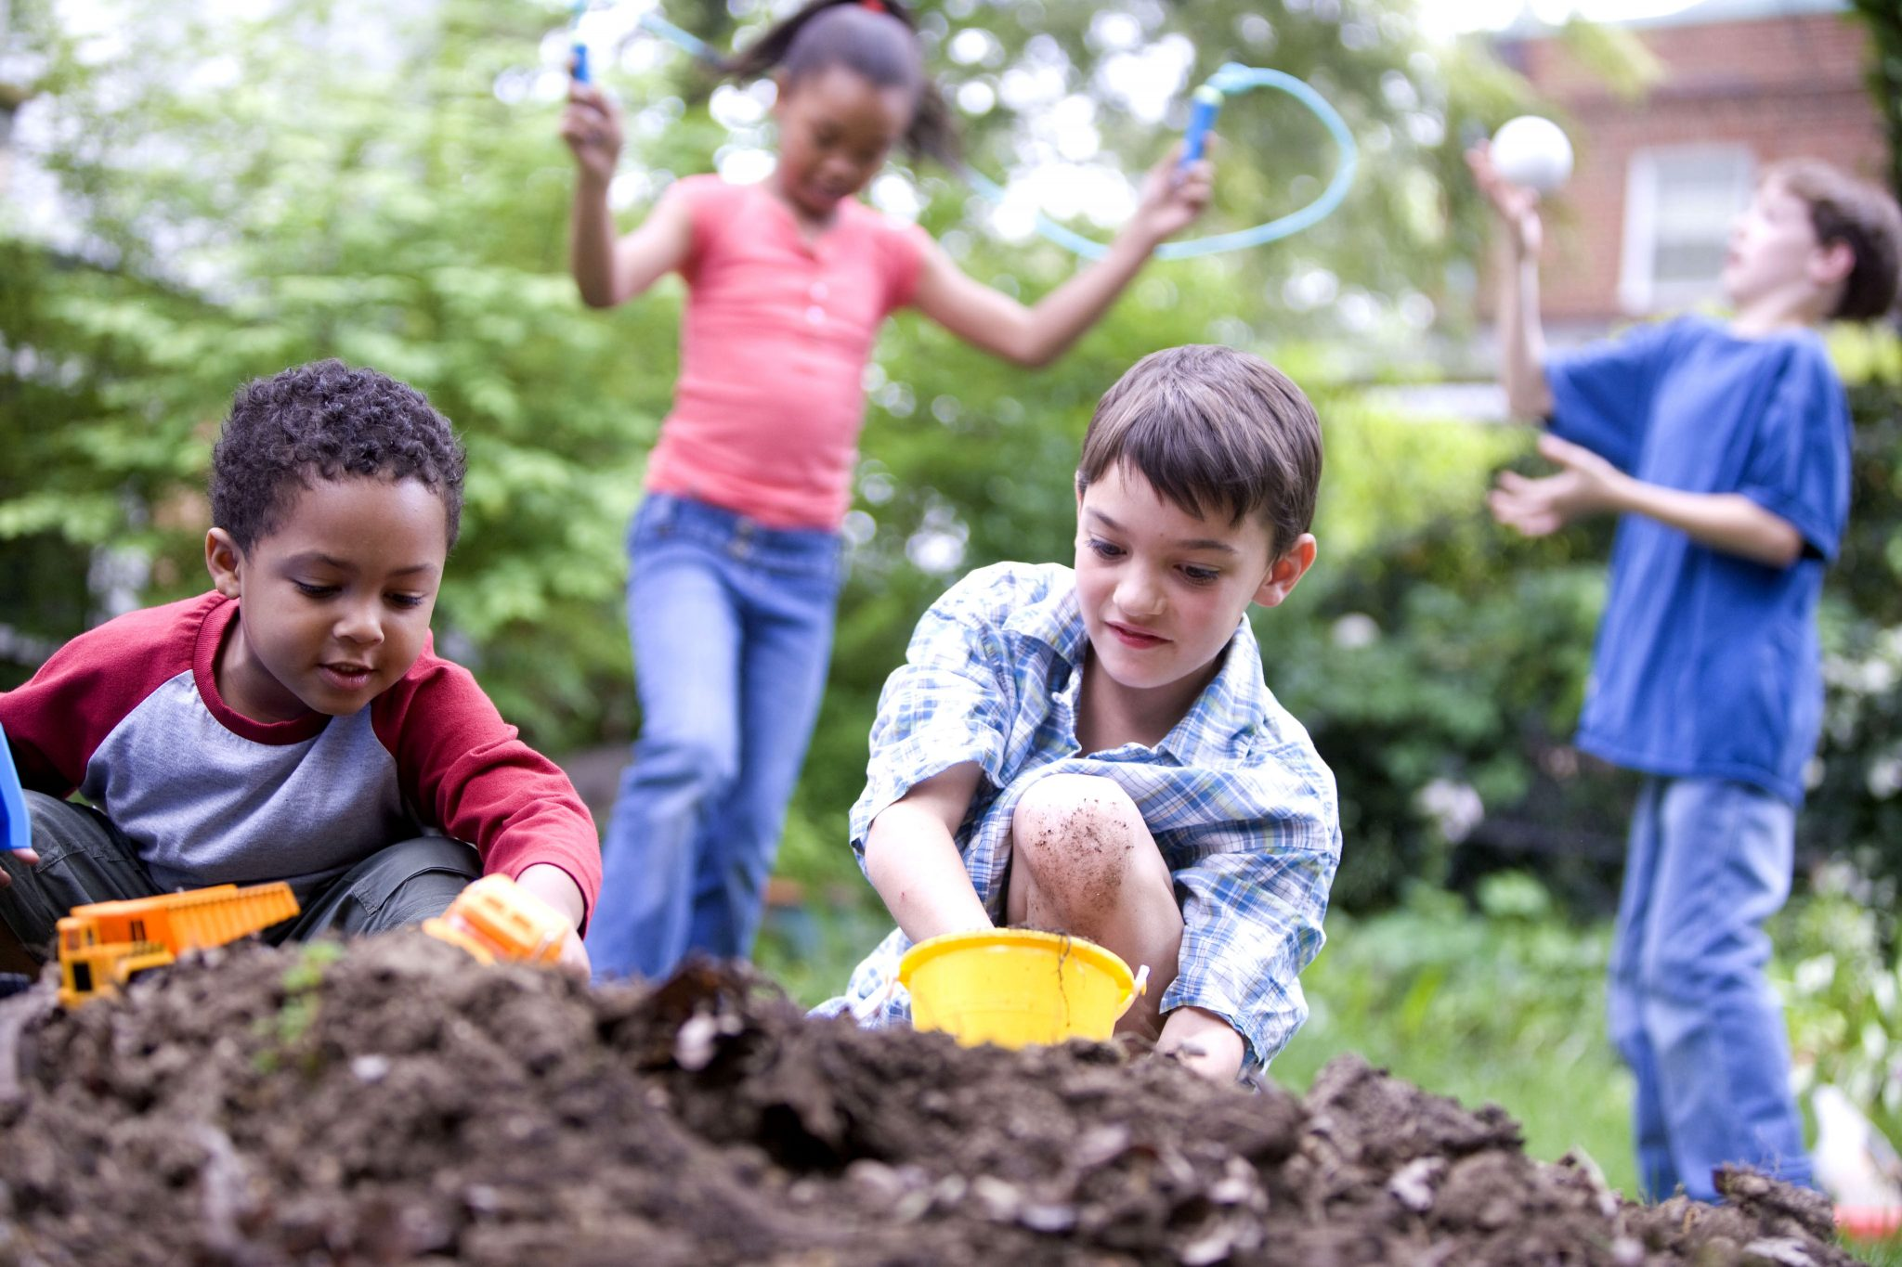
We had joy, we had fun

Slide 44
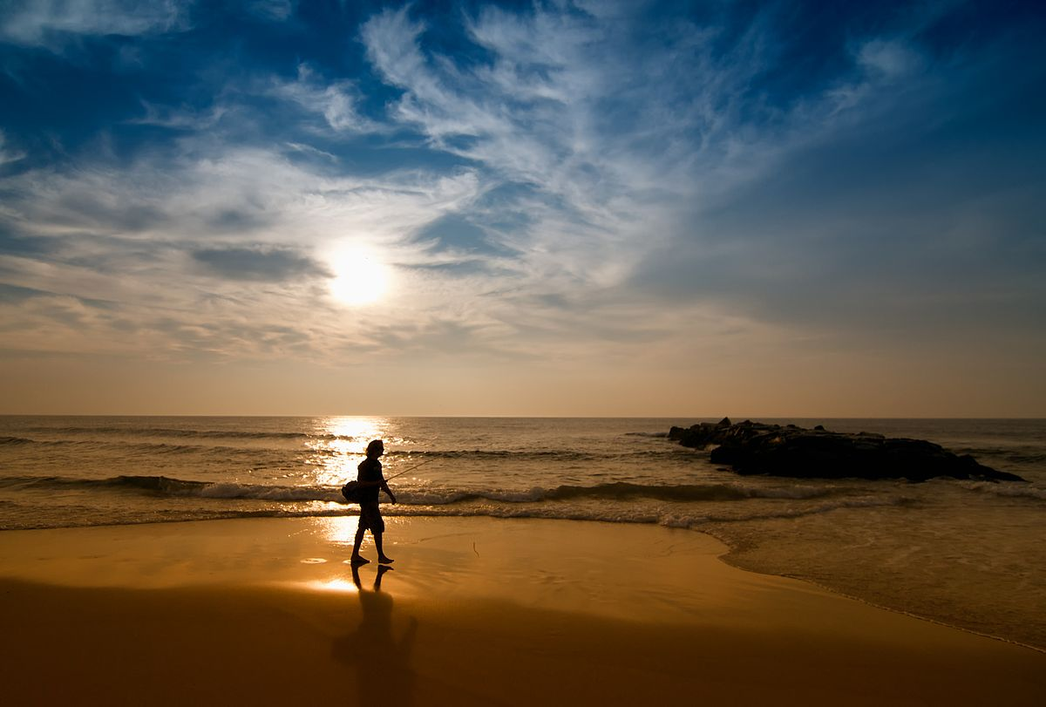
We had seasons in the sun

Slide 45
But the hills that we climbed

Slide 46
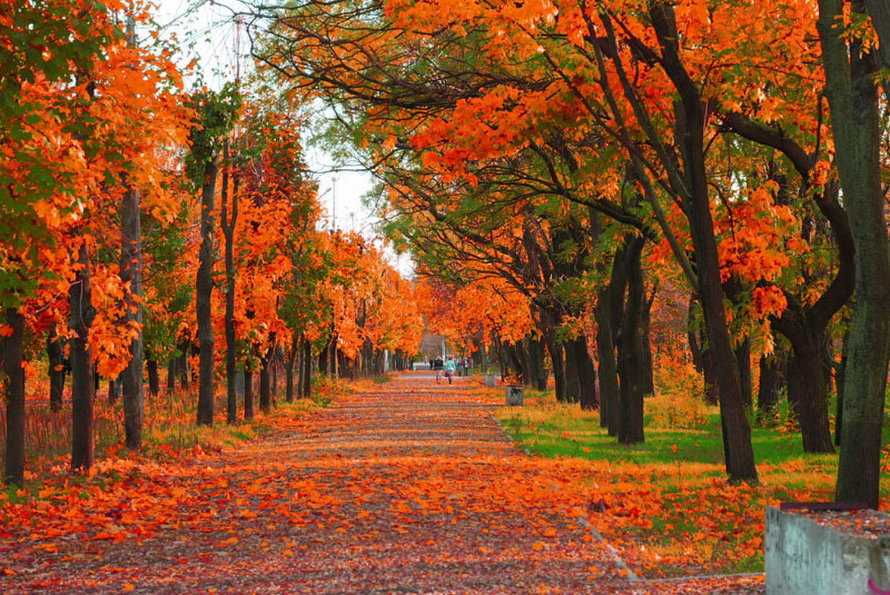
Were just seasons out of time

Slide 47
We had joy, we had fun

Slide 48
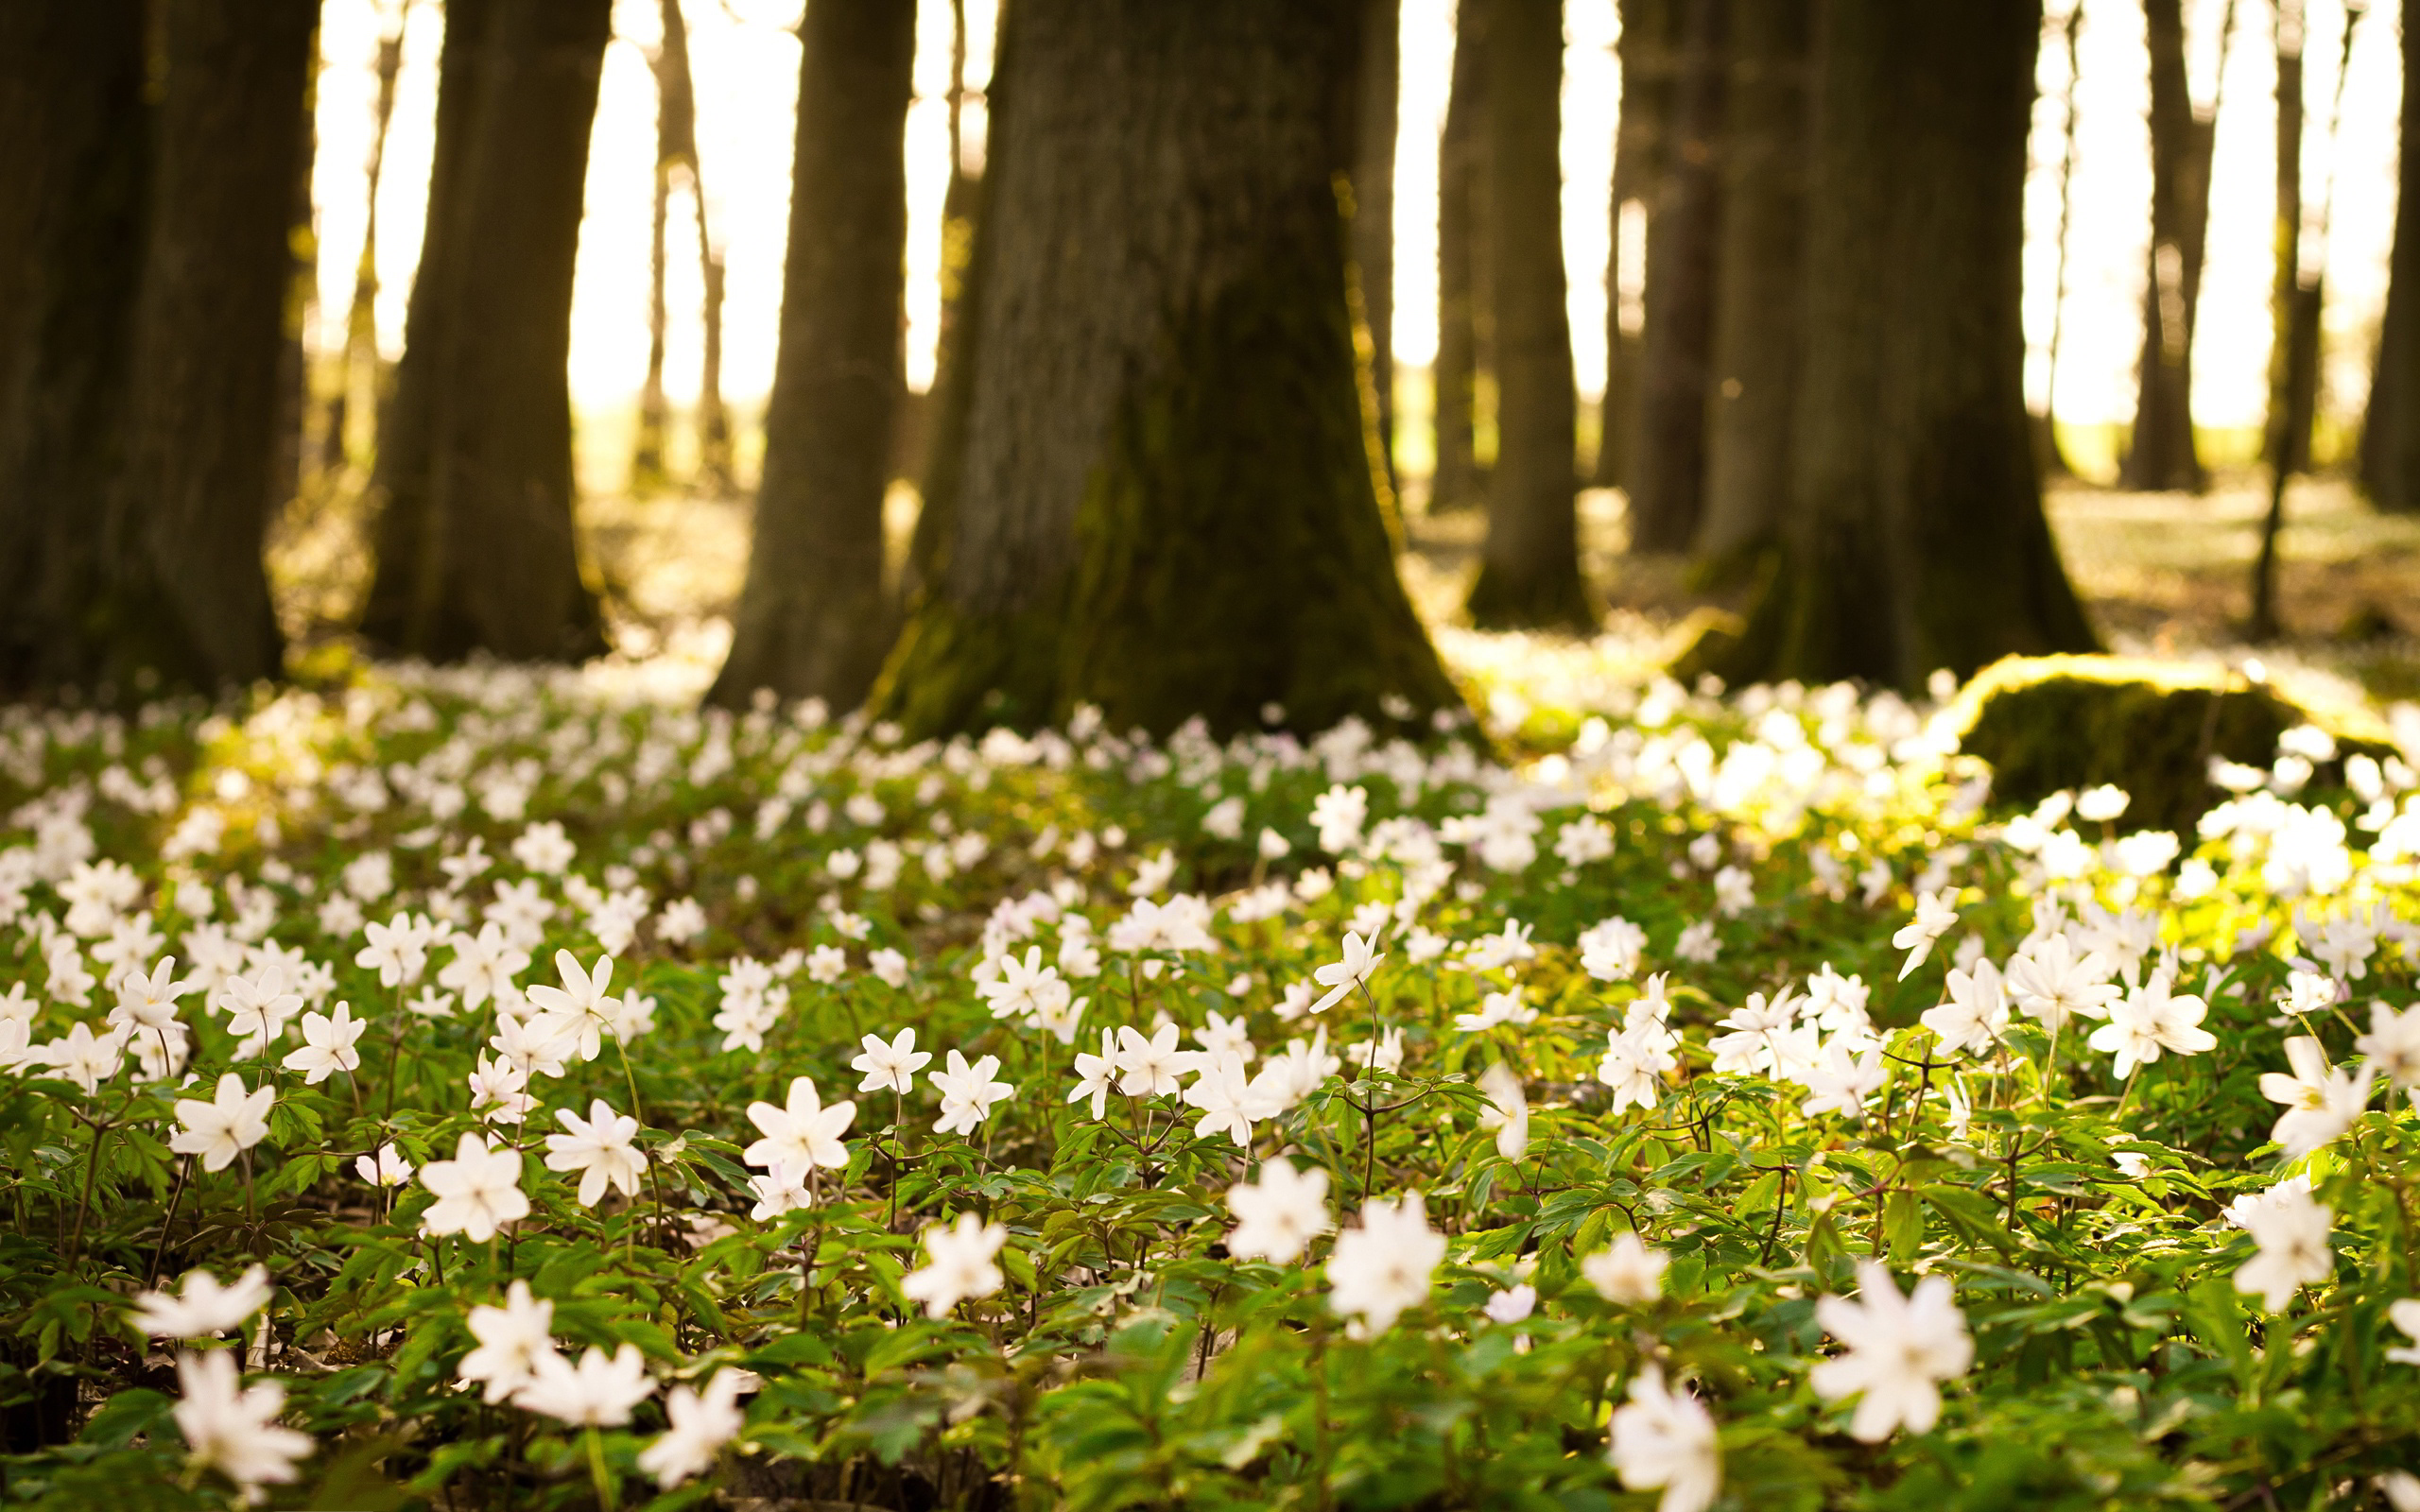
We had seasons in the sun

Slide 49
But the wine and the song

Slide 50
Like the seasons have all gone

Slide 51
We had joy, we had fun

Slide 52
We had seasons in the sun

Slide 53
But the wine and the song

Slide 54
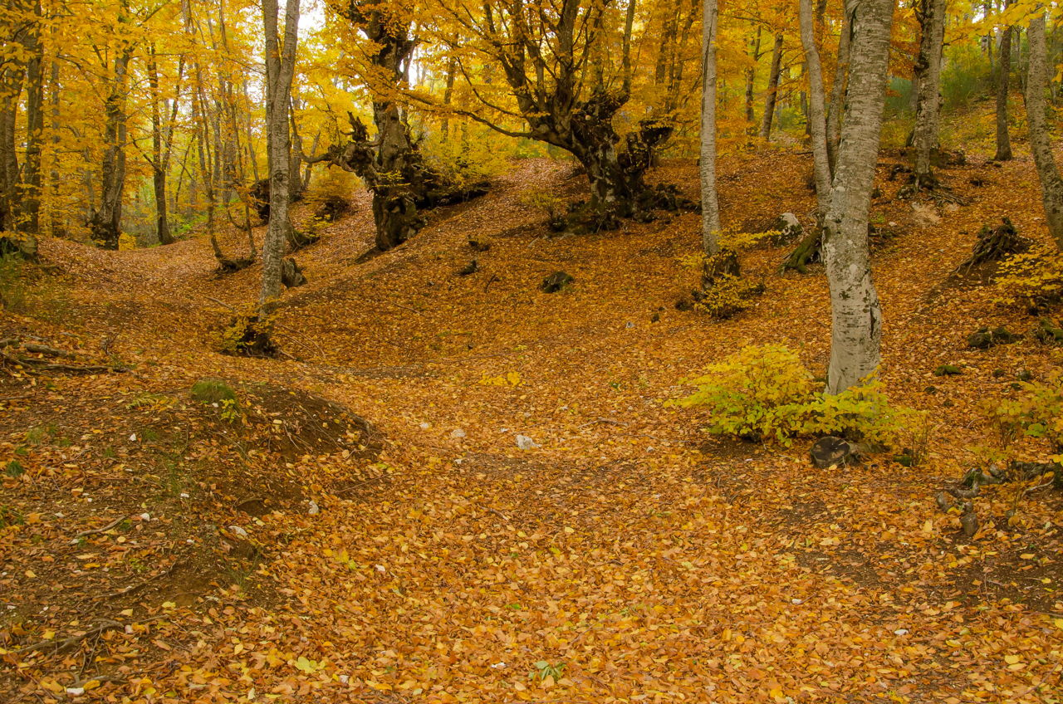
Like the seasons have all gone

Slide 55
We had joy, we had fun

Slide 56
We had seasons in the sun

Slide 57
But the wine and the song

Slide 58
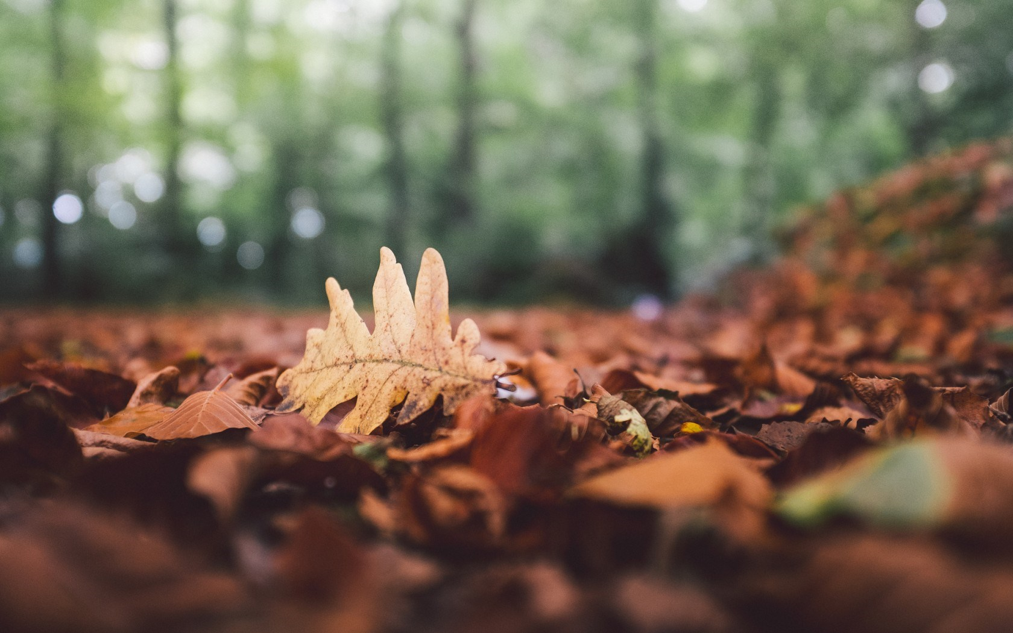
Like the seasons have all gone

