Slide 1
Just the way you are
adverbial clause of time
华南师范大学外国语言文化学院 熊芳
广东省河源市东江中学 游双梅

Slide 2
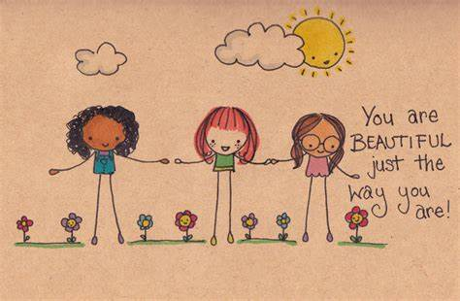
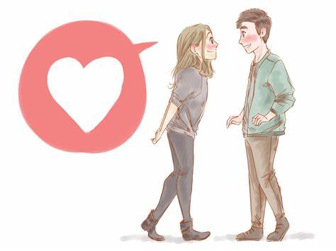

Slide 3
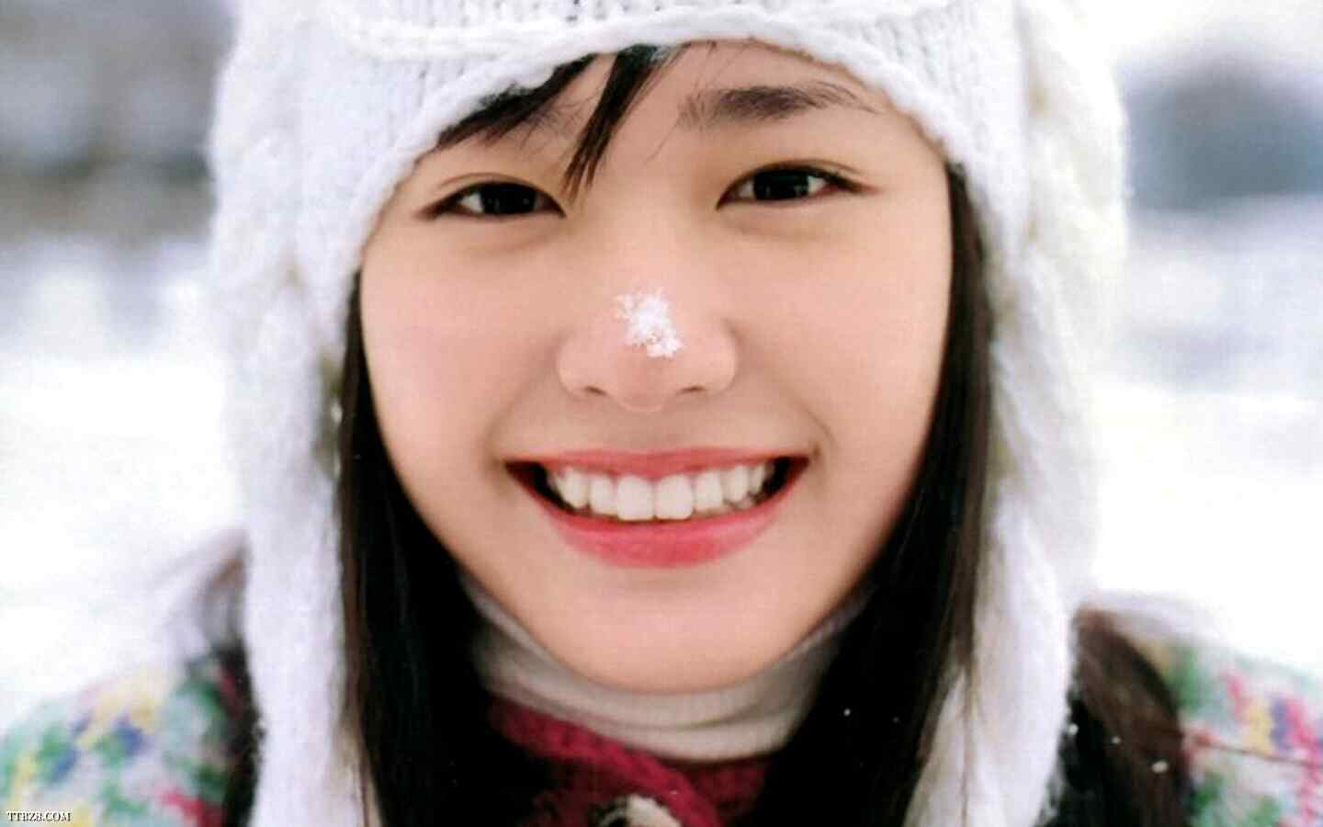
Oh her eyes her eyes
make the stars look like
they're not shining

Slide 4
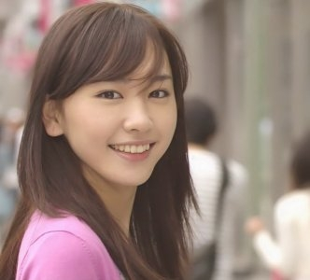
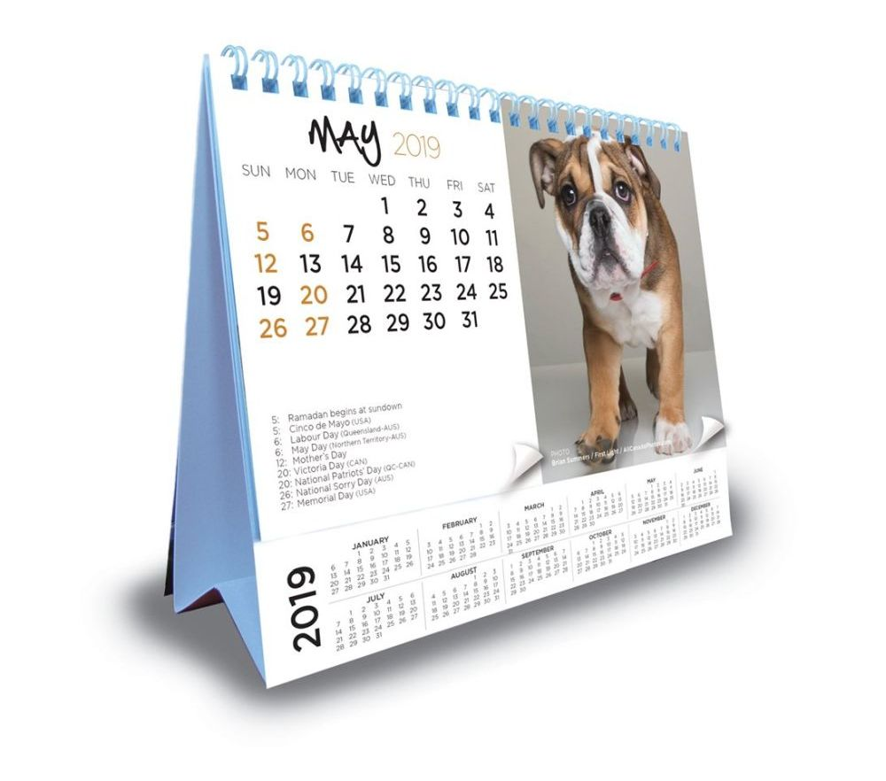
Her hair her hair
falls perfectly without her trying
She's so beautiful
and I tell her every day

Slide 5
Yeah I know I know when I compliment her she won't believe me

Slide 6
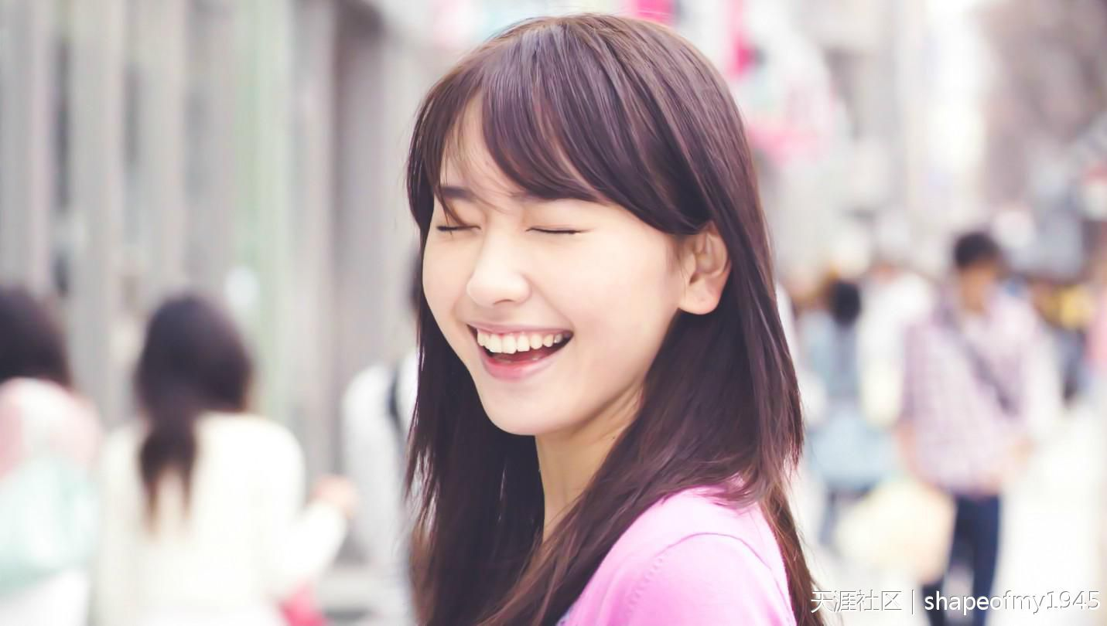
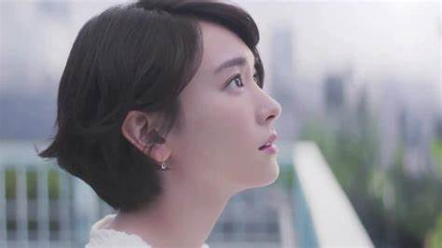
And it's so it's so
sad to think that she
don't see what I see
But every time she asks me
do I look ok I say

Slide 7
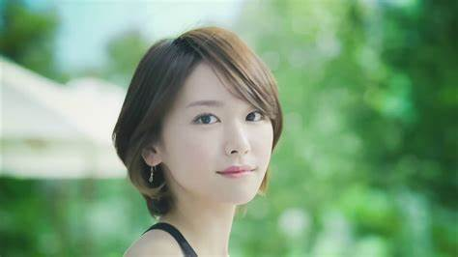
When I see your face there's not a thing that I would change

Slide 8
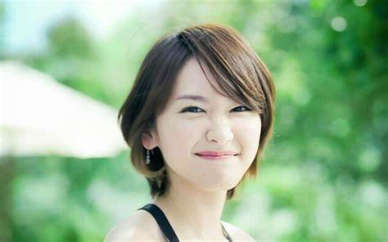
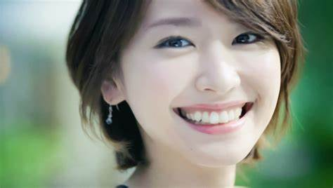
Cause you're amazing just the way you are
And when you smile the whole world stops and
stares for a while

Slide 9
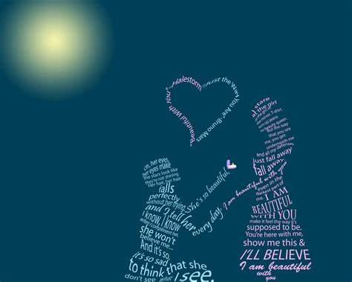
Cause girl you're amazing just the way you are

Slide 10
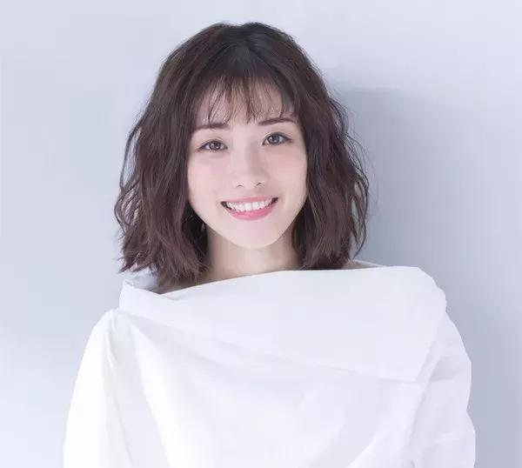
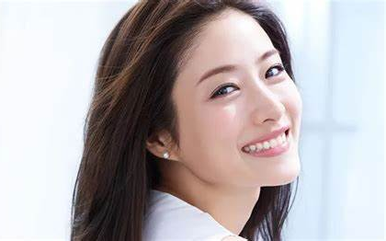
Her lips her lips I could kiss them all day if she let me

Slide 11
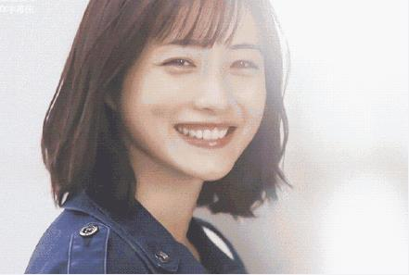
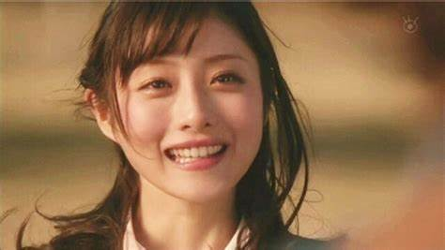
Her laugh her laugh she hates but I think it's so sexy
She's so beautiful and I tell her every day

Slide 12
Oh you know you know you know I'd never ask you to change

Slide 13
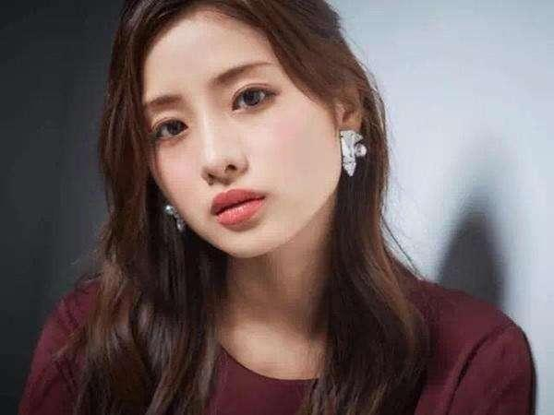
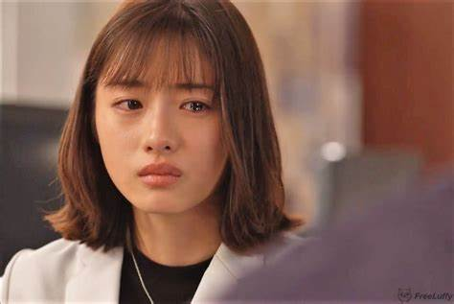
If perfect's what you're searching for then just stay the same
So don't even bother asking if you look ok You know I'll say

Slide 14
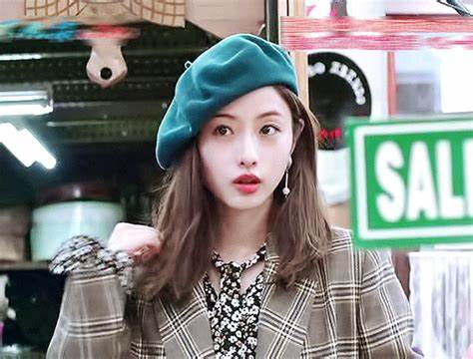
When I see your face there's not a thing that I would change

Slide 15
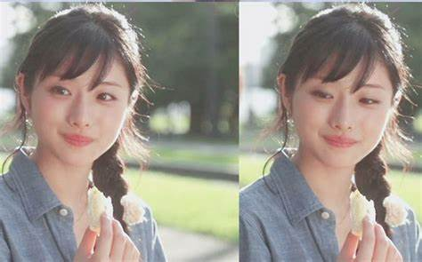
Cause you're amazing just the way you are

Slide 16
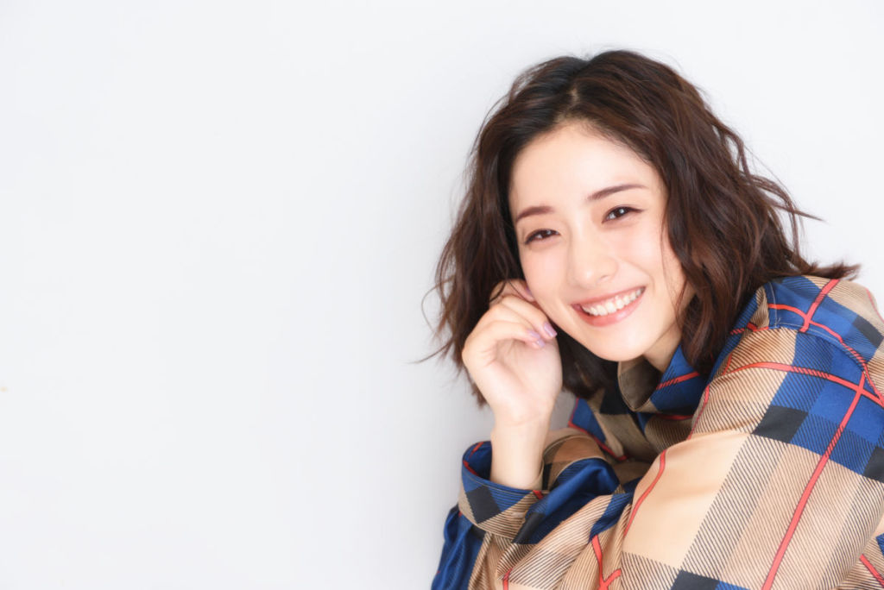
And when you smile the whole world stops and
stares for a while

Slide 17
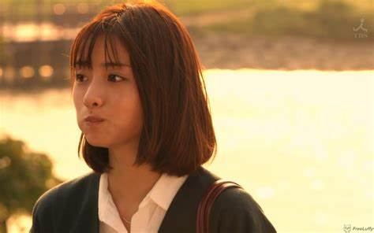
Cause girl you're amazing just the way you are

Slide 18
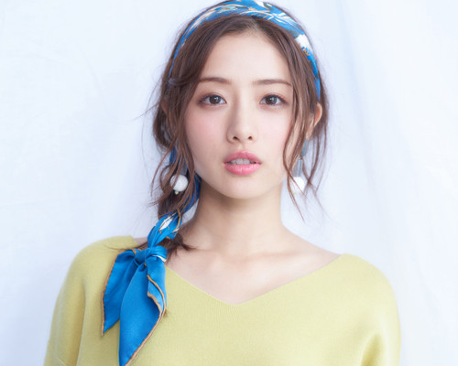
The way you are the way you are

Slide 19
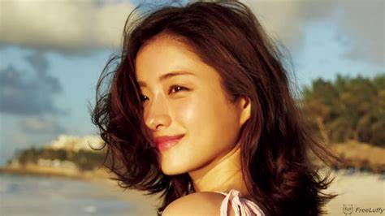
Girl you're amazing just the way you are

Slide 20
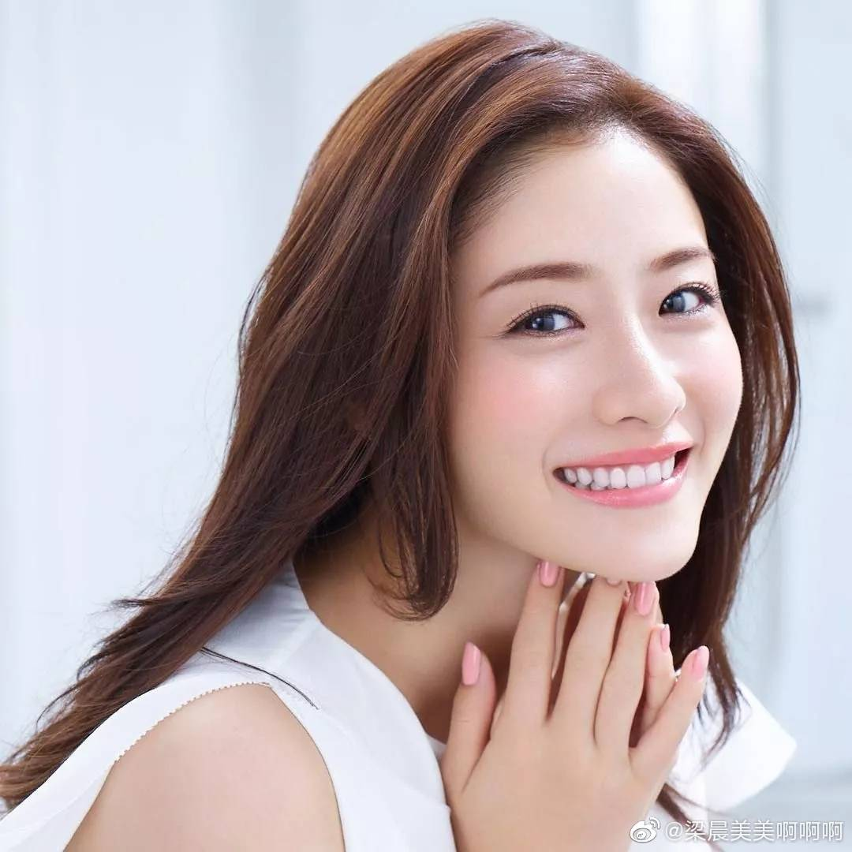
When I see your face there's not a thing that
I would change

Slide 21
Cause you're amazing just the way you are

Slide 22
And when you smile the whole world stops
and stares for a while

Slide 23
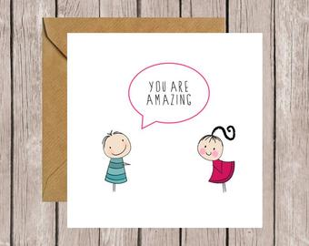
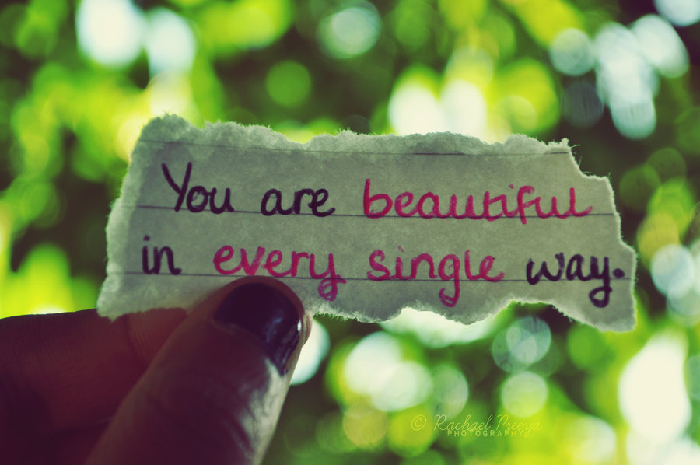
Cause girl you're amazing just the way you are

