Slide 1
All you need is love
---被动语态
华南师范大学外国语言文化学院 陈慧琳
广东省河源市东源县实验中学 廖丽芳

Slide 2
Love, Love, Love, love
Love, Love, Love, love

Slide 3
There's nothing you can do that can't be done

Slide 4
Nothing you can sing that can't be sung

Slide 5
GAME
Nothing you can say but you can learn how to play the game

Slide 6
It's easy

Slide 7
Nothing you can make that can't be made

Slide 8
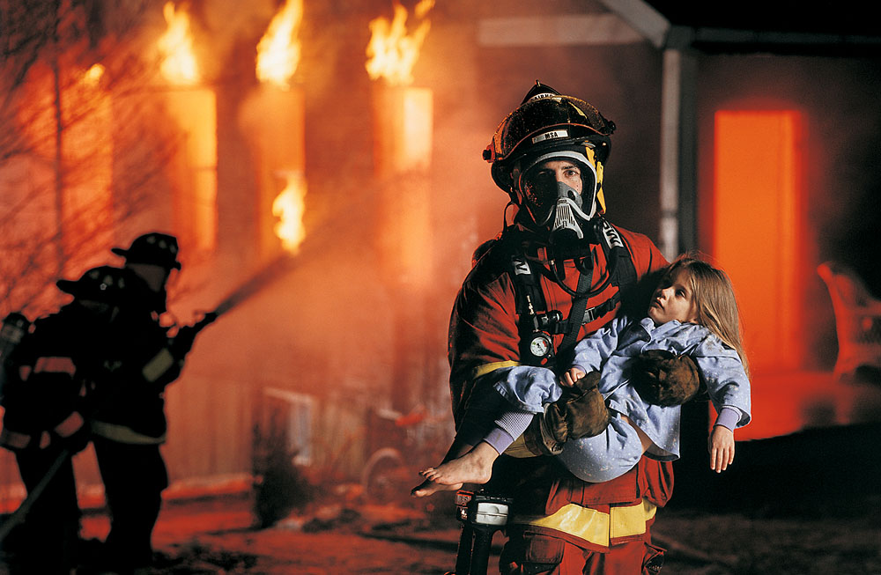
No one you can save that can't be saved

Slide 9
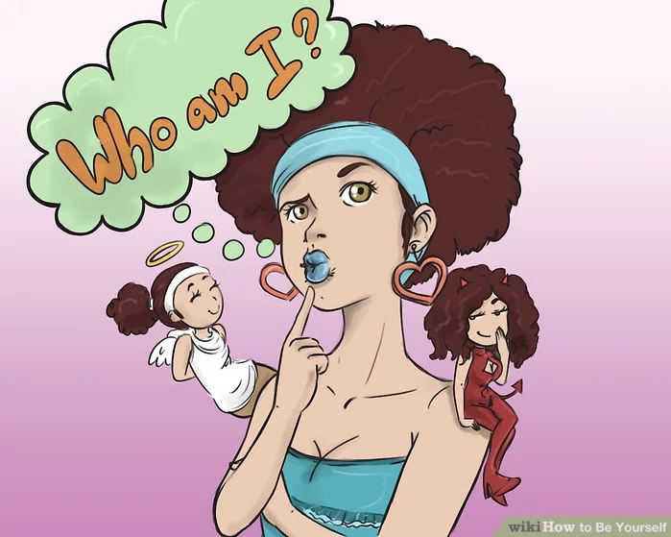
Nothing you can do but you can learn how to be you in time

Slide 10
It's easy

Slide 11
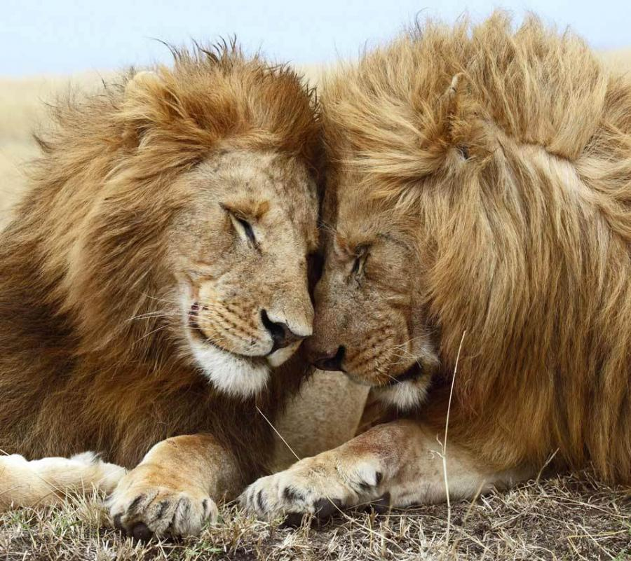
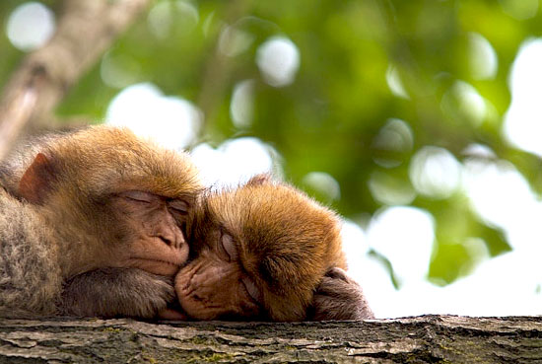
All you need is love
All you need is love

Slide 12
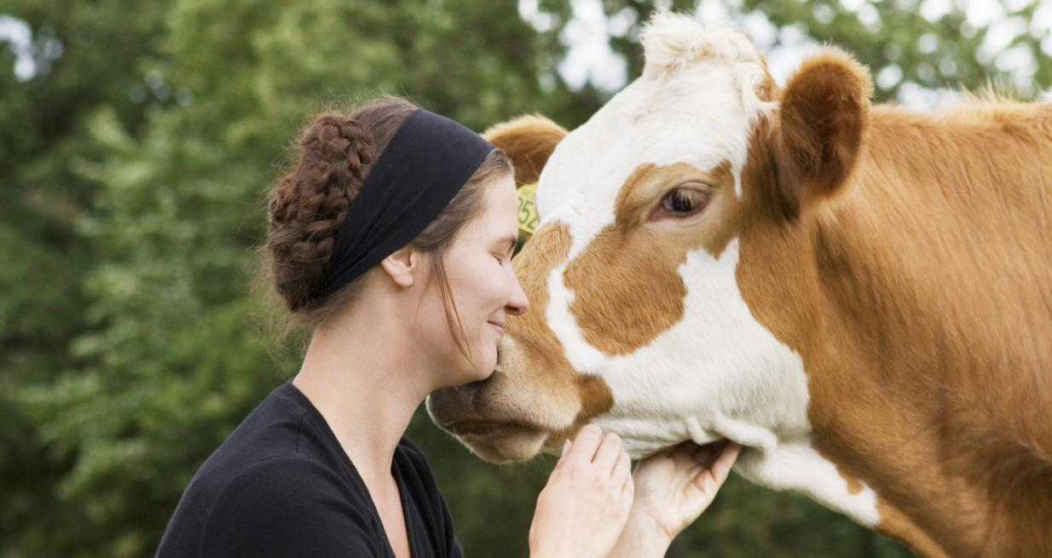
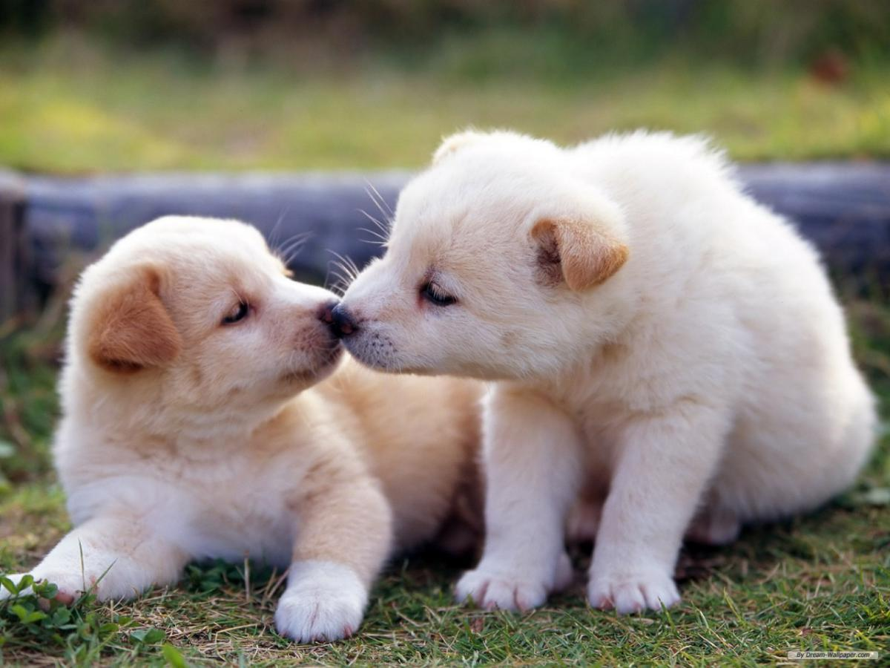
All you need is love, love
Love is all you need

Slide 14
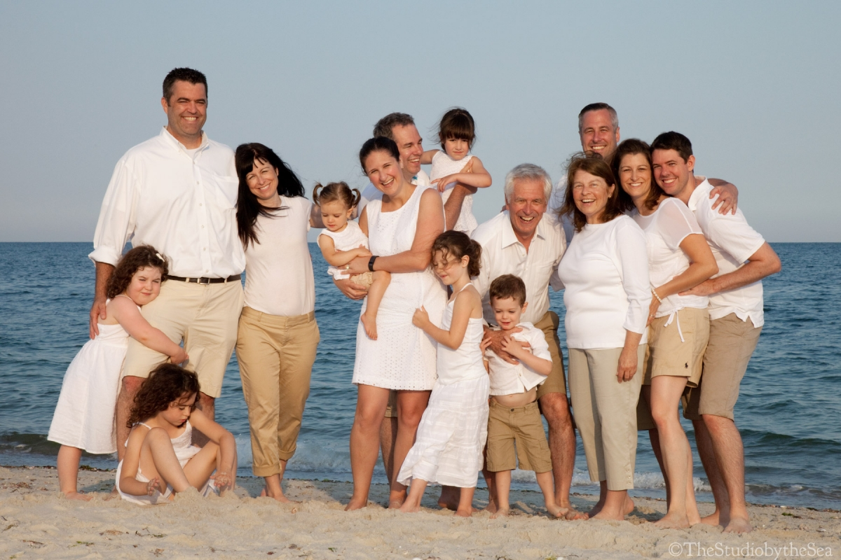
All you need is love

Slide 15
All you need is love

Slide 16
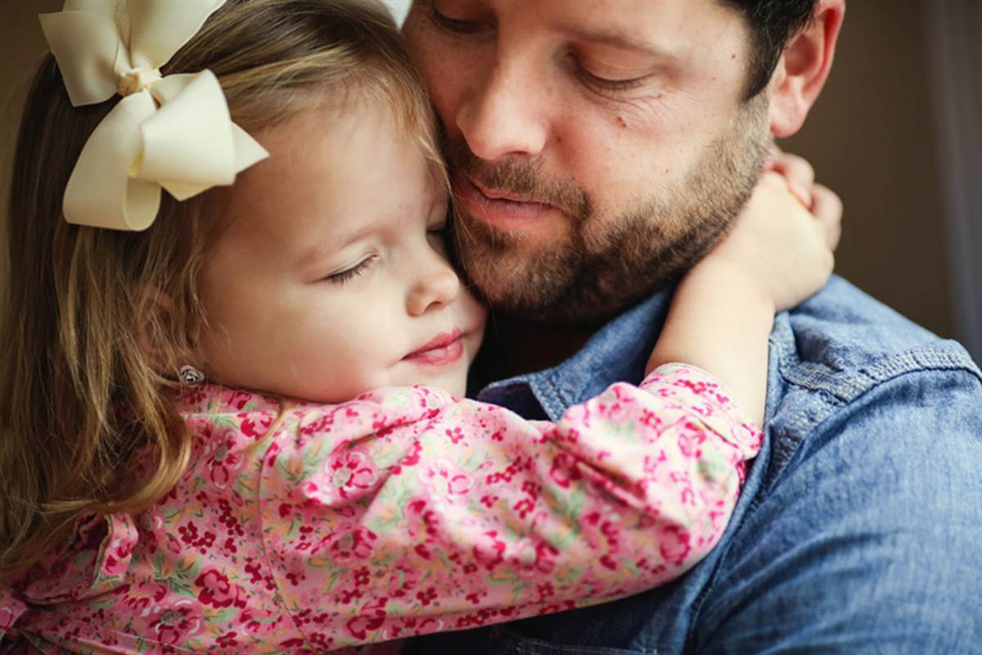
All you need is love, love
Love is all you need

Slide 17
Nothing you can know that isn't known

Slide 18
Nothing you can see that isn't shown

Slide 19
Nowhere you can be that isn't where you're meant to be

Slide 20
It's easy

Slide 21
All you need is love

Slide 22
All you need is love

Slide 23
All you need is love, love

Slide 24
Love is all you need

Slide 25
All you need is love

Slide 26
All you need is love

Slide 27
Love is all you need
All you need is love, love

Slide 28
Love is all you need

