Slide 1
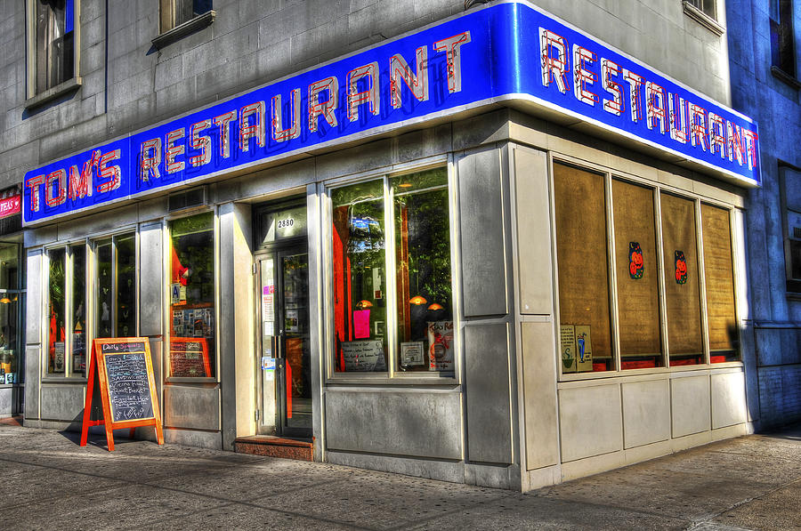

Slide 2
Song: Tom’s Diner
语法：现在进行时
华南师范大学外国语言文化学院：谢童
广东省河源市东源实验中学：陈秀莲

Slide 3
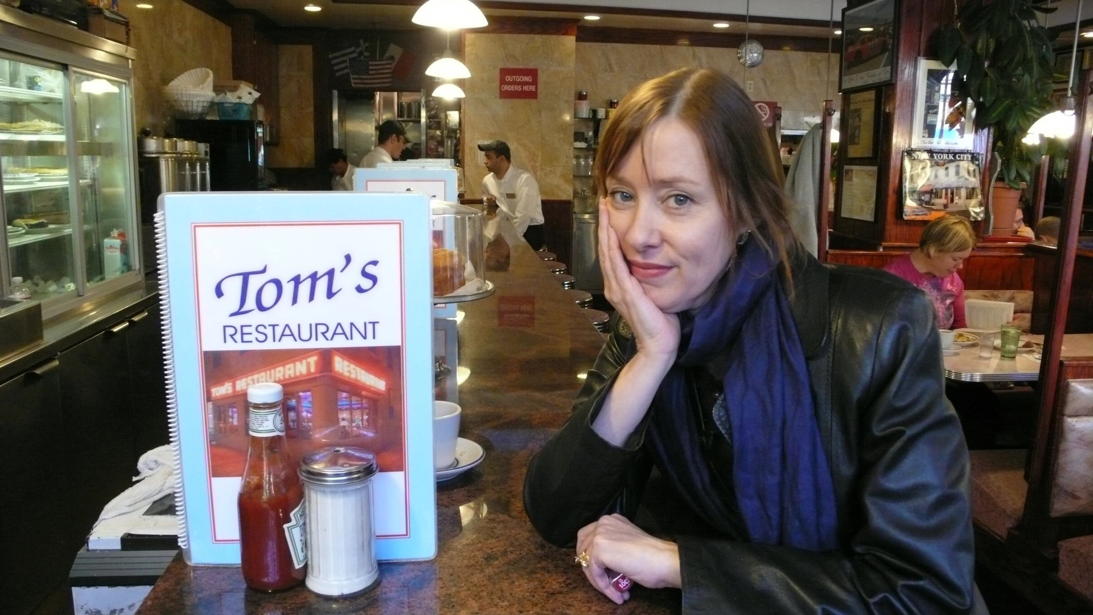
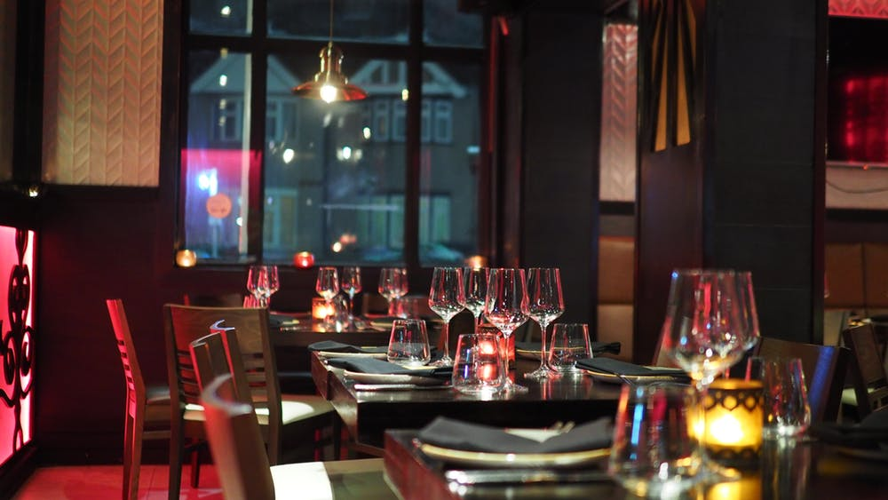
I am sitting in the morning
At the diner on the corner

Slide 4
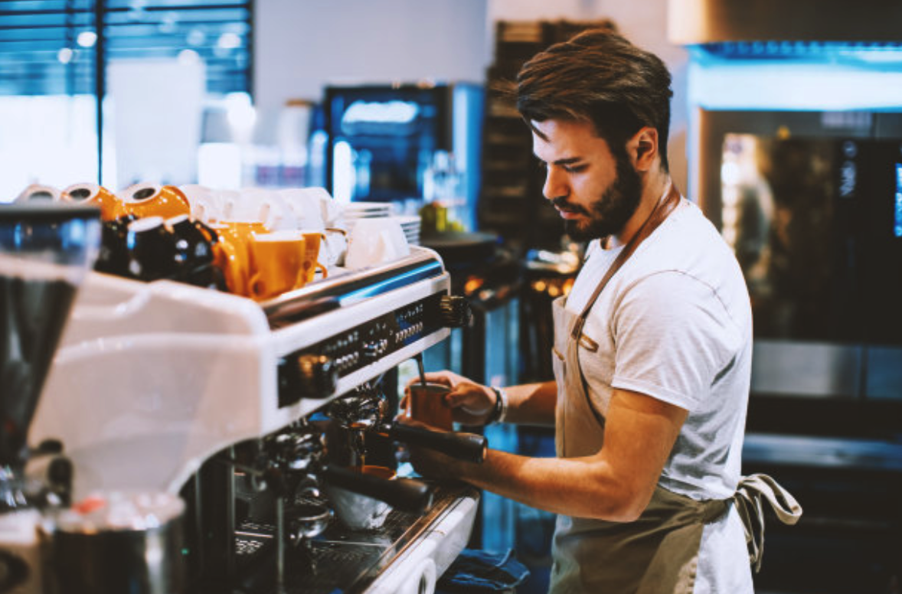
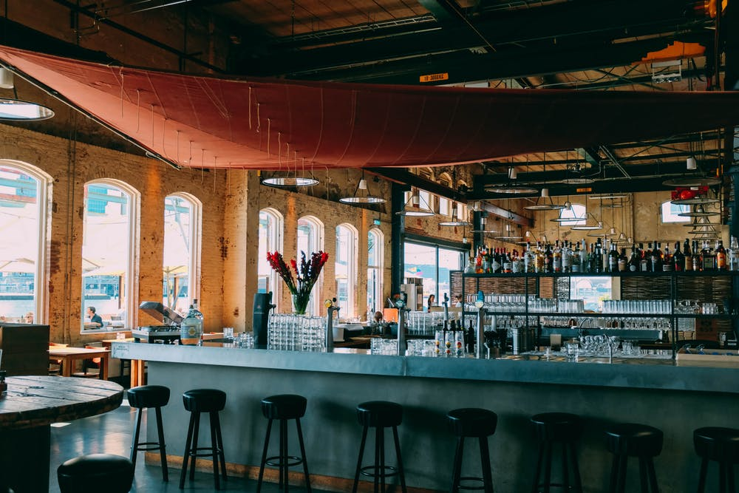
I am waiting at the counter
For the man
to pour the coffee

Slide 5
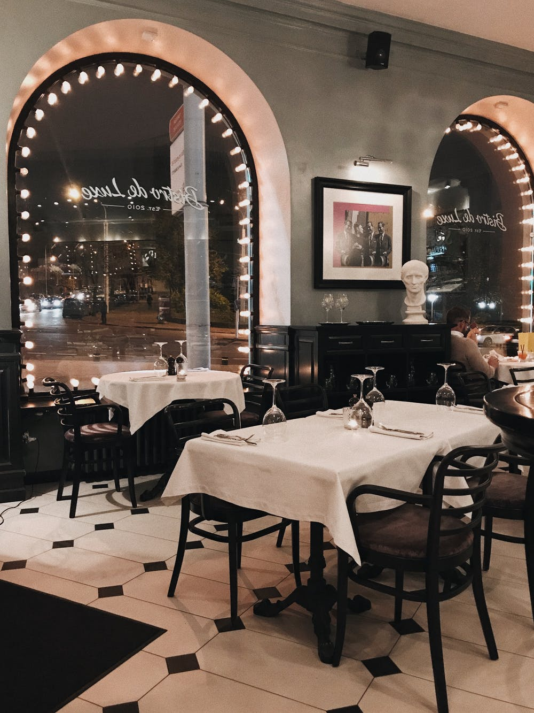
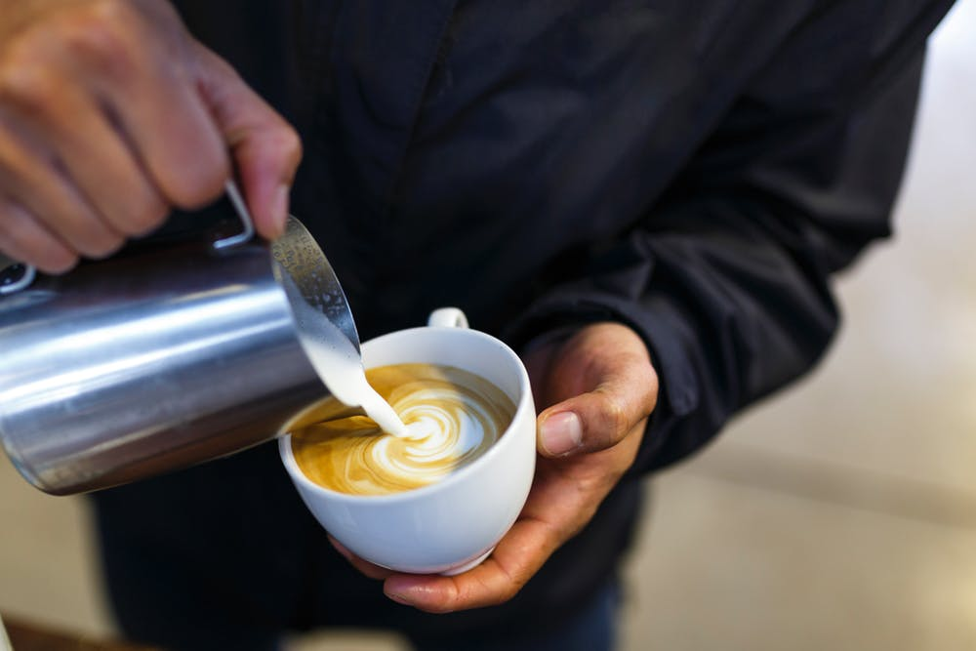
He is looking out the window
And he fills it only halfway
At somebody coming in
And before I even argue

Slide 6
De De De …
De De De …
De De De …

Slide 7
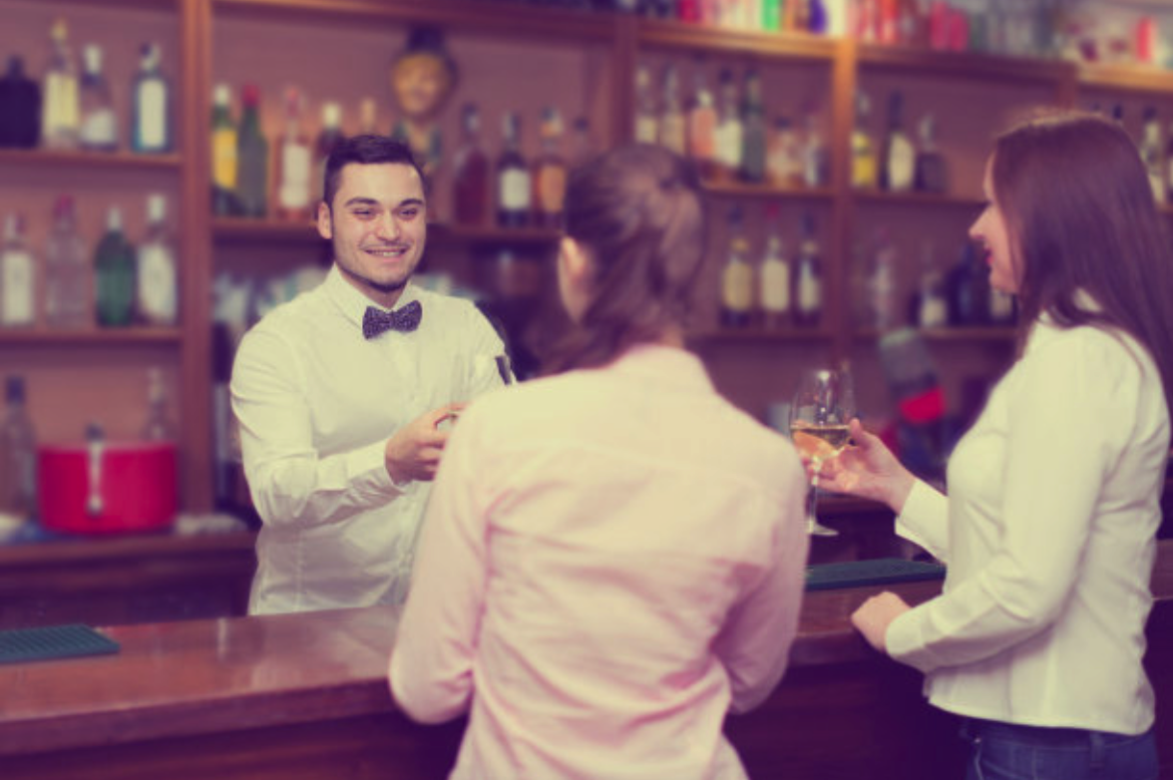
“It is always nice to see you”
Says the man behind the counter
To the woman who has come in
She is shaking her umbrella

Slide 8
And I look the other way
As they are kissing their hellos

Slide 9
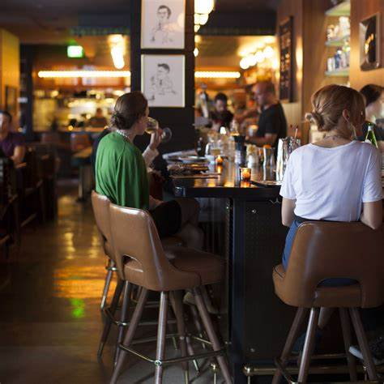
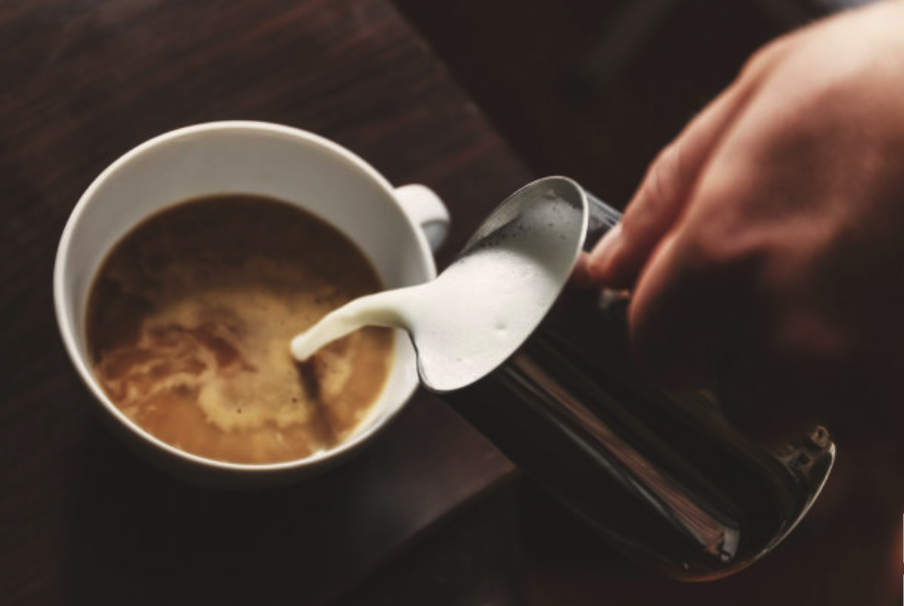
I’m pretending not to see them
Instead I pour the milk

Slide 10
De De De …
De De De …
De De De …
Notes:
9秒空白 1：17开始唱下一段

Slide 11
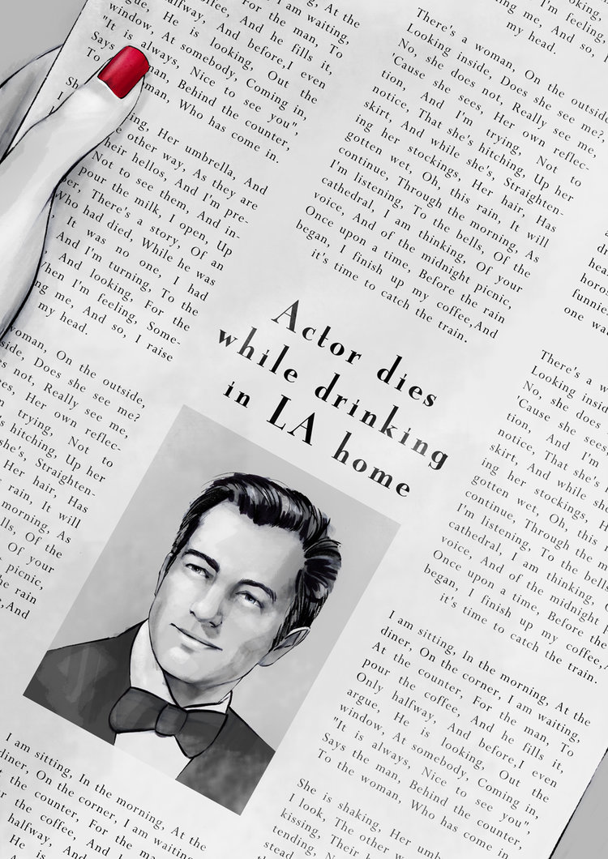
And I open up the paper
Who had died while he was drinking
There‘s a story of an actor
It was no one I had heard of
Notes:
1：17开始唱歌

Slide 12
And I’m turning
to the horoscope
And looking for
the funnies

Slide 13
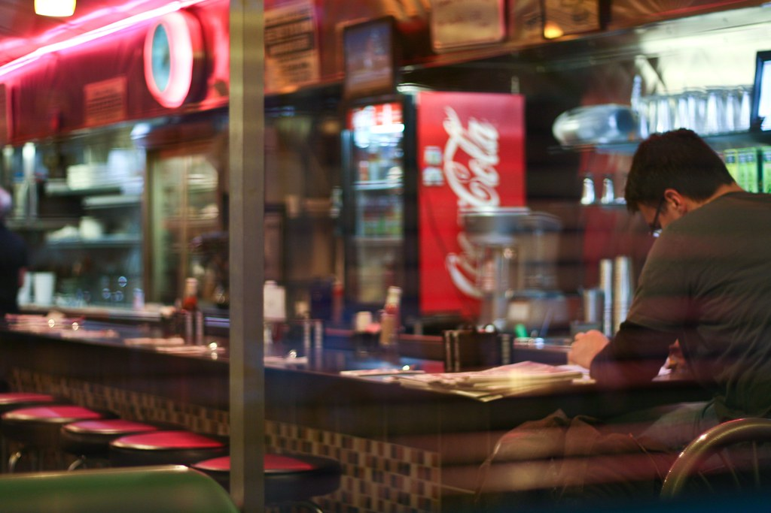
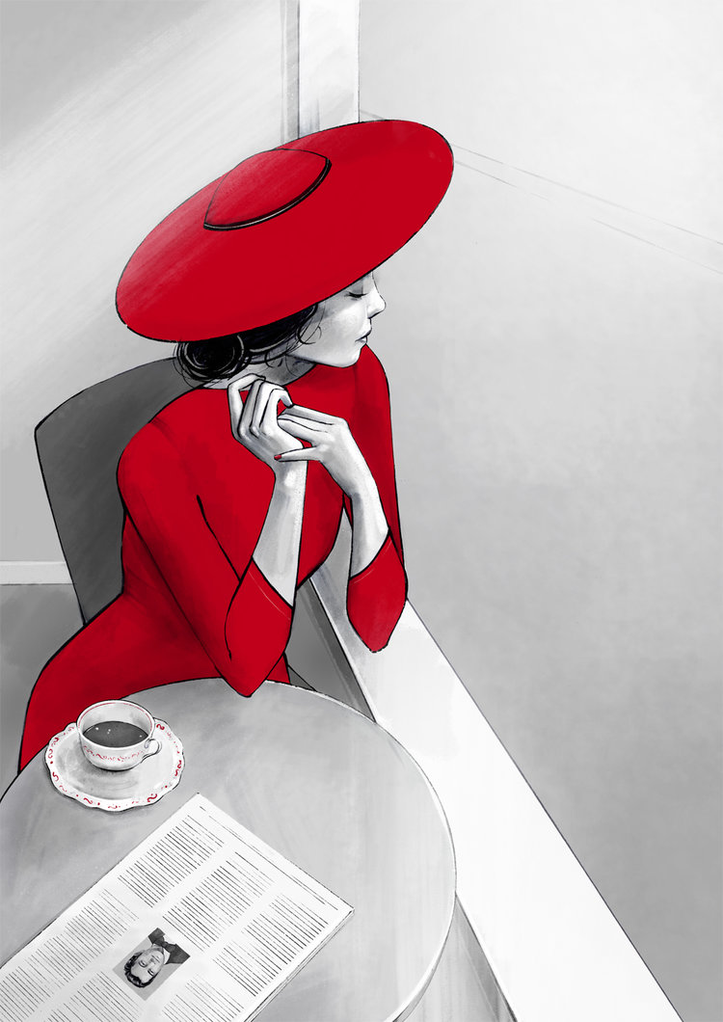
When I’m feeling
someone watching me
And so
I raise my head

Slide 14
De De De …
De De De …
De De De …
Notes:
1：36-1：57 （减去9秒）实际到1：50即可
二次修改版：1：26-1：40？

Slide 15
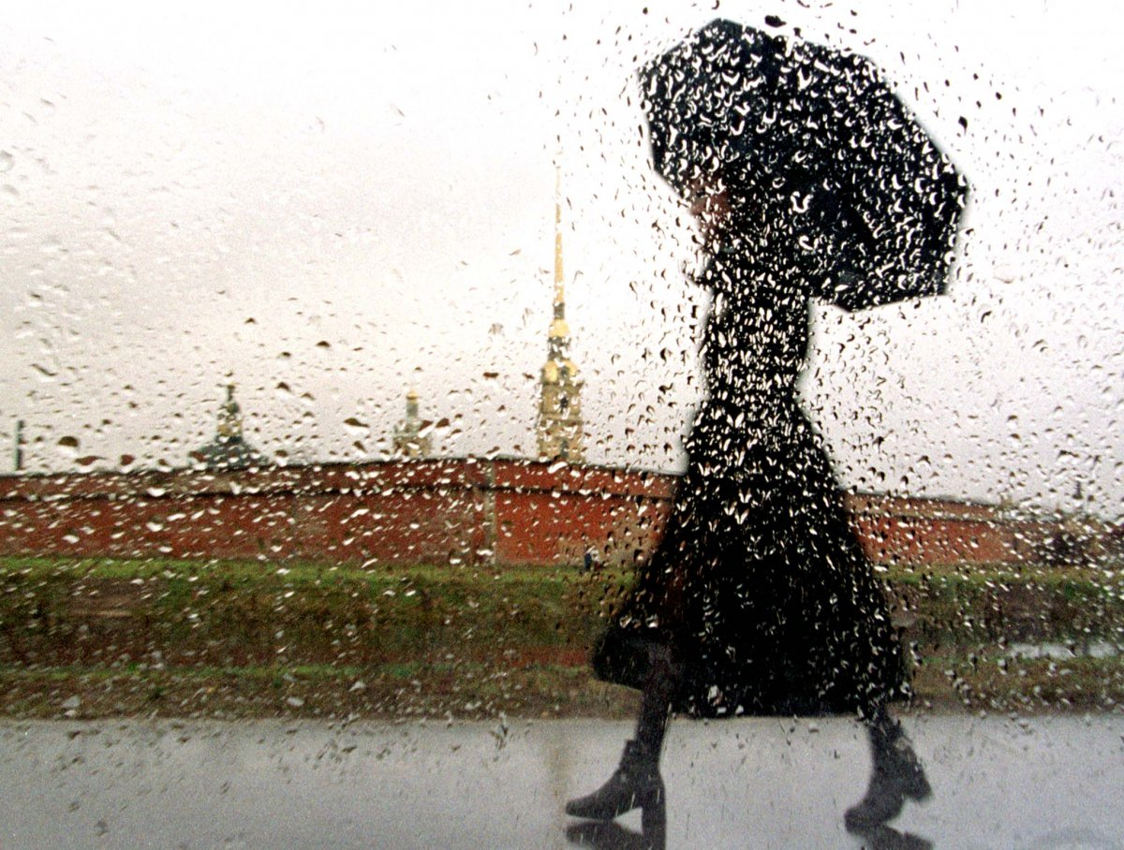
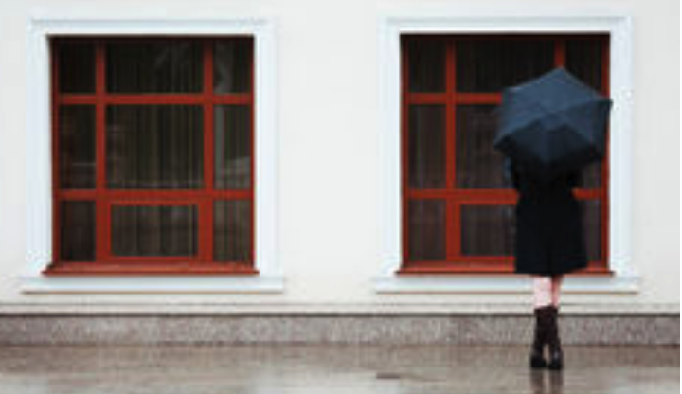
There’s a woman on the outside
And I’m trying not to notice
That she’s hitching up her skirt
Looking inside. Does she see me?
No she does not really see me
And while she's straightening her stockings
Cause she sees her own reflection
Her hair has gotten wet
Notes:
到2：07结束

Slide 16
De De De …
De De De …
De De De …
Notes:
2：17 – 2：25（变奏）-2：30
1；59.3
2：13变奏

Slide 17
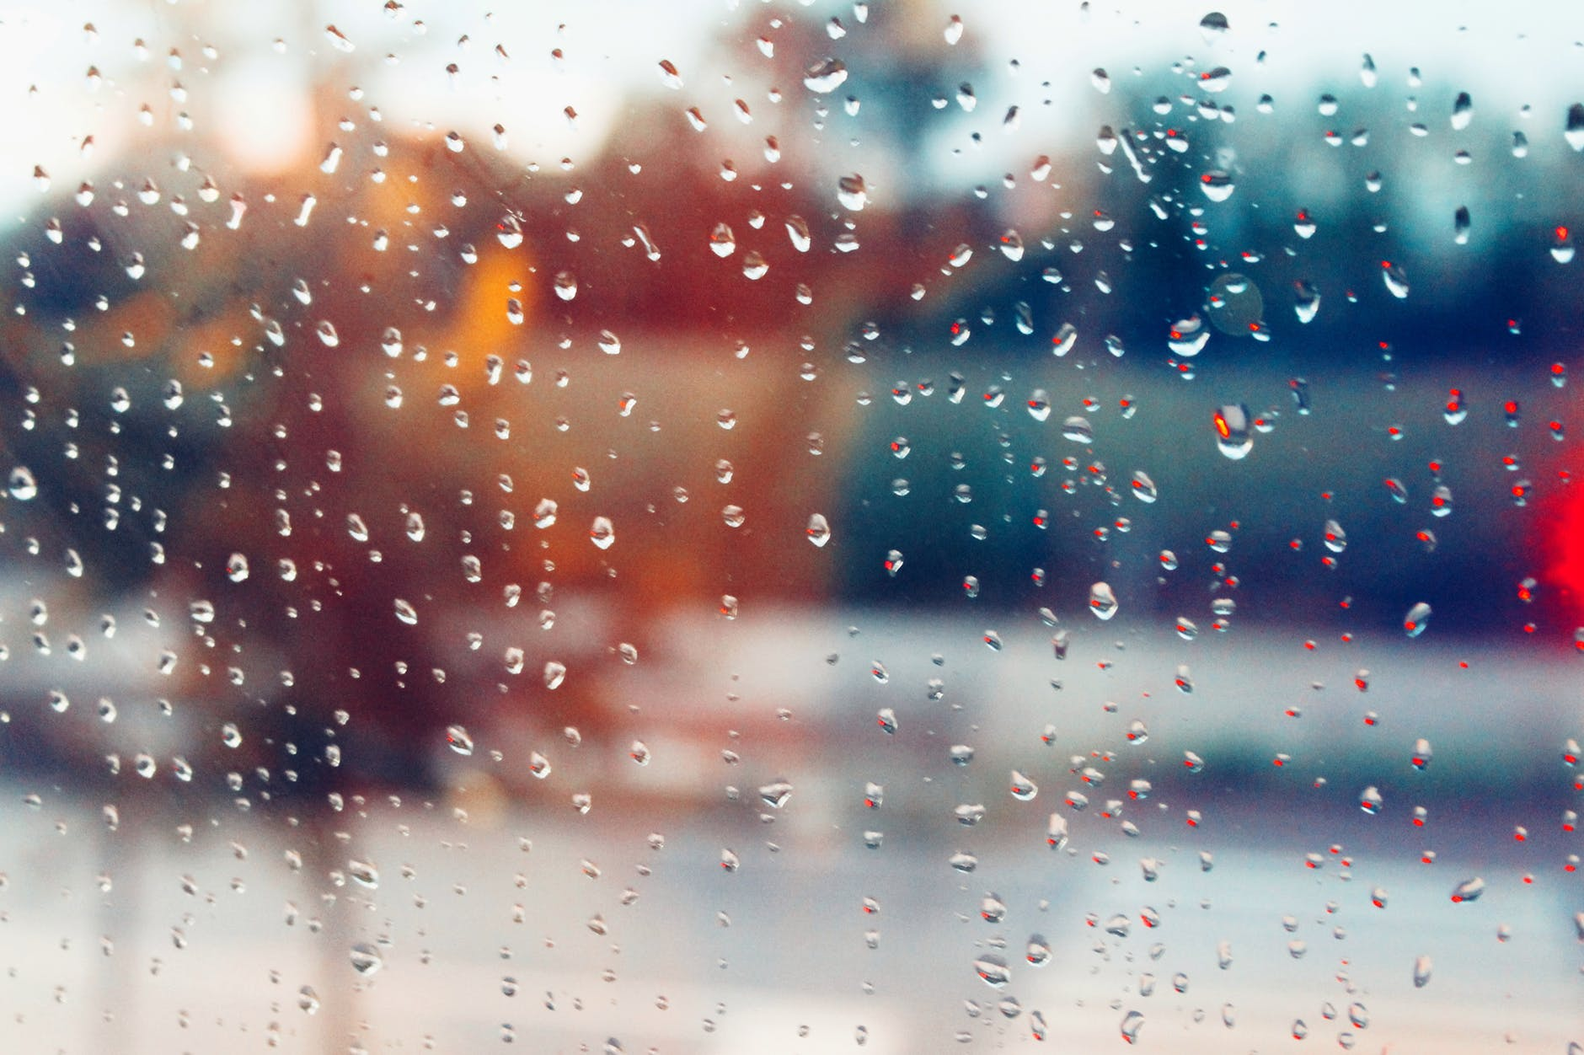
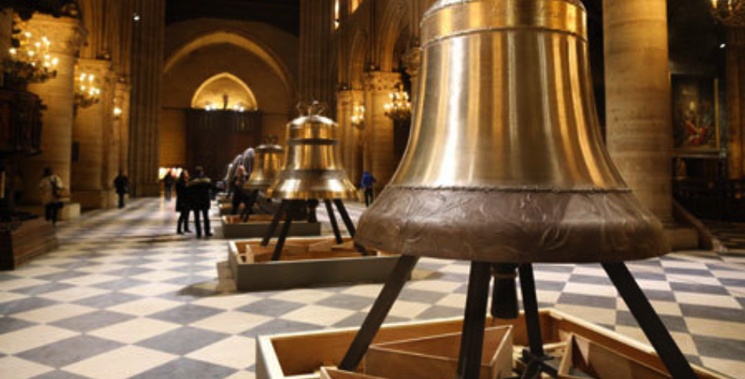
Oh, this rain it will continue
Through the morning as I’m listening
To the bells of the cathedral
I am thinking of your voice…
Notes:
2：30-

Slide 18
De De De …

Slide 19
Thank you for watching !
Notes:
前面部分留白12秒（包括空出来3秒到第3页）

