Slide 1

Season In The Sun
-- Past Simple Tense
华南师范大学外国语言文化学院 黄 雯
广东省河源市第二中学 曾惠娜

Slide 2

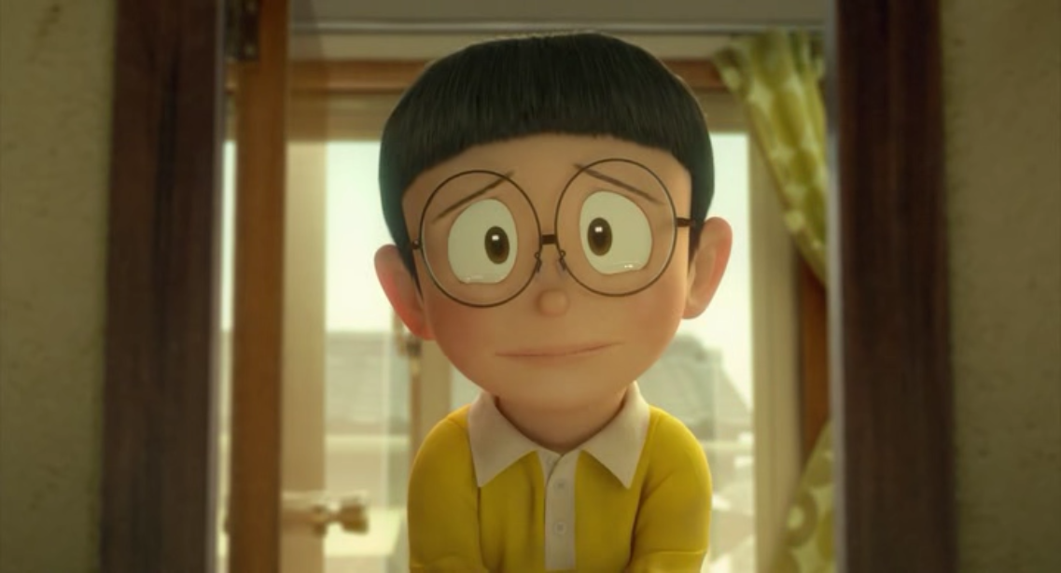
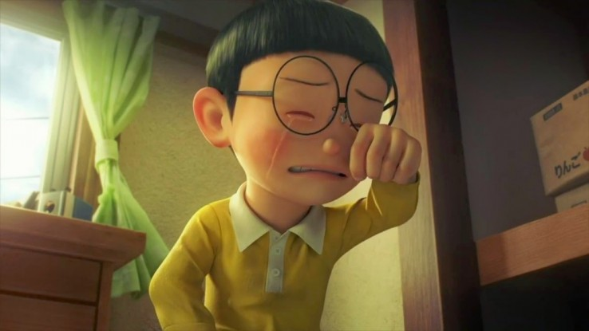
Goodbye to you,
my trusted friend.

Slide 3
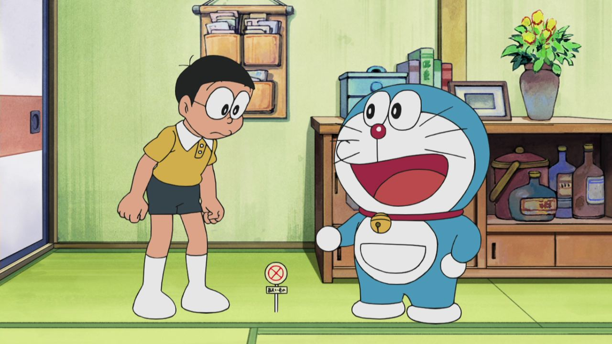
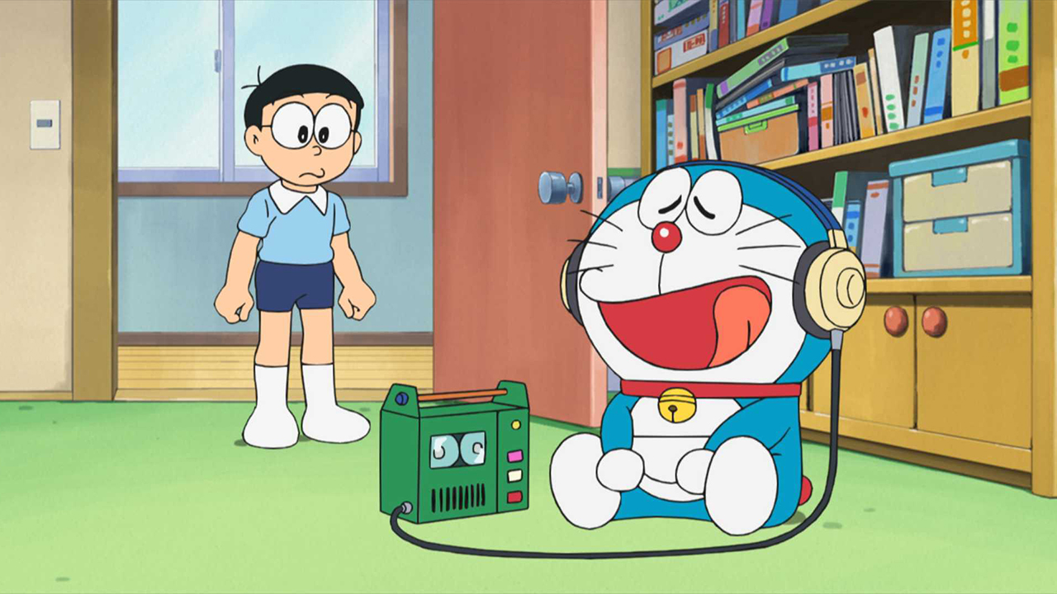
We've known each other
since we were nine or ten.

Slide 4
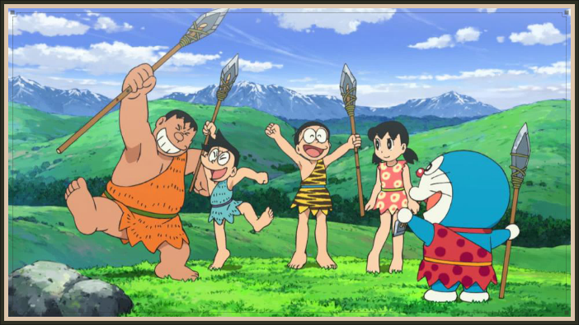
Together we've climbed
hills and trees.

Slide 5
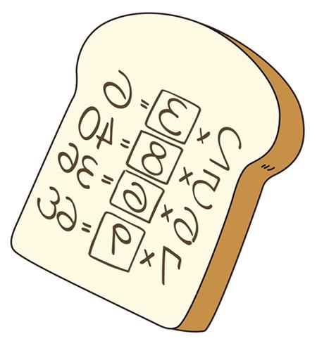
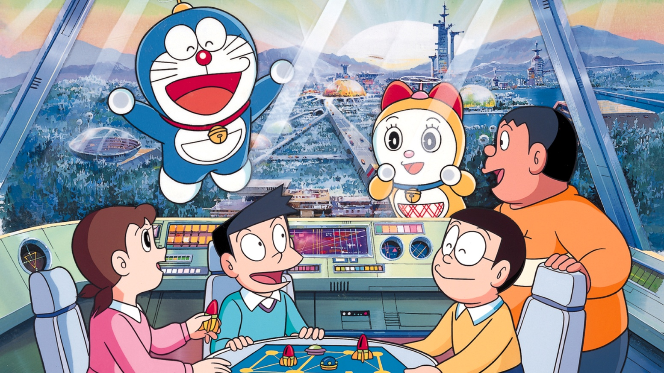
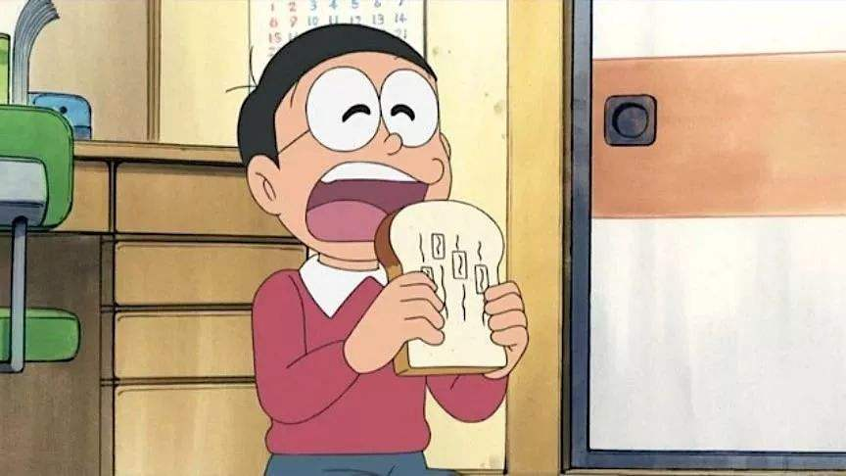
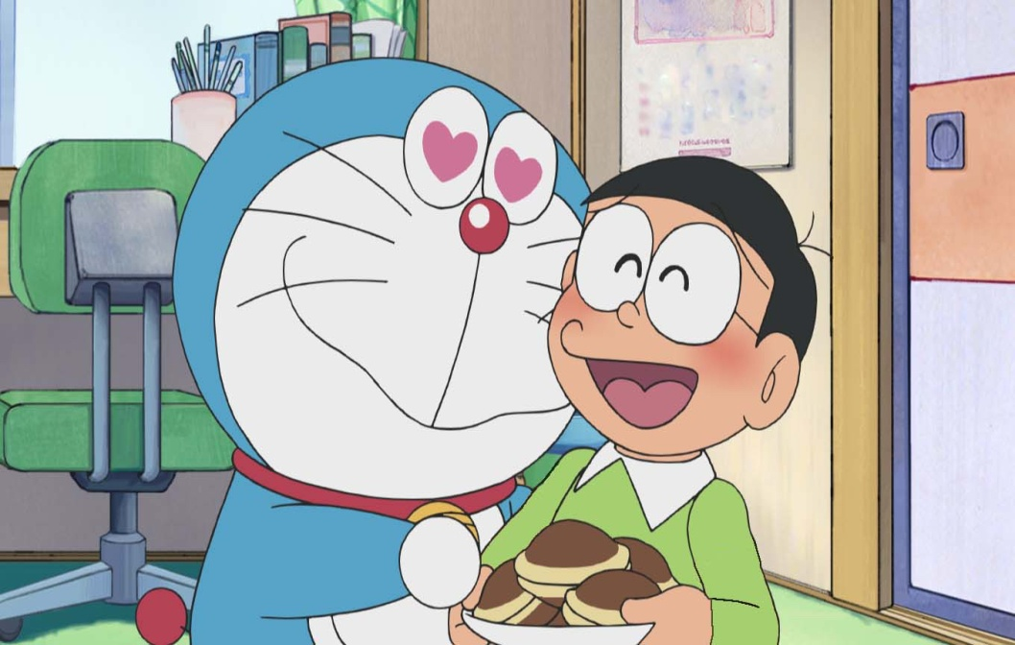
skinned our heart and skinned our knees.
learned of love and ABCs.

Slide 6
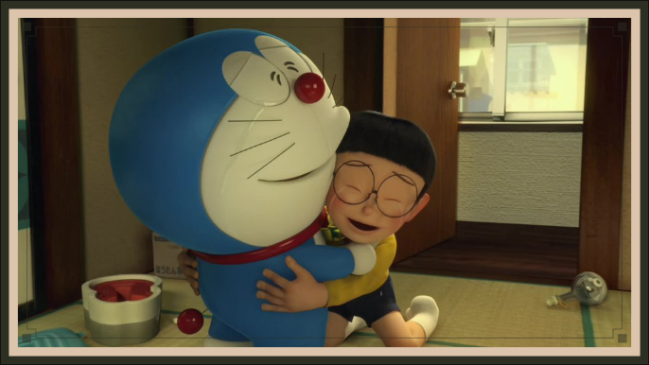
Goodbye my friend,
it's hard to die.

Slide 7

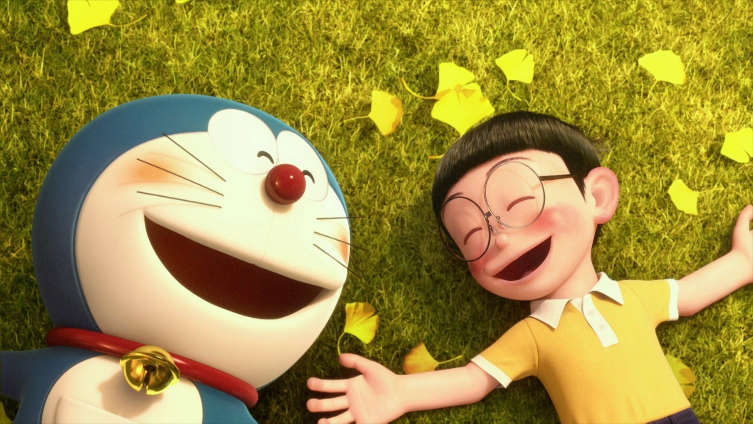
When all the birds
are singing in the sky.
Now that the spring
is in the air.

Slide 8
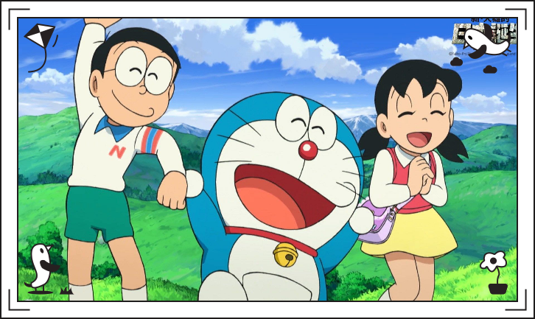
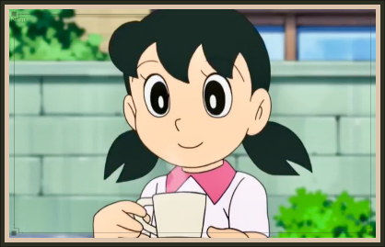
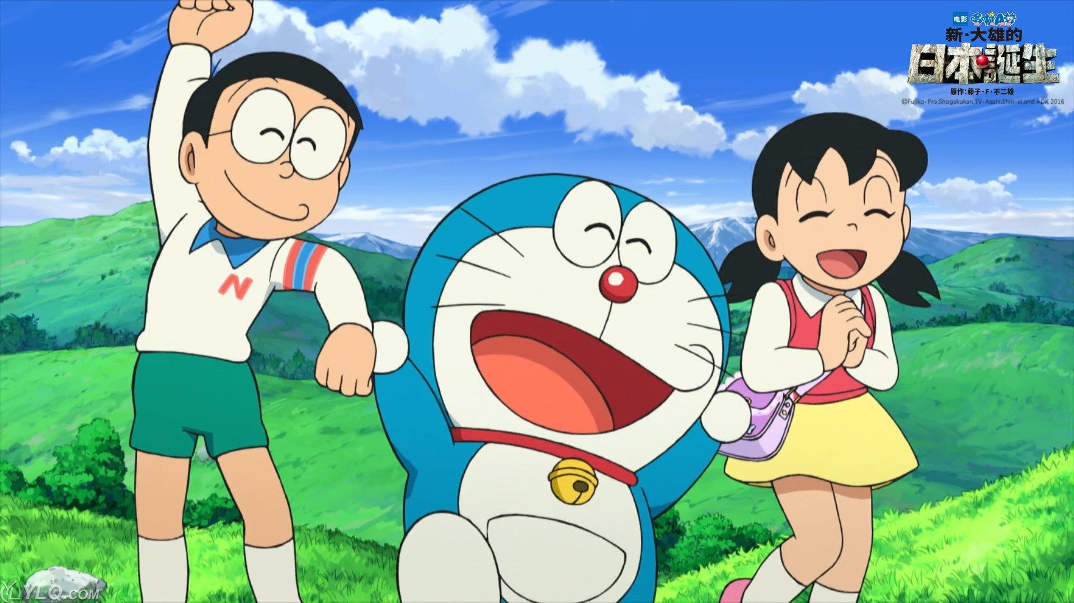
Pretty girls are everywhere.

Slide 9
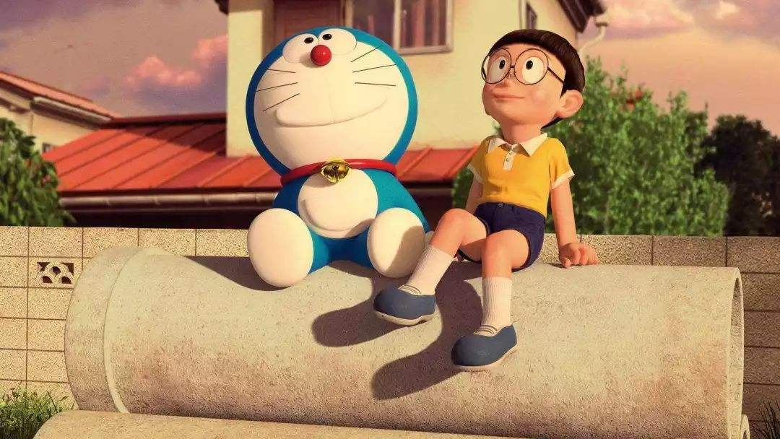
Think of me
and I'll be there.

Slide 10
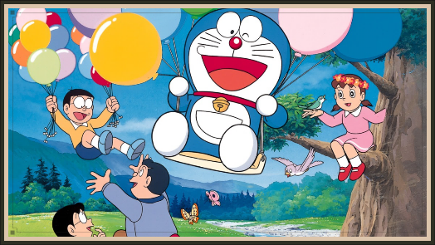
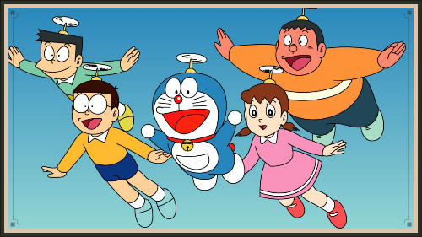
We had joy，we had fun.
We had seasons in the sun.

Slide 11
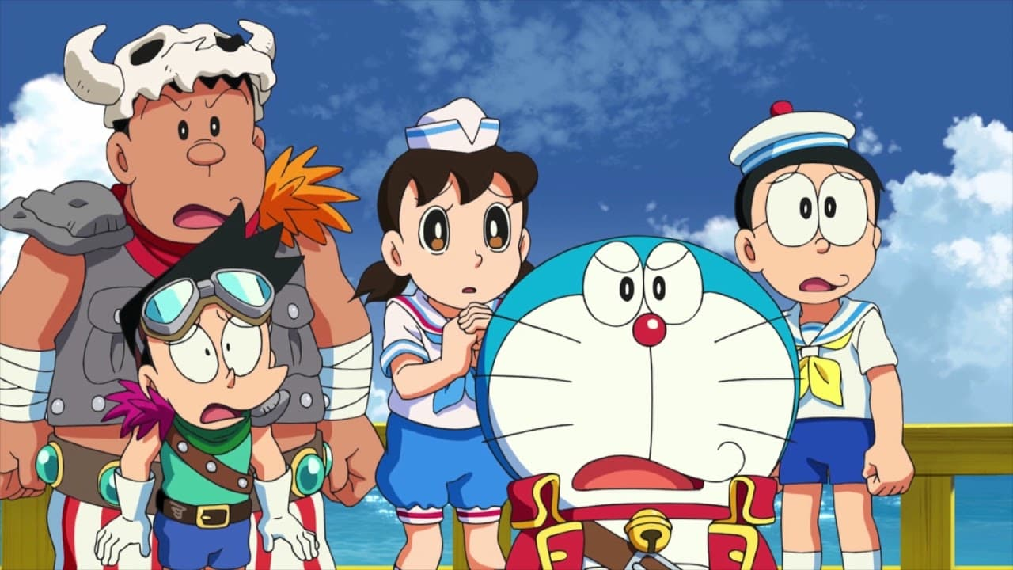
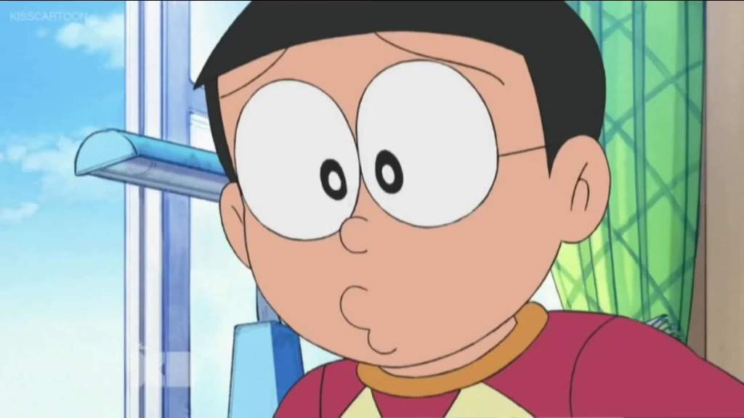
But the hills that we climbed
were just seasons out of time

Slide 12
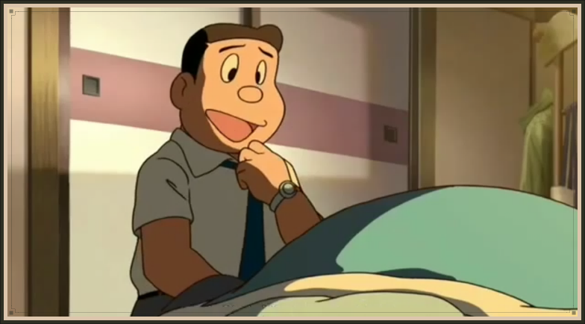

Goodbye papa please pray for me.

Slide 13
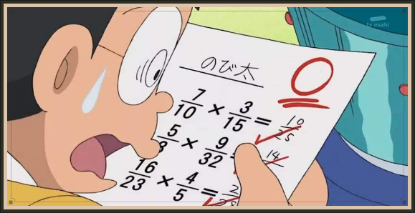
I was the black sheep of the family.

Slide 14
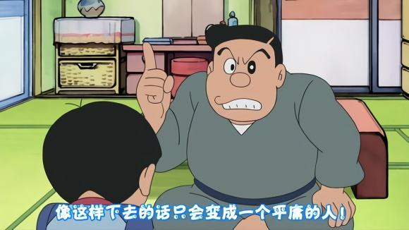
You tried to teach me right from wrong.

Slide 15
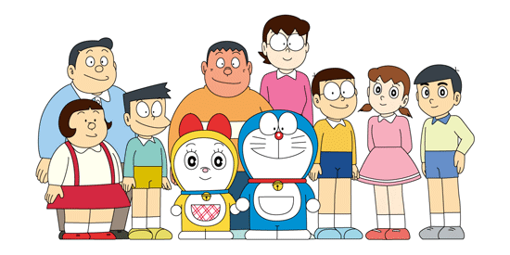
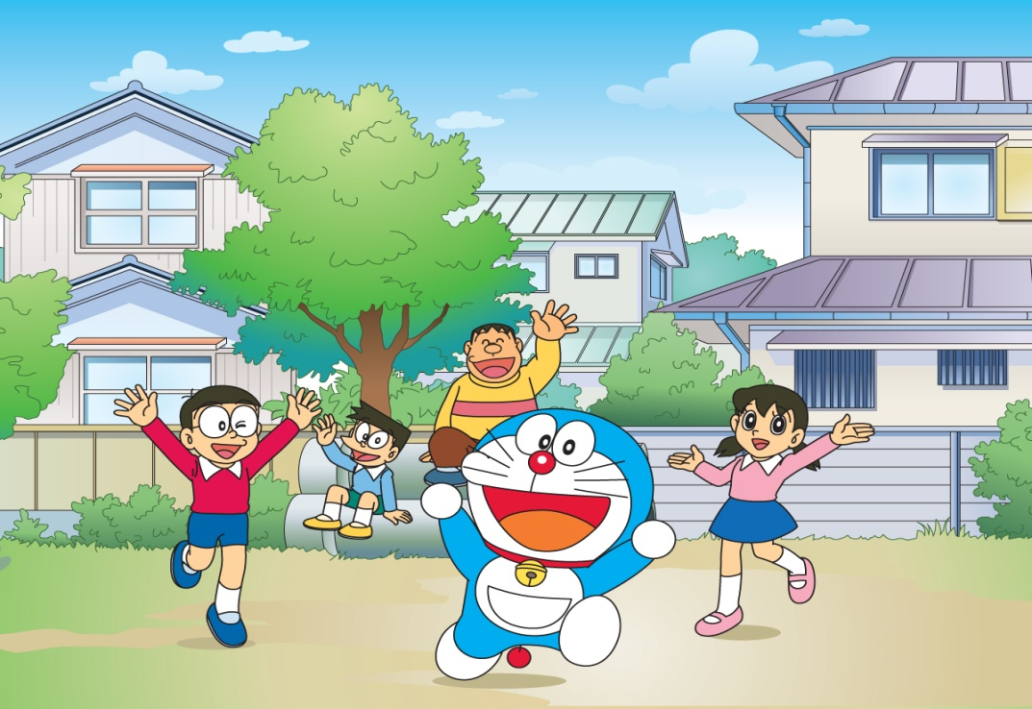
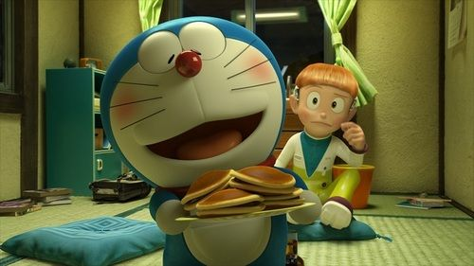
Too much wine
and too much song.
Wonder how I got along.

Slide 16
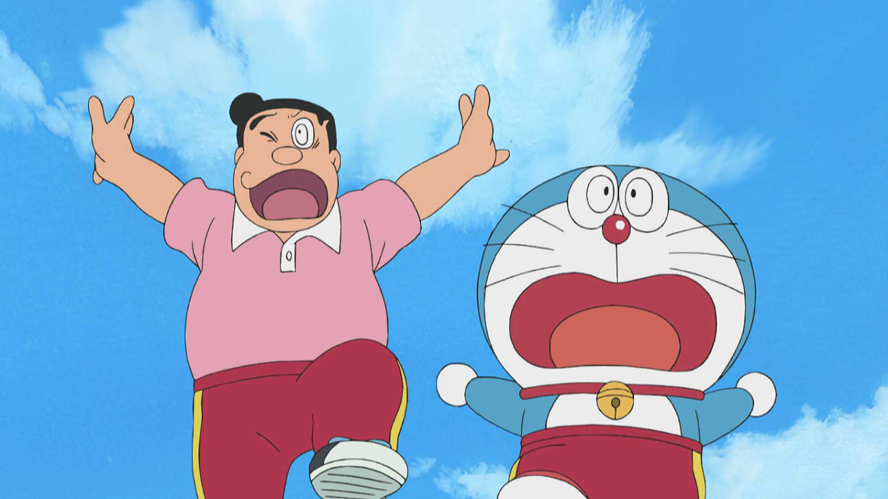
Goodbye papa, it's hard to die

Slide 17
When all the birds
are singing in the sky.
Now that the spring
is in the air.

Slide 18
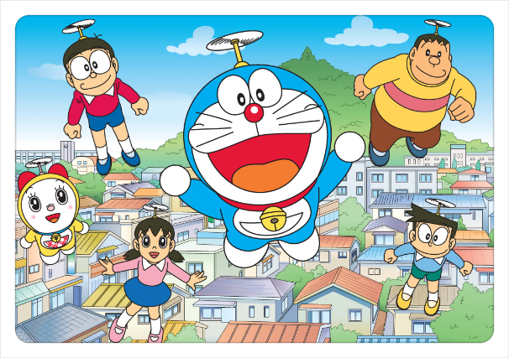
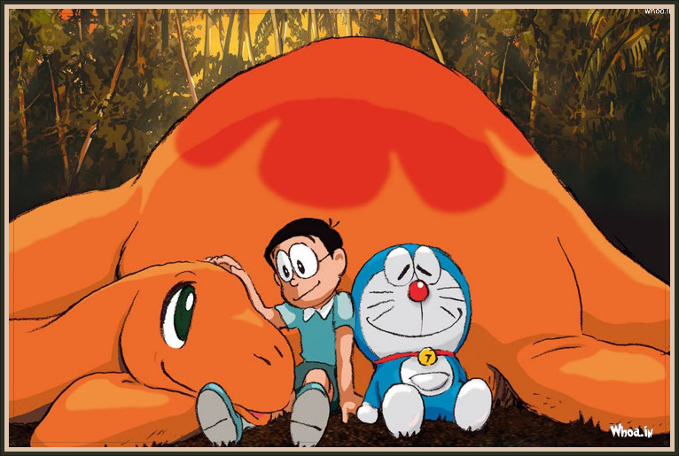
Little children everywhere.

Slide 19
When you see them,
I'll be there.

Slide 20
We had joy，we had fun.
We had seasons in the sun.

Slide 21
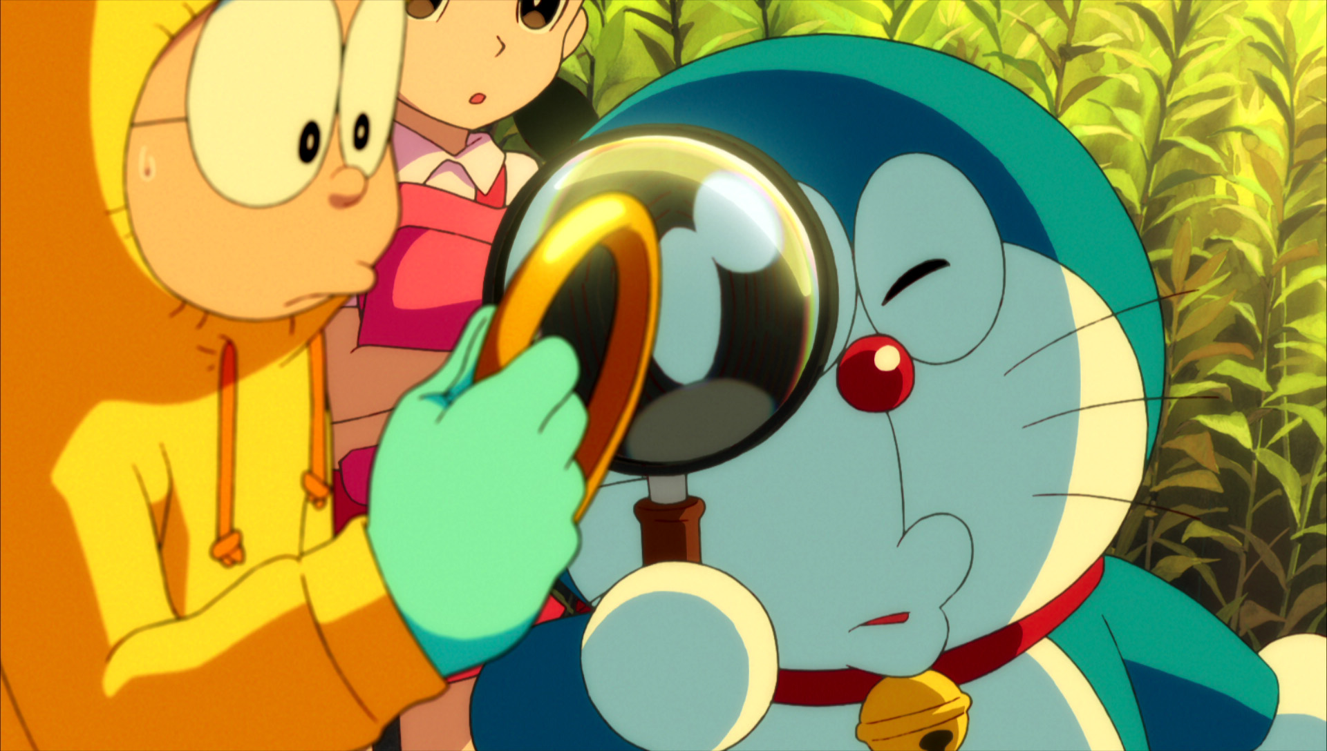
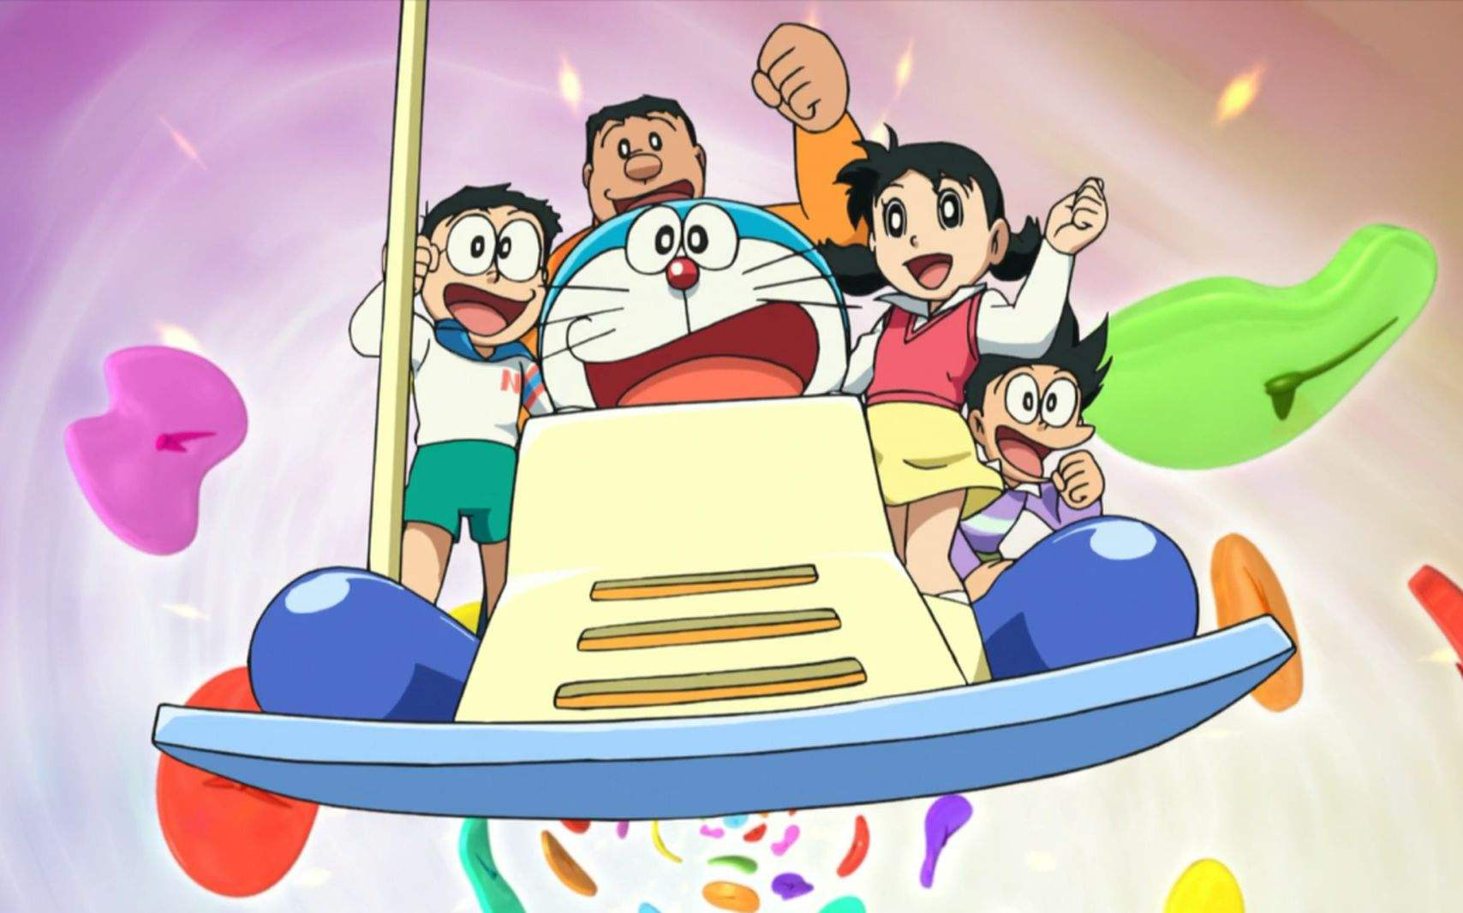
But the wine and the song
like the season has all gone.

Slide 22
We had joy，we had fun.
We had seasons in the sun.

Slide 23
But the wine and the song
like the season has all gone.

Slide 24
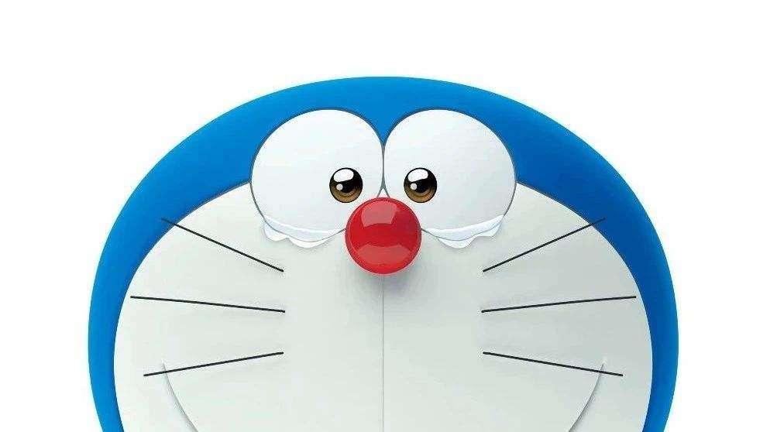
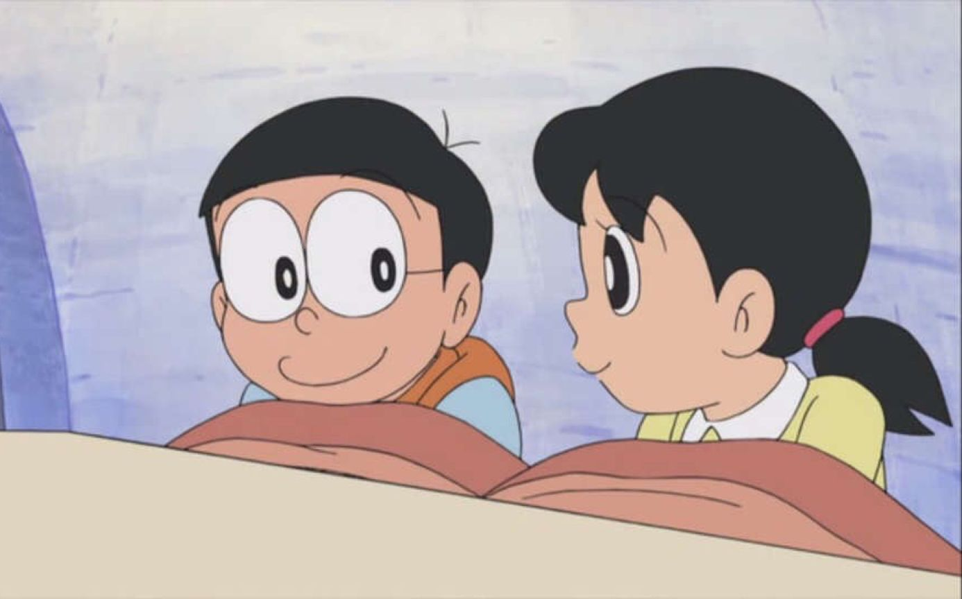
Goodbye michelle,
my little one.
You gave me love and
helped me find the sun.

Slide 25
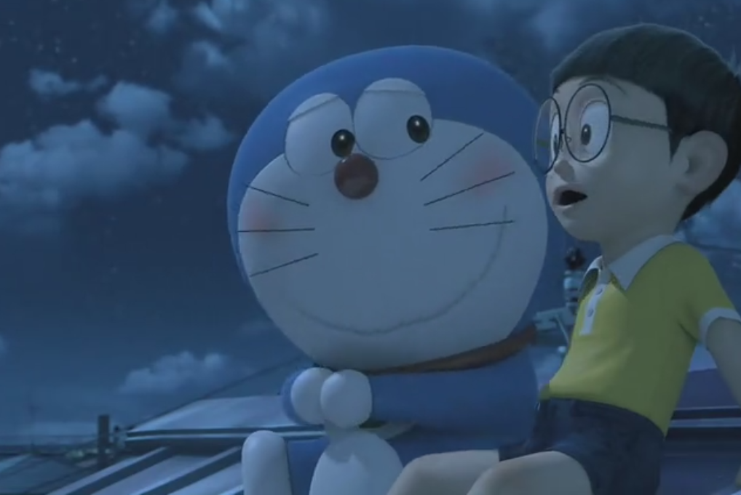
You would always come around
And every time
that I was down.
and get my feet back on the ground.

Slide 26

Goodbye michelle,
it's hard to die.

Slide 27
When all the birds
are singing in the sky.
Now that the spring
is in the air.

Slide 28
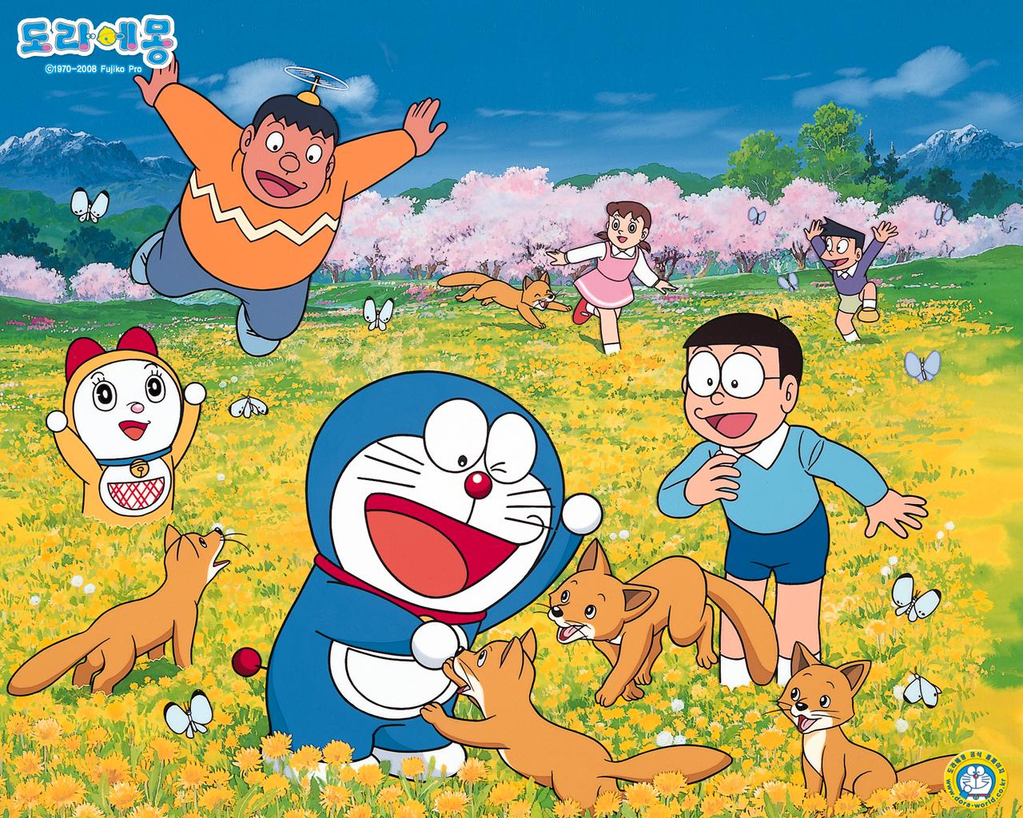
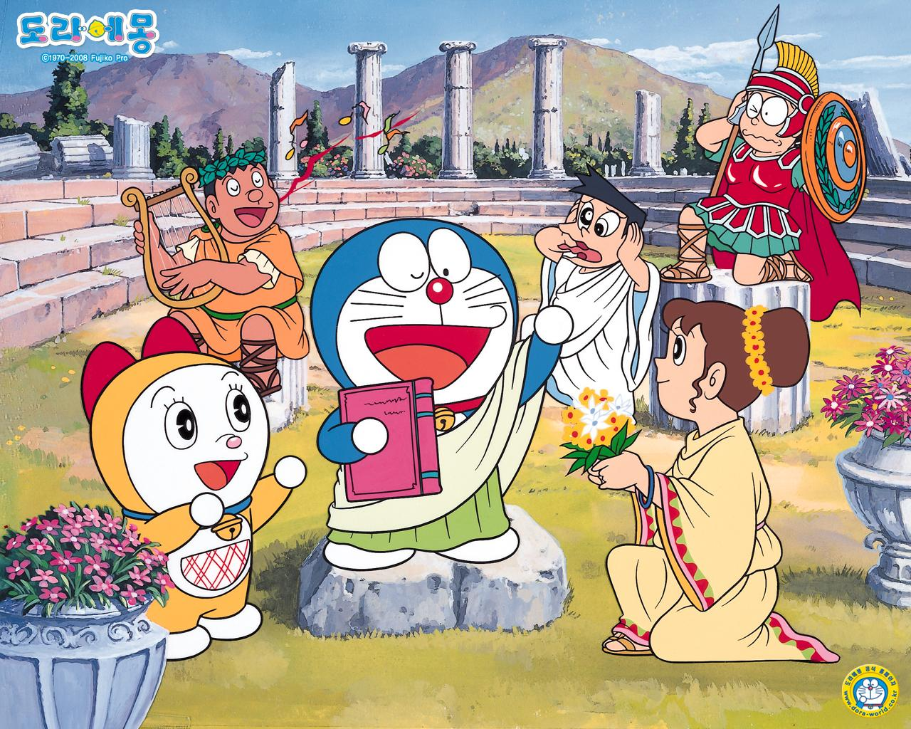
With the flowers everywhere.

Slide 29
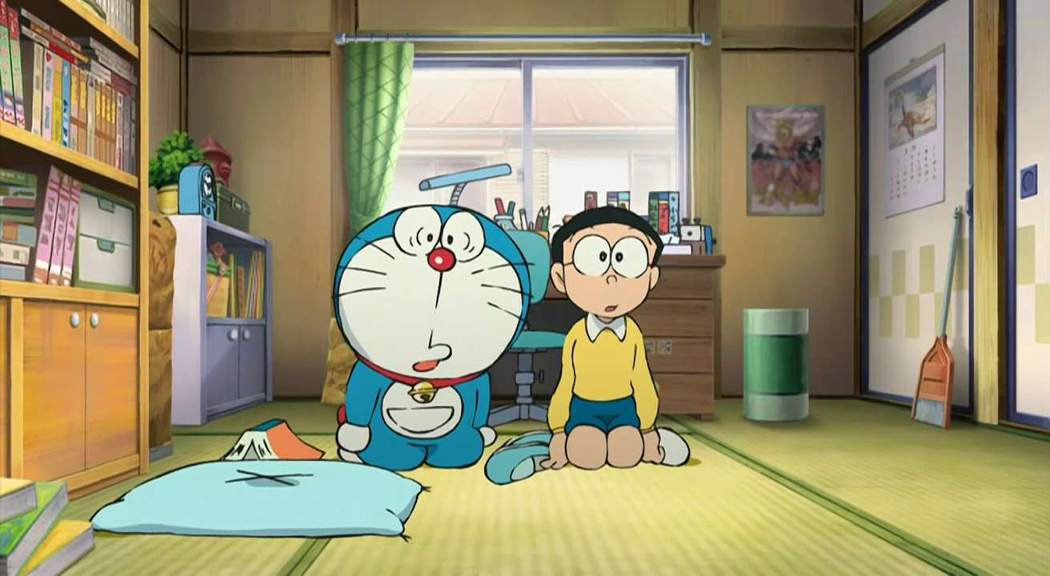
I wish that we could both be there !

Slide 30
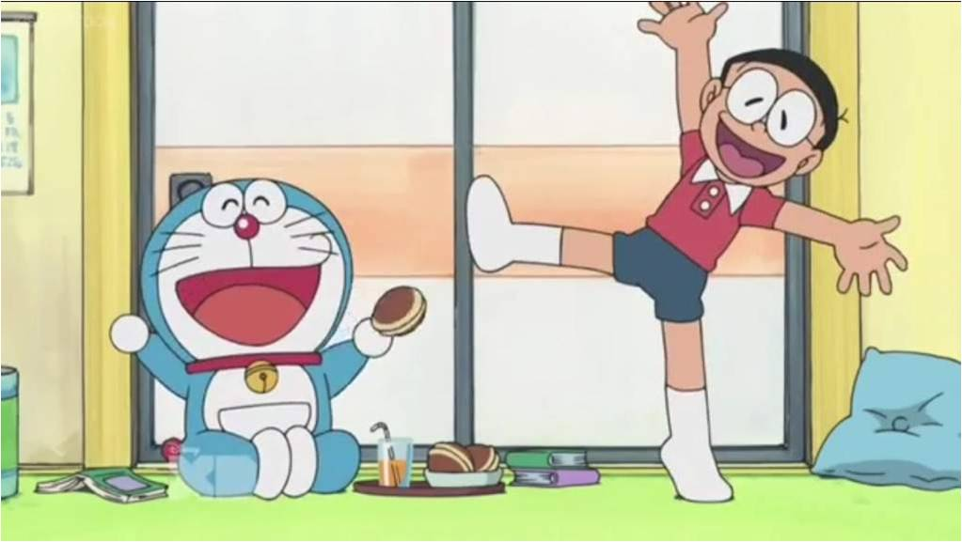
We had joy，we had fun.
We had seasons in the sun.

Slide 31
But the hills that we climbed
were just seasons out of time

Slide 32
We had joy，we had fun.
We had seasons in the sun.

Slide 33
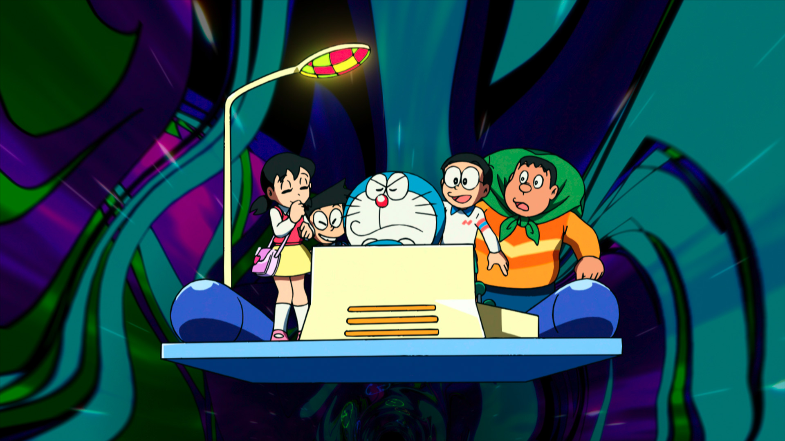
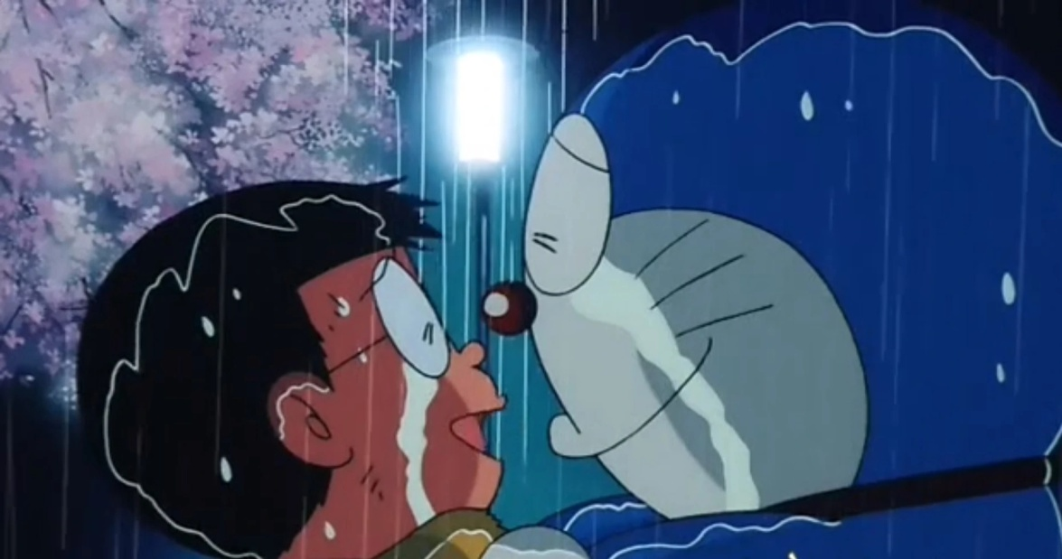
But the wine and the song
like the season has all gone.

Slide 34
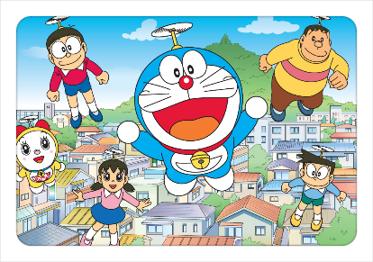
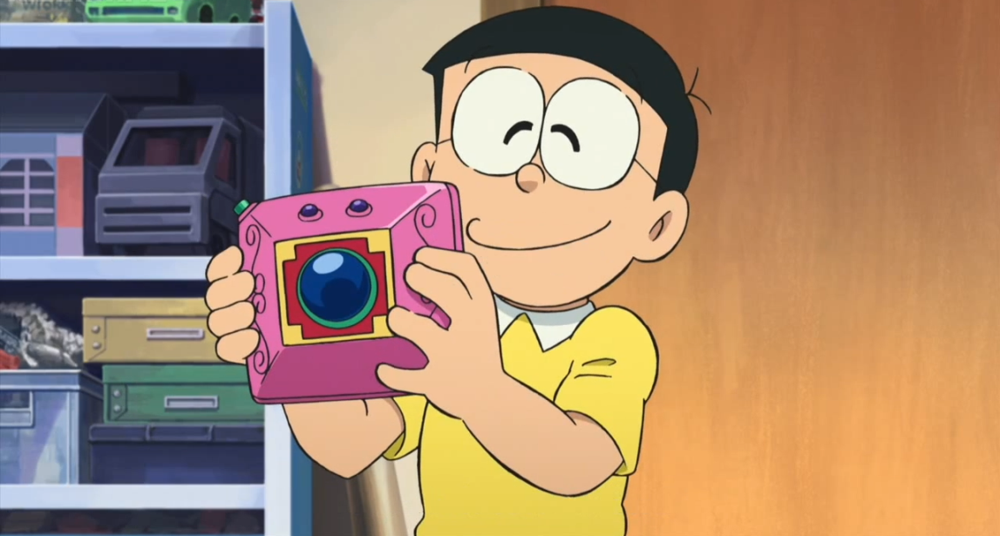
We had joy，we had fun.
We had seasons in the sun.

Slide 35
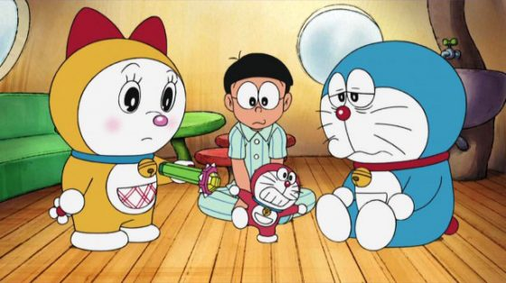
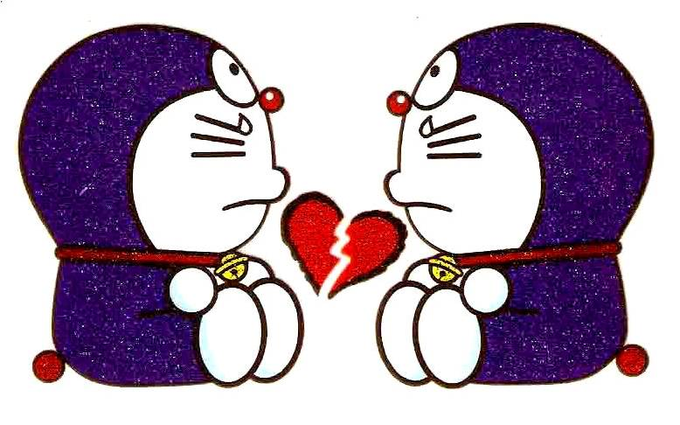
But the wine and the song
like the season has all gone.

Slide 36
PPT模板下载：www.1ppt.com/moban/ 行业PPT模板：www.1ppt.com/hangye/
节日PPT模板：www.1ppt.com/jieri/ PPT素材下载：www.1ppt.com/sucai/
PPT背景图片：www.1ppt.com/beijing/ PPT图表下载：www.1ppt.com/tubiao/
优秀PPT下载：www.1ppt.com/xiazai/ PPT教程： www.1ppt.com/powerpoint/
Word教程： www.1ppt.com/word/ Excel教程：www.1ppt.com/excel/
资料下载：www.1ppt.com/ziliao/ PPT课件下载：www.1ppt.com/kejian/
范文下载：www.1ppt.com/fanwen/ 试卷下载：www.1ppt.com/shiti/
教案下载：www.1ppt.com/jiaoan/
THE END

