Slide 1
The Simple Future Tense
作者 | 黎树权 张丽娟
单位 | 华南师范大学外国语言文化学院
广东省河源市第二中学

Slide 2
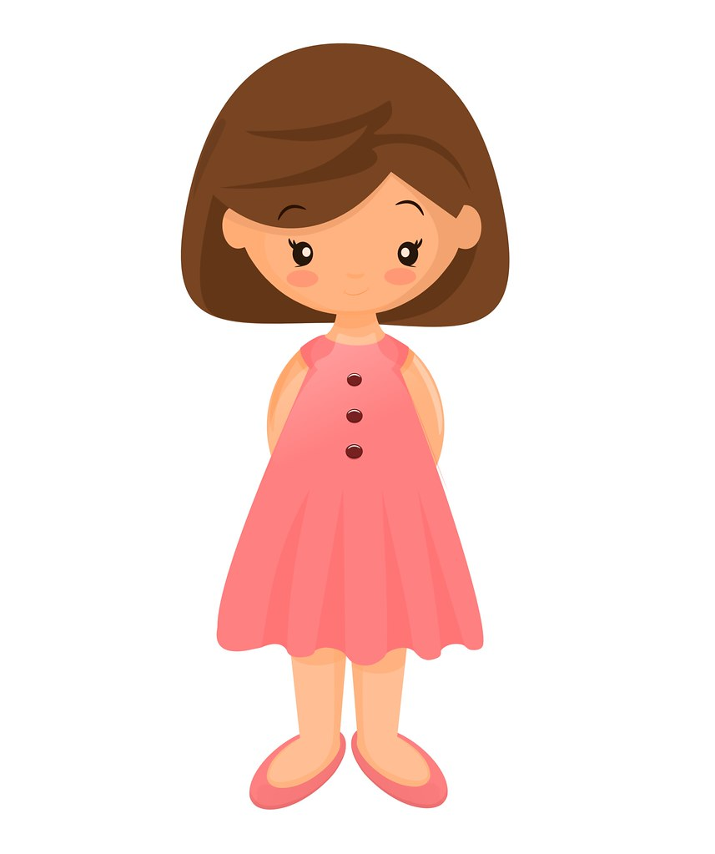
When I was just a little girl

Slide 3
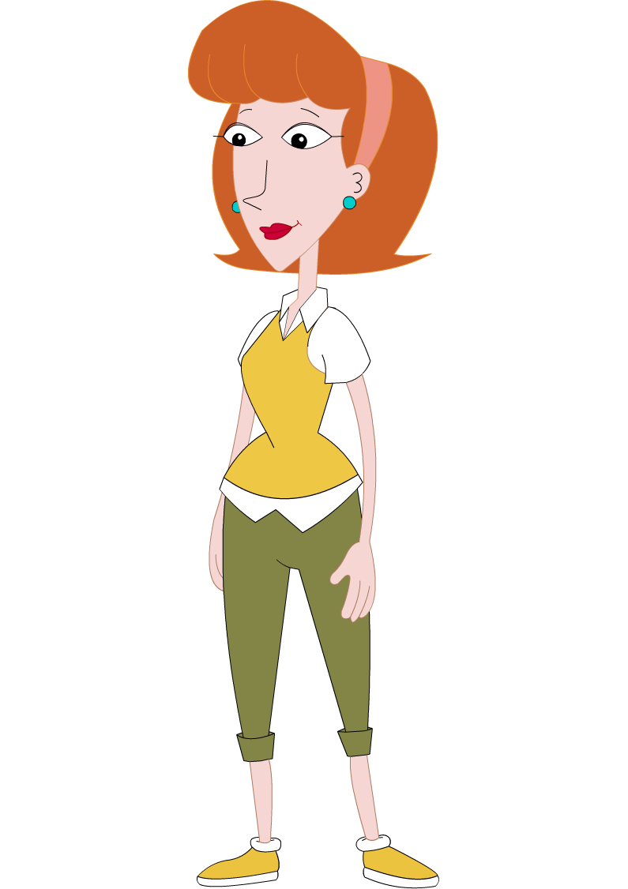
I asked my mother
What will I be

Slide 4
Will I be pretty

Slide 5
Will I be rich

Slide 6
Here's what she said to me
Que sera, sera
Whatever will be, will be

Slide 7
The future's not ours to see
Que sera, sera
What will be, will be

Slide 8
When I grew up and fell in love
I asked my sweetheart
What lies ahead

Slide 9
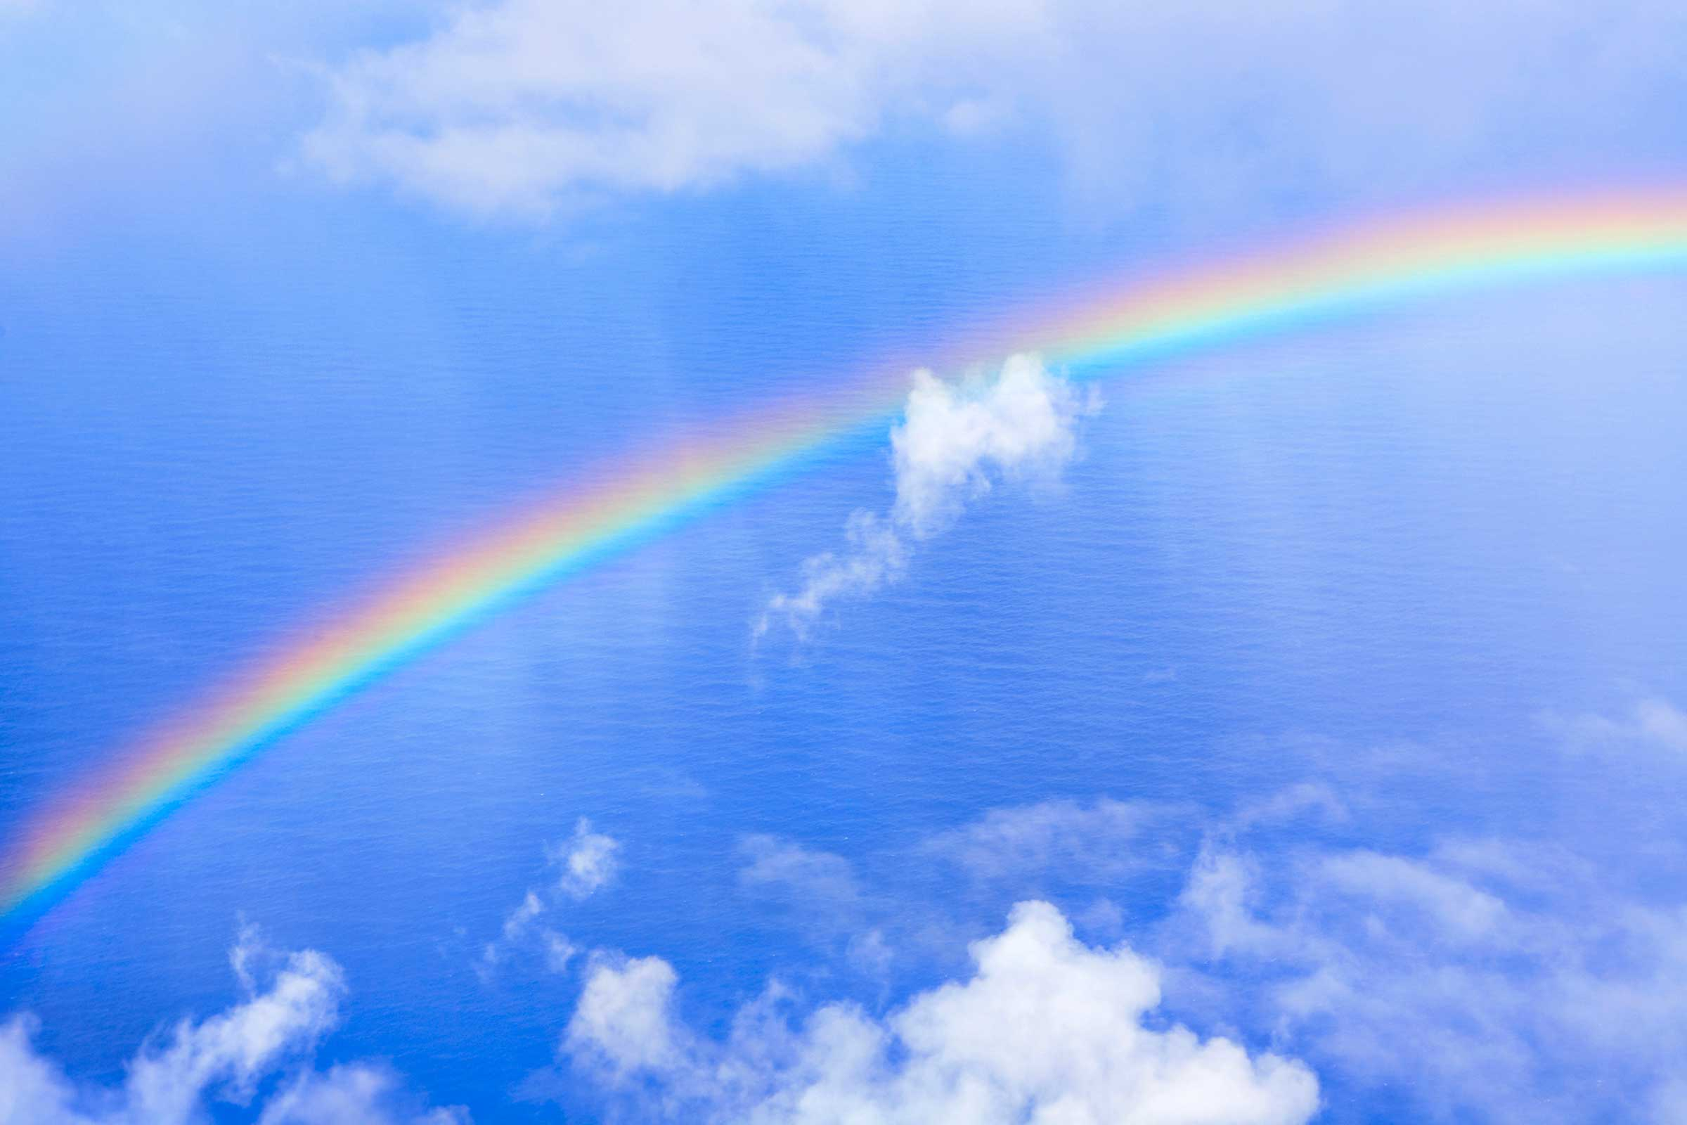
Will we have rainbows day after day

Slide 10
Here's what my sweetheart said
Que sera, sera
Whatever will be, will be

Slide 11
The future's not ours to see
Que sera, sera
What will be, will be

Slide 12
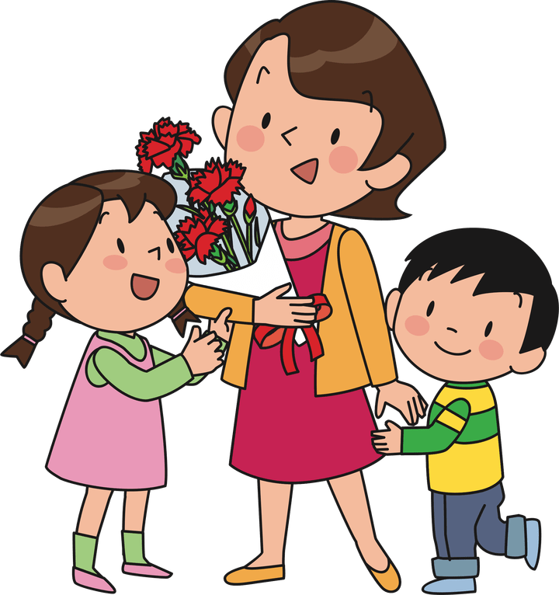
Now I have children of my own
They ask their mother
What will I be

Slide 13
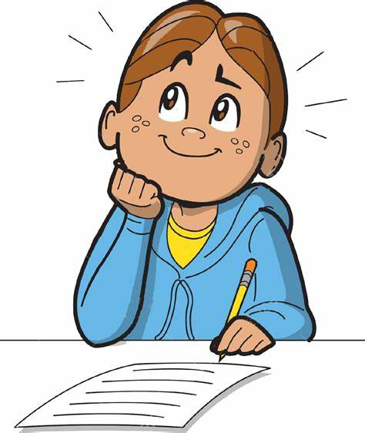
Will I be handsome
Will I be rich

Slide 14
I tell them tenderly
Que sera, sera
Whatever will be, will be

Slide 15
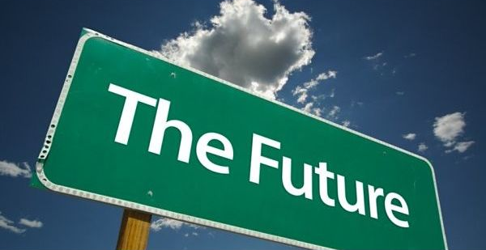
The future's not ours to see

Slide 16
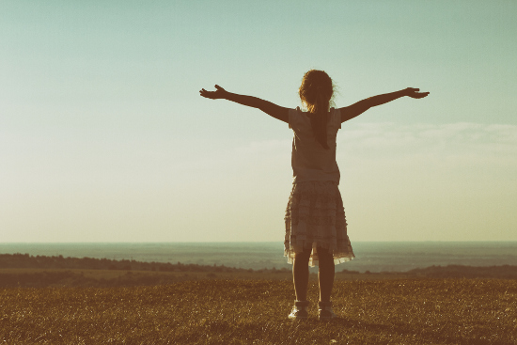
Que Sera, Sera!
What will be, will be
Que sera, sera

