Slide 1
We Never Change
Adverb：Never
作者：华南师范大学外国语言文化学院 罗雪莲
广东省河源市第一中学教师 骆玫玫
此照片，作者: 未知作者，许可证: CC BY-NC-ND

Slide 2
I wanna live life, never be cruel

Slide 3
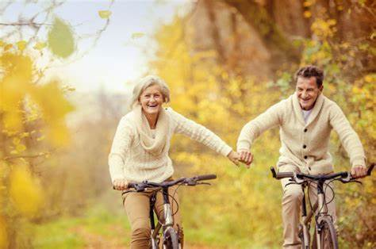
I wanna live life, be good to you

Slide 4
I wanna fly, never come down

Slide 5
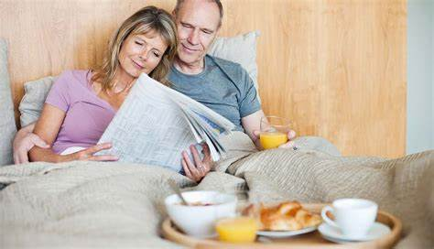
And live my life

Slide 6
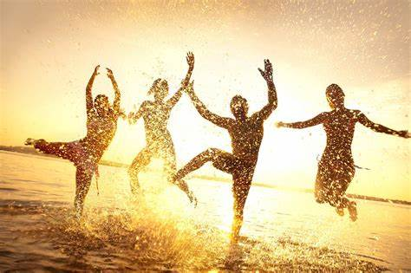
And have friends around

Slide 7
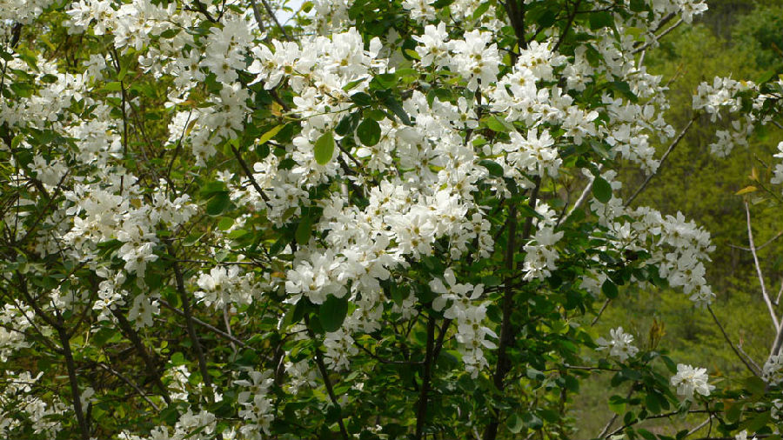
We never change, do we?

Slide 8
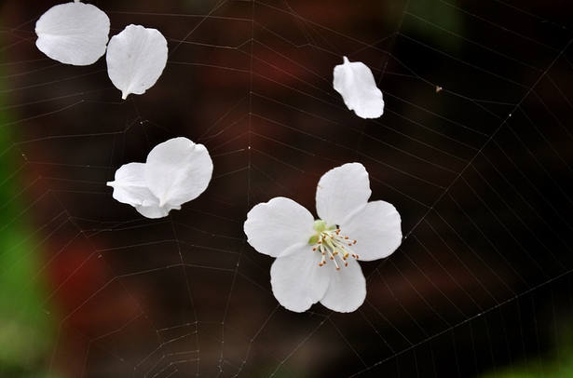
No… no…

Slide 9
We never learn, do we?

Slide 10
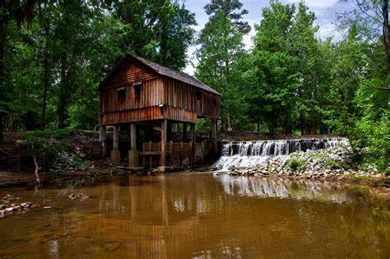
So I wanna live in a wooden house

Slide 11
I wanna live life, and always be ture

Slide 12
I wanna live life, and be good to you

Slide 13
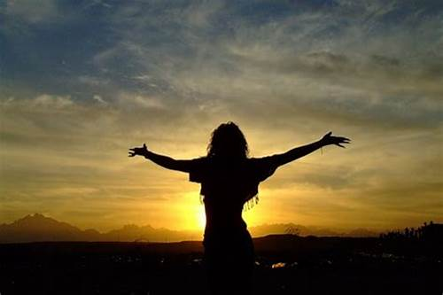
I wanna fly, and never come down

Slide 14
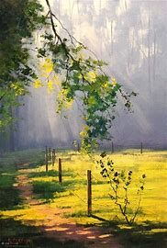
And live my life

Slide 15
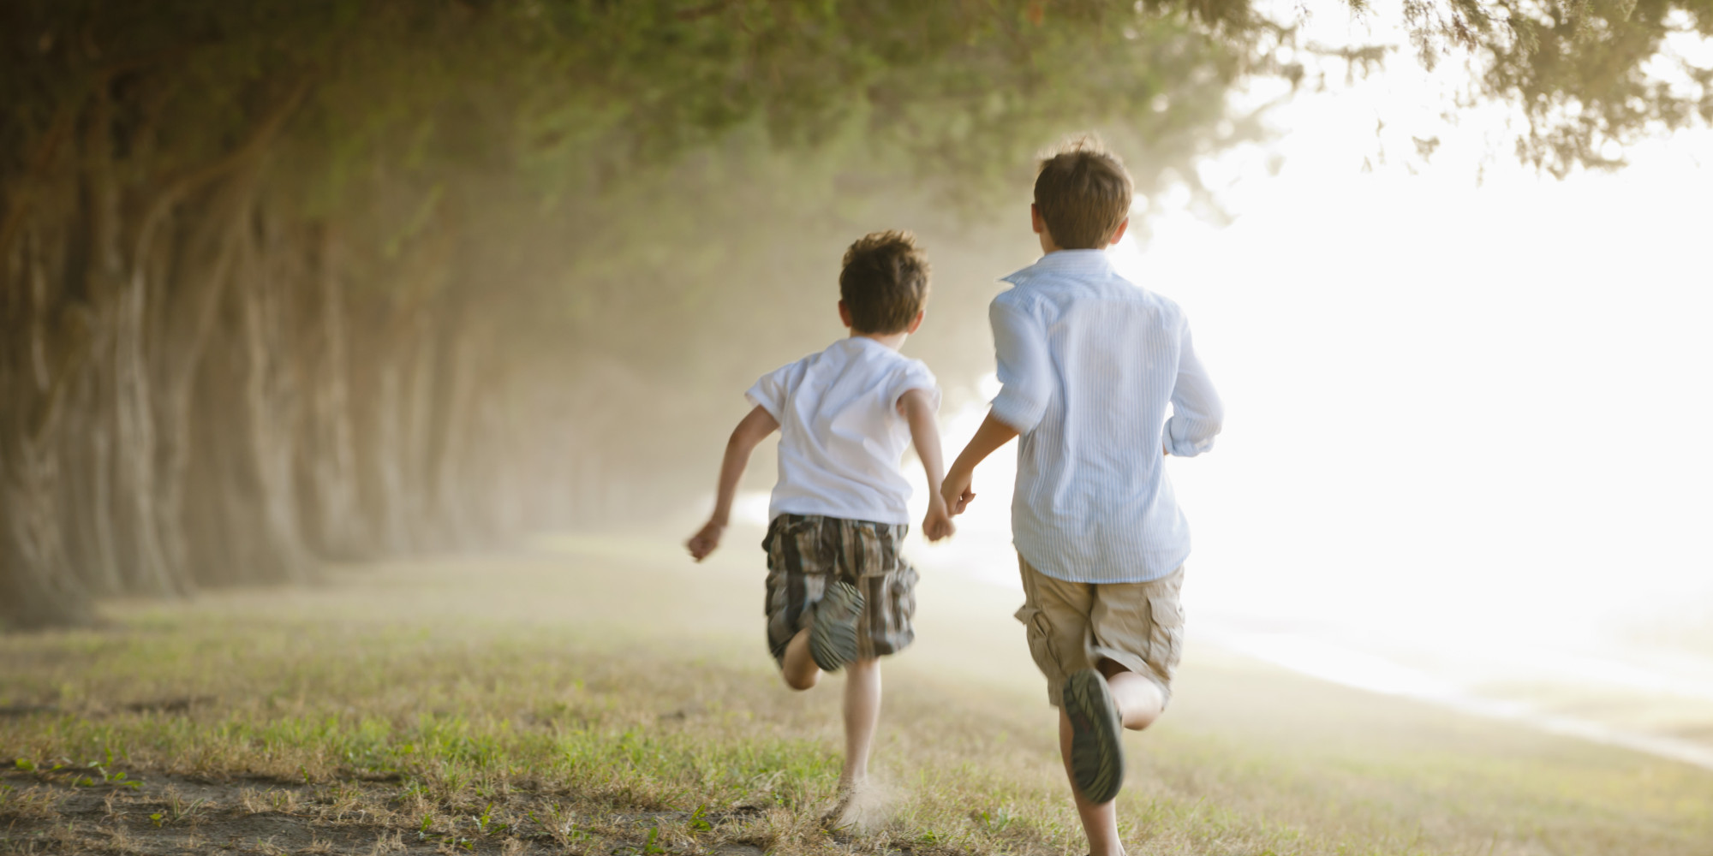
And have friends around

Slide 16
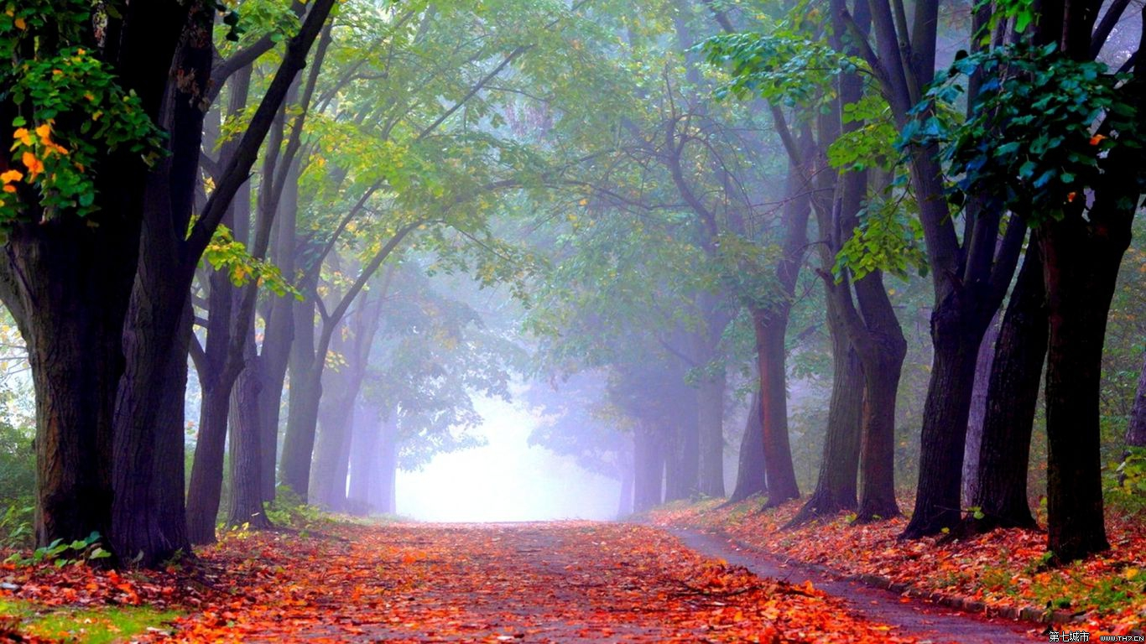
We never change, do we?

Slide 17
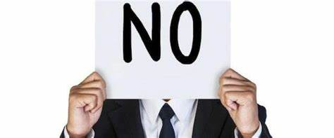
No… no…

Slide 18
We never learn to leave

Slide 19
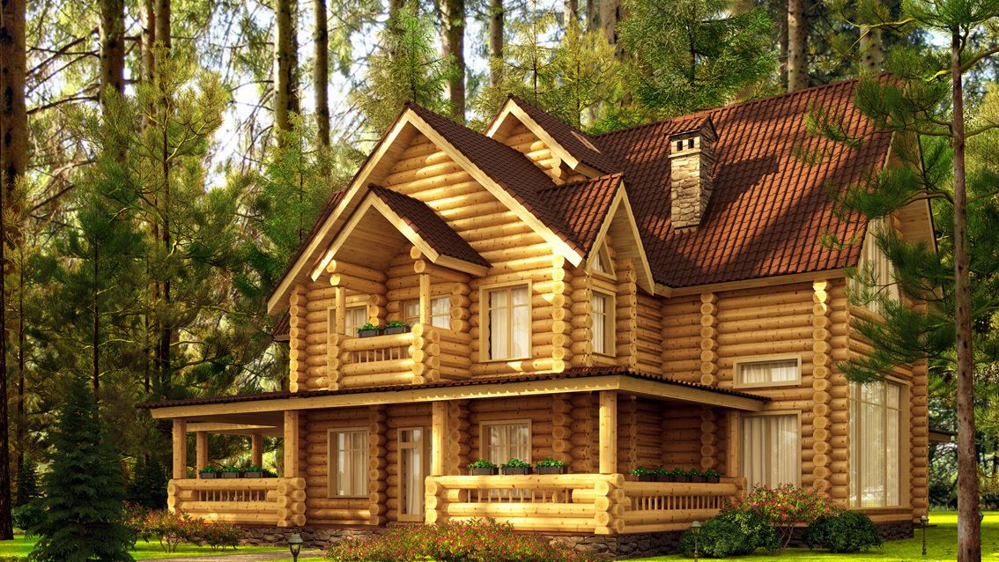
So I wanna live in a wooden house

Slide 20
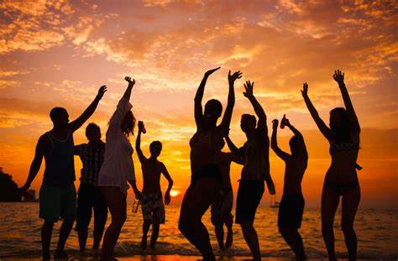
Making more friends would be easy

Slide 21
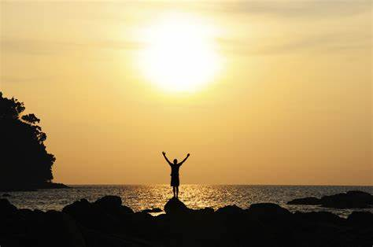
Oh and I don’t have a soul to save

Slide 22
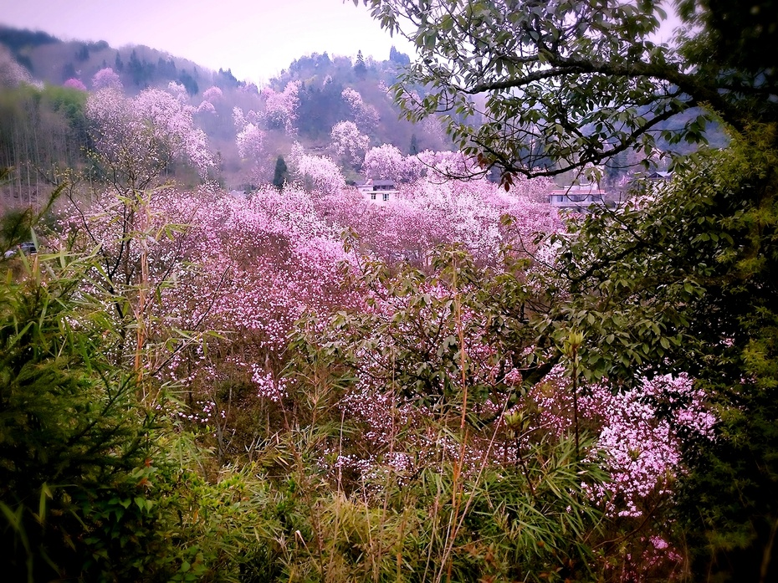
Yes, I sing every single day

Slide 23
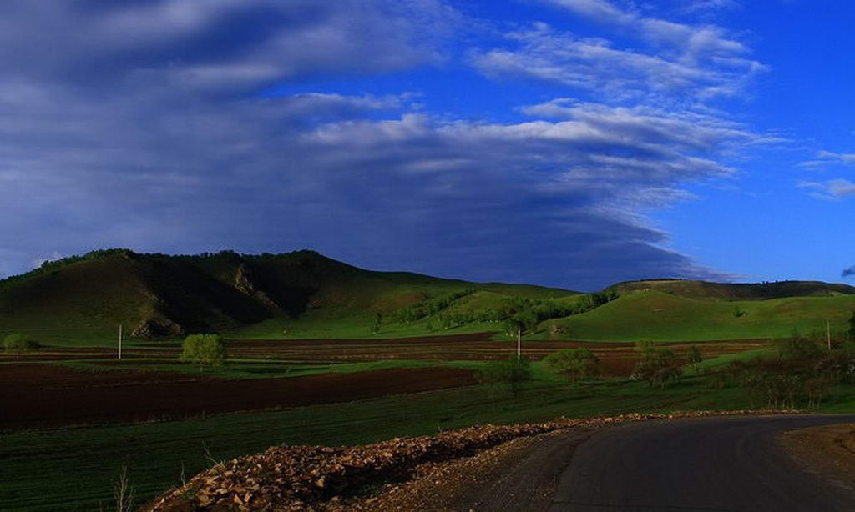
We never change, do we?

Slide 24
We never learn, do we?

Slide 25
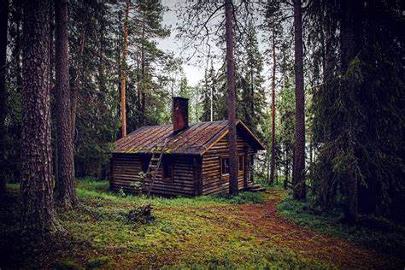
So, I wanna live in a wooden house

Slide 26
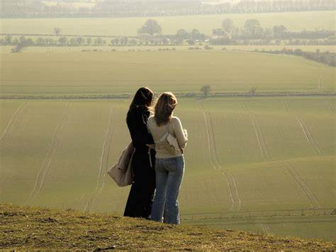
Making more friends would be easy

Slide 27
I wanna live where the sun comes out

Slide 28
Thank you

