Slide 1
Hero
—Conjunction
制作：
华南师范大学外国语言文化学院 曾昭麒
广东省河源市河源中学实验学校 黄飞映

Slide 2
There's a hero

Slide 3
If you look inside your heart

Slide 4
You don't have to be afraid

Slide 5
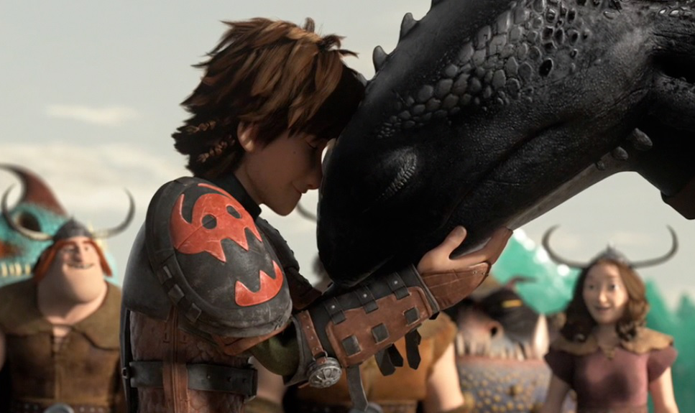
Of what you are

Slide 6
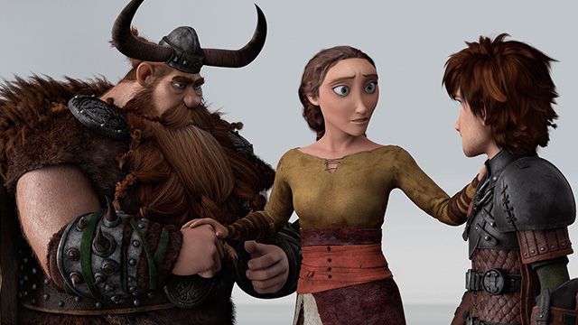
There's an answer

Slide 7
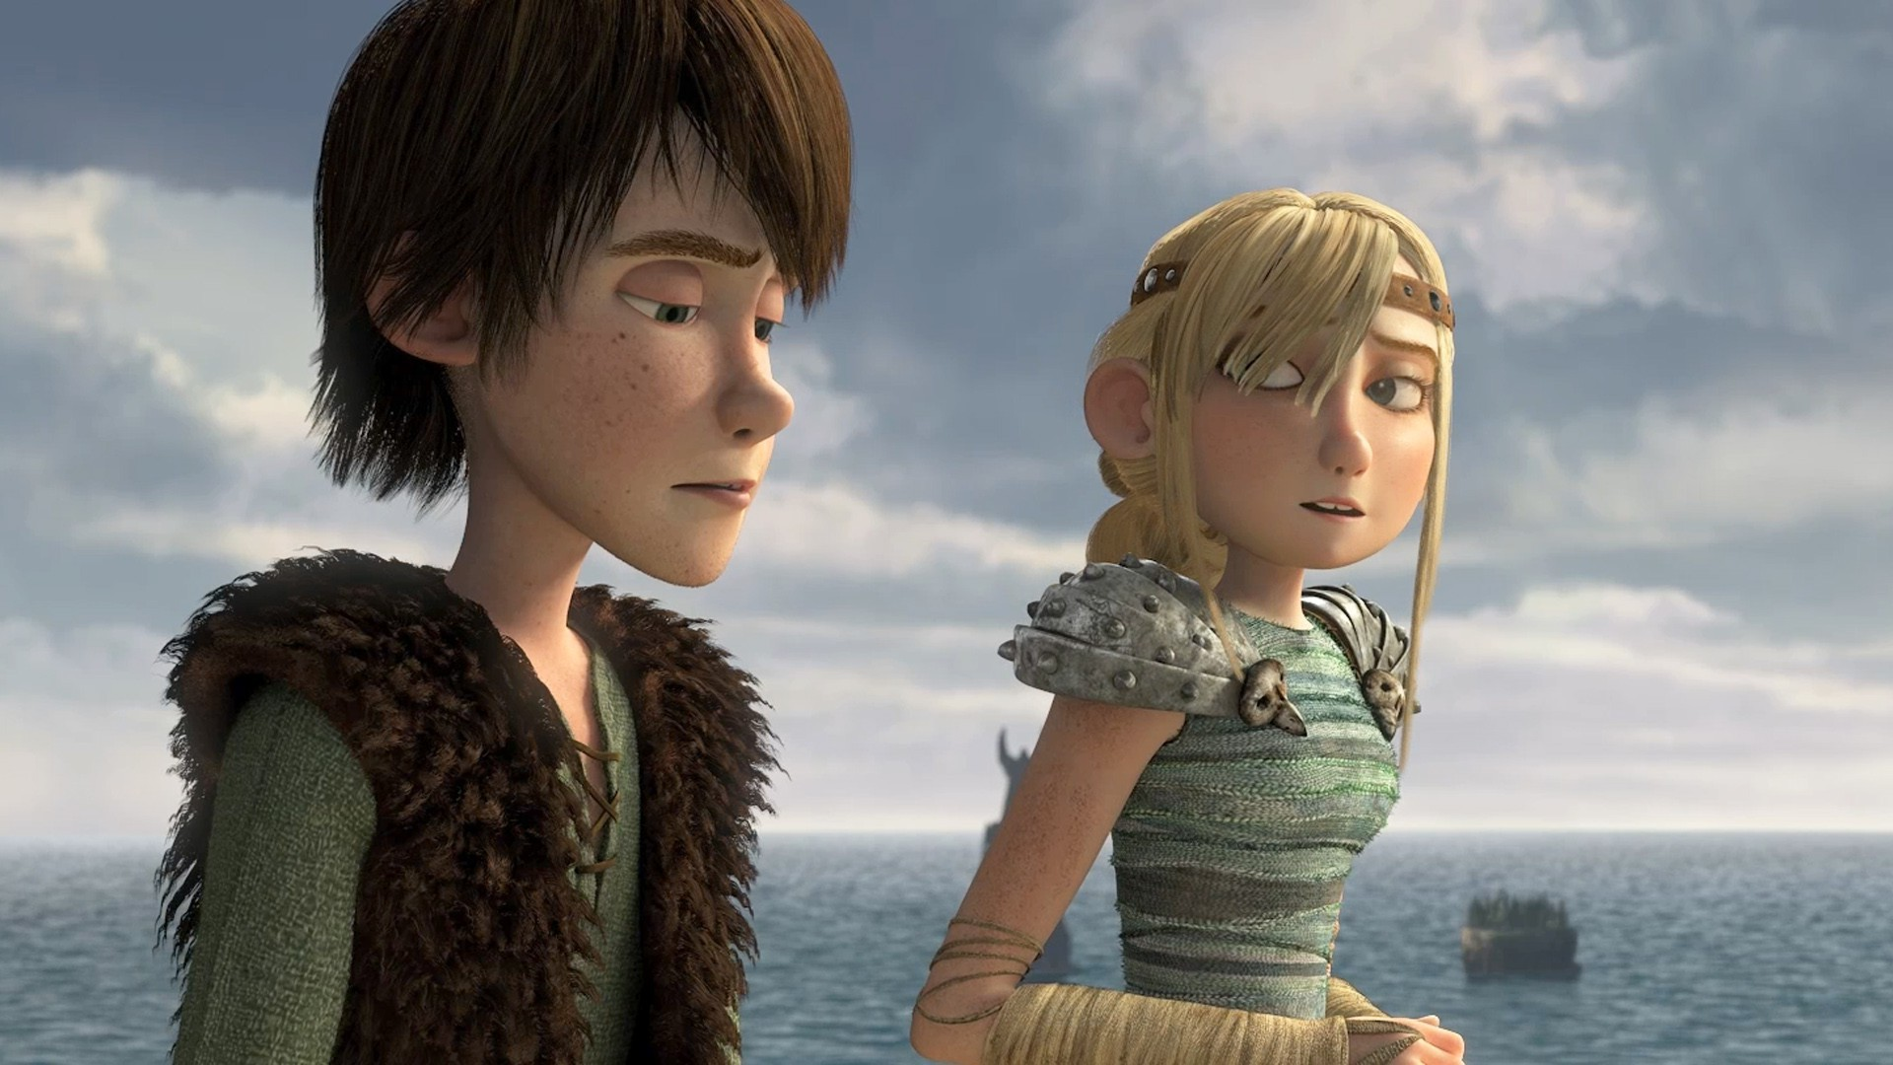
If you reach into your soul

Slide 8
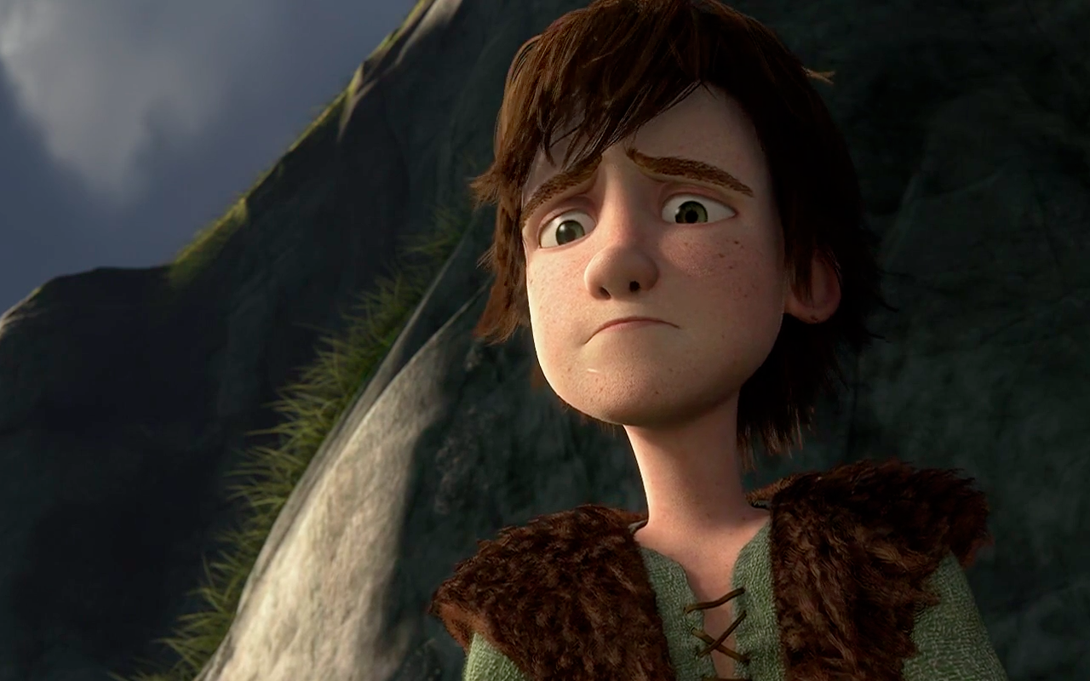
And the sorrow that you know

Slide 9
Will melt away

Slide 10
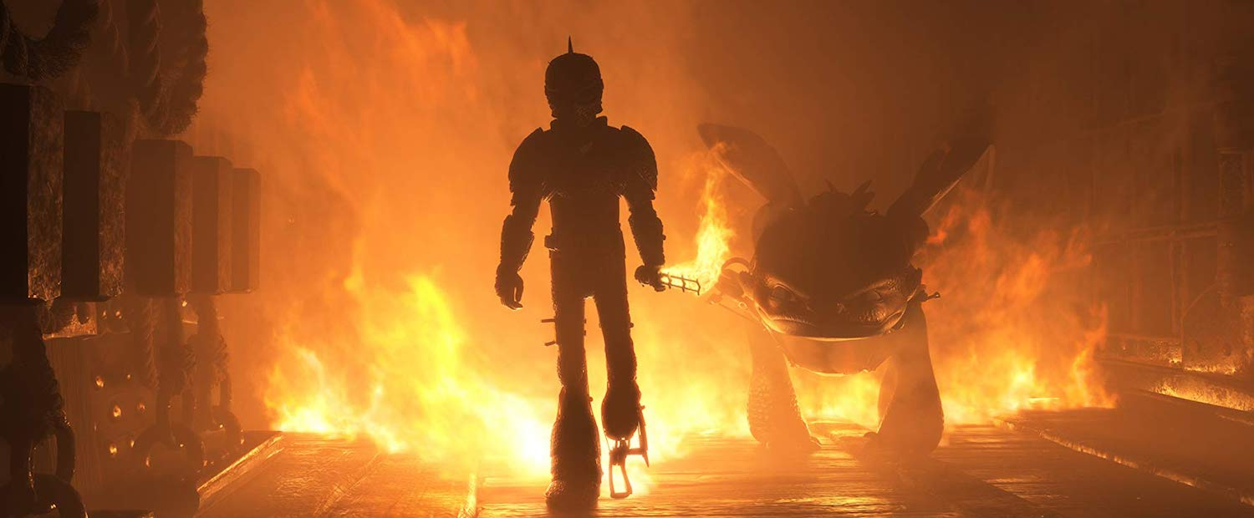
And then a hero comes along

Slide 11
With the strength to carry on

Slide 12
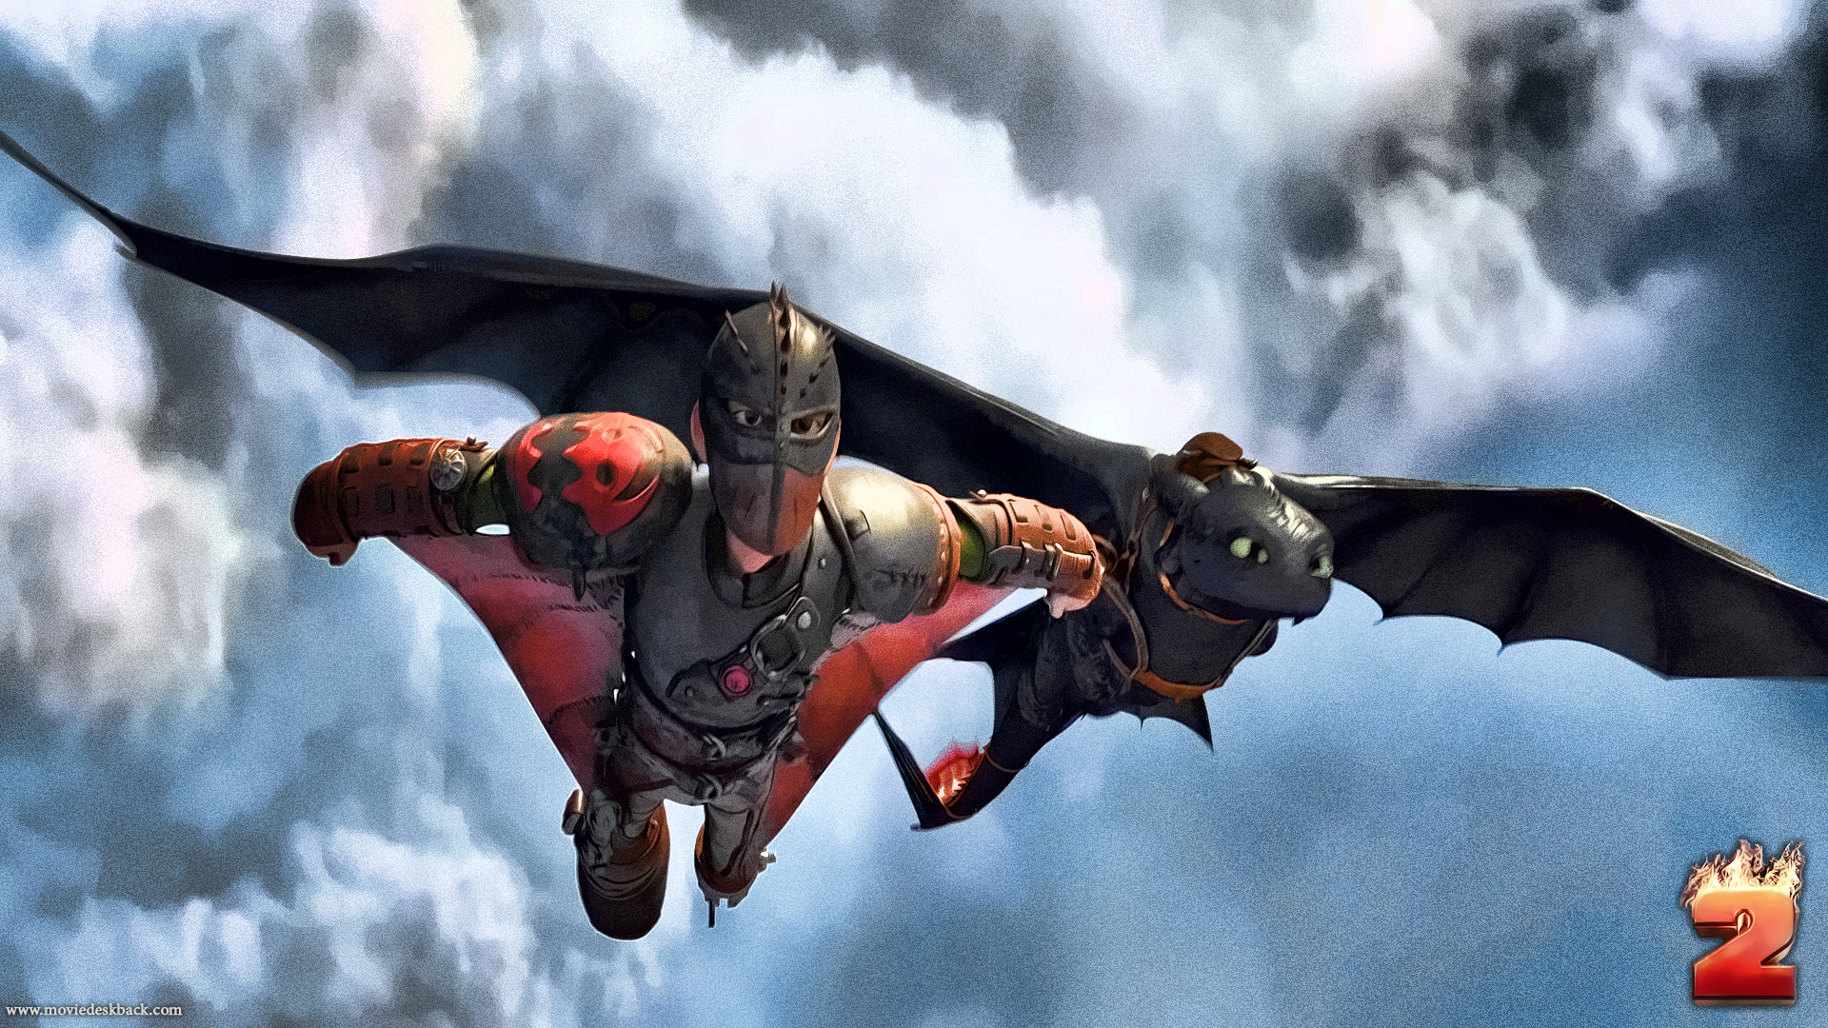
And you cast your fears aside

Slide 13
And you know you can survive

Slide 14
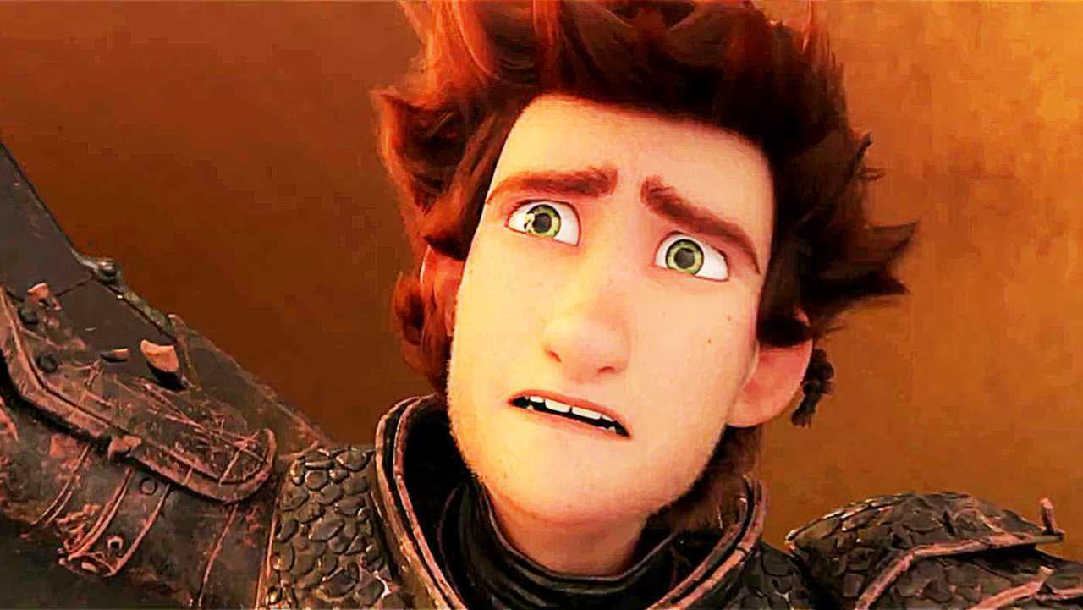
So when you feel like hope is gone

Slide 15
Look inside you and be strong

Slide 16
And you'll finally see the truth

Slide 17
That a hero lies in you

Slide 18
It's a long road

Slide 19
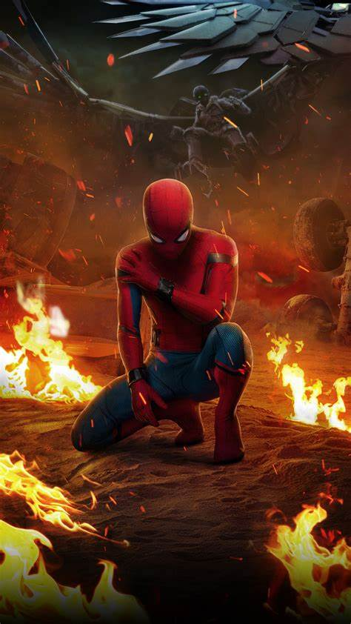
When you face the world alone

Slide 20
No one reaches out a hand

Slide 21
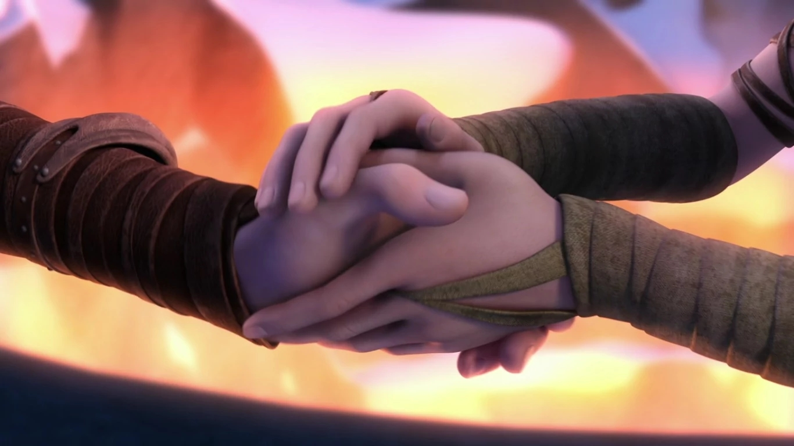
For you to hold

Slide 22
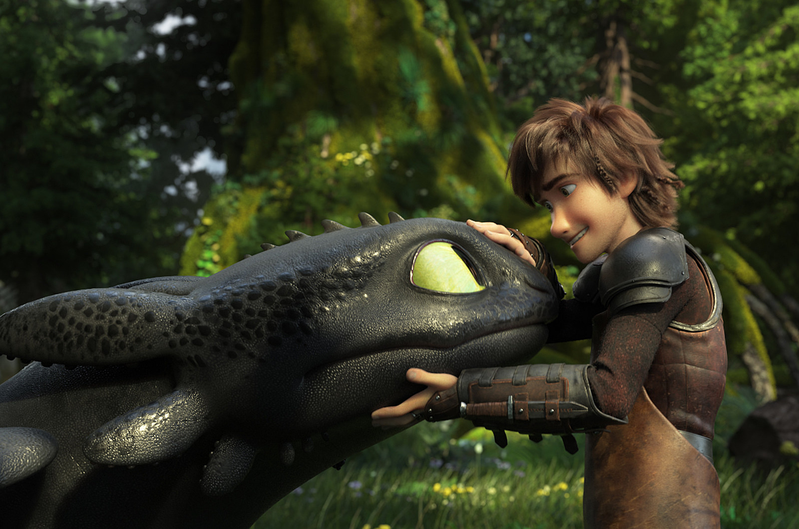
You can find love

Slide 23
If you search within yourself

Slide 24
And the emptiness you felt

Slide 25
Will disappear

Slide 26
And then a hero comes along

Slide 27
With the strength to carry on

Slide 28
And you cast your fears aside

Slide 29
And you know you can survive

Slide 30
So when you feel like hope is gone

Slide 31
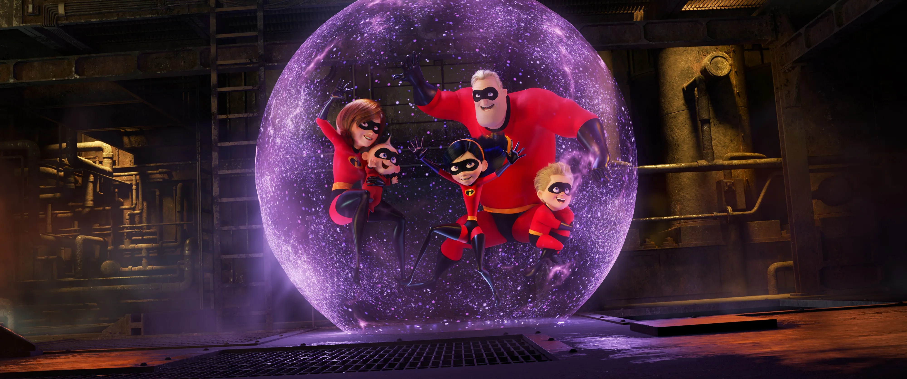
Look inside you and be strong

Slide 32
And you'll finally see the truth

Slide 33
That a hero lies in you

Slide 34
Lord knows

Slide 35
Dreams are hard to follow

Slide 36
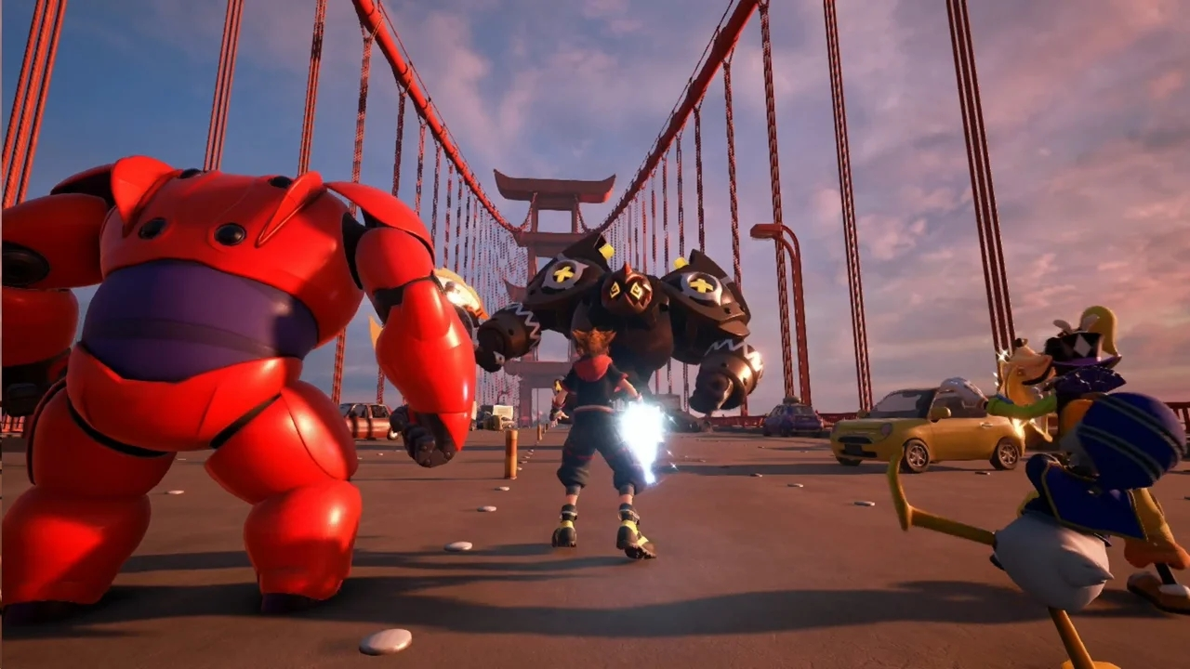
But don't let anyone

Slide 37
Tear them away

Slide 38
Hold on

Slide 39
There will be tomorrow

Slide 40
In time

Slide 41
You'll find the way

Slide 42
And then a hero comes along

Slide 43
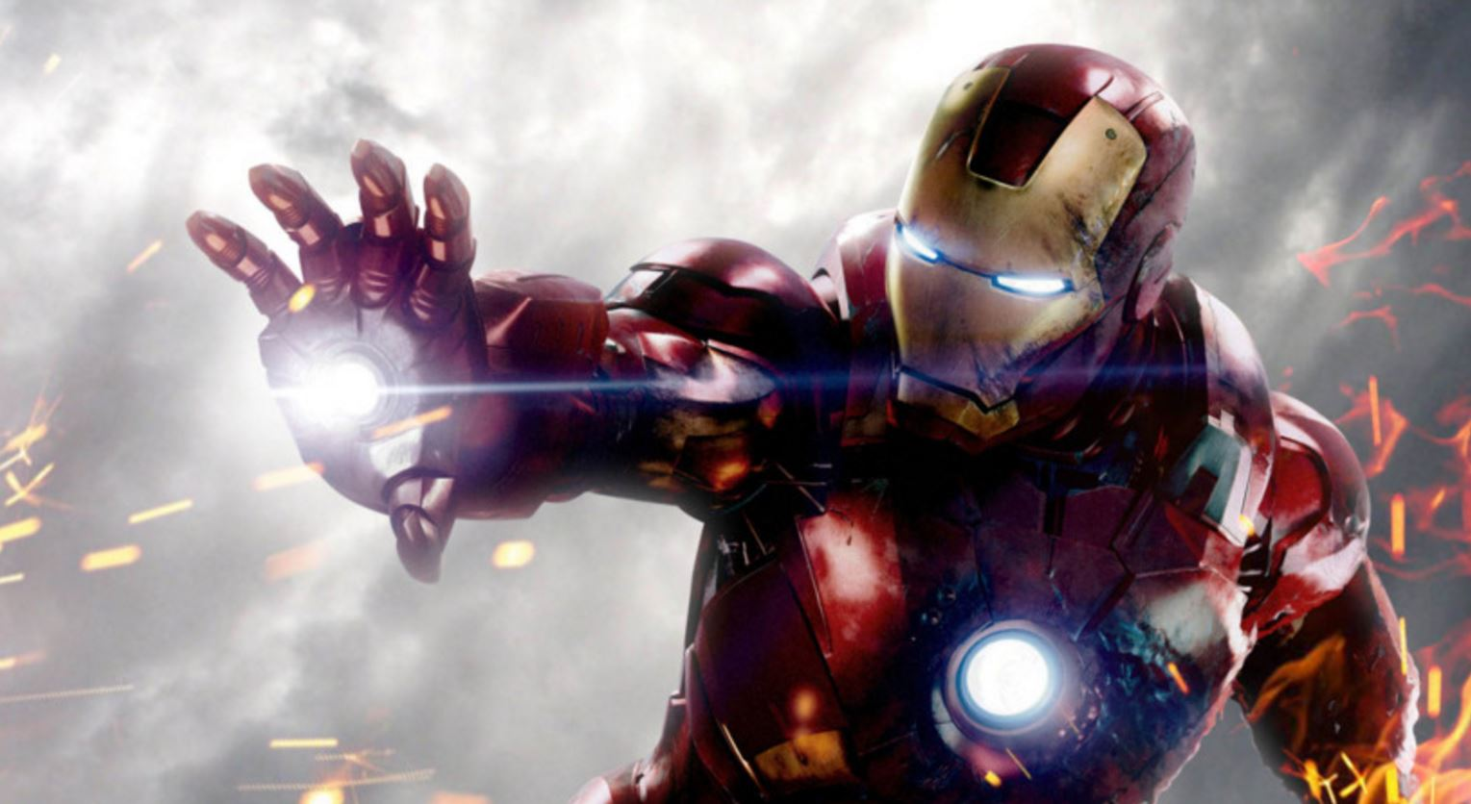
With the strength to carry on

Slide 44
And you cast your fears aside

Slide 45
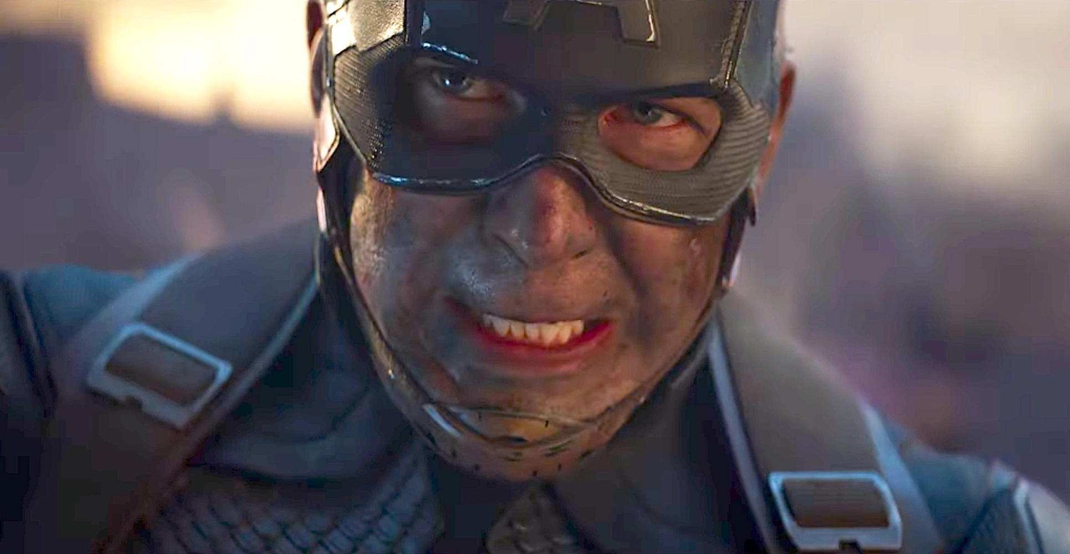
And you know you can survive

Slide 46
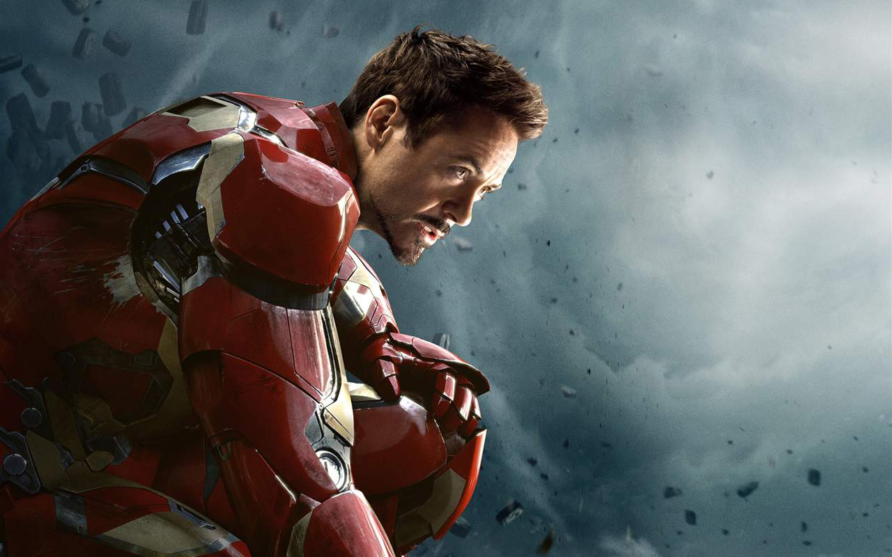
So when you feel like hope is gone

Slide 47
Look inside you and be strong

Slide 48
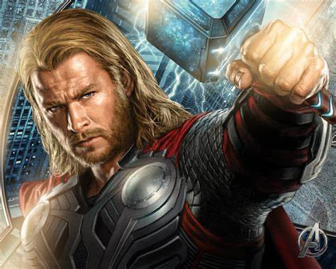
And you'll finally see the truth

Slide 49
That a hero lies in you

