Slide 1
Three
Three is a magic number
Numerals
By 华南师范大学外国语言文化学院 黄晓真
广东省河源市河源中学实验学校 张传胜
is a magic number

Slide 2
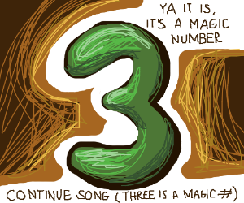
Yes, it is ,
it’s a magic number

Slide 3
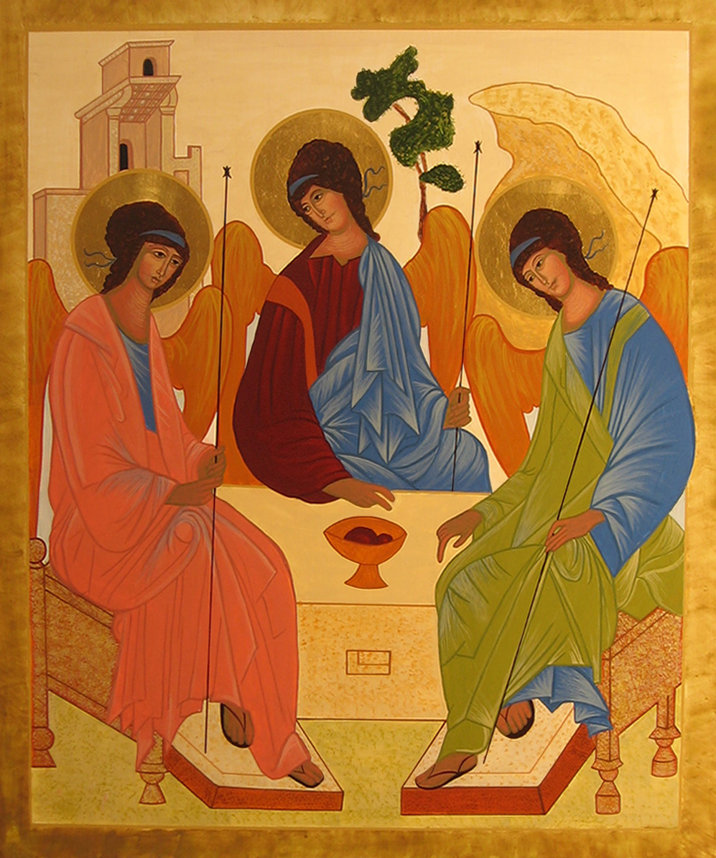
Somewhere in that ancient mystic trinity
as a magic number
You get three

Slide 4
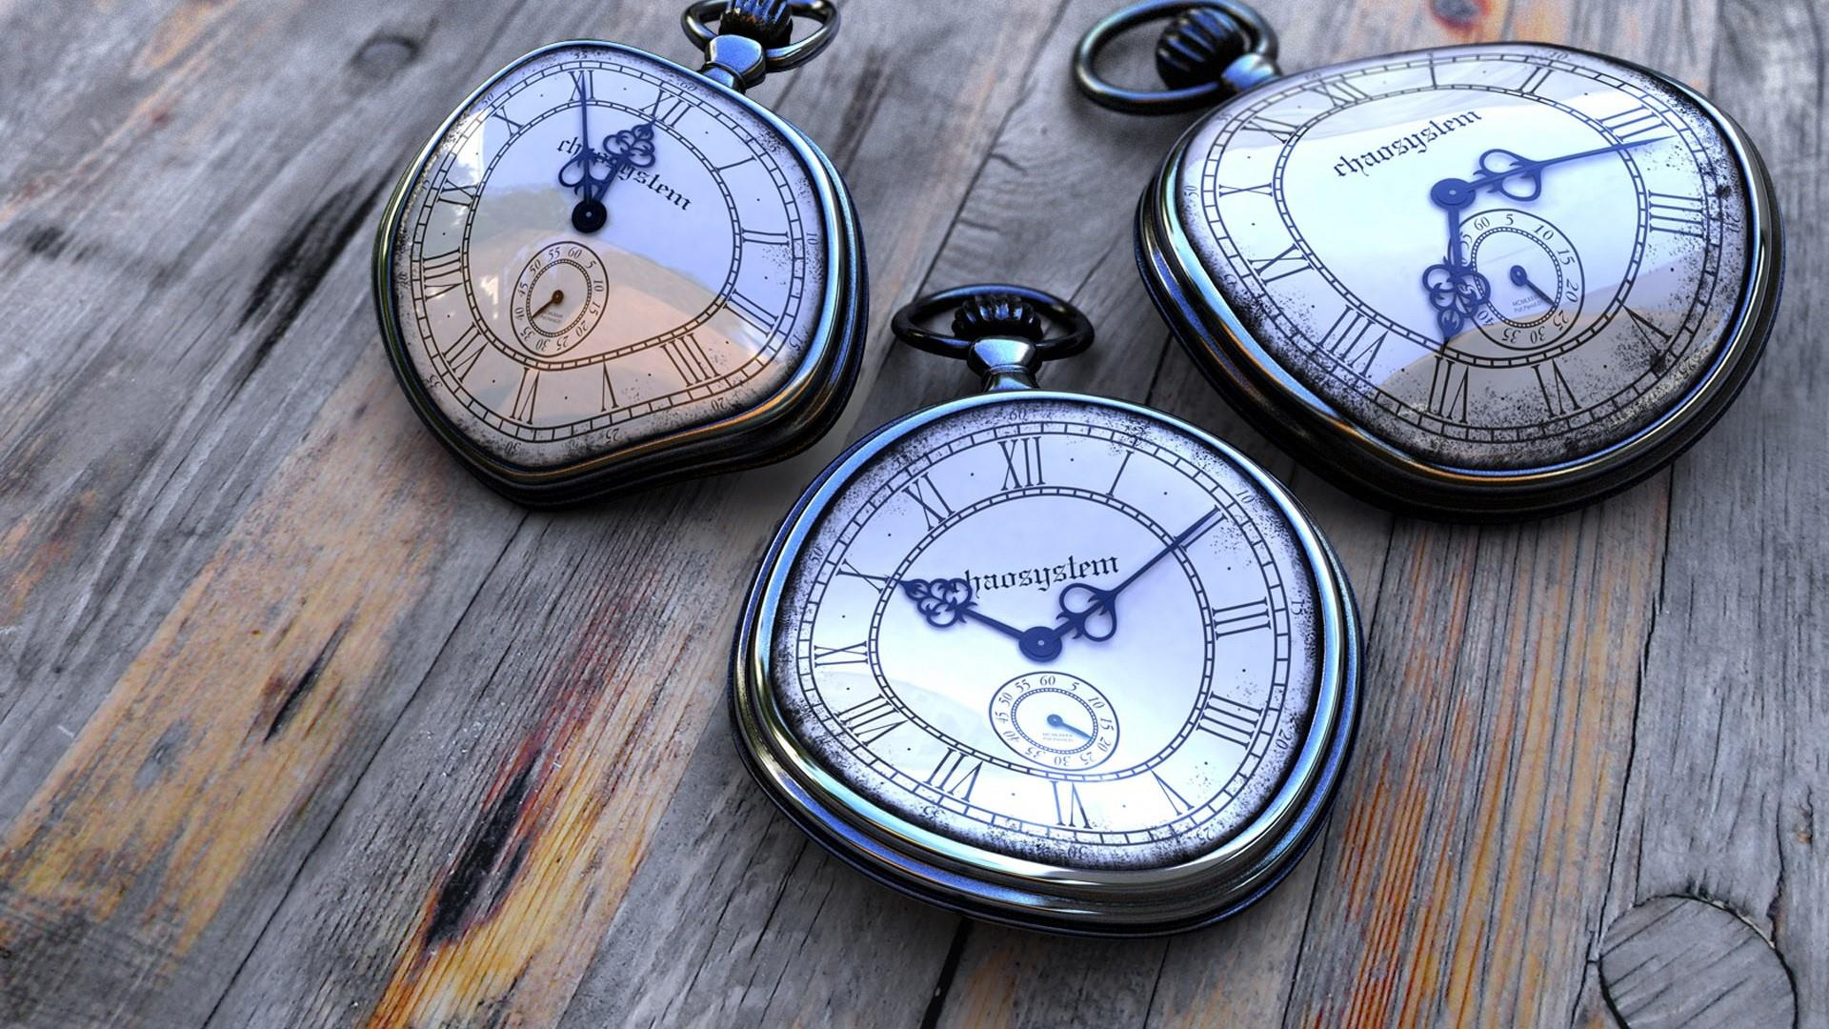
·
The past and the present and the future

Slide 5
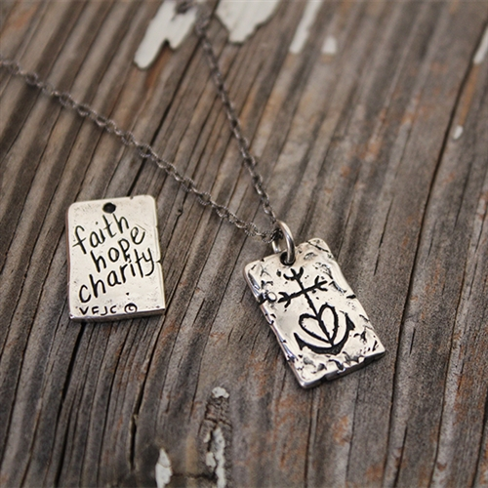
The faith and hope and charity

Slide 6
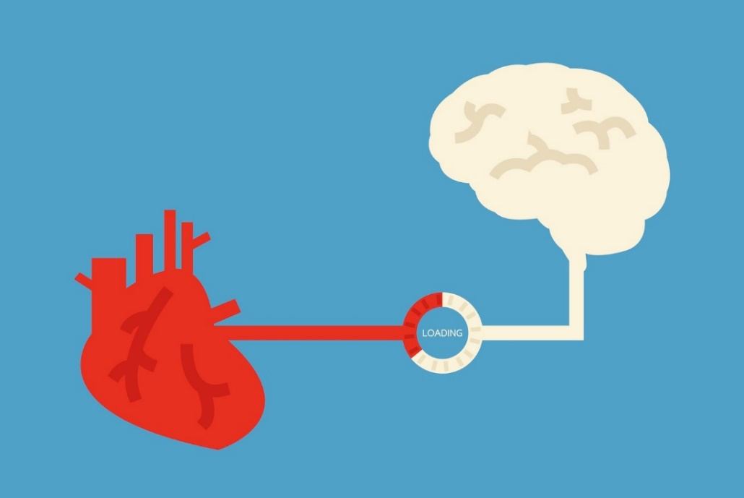
The heart and the brain and the body

Slide 7
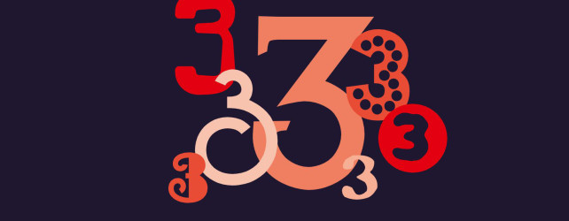
Give you three
as a magic number

Slide 8
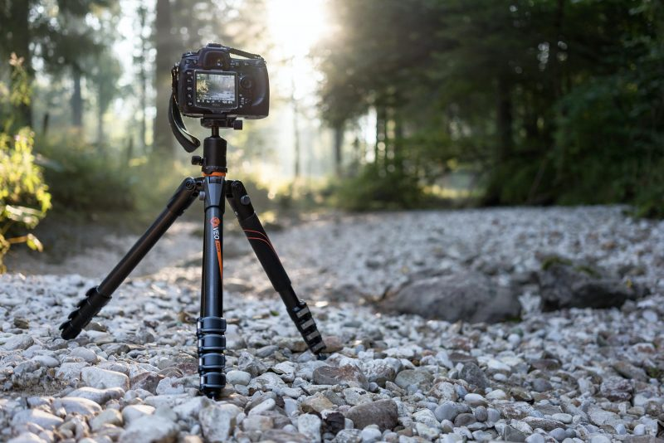
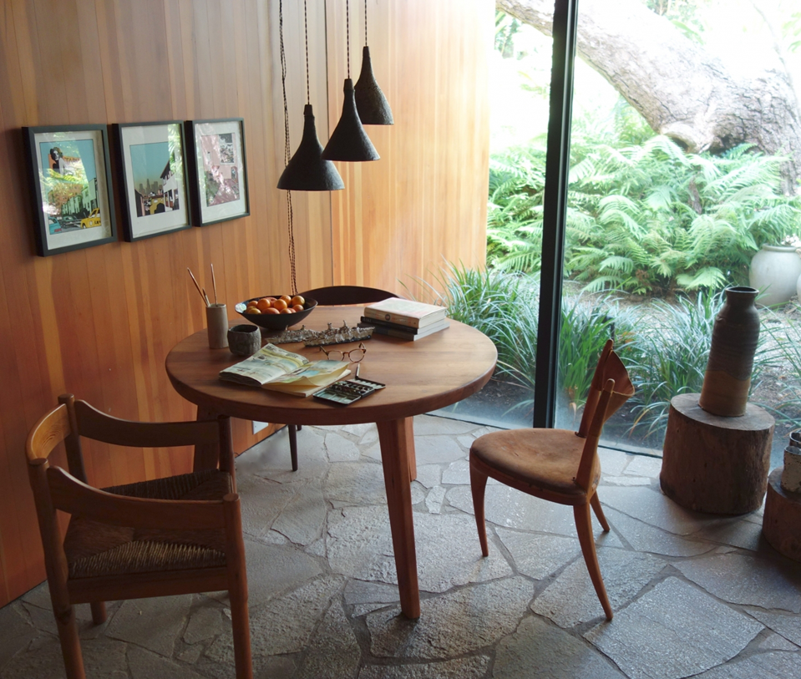
It takes three legs to make a tripod
or to make a table stand

Slide 9
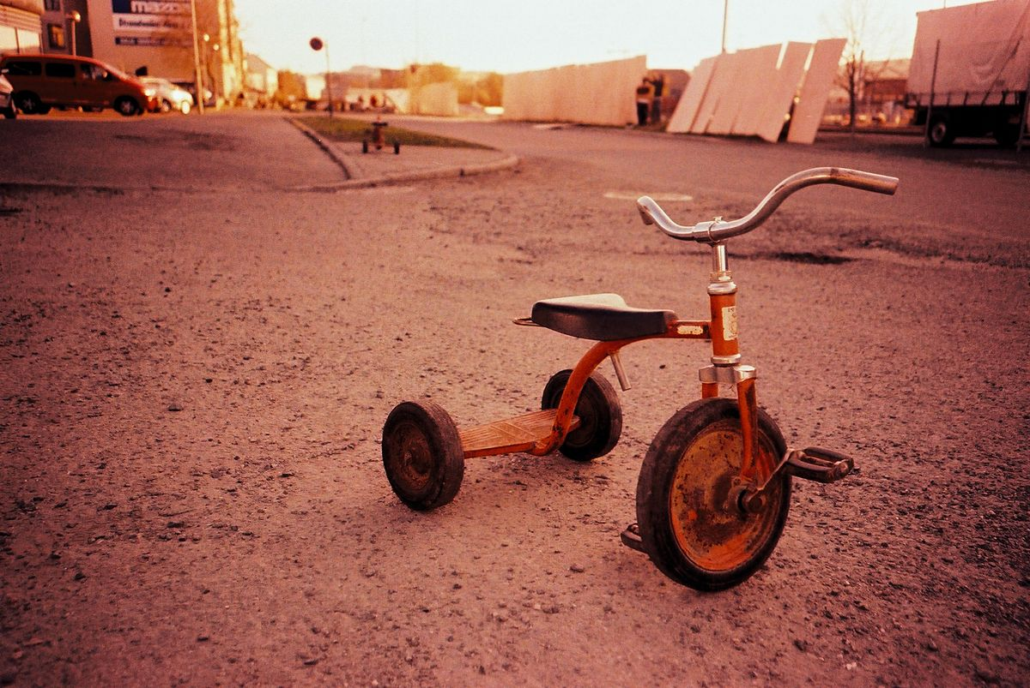
And it takes three wheels to make a vehicle called
a tricycle

Slide 10
Every triangle has three corners,
Every triangle has three sides

Slide 11
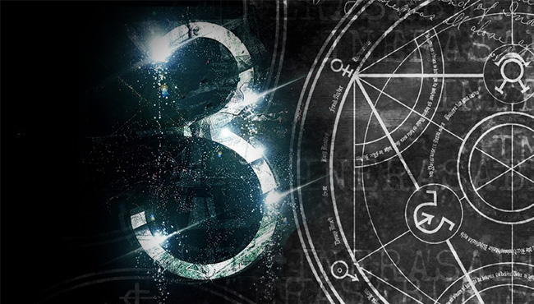
you don't have to guess
No more, no less,
When it's three,
you can see
it's a magic number

Slide 12
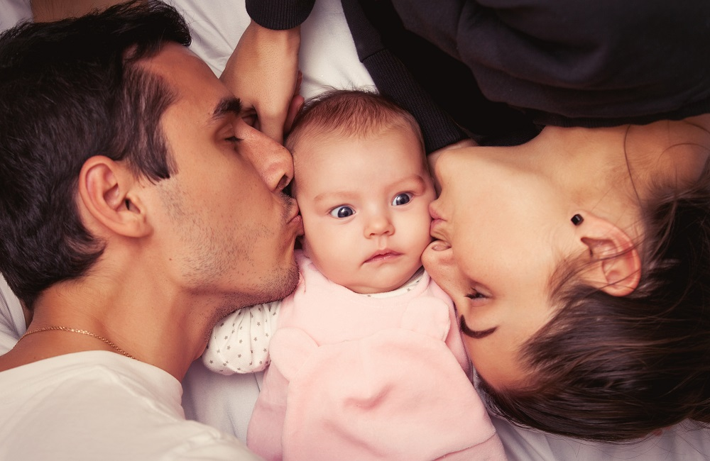
A man and a woman had a little baby
Yes, they did

Slide 13
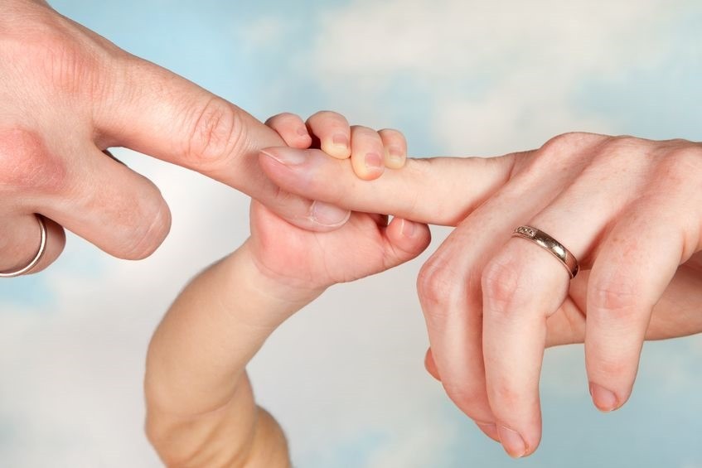
And they had three
in the family

Slide 14
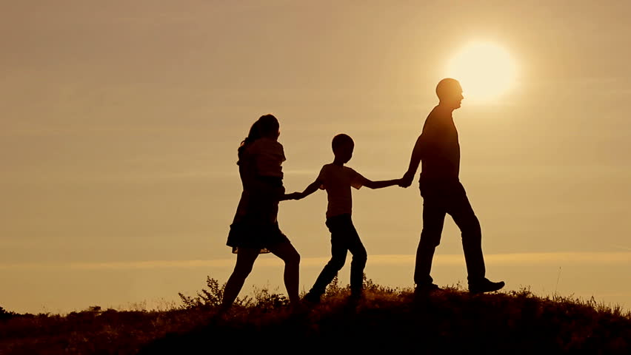
That's a magic number

Slide 15
Three, six, nine
Three, six, nine
Twelve, fifteen, eighteen
Twelve, fifteen, eighteen
Twenty-one, twenty-four,
Twenty-one, twenty-four,
twenty-seven
twenty-seven
Thirty
Thirty

Slide 16
In the first 10
you get 3-6-9,
Now the Multiples of 3
and in the teens ten
its 12-15 and 18,
come up three times in each set of 10.
and in the 20's
you get a 21-24-27,
and it comes out even on 30.

Slide 17
Now

Slide 18
multiply backwards from three times ten

Slide 19
Three times six is eighteen
Three times ten is thirty
Three times five is fifteen
Three times nine is twenty-seven
Three times four is twelve
Three times eight is twenty-four
And three times three is nine
Three times seven is twenty-one
And three times two is six
And three times one is three
Of course.☺

Slide 20
Now dig the pattern once more

Slide 21
3....3-6-9 12...12-15-18 21...21-24-27...30
(Three) Three, six, nine
(Twelve) Twelve, fifteen, eighteen
(Twenty-one) Twenty-one, twenty-four,
twenty-seven
Thirty

Slide 22
Now multiply from
ten backwards

Slide 23
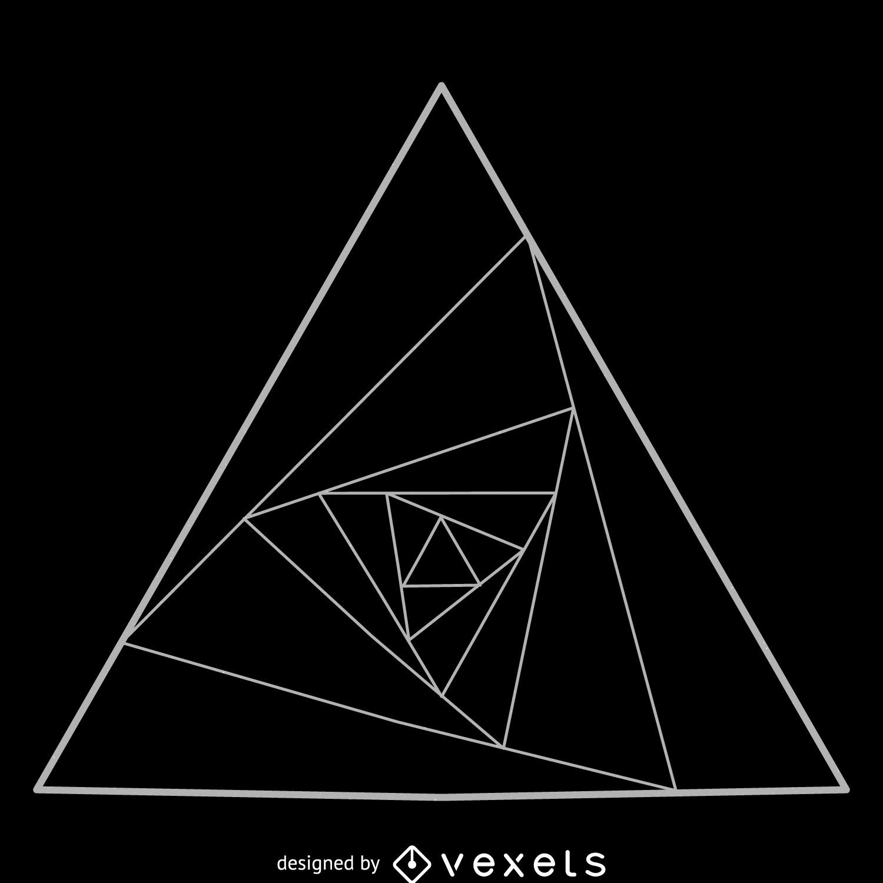
3 x 10 = 30
Going On
And 3 X 2 = 6
3 x 9 = 27
And 3 x 1 ...
3 X 5 = 15
3 x 8 = 24
And 3 x 3 = 9
3 x 7 = 21
3 x 4 = 12
3 x 6 = 18

Slide 24
What is it?!
Three!
Yeah. That's a magic number.

Slide 25
A man and a woman had a little baby
Yes, they did

Slide 26
And they had three
in the family

Slide 27
That's a magic number
THANK YOU

