Slide 1
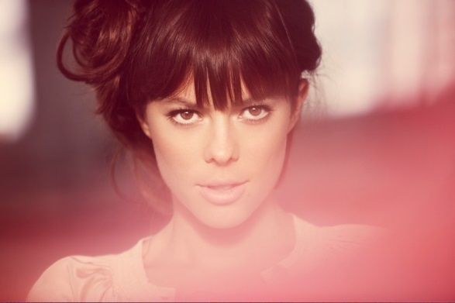
WE ARE THE BRAVE
定冠词 the
华南师范大学外国语言文化学院 岑紫莹
广东省河源市体育运动学校 张晶晶

Slide 2
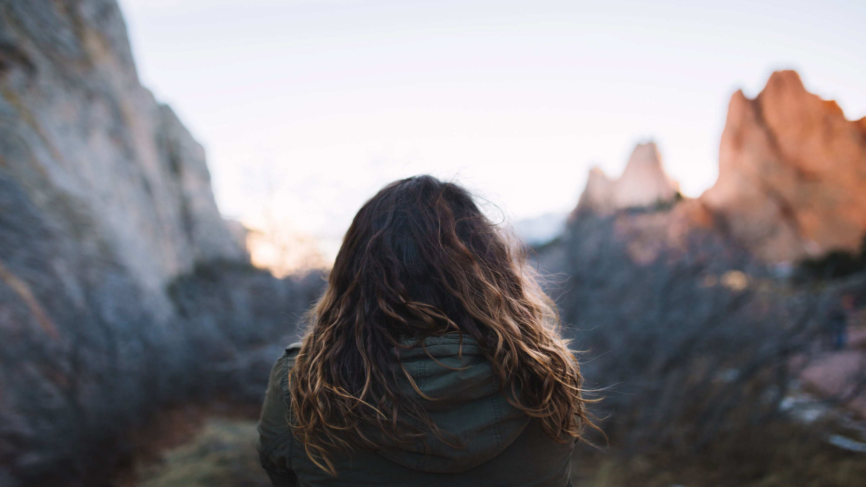

Slide 3
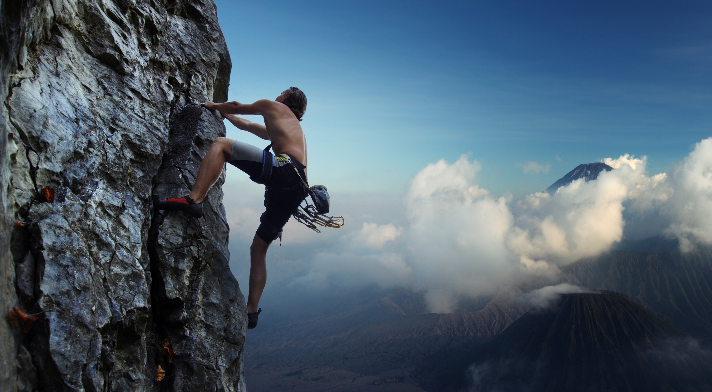
We are
the brave

Slide 4
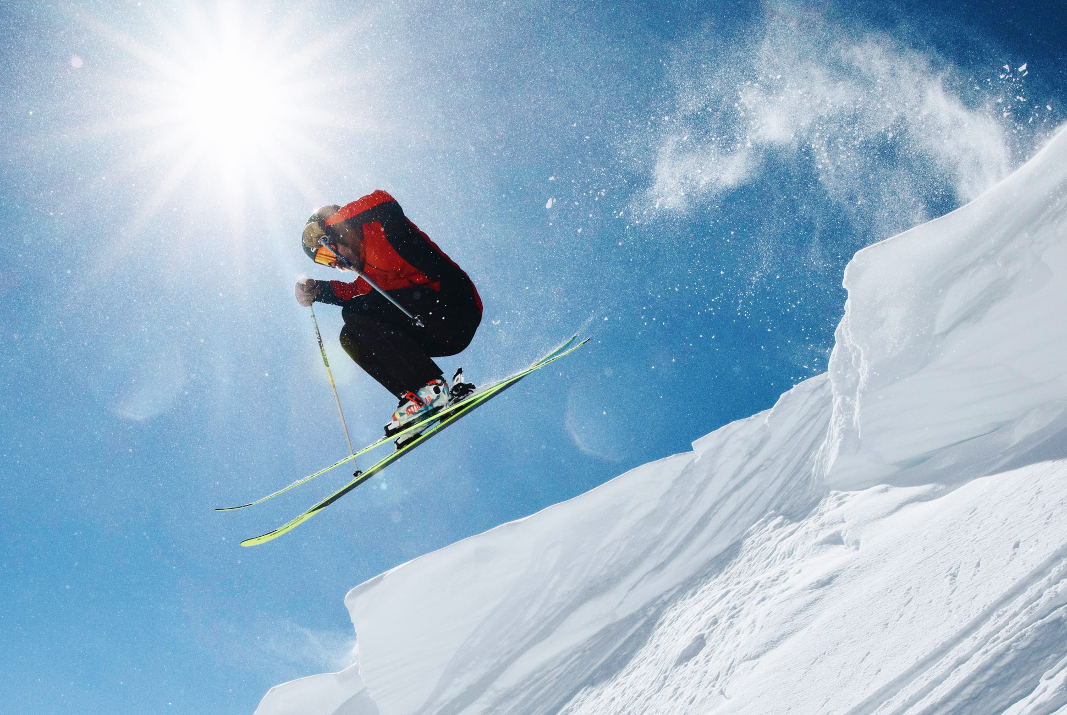
the bold
We are

Slide 5
We can be anything

Slide 6
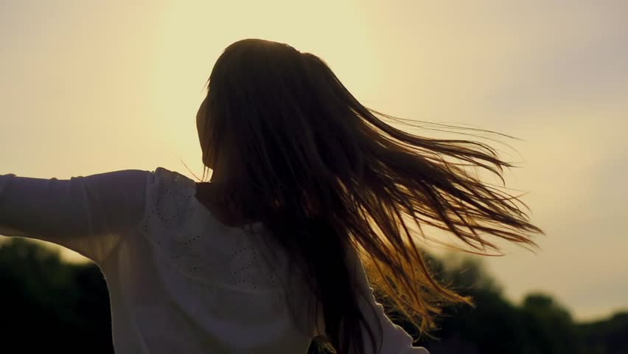
anything

Slide 7
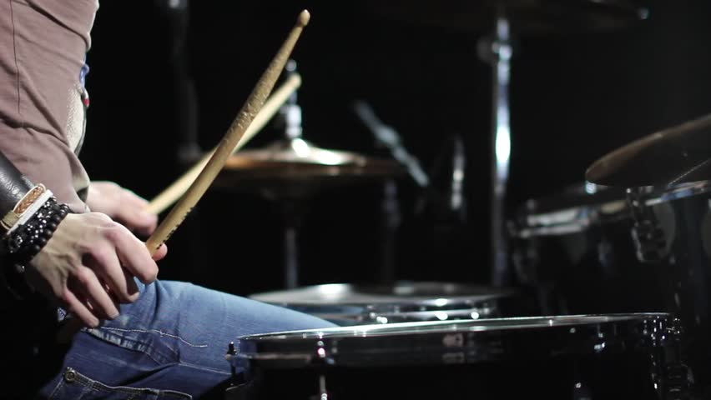
anything

Slide 8
We are
the light

Slide 9
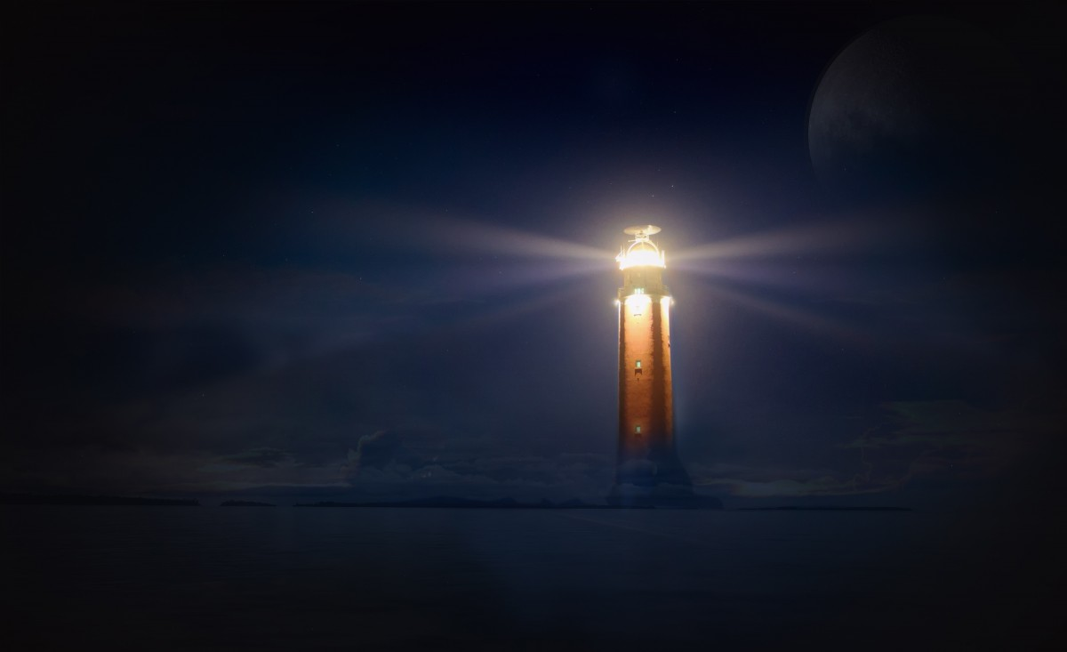
We light
the dark

Slide 10
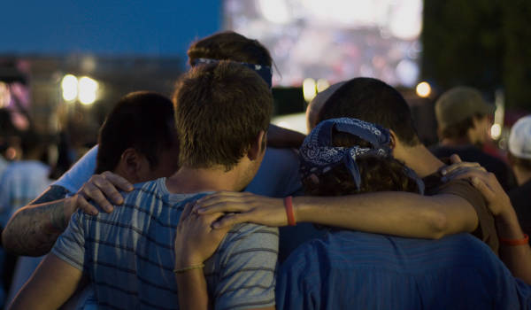
We can do everything

Slide 11
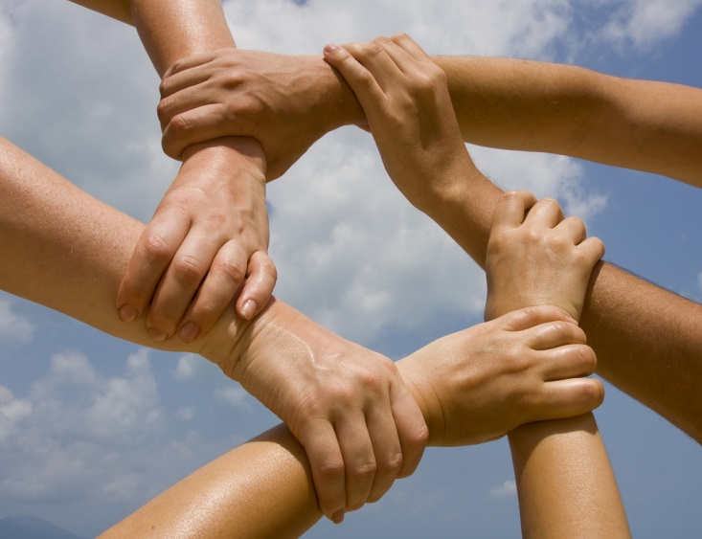
everything

Slide 12
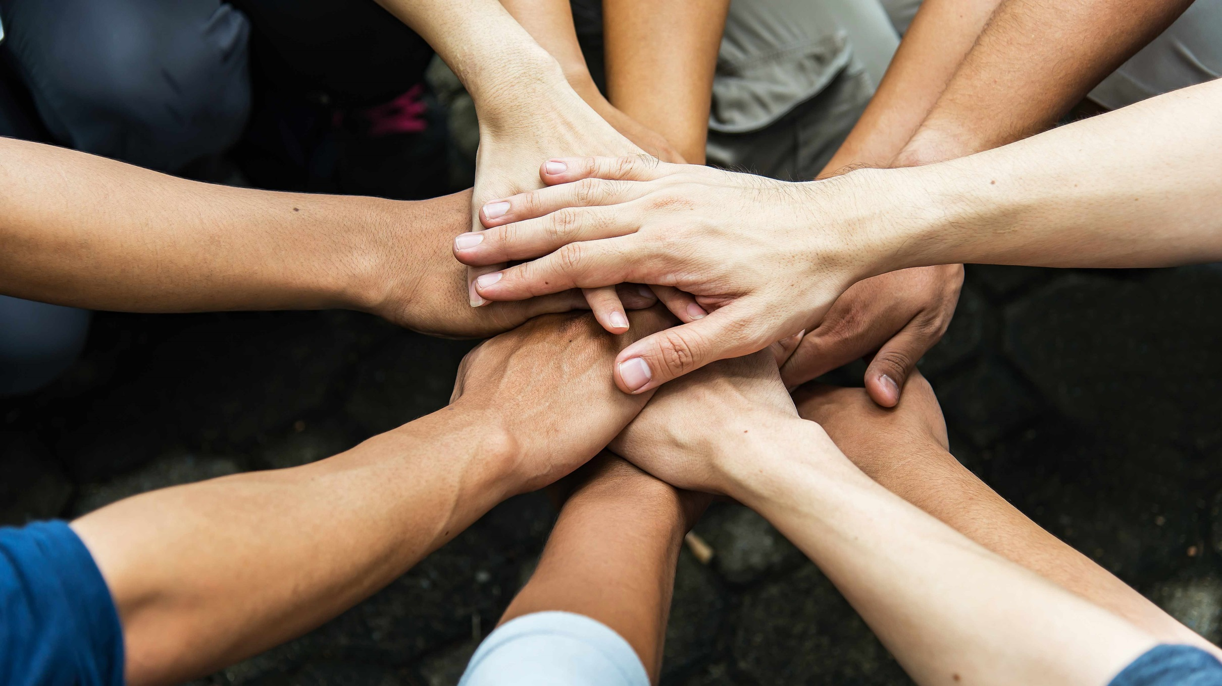
everything

Slide 13
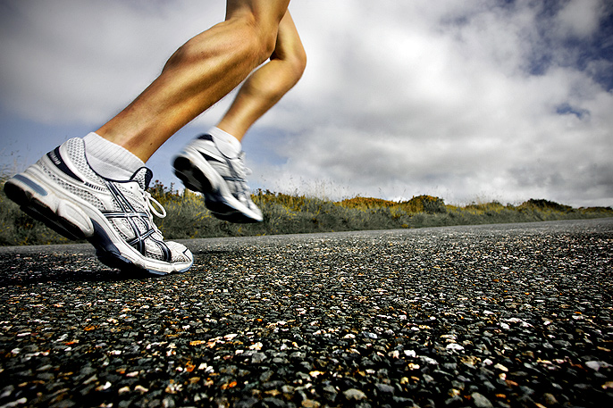
So hold on don't stop

Slide 14
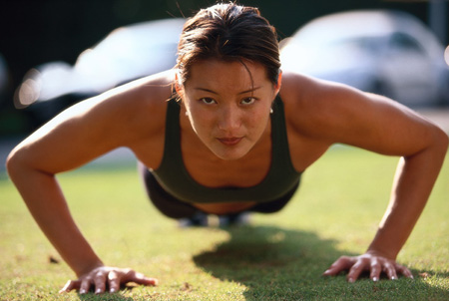
There's so much in you

Slide 15
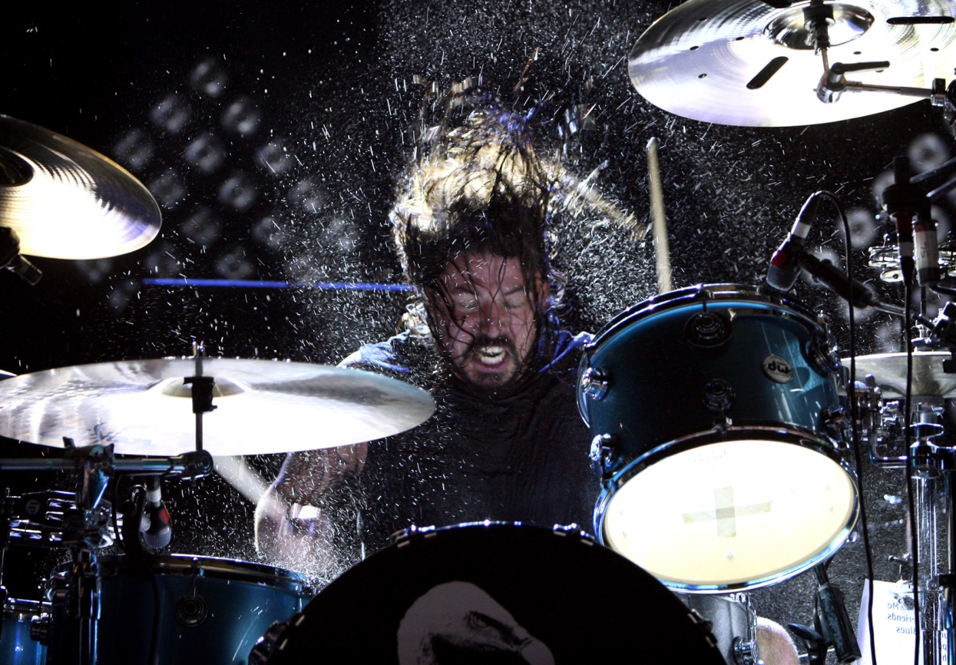
We are oh oh
the brave

Slide 16
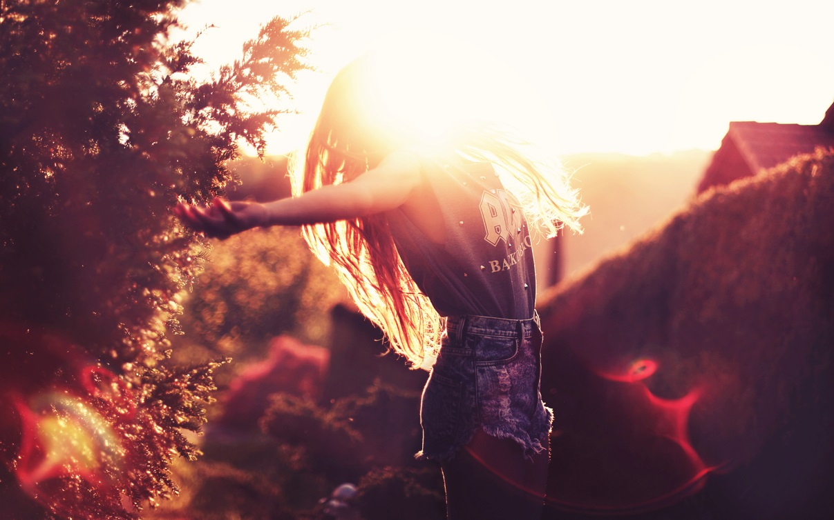
We are oh oh
the free

Slide 17
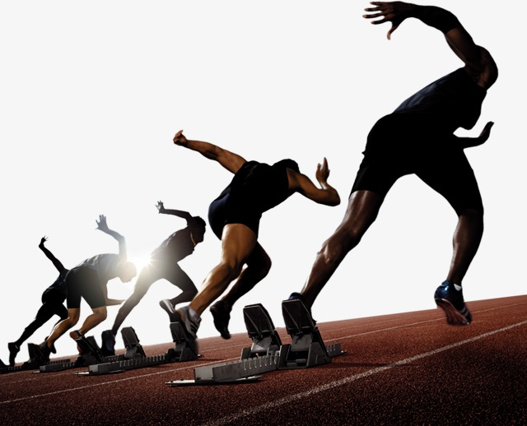
the power
We have to be stronger

Slide 18
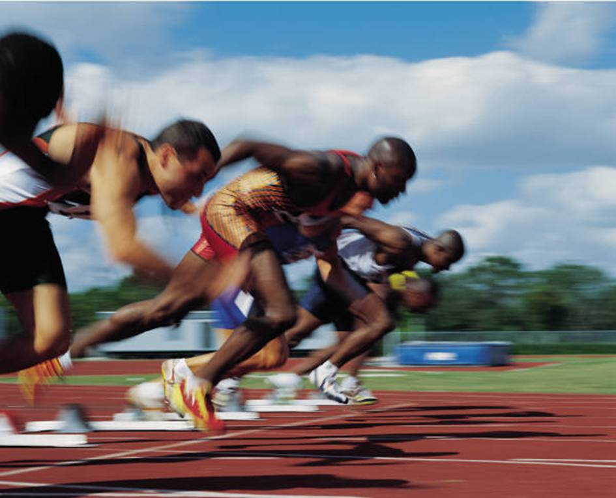
If we want it

Slide 19
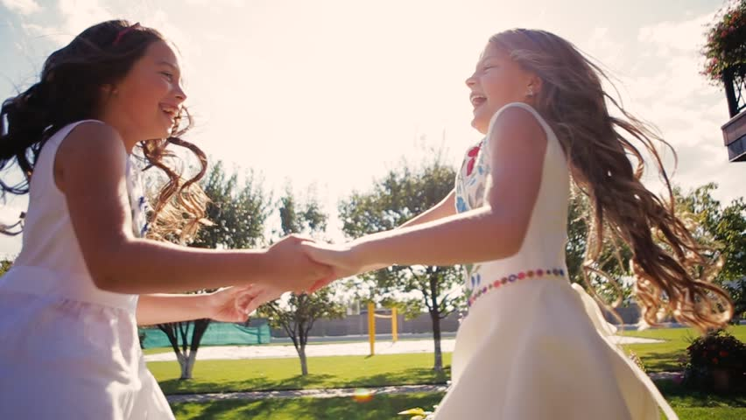
You and me

Slide 20
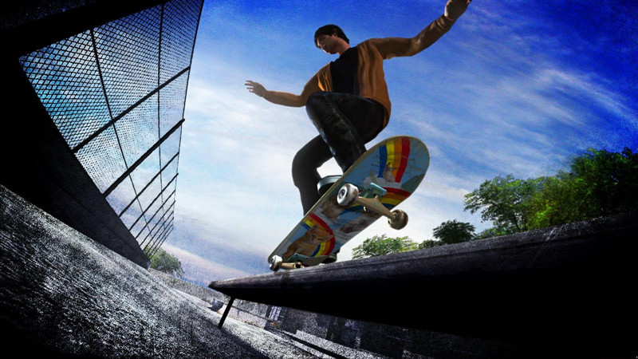
This our time

Slide 21
This our day

Slide 22
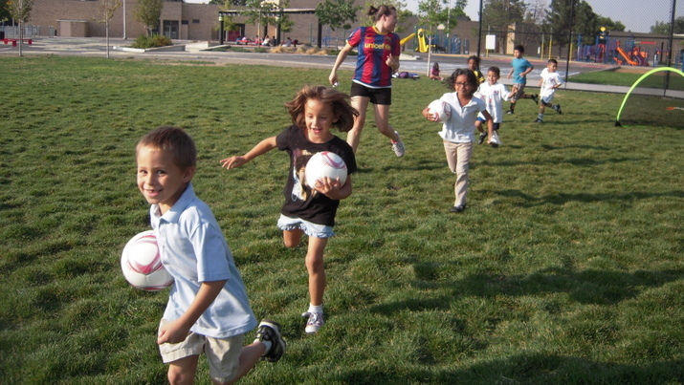
We can do anything

Slide 23
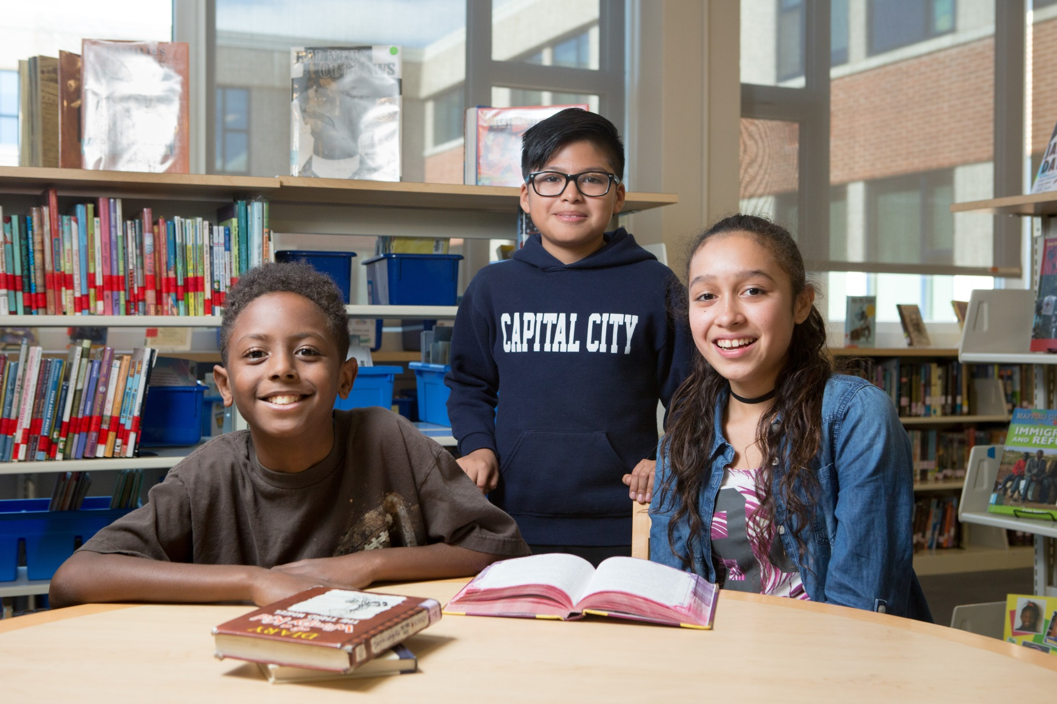
anything

Slide 24
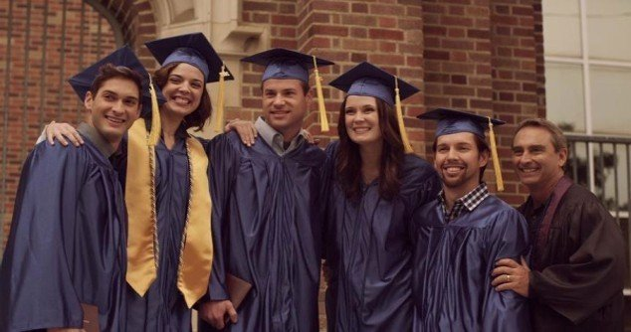
anything

Slide 25
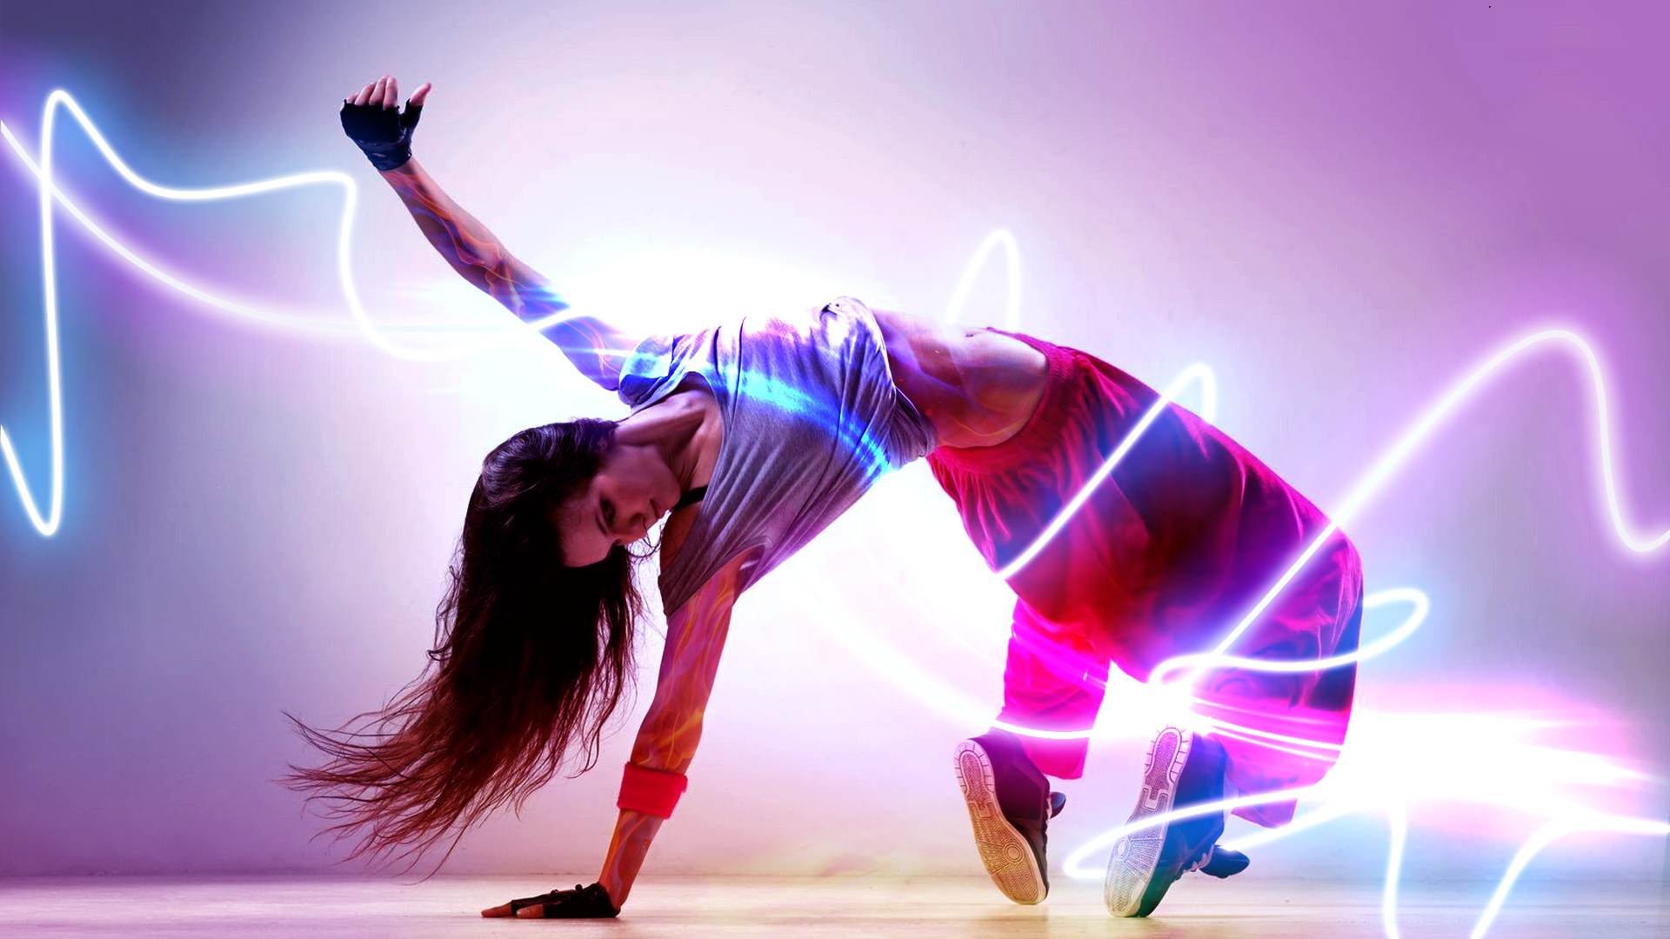
And all our dreams

Slide 26
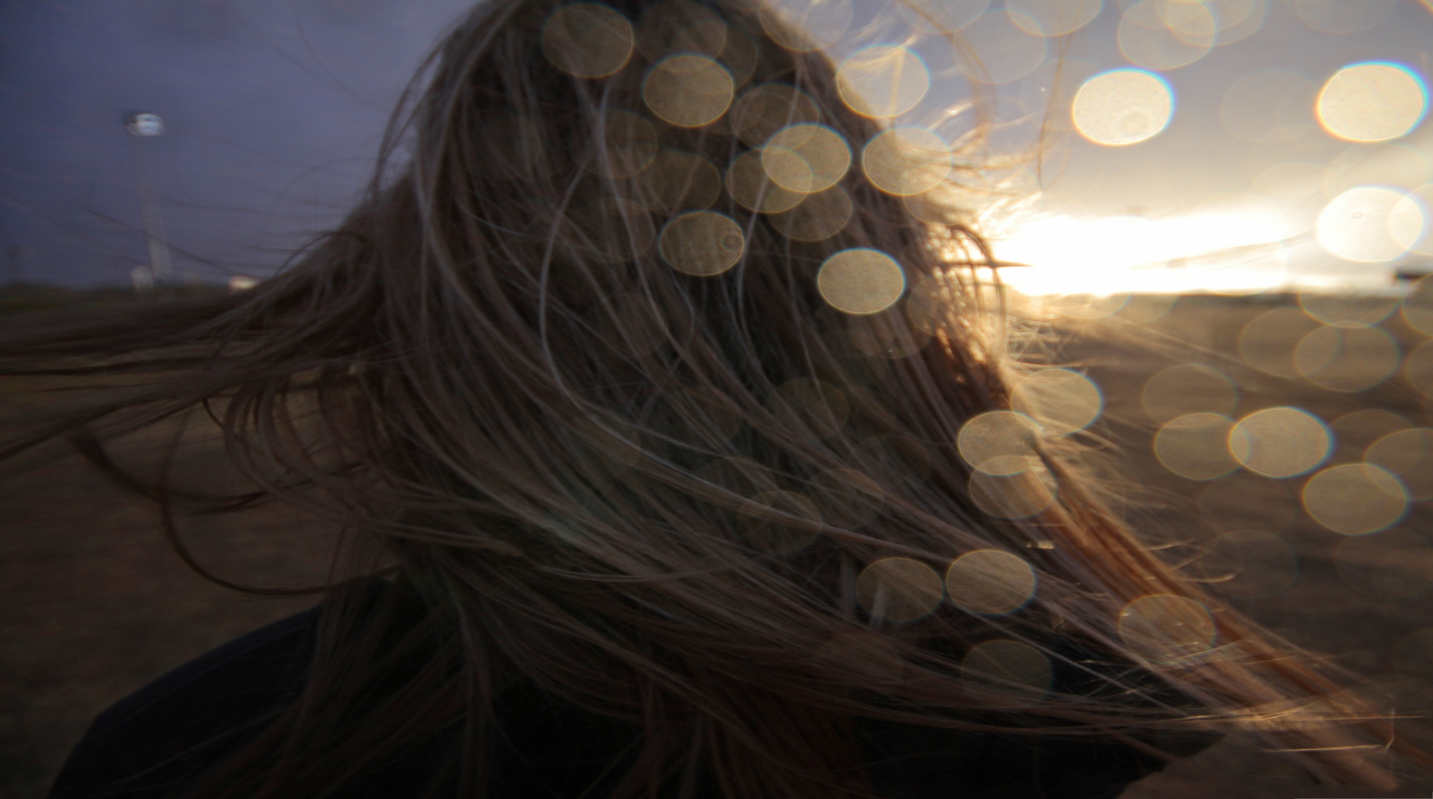
light up
the way

Slide 27
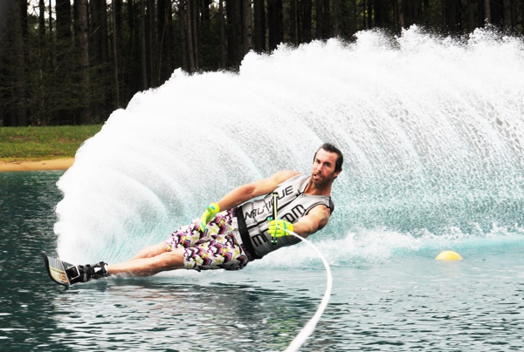
We can have everything

Slide 28
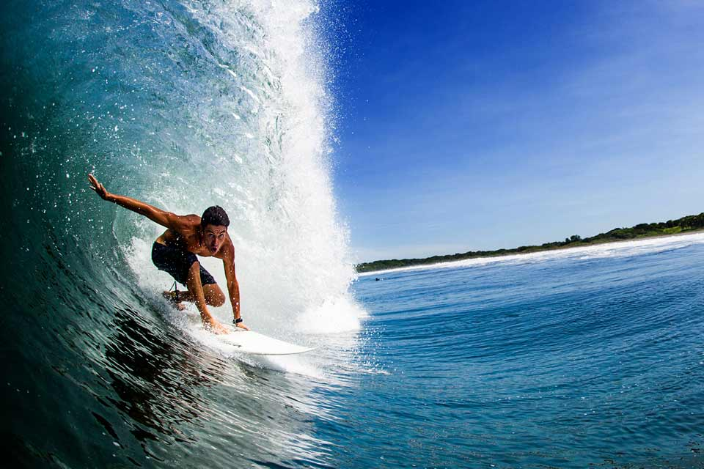
everything

Slide 29
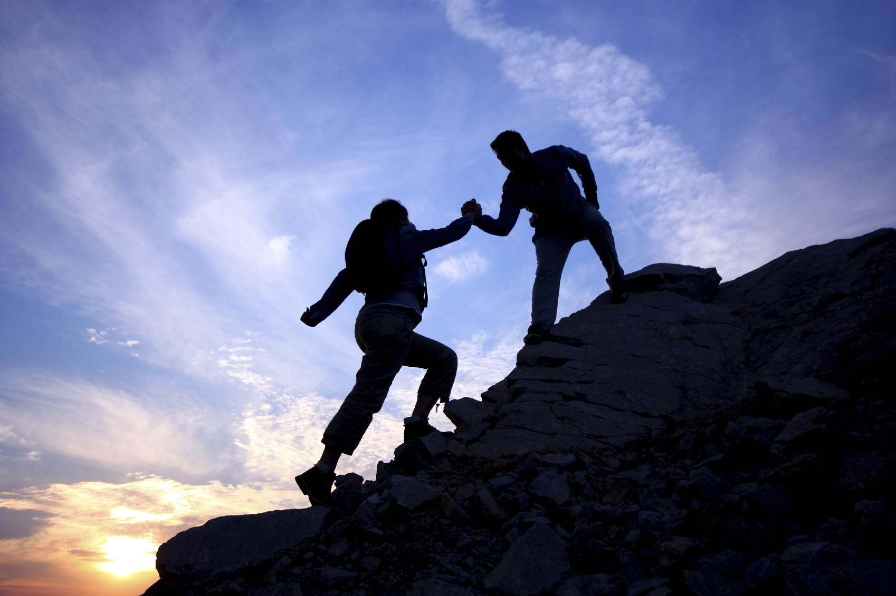
everything

Slide 30
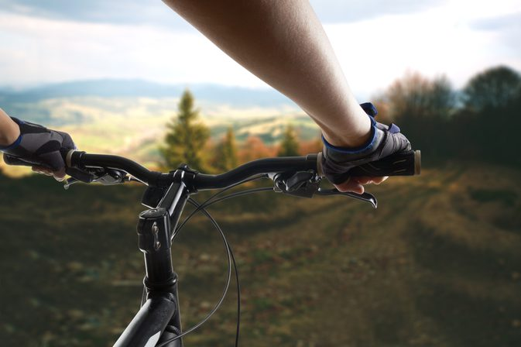
So stand up don't stop

Slide 31
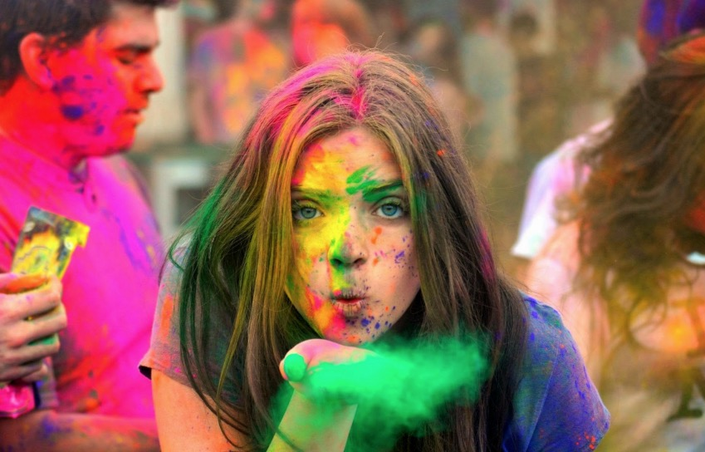
The best is in you
The best

Slide 32
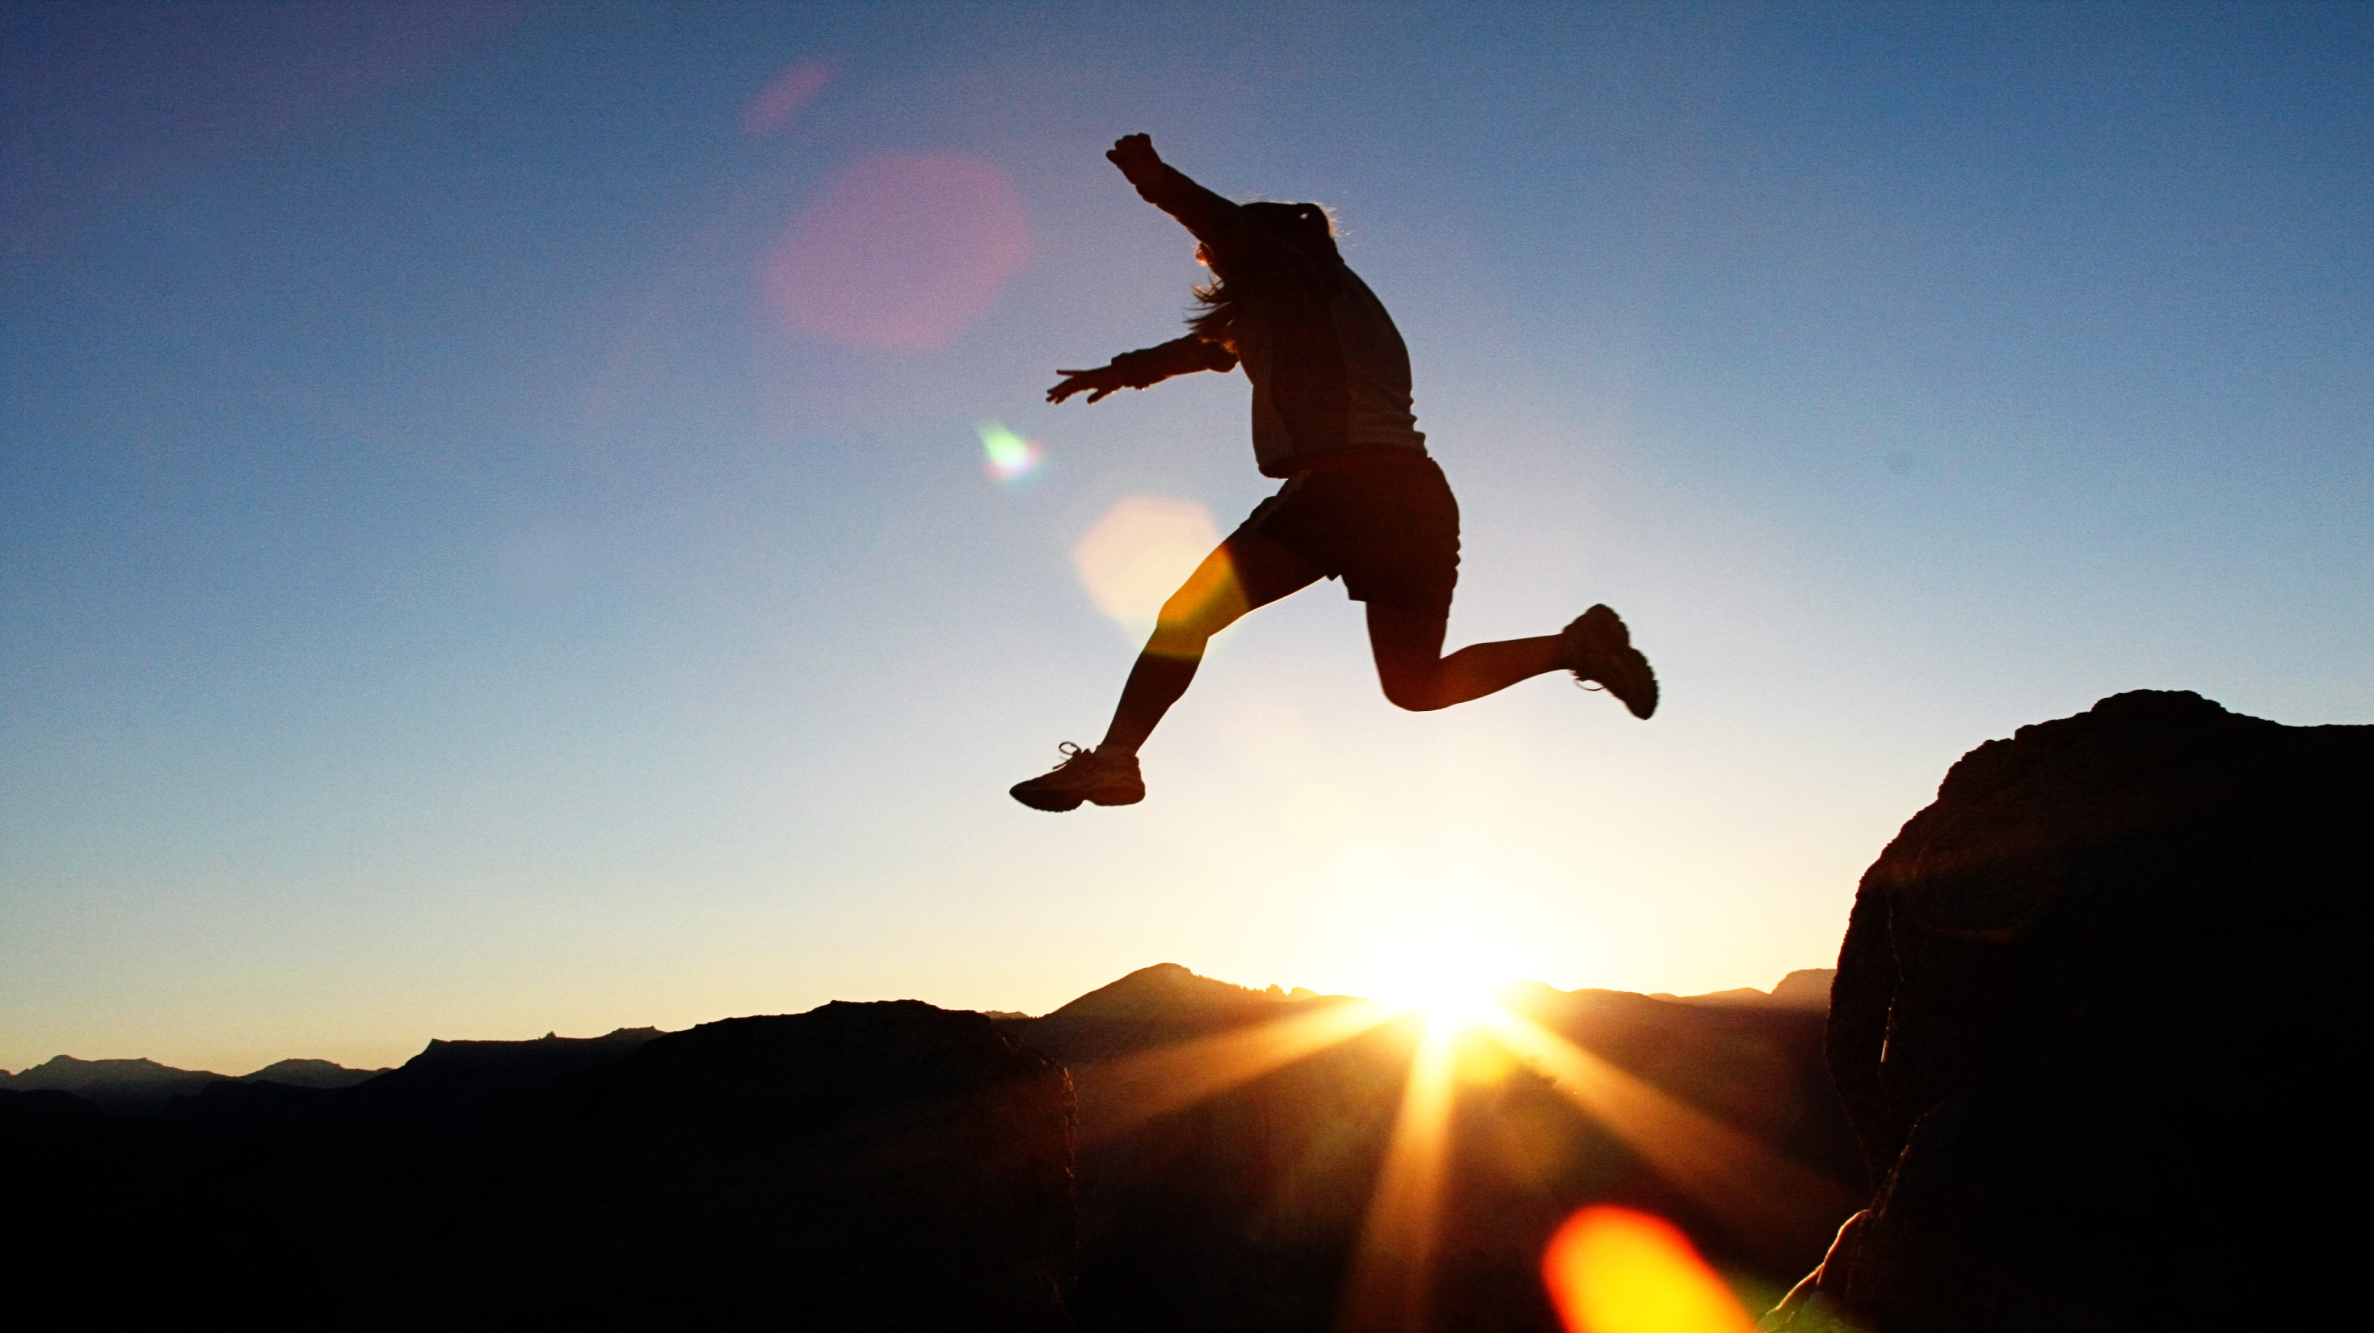
We are the brave oh oh
the brave

Slide 33
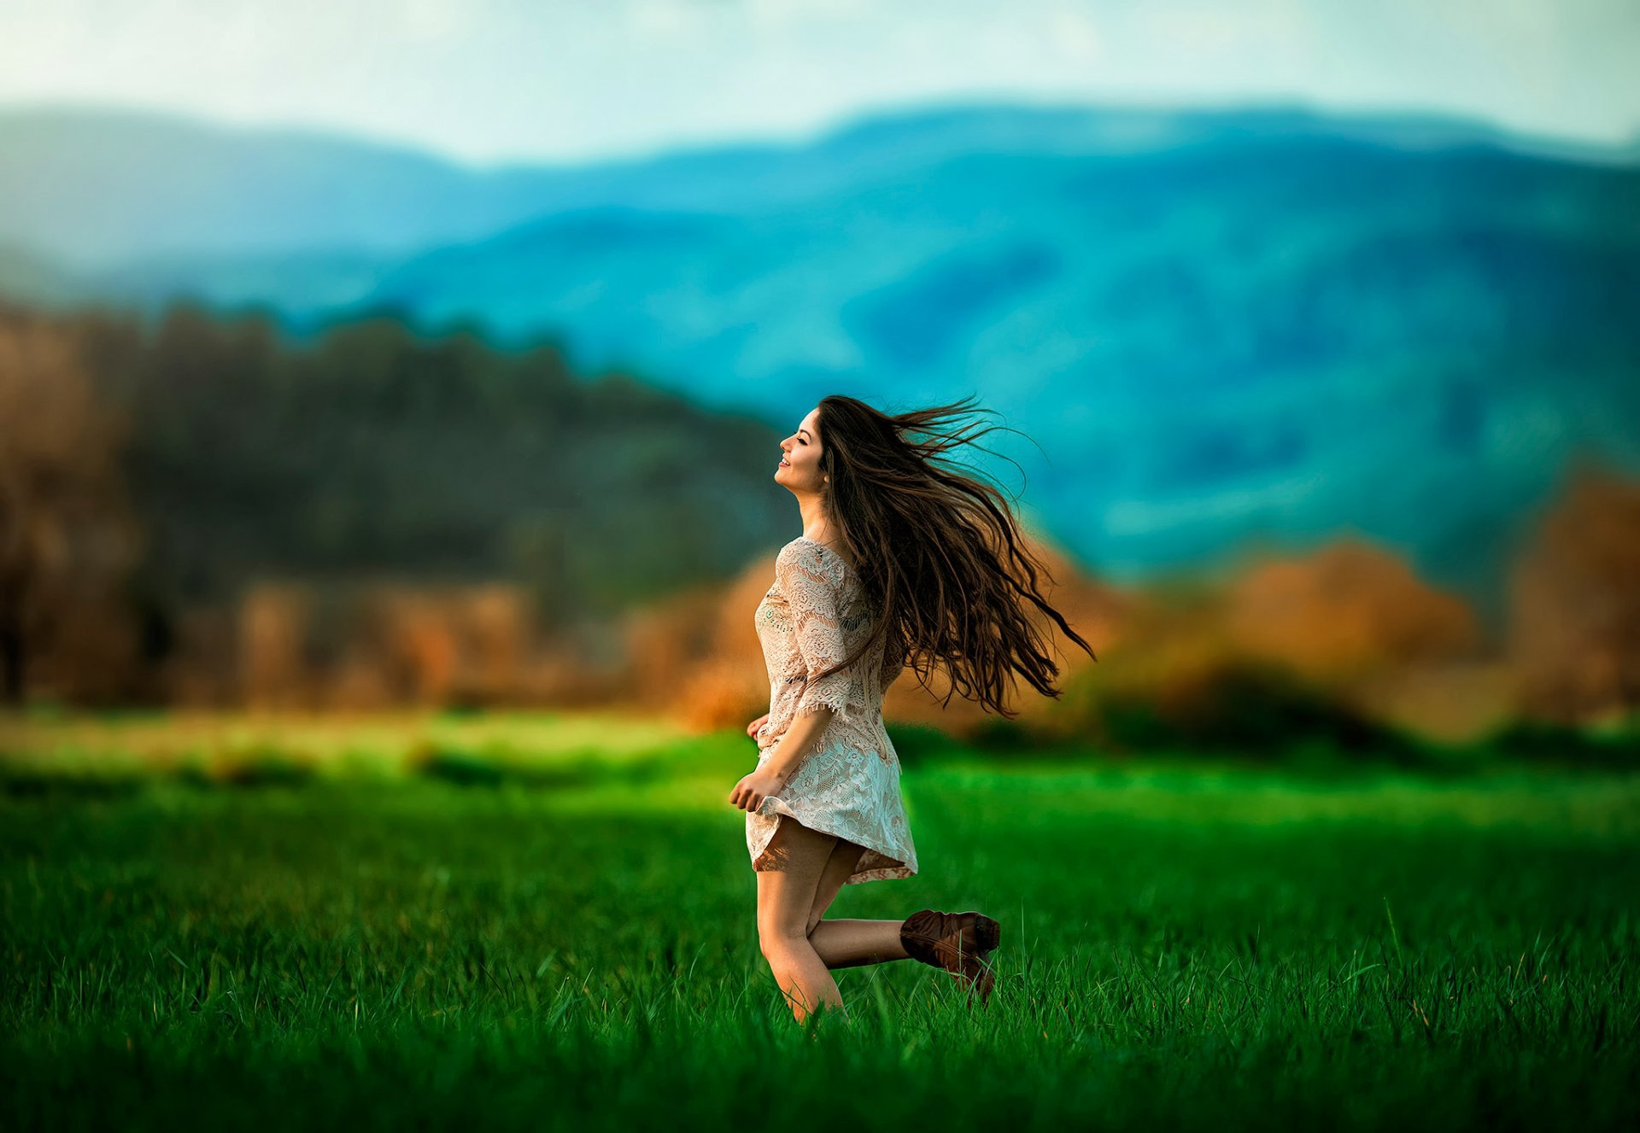
We are the free oh oh
the free

Slide 34
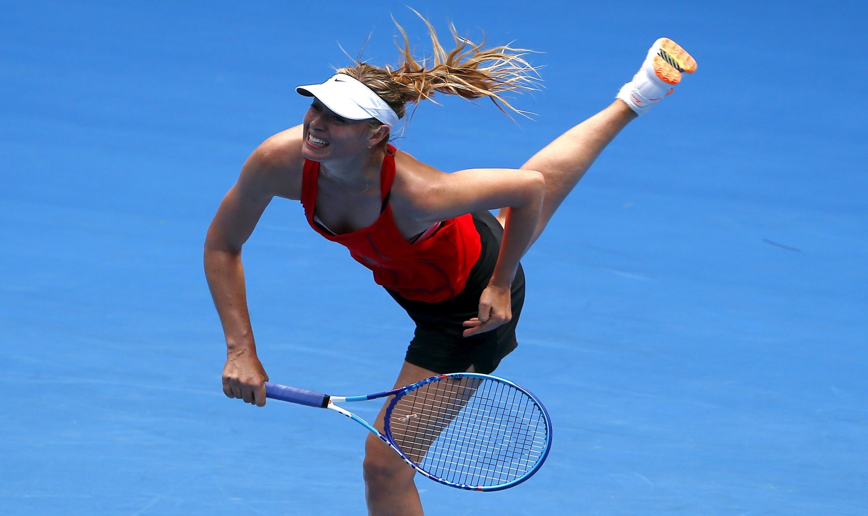
the power
We have the power to be stronger
If we want it

Slide 35
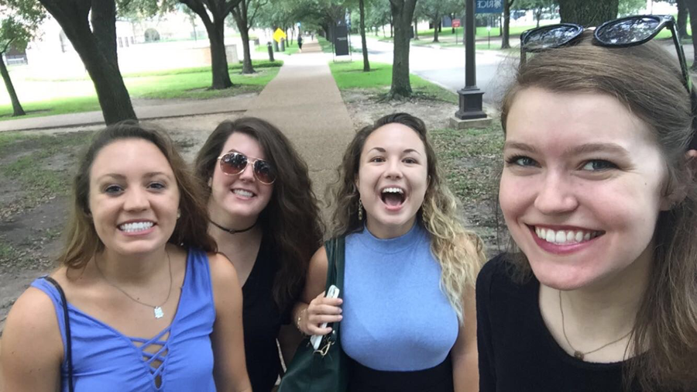
You and me oh oh

Slide 36
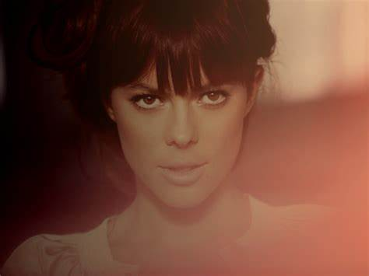
So light up the power in you
the power

Slide 37
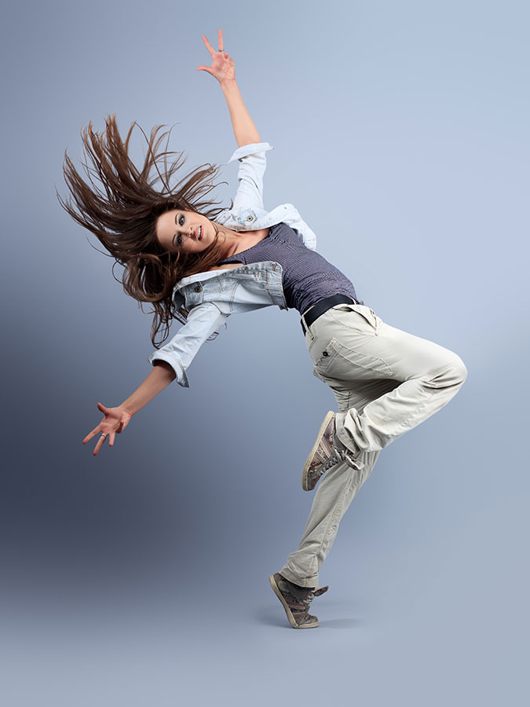
the best
And go for the best in you

Slide 38
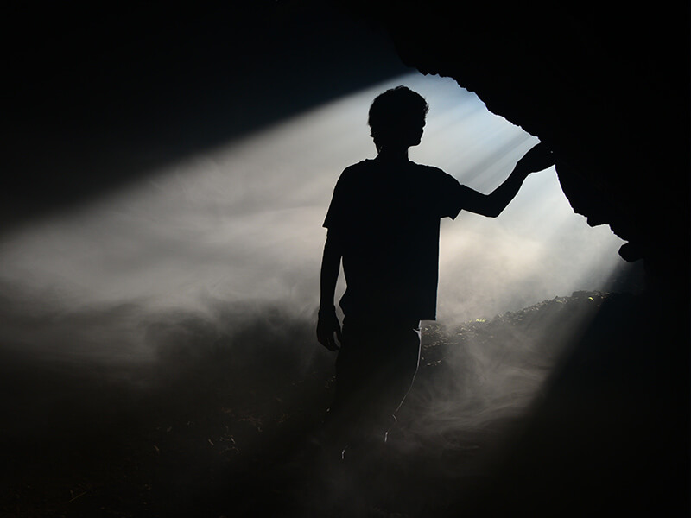
Cause I see a light shine through

Slide 39
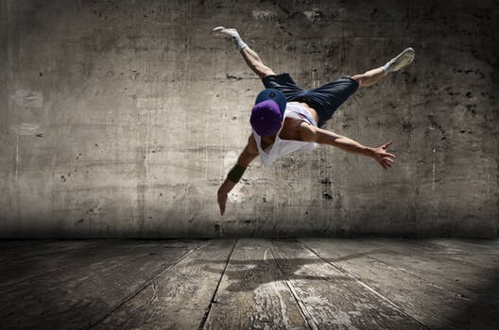
Oh oh

Slide 40
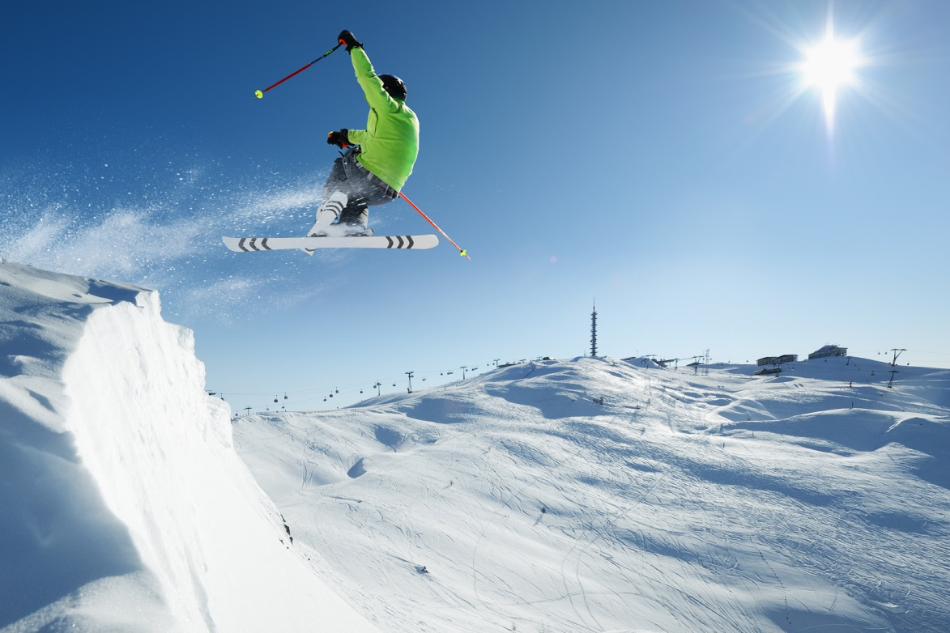
So light up the power in you
the power

Slide 41
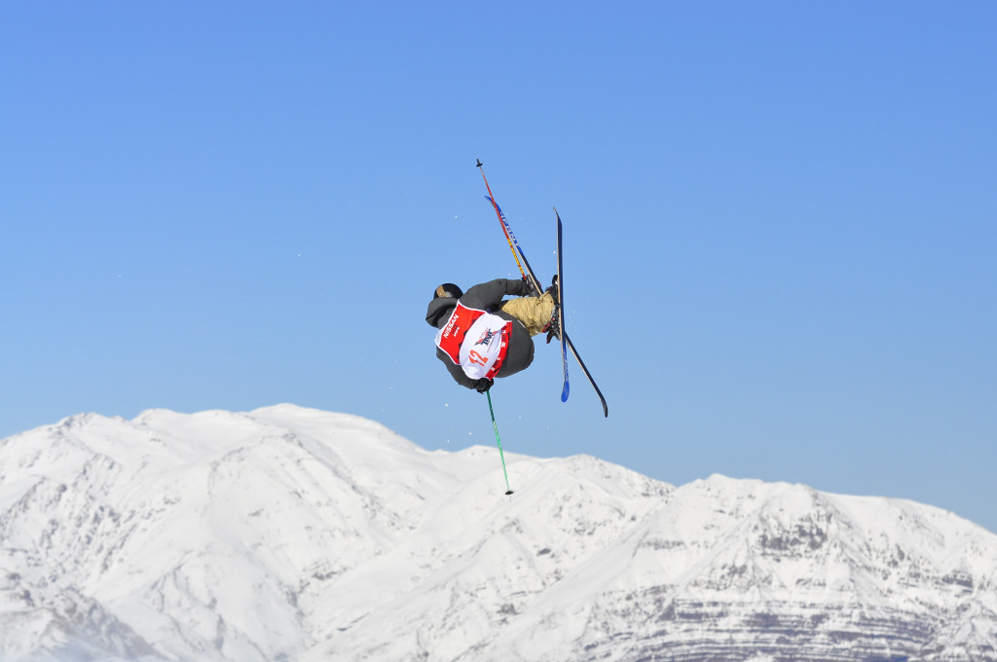
And go for the best in you
the best

Slide 42
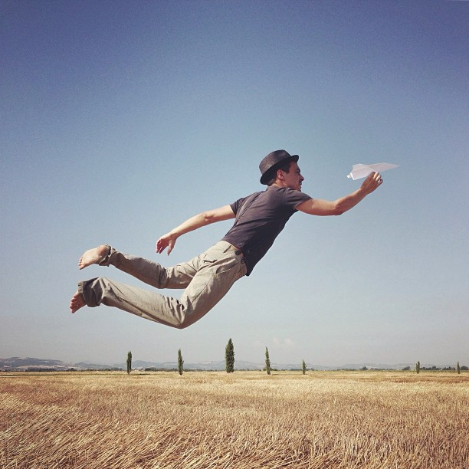
Cause I see a light shine through

Slide 43
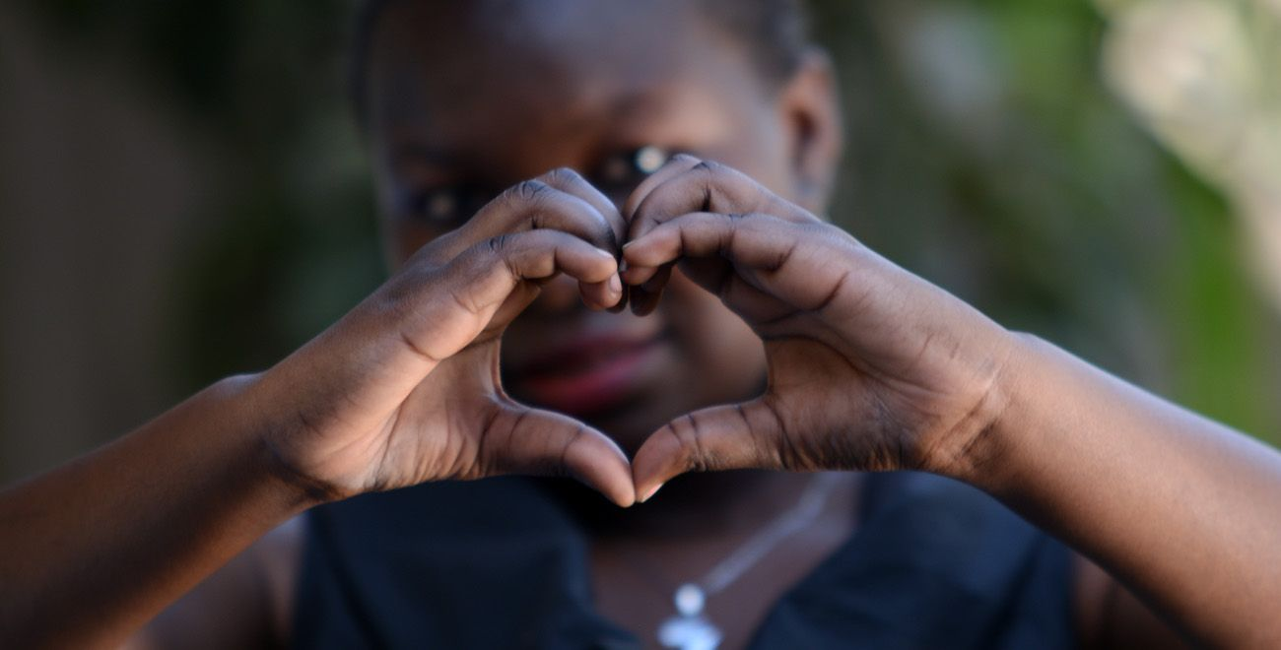
Oh oh

Slide 44
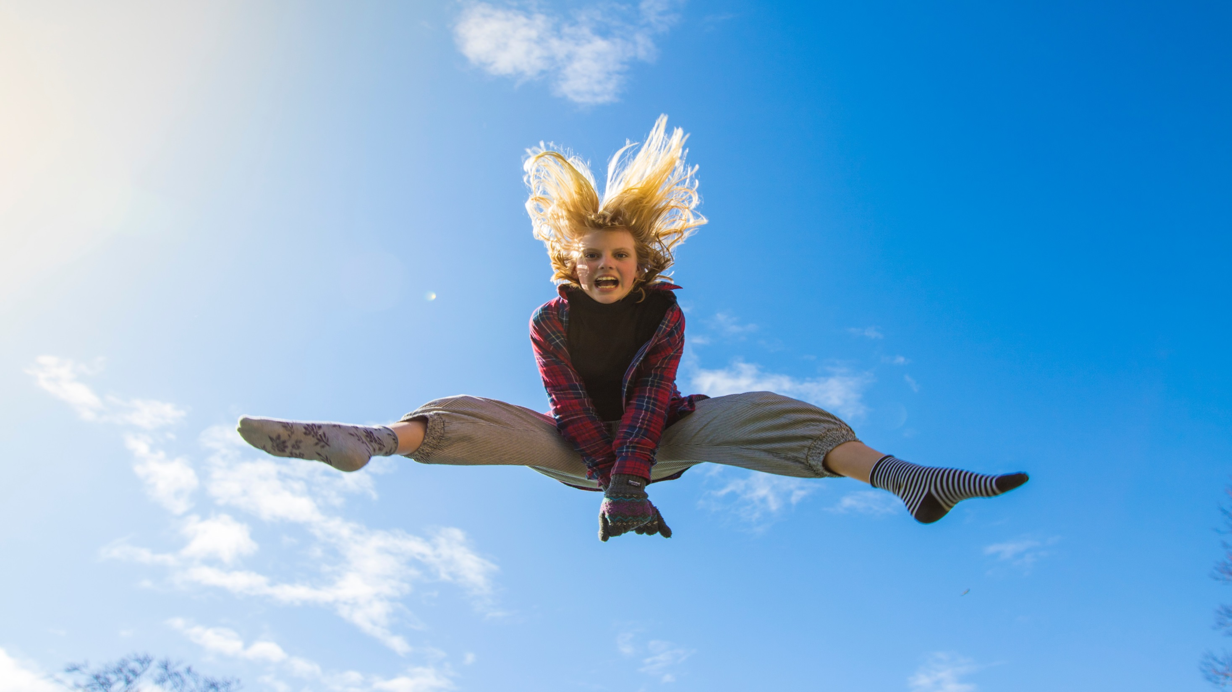
the brave
We are the brave oh oh

Slide 45
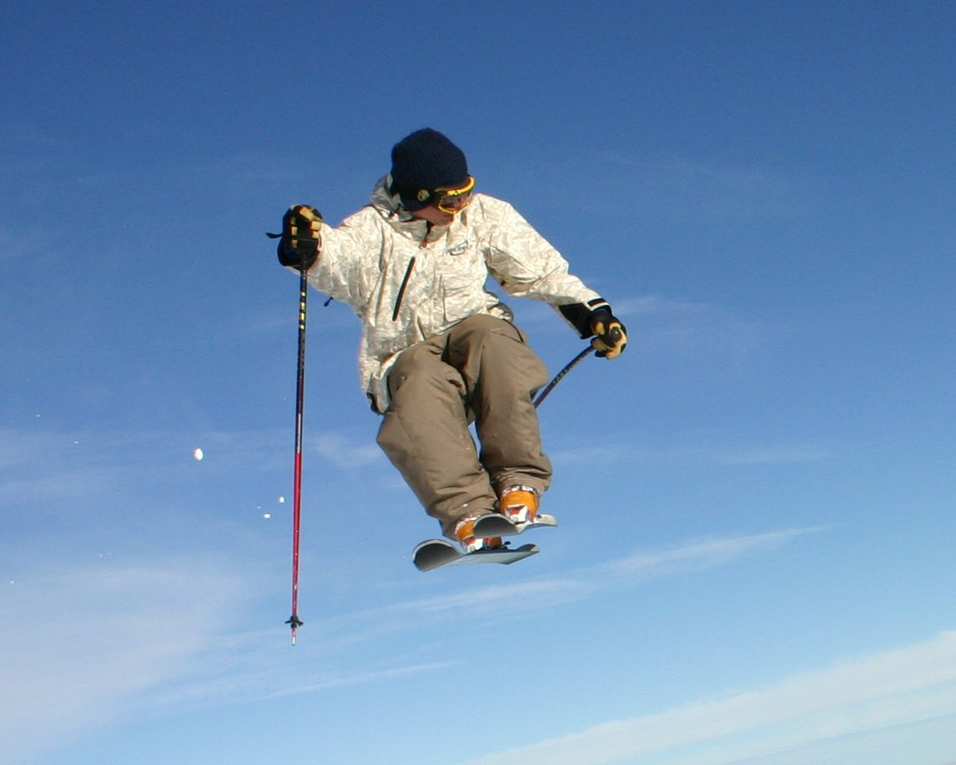
Oh oh…

Slide 46
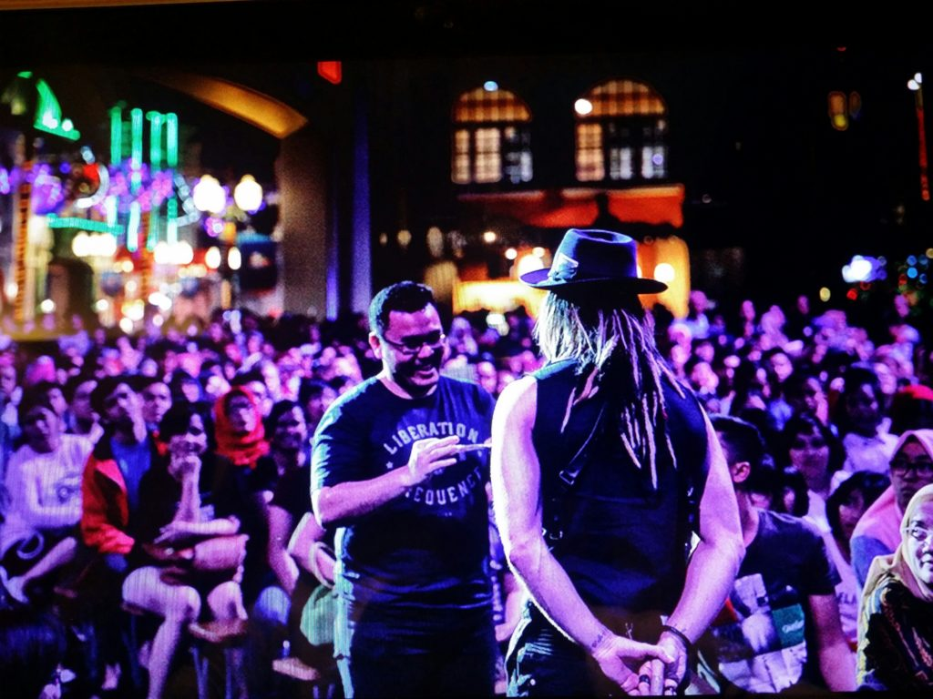
Oh oh…

Slide 47
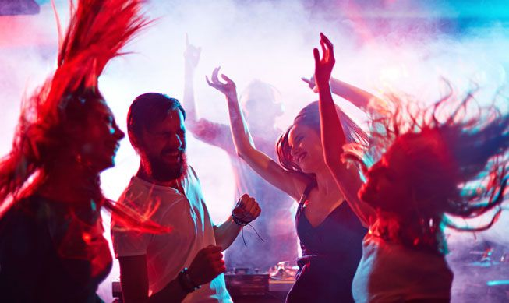
Oh oh…

Slide 48
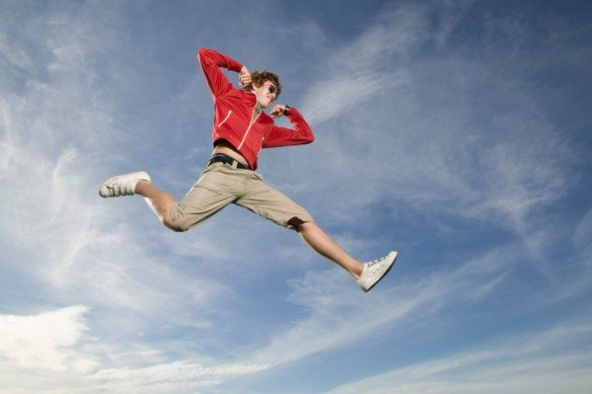
We are the brave oh oh
the brave

Slide 49
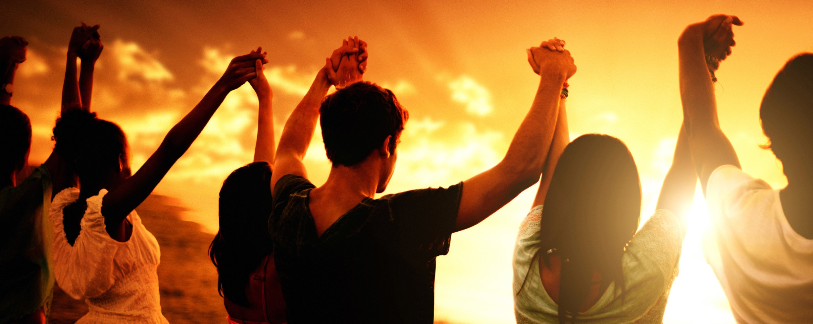
Oh oh…

Slide 50
Oh oh…

Slide 51
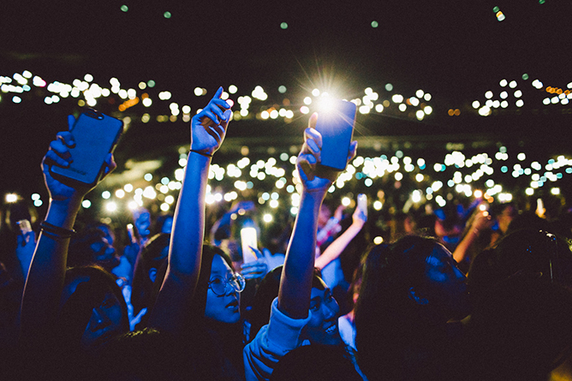
Oh oh…

Slide 52
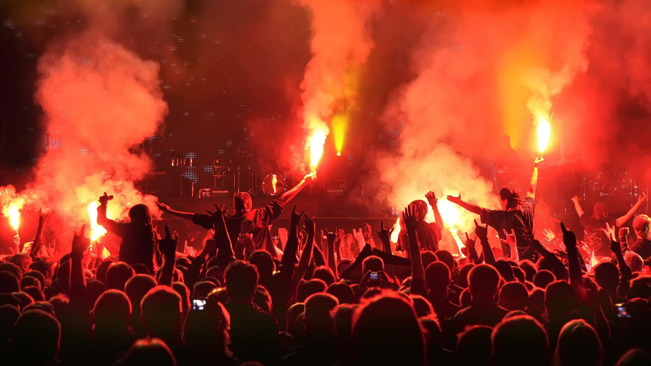
the brave
We are the brave oh oh

Slide 53
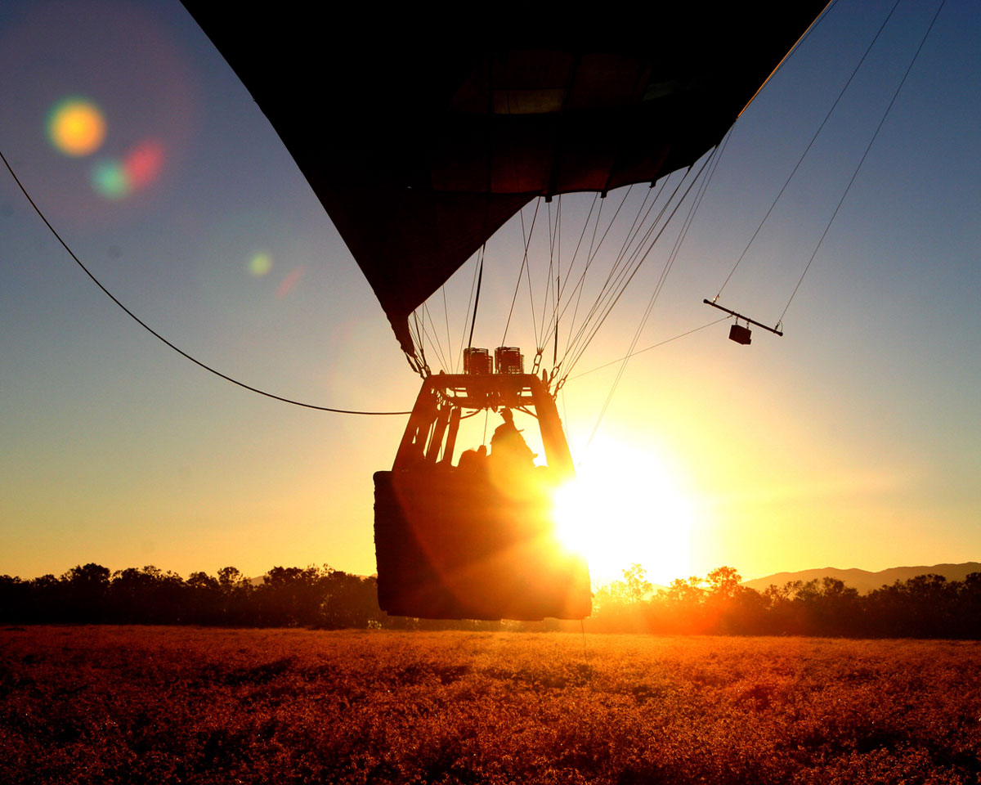
So light up the power in you
the power

Slide 54
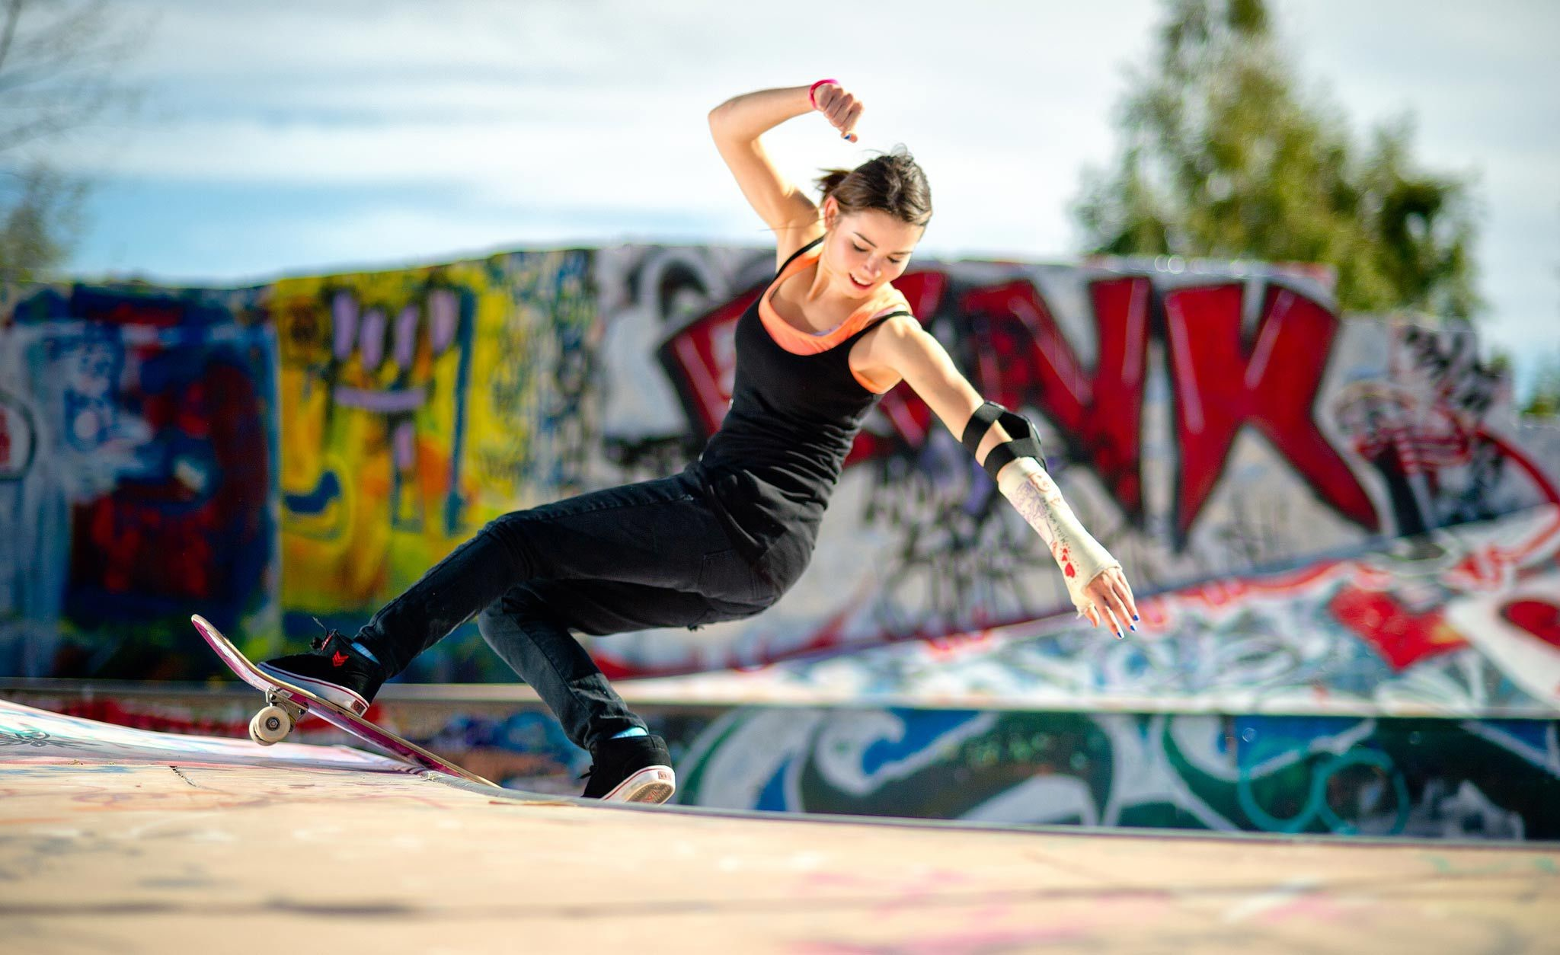
the best
And go for the best in you

Slide 55
Cause I see a light shine through

Slide 56
Oh oh

Slide 57
the brave
We are oh oh

Slide 58
So light up the power in you
the power

Slide 59
And go for the best in you
the best

Slide 60
Cause I see a light shine through

Slide 61
Oh oh…

Slide 62
We are oh oh
the brave

Slide 63
Oh oh…

Slide 64
Oh oh…

Slide 65
Oh oh…

Slide 66
Oh oh…

Slide 67
WE ARE THE BRAVE

