Slide 1
Song : I Turn To You
短语 turn to sb＋turn…around
作者：华南师范大学外国语言文化学院 陈卓凡
广东省河源市田家炳实验中学 李素

Slide 2
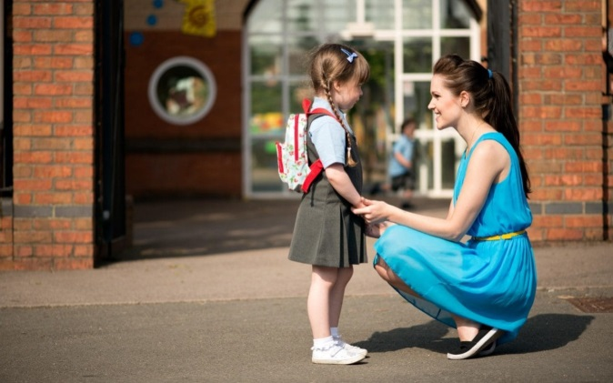
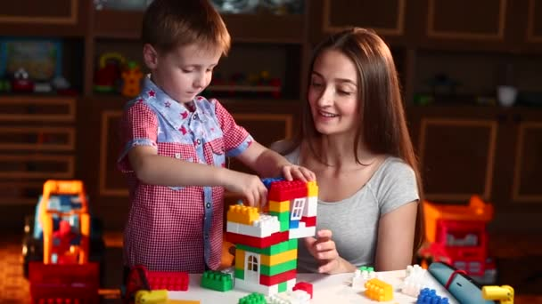

Slide 3
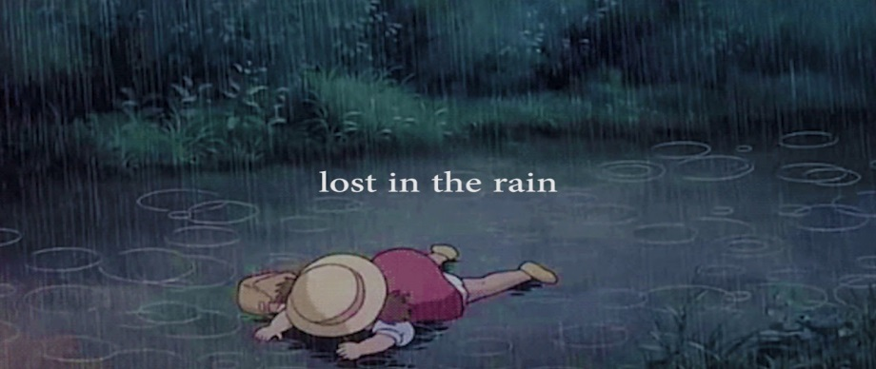
When I'm lost in the rain

Slide 4
In your eyes I know I'll find The light to light my way

Slide 5
And when I'm scared

Slide 6
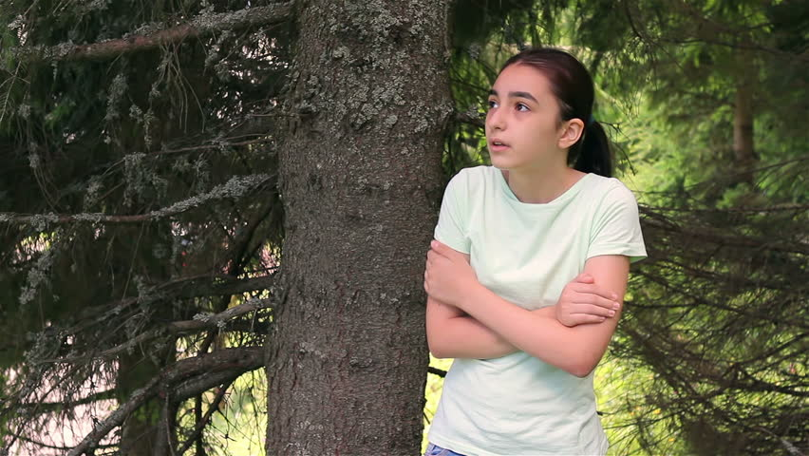
And losing ground

Slide 7
When my world is going crazy

Slide 8
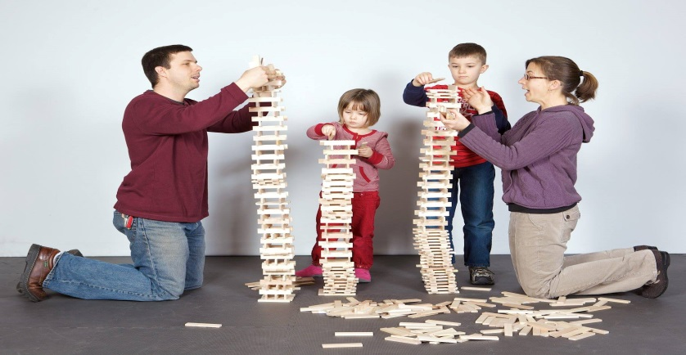
You can turn it all around

Slide 9
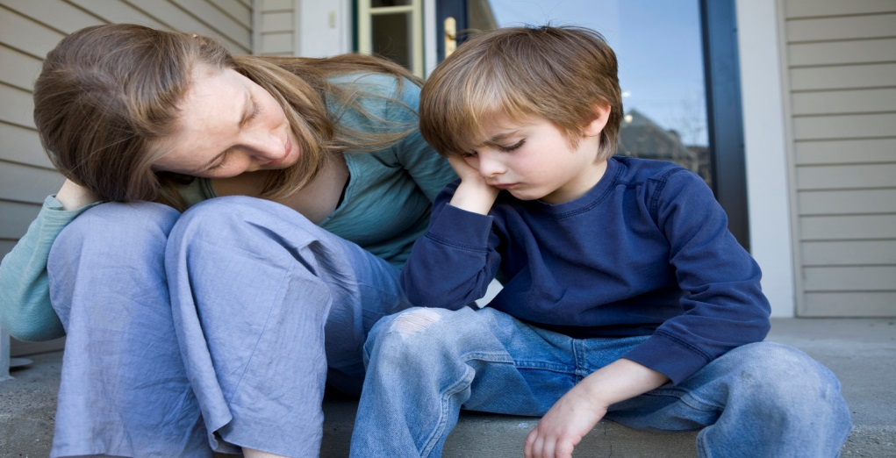
And when I'm down you're there

Slide 10
Pushing me to the top

Slide 11
You're always there
Giving me all you've got

Slide 12
For a shield from the storm

Slide 13
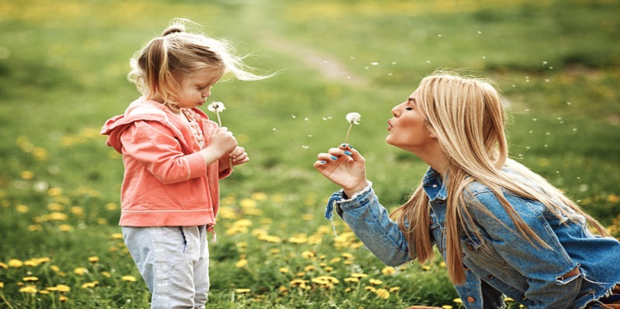
For a friend, for a love
To keep me safe and warm

Slide 14
I turn to you

Slide 15
For the strength to be strong

Slide 16
For the will to carry on

Slide 17
For everything you do

Slide 18
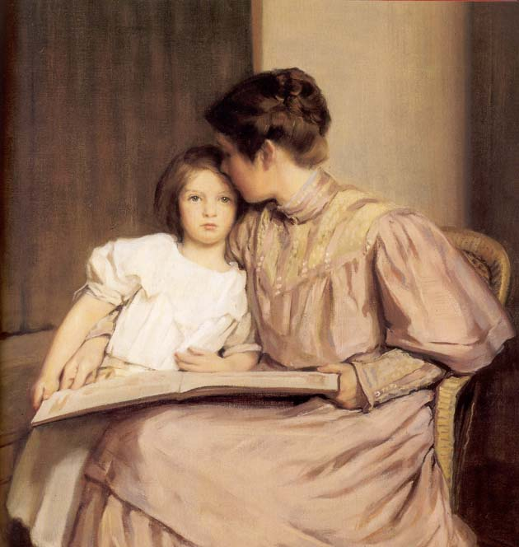
For everything that's true

Slide 19
I turn to you

Slide 20
When I lose the will to win

Slide 21
I just reach for you and
I can reach the sky again

Slide 22
I can do anything

Slide 23
'Cause your love is so amazing

Slide 24
'Cause your love inspires me

Slide 25
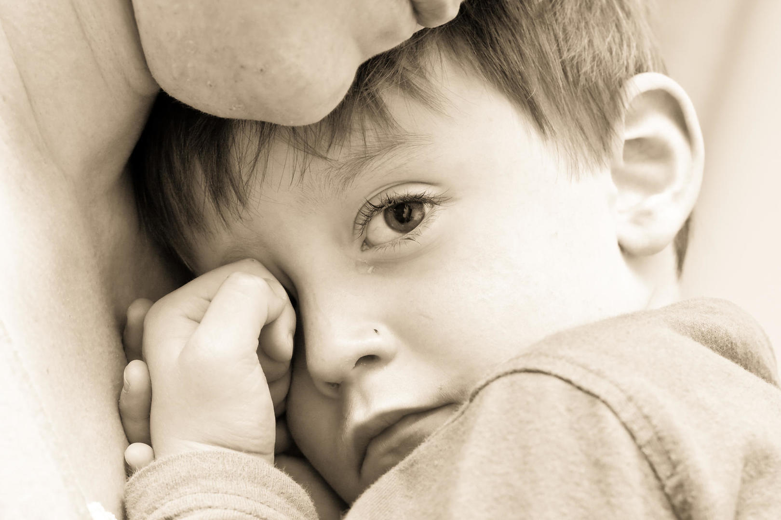
And when I need a friend

Slide 26
You're always on my side

Slide 27
That gets me through the night
Giving me faith

Slide 28
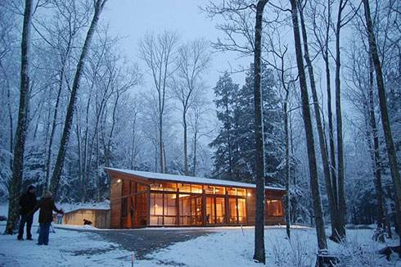
For a shield from the storm

Slide 29
For a friend, for a love
To keep me safe and warm

Slide 30
I turn to you

Slide 31
For the strength to be strong

Slide 32
For the will to carry on

Slide 33
For everything you do

Slide 34
I turn to you

Slide 35
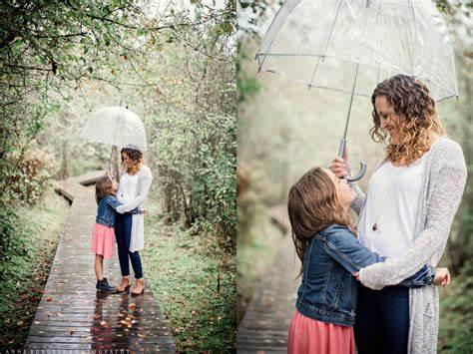
For the arms to be my shelter Through all the rain

Slide 36
For truth that will never change

Slide 37
For someone to lean on

Slide 38
For a heart I can rely on through anything

Slide 39
For that one who I can run to

Slide 40
For a shield from the storm

Slide 41
For a friend, for a love
To keep me safe and warm

Slide 42
I turn to you

Slide 43
For the strength to be strong

Slide 44
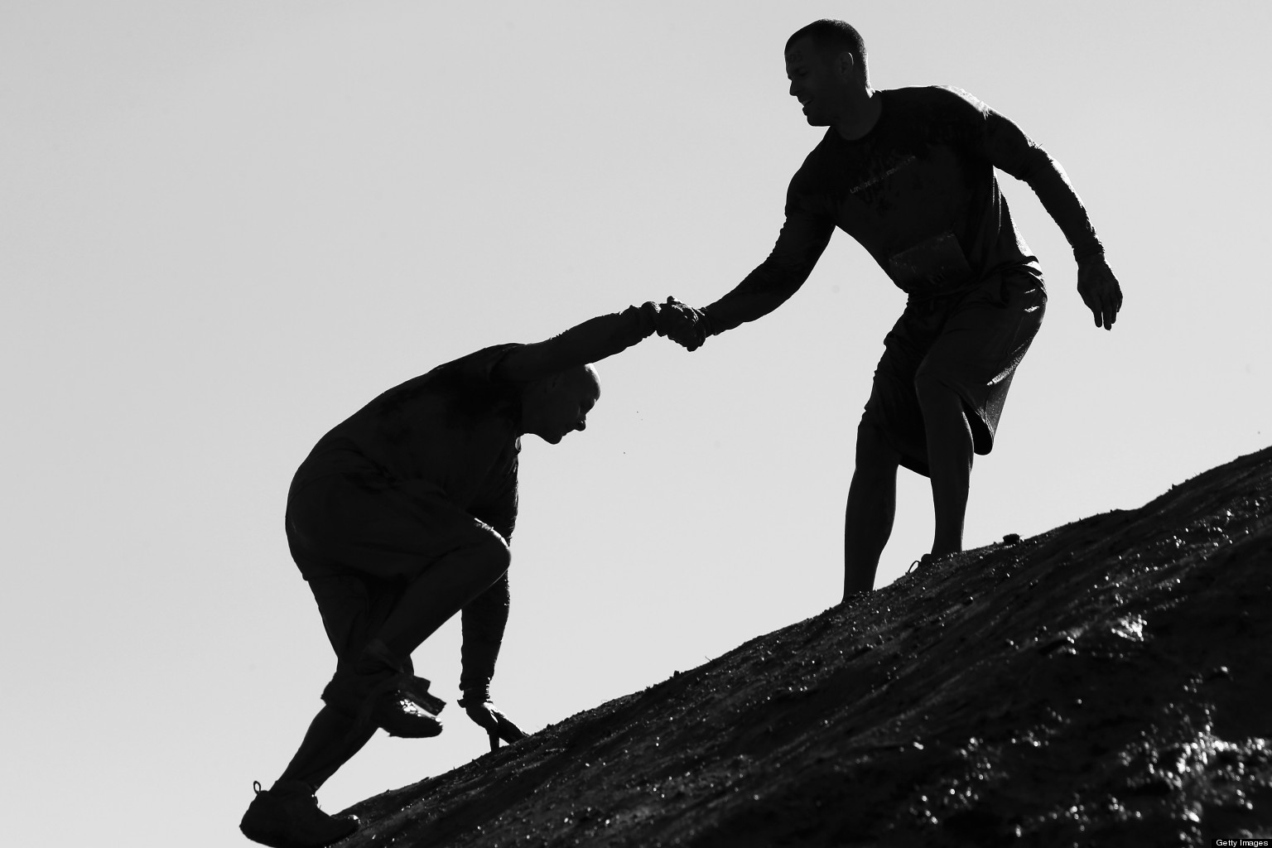
For the will to carry on

Slide 45
For everything you do

Slide 46
For everything that's true

Slide 47
For everything you do

Slide 48
For everything that's true

Slide 49
I turn to you

