Slide 1
Keep Holding On
——与keep有关的短语
设计制作：华南师范大学外国语言文化学院 张雪敏
广东省河源市田家炳实验中学 周惠瑞
指导老师：周惠瑞、刘晓斌

Slide 2
You're
not alone

Slide 3
Together we stand

Slide 4
I'll be
by your side

Slide 5
You know I'll take your hand

Slide 6
When it gets cold
And it feels like the end
There's no place to go

Slide 7
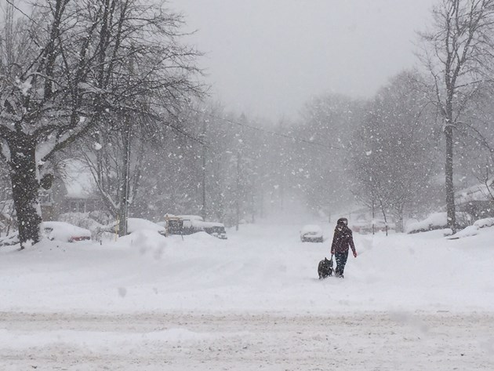
Keep holding on
No, I won't give in
You know I won't give in

Slide 8
We'll
make it through
Cause you know we'll make it through

Slide 9
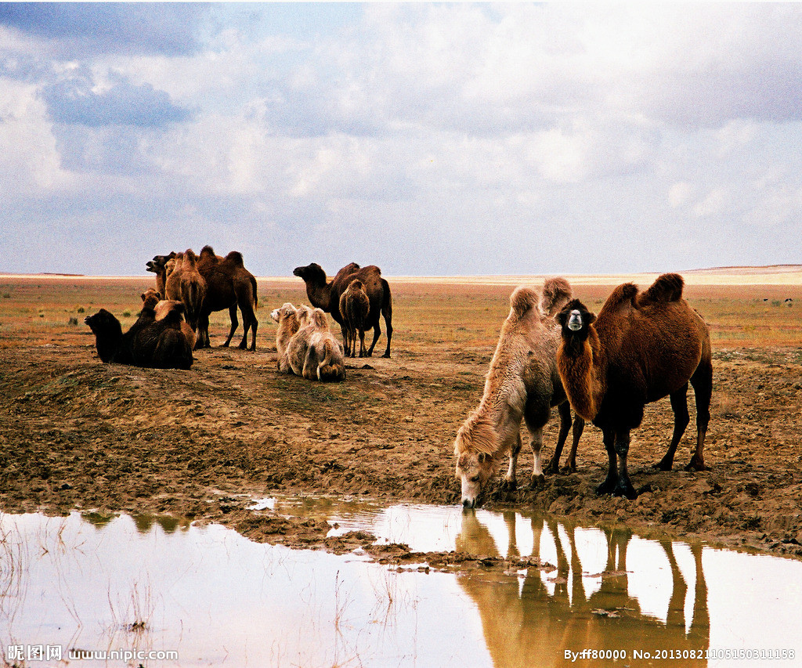
Just stay strong
I'm here for you
Cause you know
I'm here for you

Slide 10
There's nothing you can say
There's no other way
when it comes to the truth
Nothing you can do

Slide 11
So, keep holding on

Slide 12
Cause you know
we'll make it through
We'll
make it through

Slide 13
Before it's too late
This could all disappear
So far away
I wish you were here

Slide 14
And it comes to an end
Before the door's close

Slide 15
I will fight and defend
I'll fight and defend
With you by my side

Slide 16
Cause you know we'll make it through
Keep holding on
We'll make it through

Slide 17
Cause you know I'm here for you
I'm here for you
Just stay strong

Slide 18
There's no other way
when it comes to the truth
Nothing you can do
There's nothing you can say

Slide 19
So, keep holding on
Cause you know we'll make it through
We'll make it through

Slide 20
When I say I believe
Hear me when I say
Nothing's gonna change

Slide 21
Nothing's gonna change destiny

Slide 22
Whatever's meant to be
Will work out perfectly

Slide 24
Keep holding on
We'll make it through
Cause you know we'll make it through

Slide 25
Cause you know I'm here for you
I'm here for you
Just stay strong

Slide 26
There's no other way
when it comes to the truth
Nothing you can do
There's nothing you can say

Slide 27
Cause you know we'll make it through
We'll make it through
So, keep holding on

Slide 28
Keep holding on

Slide 29
Thanks For Watching!

