Slide 1
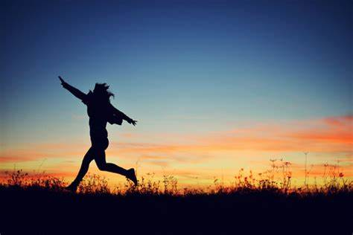
Dream It Possible
——与take有关的短语
华南师范大学外国语言文化学院 陈珺怡
广东省河源市第二中学 朱丽娟
I will run, I will climb, I will soar
I'm undefeated

Slide 2
Jumping out of my skin, pull the chord
Yeah I believe it

Slide 3
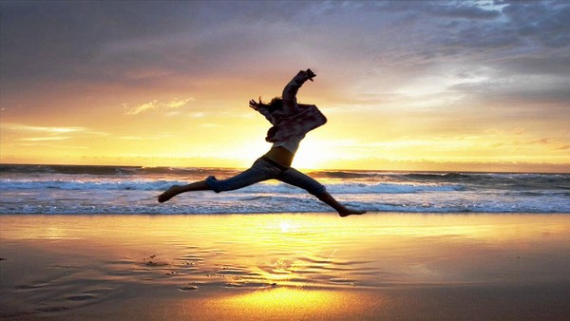
The past is everything we were
Don't make us who we are

Slide 4
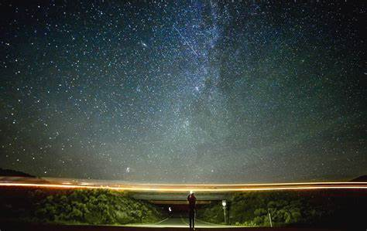
So I'll dream until I make it real
and all I see is stars

Slide 5
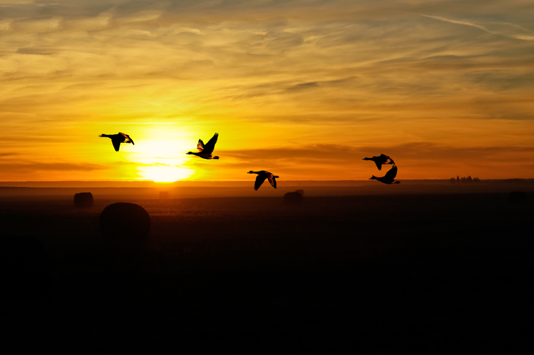
Its not until you fall that you fly

Slide 6
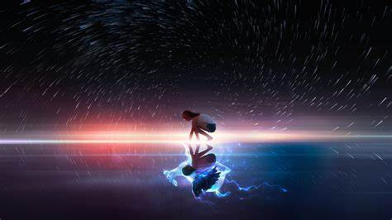
When your dreams come alive
you're unstoppable

Slide 7
Take a shot, chase the sun, find the beautiful

Slide 8
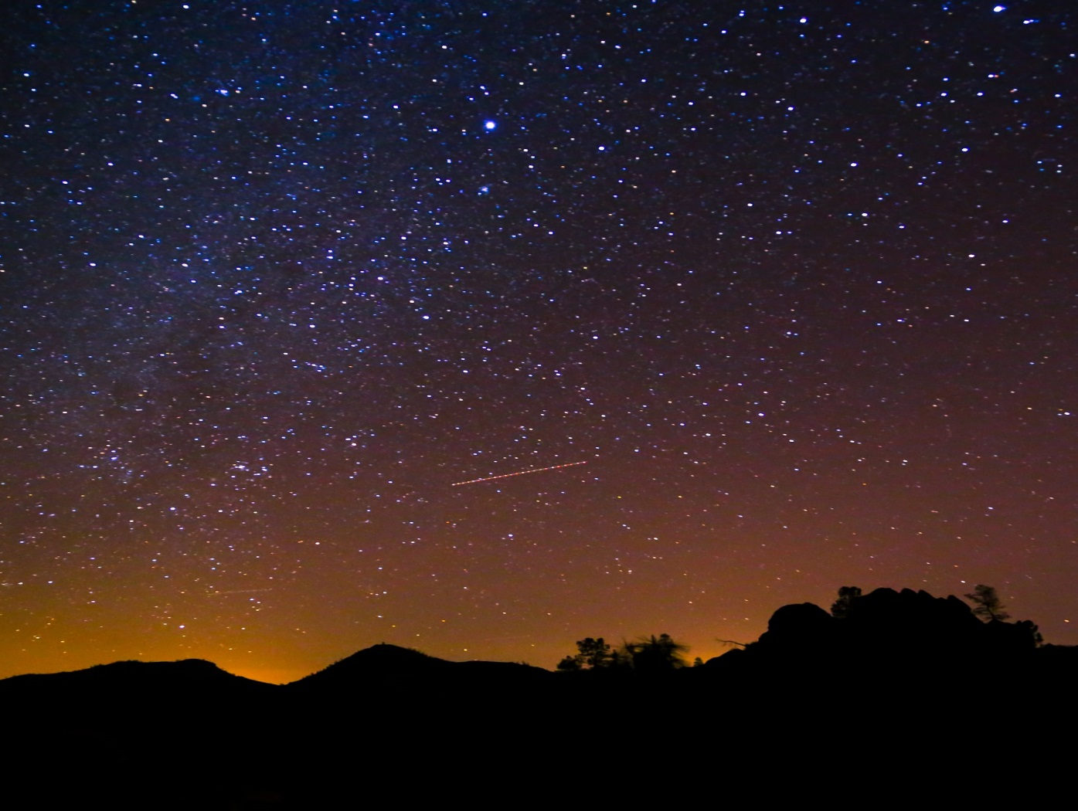
We will glow in the dark turning dust to gold

Slide 9
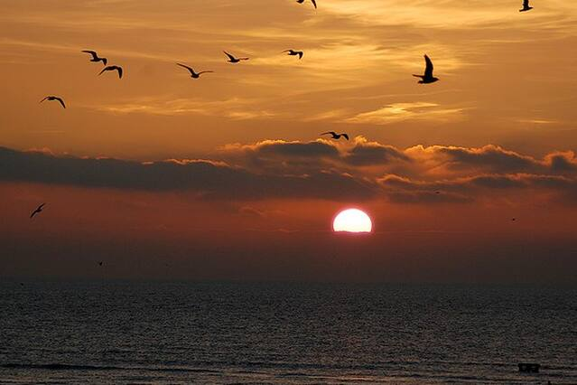
And we'll dream it possible
possible, and we'll dream it possible

Slide 10
I will chase, I will reach, I will fly
until I'm breaking, until I'm breaking

Slide 11
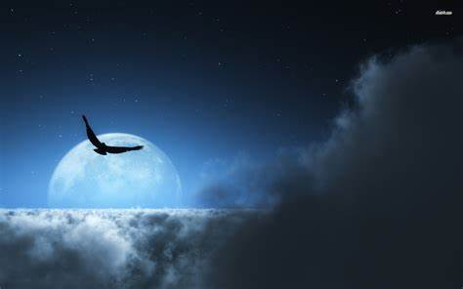
Out of my cage like a bird in the night

Slide 12
I know I'm changing, I know I'm changing
in into something big better than before

Slide 13
And if it takes, takes a thousand lives
then It's worth fighting for

Slide 14
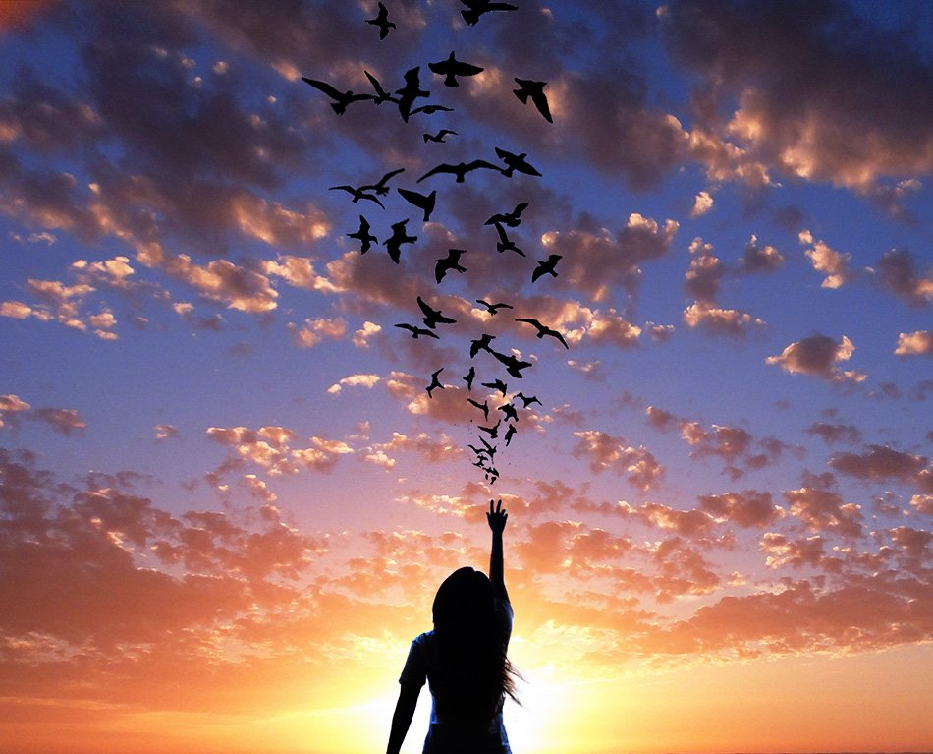
Its not until you fall that you fly

Slide 15
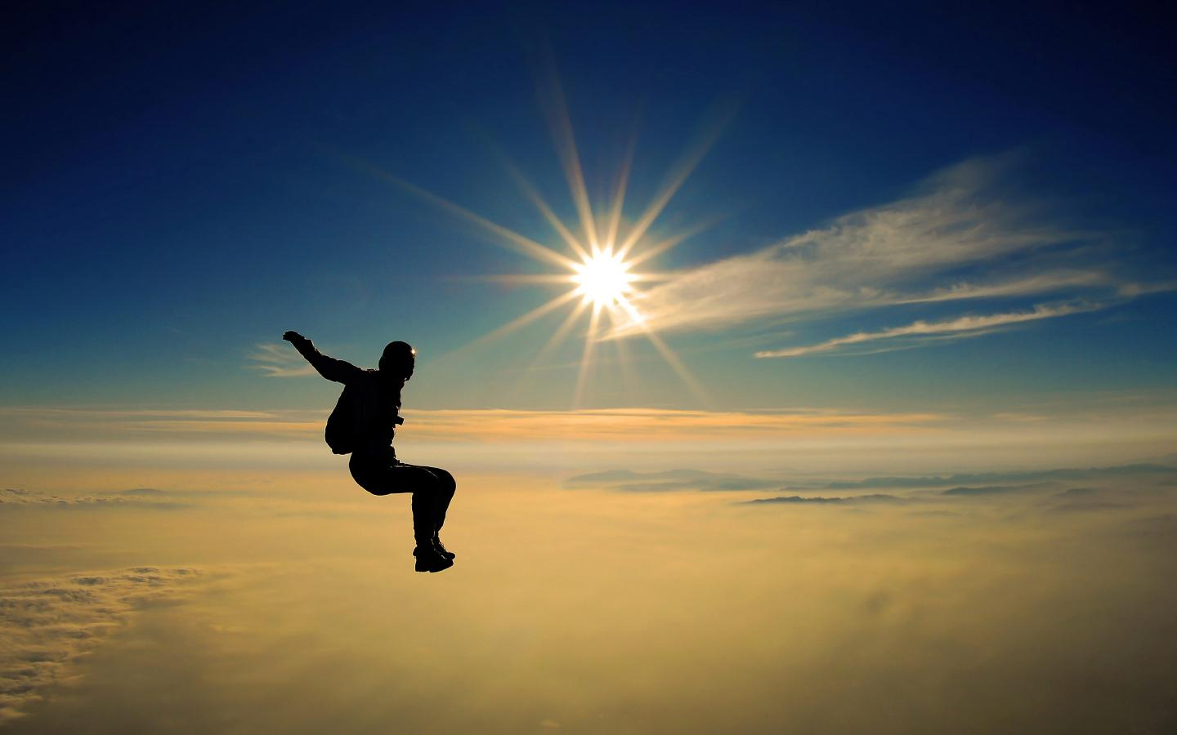
When your dreams come alive
you're unstoppable

Slide 16
Take a shot, chase the sun, find the beautiful

Slide 17
We will glow in the dark turning dust to gold

Slide 18
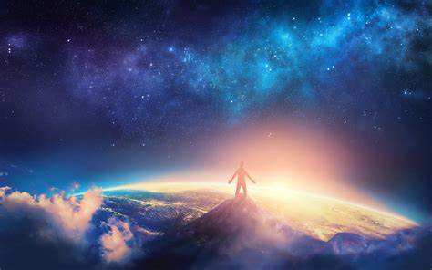
And we'll dream it possible

Slide 19
Possible…

Slide 20
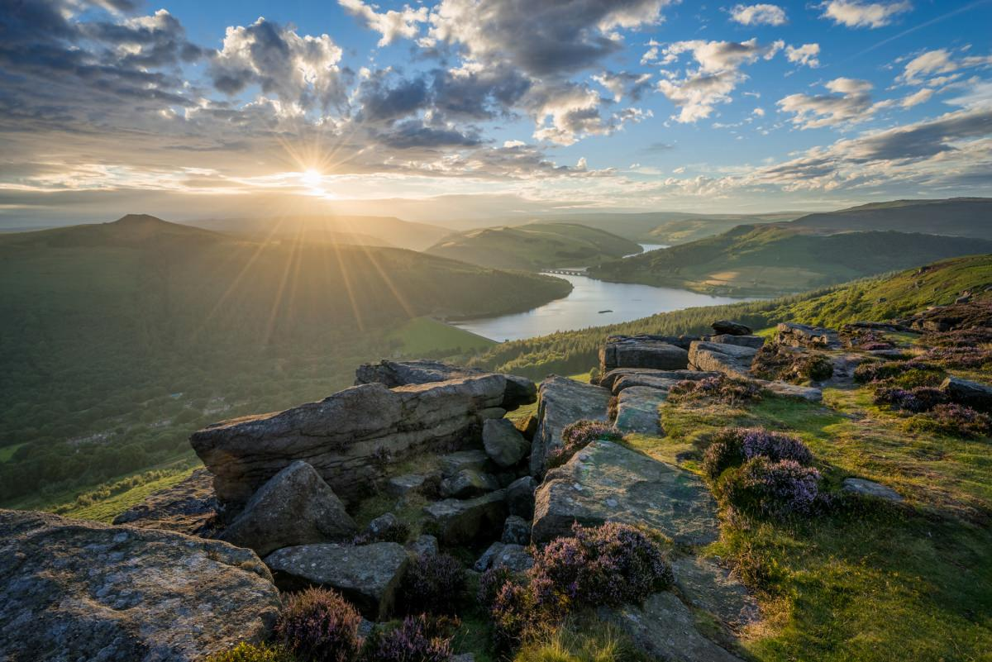
From the bottom to the top
we're sparking wild fire's

Slide 21
Never quit and never stop
the rest of our lives

Slide 22
From the bottom to the top
we're sparking wild fire's

Slide 23
Never quit and never stop

Slide 24
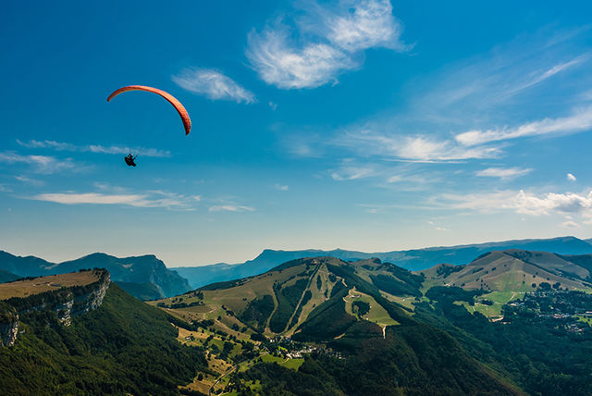
Its not until you fall that you fly

Slide 25
When your dreams come alive
you're unstoppable

Slide 26
Take a shot, chase the sun, find the beautiful

Slide 27
We will glow in the dark turning dust to gold

Slide 28
And we'll dream it possible

Slide 29
Possible…

Slide 30
And we'll dream it possible

