Slide 1
A LITTLE LOVE
与make有关的短语
华南师范大学外国语言文化学院 李剑琴
广东省河源市第二中学 翟玉凤

Slide 2
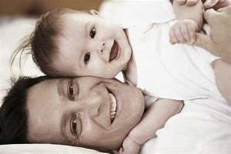
greatness as you
smallest as me
you show me
what is deep as sea

Slide 3
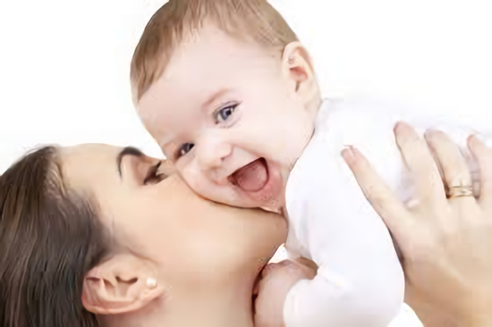
a little love little kiss a little hug little gift

Slide 4
all of little something
these are our memories

Slide 5
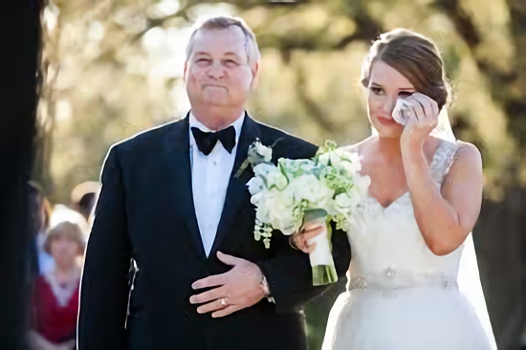
you make me cry
make me smile
make me feel that love is true

Slide 6
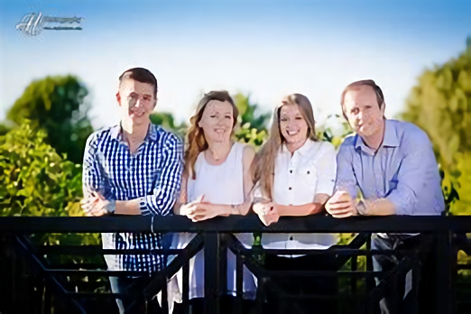
you always stand by my side
i don’t want to say goodbye

Slide 7
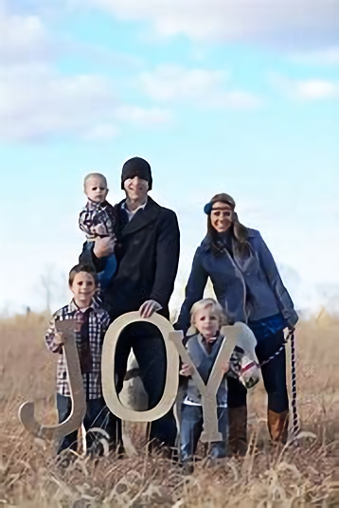
you make me cry
make me smile
make me feel
the joy of love
oh kissing you

Slide 8
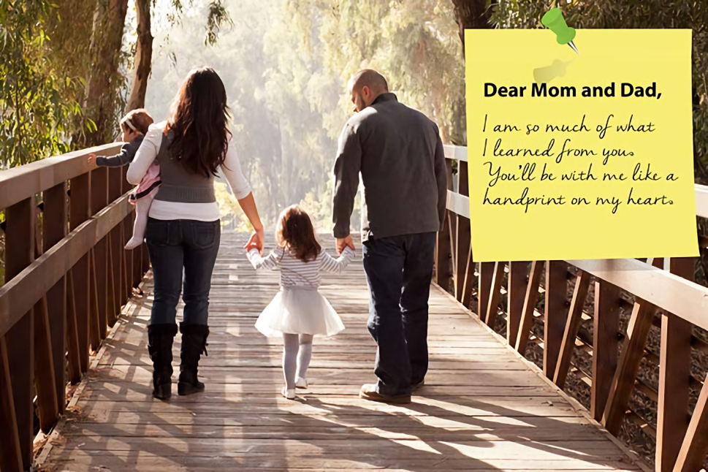
thank you for all the love
you always give to me
oh i love you

Slide 9
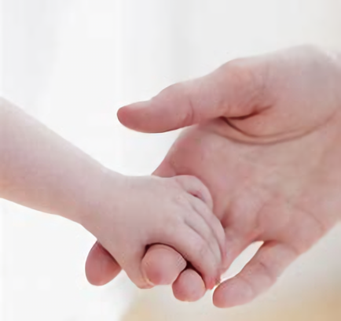
greatness as you smallest as me

Slide 10
you show me
what is deep as sea

Slide 11
a little love little kiss a little hug little gift

Slide 12
all of little something
these are our memories

Slide 13
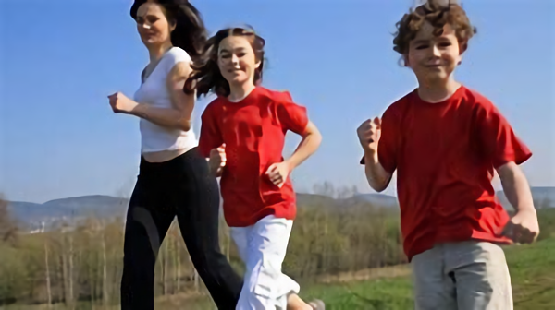
you make me cry
make me smile
make me feel that love is true

Slide 14
you always stand by my side
i don’t want to say goodbye

Slide 15
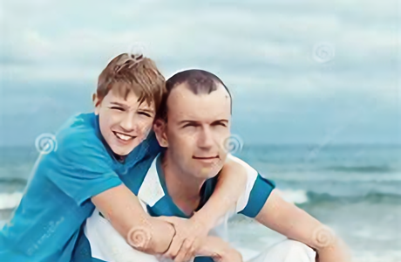
you make me cry
make me smile
make me feel
the joy of love
oh kissing you

Slide 16
thank you for all the love
you always give to me
oh i love you

Slide 17
yes i do
i always do

Slide 18
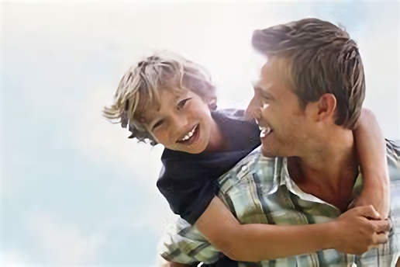
make me cry
make me smile
make me feel that love is true

Slide 19
you always stand by my side
i don’t want to say goodbye

Slide 20
you make me cry
make me smile
make me feel
the joy of love
oh kissing you

Slide 21
thank you for all the love
you always give to me
oh i love you

Slide 22
to be with you
oh i love you

