Slide 1
Song: Put Your Hearts Up
语法：phrases about “put”
Editor: 华南师范大学外国语言文化学院 叶家敏
广东省河源市第二中学 郭辉兵

Slide 2
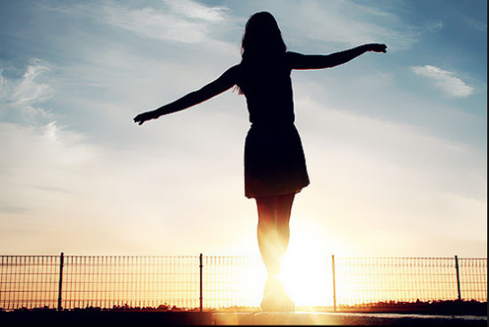
Let me see you put your hearts up, yeah

Slide 3
If we give a little love,
maybe
we can change the world,

Slide 4
You think you're so small, like you're itty bitty,

Slide 5
Just one match in the lights of the city

Slide 6
Walking by strangers on the side of the street

Slide 7
Like a quarter in a cup'll get 'em off on their feet like

Slide 8
You think you're never gonna make your mark

Slide 9
Sit back and watch the world while it falls apart like,

Slide 10
Out of sight,
out of mind like,

Slide 11
It's just a waste of time,
like, like, like

Slide 12
Hey yeah yeah yeah

Slide 13
If we give a little love,

Slide 14
Maybe we can change the world

Slide 15
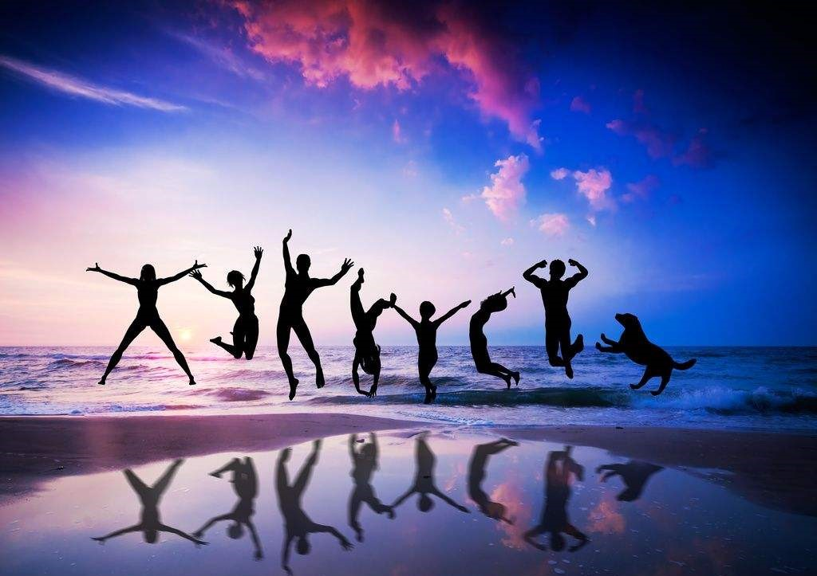
I said,
I said
Hey yeah yeah yeah yeah,

Slide 16
Sing it if you're with me
all you boys and all you girls.

Slide 17
Let me see you put your hearts up, yeah,

Slide 18
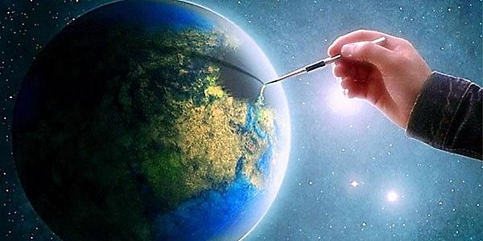
If we give a little love
maybe we can change the world

Slide 19
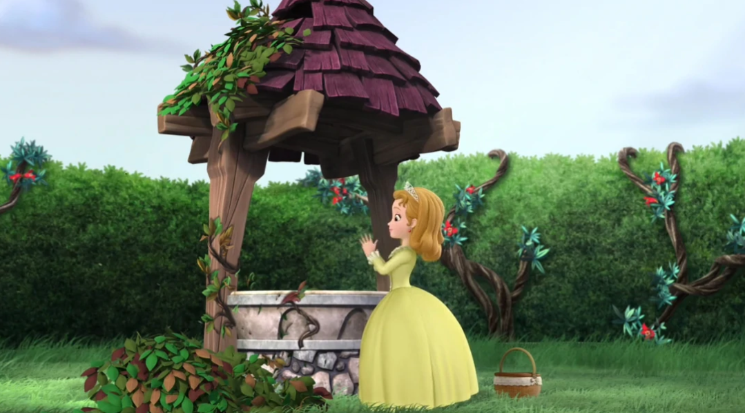
wishing well
Wish in a well

Slide 20
shooting star in the sky

Slide 21
We can do anything if we try

Slide 22
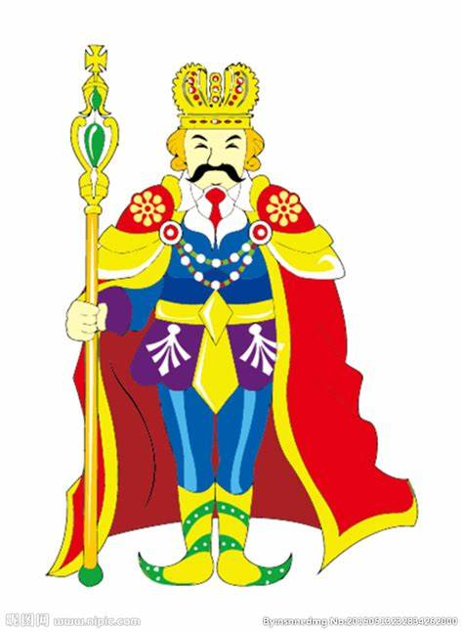
Can't resurrect Ghandi
resurrect king

Slide 23
But if we put our heads together
We can do anything like

Slide 24
You don't have to be a billionaire

Slide 25
You don't have to have much to show how much care

Slide 26
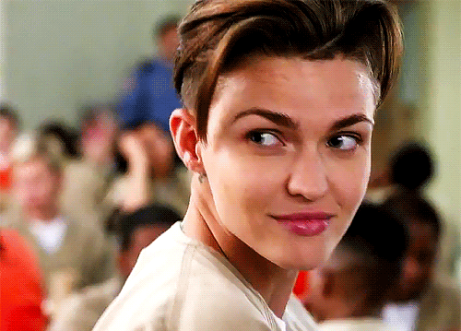
Give a wink, give a kiss, like,

Slide 27
Like give a little happiness
Like, like, like

Slide 28
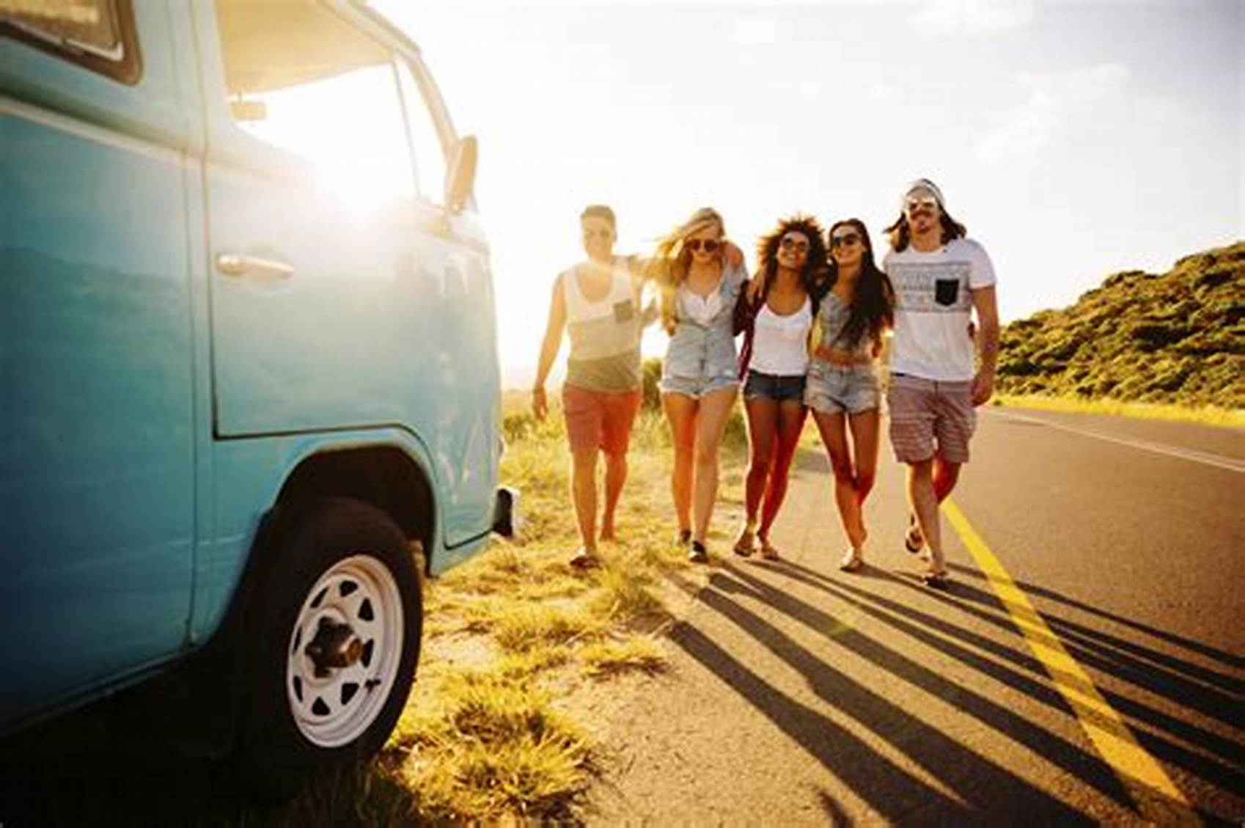
Hey yeah yeah yeah yeah

Slide 29
If we give a little love,
maybe we can change the world,

Slide 30
I said,
Hey yeah yeah yeah yeah,
I said

Slide 31
Sing it if you're with me
all you boys and all you girls.

Slide 32
Let me see you put your hearts up, yeah

Slide 33
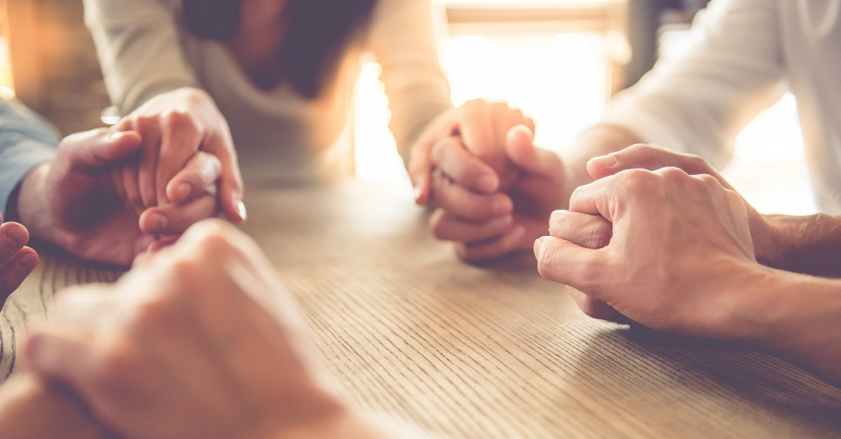
If we give a little love,

Slide 34
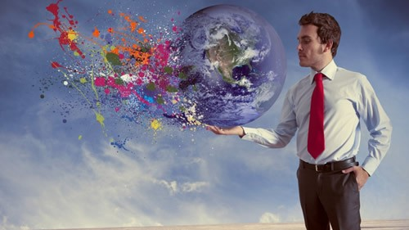
Maybe we can change the world

Slide 35
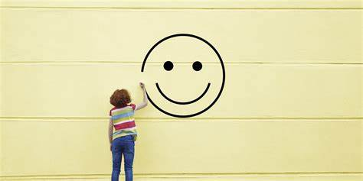
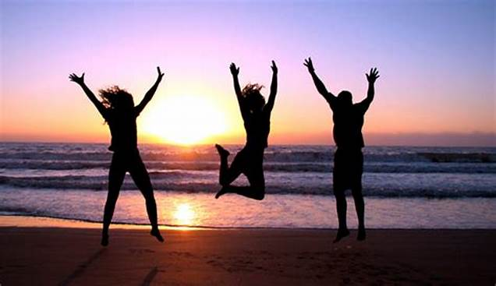
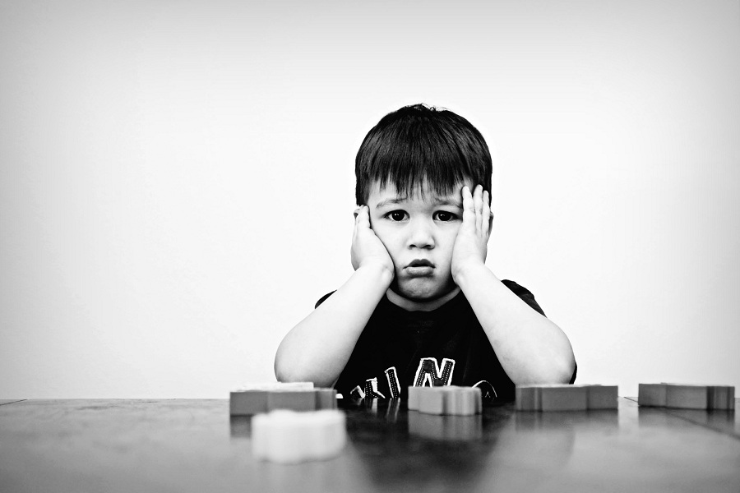
Don't let them bring you down now, down-now,

Slide 36
Ain't got nothing but love now, love now

Slide 37
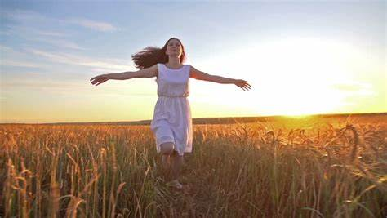
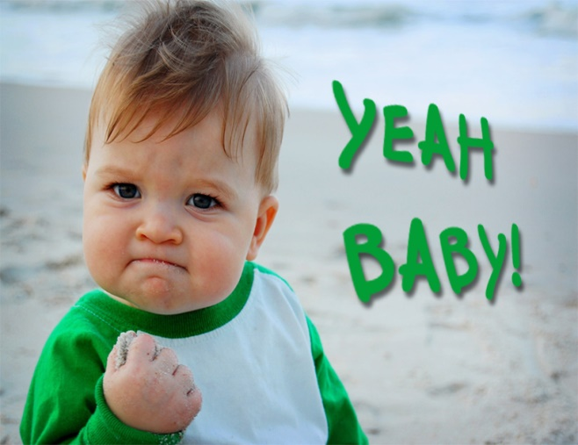
Don't let them bring you down now, down-now,

Slide 38
Ain't got nothing but love now, love now

Slide 39
Hey yeah yeah yeah

Slide 40
If we give a little love,

Slide 41
Maybe we can change the world

Slide 42
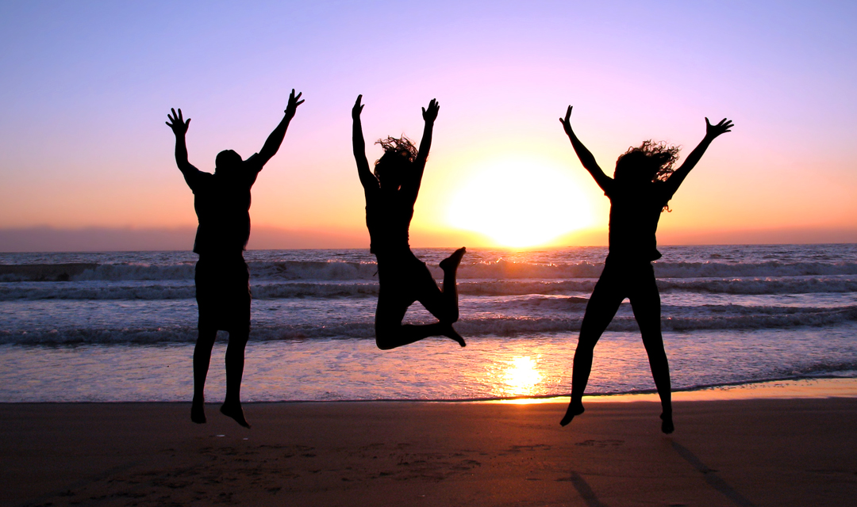
I said
I said,
Hey yeah yeah yeah yeah,

Slide 43
Sing it if you're with me
all you boys and all you girls.

Slide 44
Let me see you put your hearts up, yeah

Slide 45
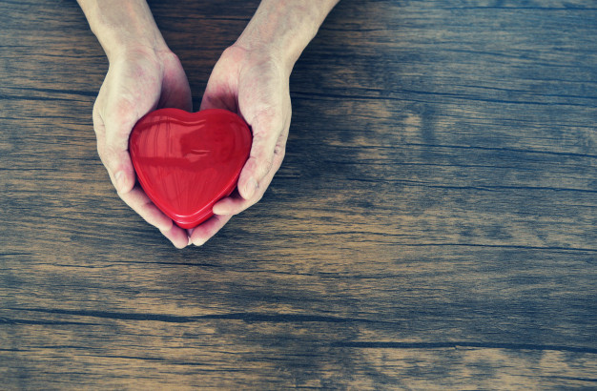
If we give a little love,

Slide 46
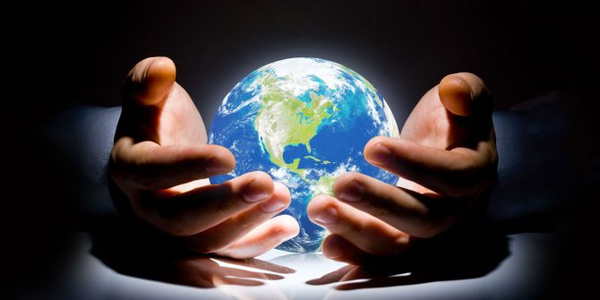
Maybe we can change the world

Slide 47
Let me see you put your hearts up, yeah

Slide 48
If we give a little love,
maybe
we can change the world,

Slide 49
Hey yeah yeah yeah

Slide 50
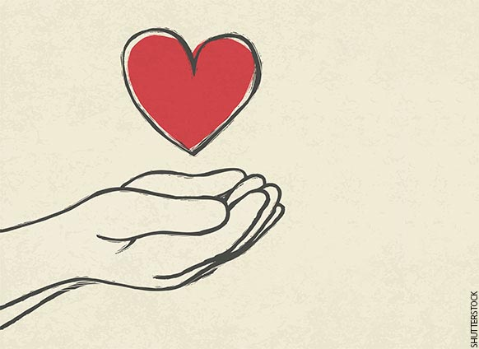
Thank you

