Slide 1
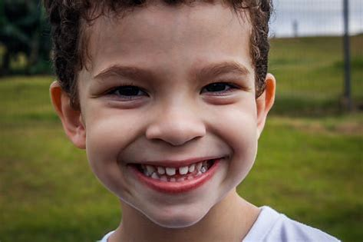
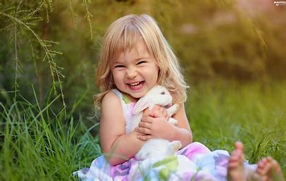
The Happy Song
---go on
华南师范大学外国语言文化学院 李敏怡
广东省河源市第一中学 欧丽敏

Slide 2
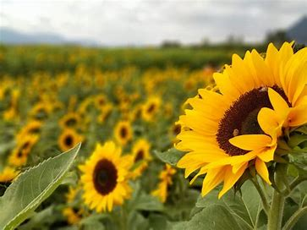
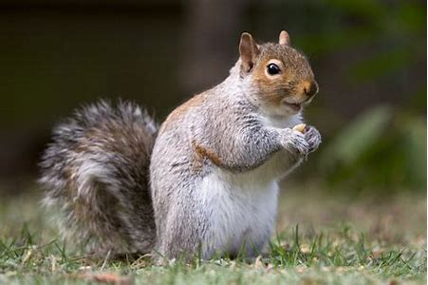
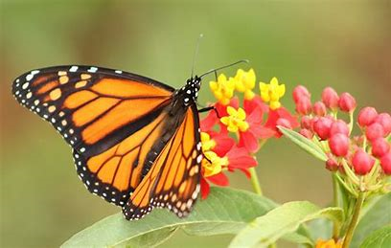
There’re so many things that make me happy
I could go on and on

Slide 3
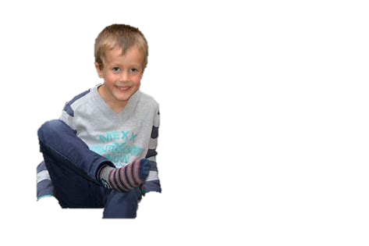
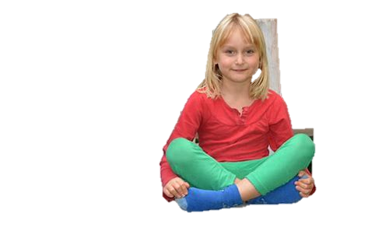
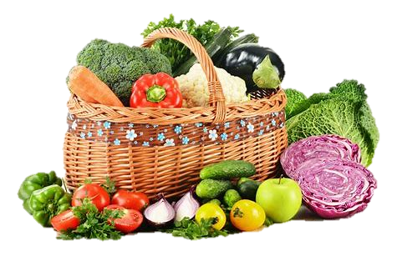
radishes cabbages holding hands
and getting packages for my friend John

Slide 4
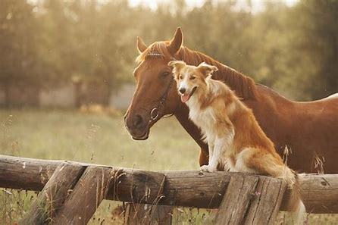
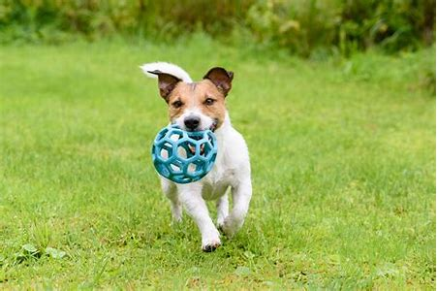
horses birthdays popsicles
and watching my dog play on the lawn

Slide 5
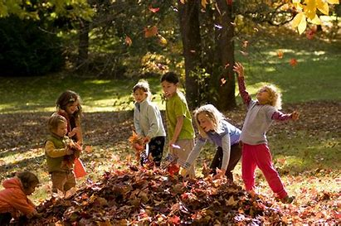
there’re so many things that make me happy
I could go on and on

Slide 6
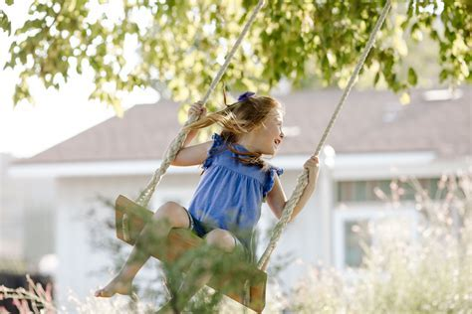
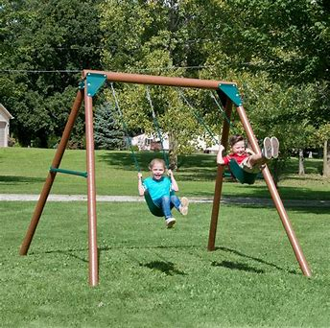
strawberries bare-feet swing sets
watching my baby brother young

Slide 7
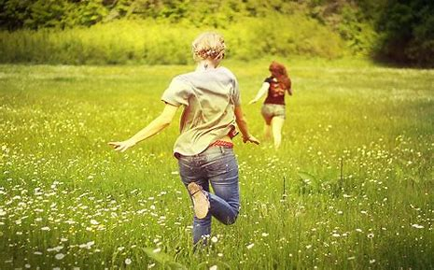
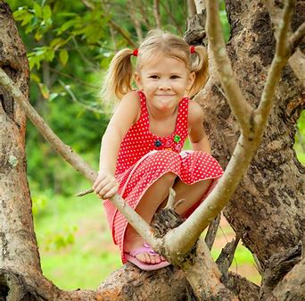
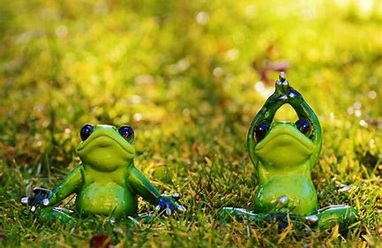
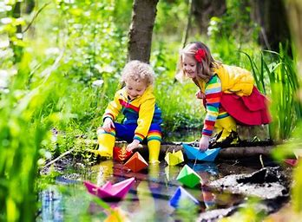
butterflies pretty boats rainbows
climbing trees are not skin in my knees
There’re so many things that make me happy
I could go on and on
and frog sitting on the lawn
girls cheese me by Uncle Don

Slide 8
when I'm feeling frustrated
mad and just a little bit sad
I can think of my list of happy
and then I get so very glad

Slide 9
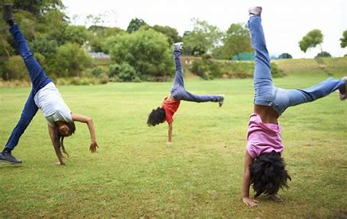
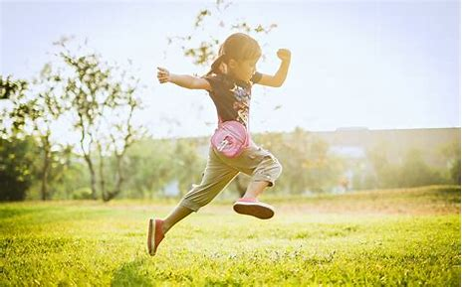
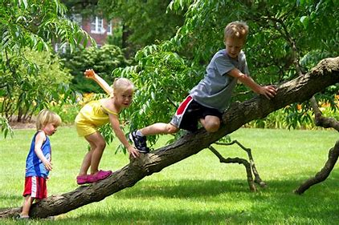
There’re so many things that make me happy
the list goes on and on

Slide 10
and now I wanna know what makes you happy
I bet your list is just as long

Slide 11
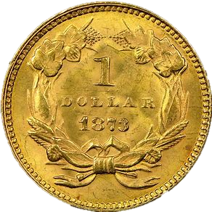
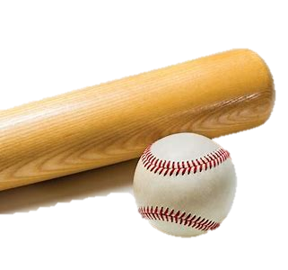
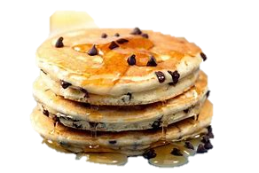
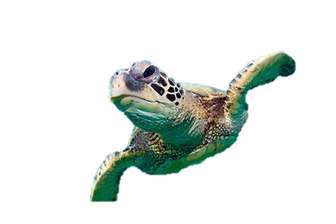
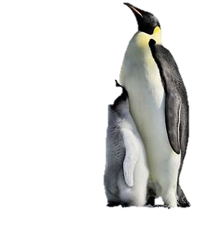
popcorn
cartwheels
baseball
pancakes
turtles
penguin

Slide 12
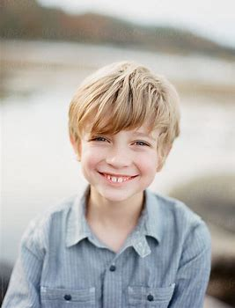
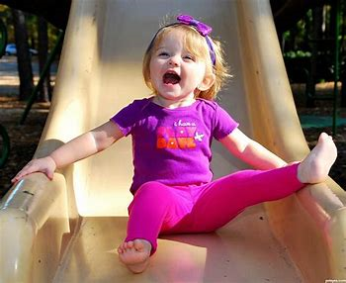
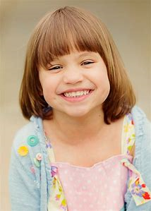
there’re so many things that make me happy
the list goes on and on
so many things that make me happy
I could go on and on

Slide 13
so many things that make me happy
I could go on and on
so many things that make me happy
I could go on and on
I could go on and on
Thanks

