Slide 1
I won't
give up
Give up
华南师范大学
外国语言文化学院
黄苑琳
广东省河源市
正德中学
何灿娟
Give up on sb.
Give sb. sth.

Slide 2
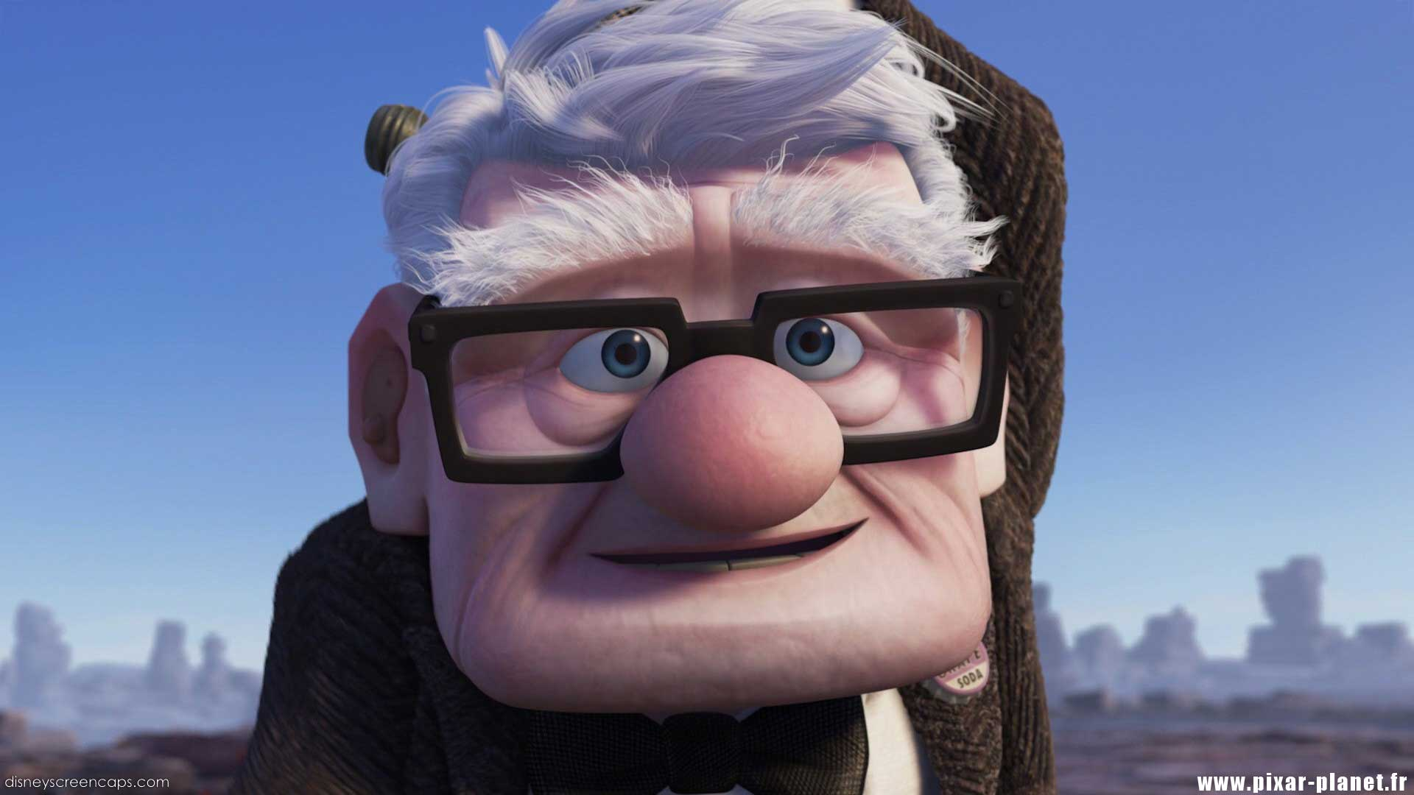
04
When I look into your eyes

Slide 3
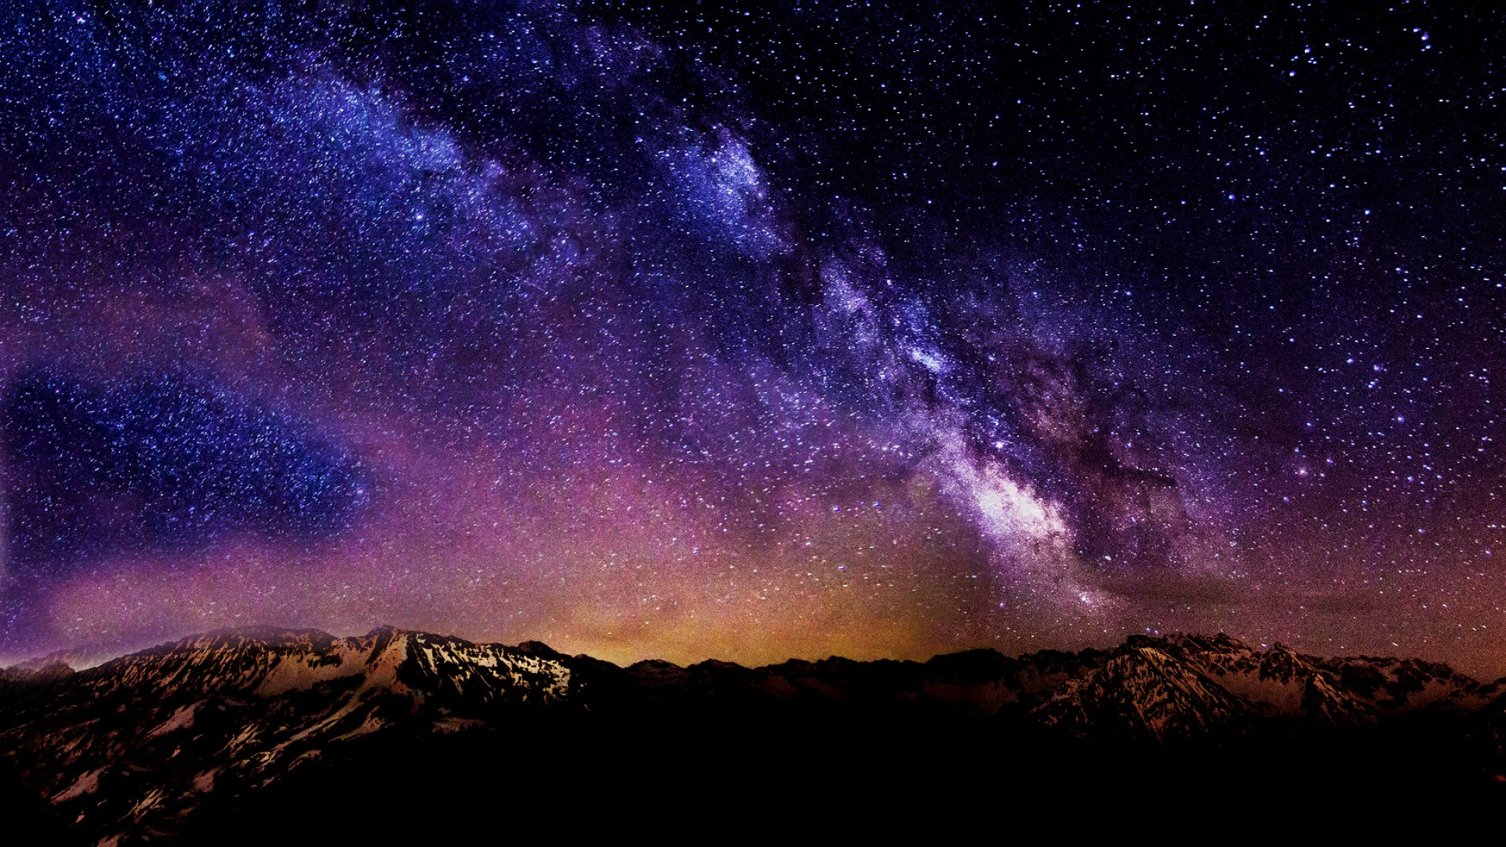
04
It's like watching the night sky

Slide 4
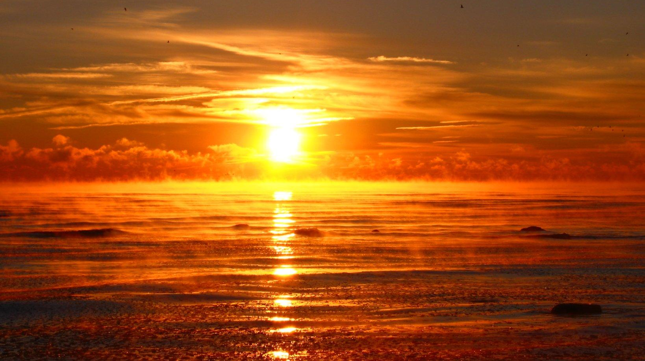
04
Or a beautiful sunrise

Slide 5
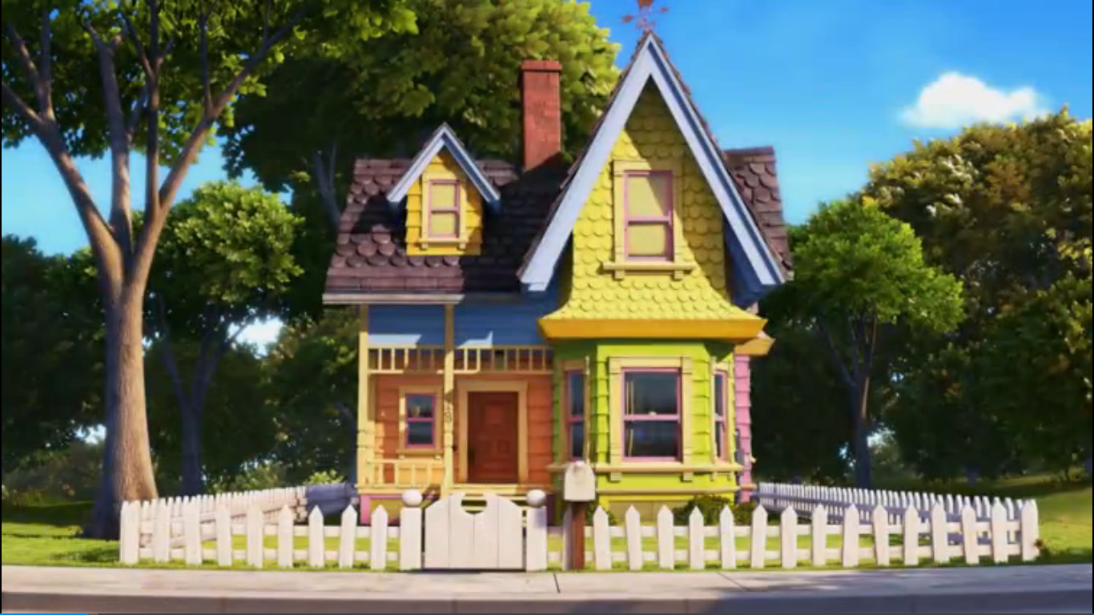
04
There's so much they hold

Slide 6
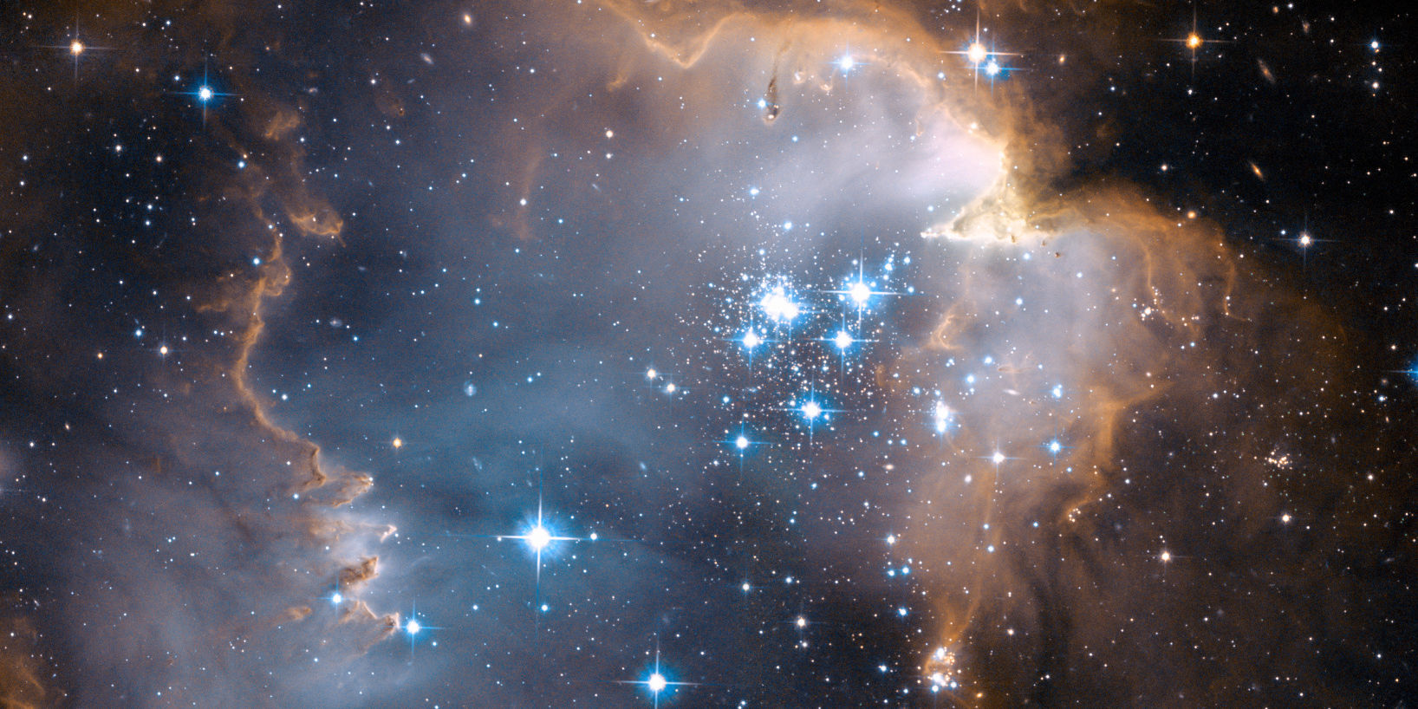
04
And just like them old stars

Slide 7
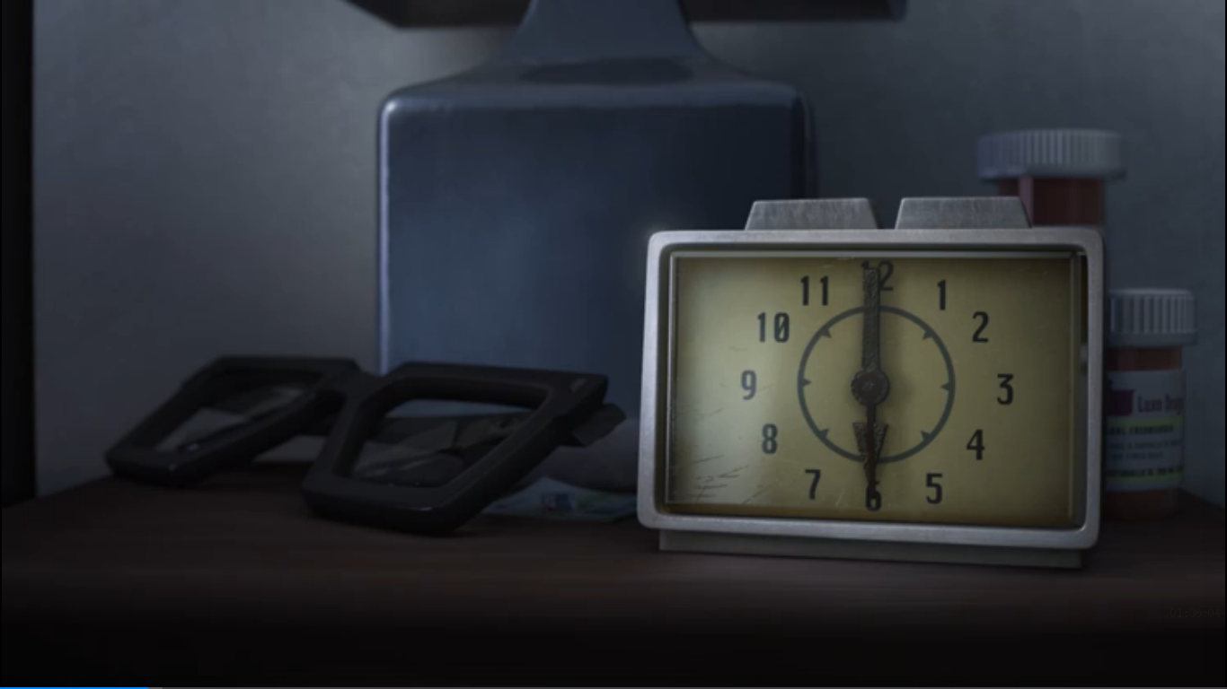
04
I see that you've come so far

Slide 8
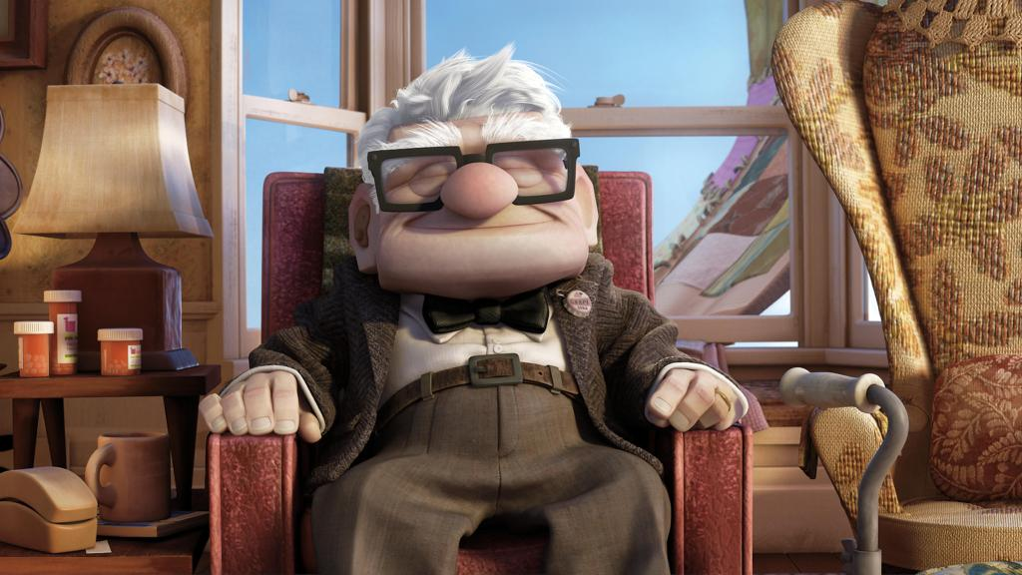
04
To be right where you are
How old is your soul?

Slide 9
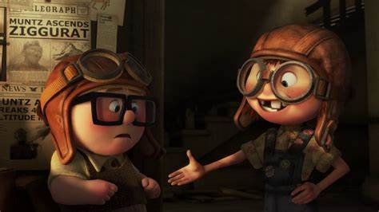
I won't give up on us

Slide 10
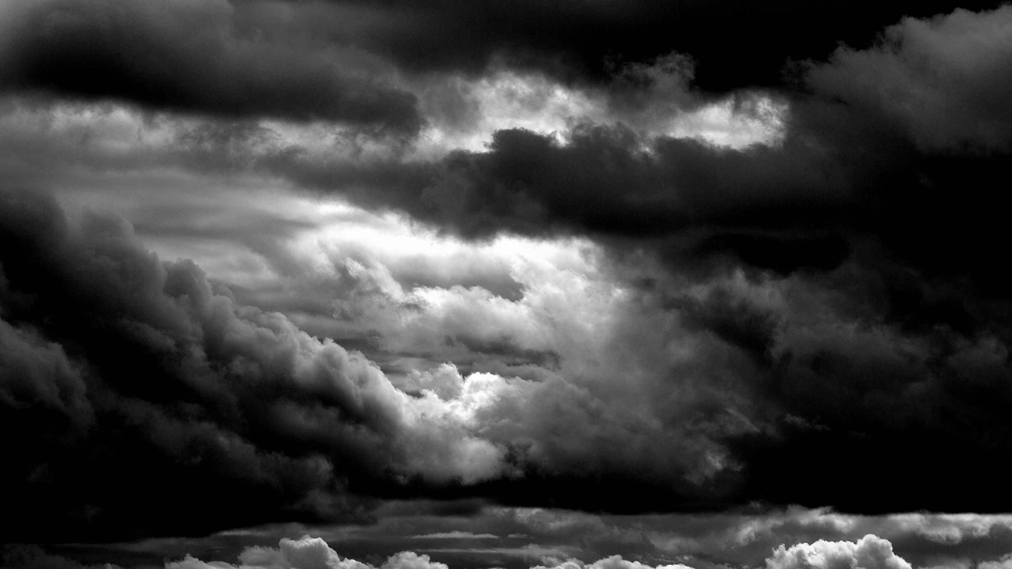
Even if the skies get rough

Slide 11
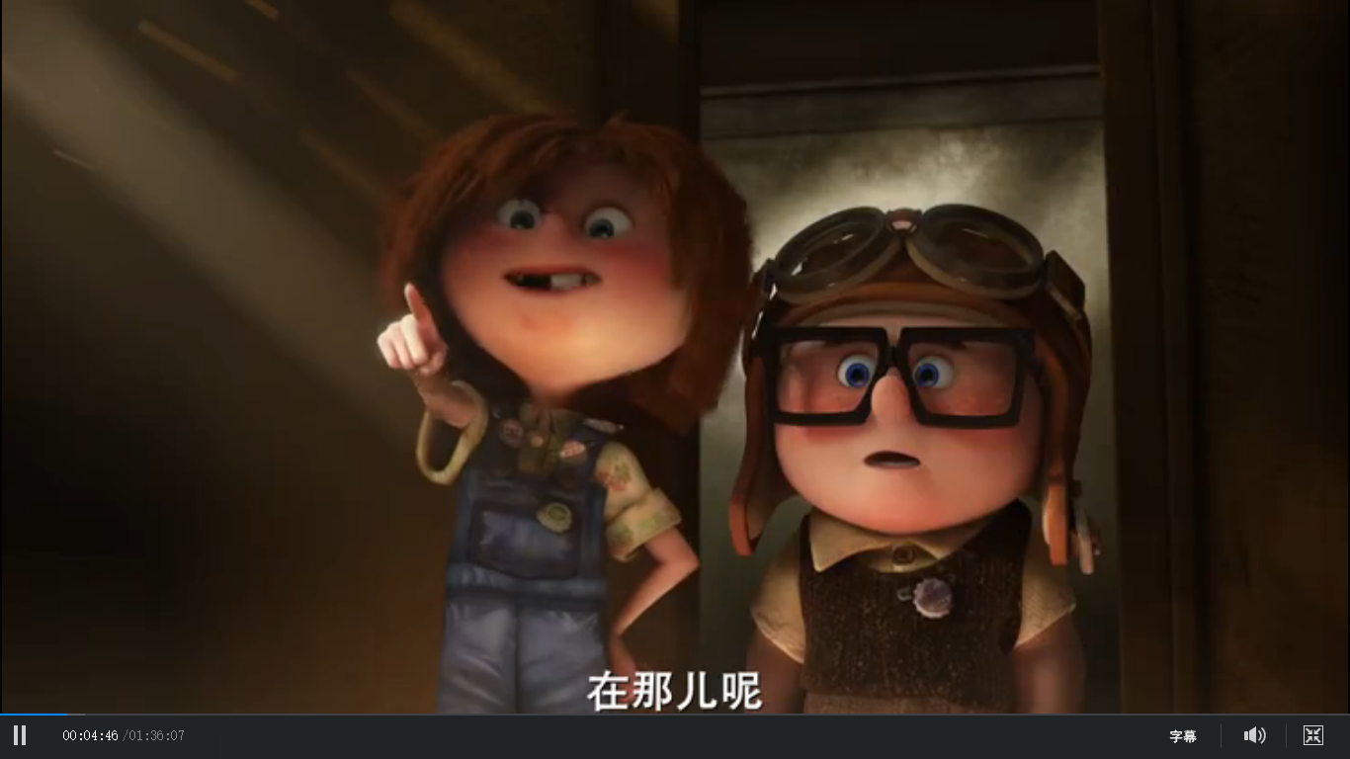
I'm giving you all my love

Slide 12
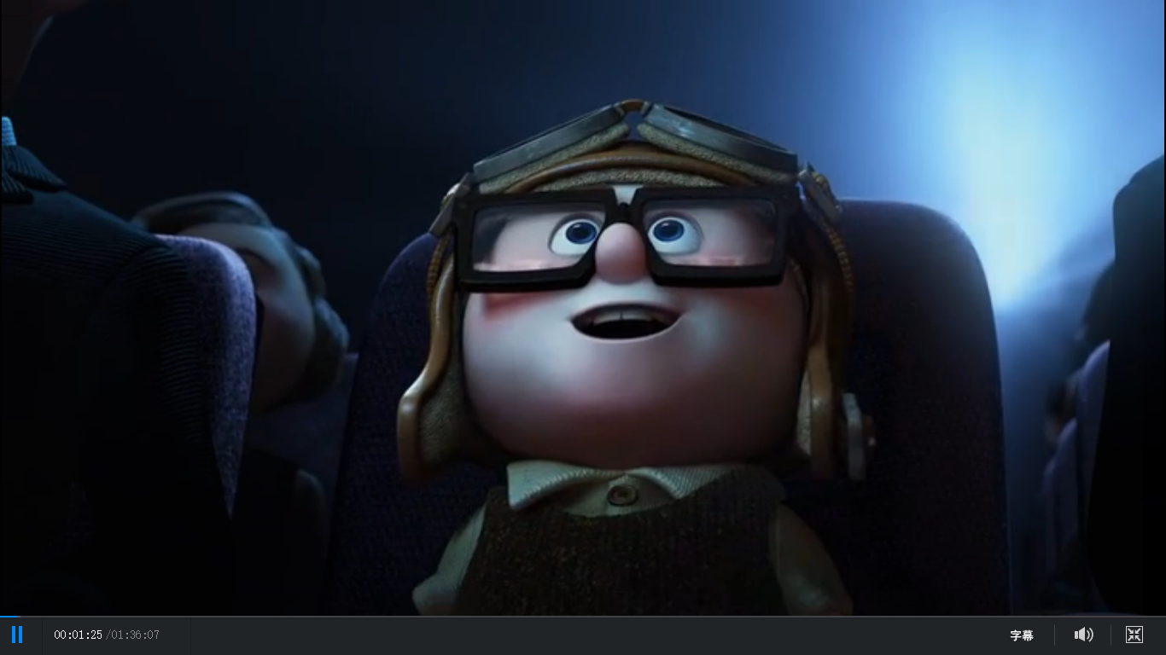
I'm still looking up

Slide 13
04
And when you're needing your space
To do some navigating

Slide 14
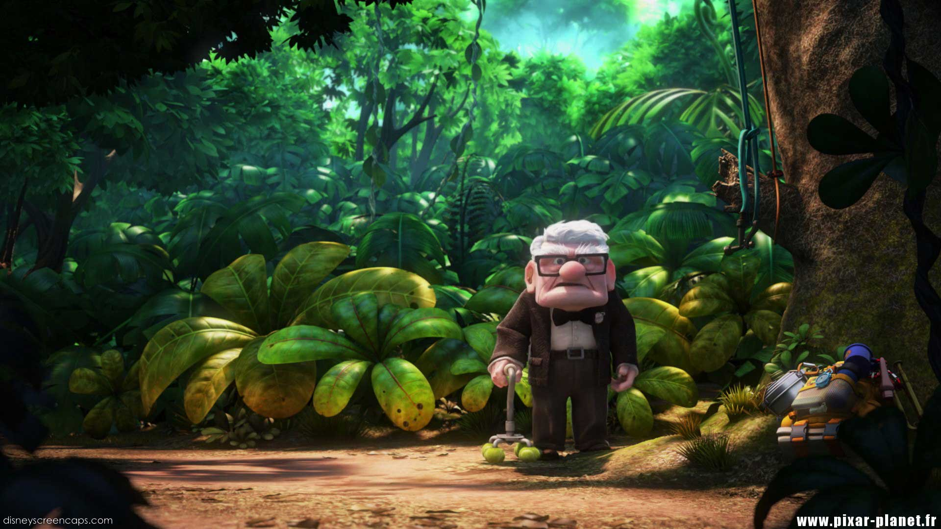
04
I'll be here patiently waiting

Slide 15
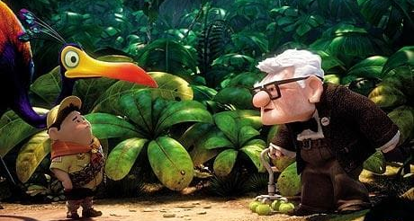
04
To see what you find

Slide 16
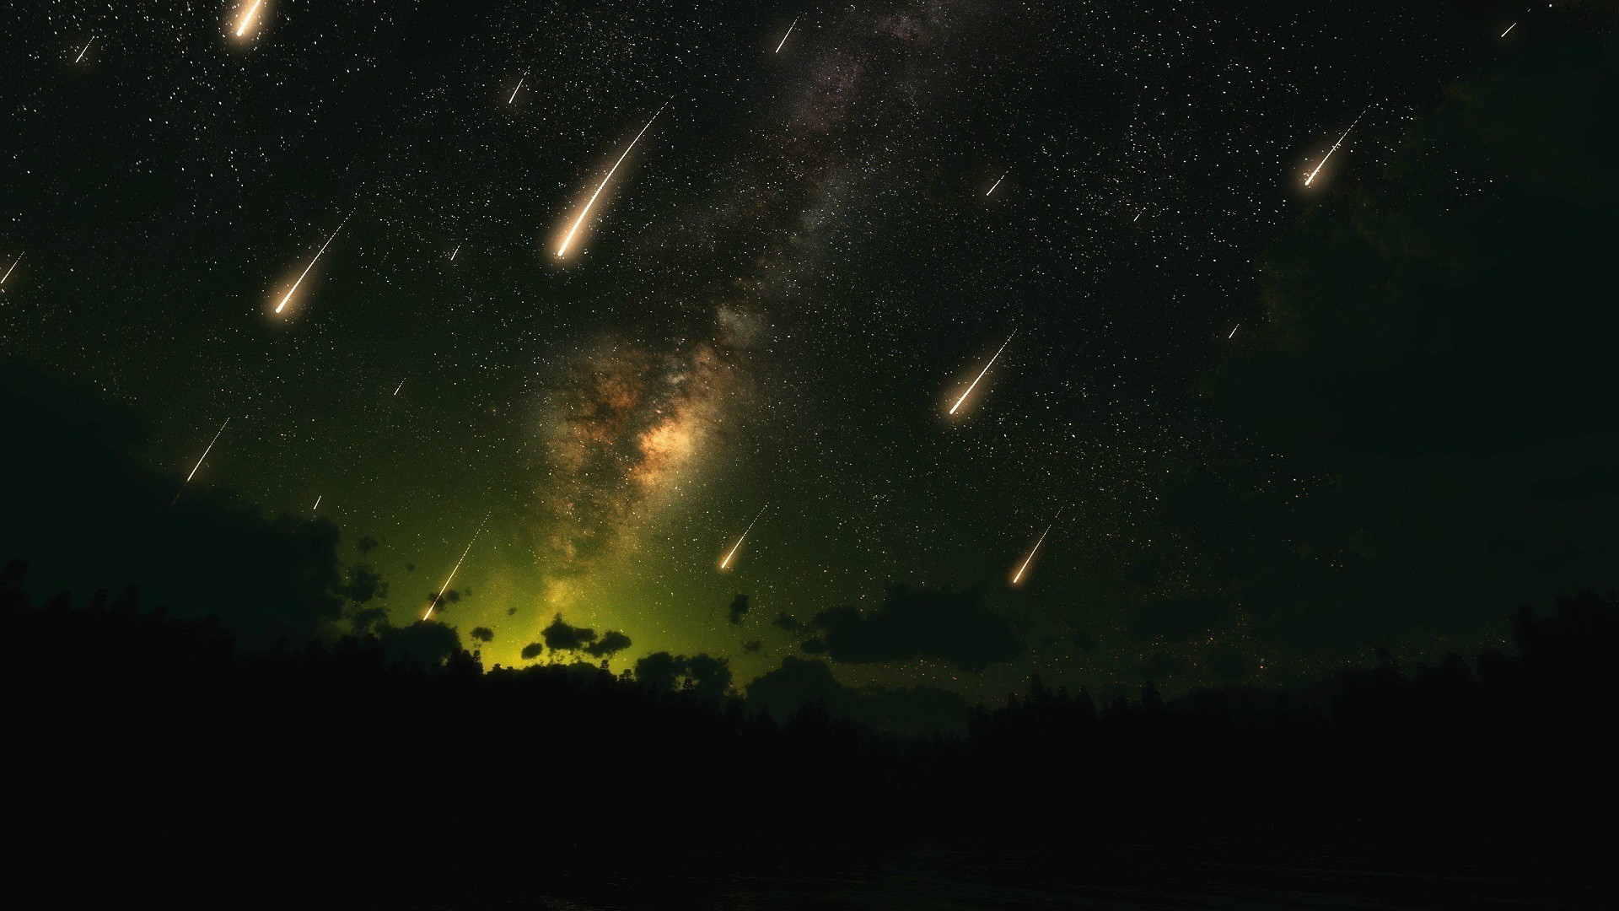
04
Cause even the stars they burn
Some even fall to the earth

Slide 17
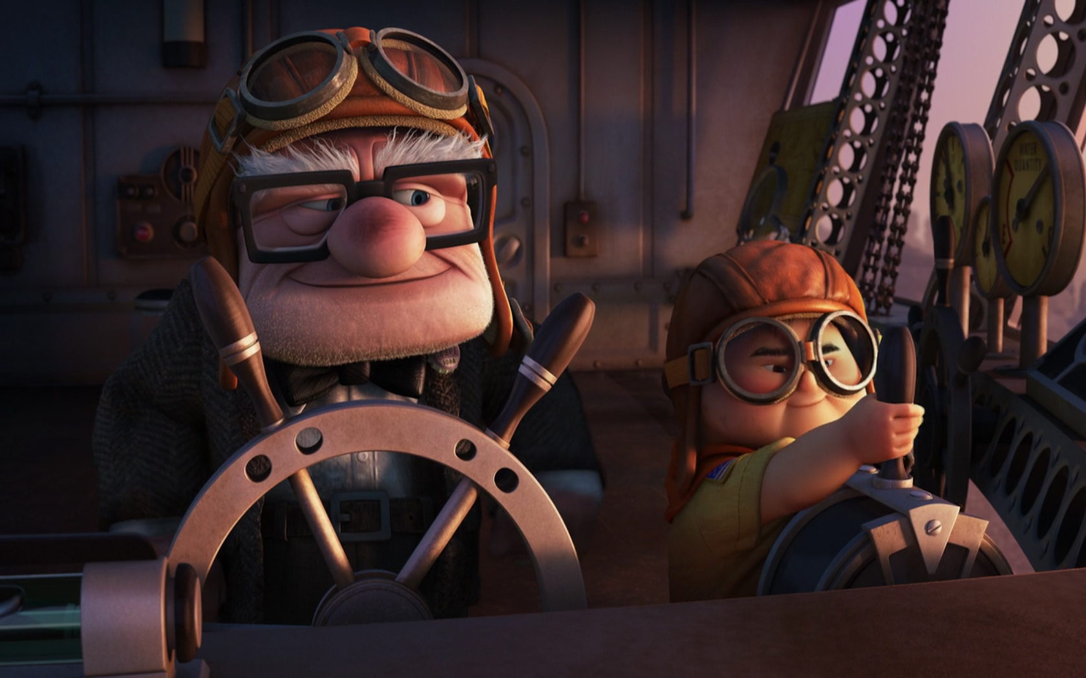
04
God knows we're worth it
We've got a lot to learn

Slide 18
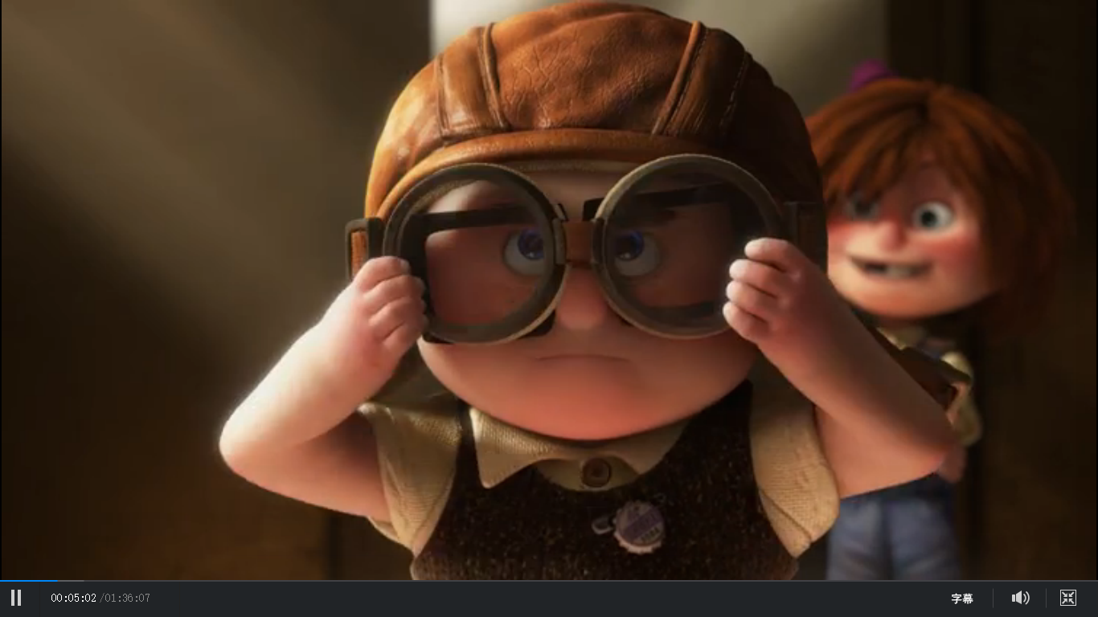
No, I won't give up

Slide 19
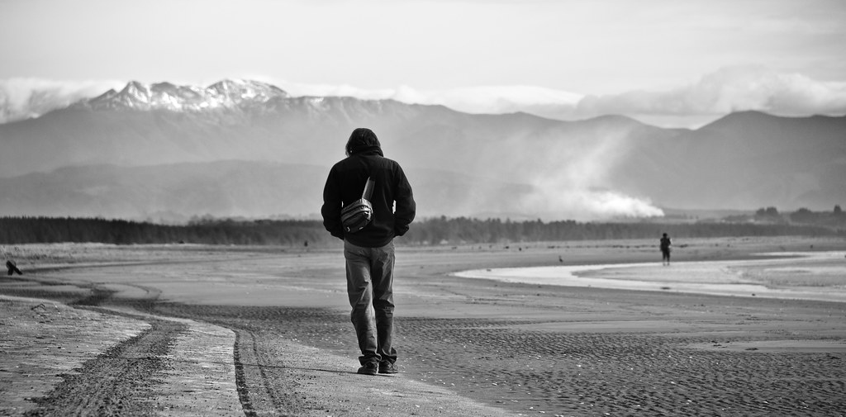
I don't wanna be someone
who walks away so easily

Slide 20
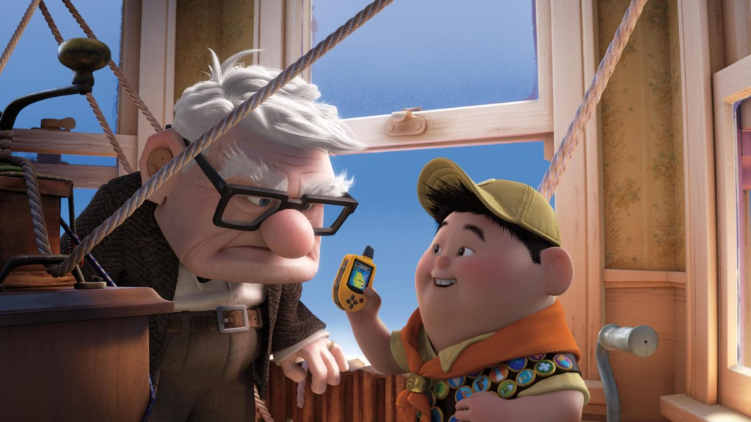
I'm here to stay and
make the difference that I can make

Slide 21
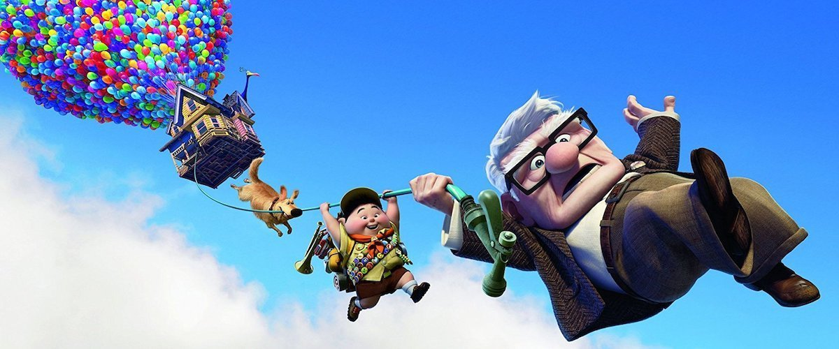
04
Our differences they do a lot
The tools and gifts we got yeah,
we got a lot at stake
to teach us how to use

Slide 22
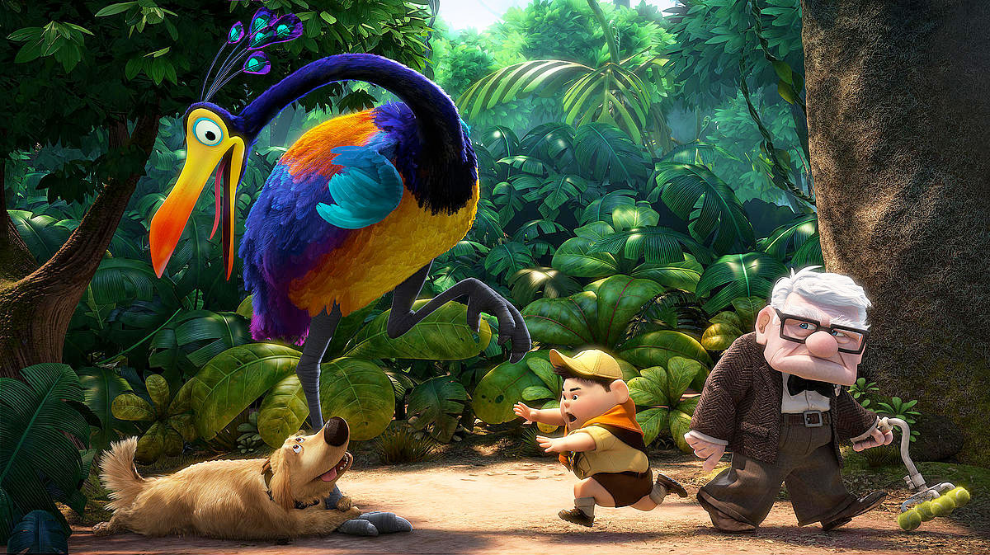
04
And in the end, you're still my friend
at least we did intend

Slide 23
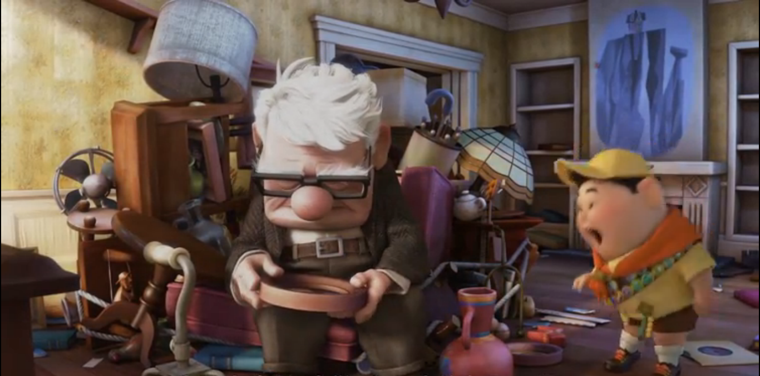
04
For us to work we didn't break,
we didn't burn

Slide 24
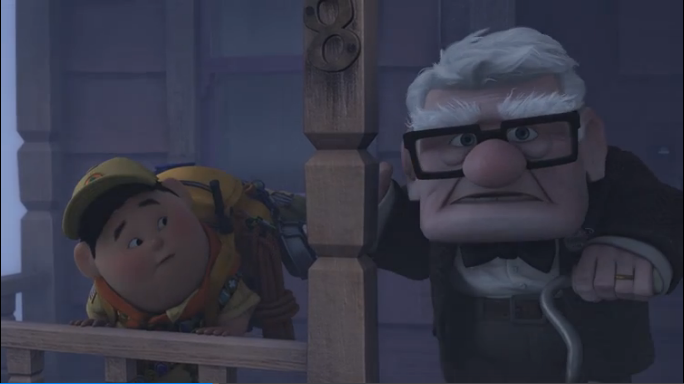
04
We had to learn how to bend
without the world caving in

Slide 25
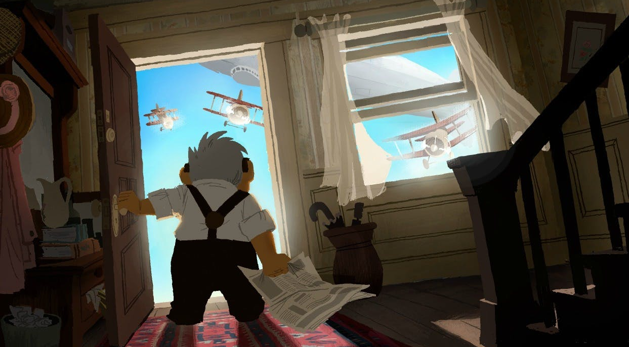
I had to learn what I've got,
and what I'm not

Slide 26
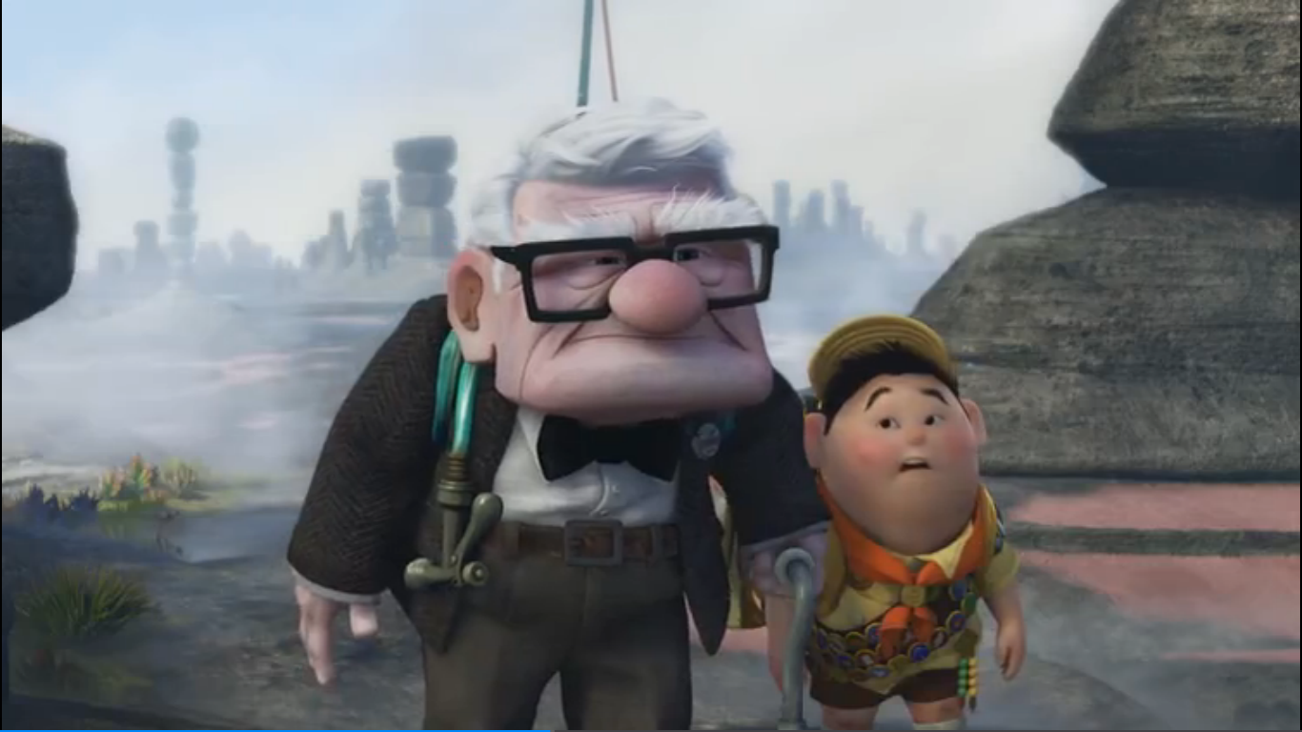
And who I am

Slide 27
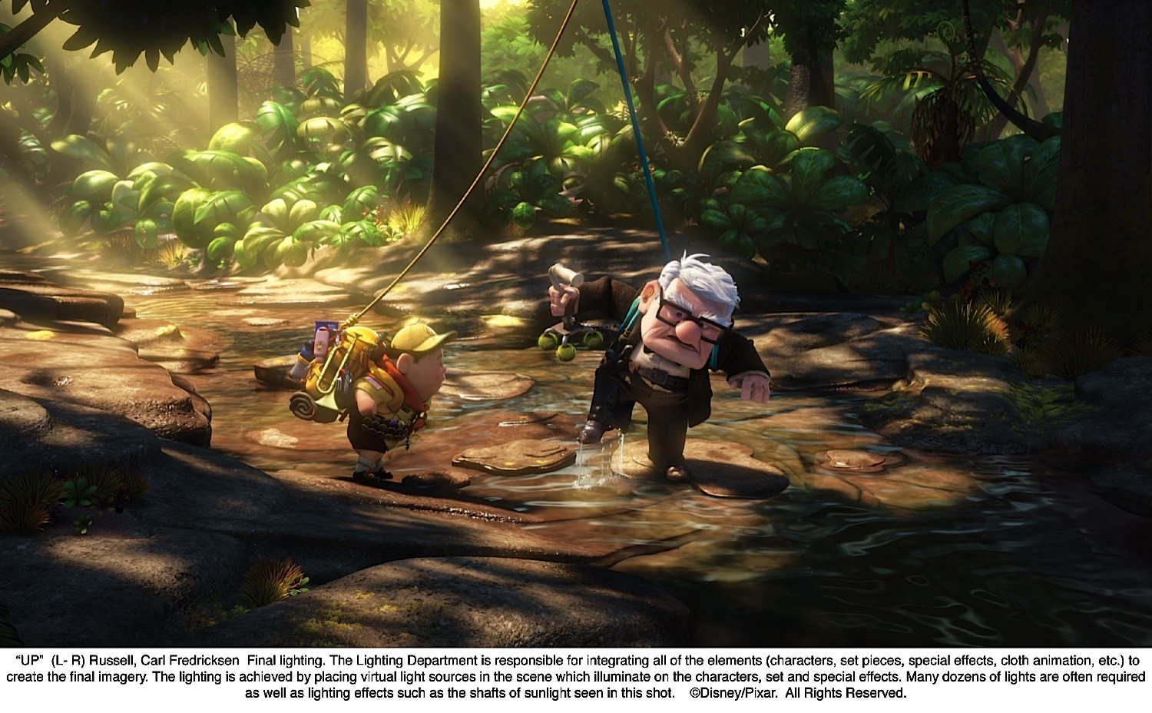
I won't give up on us

Slide 28
Even if the skies get rough

Slide 29
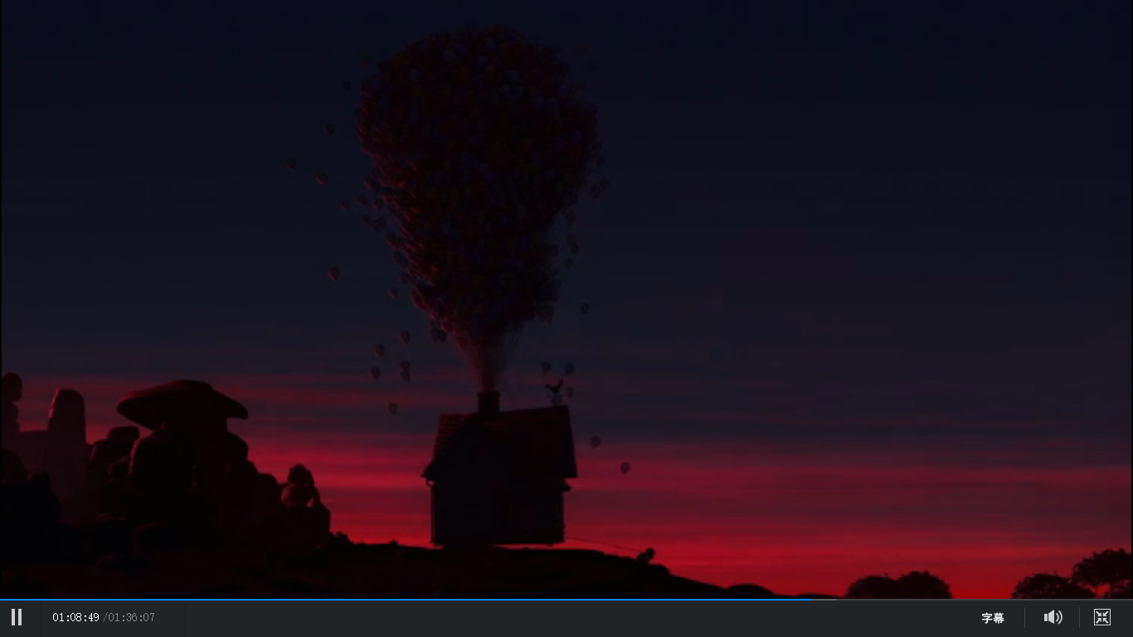
I'm giving you all my love

Slide 30
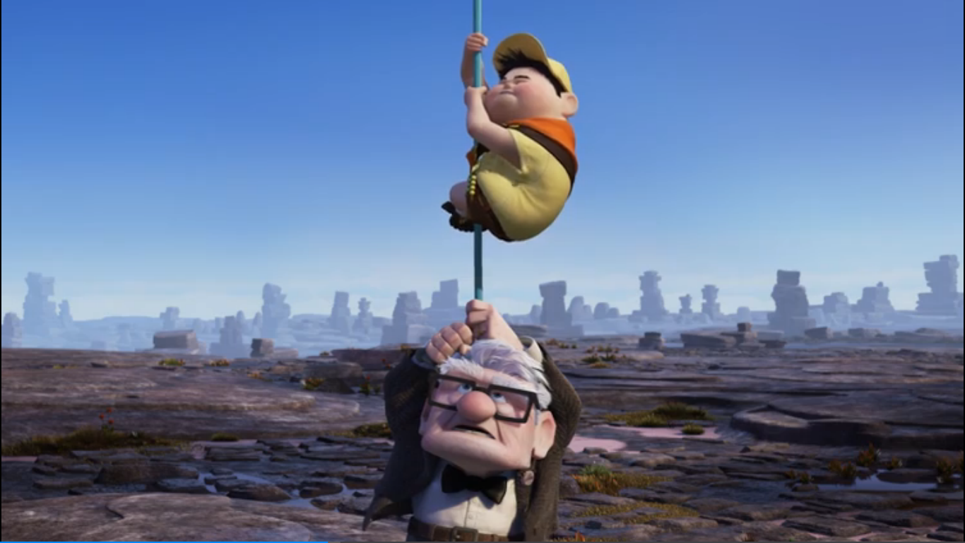
I'm still looking up

Slide 31
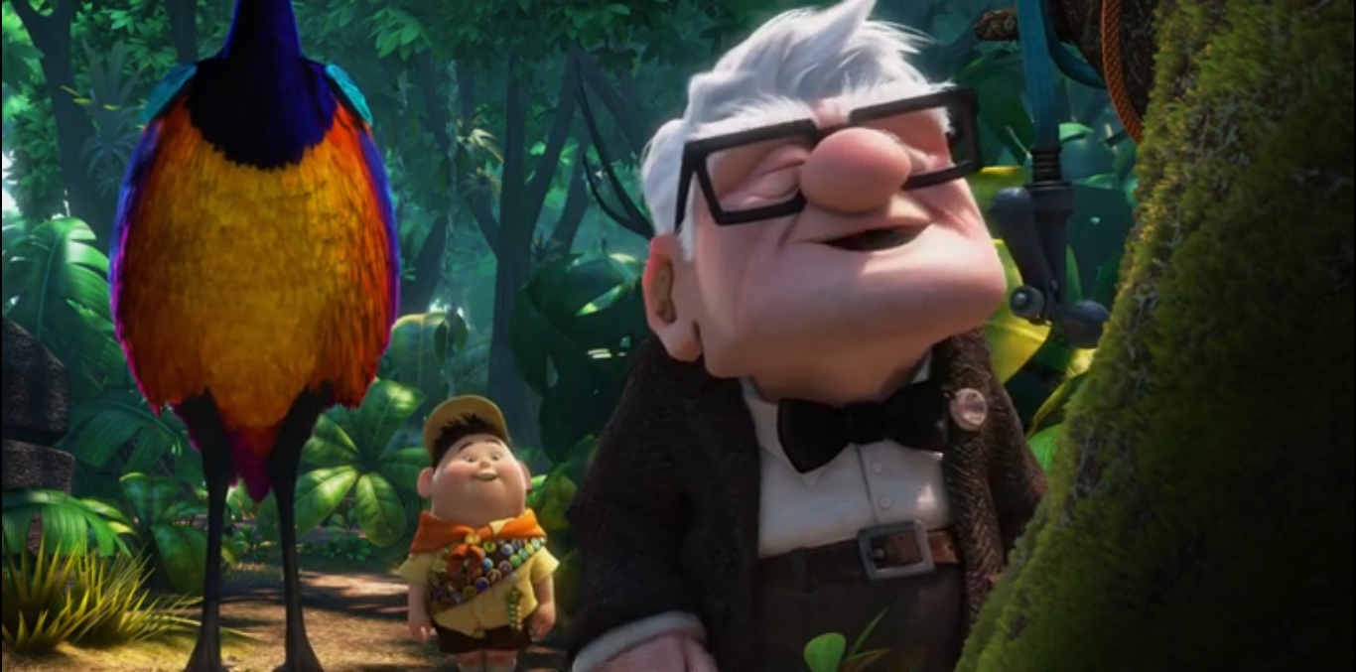
still looking up

Slide 32
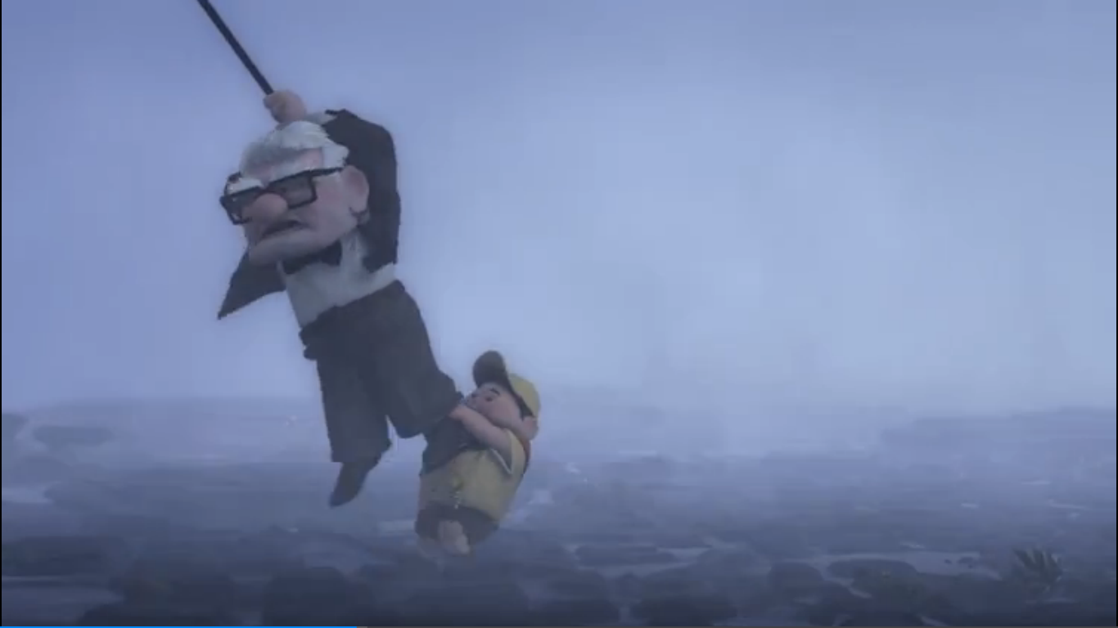
I won't give up on us

Slide 33
04
God knows I'm tough enough

Slide 34
04
God knows we're worth it
We've got a lot to learn

Slide 35
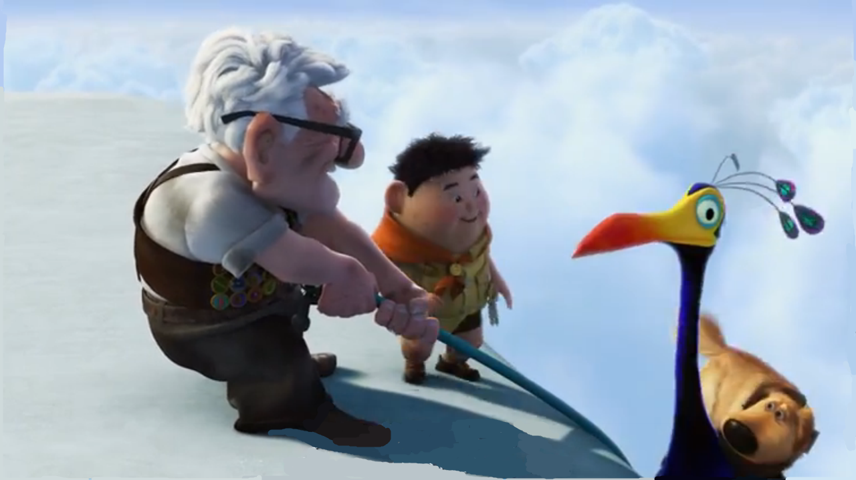
I won't give up on us

Slide 36
Even if the skies get rough

Slide 37
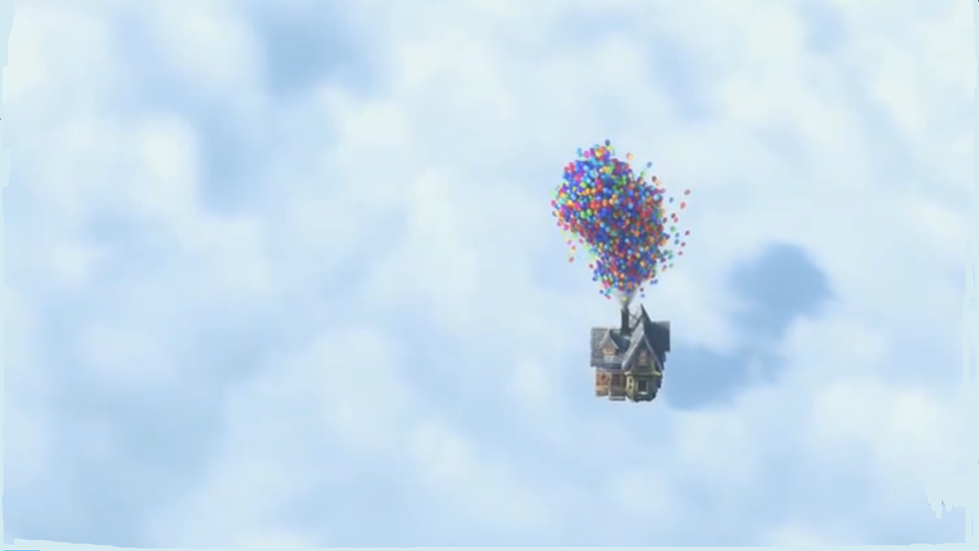
I'm giving you all my love

Slide 38
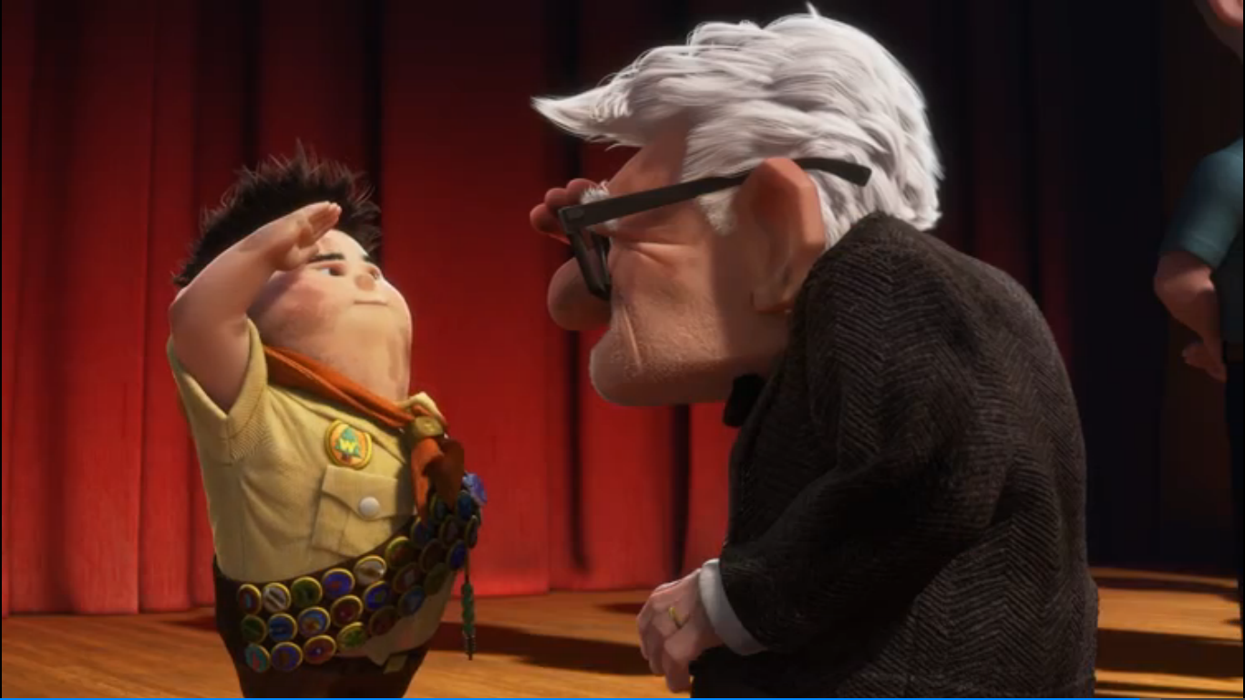
I'm still looking up

Slide 39
give up on sb.
give up
I won't give up on us
give sb. sth.
No, I won't give up.
I'm giving you all my love.

Slide 40
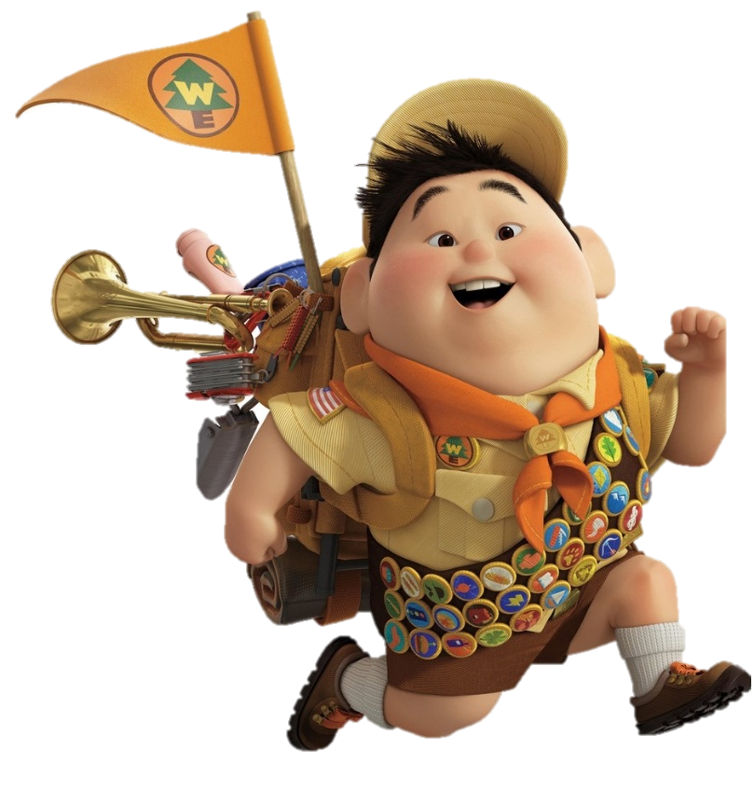
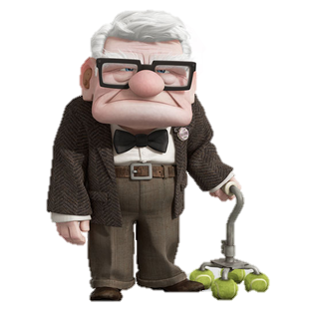
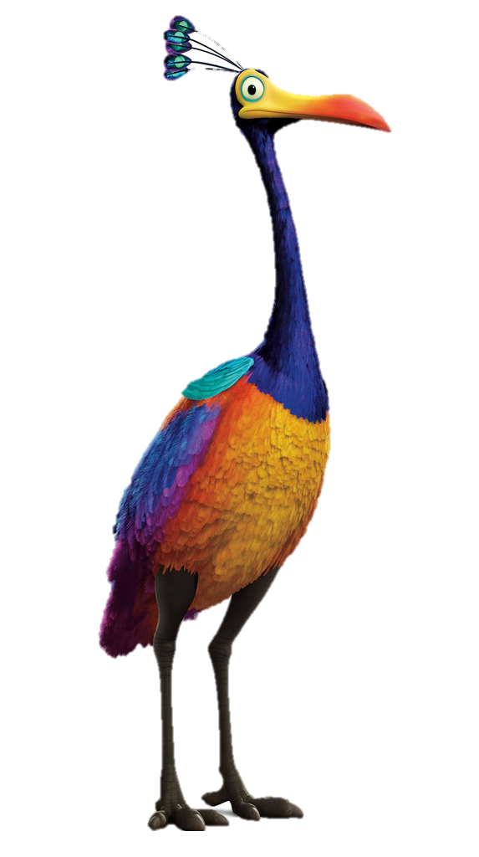
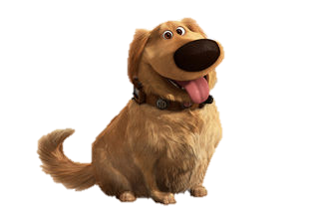
The End

