Slide 1
与get有关的短语
作者：
华南师范大学外文学院 肖婉仪
广东省河源市正德中学 黄秋玲

Slide 2
Kenny Chesney
<get along>

Slide 3
Met a man wearin' a T-shirt says Virginia is for lovers

Slide 4
Had a Bible in his left hand and a bottle in the other

Slide 5
He says All you're really given is the sunshine and your name

Slide 6
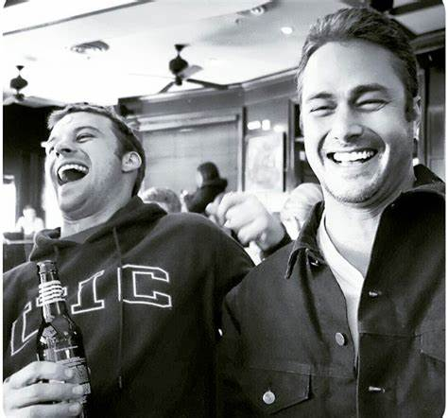
We both started laughin' when the sky started to rain

Slide 7
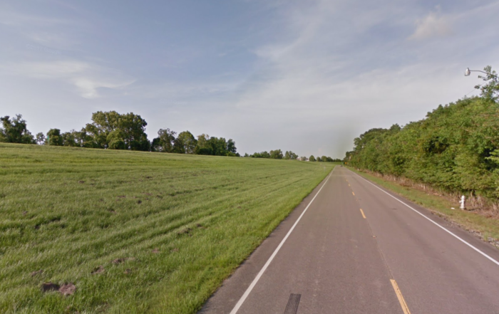
Get along on down the road

Slide 8
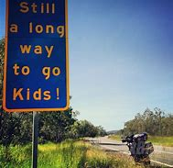
We've got a long long way to go

Slide 9
Scared to live scared to die

Slide 10
We ain't perfect but we try

Slide 11
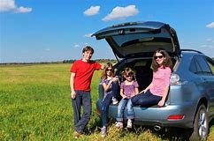
Get along while we can

Slide 12
Always give love the upper hand
We ain't perfect but we try

Slide 13
Paint a wall learn to dance
Get along while we can

Slide 14
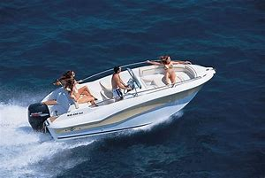
Call your mom buy a boat
We ain't perfect but we try

Slide 15
Drink a beer sing a song
Get along while we can

Slide 16
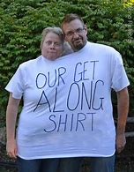
Make a friend can't we all get along
We ain't perfect but we try

Slide 17
Saw a model on a billboard 1-800 get to know me
Get along while we can

Slide 18
Wondered was she photoshopped or
were her eyes really that lonely
Get along while we can

Slide 19
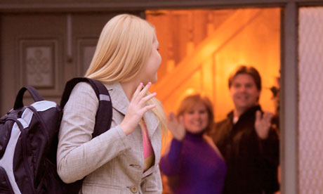
Did she leave her hometown thinkin' she'd end up in L.A.
We ain't perfect but we try

Slide 20
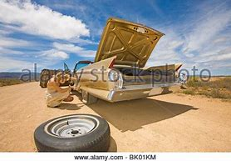
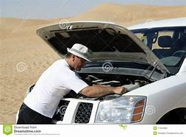
Did she break down in the desert and get stuck beside the highway

Slide 21
Get along on down the road

Slide 22
We've got a long long way to go

Slide 23
Scared to live scared to die

Slide 24
We ain't perfect but we try

Slide 25
Get along while we can

Slide 26
Always give love the upper hand
We ain't perfect but we try

Slide 27
Paint a wall learn to dance
Get along while we can

Slide 28
Call your mom buy a boat
We ain't perfect but we try

Slide 29
Drink a beer sing a song
Get along while we can

Slide 30
Make a friend can't we all get along
We ain't perfect but we try

Slide 31
We find out when you die the keys to heaven can't be bought
We ain't perfect but we try

Slide 32
We still don't know what love is but we sure know what it's not
Get along while we can

Slide 33
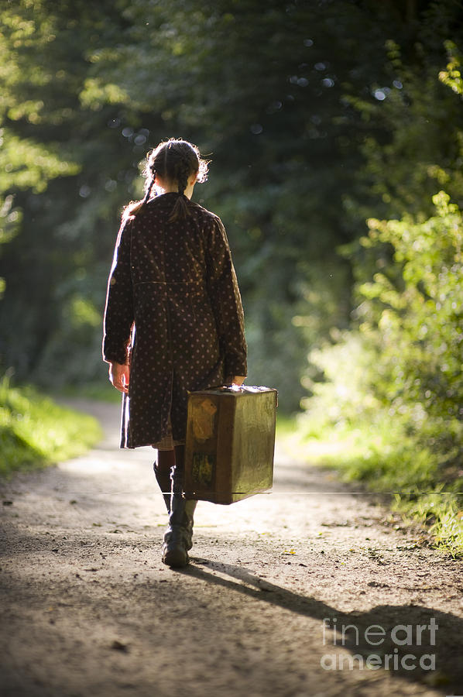
Sometimes you got to
We ain't perfect but we try

Slide 34
Get along on down the road

Slide 35
We've got a long long way to go

Slide 36
Scared to live scared to die

Slide 37
We ain't perfect but we try

Slide 38
Get along while we can

Slide 39
Always give love the upper hand
We ain't perfect but we try

Slide 40
Paint a wall learn to dance
Get along while we can

Slide 41
Call your mom buy a boat
We ain't perfect but we try

Slide 42
Drink a beer sing a song
Get along while we can

Slide 43
Make a friend can't we all get along
We ain't perfect but we try

Slide 44
THANKS！

