Slide 1
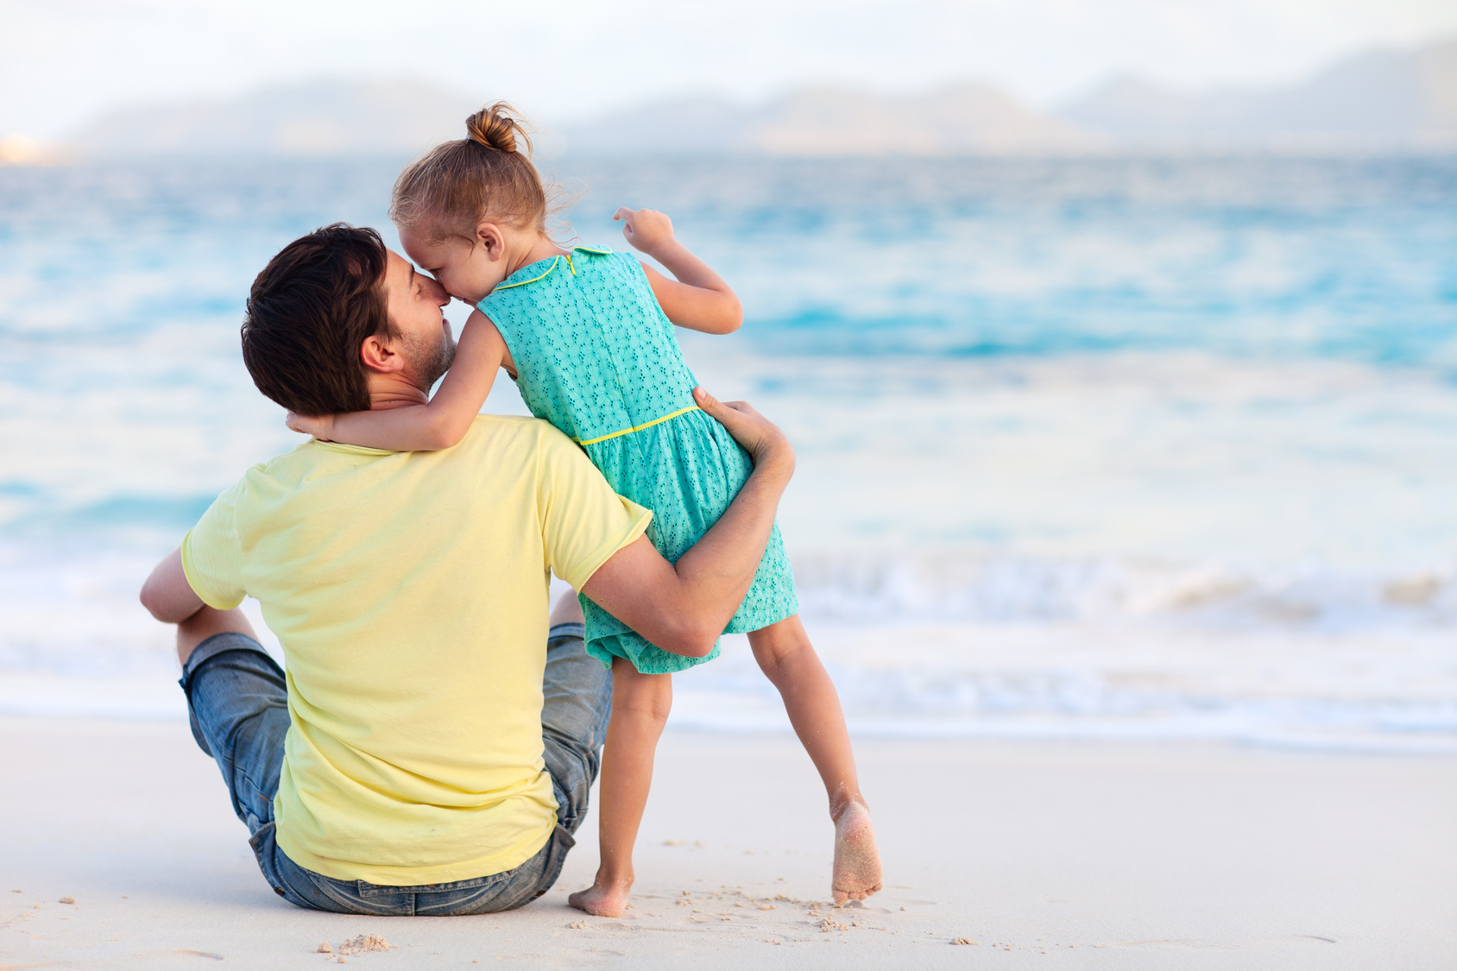
华南师范大学外国语言文化学院 曾婉静 河源市正德中学 黄佩珏
Fall in Love with You
-fall in love with

Slide 4
You might be the favorite part of me

Slide 5
Spring
Summer
Autumn
You're my season

Slide 6
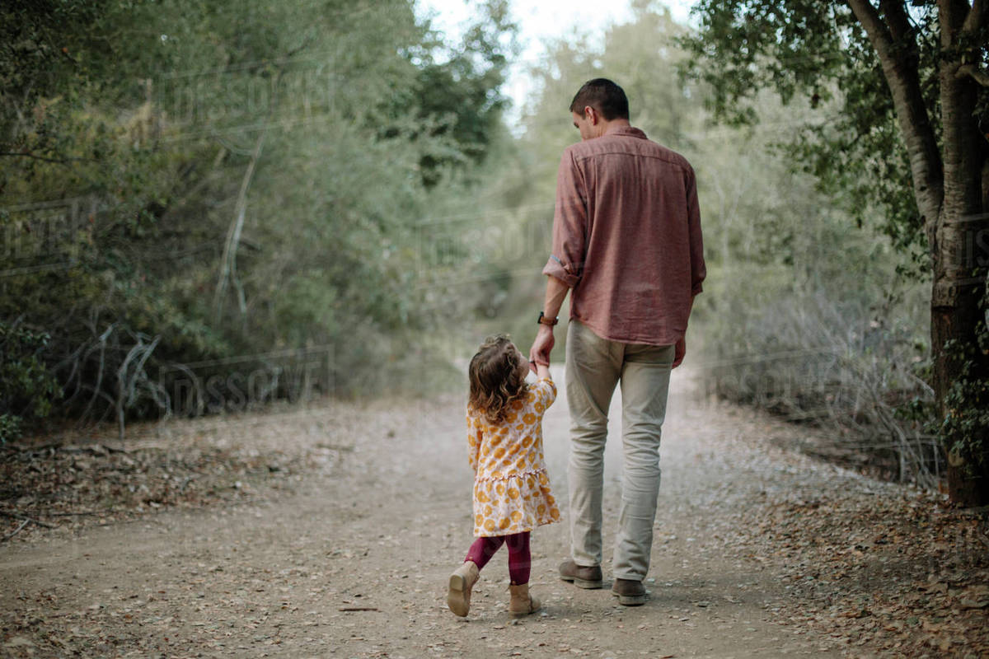
I won't go back you'll get all of me oh

Slide 7
I'll come running when you call on me

Slide 8
Over mountains underneath the sea

Slide 9
Bet you bottom dollar I will be here

Slide 10
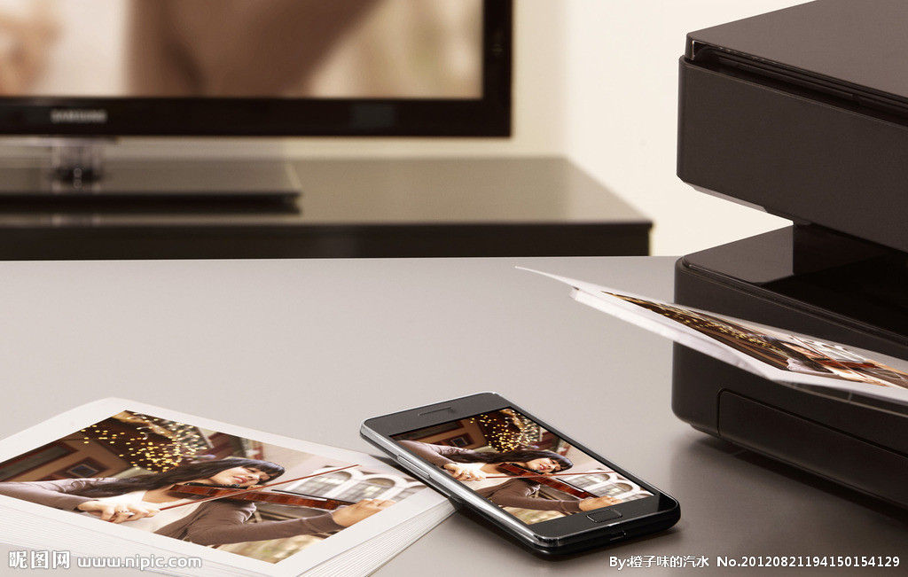
I'm going through pictures in my phone of you

Slide 11
I can't wait to get home to you

Slide 12
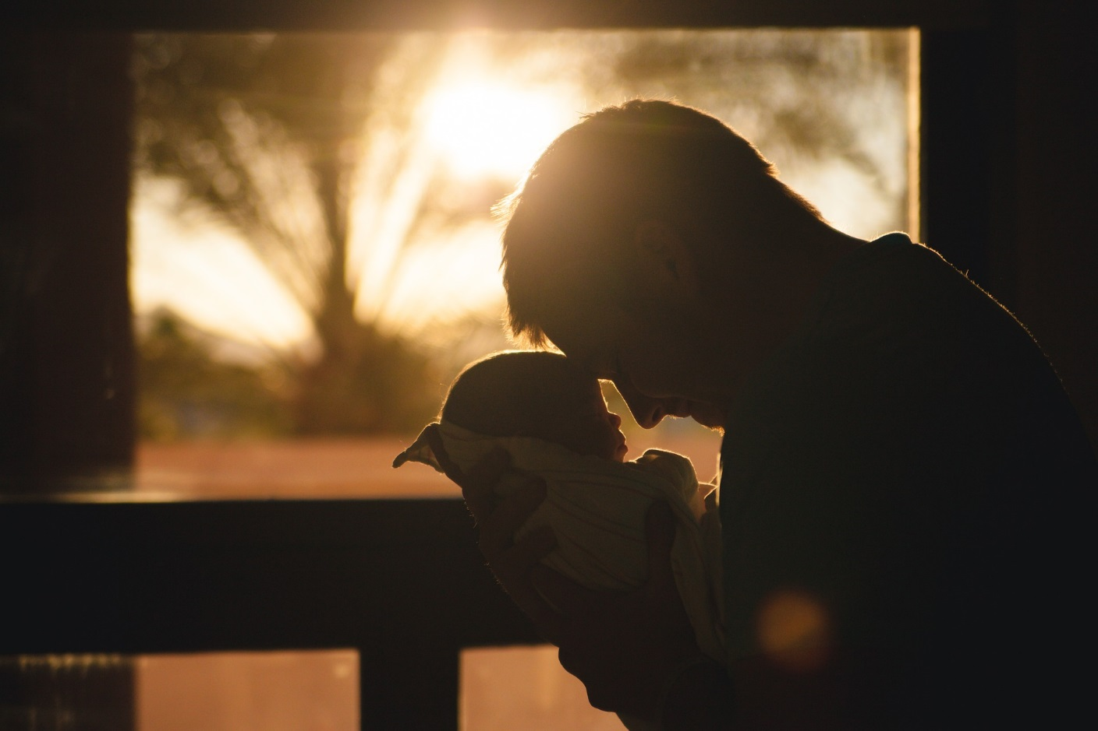
Good morning to you baby
When I fall
I fall in love with you

Slide 13
Good morning to you baby
When I fall
I fall in love with you

Slide 14
I'm watching you sprout right in front of me

Slide 15
Wonder what your life will come to be

Slide 16
When you look back I will be behind you

Slide 17
And when I'm old I pray that you will find

Slide 18
Daddy left you all you needed

Slide 19
I love you with my soul now baby you go

Slide 20
Oh I hate being gone from you
Caught a red eye
to get home to you

Slide 21
So I could say
Good morning to you baby

Slide 22
When I fall
I fall in love with you

Slide 23
Good morning to you baby
When I fall I fall in love with you

Slide 24
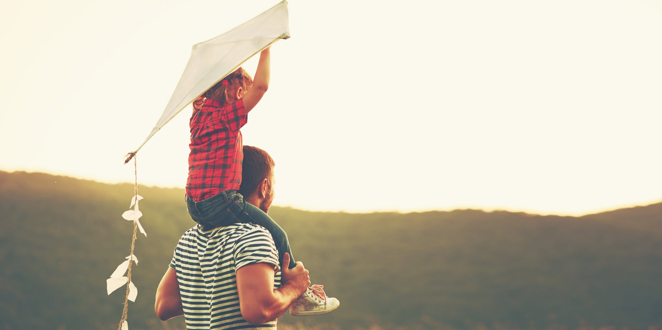
Fall in Love
with You

