Slide 1
Song: All I Want For Christmas Is You
-知识点: come true
作者：
华南师范大学外国语言文化学院 黎嘉乐
广东省河源市古竹中学 李素莹

Slide 2
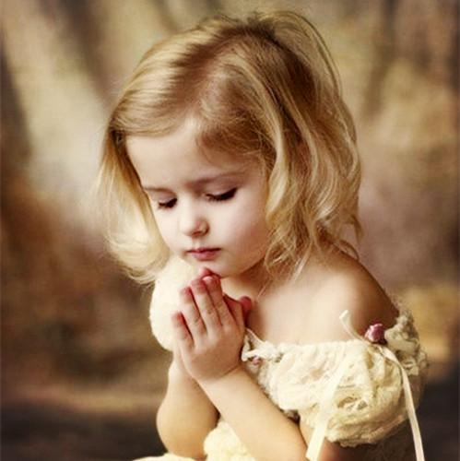
I don't want a lot for Christmas
There is just one thing I need

Slide 3
I don't care about the presents
Underneath the Christmas tree

Slide 4
I just want you for my own
More than you could ever know

Slide 5
Make my wish
come true

Slide 6
All I want for Christmas
is you
baby

Slide 7
You
Baby

Slide 8
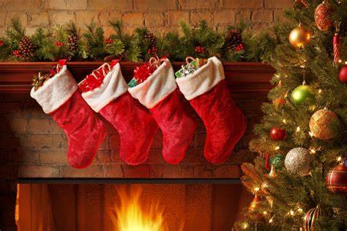
I don't need to hang my stocking
There upon the fireplace

Slide 9
Santa Claus won't
make me happy
With a toy on Christmas day

Slide 10
I just want you for my own
More than you could ever know

Slide 11
Make my wish
come true

Slide 12
All I want for Christmas
is you
baby

Slide 13
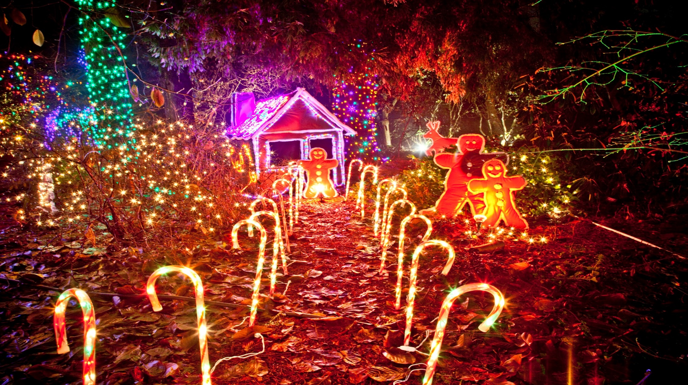
All the lights are shining
So brightly everywhere

Slide 14
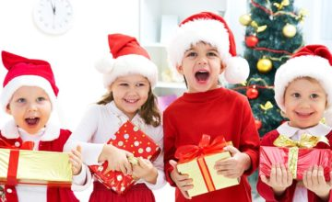
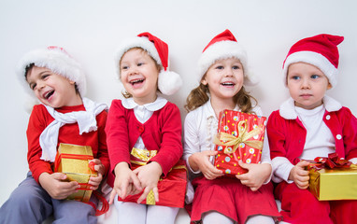
And the sound of childrens'
Laughter fills the air

Slide 15
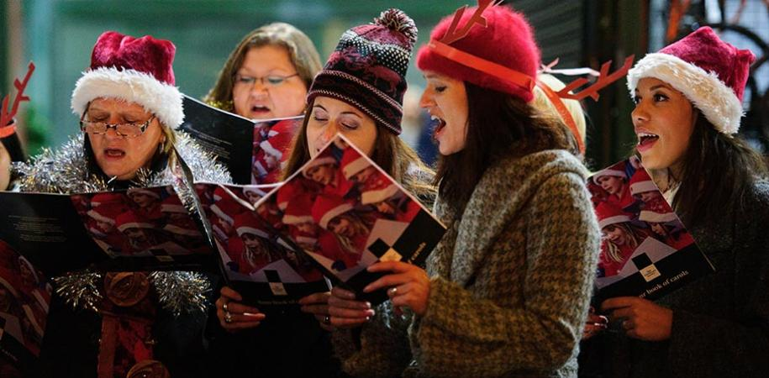
And everyone is singin'

Slide 16
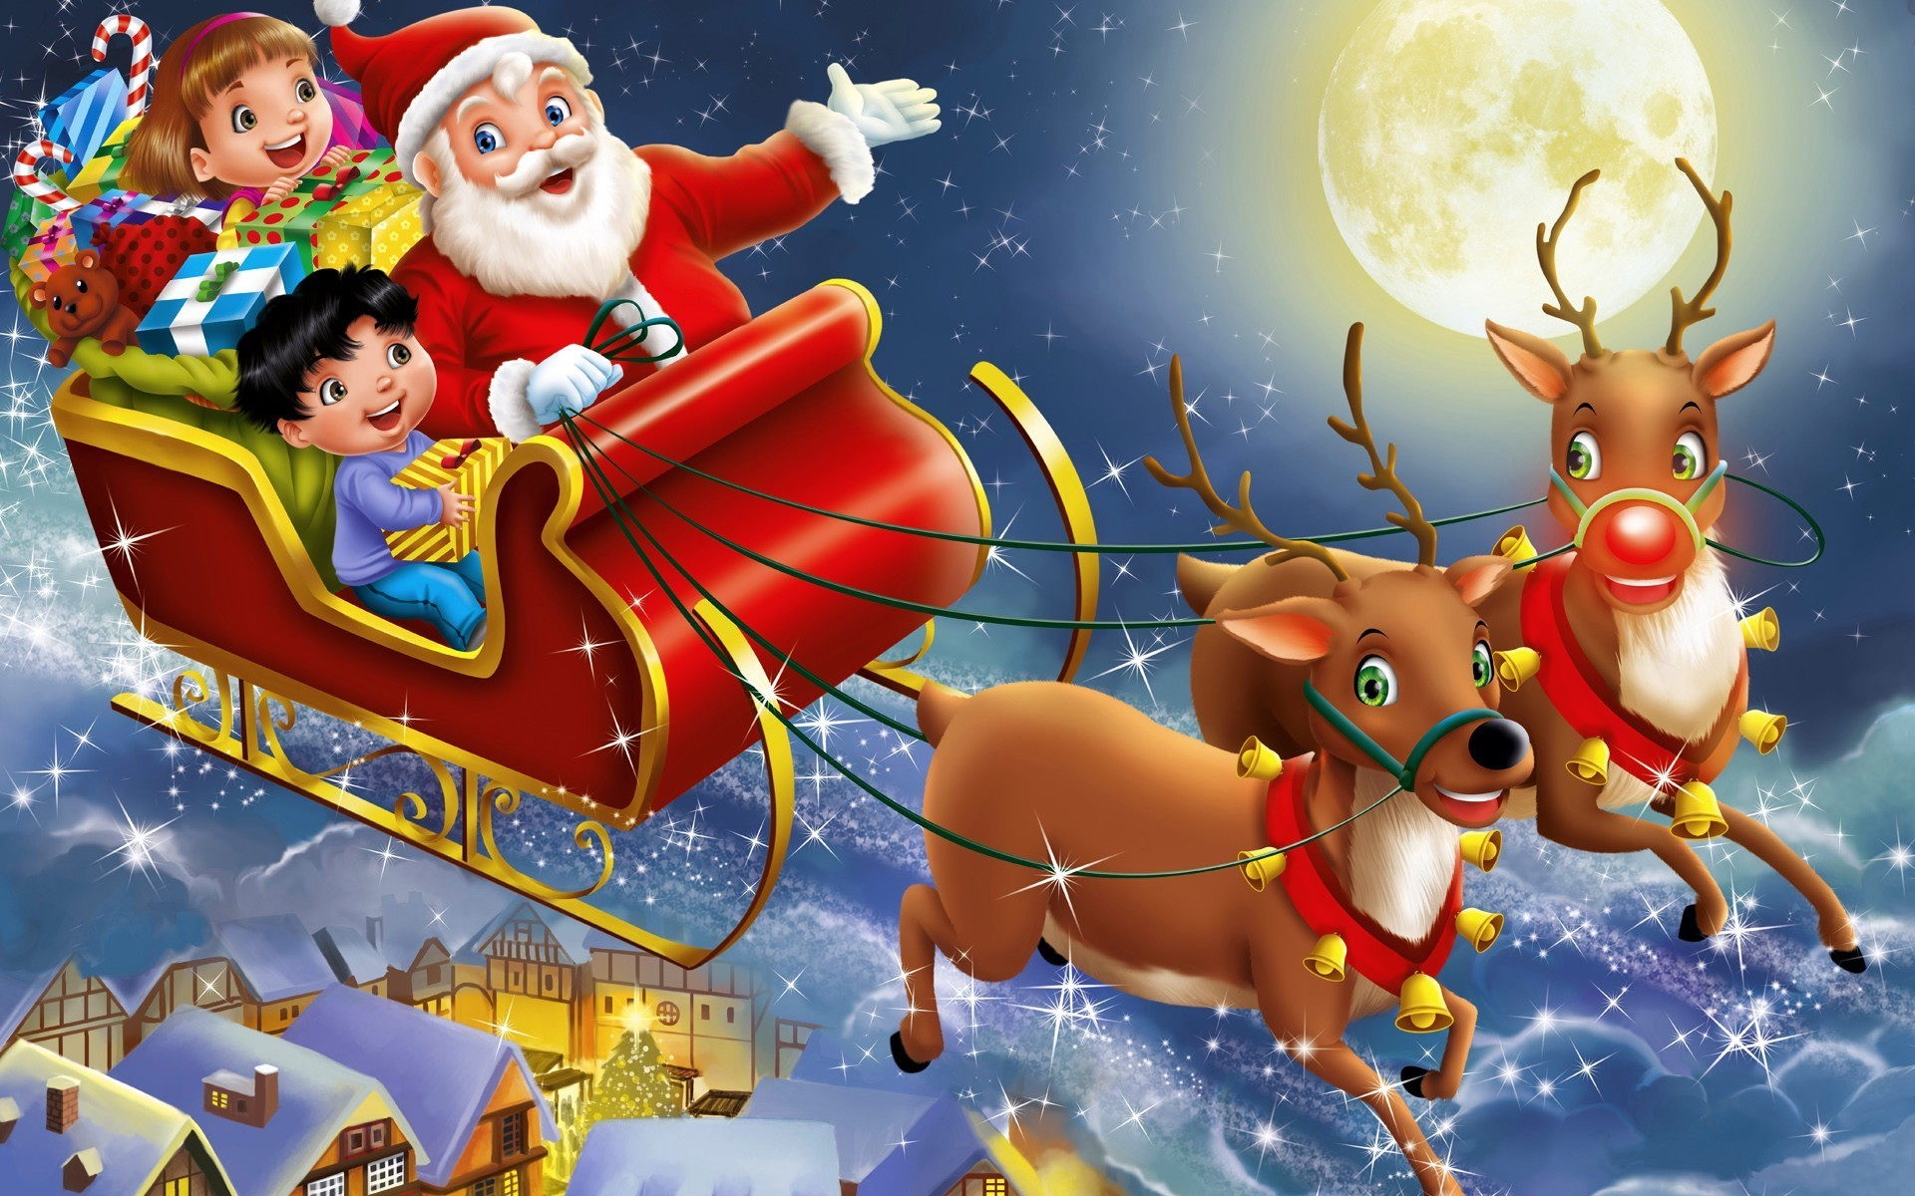
I hear those sleigh bells ringin'

Slide 17
Santa won't you bring me
The one I really need

Slide 18
Oh bring my baby to me

Slide 19
I don't want a lot for Christmas
This is all I'm askin' for

Slide 20
Standing right outside my door
I just wanna see my baby

Slide 21
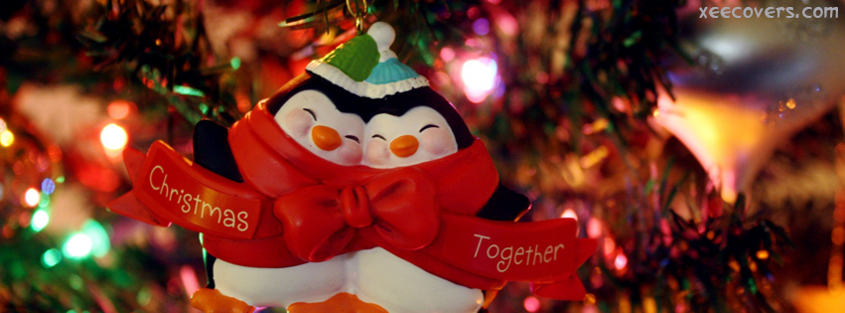
I just want him for my own
More than you could ever know

Slide 22
Make my wish
come true

Slide 23
All I want for Christmas
is you
baby

Slide 24
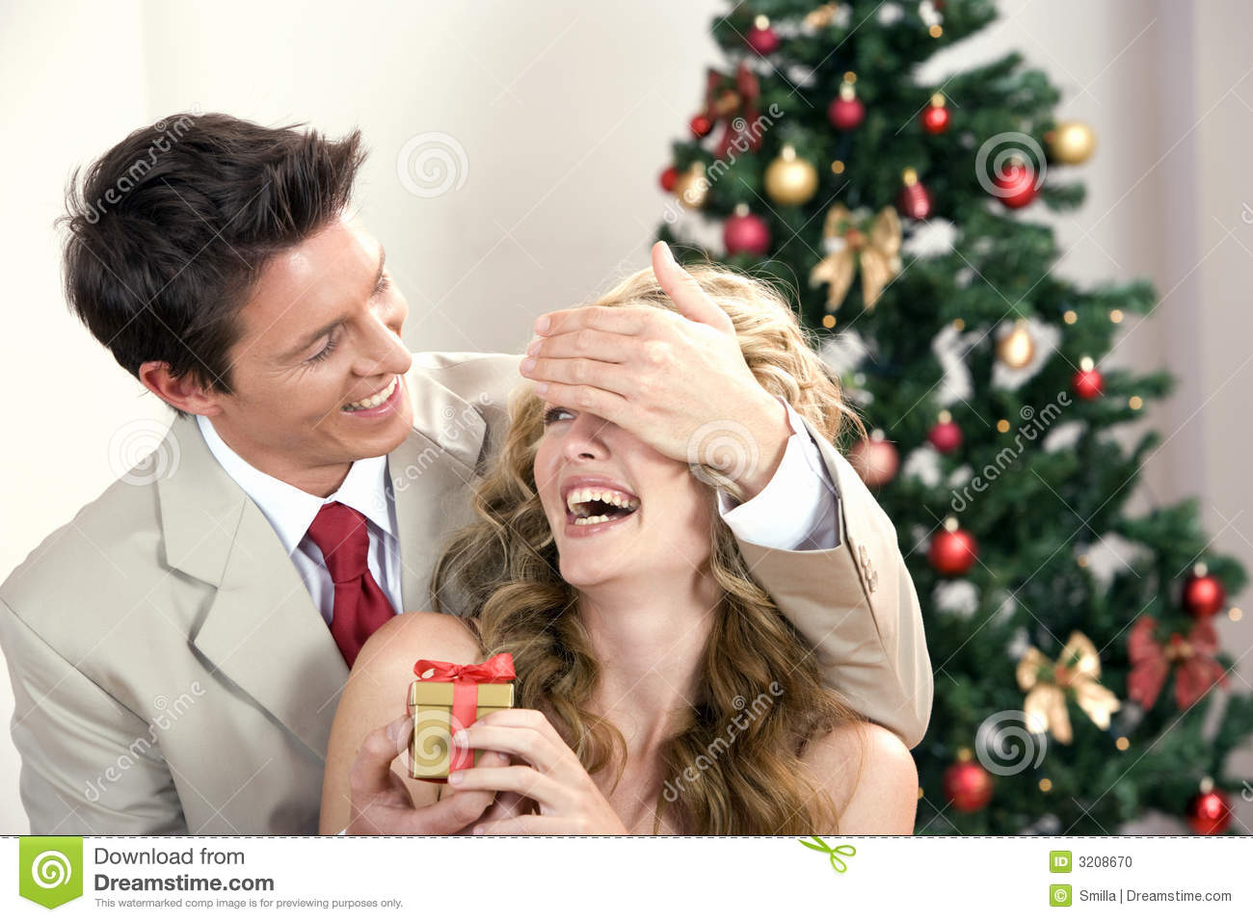
You
Baby

Slide 25
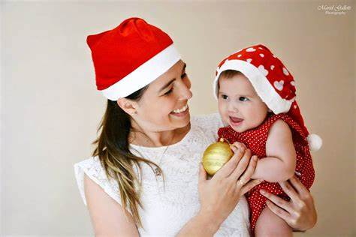
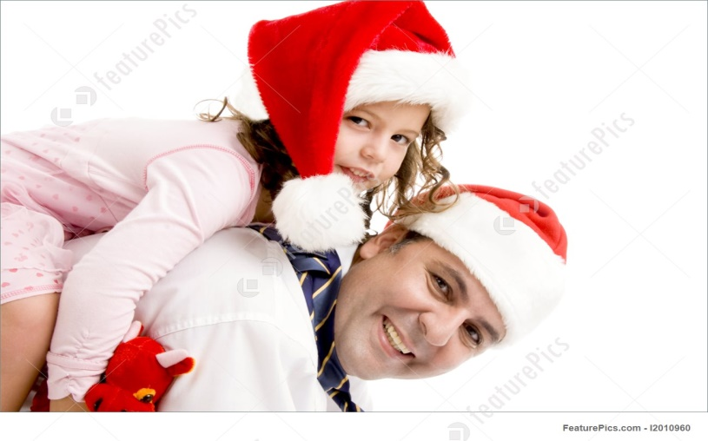
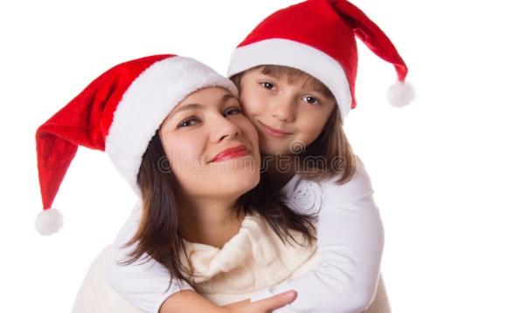
You
Baby

Slide 26
You

