Slide 1
Goodbye Weekend
|agree动词搭配知识点教学
|华南师范大学外国语言文化学院 李祯
|广东省河源临江中学 郭全霞

Slide 3
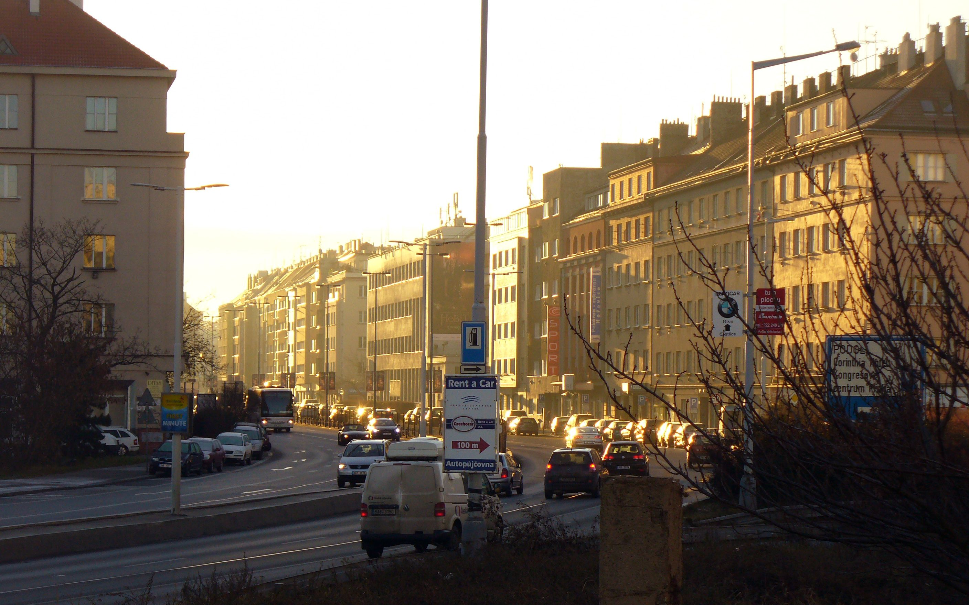

Slide 4
Goodbye Weekend
So long darling

Slide 5
Macky’s been a bad bad boy

Slide 6
And when their preaching
Is sure to change me

Slide 7
Should rearrange me
Or so they thought

Slide 8
So
Don’t go
Telling me
How this boy
Should be leaving

Slide 9
his
own
life

Slide 10
Sometimes rough
BUT
Generally speaking I’m fine

Slide 11
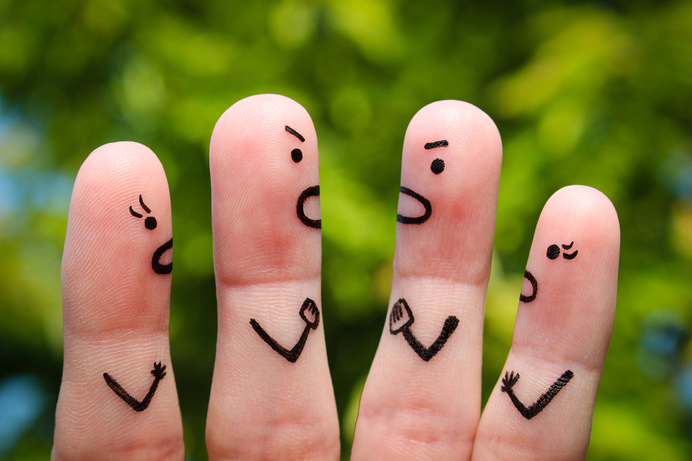
If you don’t agree with the things that go on
within
In my life
♦agree with sth./sb.
♦agree to do sth.

Slide 12
Well honey that’s fine there’s no itch in wasting in your time

Slide 13
Suddenly
Place me
Give me a sign

Slide 14
Repeat
The metra
When
You’re stepping out of line

Slide 15
Give me another
Give me another
Something to be
Something to be

Slide 16
May help out
the country boy but
it won’t work out on me

Slide 17
So
Don’t go
Telling me
How this boy
Should be leaving

Slide 18
his
own
life

Slide 19
Sometimes rough
BUT
Generally speaking I’m fine

Slide 20
If you don’t agree with the things that go on
within
in my life
agree with
♦agree with sth./sb.
♦agree to do sth.

Slide 21
Well honey that’s fine there’s no itch in wasting in your time

Slide 23
So
Don’t go
Telling me
How this boy
Should be leaving

Slide 24
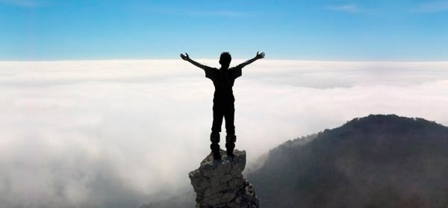
his
own
life

Slide 25
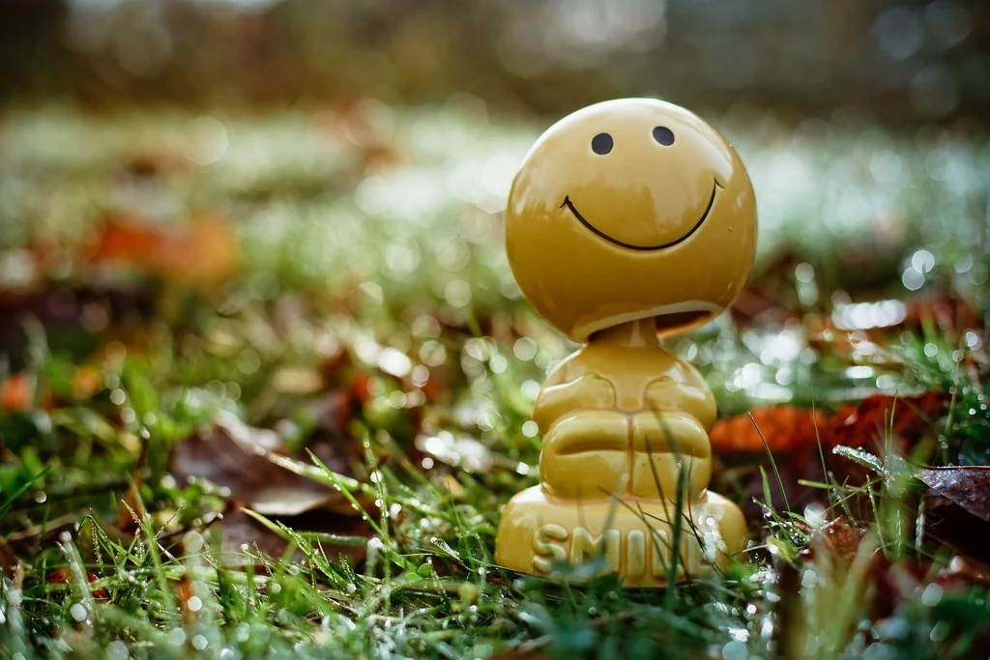
Sometimes rough
BUT
Generally speaking I’m fine

Slide 26
If you don’t agree with the things that go on
within
in my life
agree with
♦agree with sth./sb.
♦agree to do sth.

Slide 27
Well honey that’s fine
there’s no itch in
wasting in your time

