Slide 1
Come Away with Me
away 的用法及常用短语
华南师范大学外国语言文化学院 李敏玲
广东省河源市江东新区新智中学 许艳丽

Slide 2
Come away with me in the night

Slide 3
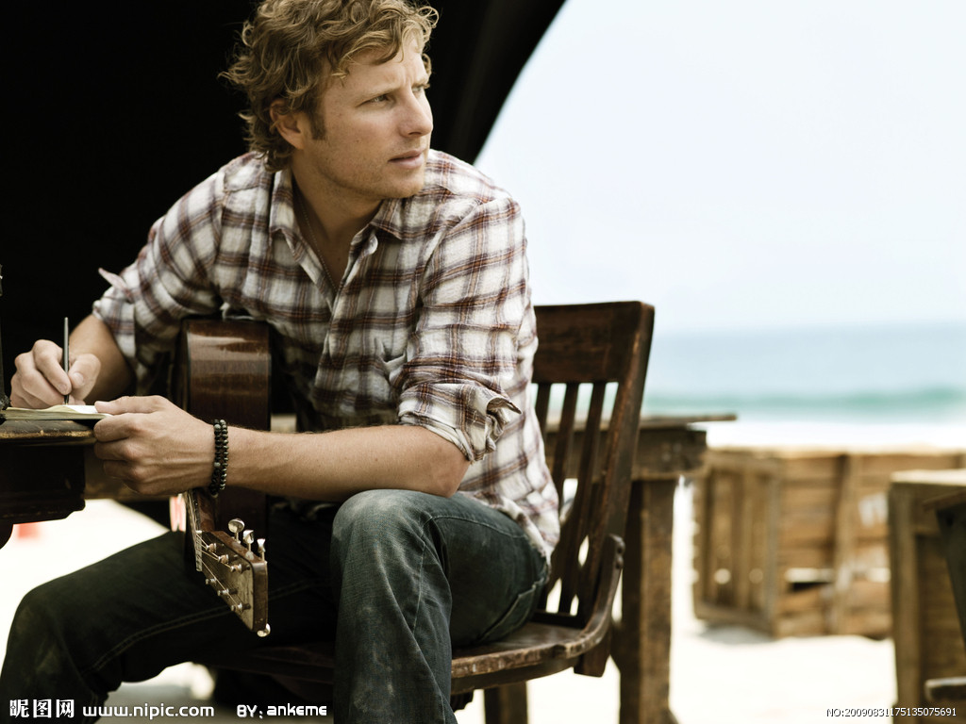
Come away with me
And I will write you a song

Slide 4
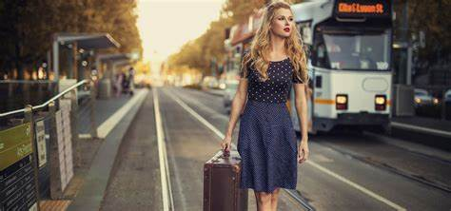
Come away with me on a bus
Come away where they can't tempt us
With their lies

Slide 5
And I want to walk with you
On a cloudy day
In fields where the yellow grass
grows knee-high
So won't you try to come?

Slide 6
Come away with me and we'll kiss
On a mountain top
Come away with me
And I'll never stop loving you

Slide 7
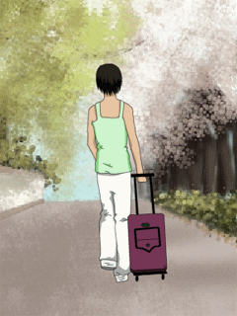
Come away
away
come away
away
come away
away
come away
away
come away
away

Slide 8
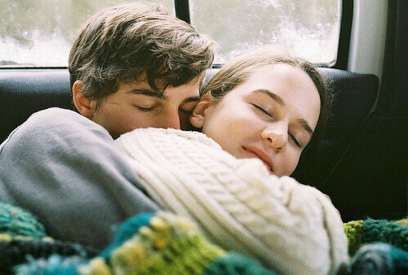
And I want to wake up with the rain
Falling on a tin roof
While I'm safe there in your arms
So all I ask is for you

Slide 9
To come away with me in the night
Come away with me

Slide 10
away 的用法 副词(adv.)：消失; 离开，远离; 在远处 形容词(adj.)：不在的; 遥远的; 客场比赛
1.away 表示方位的副词，其基本意思是“离开”。用在动词或短语动词之后表示与“离开”有关的各种不同的意思。可以表示“离开”的状态，也可表示“离开”的动作。
例句：
He lives 5 miles away from here.他住在距离这里五英里的地方。
I hope to get away early in the morning.我希望一早就动身离开。

Slide 11
2.虽然away做形容词的频率没有副词高，但在谈论体育比赛的语境中，还是很常见的，意思是“客场的”。相对地，“主场的”说法是home。
例句:
The away team won the game despite of the disadvantage.
客场队伍在地理位置的劣势下仍然赢得了比赛。

Slide 12
常用away短语
away from 远离 away with 离开
back away 退避，躲避
blow away 吹走，驱散，炸飞
break away 脱离挣脱，改掉
burn away 燃烧没了
carry away 运走，使失去自制力 clear away 清除，收拾，消失 come away 离开
cut away 切除、剪掉不好的部分
die away ( 声音、光线、风等)逐渐平息，消失
draw away 引开，离开，拉开
dream away 遐想，出神
drive away（汽车）离开

Slide 13
far away from 远离
frighten…away 把…吓走或吓跑
get away 逃脱，离开
get away with 饶幸做成，侥幸得手
give away 赠送，分发，泄露
go away 走开
keep away from 避开，不接近
look away 朝其他方向看部分
make away （急忙）离去，逃走
make away with 而逃，摧毁，浪费
melt away（情绪、人群）消失，消散
move away 离开，搬走，移开
put away 整理，把收起来放好
pass away 去世，逝世

Slide 14
ride away 骑车离去
right away 立刻，马上
run away 流失，逃跑，逃脱
rub away 擦掉，磨去
shoot away 不停地射击
smooth away difficulties 克服困难
stay away from 远离
take away 拿走，拿开
throw away 扔掉
walk away 走开，离去
weep away 在哭泣中度过

Slide 15
一、翻译下列短语。
1. 远离
2.走开
3.拿走,带走
4.赠送，分发
5.遐想，出神
6.流失，逃跑
7.整理,收拾
8.驱散，吹走
9.搬走，移开
10.立刻，马上
away from
go away
take away
give away
dream away
run away
put away
blow away
move away
right away

Slide 16
二、选择题。
1. ---- As an old customer, would you _____ some books to
us for free?
---- No problem. We'd love to do.
A. pay off B. call off C. give away D. put away
2. ---- Peter, your school things are everywhere in your study.
---- Oh, sorry. I'll _____ right now.
A. put them away B. put away them
C. put them on D. put on them
3. My hometown is not _____.
A. away from B. far away from C. far from D. far away
4. Don’t ______ your empty bottles, please.
A. get away B. throw away C. break away D. run away
C
A
D
B

Slide 17
Thanks for appreciating!

