Slide 1
This is me
与to有关的短语
华南师范大学外国语言文化学院 林诗琪
广东省河源市连平县雁桥中学 刘剑玲

Slide 2
I am not a stranger to the dark

Slide 3
Cause we don't want your broken parts
Hide away they say

Slide 4
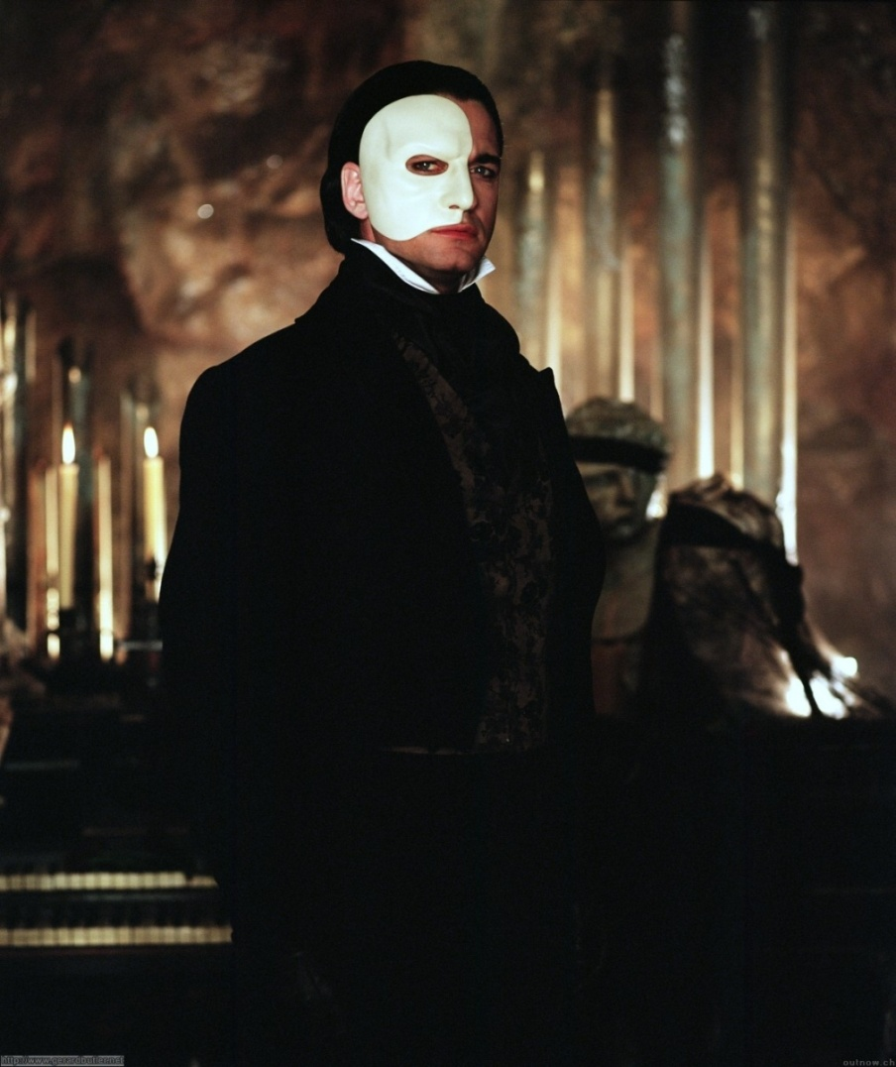
I've learned to
be ashamed of all my scars

Slide 5
Run away they say
No one'll love you as you are

Slide 6
But I won't let them break me down to dust

Slide 7
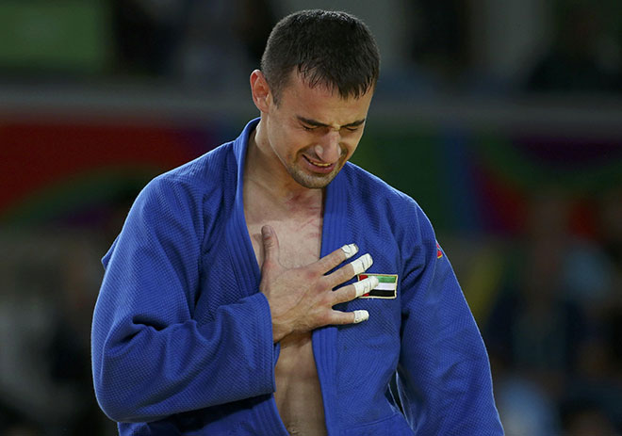
I know that there's a place for us

Slide 8
For we are glorious

Slide 9
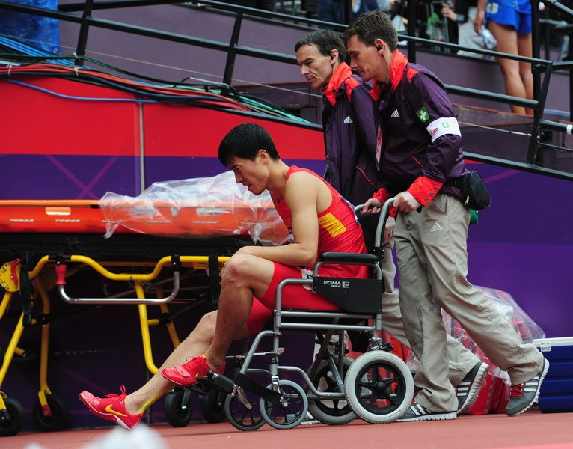
When the sharpest words wanna cut me down

Slide 10
I'm gonna send a flood gonna drown them out

Slide 11
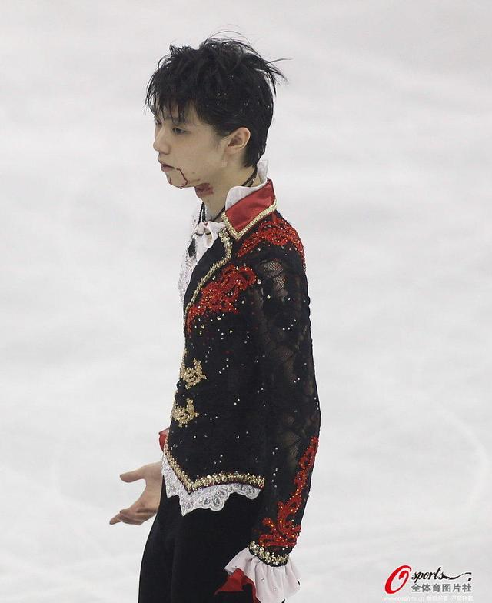
I am brave
I am bruised

Slide 12
I'm who I meant to be

Slide 13
This is me

Slide 14
Look out cause here I come

Slide 15
And I'm marching on to the beat I drum

Slide 16
I'm not scared to be seen

Slide 17
This is me
I make no apologies

Slide 19
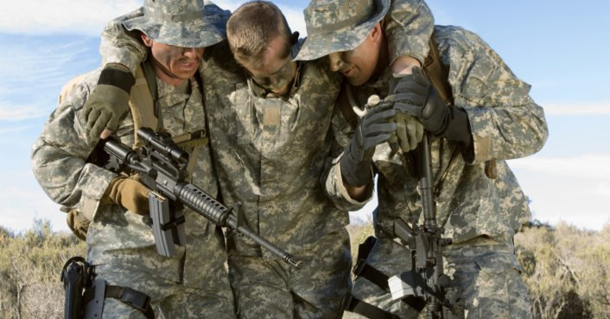
Another round of bullets hits my skin

Slide 20
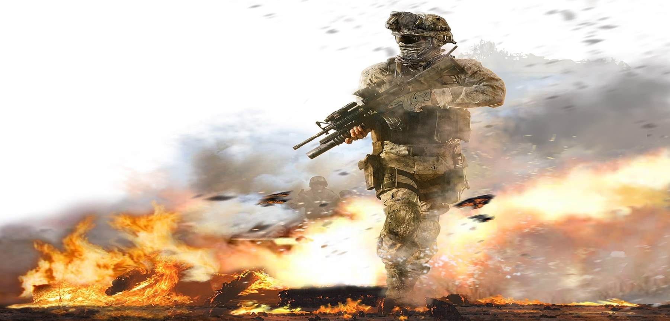
Well fire away 'cause today
I won't let the shame sink in

Slide 21
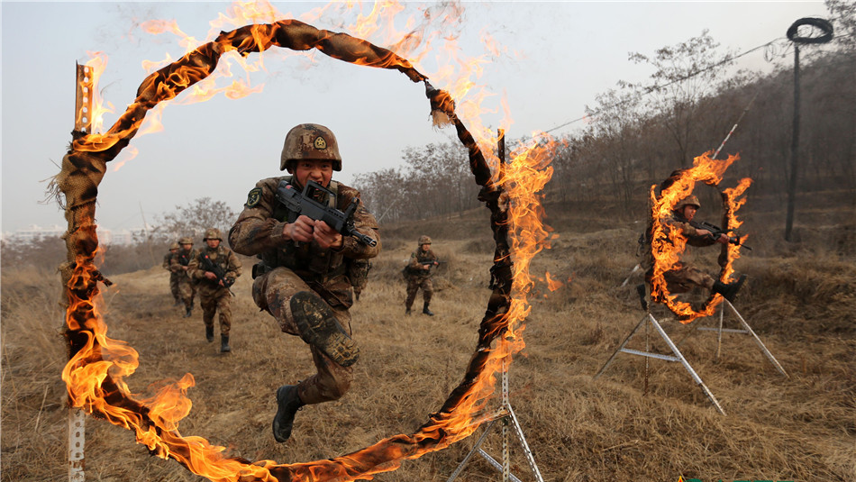
We are bursting through the barricades

Slide 22
And reaching for the sun

Slide 23
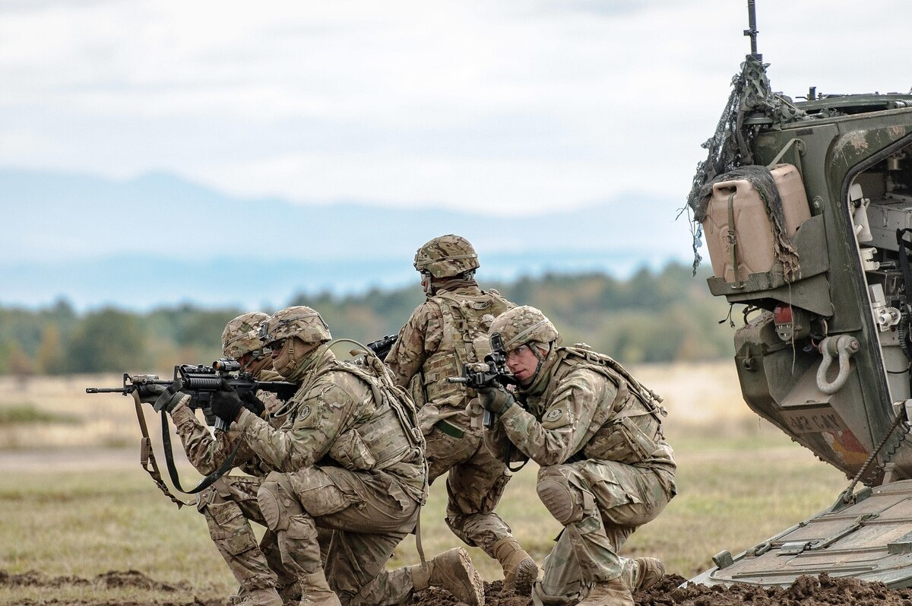
We are warriors
Yeah that's what we've become

Slide 24
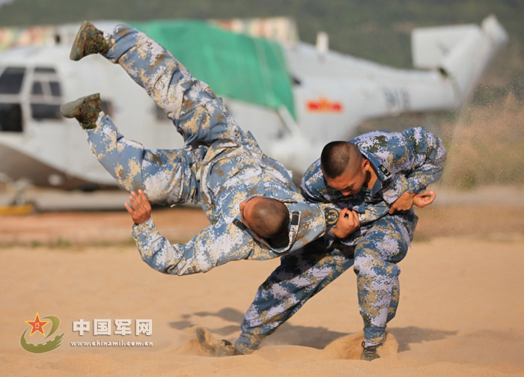
Won't let them break me down to dust

Slide 25
I know that there's a place for us

Slide 26
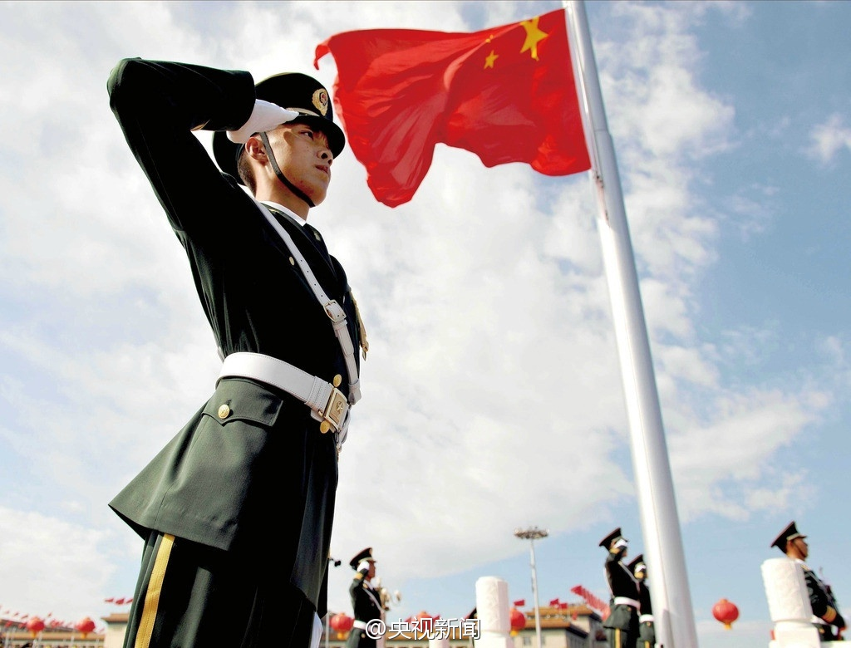
For we are glorious

Slide 27
When the sharpest words wanna cut me down

Slide 28
I'm gonna send a flood
gonna drown them out

Slide 29
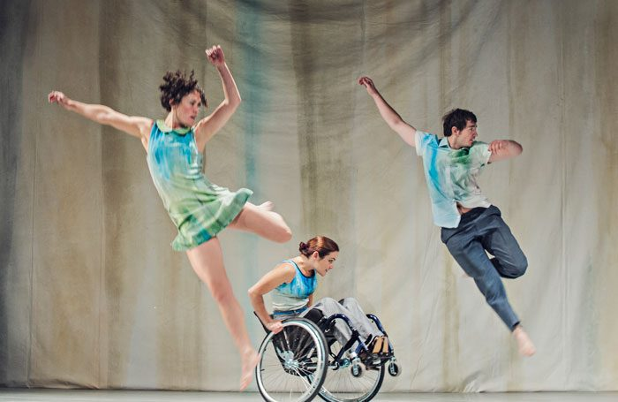
I am brave I am bruised

Slide 30
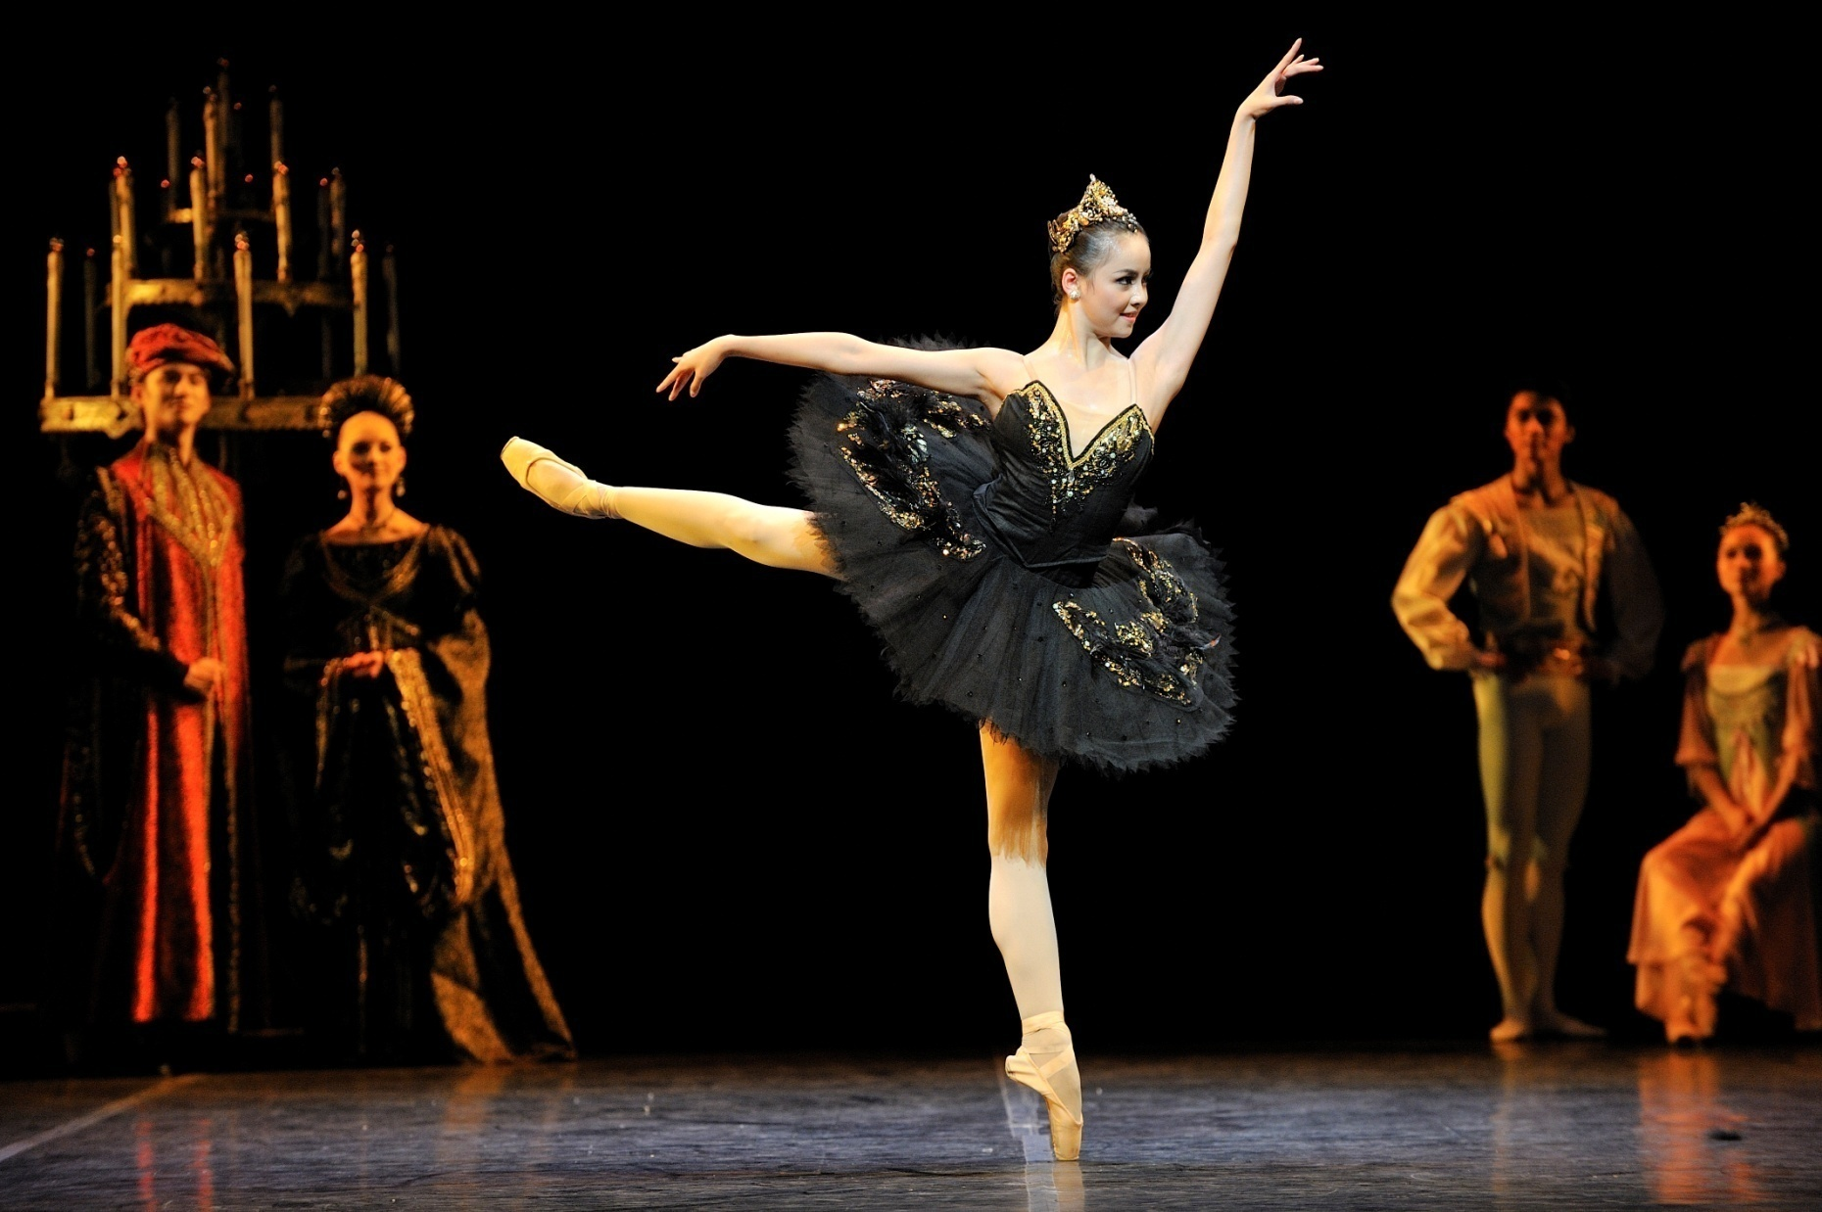
This is me
I am who I'm meant to be

Slide 31
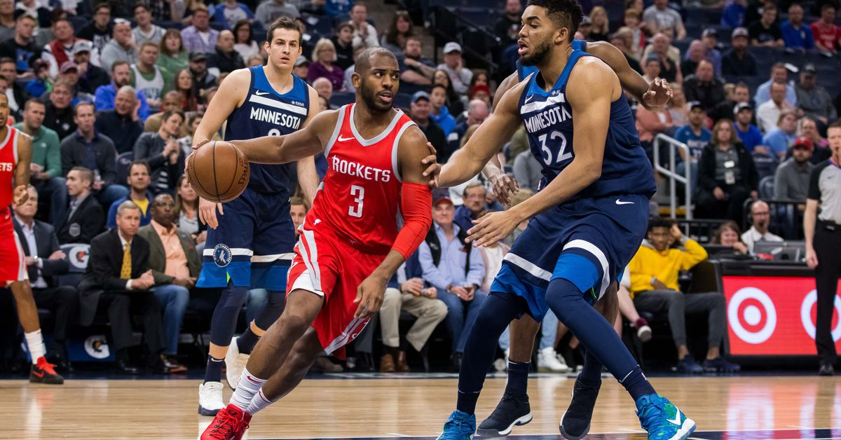
Look out cause here I come

Slide 32
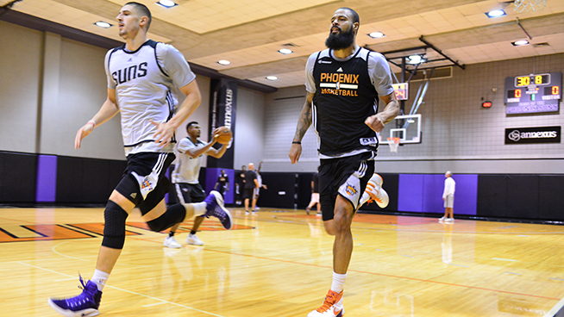
And I'm marching on to the beat I drum

Slide 33
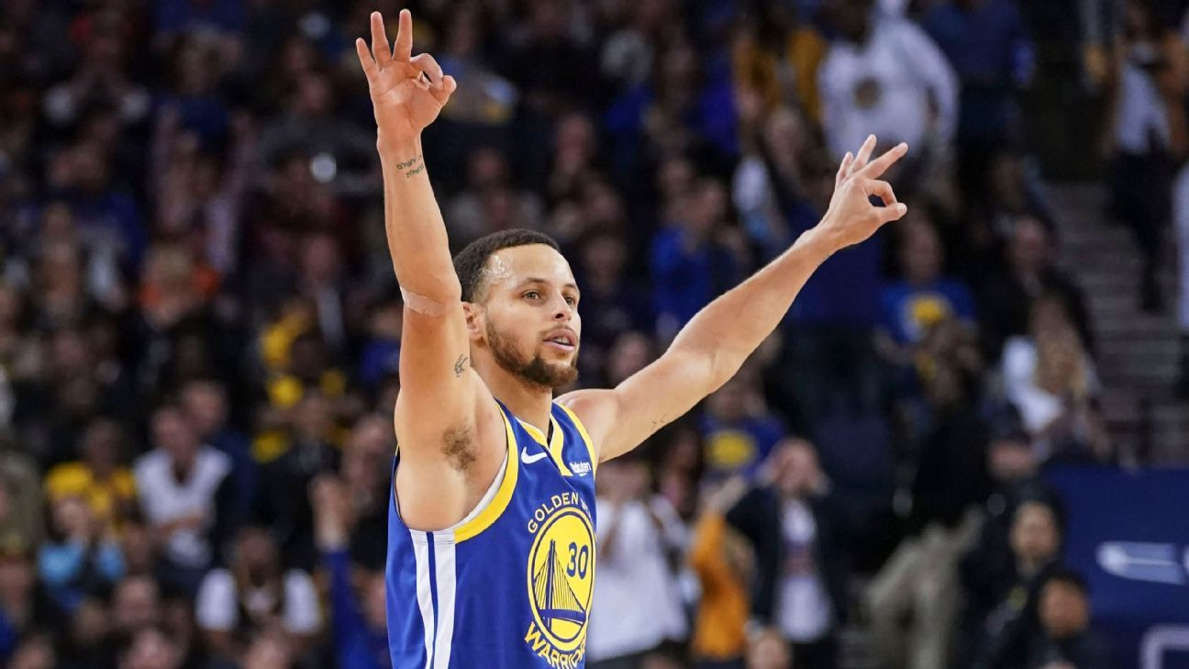
I'm not scared to be seen

Slide 34
I make no apologies
This is me

Slide 36
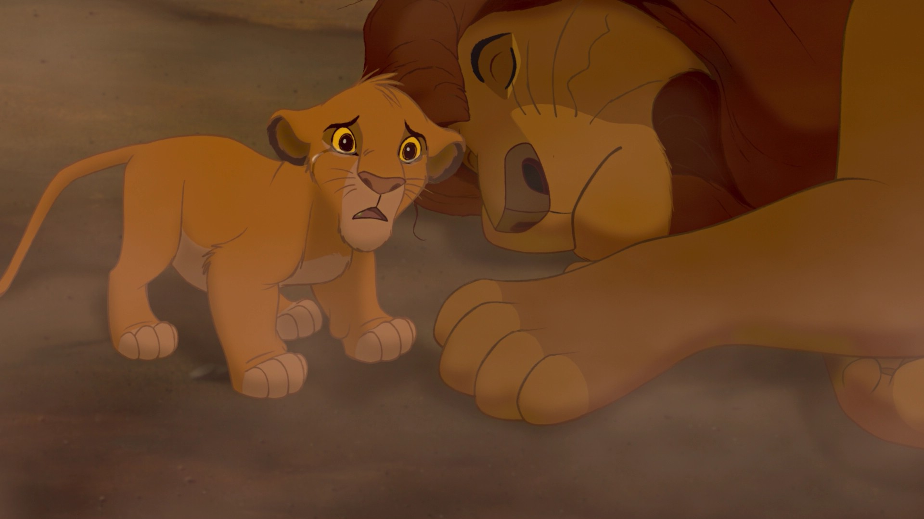
And I know that I deserve your love

Slide 37
There’s nothing I am not worthy of

Slide 38
When the sharpest words wanna cut me down

Slide 39
I'm gonna send a flood gonna drown them out

Slide 40
This is brave
this is bruised

Slide 41
This is me
This is who I'm meant to be

Slide 42
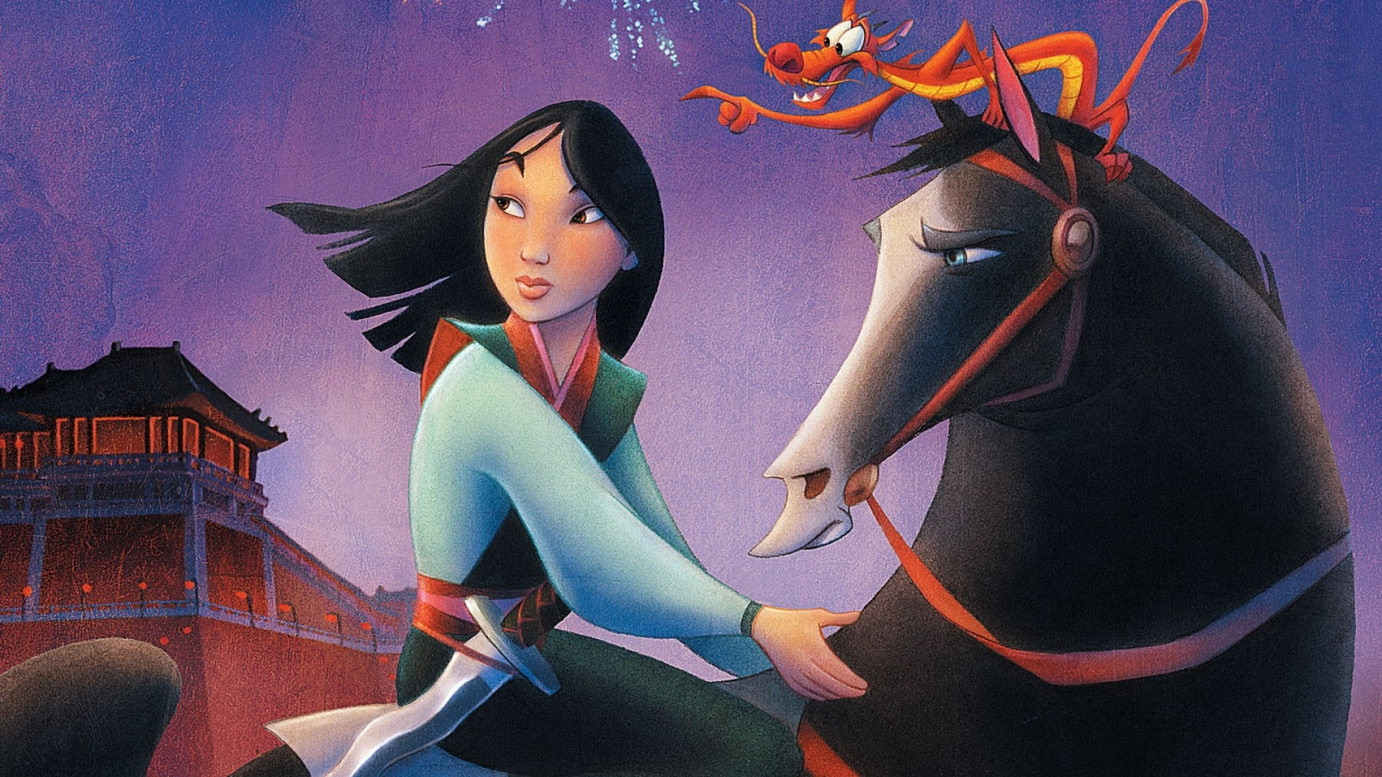
Look out cause here I come

Slide 43
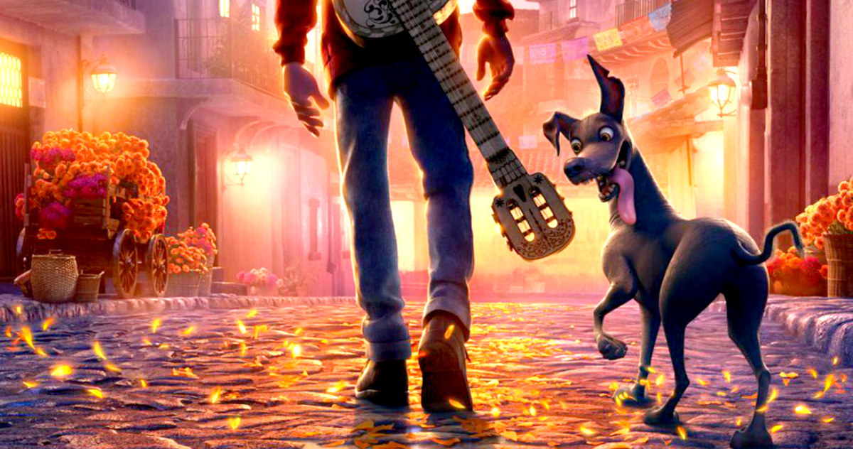
And I’m marching on to the beat I drum

Slide 44
I'm not scared to be seen

Slide 45
I make no apologies
This is me

Slide 46
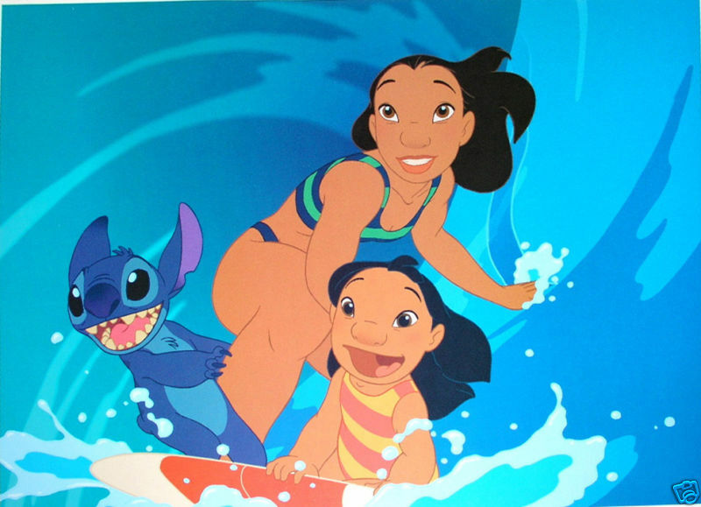
Gonna drown them out
I'm gonna send a flood

Slide 47
This is me

