Slide 1
Look at me now
—— 与down 有关的短语
设计制作：华南师范大学外国语言文化学院 陈丹
广东省河源市三角中学 巫超

Slide 2
I said this time next year

Slide 3
I'm gonna be the one to do
Everything and more you said I couldn't do

Slide 4
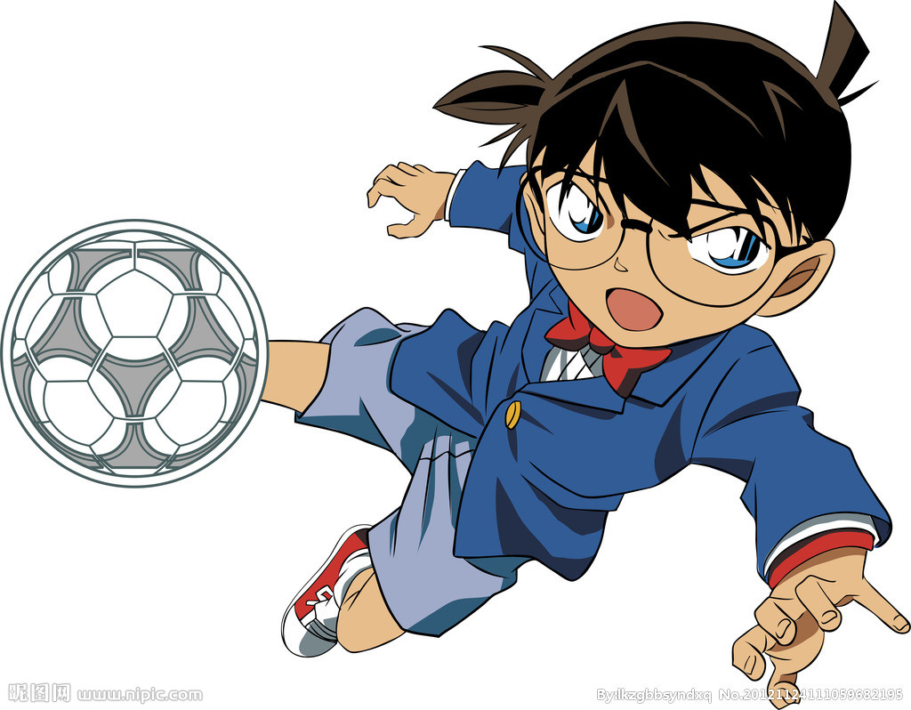
This one is for you

Slide 5
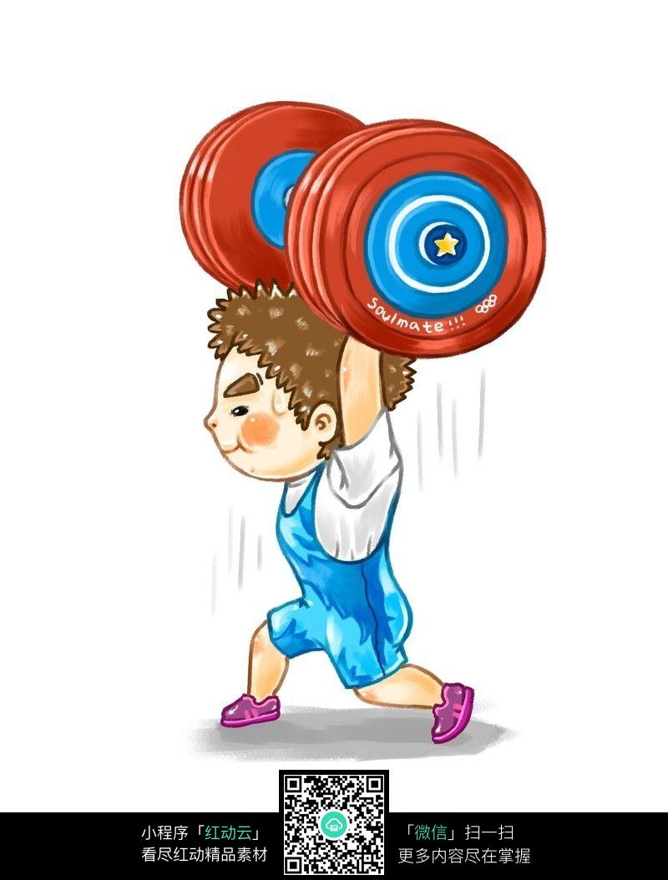
This time next year
I'm gonna be
stronger
A little bit
taller

Slide 6
Top is my
only view

Slide 7
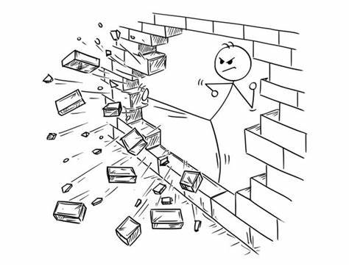
I'm kicking in the door now
Better get out of my way

Slide 8
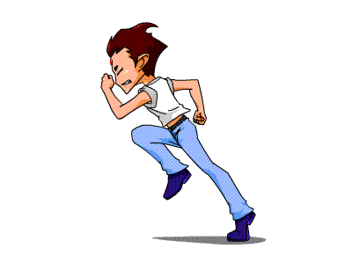
You left with nothing to say
Never really saw me coming

Slide 9
This is for everybody
Who always put me down

Slide 10
I hope you open up your eyes
And take a good look at me now

Slide 11
Take a good look at me now

Slide 12
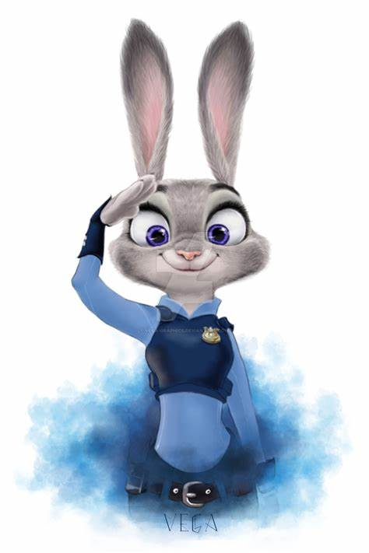
Cause this time next year
I'm gonna walk down these halls
And show my face
for the world to see
Gonna see me

Slide 13
And I'm gonna call
every girl that
turned me down

Slide 14
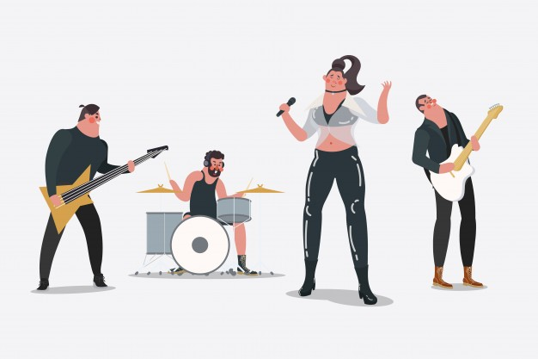
And tell them now that
I'm just too busy
Cause I don't have the time

Slide 15
And its funny how
My so called friends
Who always
left me alone
Suddenly running into me
And blowing up my phone

Slide 16
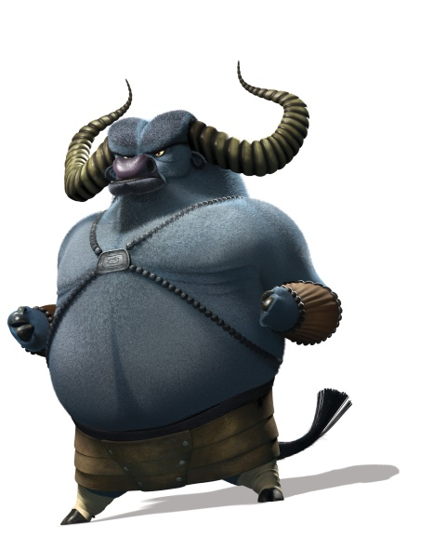
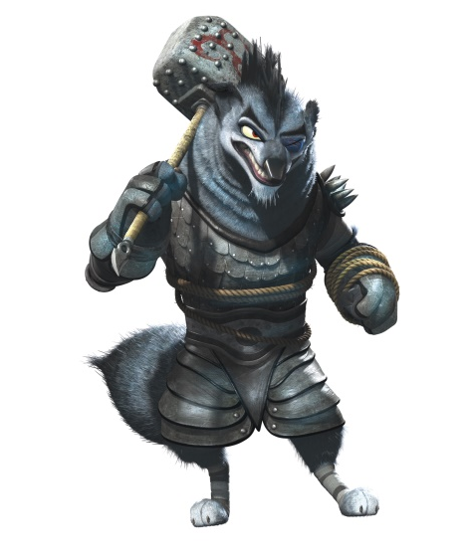
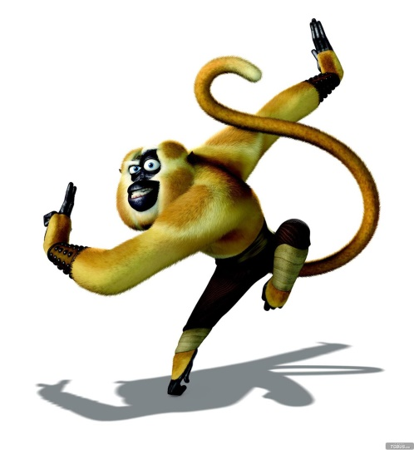
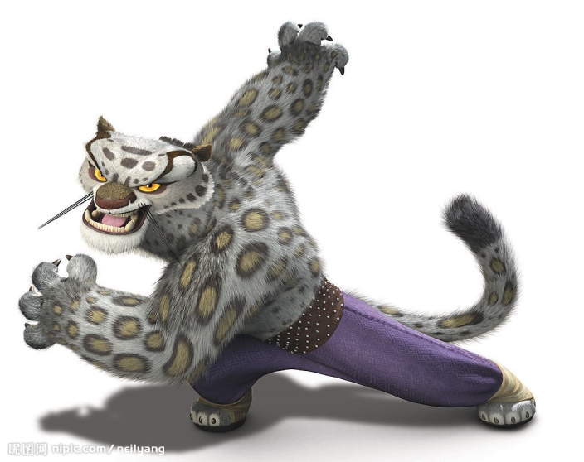
I'm kicking in the door now
Better get out of my way

Slide 17
Never really saw me coming
You left with nothing to say
I'm kicking in the door now
Better get out of my way

Slide 18
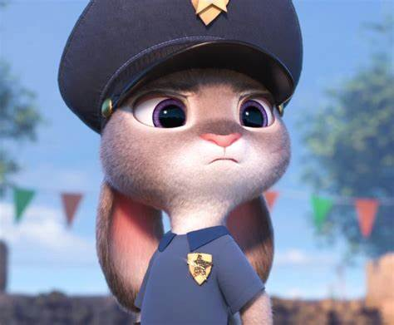
This is for everybody
Who always put me down

Slide 19
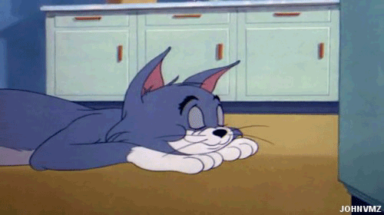
Take a good look at me now
I hope you open up your eyes
And take a good look at me now

Slide 20
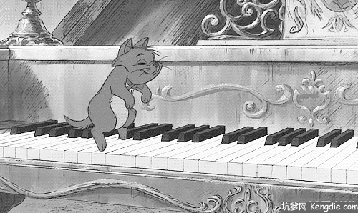
Oh baby Take a good look at me now

Slide 22
Take a good look at me now
This is for everybody who always put me down I hope you open up your eyes And take a good look at me now...
Oh, look at me now Oh this one is dedicated to all of the people who said I would be nothing Look at me now...
I'm kicking in the door now Better get out of my way Never really saw me coming You left with nothing to say

