Slide 1
Break into the Dark
——与into有关的短语: break into
设计制作：华南师范大学外国语言文化学院 黄祖健
广东省河源市连平县第一初级中学 李宁艳

Slide 2
Back when I was a kid
my mom told me how to let go from everything.

Slide 3
"Find your inner peace" that's what she told me

Slide 4
Cause nothing, nothing comes for free

Slide 5
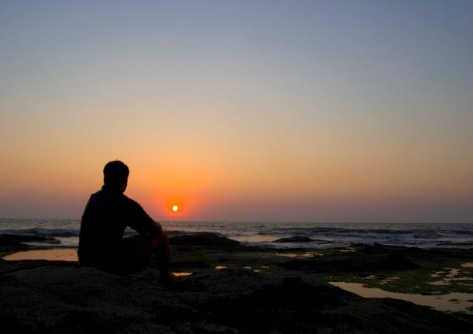
Whenever I feel like I’m all alone,
I will find the glory
deep inside my soul.

Slide 6
And I'll fight for my passion in life

Slide 7
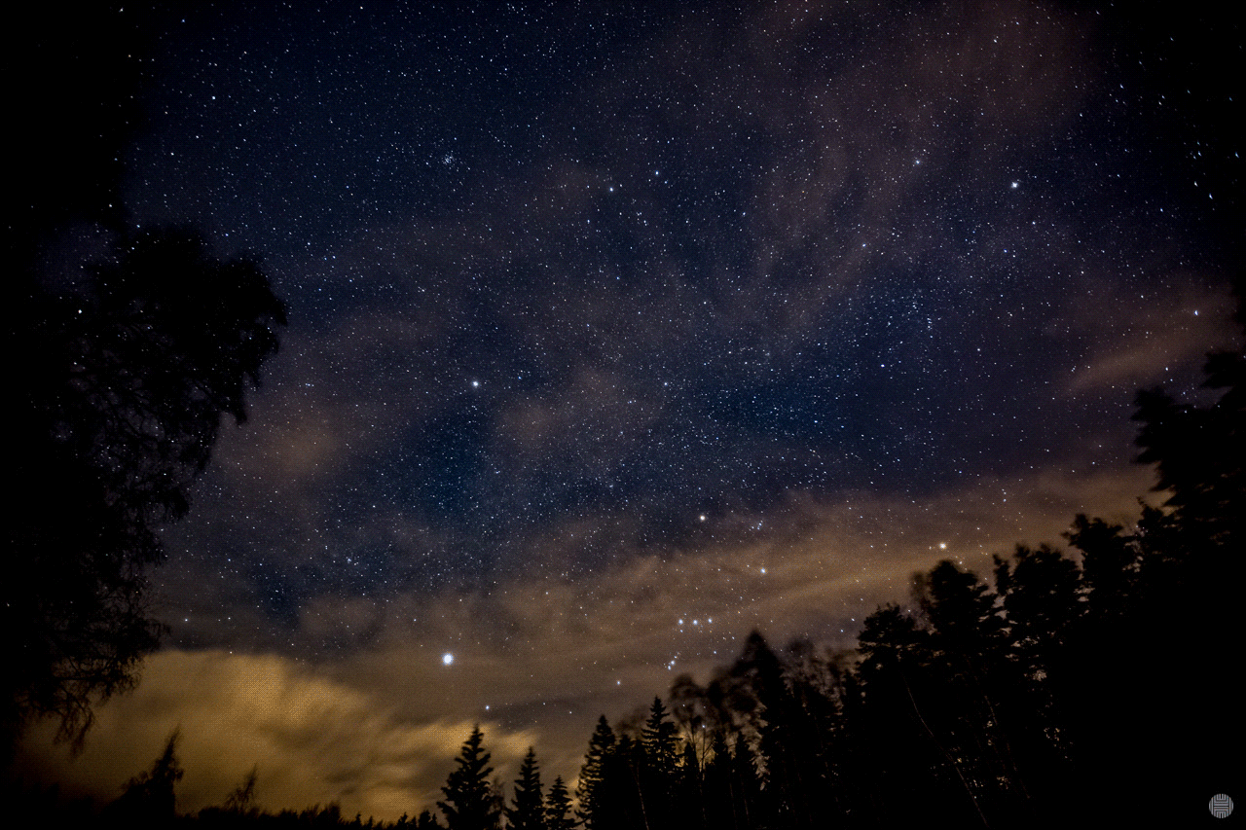
Give everything I have in me and break into the dark

Slide 8
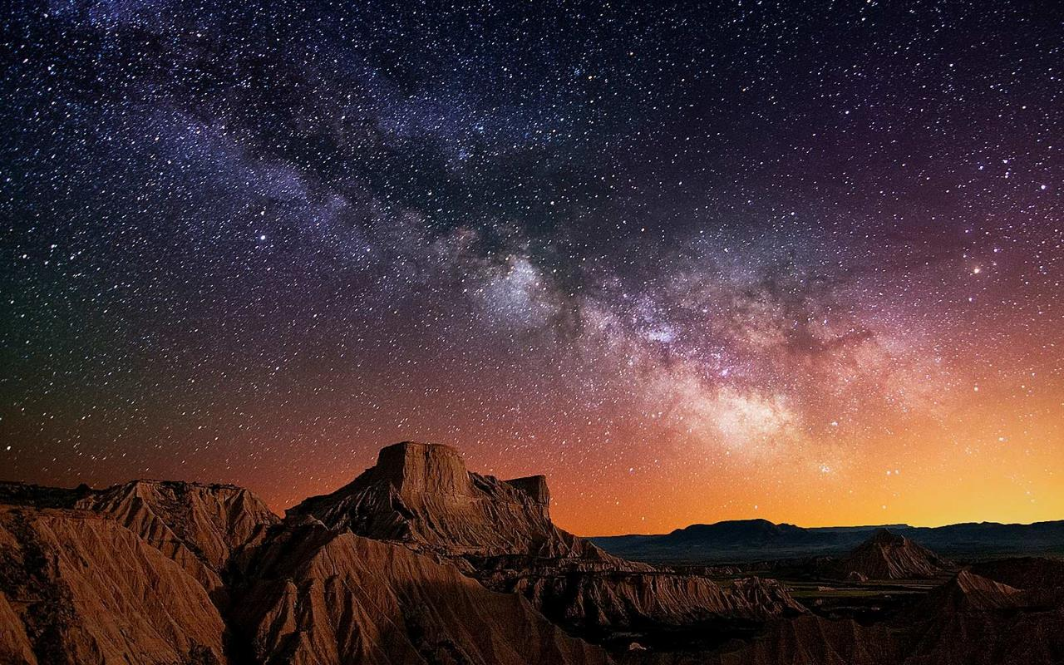
I’ll break into the dark

Slide 9
I’ll give everything I have, and everything I had

Slide 10
I’m one step closer to the light

Slide 11
I’ll break into the dark,
I’ll break into the dark

Slide 12
Deep underneath your skin,
there lies a new sin
that’s life we’re living in.

Slide 13
But I'll be standing strong in all the fights I’ve lost
cause that’s, that’s just who we are

Slide 14
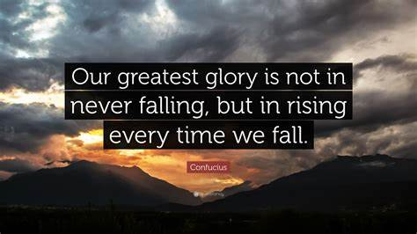
Whenever I feel like I’m all alone,
I will find the glory
deep inside my soul.

Slide 15
And I’ll fight for my passion in life

Slide 16
Give everything I have in me and break into the dark

Slide 17
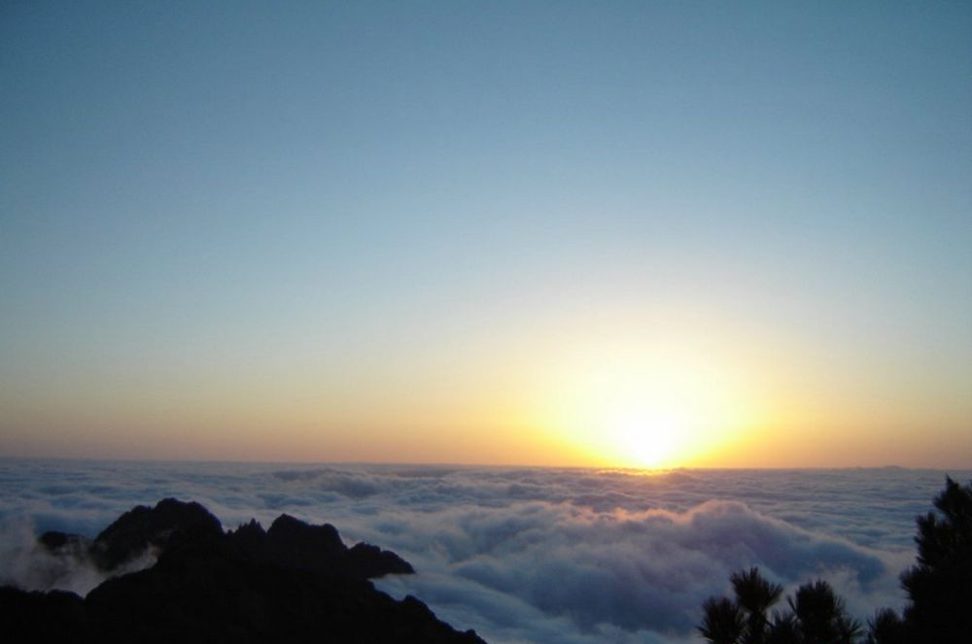
I’ll break into the dark

Slide 18
I’ll give everything I have, and everything I have

Slide 19
I’m one step closer to the light

Slide 20
I’ll break into the dark
I’ll break into the dark

Slide 21
No, I‘m not gonna give up,
I'm gonna give it my all.

Slide 22
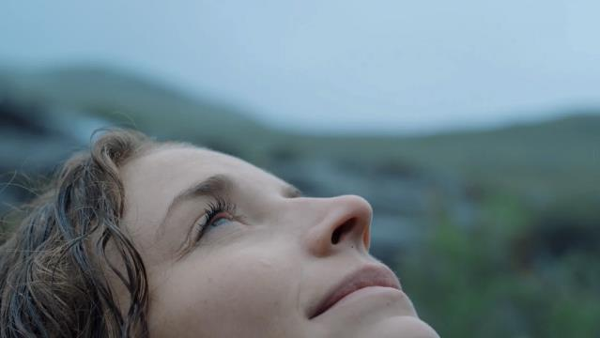
Rise above the ground,
no more looking down and shine.

Slide 23
And break into the dark

Slide 24
I'll break into the dark, oh

Slide 25
I’ll give everything I have, and everything I had
and one step closer to the light

Slide 26
I’ll break into the dark,
I’ll break into the dark.
THANK YOU!

