Slide 1
You raise me up 主题：与“on”有关的短语 作者：华南师范大学外国语言文化学院 冯东晖 广东省河源市连平县第一初级中学 谢志旺

Slide 2
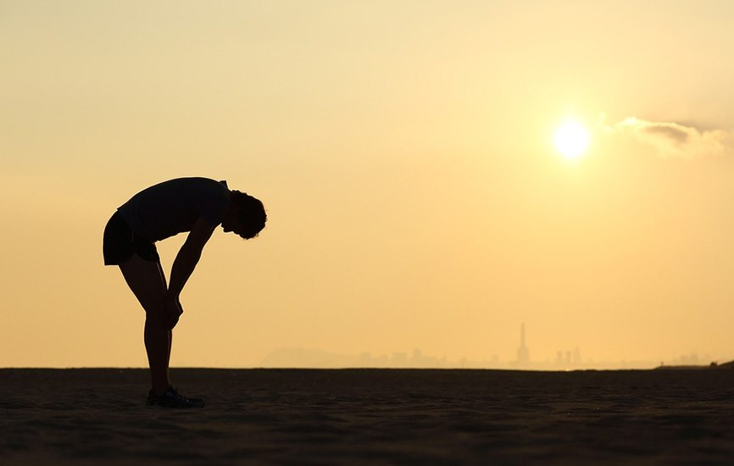
When I am down and
oh my soul
so weary

Slide 3
When troubles come

Slide 4
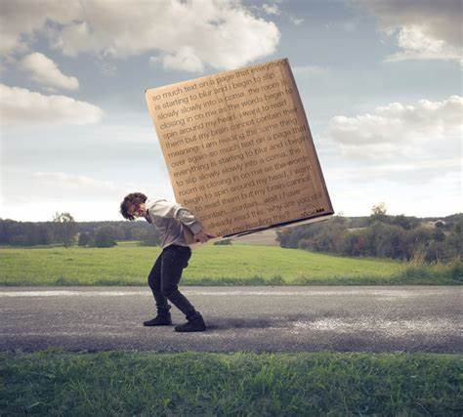
And my heart burdened be

Slide 5
Then
I am still
and wait here
in the silence

Slide 6
Until you come and sit a while with me

Slide 7
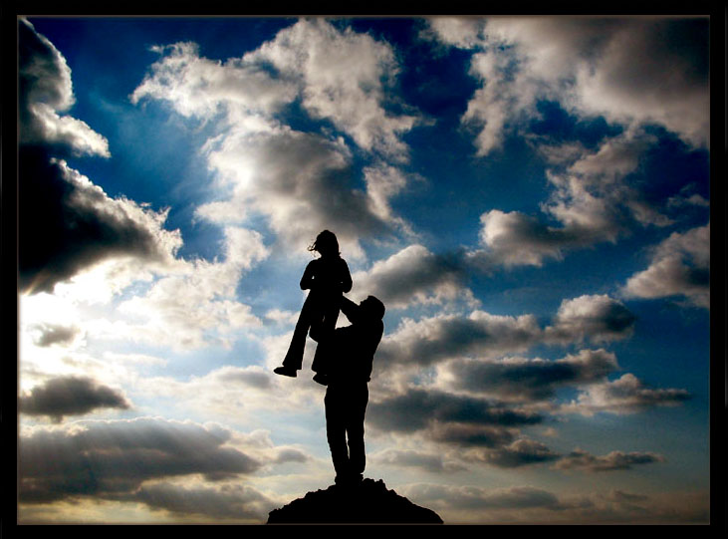
You raise me up

Slide 8
So I can stand on mountains

Slide 9
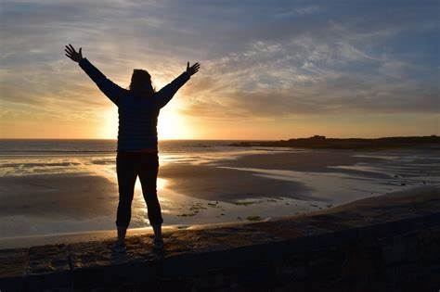
You raise me up

Slide 10
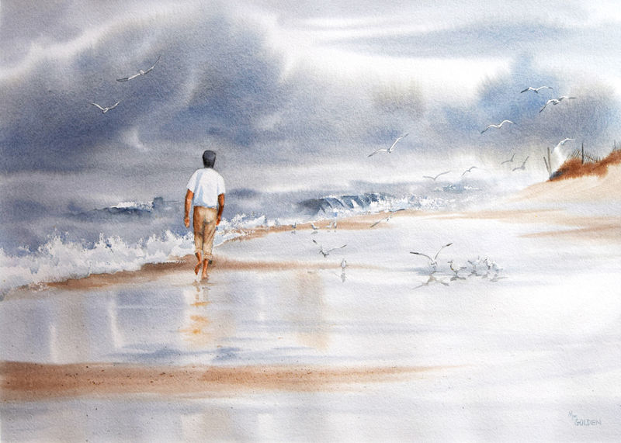
To walk on stormy seas

Slide 11
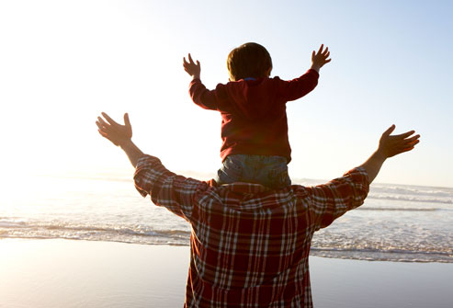
I am strong
when I am on
your
shoulders

Slide 13
You raise me up

Slide 14
So I can stand on mountains

Slide 15
You raise me up

Slide 16
To walk on stormy seas

Slide 17
I am strong
when I am on
your
shoulders

Slide 19
There is no life –
no life without its hunger

Slide 20
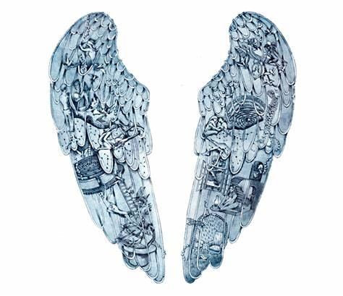
Each
restless
heart
beats
so
imperfectly

Slide 21
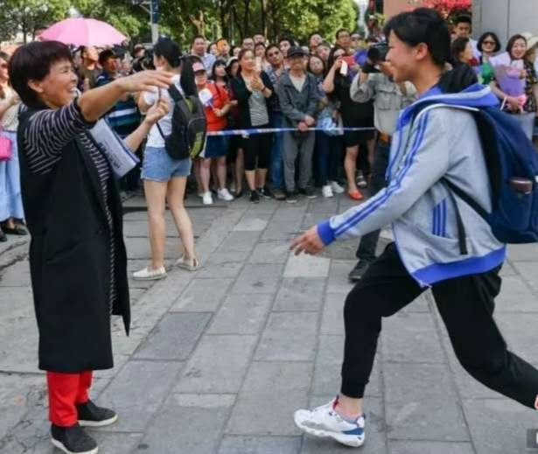
But
when
you come

Slide 22
And I am
filled with
wonder

Slide 23
Sometimes
I think I glimpse eternity

Slide 24
You raise me up

Slide 25
So I can stand on mountains

Slide 26
You raise me up

Slide 27
To walk on stormy seas

Slide 28
I am strong
when I am on
your
shoulders

