Slide 1
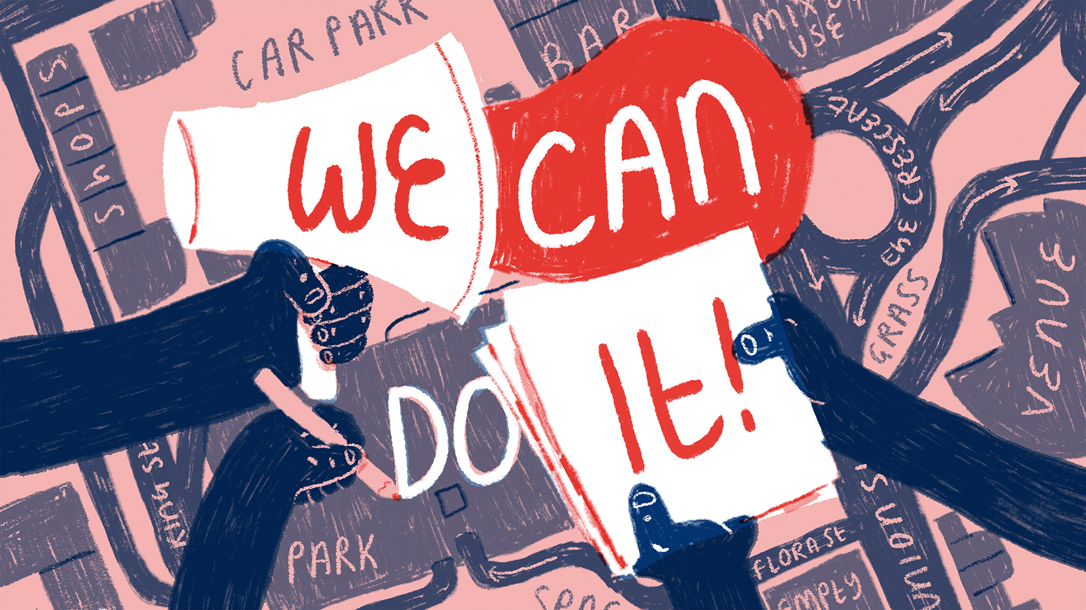
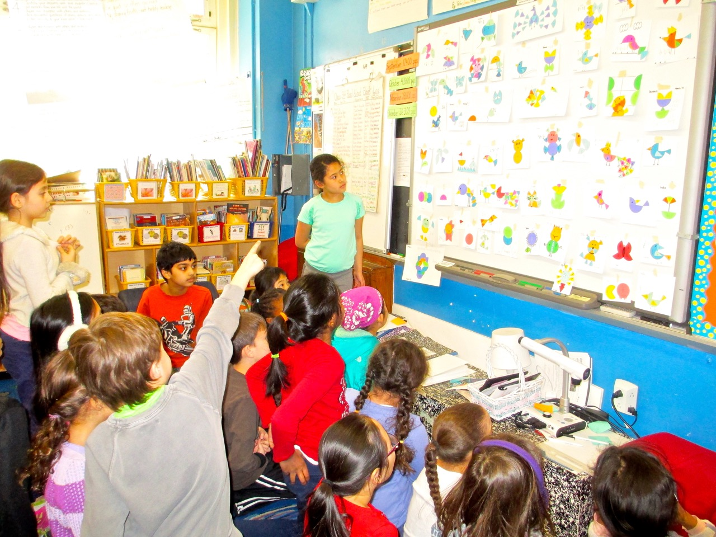
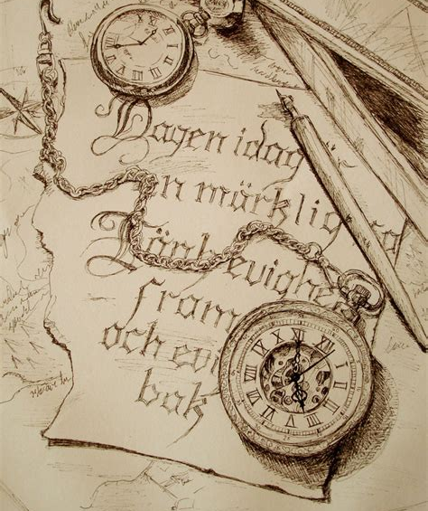
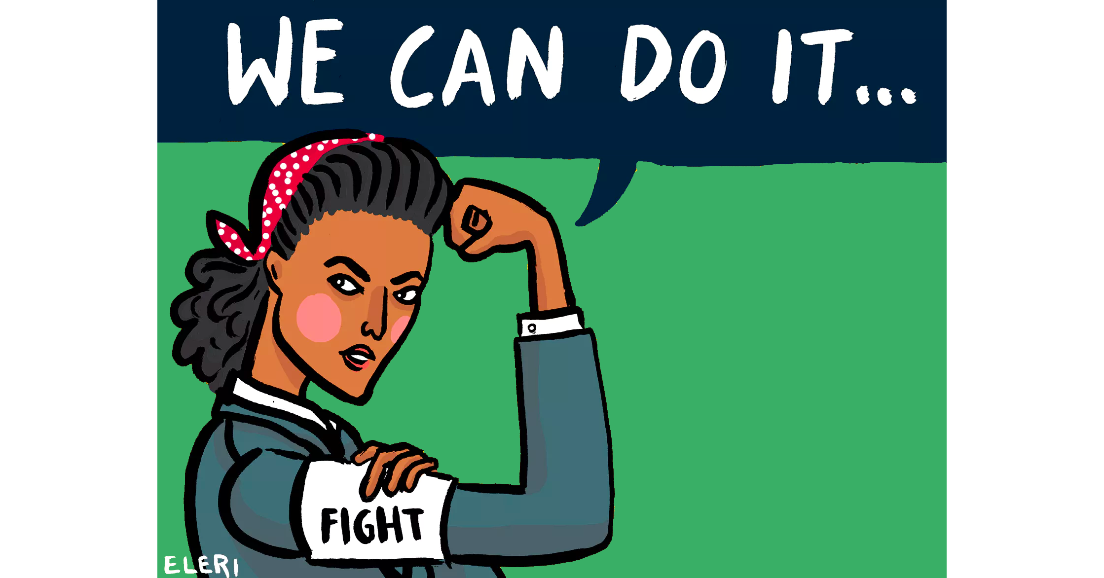
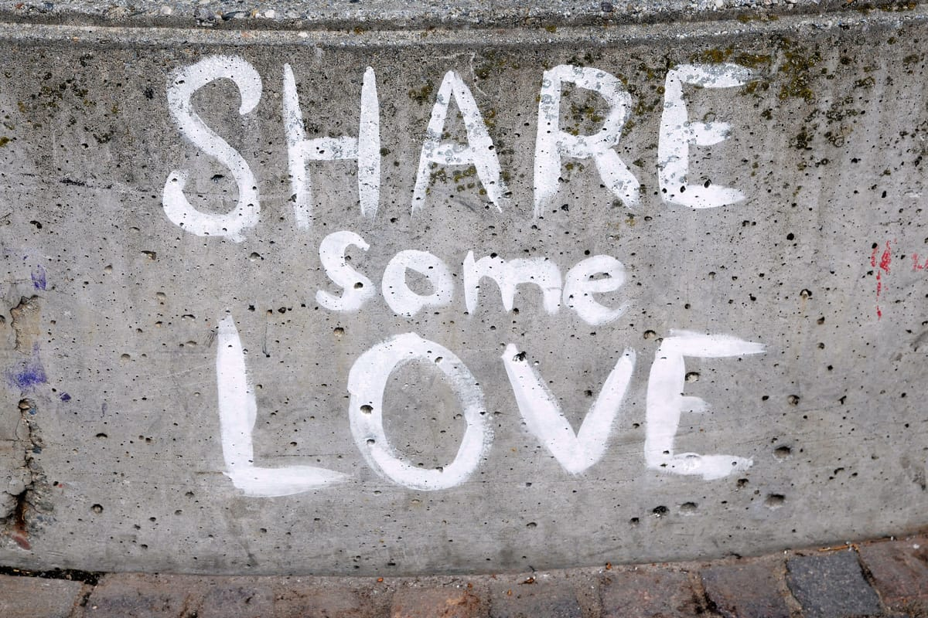
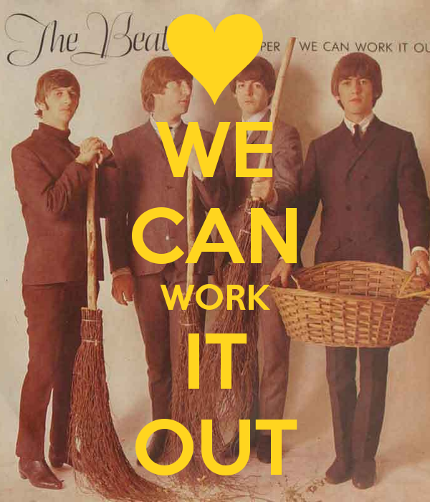
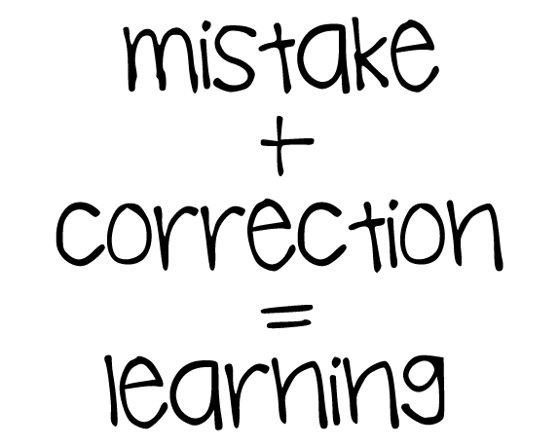
we can work it out
与Out有关的短语
华南师范大学外国语言文化学院 姚瑶
广东省河源市隆街中学 叶春梅
I can't see why everybody has to fight
We should live to the fullest each and everyday
Life's too short, there must be another way
And if we just forgive In this world we live
Cos two wrongs don't make a right
(Together we can change it)
Cos there's no stop in time
(Together we can make it)
A fall in life is justified
That is what they say
And share some love
We can work it out
We can work it out
We can work it out
And if we just forgive, Within this world we live
And share some love
We can work it out
We can work it out
Yes, we can
We can work it out
(Together we can change it)
Together we can change it
Maybe we can make it
And if we just forgive
Within this world we live
If we life is too short
We can work it out
If we come together we can change it
We can work it
And together we can make it
And if we just believe in love
Within this world we live to love
(Just miracle) Just miracle
(Just very short)
We can work it out
Life's too short, there's no need to be afraid
And yesterday's past mistakes
Shouldn't bring us down
We can work it out
(Together we can change it)
We can work it out
(Together we can make it)

