Slide 1
Song: Can’t take my eyes off you Teaching Point: 与off有关的短语 Editor: 华南师范大学外国语言文化学院 温宁慧 广东省河源市连平县崧岭中学 梁晓君

Slide 2
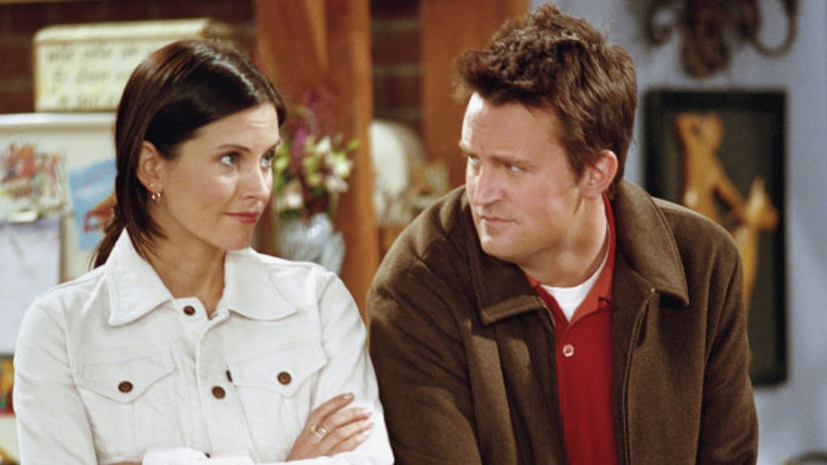
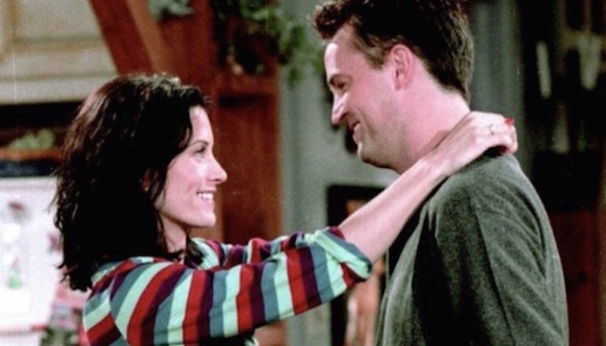

Slide 4
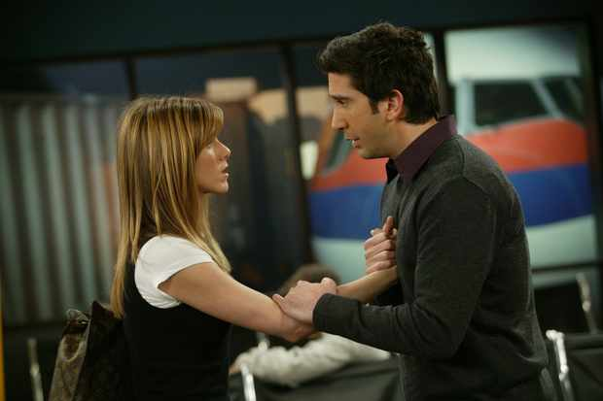
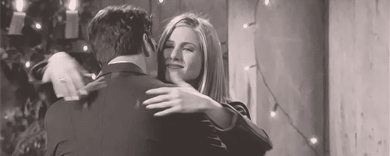

Slide 5
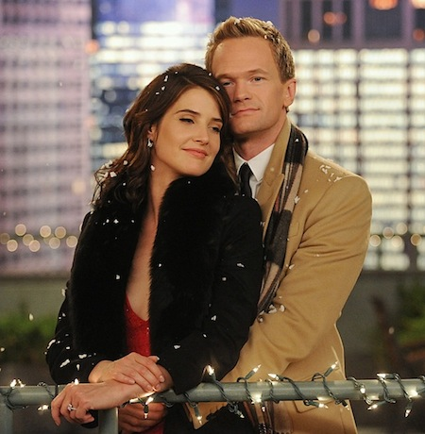

Slide 6
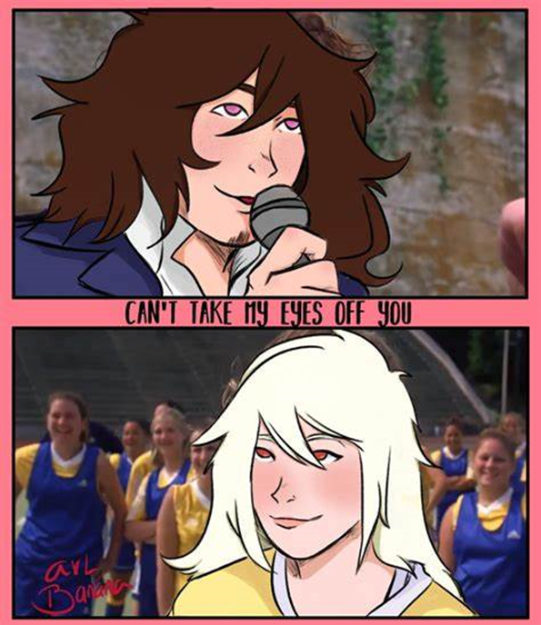
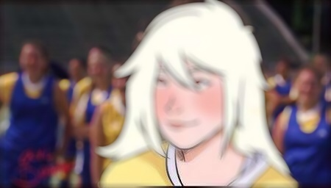
You're just too good to be true
Can't take my eyes off you

Slide 7
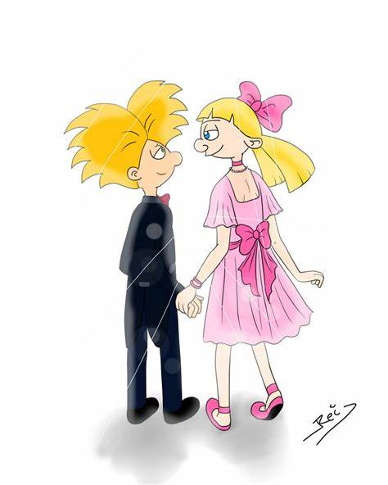
You'd be like heaven to touch
Oh, I want to hold you so much

Slide 8
At long last love has arrived
And I thank God I'm alive

Slide 9
You're just too good to be true

Slide 10
I can't take my eyes off you

Slide 11
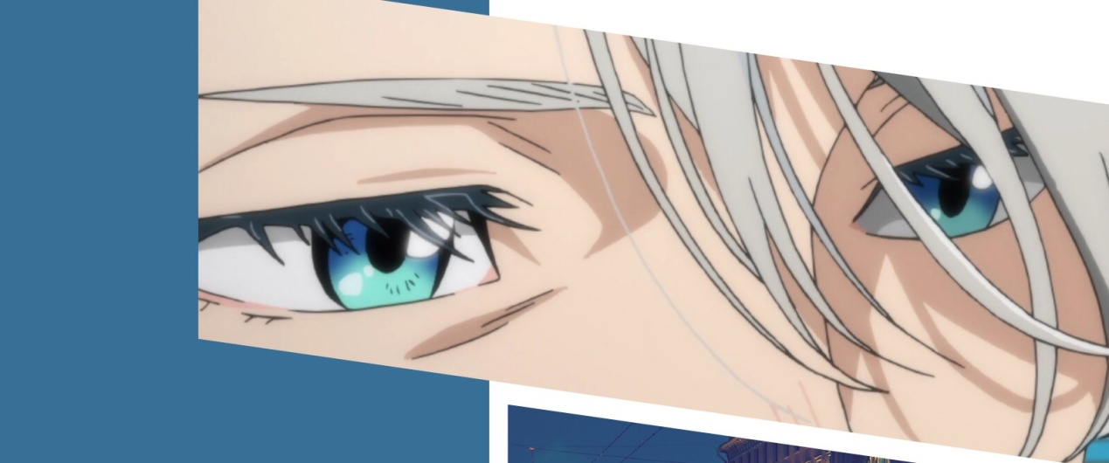
Pardon the way that I stare

Slide 12
There's nothing else to compare

Slide 13
The thought of you leaves me weak

Slide 14
There're no words left to speak

Slide 15
But if you feel like I feel

Slide 16
Oh, did let me know that it's real

Slide 18
Can't take my eyes off you

Slide 20
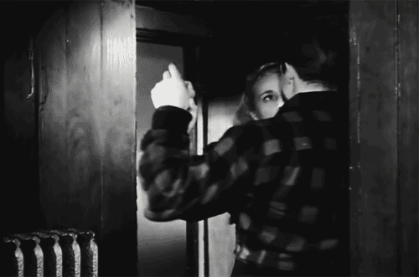

Slide 21
I love you baby

Slide 22
And if it's quite all right

Slide 23
I need you baby
To warm a lonely night

Slide 24
I love you baby
Trust in me when I say

Slide 25
Oh, pretty baby
Don't bring me down, I pray

Slide 26
Oh, pretty baby

Slide 27
Now that I found you, stay

Slide 28
And let me love you, baby, let me love you

Slide 29
You're just too good to be true

Slide 30
Can't take my eyes off you

Slide 31
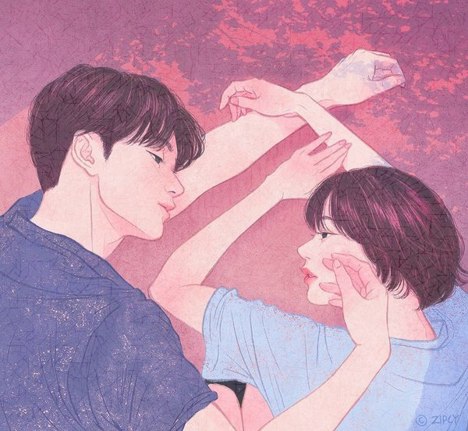
You'd be like heaven to touch

Slide 32
Oh, I want to hold you so much

Slide 33
At long last love has arrived
And I thank God I'm alive

Slide 34
You're just too good to be true
Can't take my eyes off you

Slide 36
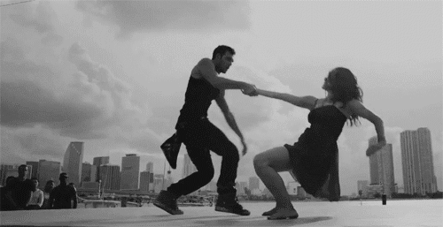
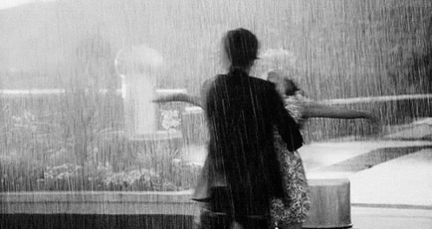

Slide 37
I love you baby
And if it's quite all right

Slide 38
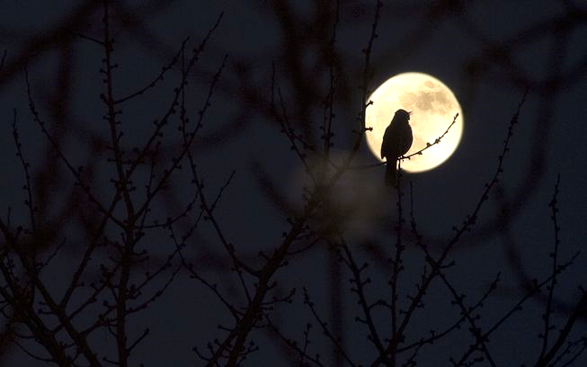
I need you baby
To warm a lonely night

Slide 39
Trust in me when I say
I love you baby

Slide 40
Oh, pretty baby
Don't bring me down, I pray

Slide 41
Oh, pretty baby
Now that I found you, stay

Slide 42
Oh, pretty baby

Slide 43
Trust in me when I say

Slide 44
I love you baby, and if it's quite all right

Slide 45
I need you baby

Slide 46
To warm a lonely night

Slide 47
I love you baby

Slide 48
End

