Slide 1
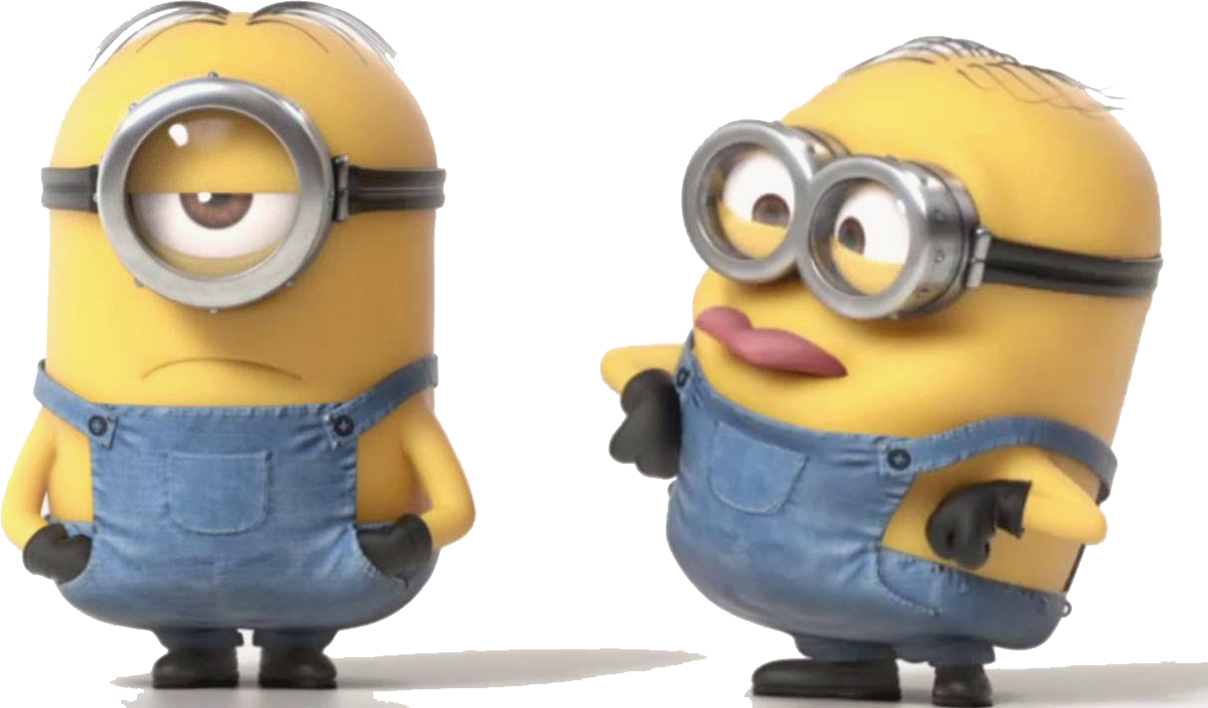
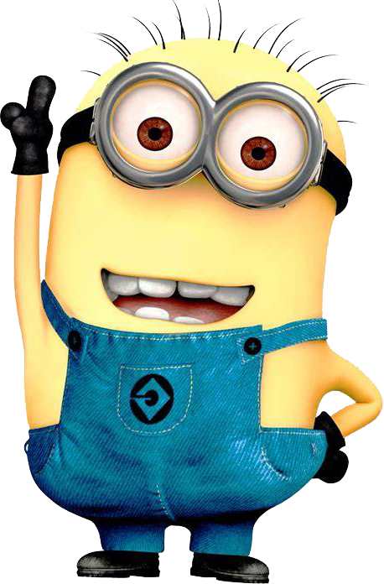
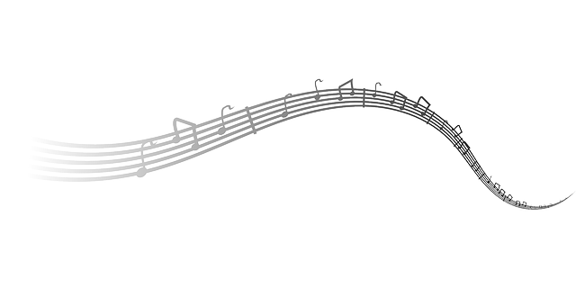
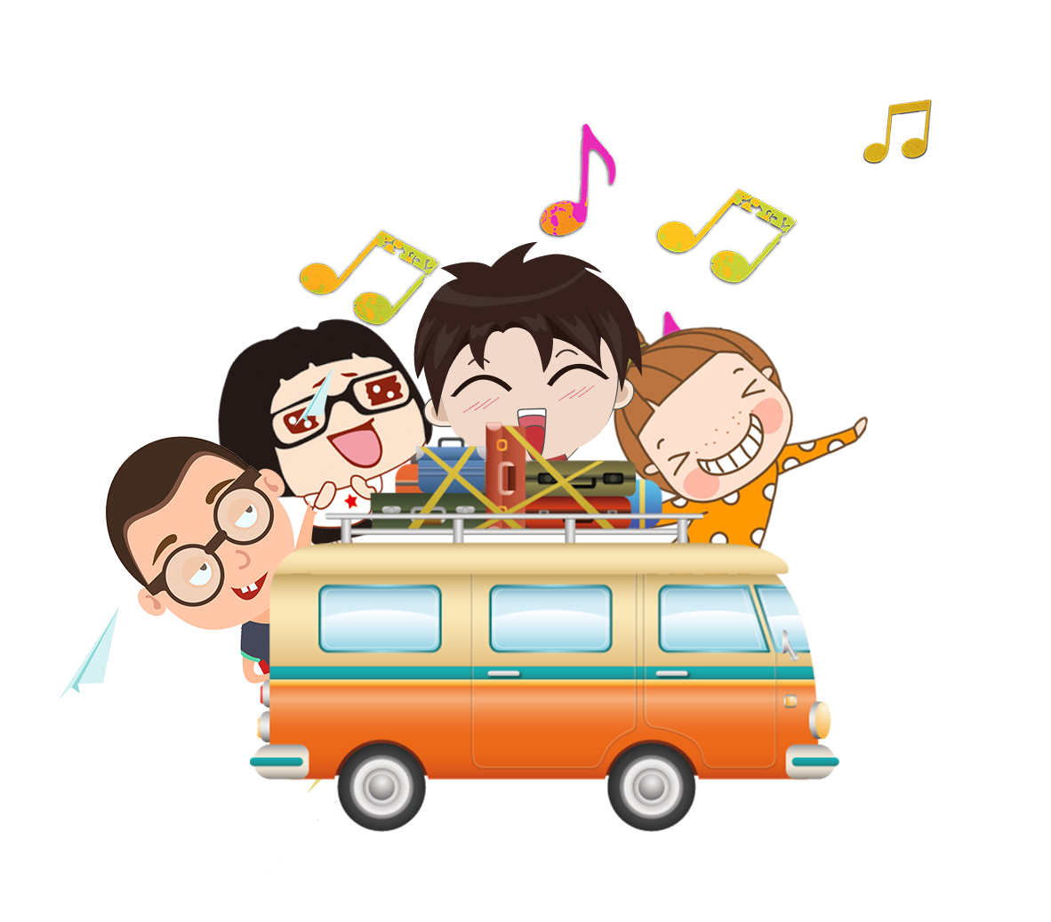
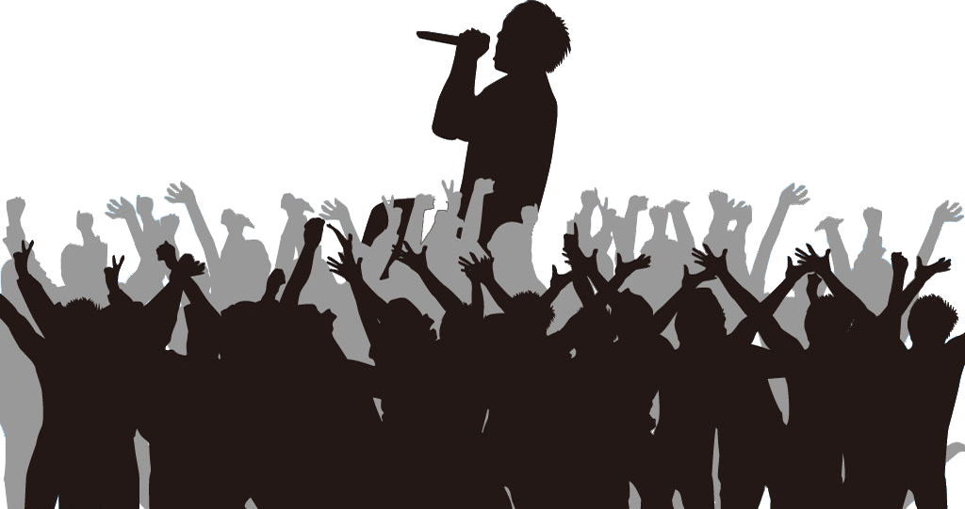
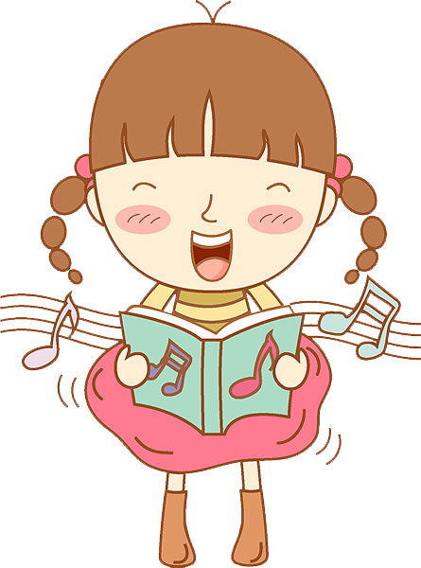
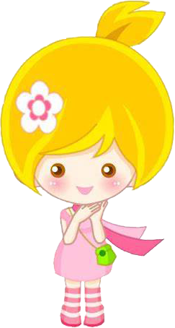
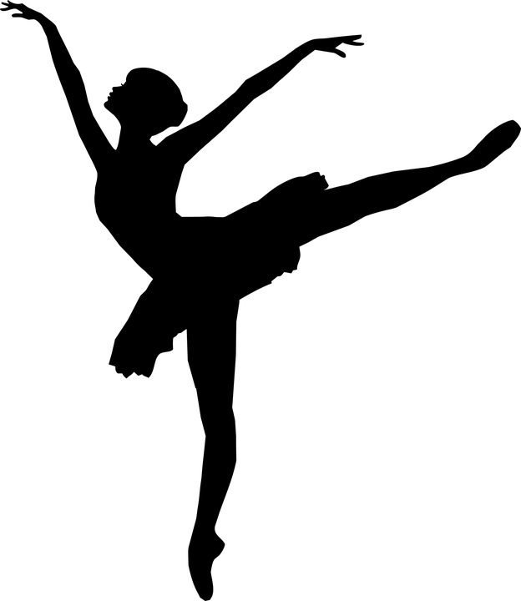
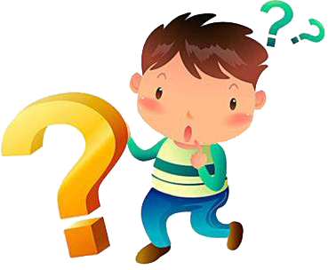
I wanna sing it out to everybody
Who can live without it,
I'm nothing special,
'Cause everyone listens
Thanks for all the joy
So I say
Thanks for all the joy
Who found out that
So I say
Mother says I was a dancer
Without a song or a dance what are we?
What would life be?
She says I began to sing
What a joy!
I ask in all honesty
And I've often wondered,
I’m a bit of a bore
So I say
in fact
they're bringing
But I have a talent,
All I want
when I start to sing
So I say
I'm so grateful
Thank you for the music,
Thank you for the music
—ABBA
I've been so lucky,
Thanks for all the joy they're bringing
before I could walk
nothing can capture a heart
long before I could talk
So I say
how did it all start?
thank you for the music,
they’re bringing
thank you for the music
a wonderful thing
What a life!
is to sing it out loud
and proud
I am the girl with golden hair
like a melody can?
Well,
thank you for the music
the songs I'm singing
作者：刘倚佳 华南师范大学外国语言文化学院
曾春花 连平县惠化中学
thank you for the music,
thank you for the music
the songs I’m singing
whoever it was,
For giving it to me
If I tell a joke,
What a chance!
For giving it to me
the songs I’m singing
Who can live without it, I ask in all honesty
Without a song or a dance what are we?
Who can live without it,
Without a song or a dance
What would life be?
For giving it to me
I'm a fan
you've probably heard it before
What would life be?
I ask in all honesty
what are we?

