Slide 1
A Day At A Time
——与at有关的短语
连平县大湖中学 何超嫦
华南师范大学外国语言文化学院 梁宇玉

Slide 2
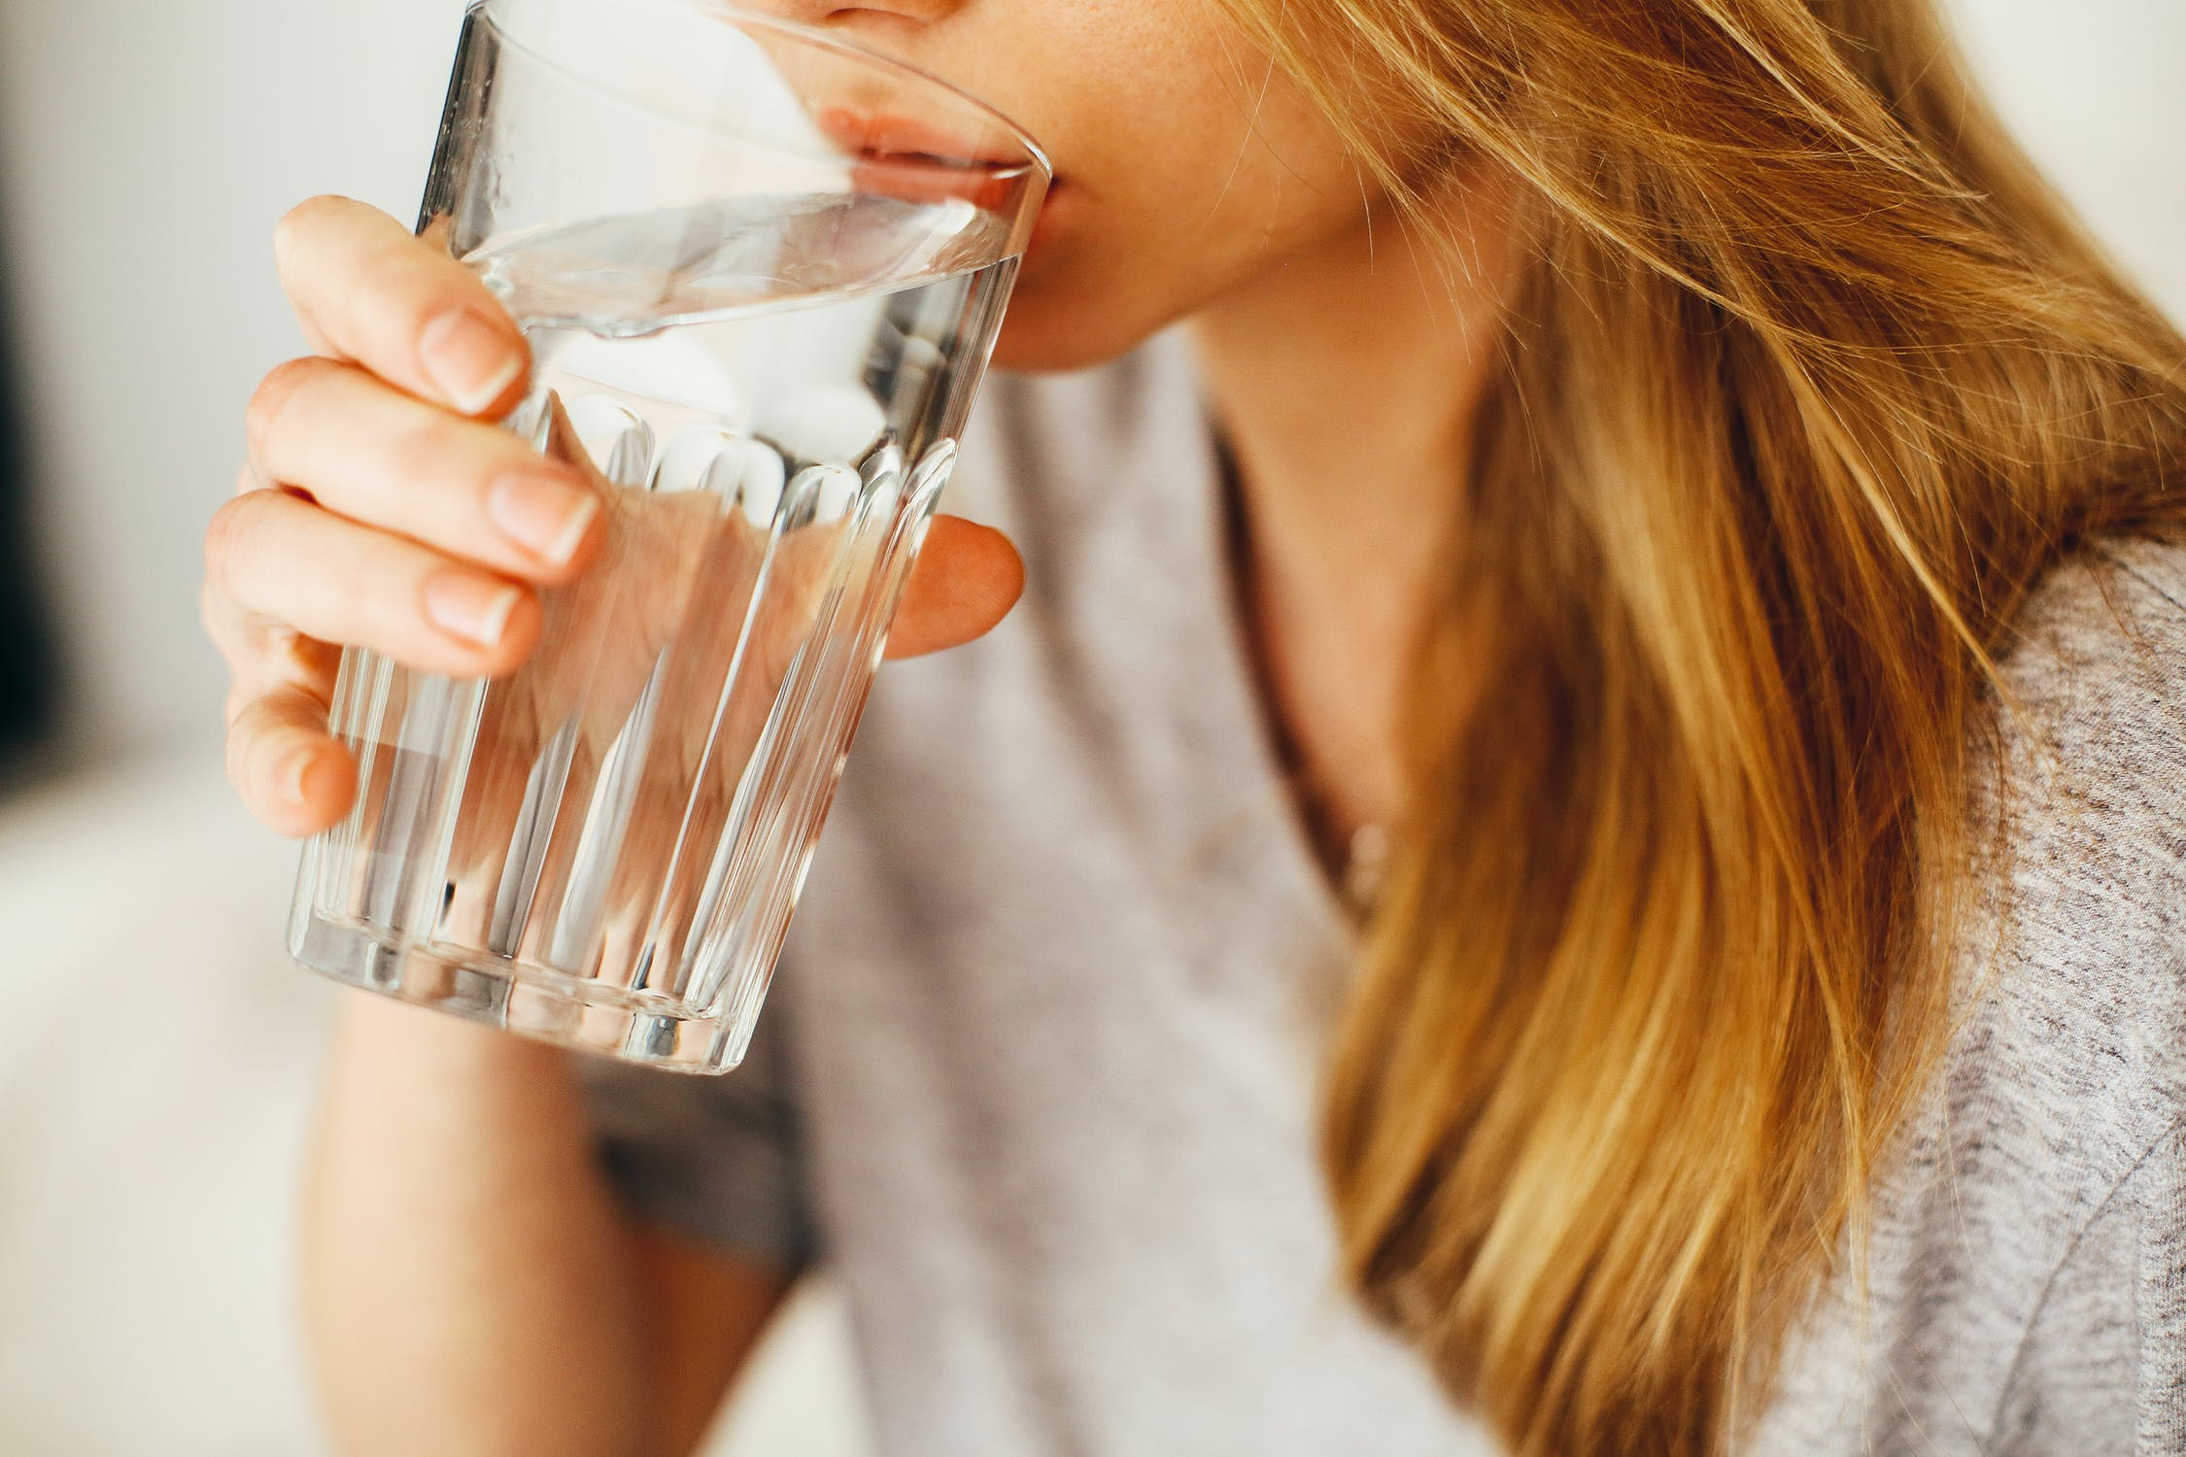
A Day At A Time
I wanna drink from the clearest water

Slide 3
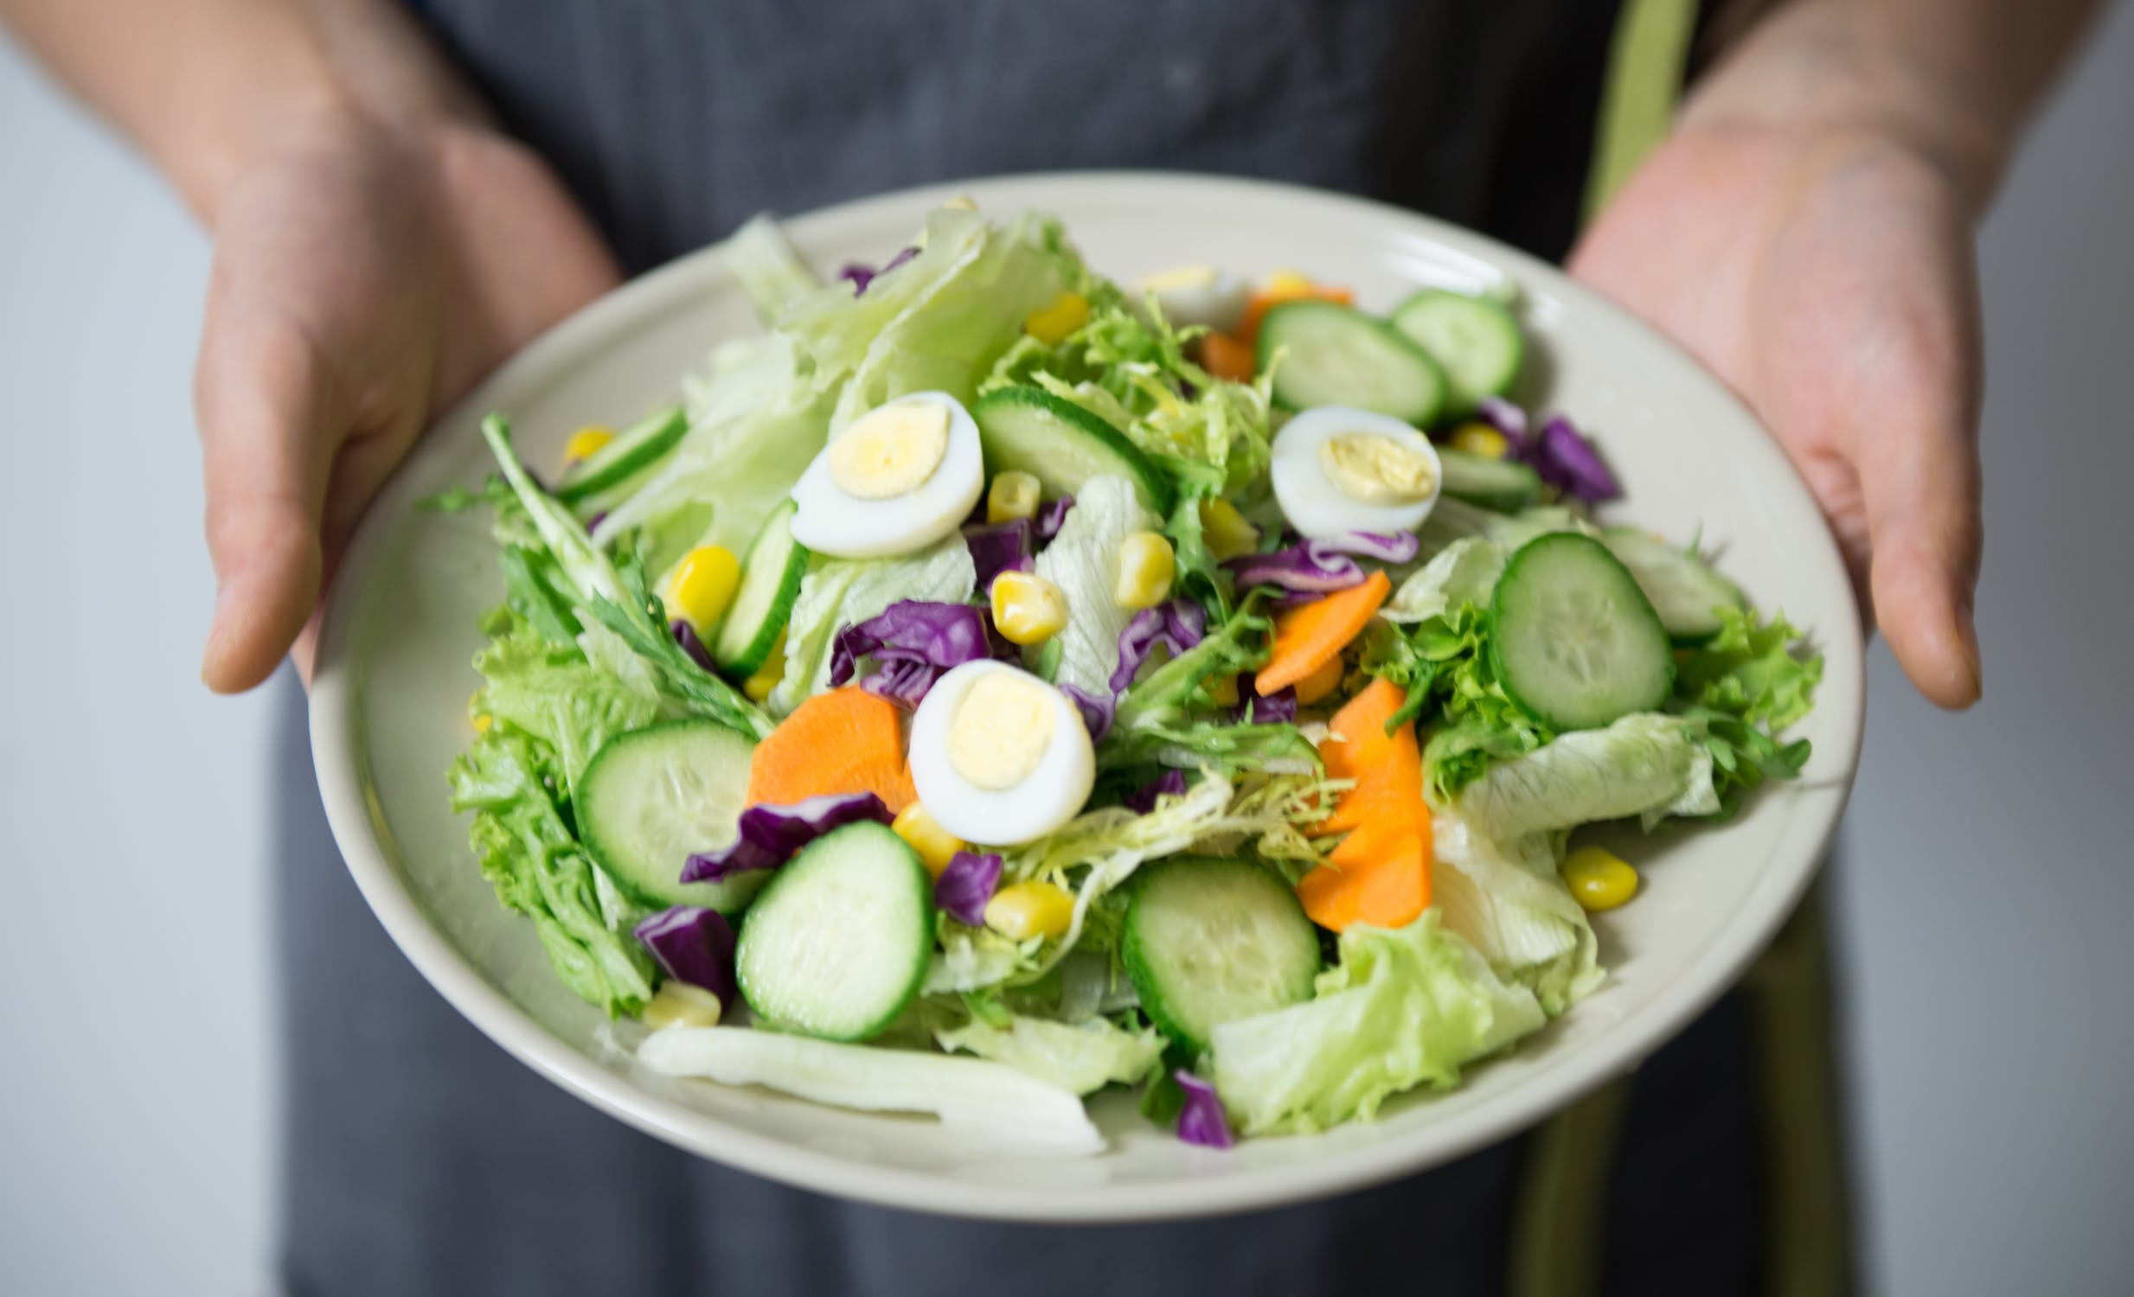
A Day At A Time
I wanna eat the things I ought to

Slide 4
A Day At A Time
I’m just warm I know

Slide 5
A Day At A Time
But I feel strong enough

Slide 6
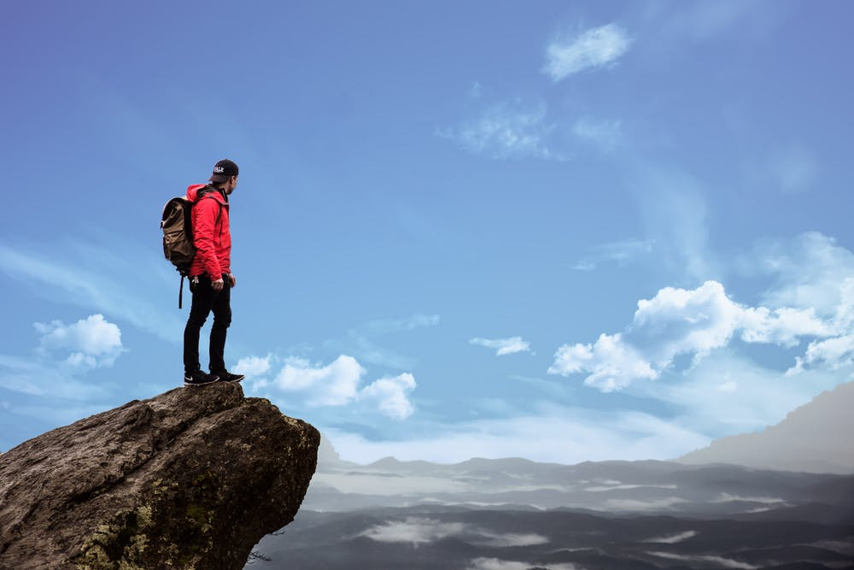
A Day At A Time
I wanna reach the greatest mountain

Slide 7
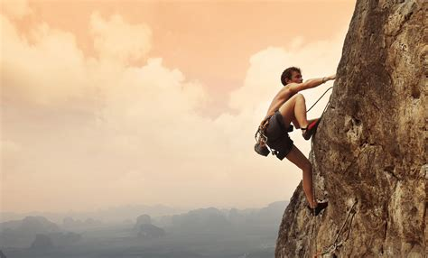
A Day At A Time
Climb I want, without all the shouting

Slide 8
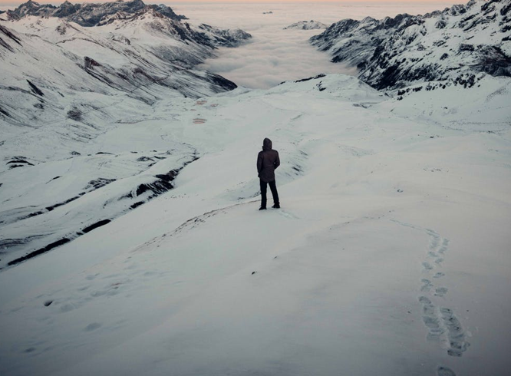
A Day At A Time
I’m Just warm I know

Slide 9
A Day At A Time
But I feel strong enough

Slide 10
A Day At A Time
And clouds wish should be white at least

Slide 11
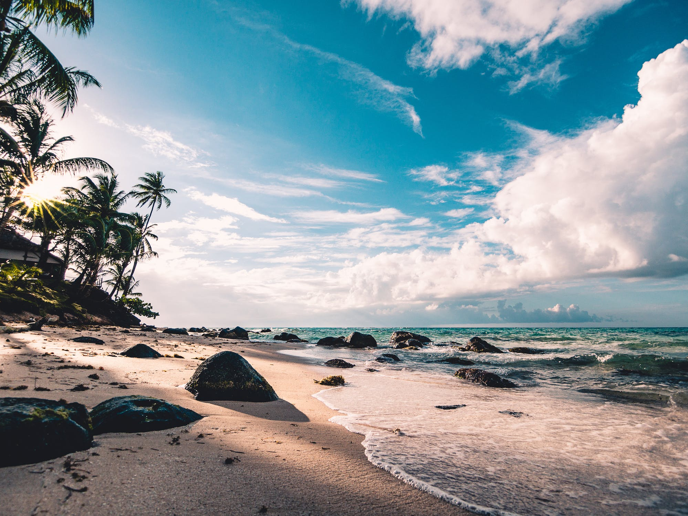
A Day At A Time
And oceans should meet us at the beach

Slide 12
A Day At A Time
And I don't want to overreach

Slide 13
A Day At A Time
I know what's in store

Slide 14
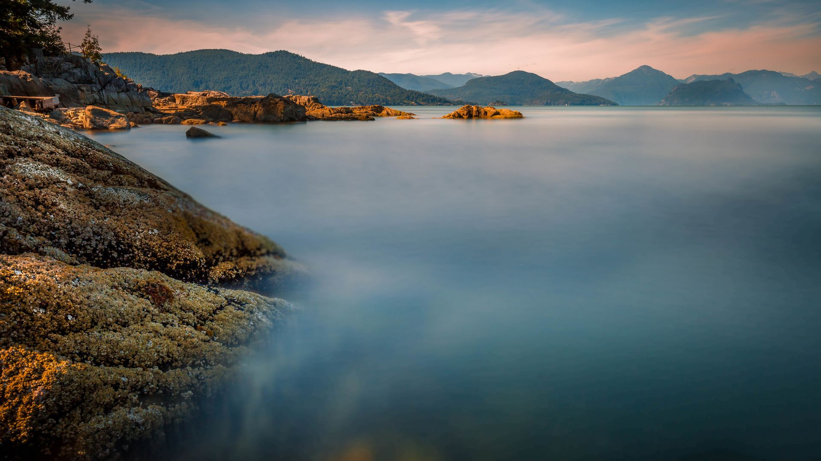
A Day At A Time
Love life a day at a time, boy

Slide 15
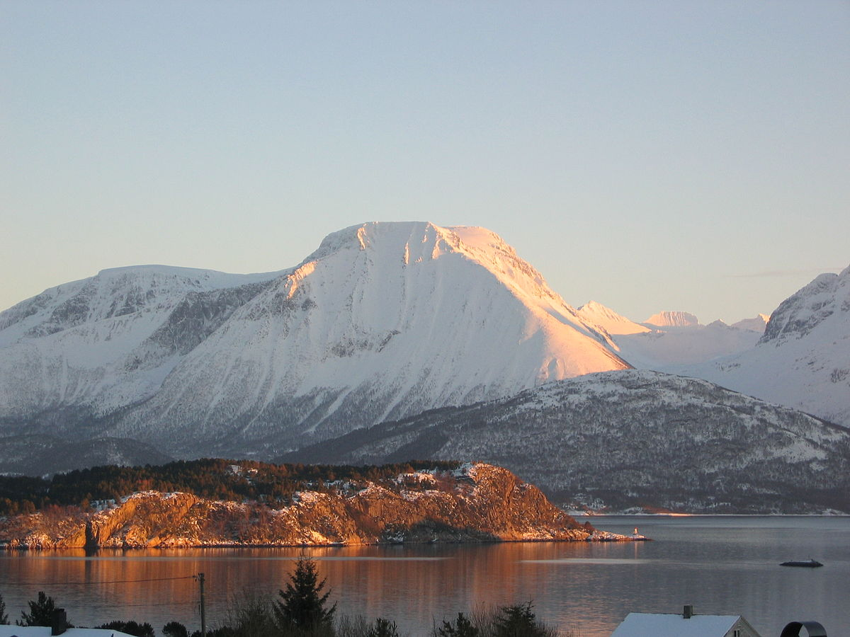
A Day At A Time
Love life a day at a time, girl

Slide 16
A Day At A Time
Love

Slide 17
A Day At A Time

Slide 20
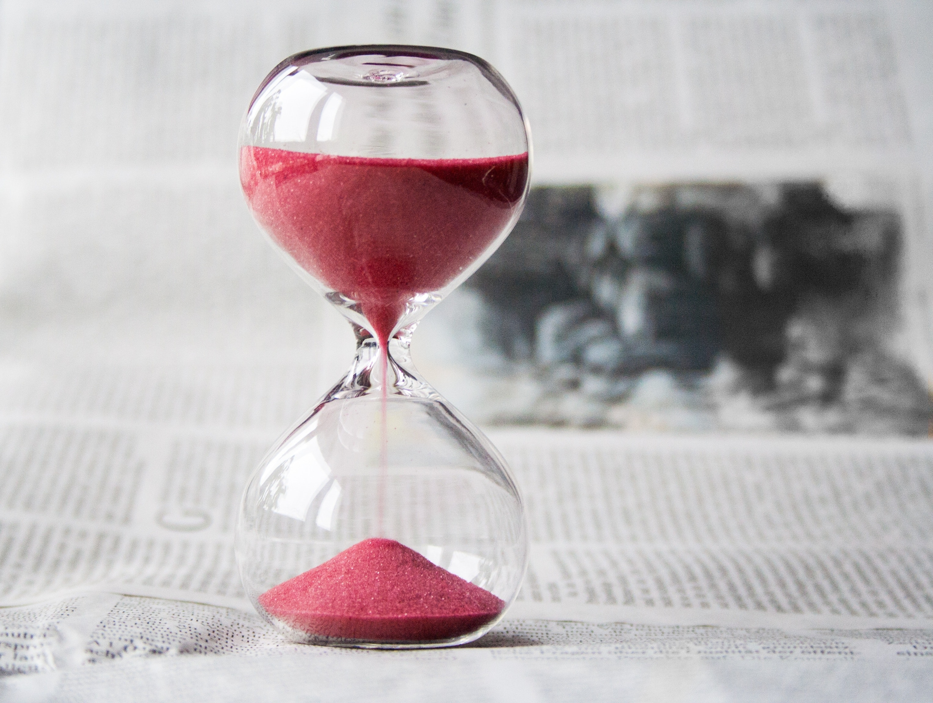

Slide 21
Thank you！

