Slide 1
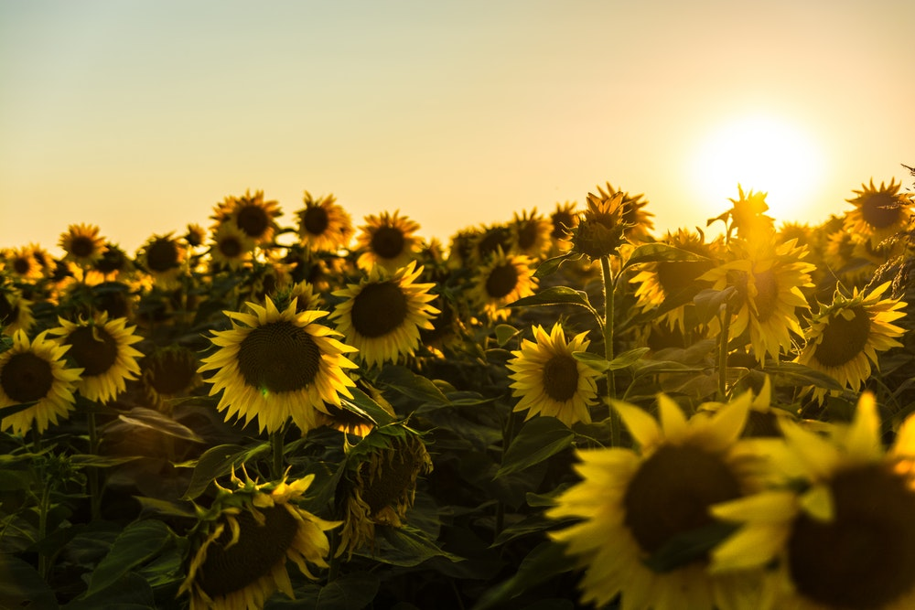
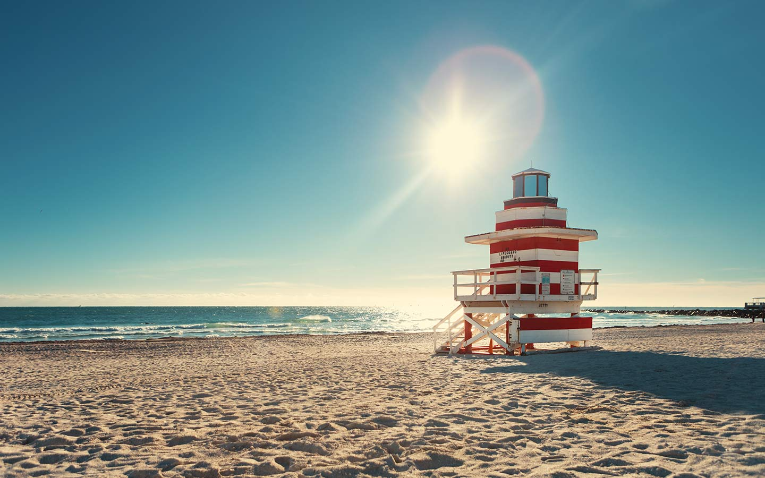
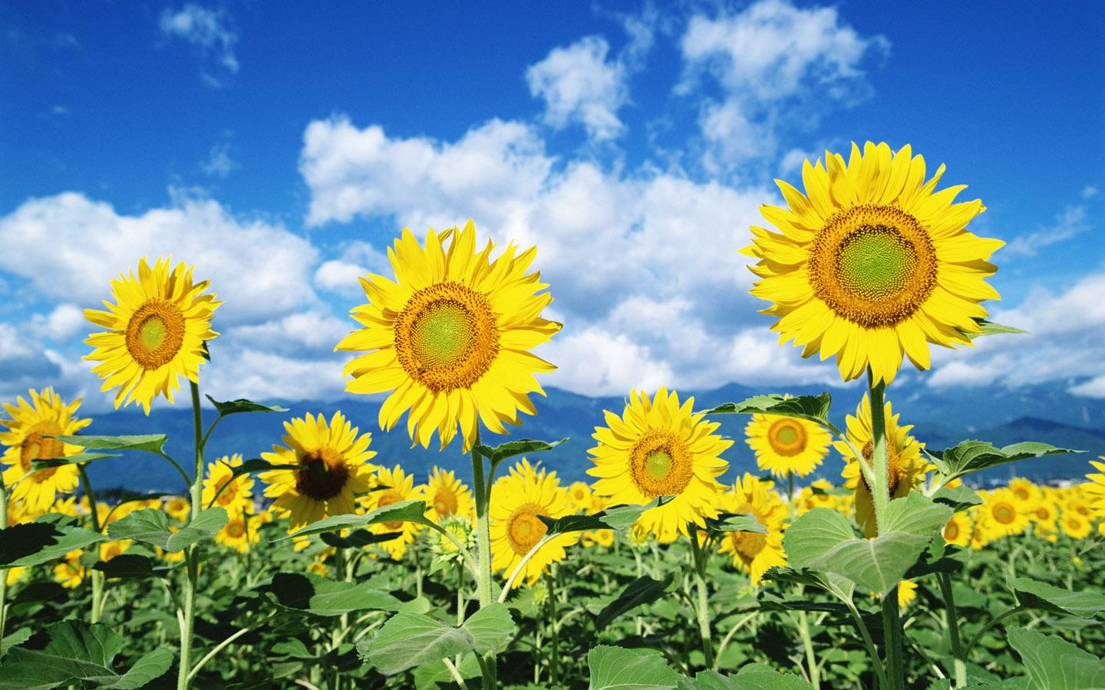
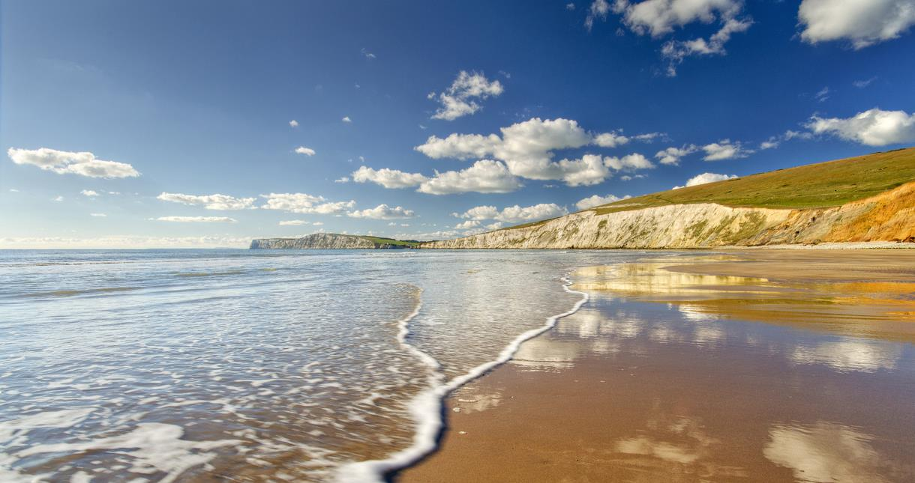
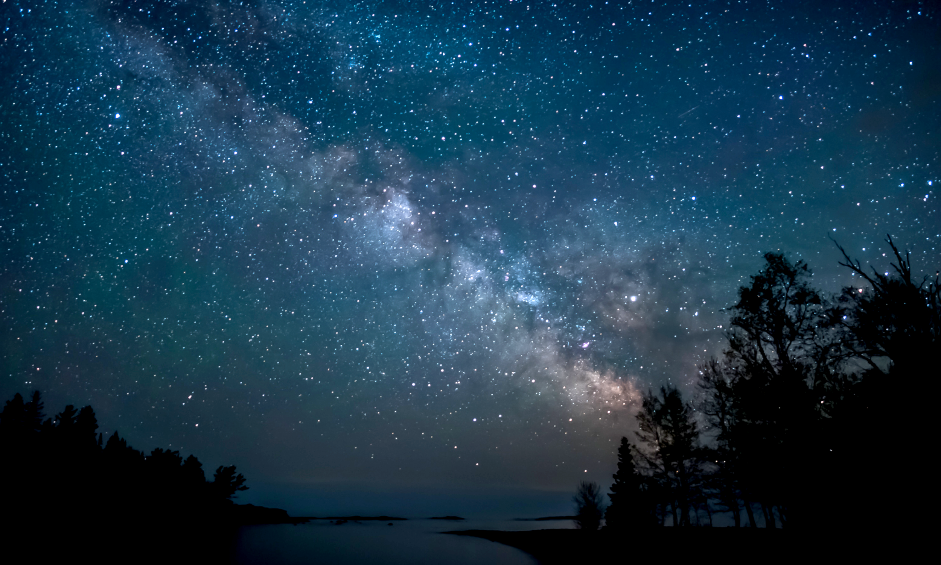
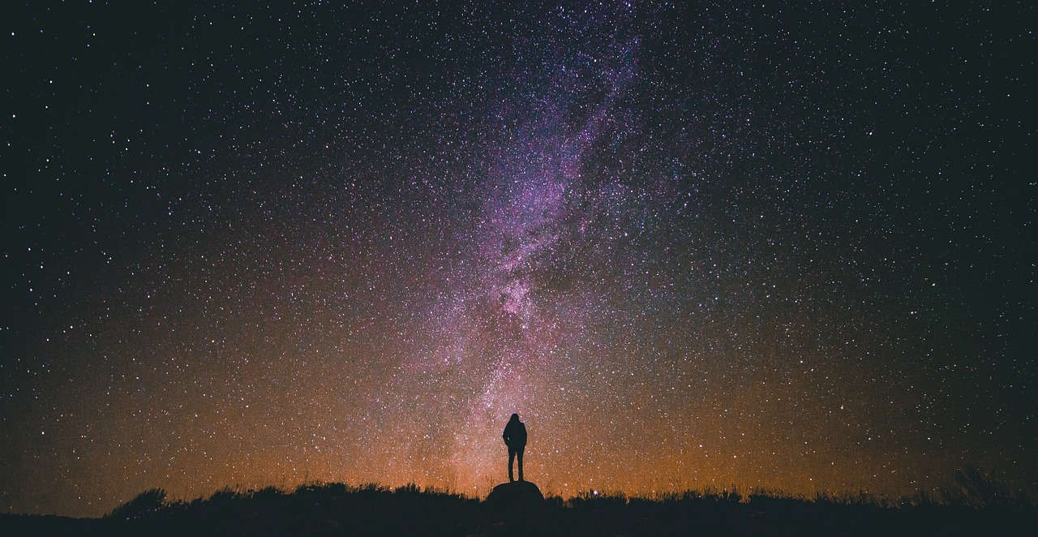
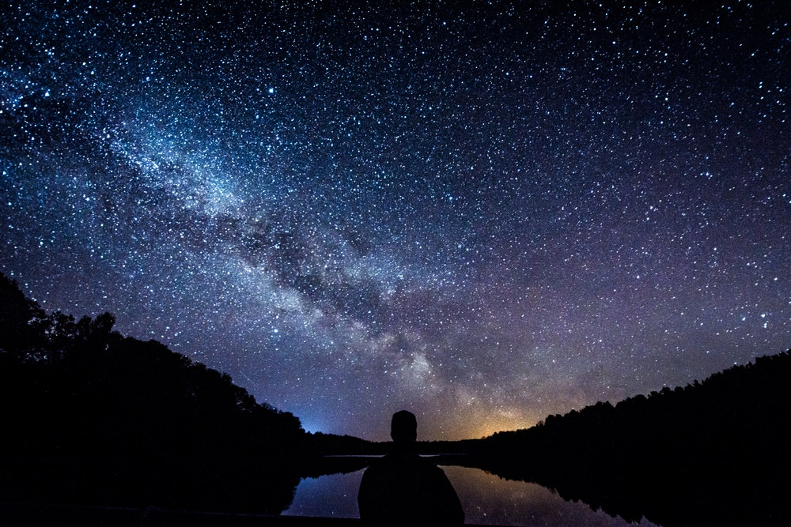
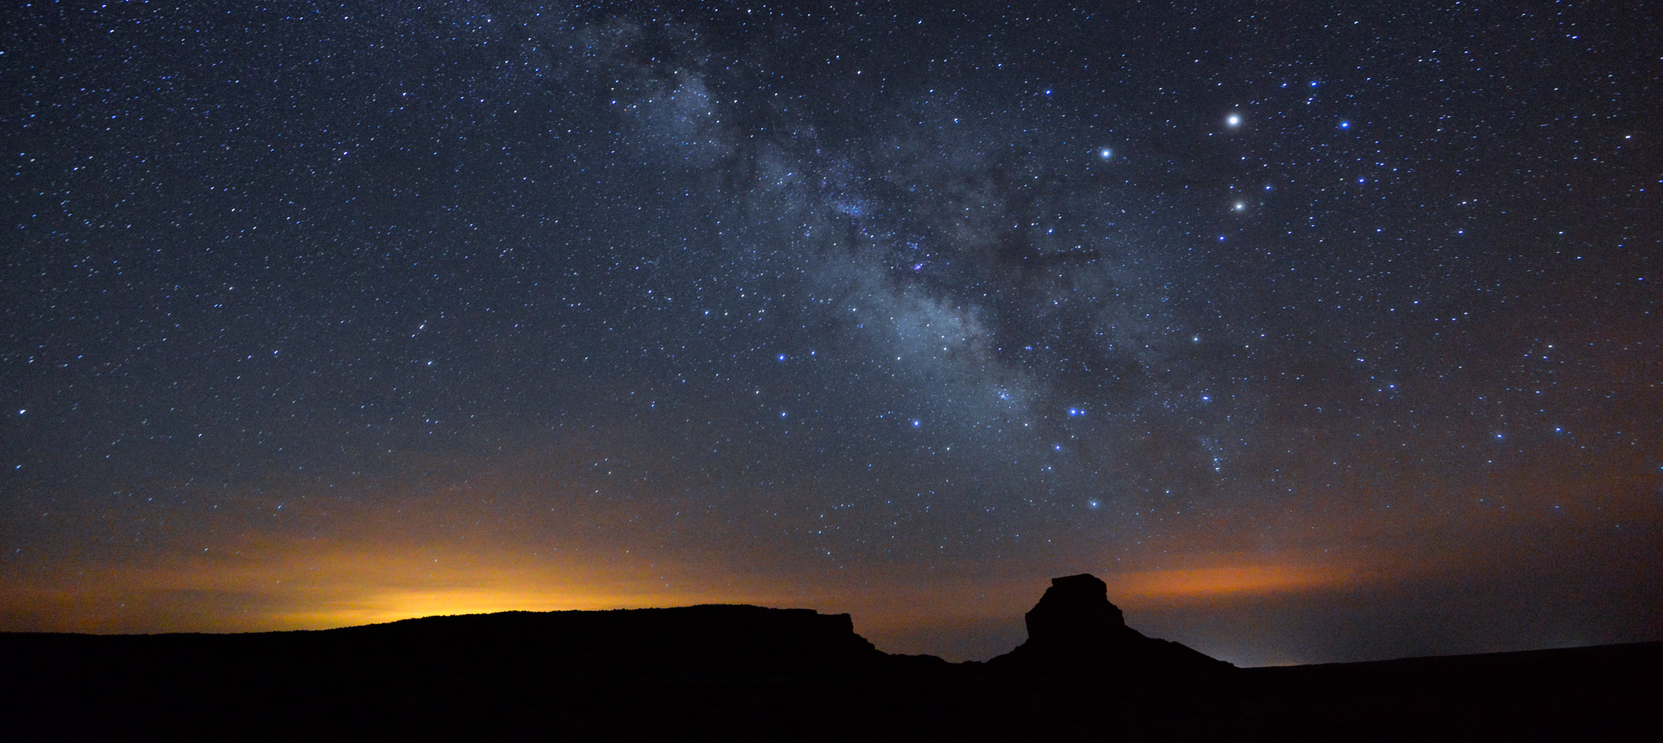
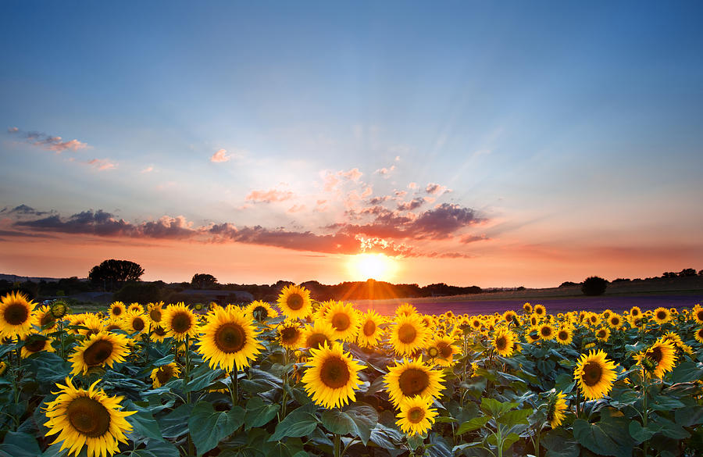
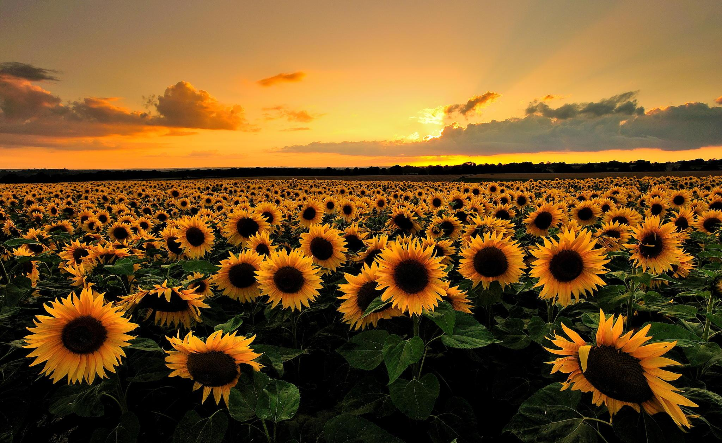
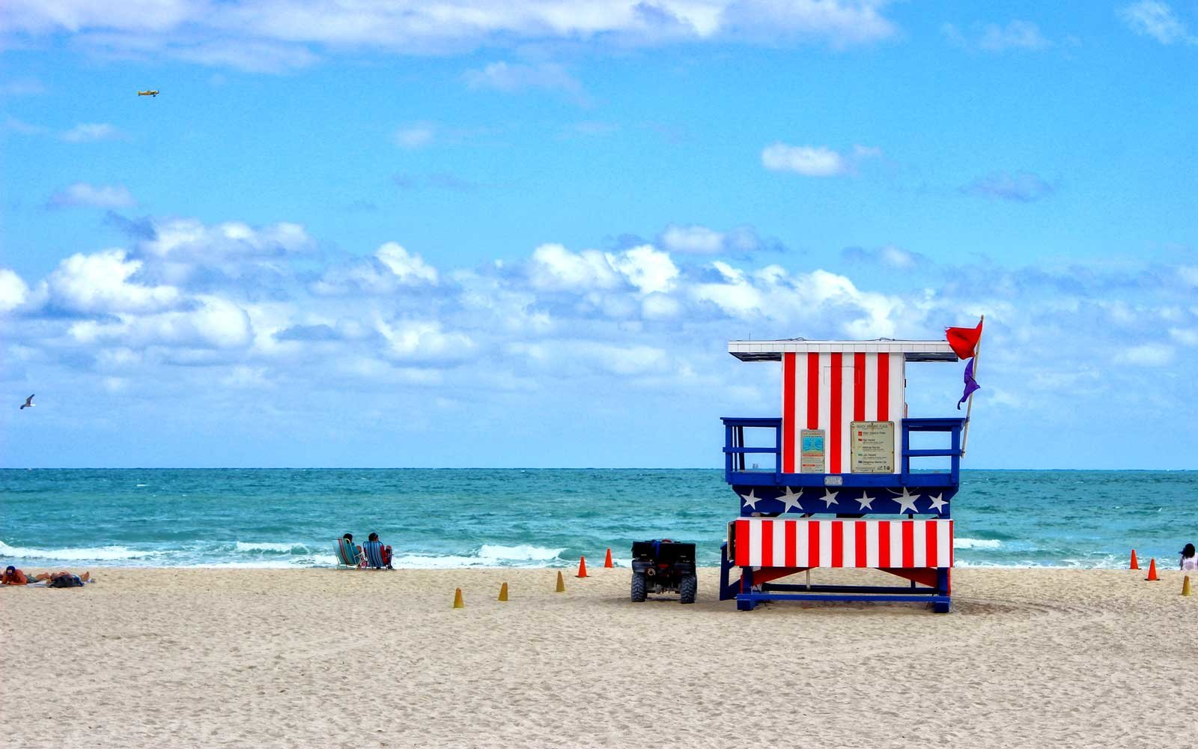
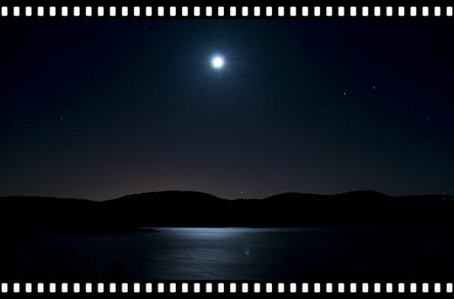
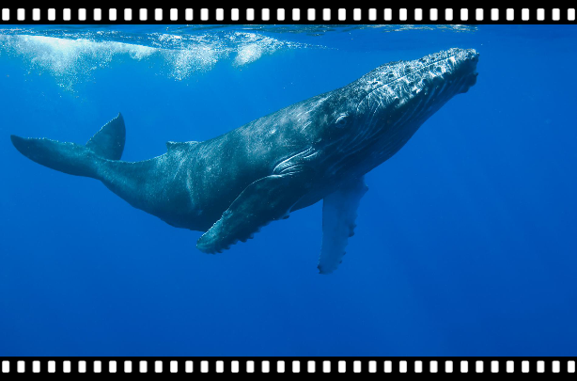
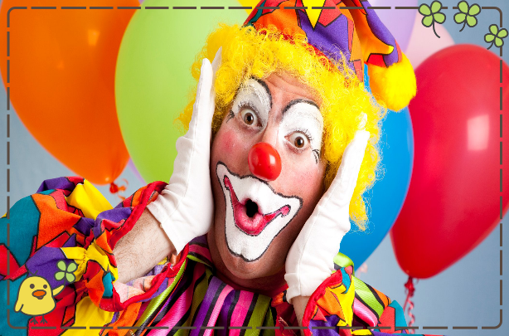
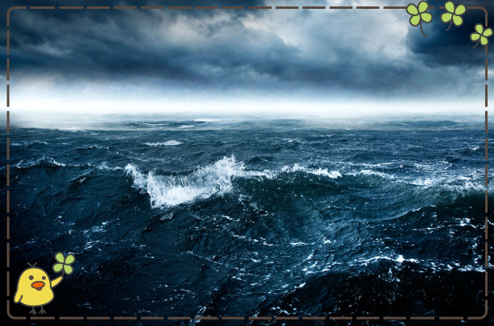
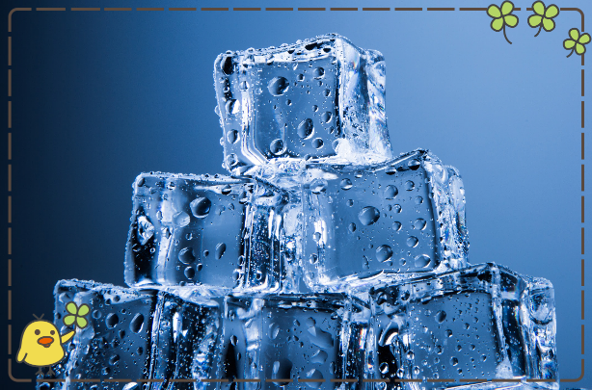
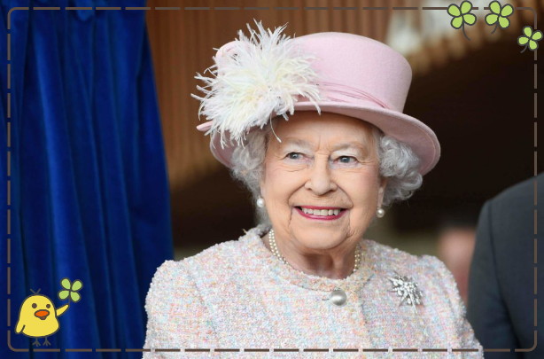
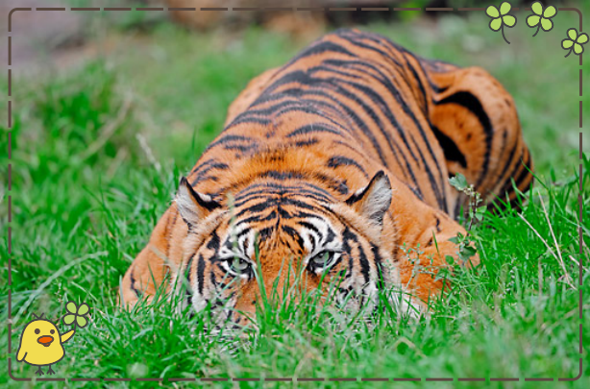
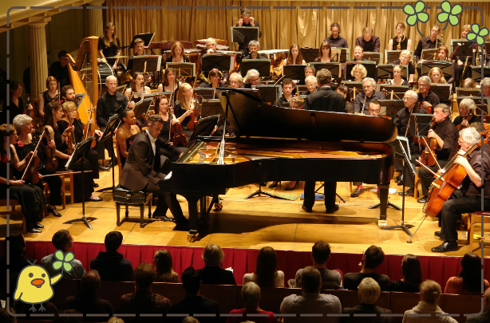
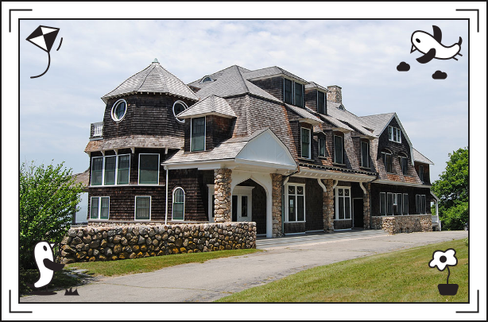
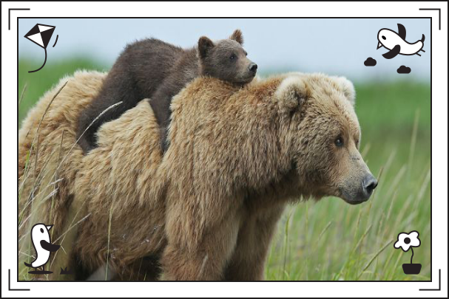
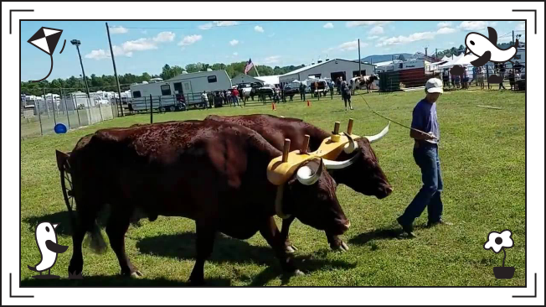
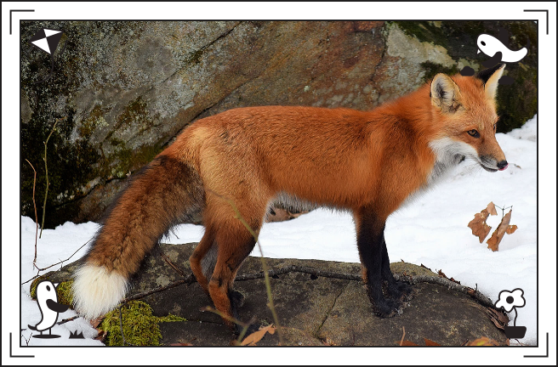
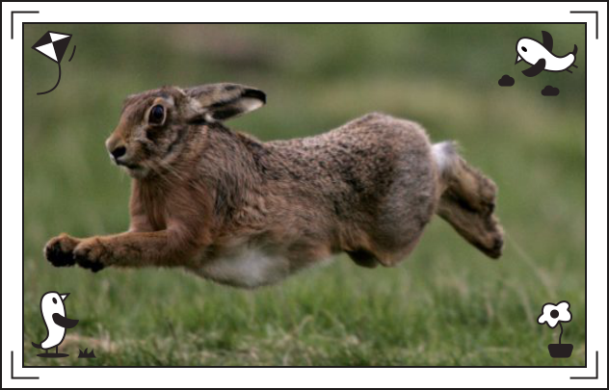
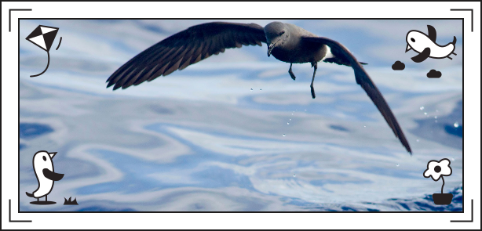
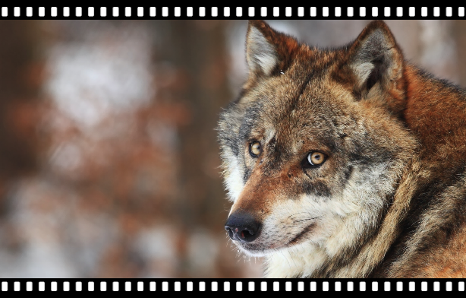
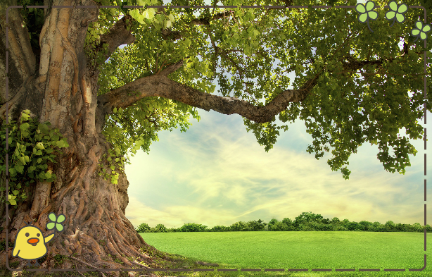
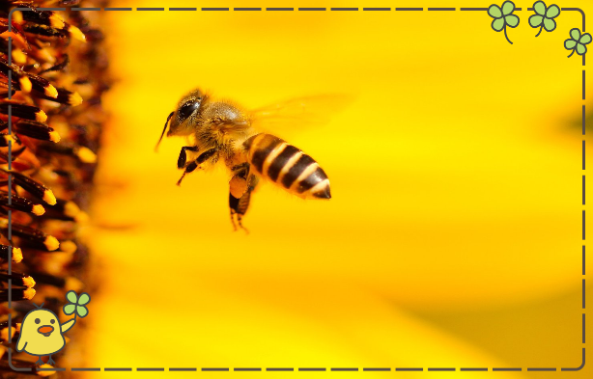
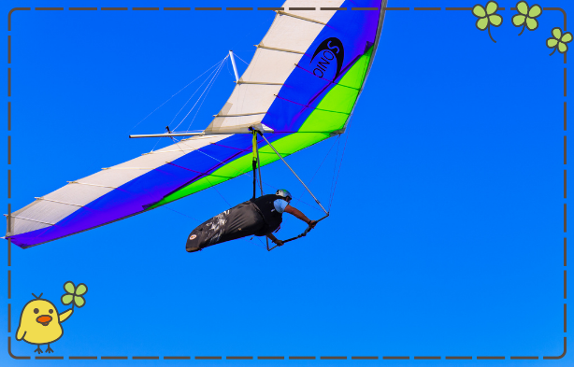
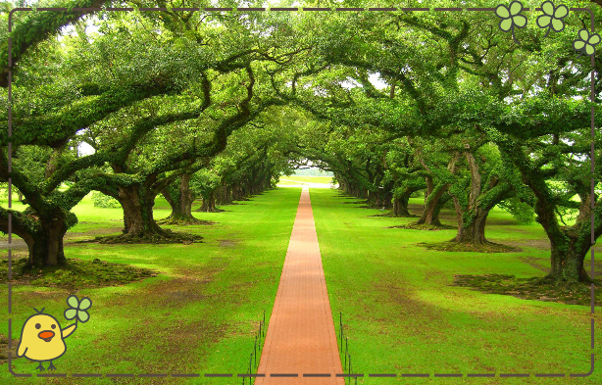
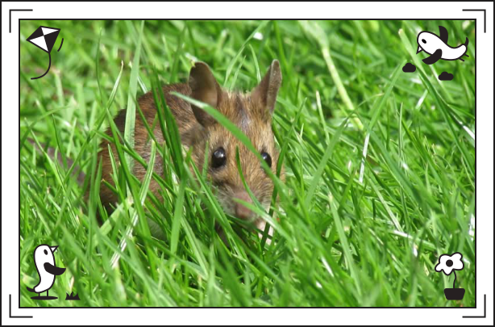
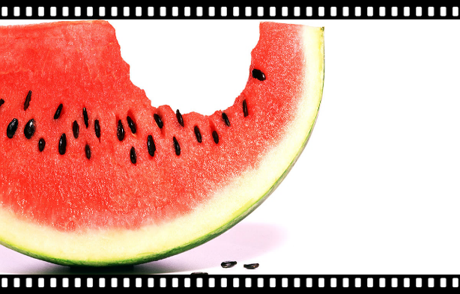
Ohhh all I wanna be...
Ohhh all I wanna be...
Is everything
All I wanna be...
As buzzed as a
bee
As cool as a tree
As hot as fire
As straight as a
line
As warm as the
sun
As deep as a bite
As bright as day
As long as a road
As quiet as a
mouse
As mean as a
wolf
As sweet as a
song
As fast as a hare
Smooth as a glider
Sweet as sugar and
everything nice
As free as a bird
As pretty as a picture hanging from a fixture
As sly as a fox
As hard as nails
——与as有关的短语
设计制作：广东省河源市连平县元善中学 季秋菊
华南师范大学外国语言文化学院 黎嘉琪
指导教师：季秋菊、刘晓斌
All I wanna be...
Everything at once
Is everything
Is everything
Ohhh all I wanna be...
Strong like a family, strong as I wanna be
Pure as a melody，pure as I wanna be
As brave as a bear
As scary as the sea
As light as play
As grand as a whale
As strong as an ox
As silly as fun
As dark as a night
As sharp as a tooth
As big as a house
As neat as a word
As old as time
Cool as ice
As right as a wrong
As royal as a queen
As ugly as a toad
As stealth as a tiger
All I wanna be...
Everything at once
Ohhh all I wanna be...

