Slide 1
PPT模板下载：www.1ppt.com/moban/ 行业PPT模板：www.1ppt.com/hangye/
节日PPT模板：www.1ppt.com/jieri/ PPT素材下载：www.1ppt.com/sucai/
PPT背景图片：www.1ppt.com/beijing/ PPT图表下载：www.1ppt.com/tubiao/
优秀PPT下载：www.1ppt.com/xiazai/ PPT教程： www.1ppt.com/powerpoint/
Word教程： www.1ppt.com/word/ Excel教程：www.1ppt.com/excel/
资料下载：www.1ppt.com/ziliao/ PPT课件下载：www.1ppt.com/kejian/
范文下载：www.1ppt.com/fanwen/ 试卷下载：www.1ppt.com/shiti/
教案下载：www.1ppt.com/jiaoan/
歌 曲：串烧：Hello & Invisible & You'll Be in My Heart
知识点：与over有关的短语
制作者：华南师范大学 外国语言文化学院 梁晶晶
广东省河源市连平县 溪山中学 欧灵芝

Slide 2
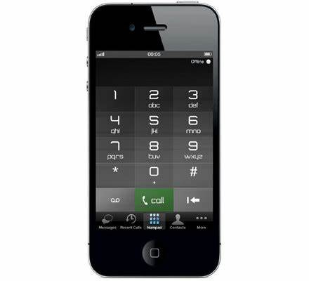

Slide 4
Hello, it's me
it's me
I was wondering if after all these years you'd like to meet

Slide 5
They say that time's supposed to heal ya but I ain't done much healing
To go over everything
go over

Slide 7
Take a moment take a seat, think it over
think it over

Slide 8
Desperately searching for a purpose in a mirror

Slide 9
I can’t figure out if I’m alive or if I’m dead, u forget to
Pull up in my hair lots of questions in my head

Slide 10
Take a moment take a seat, think it over
think it over

Slide 11
Desperately searching for a purpose in a mirror

Slide 12
While I’m watching I’m putting up my fire

Slide 13
I can’t seem to be seen that I need to be admired.

Slide 14
Take a moment take a seat, think it over
think it over
I can’t seem to be seen that I need to be admired

Slide 15
Take a moment take breeze and think it over
think it over

Slide 16
Midnight leaving now.

Slide 18
Don’t listen to them, cause what do they know

Slide 19
They’ll see in time, I know
We need each other, to have and to hold
I know

Slide 20
When destiny calls you, you must be strong
I may not be with you, but you gotta hold on

Slide 21
We’ll show them together cuz...
They’ll see in time, I know
I know
You’ll be in my heart

Slide 22
I’ll be there from this day on
I believe, you’ll be in my heart
Now and forever more

Slide 23
You’ll be in my heart
No matter what they say
I believe, you’ll be here in my heart. I’ll be there always
Always...

Slide 24
Always and always
I’ll be with you
I’ll be there for you always

Slide 25
Just look over your shoulder
Just look over your shoulder
look over

Slide 26
I’ll be there always
Just look over your shoulder
look over

Slide 27
Thank you

