Slide 1
Stand By You
与by有关的短语
华南师范大学外国语言文化学院 邓诗婷
广东省河源市连平县陂头中学 赖海燕

Slide 2
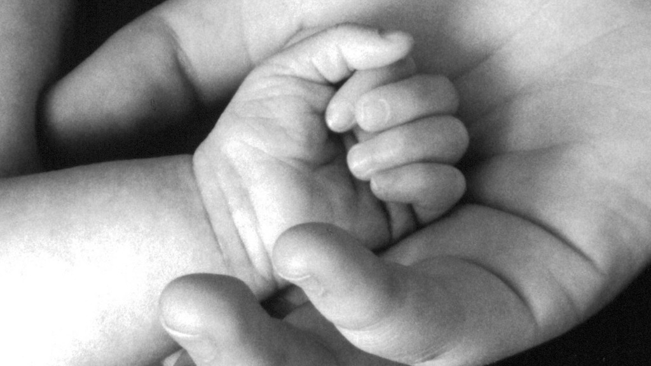
Hands put your empty hands in mine

Slide 3
And scars show me all the scars you hide

Slide 4
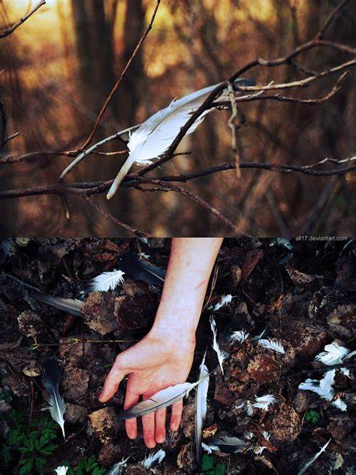
And hey if your wings are broken

Slide 5
Please take mine so yours can open too

Slide 6
Cause
I'm gonna stand by you
by

Slide 7
Oh tears make a lot of scopes in your eyes

Slide 8
And hurt I know you're hurting but so am I

Slide 9
And love if your wings are broken

Slide 10
Borrow mine so yours can open too

Slide 11
Cause
I'm gonna stand by you
by

Slide 12
Even if we're breaking down

Slide 13
We can find a way to break through

Slide 14
Even if we can't find heaven

Slide 15
I'll walk through Hell with you

Slide 16
Love you're not alone
Cause I'm gonna stand by you
by

Slide 17
Even if we can't find heaven

Slide 18
I'm gonna
stand by you
by

Slide 19
Even if we can't find heaven

Slide 20
I'll walk through Hell with you

Slide 21
Love you're not alone
Cause I'm gonna stand by you
by

Slide 22
Yeah you're all I never knew I needed

Slide 23
And the hurt
sometimes it's unclear why it's bleeding

Slide 24
And love if your wings are broken

Slide 25
We can brave through those emotions too

Slide 26
Cause
I'm gonna stand by you
by

Slide 27
Oh truth I guess truth is what you believe in

Slide 28
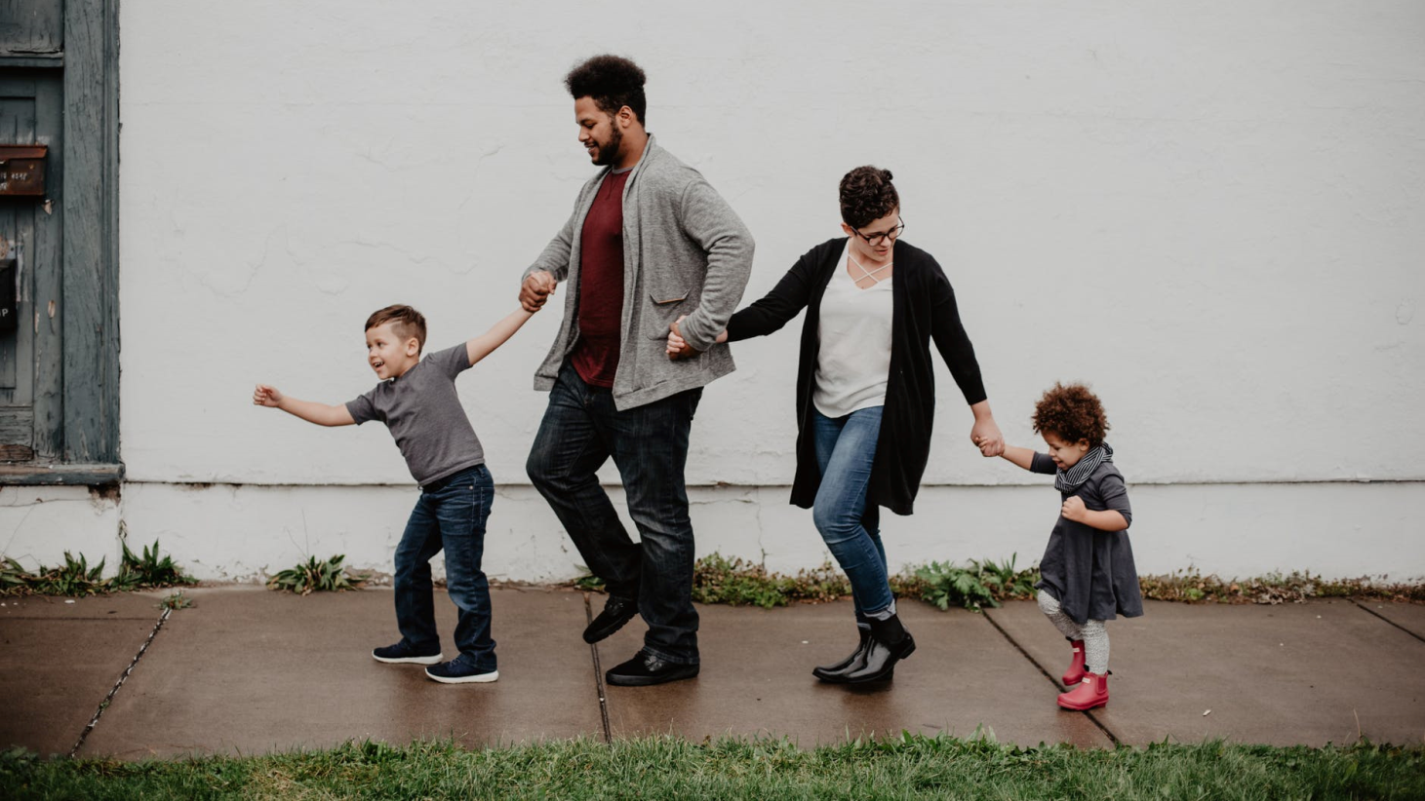
And faith I think faith is helping to reason

Slide 29
No no no love if your wings are broken

Slide 30
Borrow mine so yours can open too

Slide 31
Cause
I'm gonna stand by you
by

Slide 32
Even if we're breaking down

Slide 33
We can find a way to break through

Slide 34
Even if we can't find heaven

Slide 35
I'll walk through Hell with you

Slide 36
Love you're not alone
Cause I'm gonna stand by you
by

Slide 37
Even if we can't find heaven

Slide 38
I'm gonna
stand by you
by

Slide 39
Even if we can't find heaven

Slide 40
I'll walk through Hell with you

Slide 41
Love you're not alone
Cause I'm gonna stand by you
by

Slide 42
And I'll be your eyes till yours can shine

Slide 43
I'll be your arms I'll be your steady satellite

Slide 44
When you can't rise
Well I'll cry with you on hands and knees

Slide 45
Cause I'm gonna stand by you
by

Slide 46
Even if we're breaking down

Slide 47
We can find a way to break through

Slide 48
Even if we can't find heaven

Slide 49
I'll walk through Hell with you

Slide 50
Love you're not alone
Cause I'm gonna stand by you
by

Slide 51
Even if we can't find heaven

Slide 52
I'm gonna
stand by you
by

Slide 53
Even if we can't find heaven

Slide 54
I'll walk through Hell with you

Slide 55
Love you're not alone
Cause I'm gonna stand by you
by

Slide 56
Love you're not alone
by
Cause I'm gonna stand by you

Slide 57
I'm gonna stand by you
by

Slide 58
Stand By You
——Rachel Platten——

