Slide 1
See You Soon
知识点：情景交际
作者：华南师范大学外国语言文化学院 赖嘉玲
广东省河源市连平县上坪中学 谢仲将

Slide 2
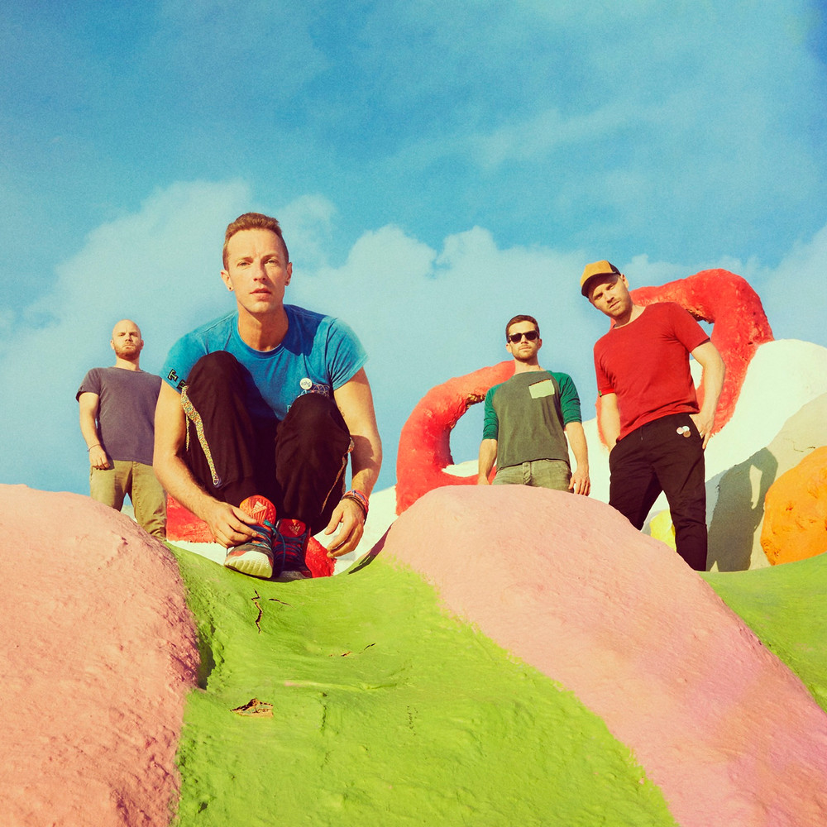
Singer:Coldplay

Slide 3
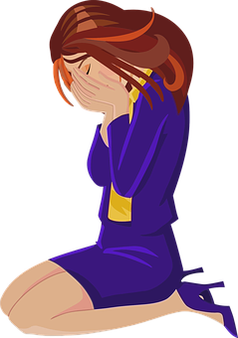
So you lost your trust
And you never should have

Slide 4
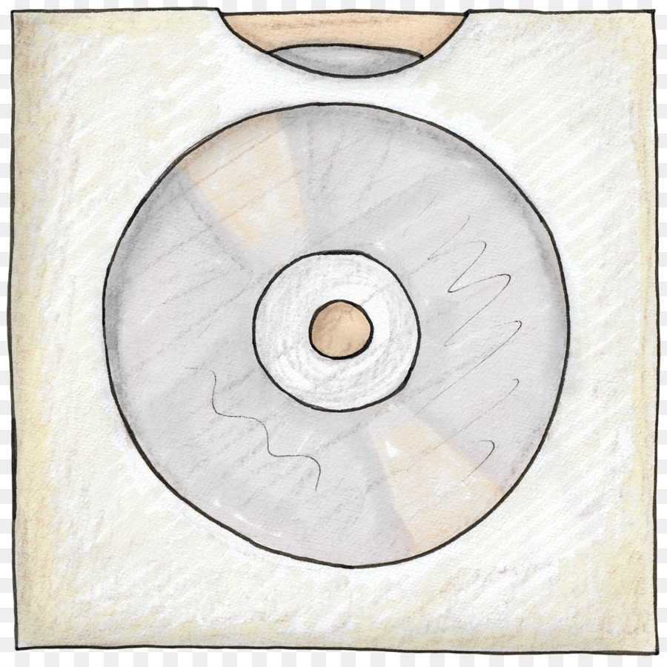
See You Soon
But don't break your back
If you ever see this

Slide 5
But don't answer that

Slide 6
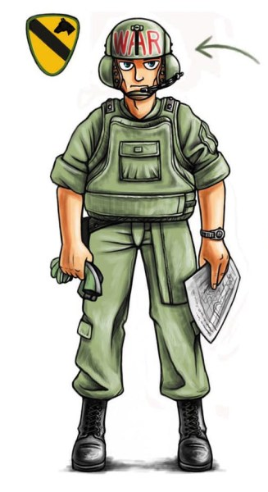
In a bullet proof vest
With the windows all closed

Slide 7
I'll be doing my best
I'll see you soon

Slide 8
In a telescope lens

Slide 9
And when all you want is friends

Slide 10
I'll see you soon

Slide 11
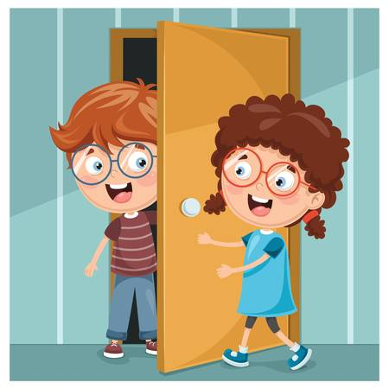
I'll see you soon

Slide 12
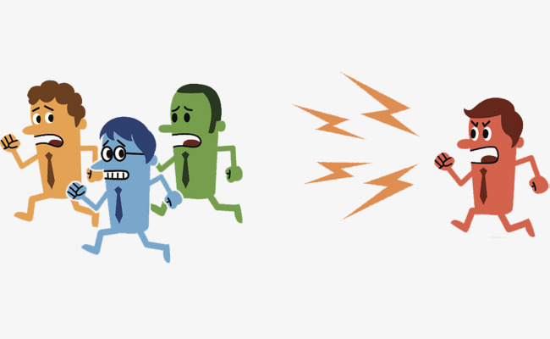
So they came for you

Slide 13
They came snapping at your heels

Slide 14
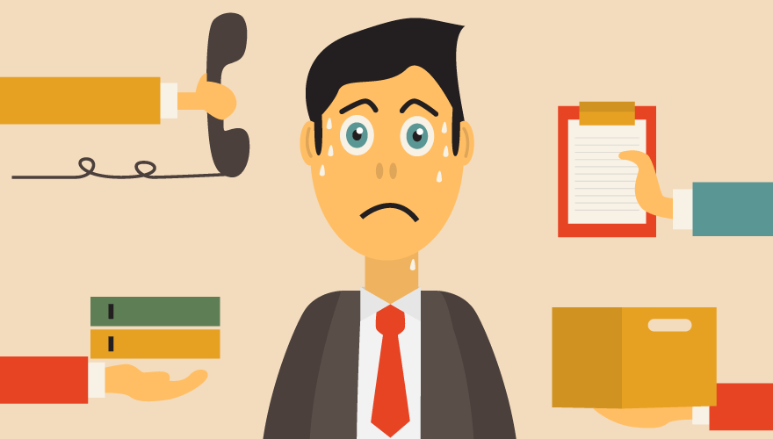
They came snapping at your heels

Slide 15
But don't break your back
If you ever say this

Slide 16
But don't answer that

Slide 17
In a bullet proof vest
With the windows all closed

Slide 18
I'll be doing my best
I'll see you soon

Slide 19
In a telescope lens

Slide 20
And when all you want is friends

Slide 21
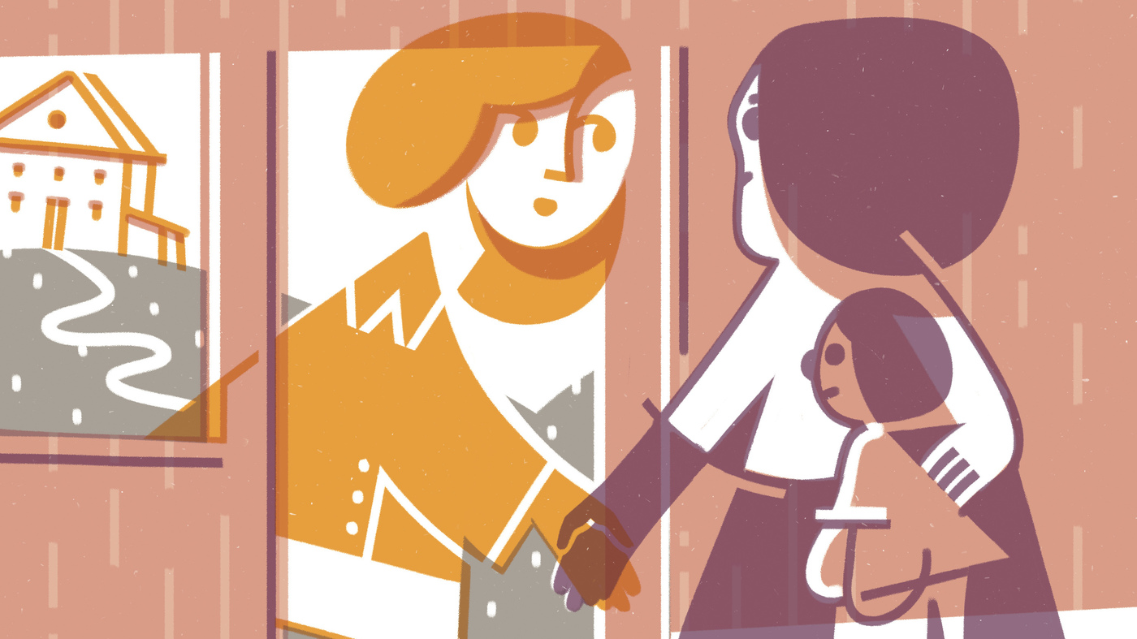
I'll see you soon

Slide 22
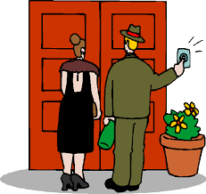
I'll see you soon

Slide 23
And oh, you lost your trust

Slide 24
And oh, you lost your trust

Slide 25
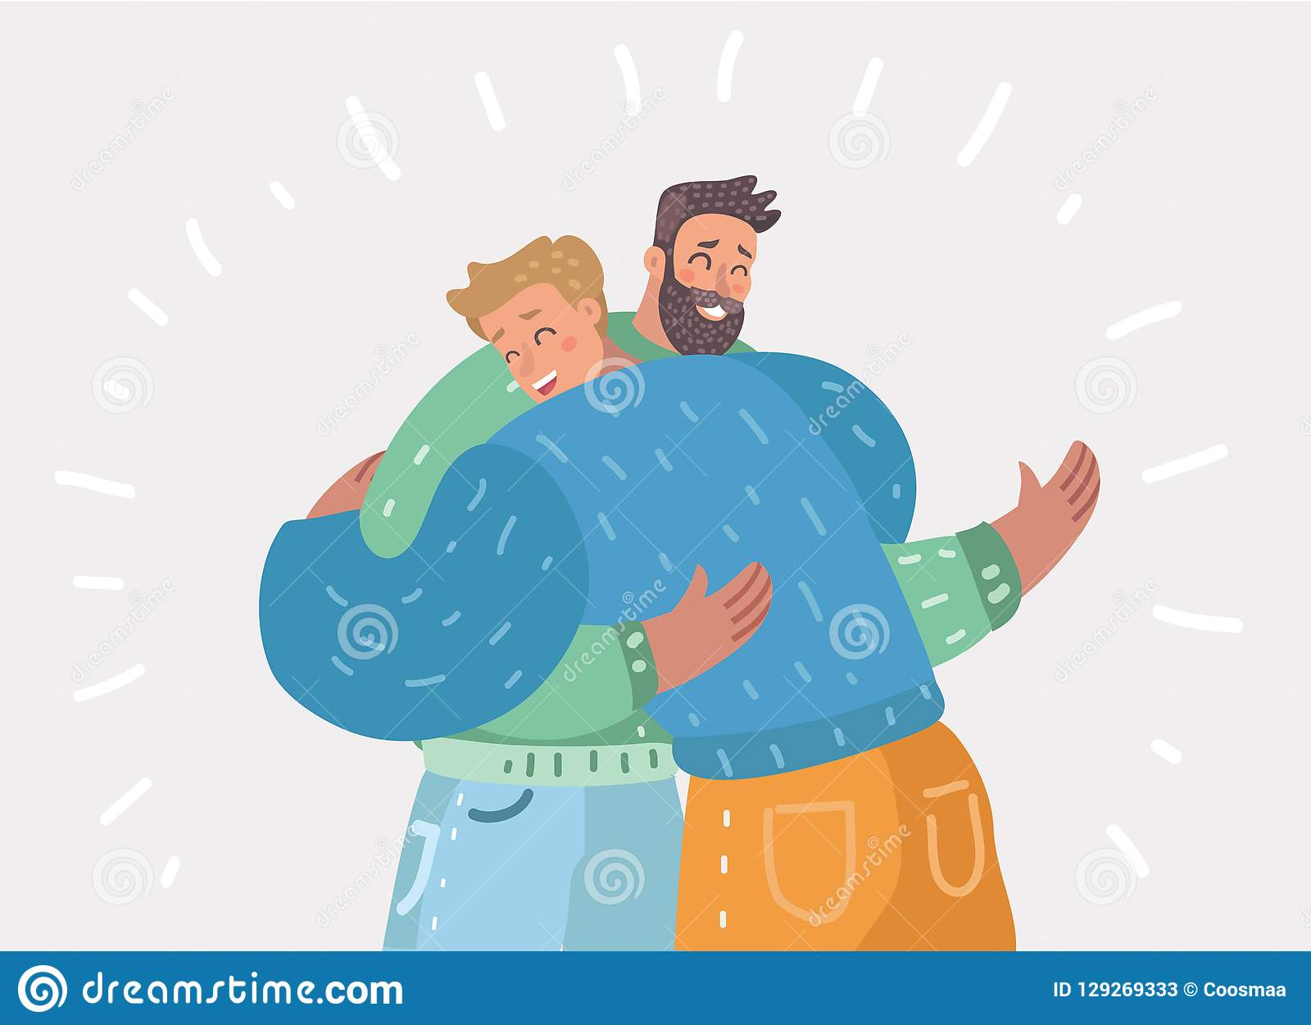
No, don't lose your trust

Slide 26
No, don't lose your trust

