Slide 1
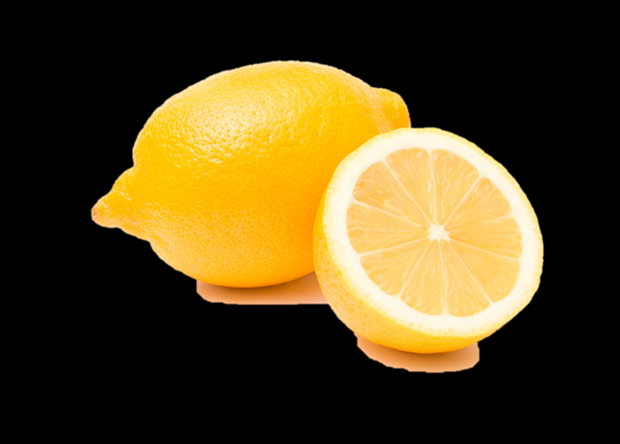
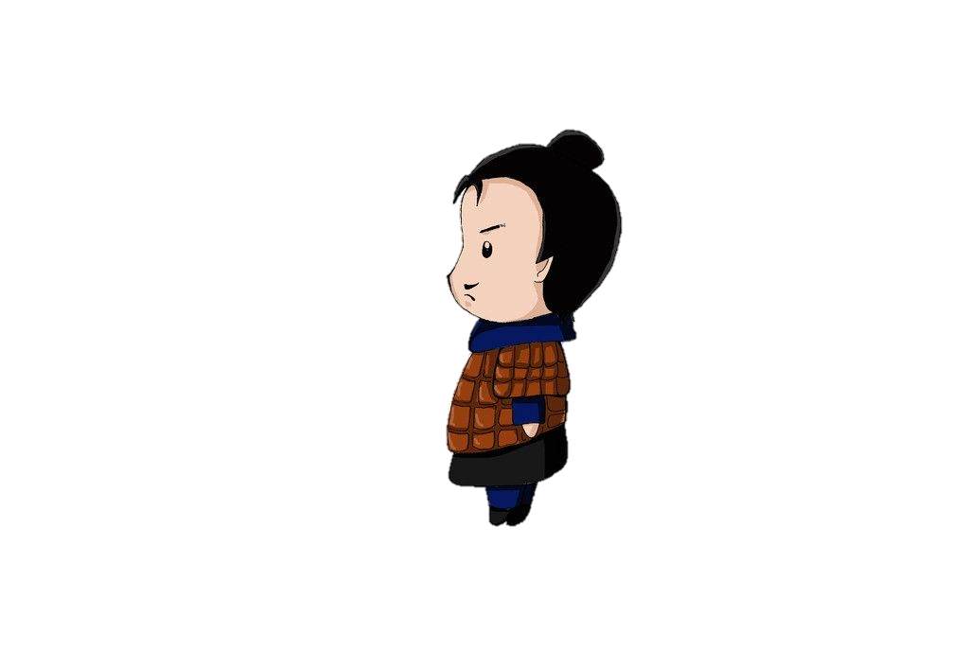

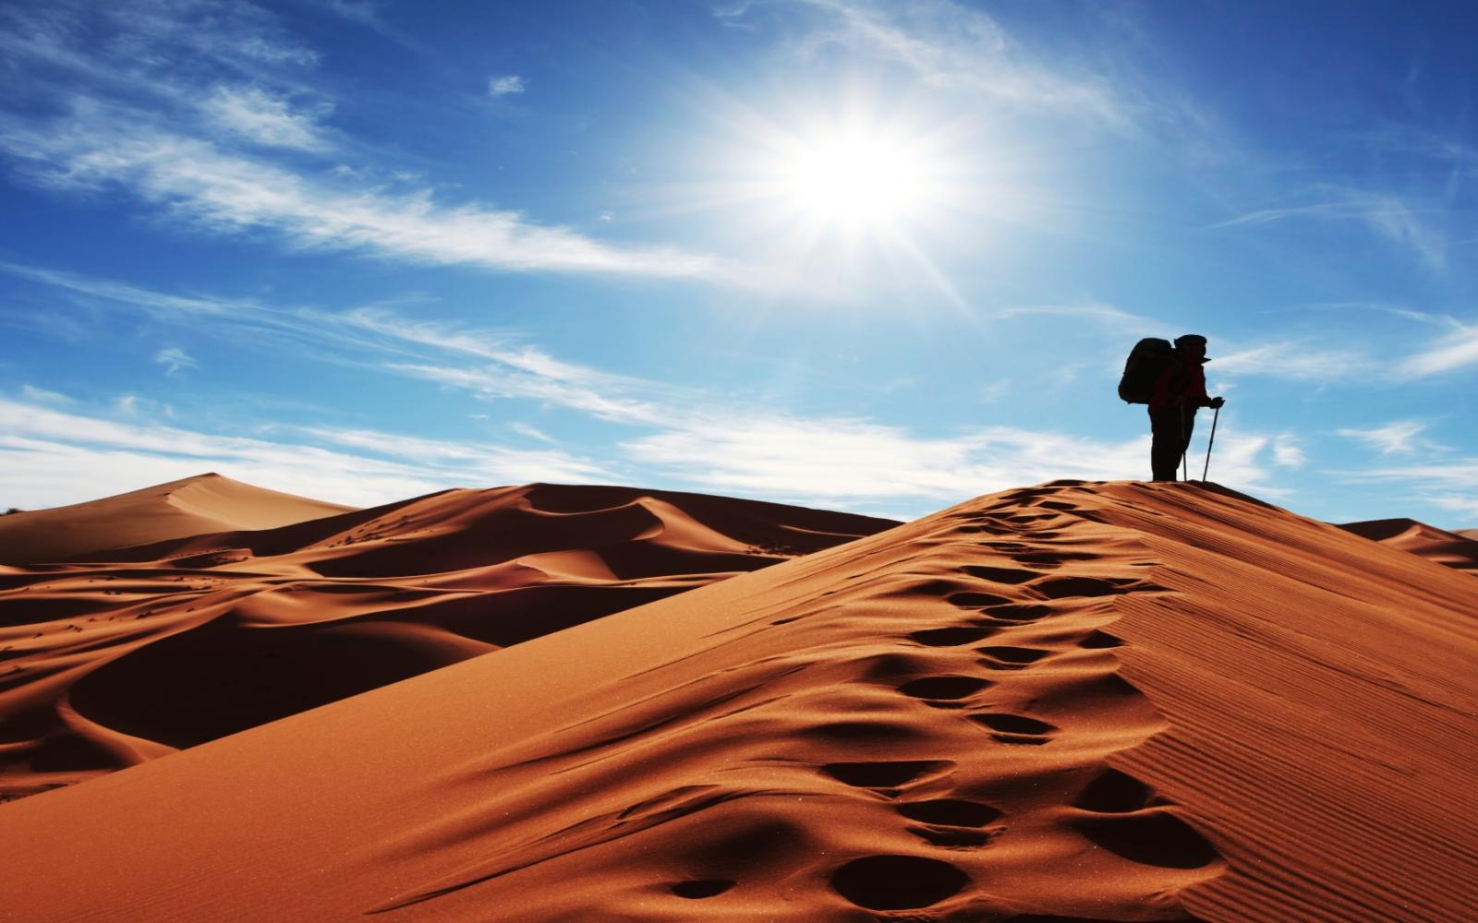
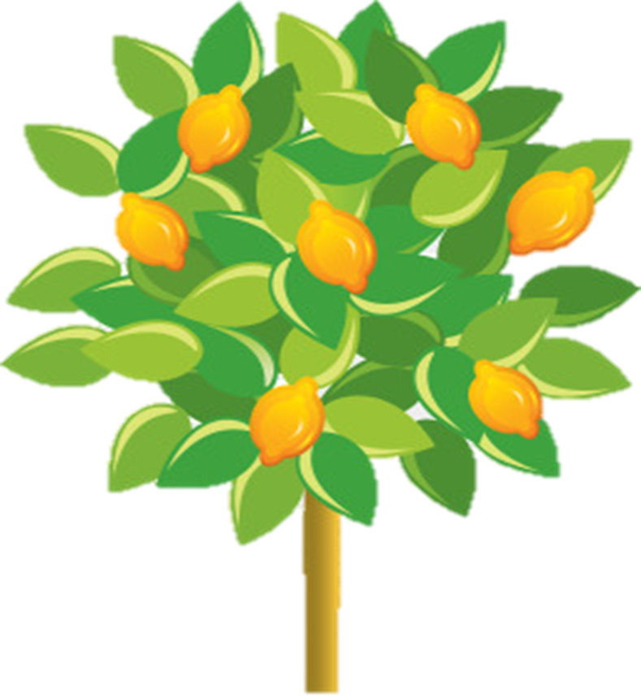
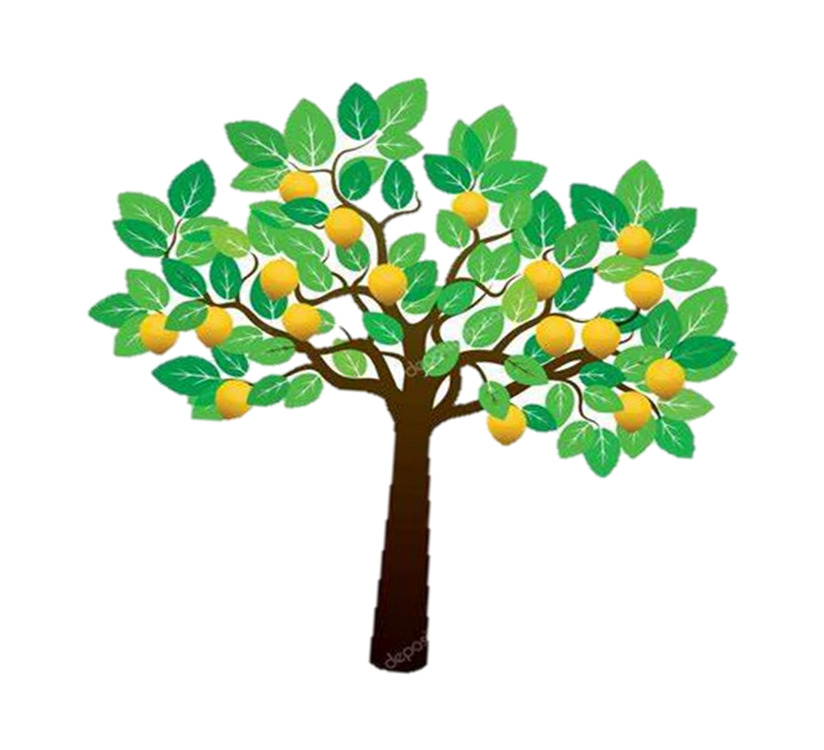


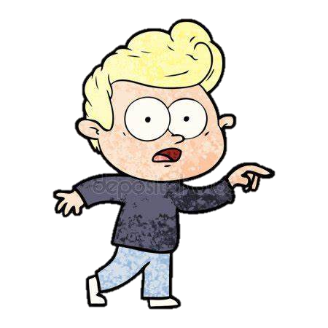




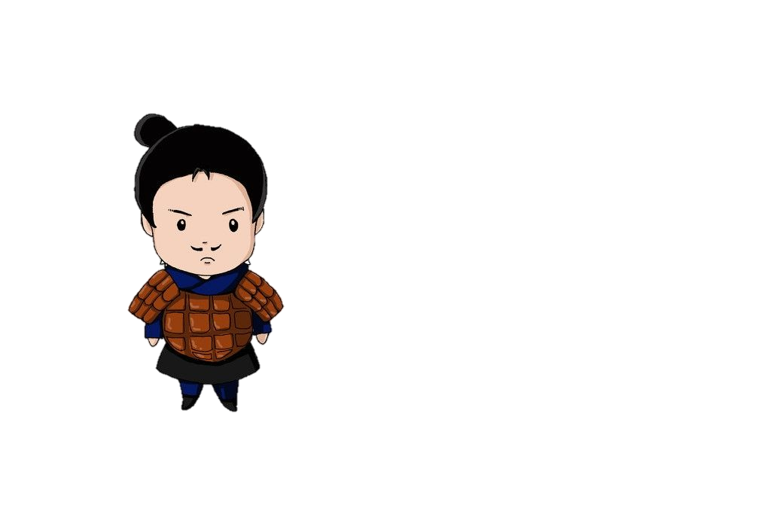
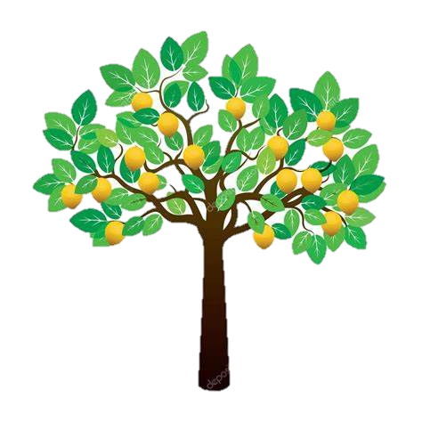
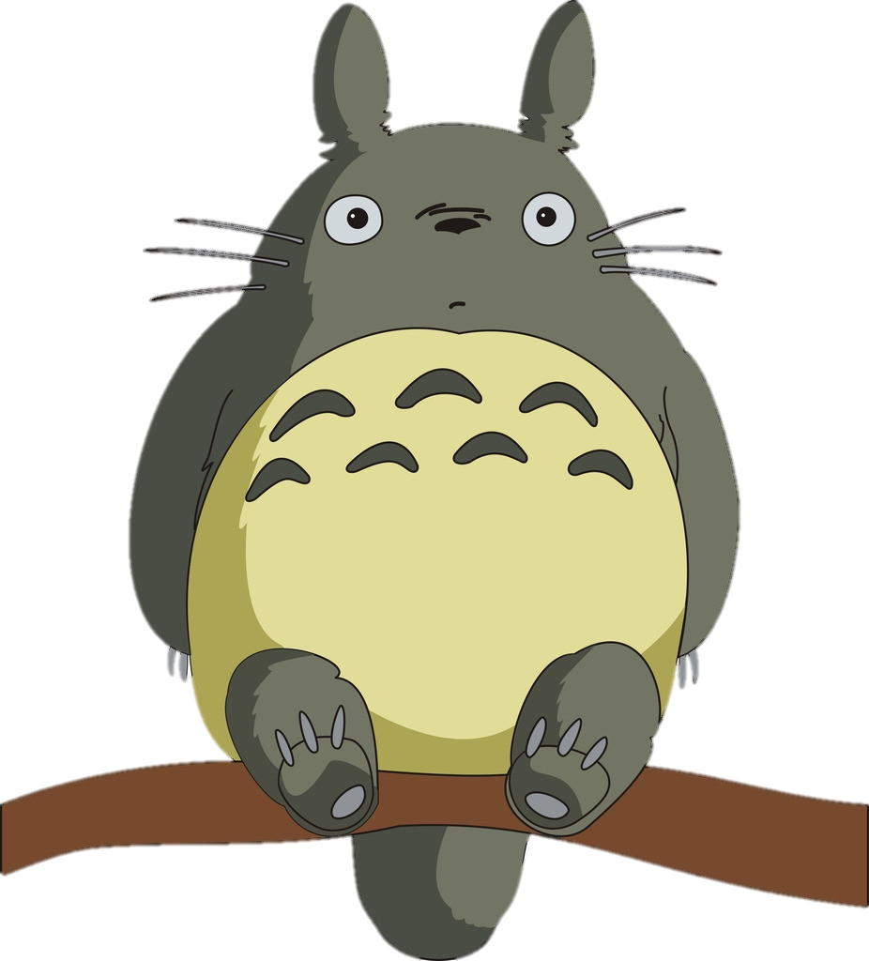


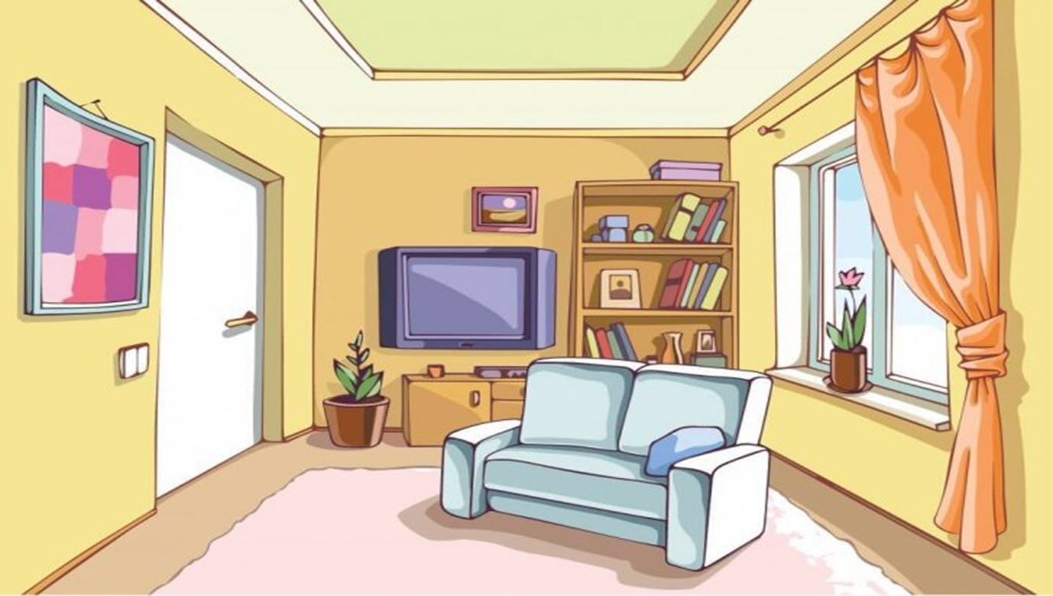


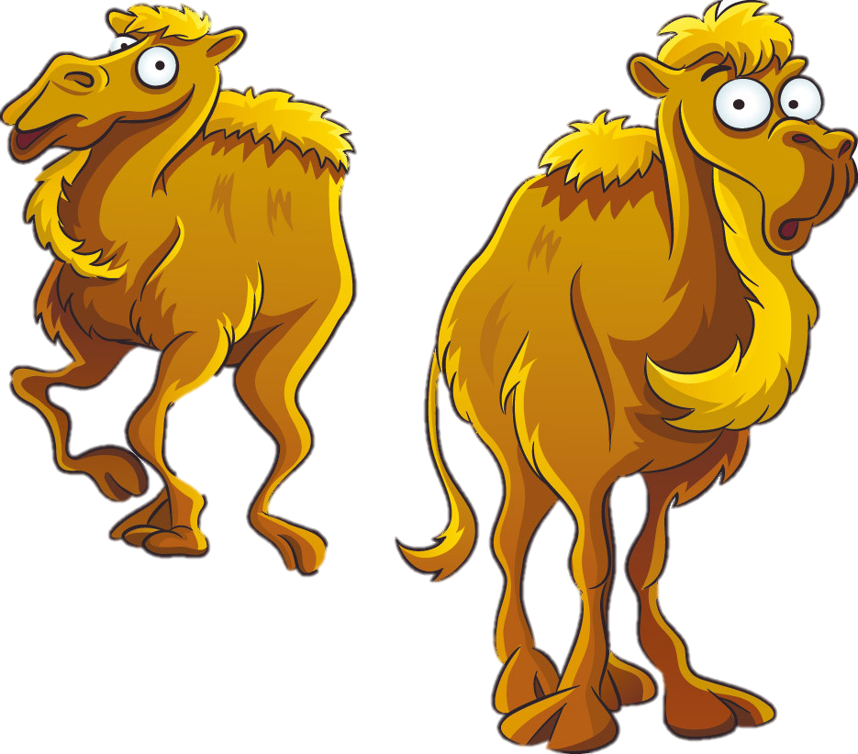




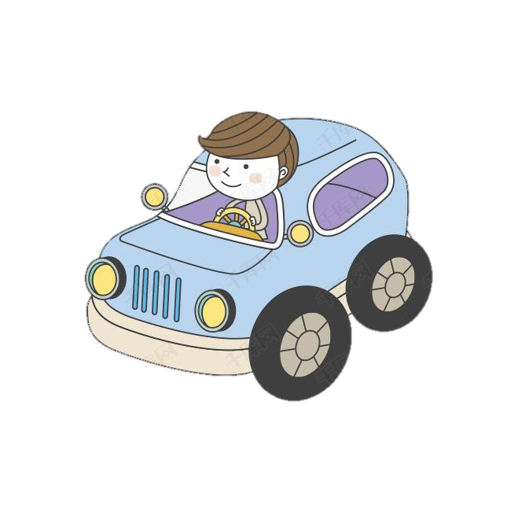


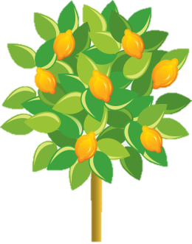
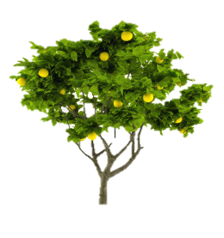
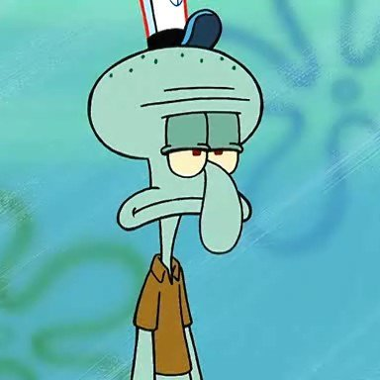

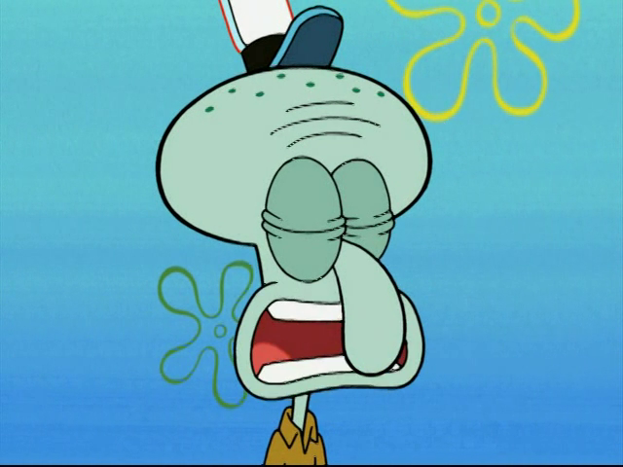
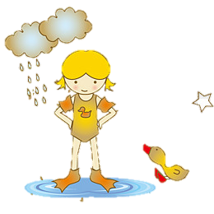
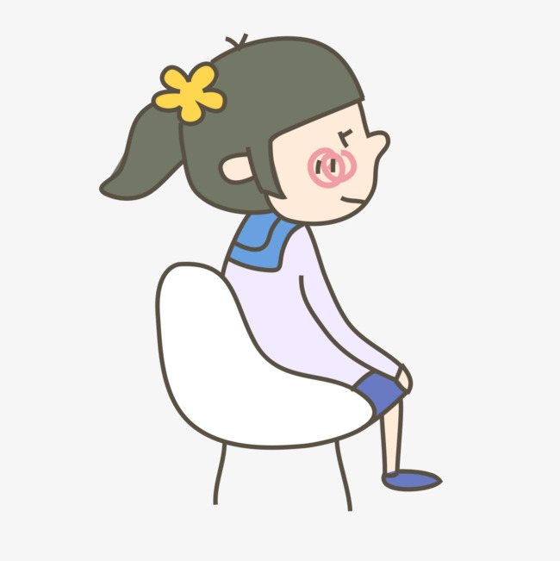

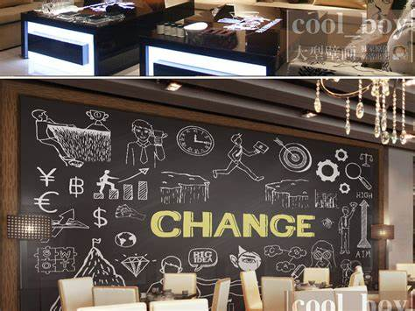
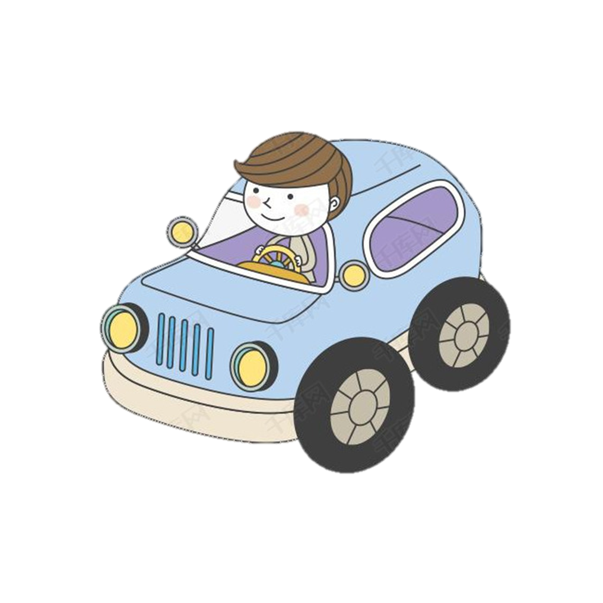
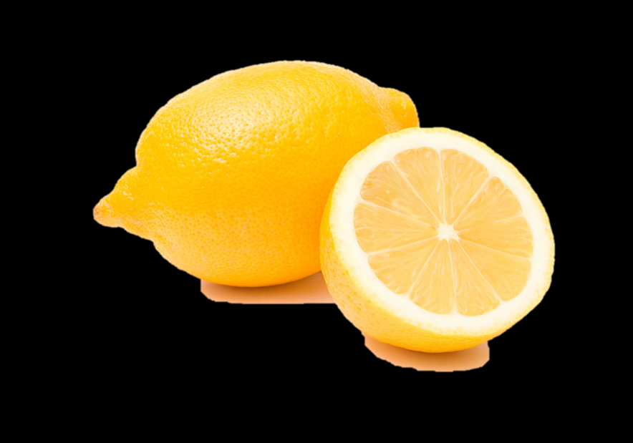
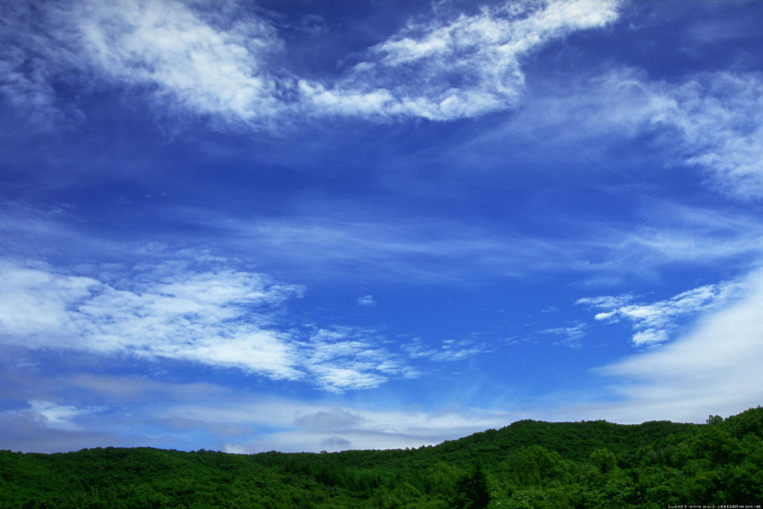
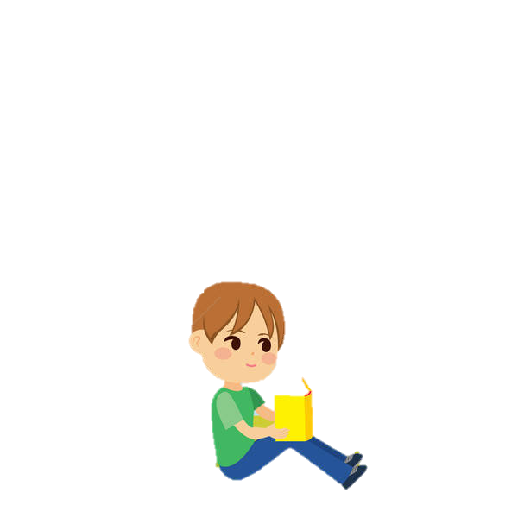
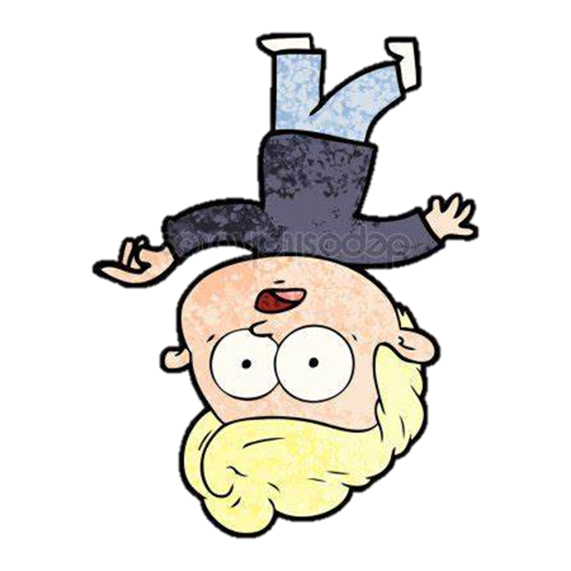

I'm turning, turning, turning, turning, turning around.
I'd like to change my point of view.
I'm driving around in my car.
And all that I can see
And all that I can see
And all that I can see
is just a yellow lemon tree
I'd like to go out taking a shower.
I'm stepping around in a desert of joy
I'm turning my head
up and down.
I'm sitting here,
and I miss the power.
Lemon Tree
Simple Sentence
I felt so lonely,
I'm waiting for you.
I'm turning, turning, turning, turning, turning around
I'm driving too fast, I'm driving too far.
I'm turning my head
up and down
And all that I can see
is just a yellow lemon tree.
And all that I can see
is just a yellow lemon tree.
But there's a heavy cloud
inside my mind.
Yesterday you told me about the blue, blue sky.
Isolation is not good for me
Isolation I don't want to sit on the lemon tree.
I wonder how,
I wonder why.
And all that I can see is just a yellow lemon tree
华南师范大学外国语言文化学院 刘悦
广东省河源市连平县忠信镇中学 吴愉霞
I'm hanging around, I'm waiting for you.
Baby, anyhow I get another toy
And everything will happen, and you wonder
I wonder how, I wonder why
I'm wasting my time, I got nothing to do.
Where nothing ever happens,
and I wonder.
Yesterday you told me about the blue, blue sky
I wonder how, I wonder why
But nothing ever happens, and I wonder.
And all that I can see is just a yellow lemon tree
But nothing ever happens, and I wonder.
I'm sitting here in a boring room.
Yesterday you told me about the blue, blue sky
It's just another rainy Sunday afternoon.

