Slide 1
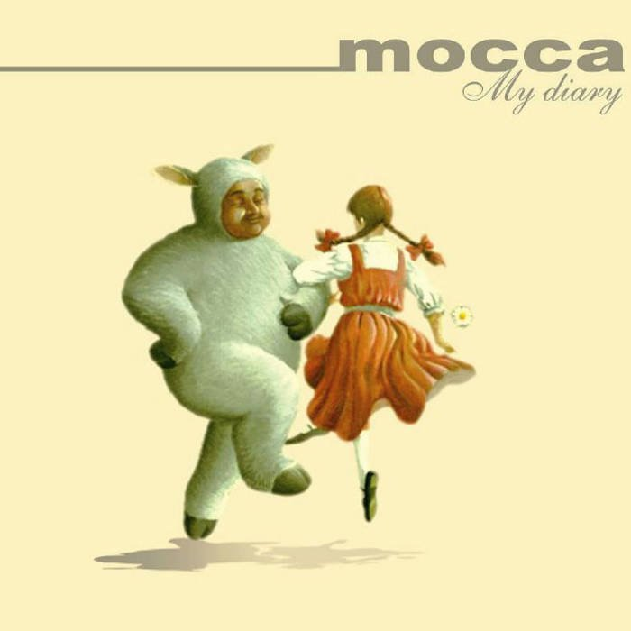
Attributive clause 定语从句
主题内容：Attributive clause
作者：罗淦元
廖玲锋
单位：华南师范大学外文学院
连平县贵东中学
I remember

Slide 2
I remember the way (that) you glanced at me, yes I remember.

Slide 3
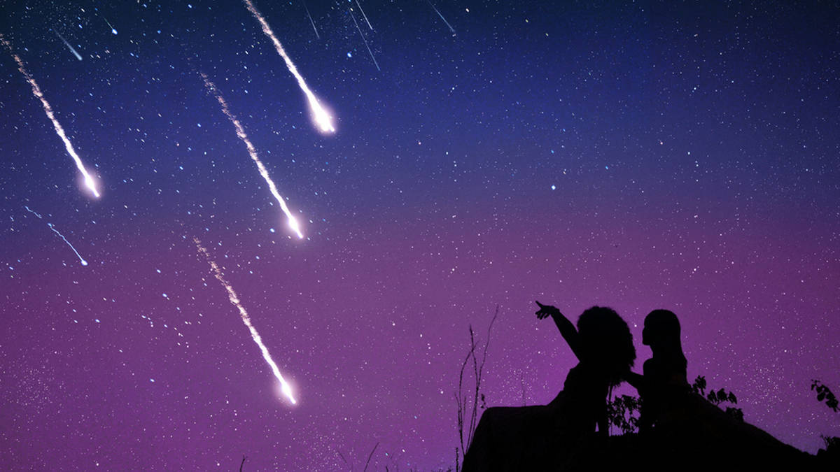
I remember, when we caught a shooting star, yes I remember.
Notes:
预览及使用此模板前先下载英文Segoe Script、中文新蒂小丸子小学版字体，预览效果会更加美观！

Slide 4
I remember all the things that we shared,
Notes:
预览及使用此模板前先下载英文Segoe Script、中文新蒂小丸子小学版字体，预览效果会更加美观！

Slide 5
and the promises (that) we made
Notes:
预览及使用此模板前先下载英文Segoe Script、中文新蒂小丸子小学版字体，预览效果会更加美观！

Slide 6
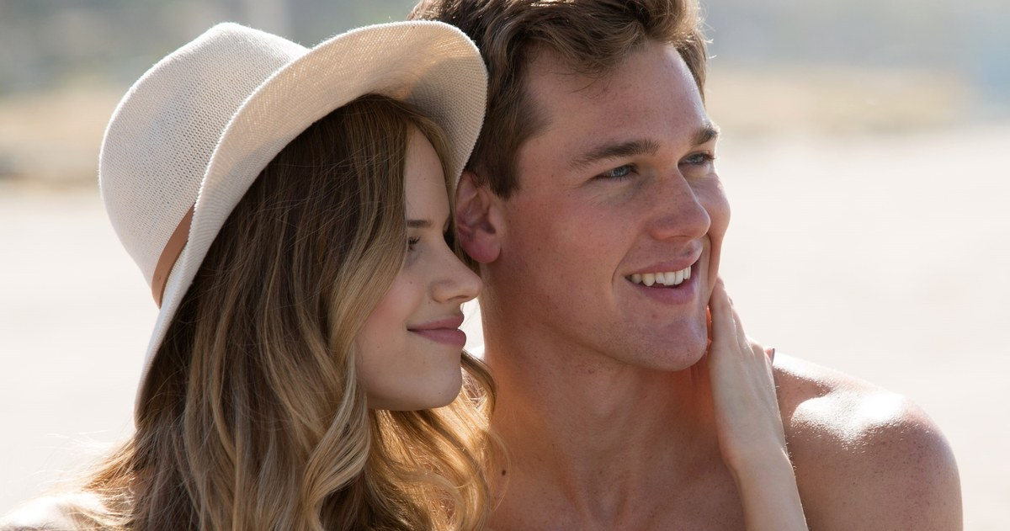
just you and I.
Notes:
预览及使用此模板前先下载英文Segoe Script、中文新蒂小丸子小学版字体，预览效果会更加美观！

Slide 7
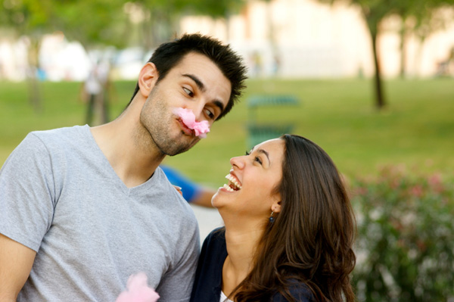
I remember all the laughter (that) we shared,

Slide 8
all the wishes (that) we made
Notes:
预览及使用此模板前先下载英文Segoe Script、中文新蒂小丸子小学版字体，预览效果会更加美观！

Slide 9
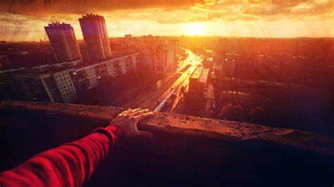
upon the roof at dawn.
Notes:
预览及使用此模板前先下载英文Segoe Script、中文新蒂小丸子小学版字体，预览效果会更加美观！

Slide 10
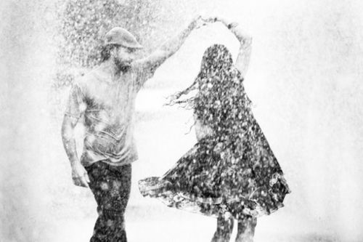
Do you remember when we were dancing in the rain in that December,
Notes:
预览及使用此模板前先下载英文Segoe Script、中文新蒂小丸子小学版字体，预览效果会更加美观！

Slide 11
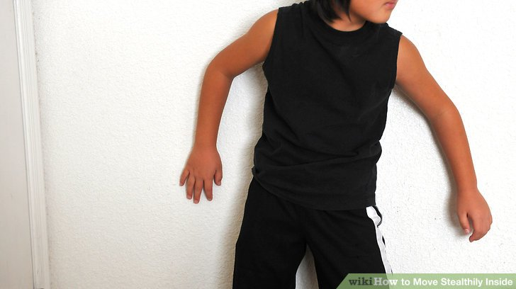
and I remember that when my father thought you were a burglar.
Notes:
预览及使用此模板前先下载英文Segoe Script、中文新蒂小丸子小学版字体，预览效果会更加美观！

Slide 12
I remember all the things that we shared
Notes:
预览及使用此模板前先下载英文Segoe Script、中文新蒂小丸子小学版字体，预览效果会更加美观！

Slide 13
and the promises (that) we made
Notes:
预览及使用此模板前先下载英文Segoe Script、中文新蒂小丸子小学版字体，预览效果会更加美观！

Slide 14
just you and I.
Notes:
预览及使用此模板前先下载英文Segoe Script、中文新蒂小丸子小学版字体，预览效果会更加美观！

Slide 15
I remember all the laughter (that) we shared,
Notes:
预览及使用此模板前先下载英文Segoe Script、中文新蒂小丸子小学版字体，预览效果会更加美观！

Slide 16
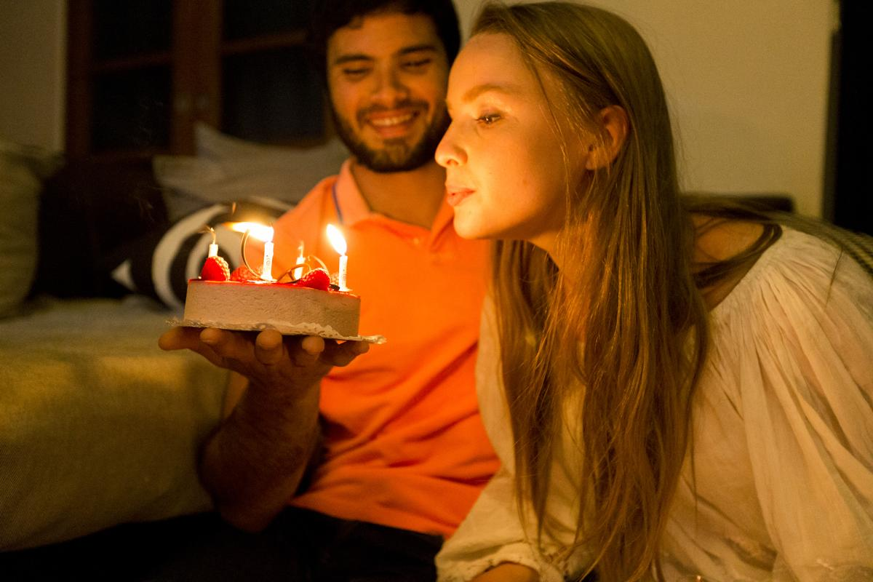
all the wishes (that) we made
Notes:
预览及使用此模板前先下载英文Segoe Script、中文新蒂小丸子小学版字体，预览效果会更加美观！

Slide 17
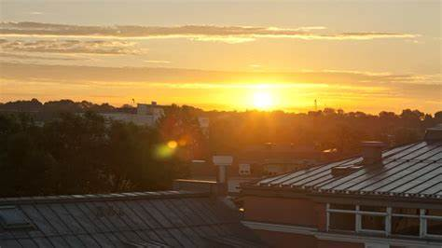
upon the roof at dawn.
Notes:
预览及使用此模板前先下载英文Segoe Script、中文新蒂小丸子小学版字体，预览效果会更加美观！

Slide 18
Ba ba ba ba …….
Notes:
预览及使用此模板前先下载英文Segoe Script、中文新蒂小丸子小学版字体，预览效果会更加美观！

Slide 19
Yes I remember all the things that we shared
Notes:
预览及使用此模板前先下载英文Segoe Script、中文新蒂小丸子小学版字体，预览效果会更加美观！

Slide 20
and the promises (that) we made
Notes:
预览及使用此模板前先下载英文Segoe Script、中文新蒂小丸子小学版字体，预览效果会更加美观！

Slide 21
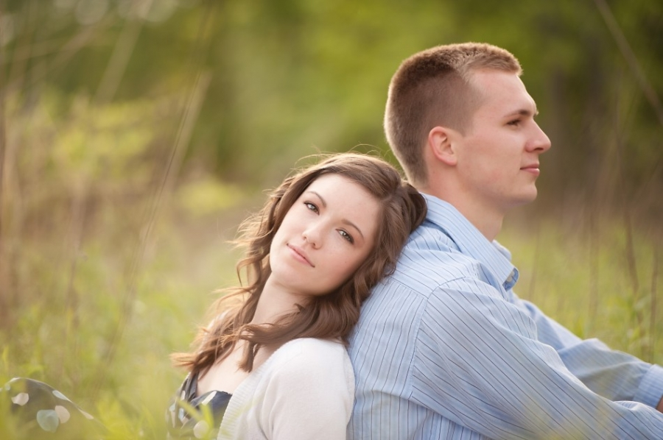
just you and I.
Notes:
预览及使用此模板前先下载英文Segoe Script、中文新蒂小丸子小学版字体，预览效果会更加美观！

Slide 22
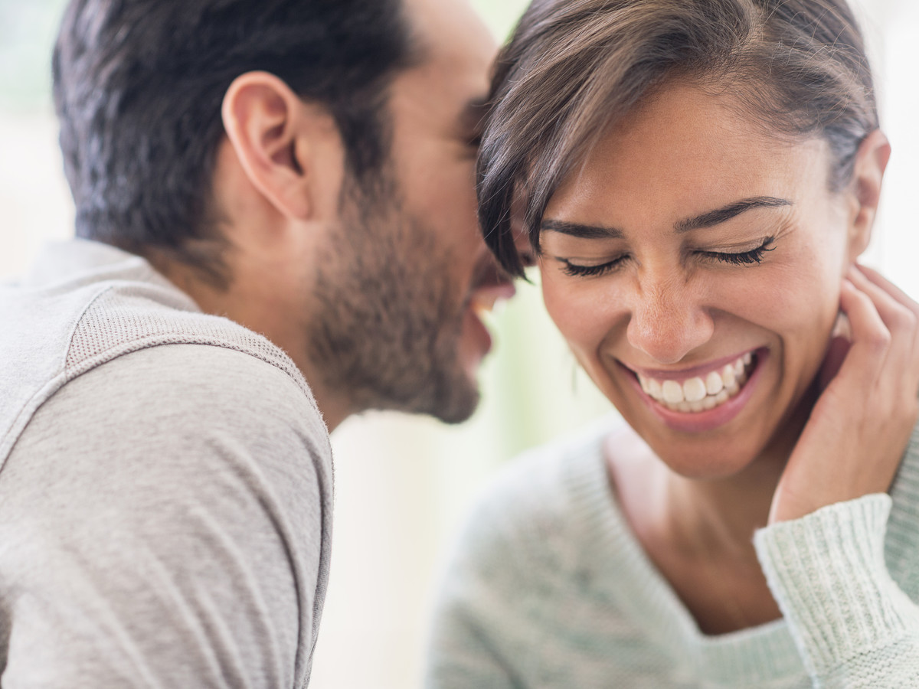
I remember all the laughter (that) we shared,
Notes:
预览及使用此模板前先下载英文Segoe Script、中文新蒂小丸子小学版字体，预览效果会更加美观！

Slide 23
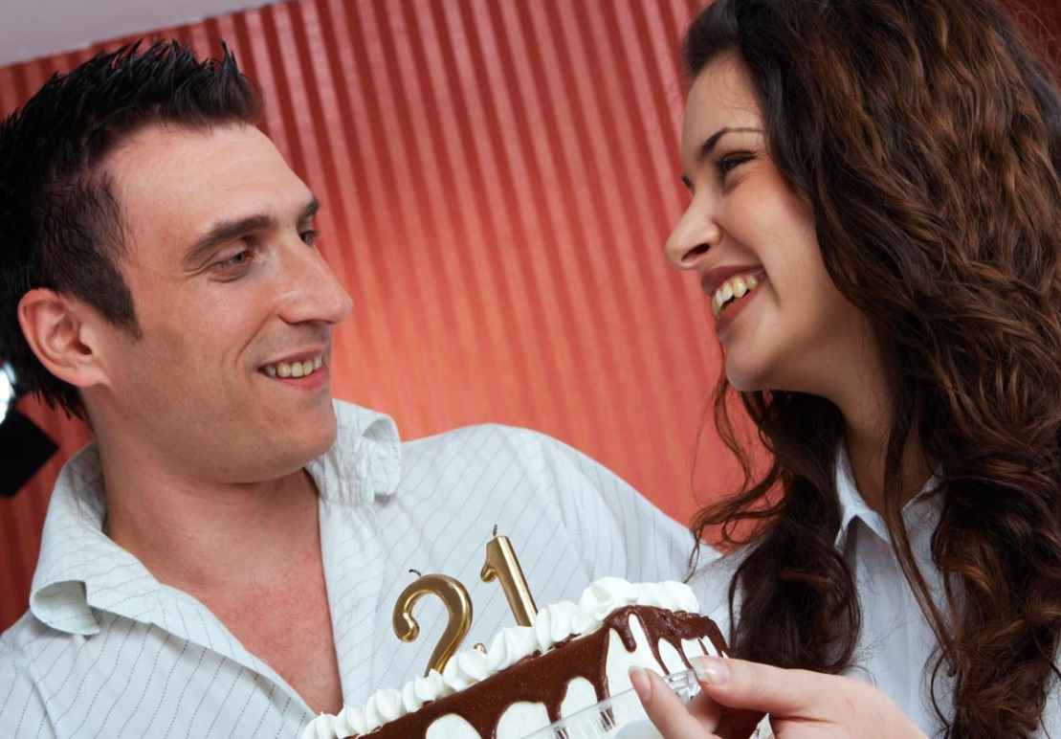
all the wishes (that) we made
Notes:
预览及使用此模板前先下载英文Segoe Script、中文新蒂小丸子小学版字体，预览效果会更加美观！

Slide 24
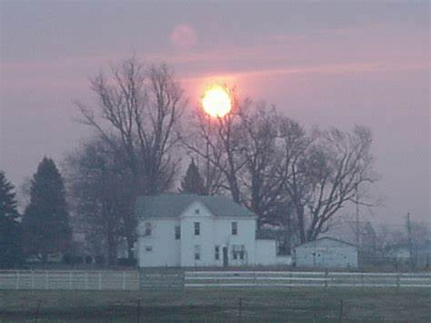
upon the roof at dawn.

Slide 25
I remember the way (that) you read your books.

Slide 26
Yes I remember the way (that) you tied your shoes.

Slide 27
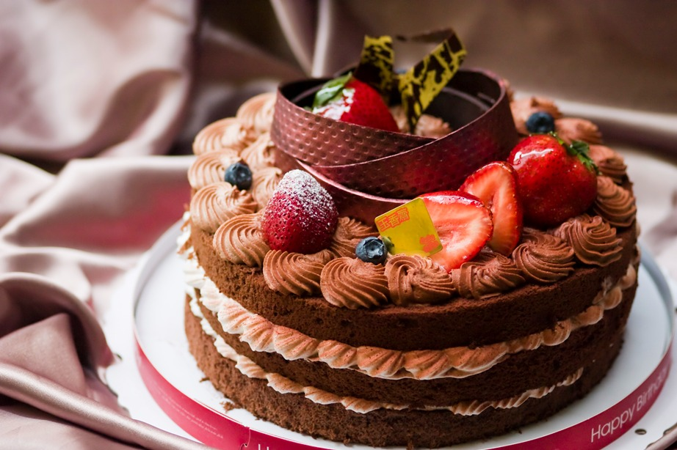
Yes I remember the cake (that) you loved the most.
Notes:
预览及使用此模板前先下载英文Segoe Script、中文新蒂小丸子小学版字体，预览效果会更加美观！

Slide 28
Yes I remember the way (that) your drank you coffee.
Notes:
预览及使用此模板前先下载英文Segoe Script、中文新蒂小丸子小学版字体，预览效果会更加美观！

Slide 29
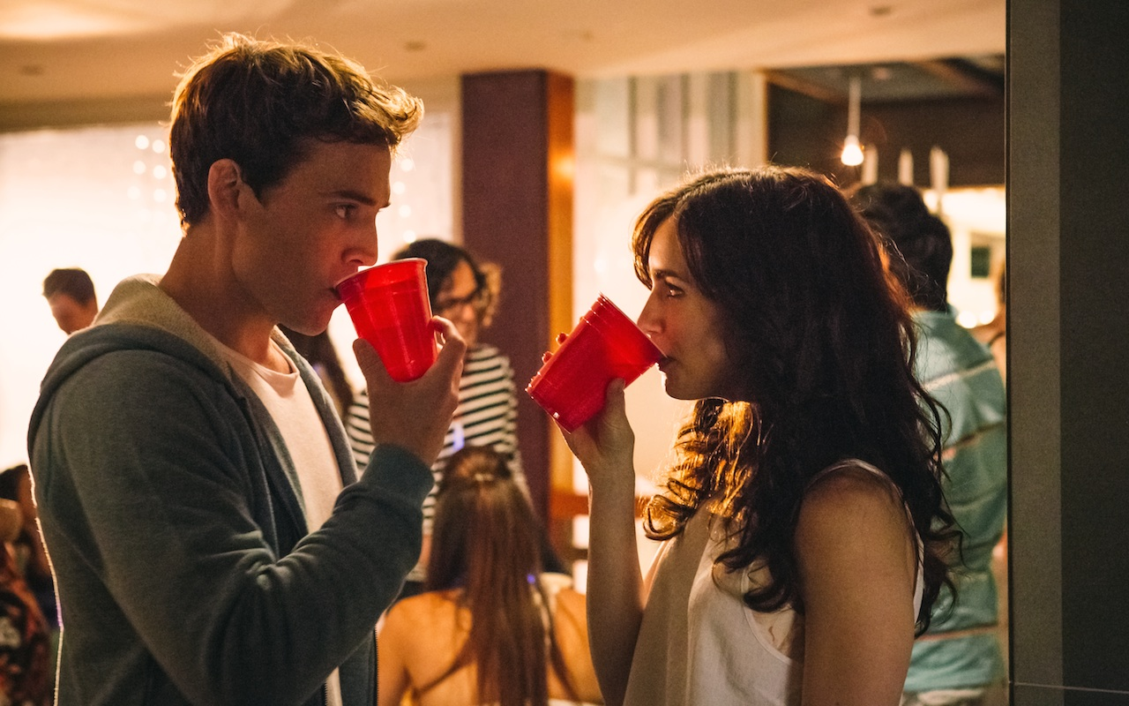
I remember the way (that) your glanced at me,

Slide 30
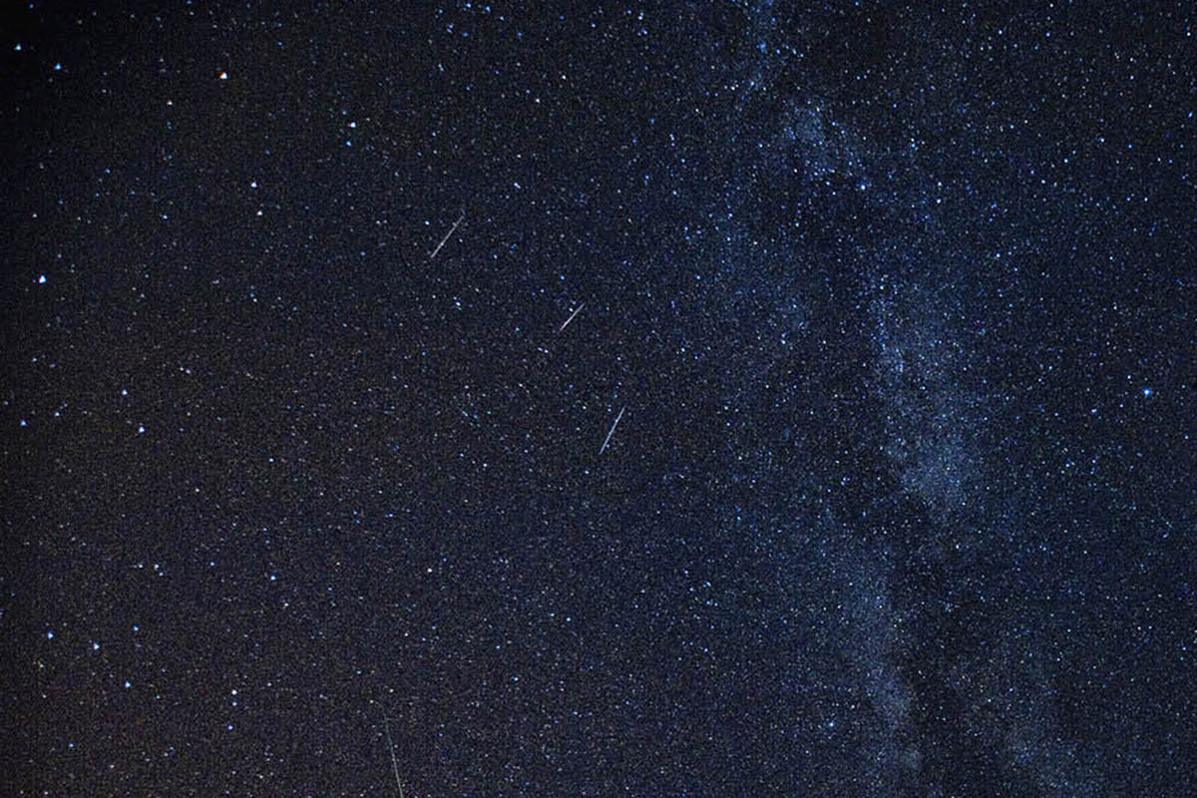
Yes I remember when we caught a shooting star.
Notes:
预览及使用此模板前先下载英文Segoe Script、中文新蒂小丸子小学版字体，预览效果会更加美观！

Slide 31
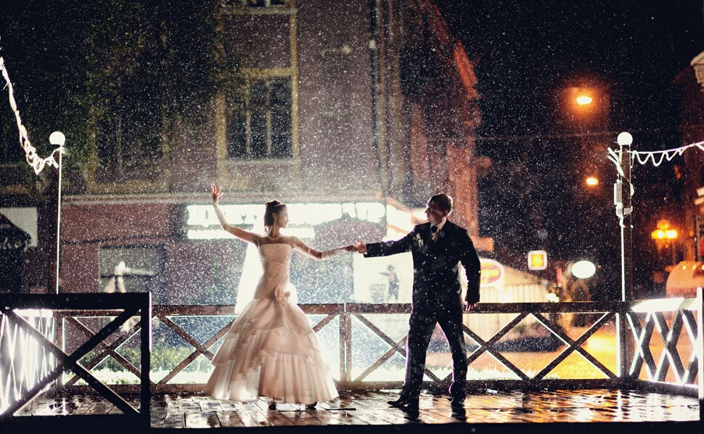
Yes I remember when we were dancing in the rain in that December
Notes:
预览及使用此模板前先下载英文Segoe Script、中文新蒂小丸子小学版字体，预览效果会更加美观！

Slide 32
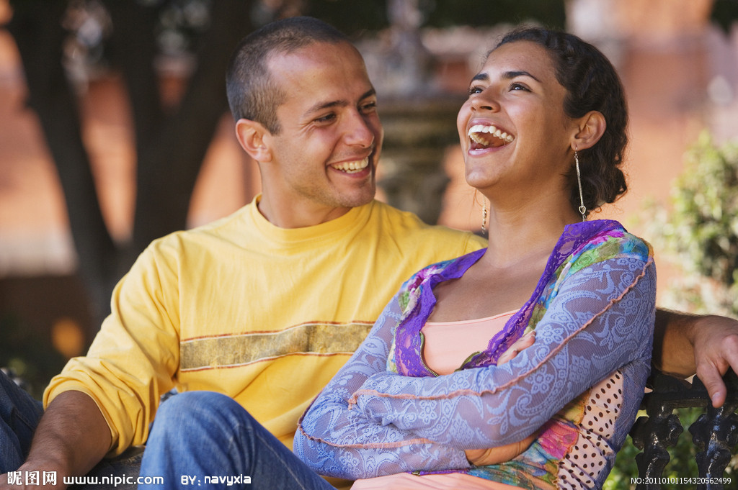
and the way (that) you smile at me,
Notes:
预览及使用此模板前先下载英文Segoe Script、中文新蒂小丸子小学版字体，预览效果会更加美观！

Slide 33
yes I remember.
Notes:
预览及使用此模板前先下载英文Segoe Script、中文新蒂小丸子小学版字体，预览效果会更加美观！

