Slide 1
Song: Girl in the movies
-- Non-finite Verb
华南师范大学外国语言文化学院：翁晓娴
广东省河源市琴江中学：唐牡丹

Slide 2
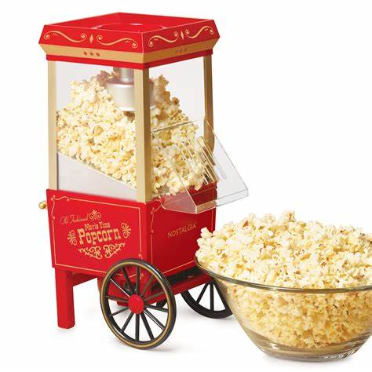
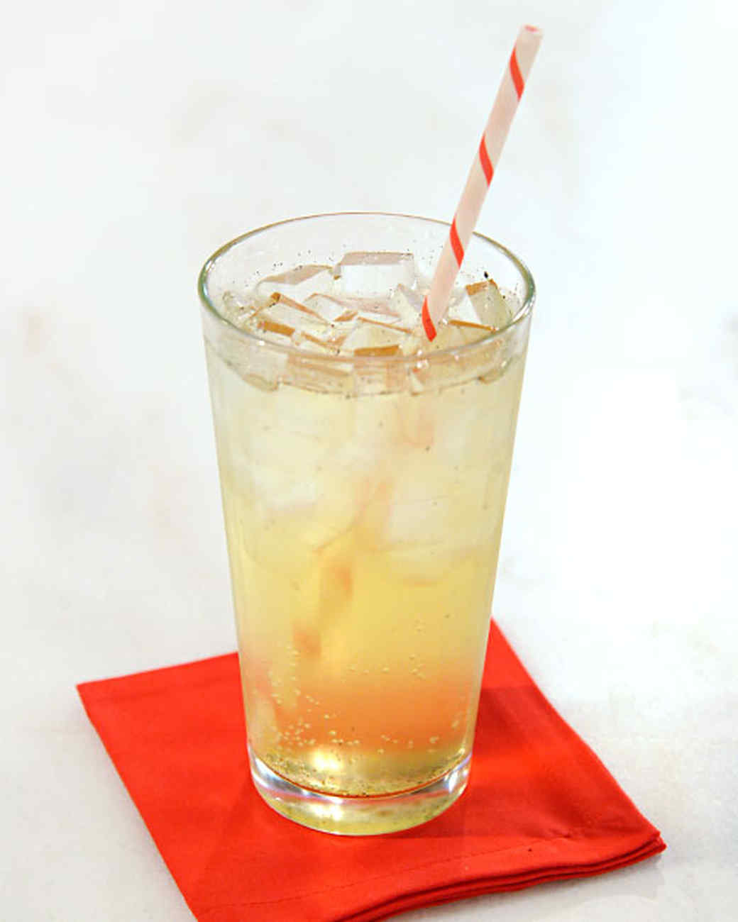
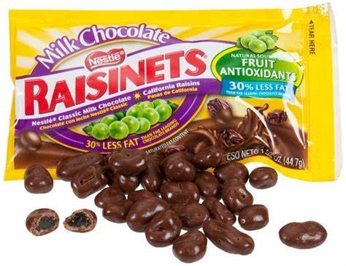
Popcorn soda box of Raisinets

Slide 3
Velvet-cushioned seats and soft armrests
Best seat in my favorite movie house

Slide 4
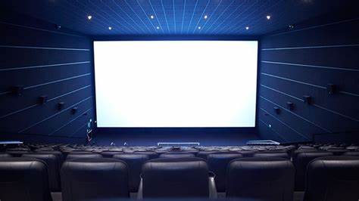
Up on the silver screen I picture me
Start my dreaming as the lights go out
Living out my passions hopes and fantasies
I want to be the girl in the movies

Slide 5
The one with the glint in her eyes
The girl that seldom loses
Beautiful with grace and style

Slide 6
Acting out her story
Happy ever after
Standing in her glory
I want to be the girl in the movies

Slide 7
Wish I had a nickel for
each dime I've spent
Here's a preview of
some things to come
Watching others live
their lives with confidence
It's not too late for me
to be someone

Slide 8
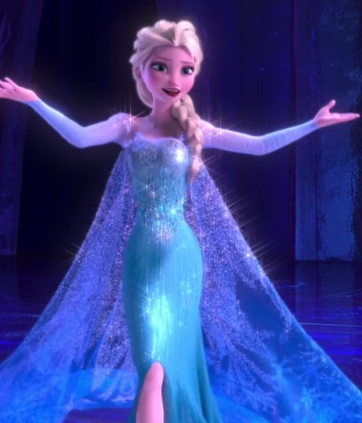
Coming attractions will be starring me
I can't keep living in their make-believe
I want to be the girl in the movies

Slide 9
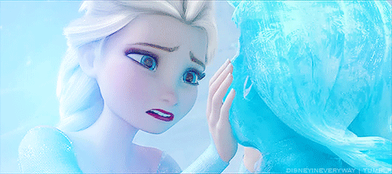
She gets the roles she chooses
The one with the stars in her eyes
She can laugh or she can cry

Slide 10
Acting in her story
Always happy endings
Standing in her glory
I want to be the girl in the movies

Slide 11
It's time I show the world just what I'm about

Slide 12
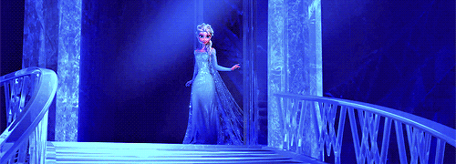
I'm steppin’ up and I'm steppin’ out

Slide 13
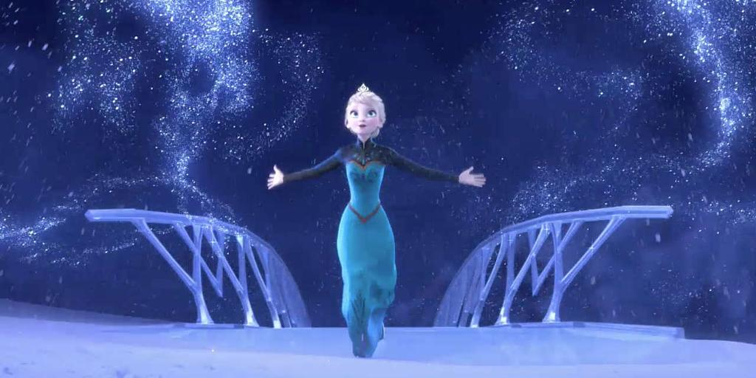
I'm feelin’ bold and I'm feelin’ proud

Slide 14
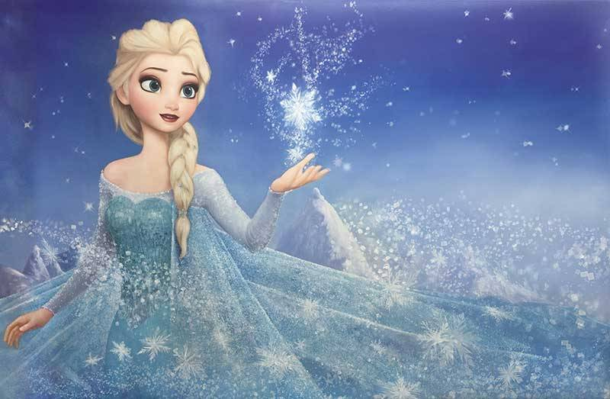
I want to be that girl
I want to be the girl
in the movies

Slide 15
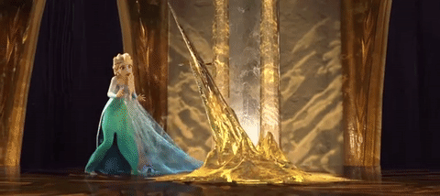
Gonna stand up
And I'm gonna matter

Slide 16
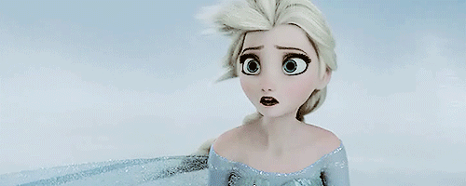
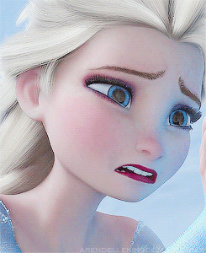
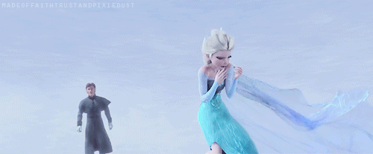
Cause I've had enough of my dreams being shattered
And I've had enough of my tears being splattered

Slide 17
I've already been that girl

Slide 18
Oh I want to be I want to be
I want to be I want to be
I want to be the girl in the movies
I want to be I want to be

Slide 19
Hey look at me
Hey look at me
I want to be the girl
in the movies

Slide 20
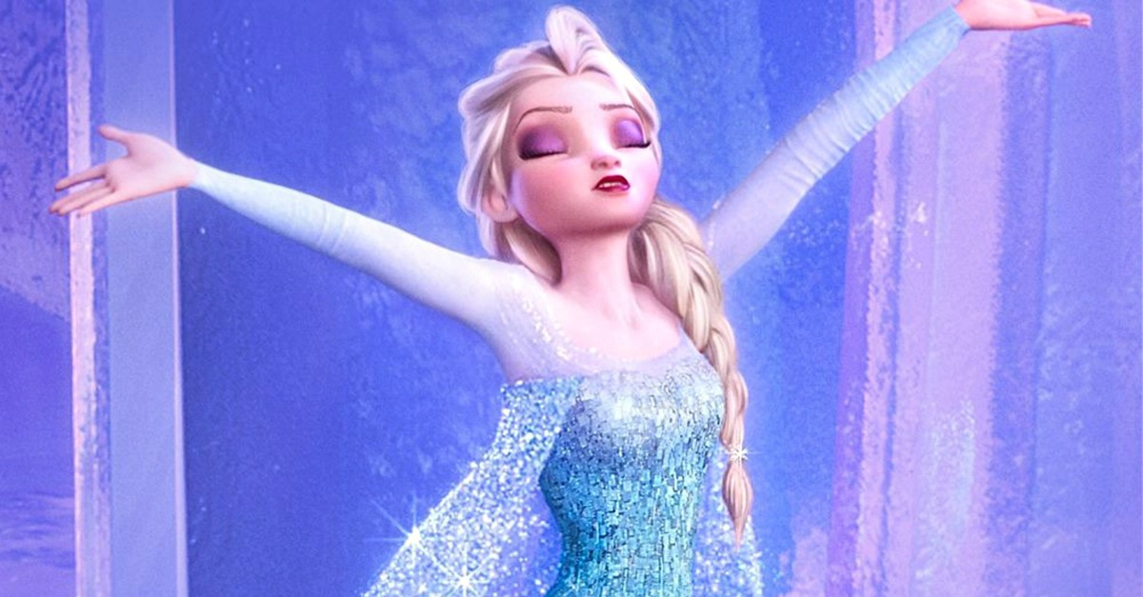
I want to shine
I want to shine

Slide 21
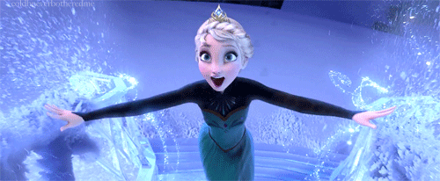
It's my time
And I want to shine

Slide 22
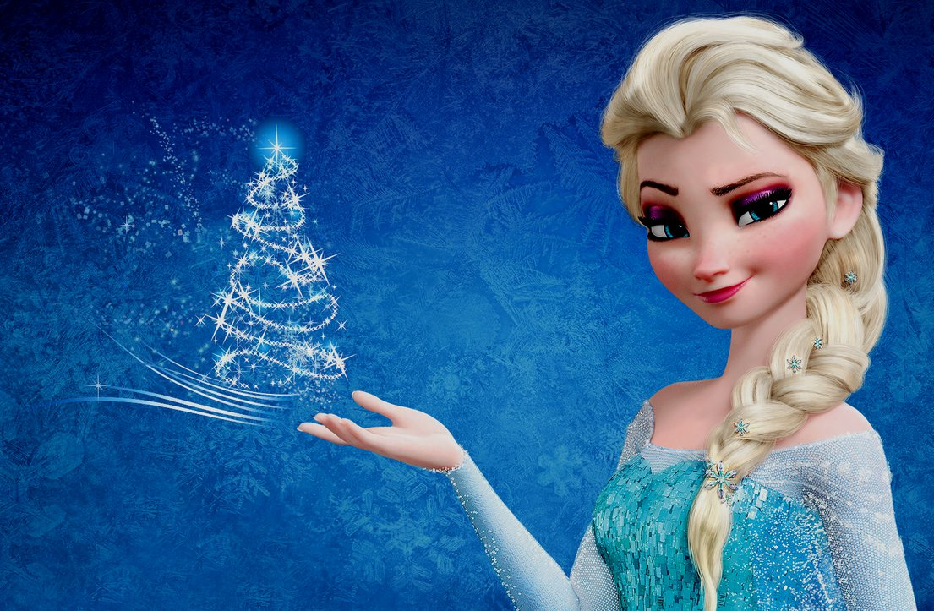
I want to be happy
I want to be free
Just like the girl
in the movies

