Slide 1
Summer Train
——被动语态
作者：华南师范大学外文学院 刘嘉红
河源市紫金县蓝塘二中 刘子凤

Slide 2
Come with me for a little ride, see the shadows passing by
跟我一起坐火车走吧，看着车窗外呼啸而过的掠影

Slide 3
Look at the sun
远望艳阳
And see the clouds turn to faces in the sky
仰望那天空的云卷云舒，看云变幻出人脸模样

Slide 4
We've been awake all night, shattered dreams all around
我们彻夜未眠，四周飘荡着梦的碎片

Slide 5
Close your sad, sad eyes
合上你布满忧愁的双眼
We will be safe and sound
我们会安然无恙

Slide 6
Come with me for a little ride,
see the shadows passing by
跟我一起坐火车走吧
看着车窗外呼啸而过的掠影

Slide 7
Look at the sun
远望艳阳
And see the clouds turn to faces in the sky
仰望那天空的云卷云舒，看云变幻出人脸模样

Slide 8
Daydreaming lightly through the rain
白日梦轻轻地穿透雨滴

Slide 9
on a summer train
在这夏日的列车上，所有的一切都能被谅解
All is forgiven

Slide 10
Come with me for a little ride, see the shadows passing by
跟我一起坐火车走吧，看着车窗外呼啸而过的掠影

Slide 11
Seems we are a thousand miles away from last night
似乎我们已和昨夜相距千里

Slide 12
As you sigh in my ear, kiss the rain goodbye
你在我耳边轻叹 与雨滴吻别

Slide 13
Come with me for a little ride, see the shadows passing by
跟我一起坐火车离开吧 看着车窗外呼啸而过的掠影

Slide 14
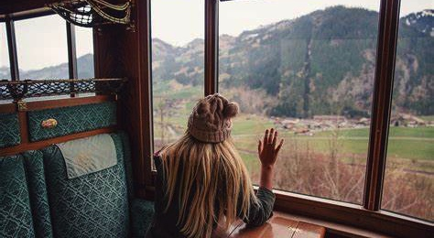
Look at sun and see the clouds turn to faces in the sky
远眺艳阳，仰望那苍穹的云，看它们变成人脸模样

Slide 15
Daydreaming lightly through the rain
在雨中轻轻地梦

Slide 16
on the summer train
所有的一切都能被谅解，在这夏日的列车上
All is forgiven

Slide 17
Come with me for a little ride, see the shadows passing by
跟我一起坐火车走吧，看着车窗外呼啸而过的掠影

Slide 18
Come away with me
同我一起
It‘s gonna be alright, just breathe
一切就都能好起来，只需要呼吸

Slide 19
It‘s gonna be alright. You’ll see.
你会看到一切就都能好起来
Come away with me
同我一起

Slide 20
And the windows are crying
而车窗在哭

Slide 21
But this train is flying us all through the Rain I fear
但是火车载着你我在雨幕中穿梭

Slide 22
And the sky's getting brighter with every mile
于是这天空随着列车的行进而渐渐明亮

Slide 23
And it all seems clear
一切变得清晰

Slide 24
Come with me for a little ride, see the shadows passing by
跟我一起坐火车离开吧 看着车窗外呼啸而过的掠影

Slide 25
Look at the sun
远望艳阳
And see the clouds turn to faces in the sky
仰望那天空的云卷云舒，看云变幻出人脸模样

Slide 26
Daydreaming lightly through the rain
在雨中轻轻地梦

Slide 27
All is forgiven on a summer train
在这夏日的列车上，所有的一切都能被谅解

Slide 28
Come with me for a little ride, see the shadows passing by
跟我一起坐火车走吧，看着车窗外呼啸而过的掠影

Slide 29
Come away with me. It's gonna be all right, just breathe.
跟我一起走吧，清浅呼吸间，一切都会好起来

Slide 30
Come away with me. It's gonna be all right you'll see
同我一起，你会看到一切都会好起来

Slide 31
Come away with me. It's gonna be all right, just breathe.
跟我一起走吧，清浅呼吸间，一切都会好起来

Slide 32
Come away with me. It's gonna be all right you'll see
同我一起，你会看到一切都会好起来

Slide 33
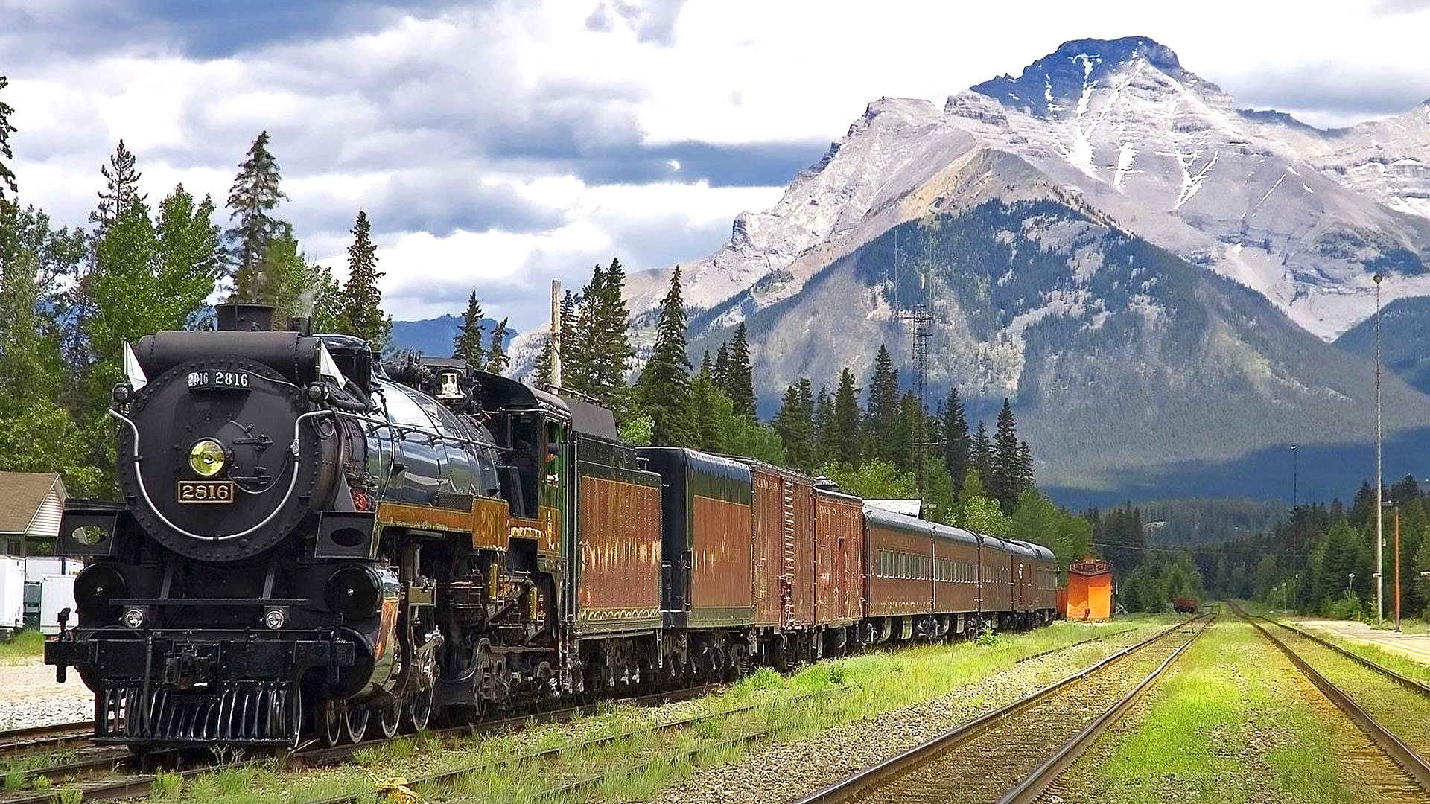
You'll see
你会看到一切都会好起来

Slide 34
Come away with me
跟我一起走吧

