Slide 1
Love story —— 过去进行时
设计制作：华南师范大学外文学院 庄瑞楠
河源市紫金县敬梓中学 张晓红
指导教师：刘晓斌

Slide 2
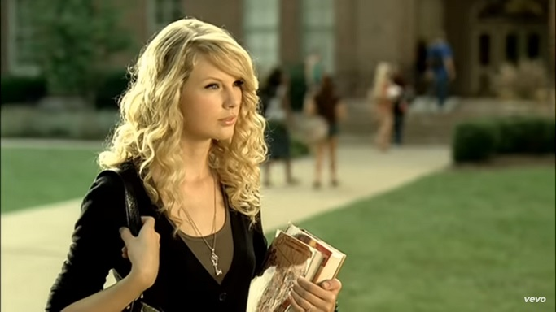
We were both young when I first saw you

Slide 3
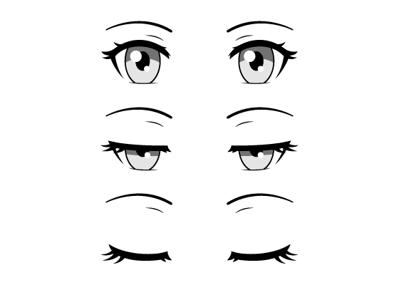
I close my eyes

Slide 4
And the flashback starts

Slide 5
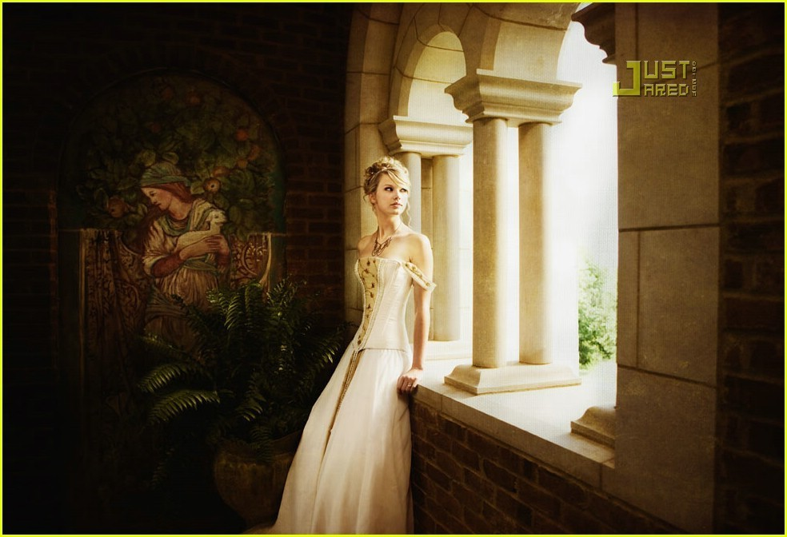
I'm standing there

Slide 6
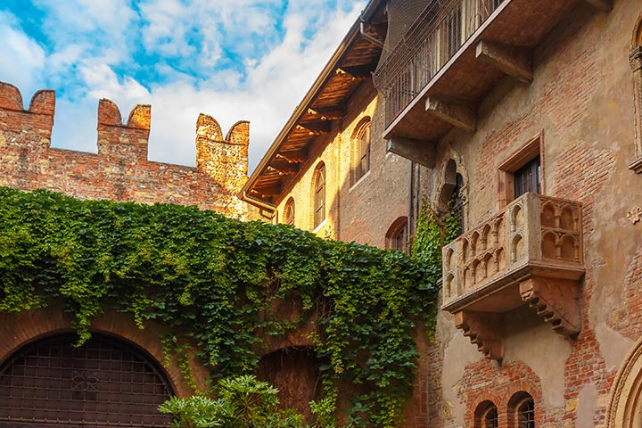
On a balcony in summer air

Slide 7
See the lights

Slide 8
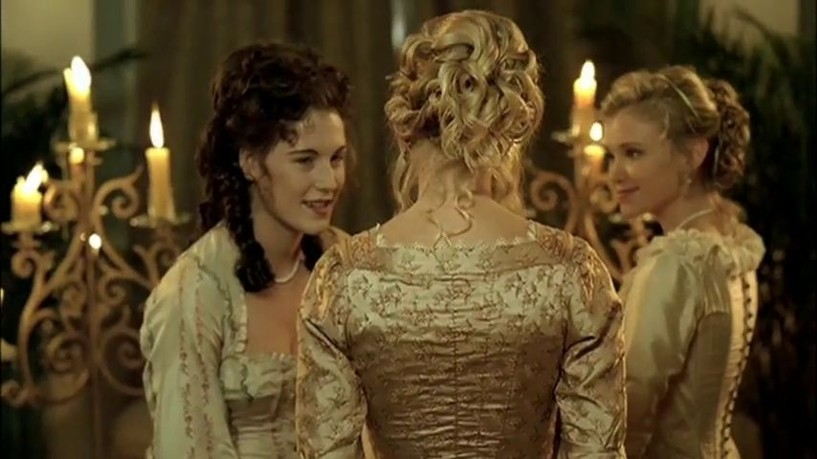
See the party the ball gowns

Slide 9
I see you make your way through the crowd

Slide 10
And say hello little did I know

Slide 11
That you were Romeo you were throwing pebbles

Slide 12
And my daddy said stay away from Juliet

Slide 13
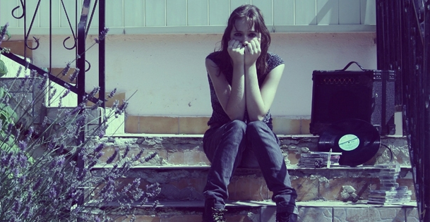
And I was crying on the staircase

Slide 14
Begging you please don't go and I said

Slide 15
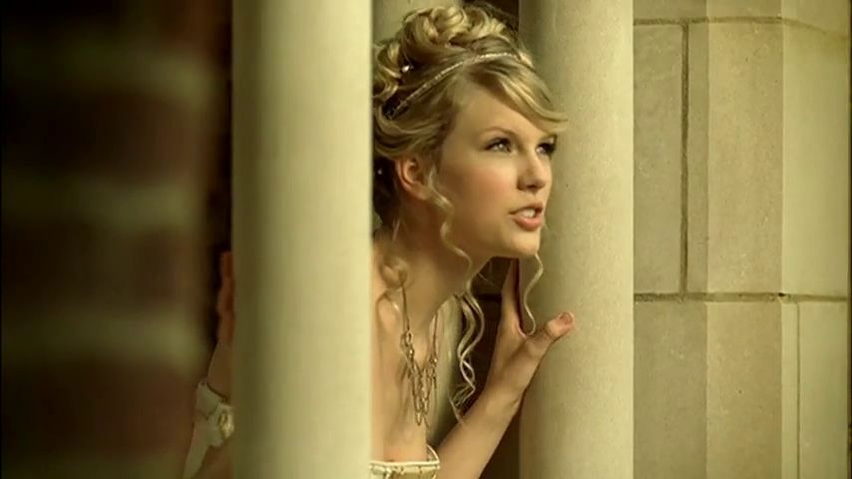
Romeo take me somewhere we can be alone

Slide 16
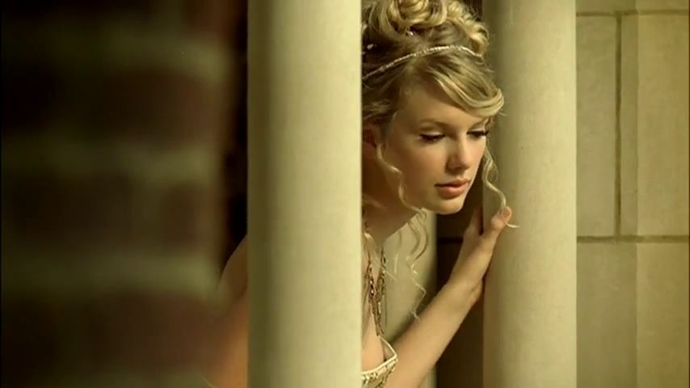
I'll be waiting all there's left to do is run

Slide 17
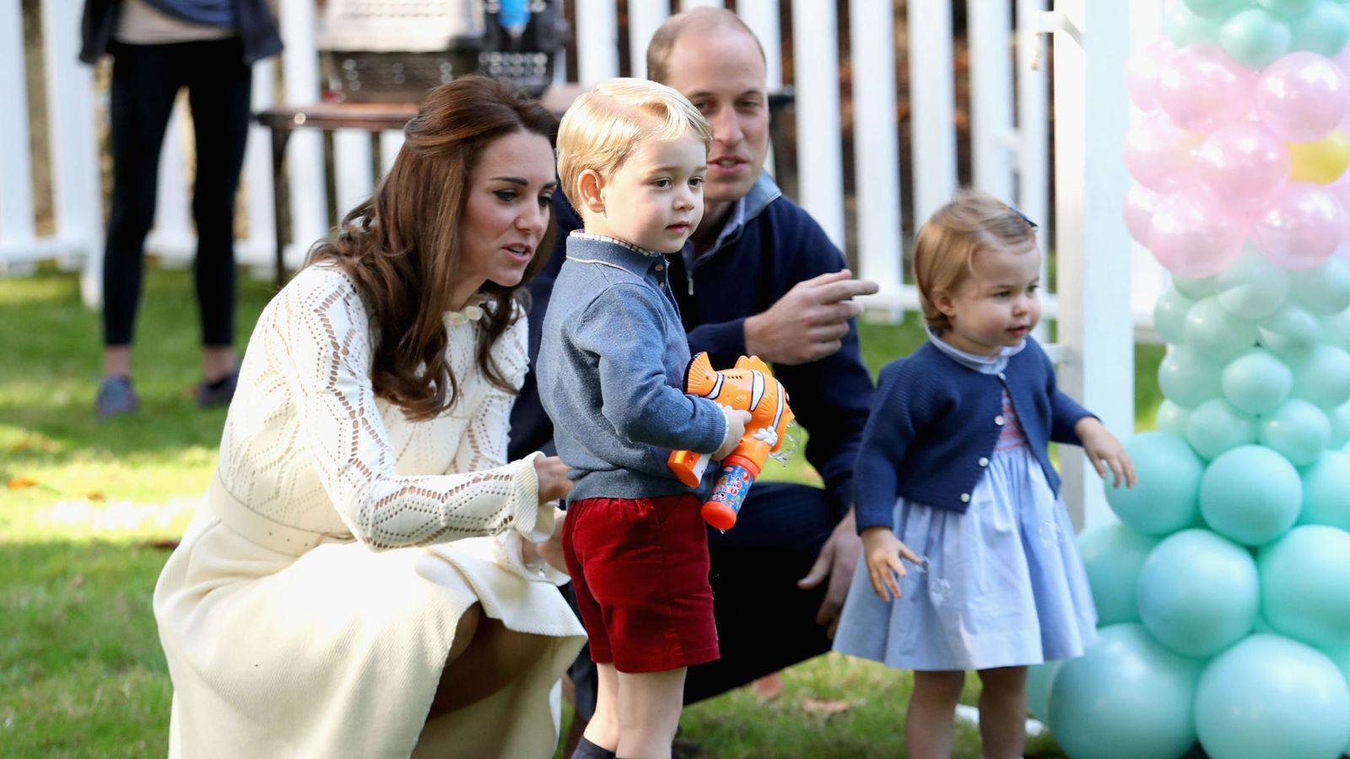
You'll be the prince and I'll be the princess

Slide 18
It's a love story baby just say yes

Slide 19
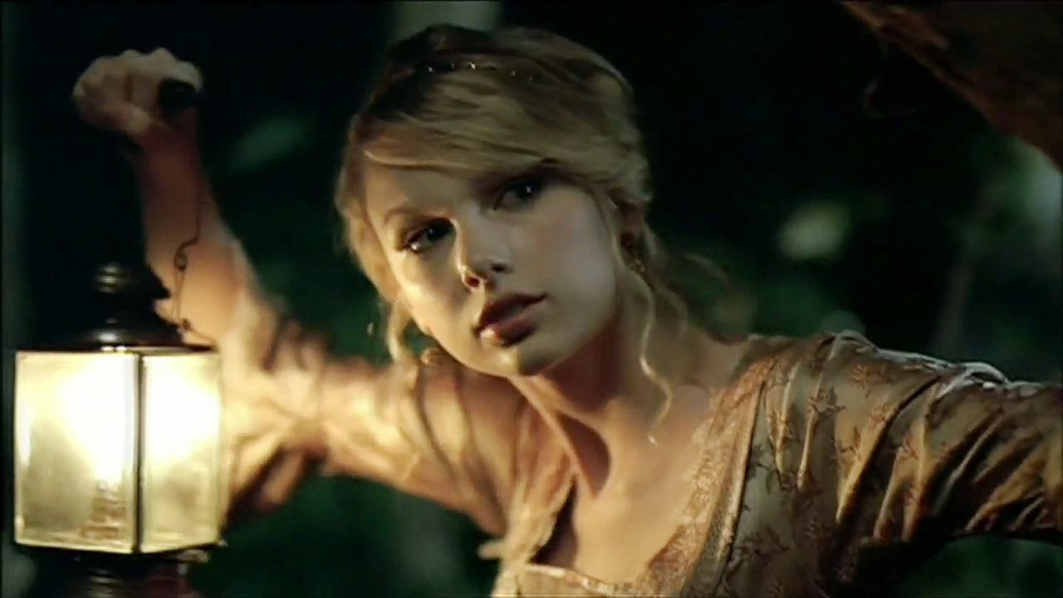
So I sneak out to the garden to see you

Slide 20
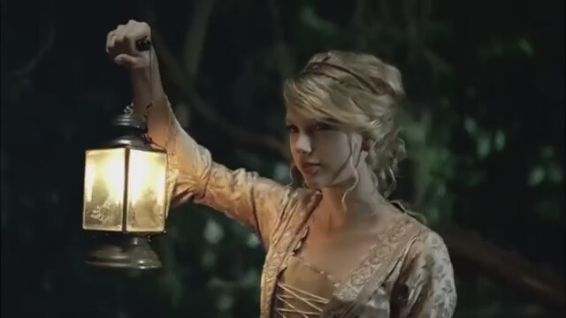
We keep quiet cause we're dead if they knew

Slide 21
So close your eyes

Slide 22
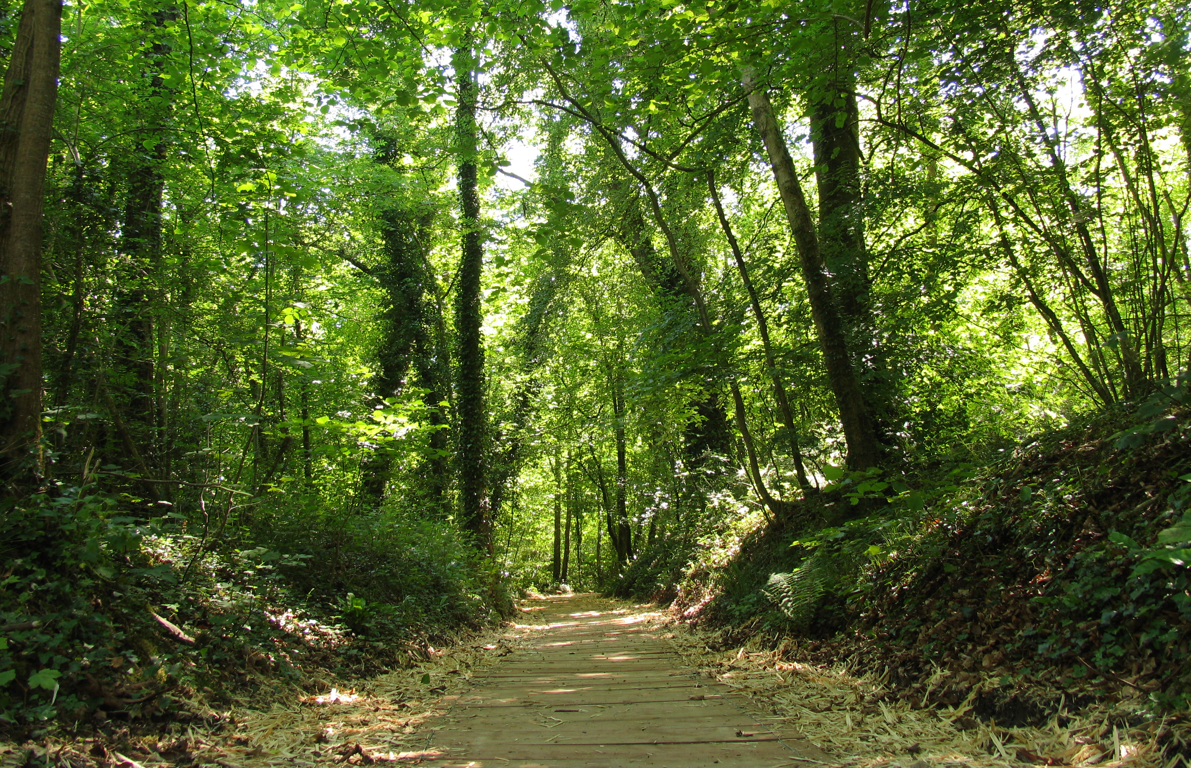
Escape this town for a little while

Slide 23
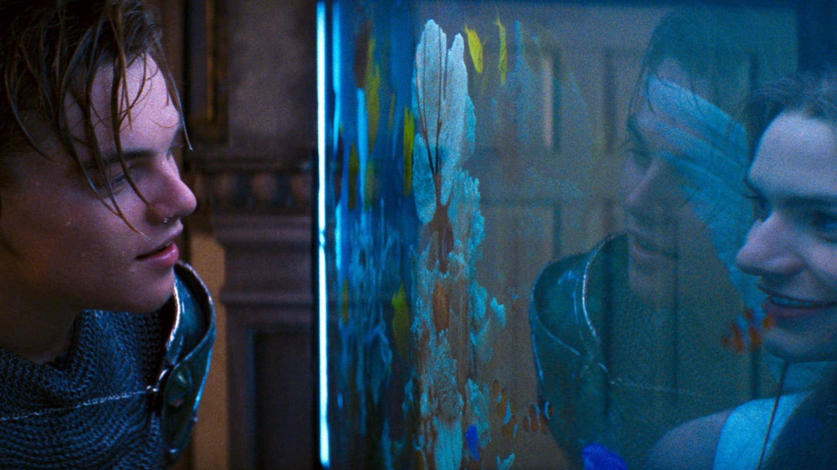
Cause you were Romeo I was a scarlet letter

Slide 24
And my daddy said stay away from Juliet

Slide 25
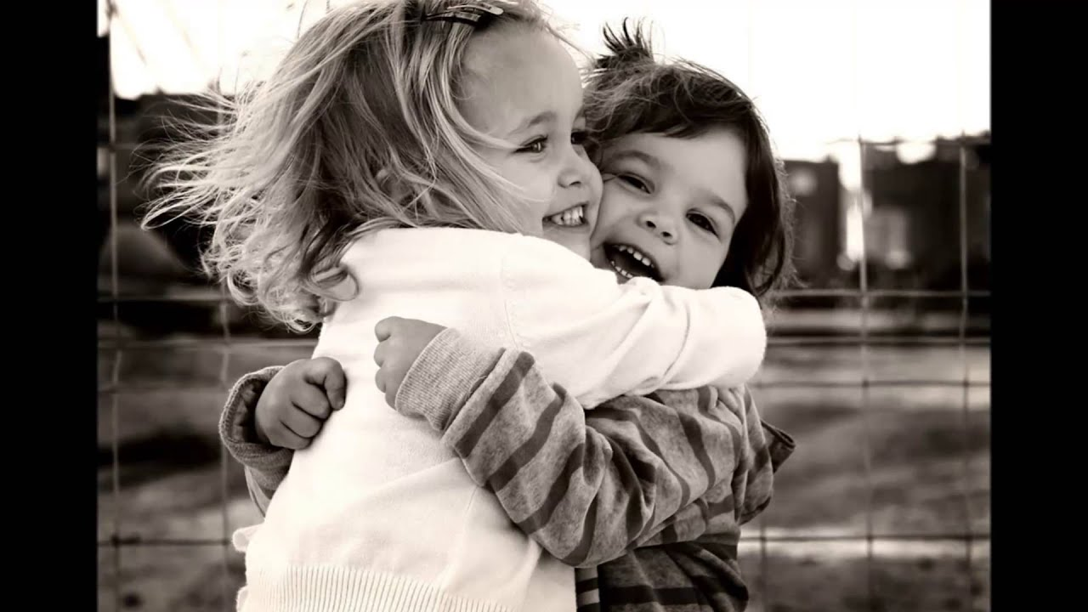
But you were everything to me

Slide 26
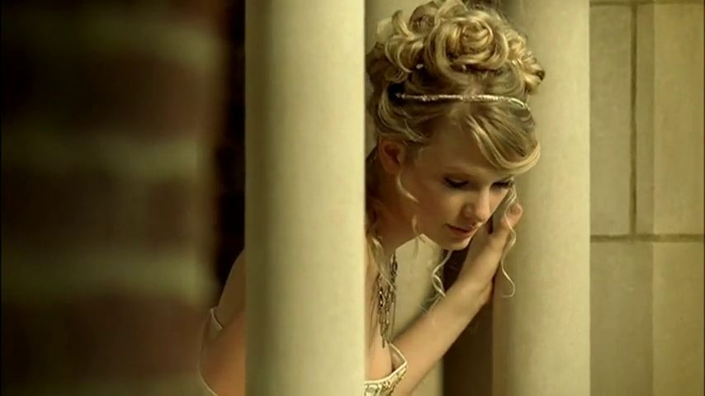
I was begging you please don't go and I said

Slide 27
Romeo take me somewhere we can be alone

Slide 28
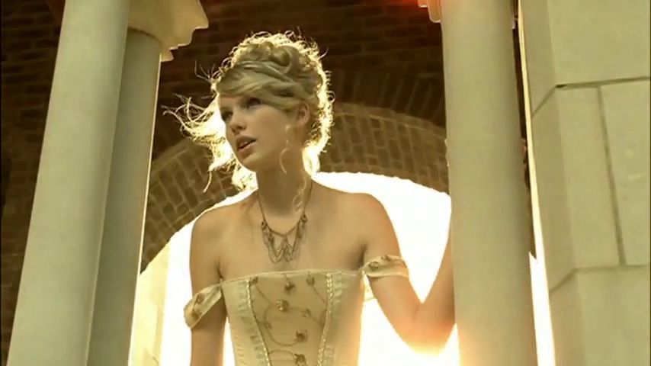
I'll be waiting all there's left to do is run

Slide 29
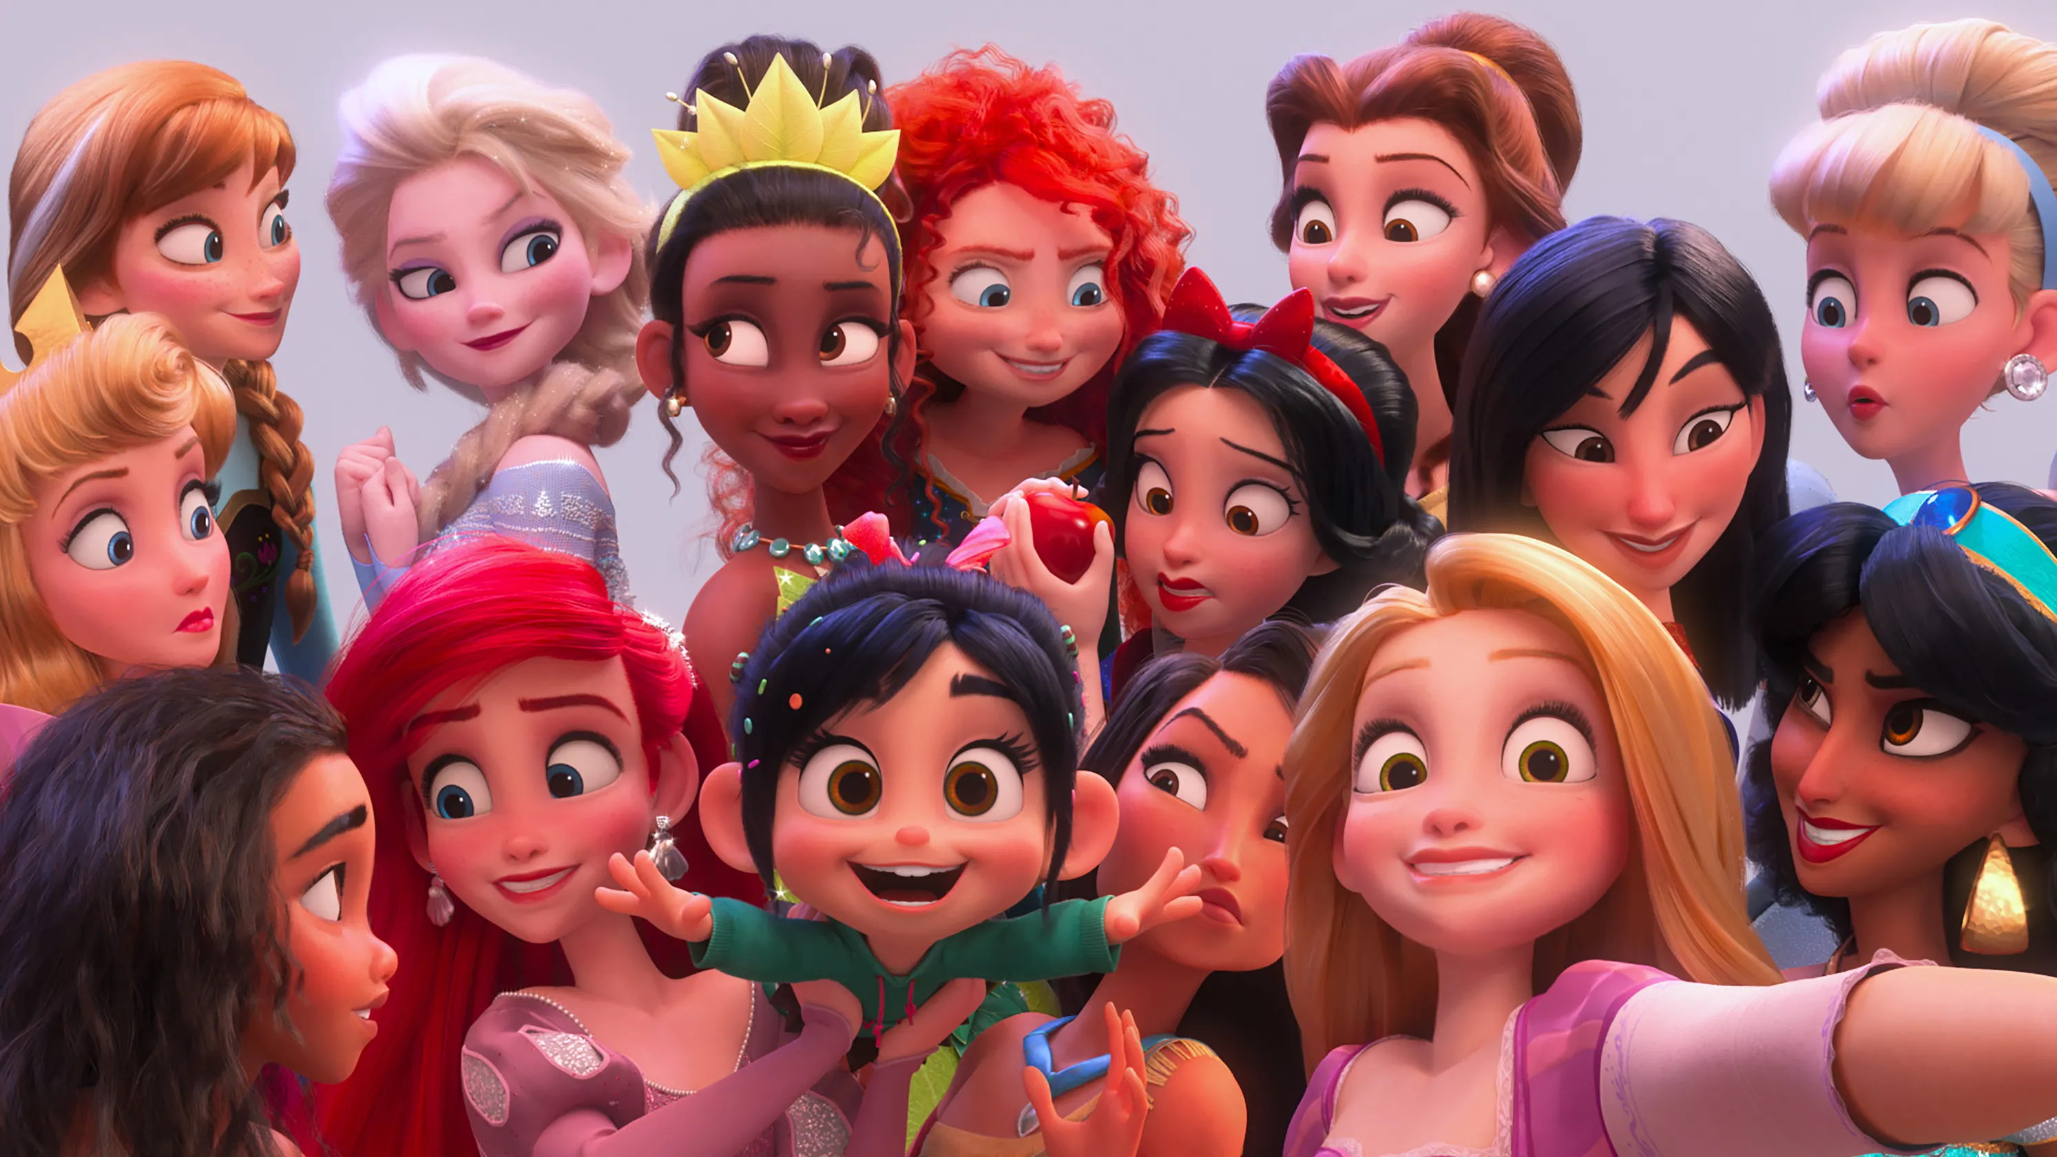
You'll be the prince and I'll be the princess

Slide 30
It's a love story baby just say yes

Slide 31
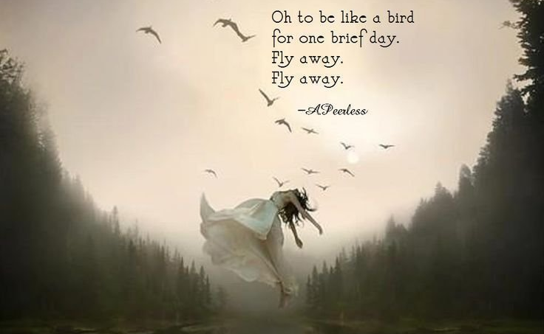
Romeo save me they try to tell me how to feel

Slide 32
This love is difficult but it's real

Slide 33
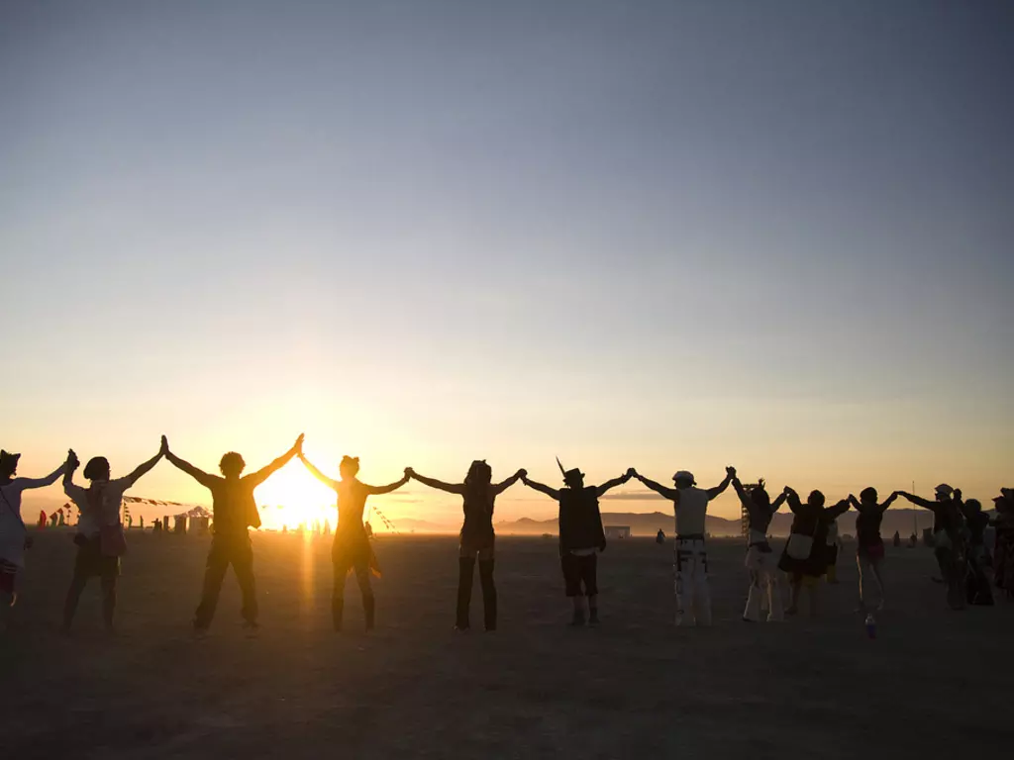
Don't be afraid we'll make it out of this mess

Slide 34
It's a love story baby just say yes

