Slide 1
华南师范大学外国语言文化学院 肖美红
广东省河源市紫金县紫城中学
严晓芬

Slide 2
Summer of ‘69
一般过去时

Slide 3
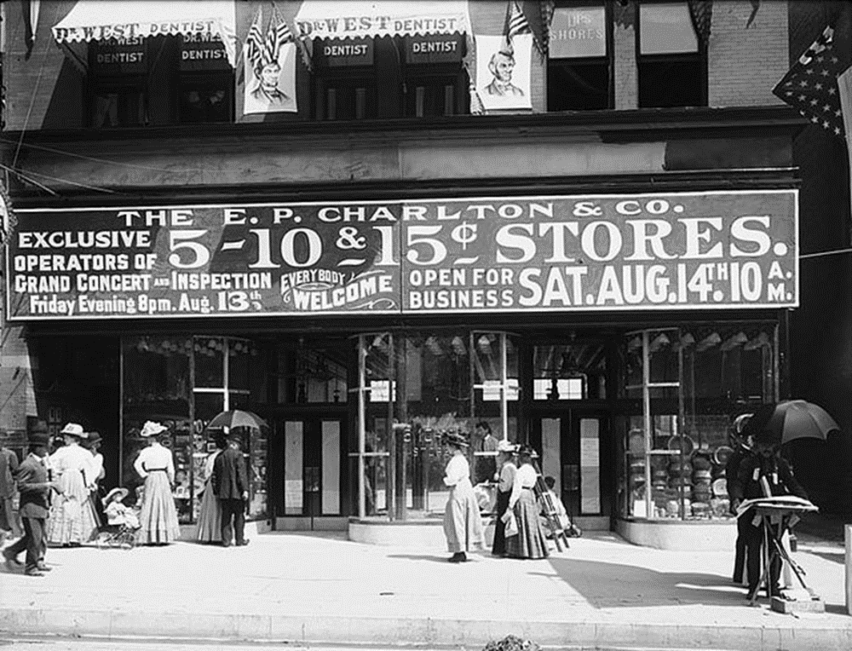
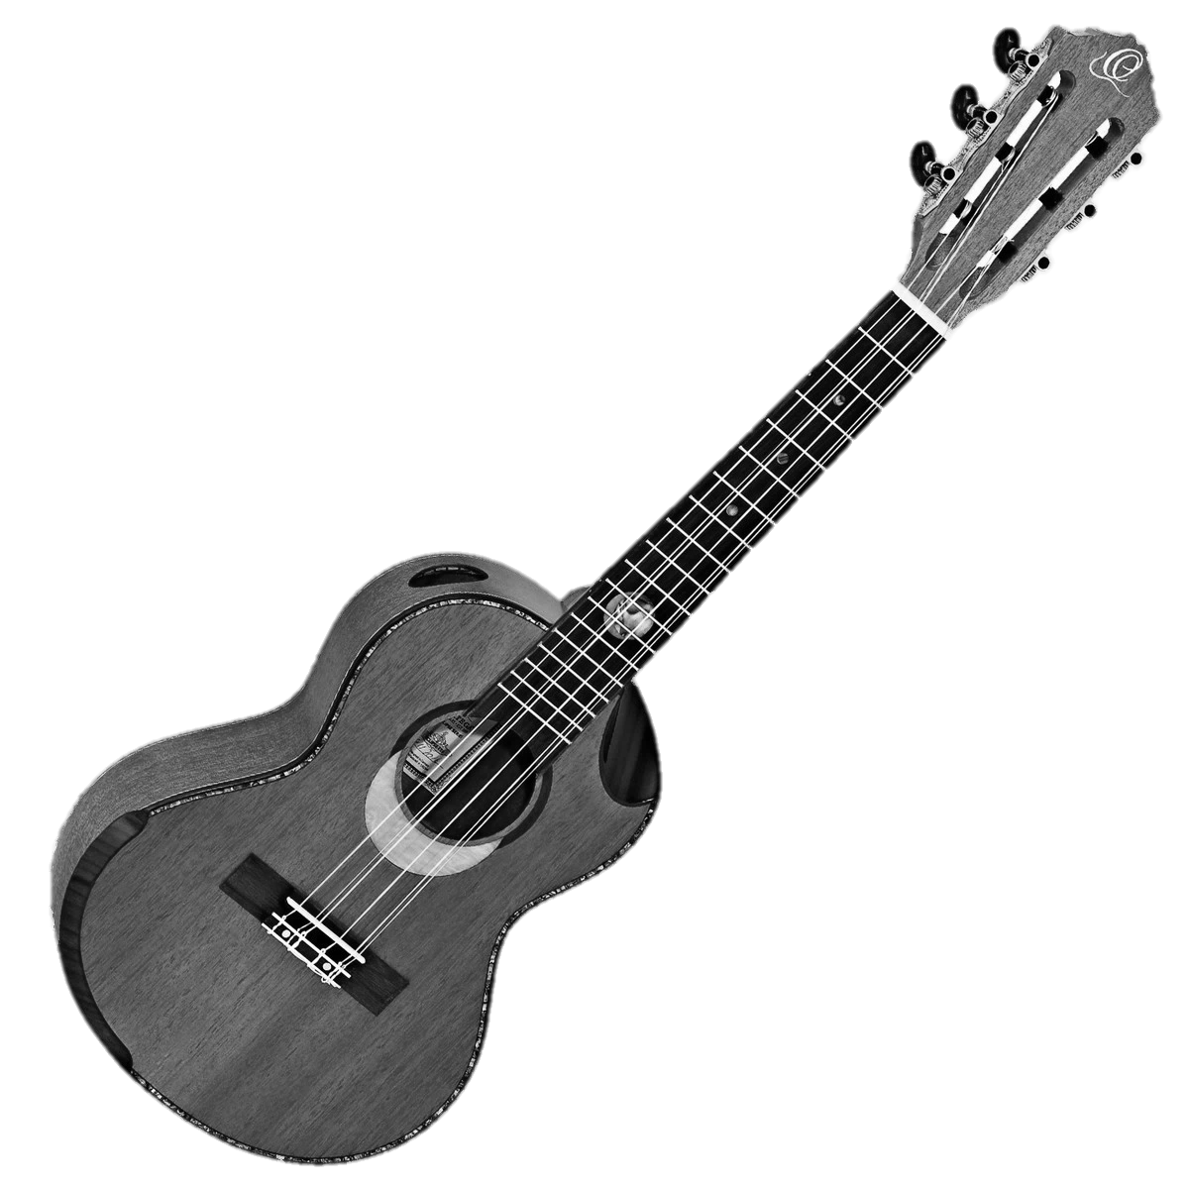
I got my first real six-string
Bought it at the five-and-dime

Slide 4
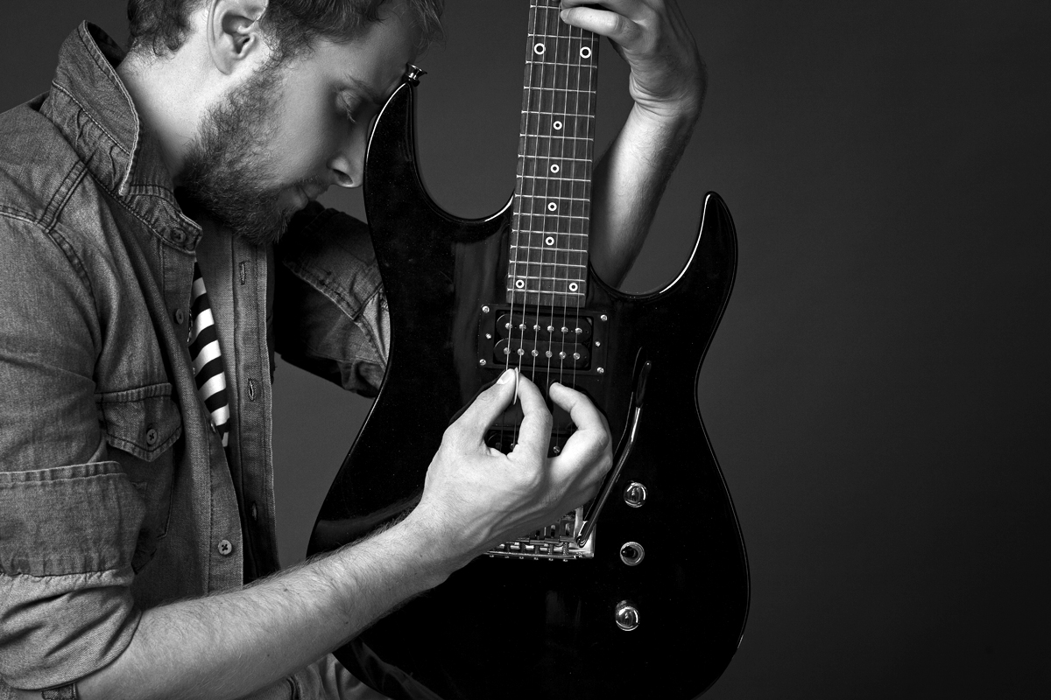
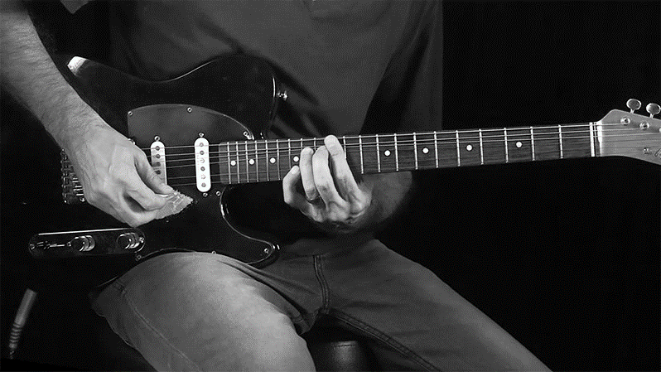
Played it till my fingers bled

Slide 5
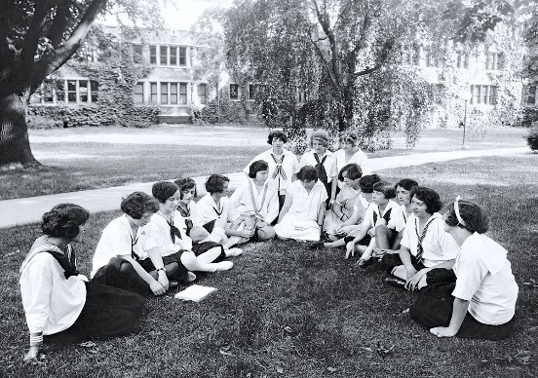
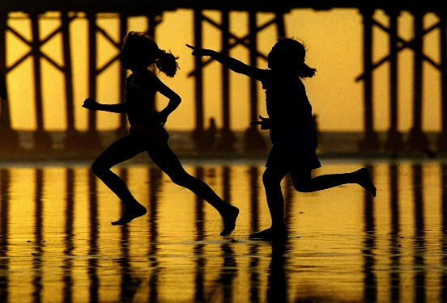
It was the summer of ‘69

Slide 6
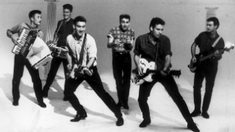
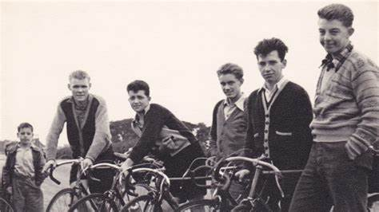
Me and some guys from school
Had a band and we tried real hard

Slide 7
I shoulda known we'd never get far
Jimmy quit and Jody got married

Slide 8
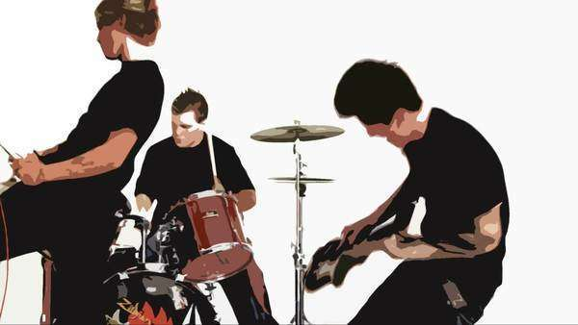
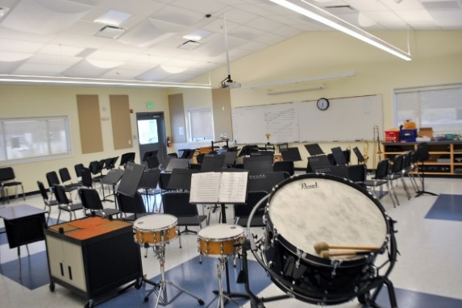
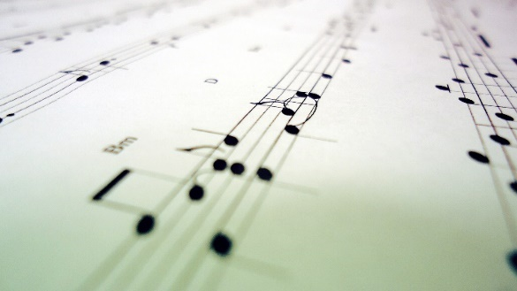
That summer seemed to last forever
Oh when I look back now
Yeah - I'd always wanna be there
And if I had the choice
Those were the best days of my life

Slide 9
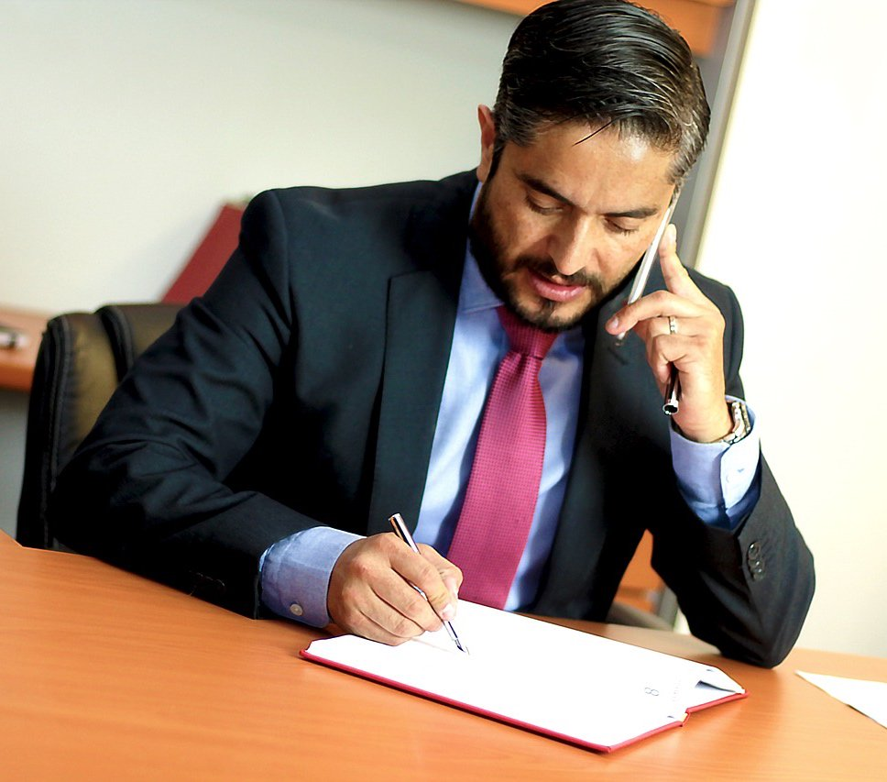
Ain't no use in complaining
When you got a job to do

Slide 10
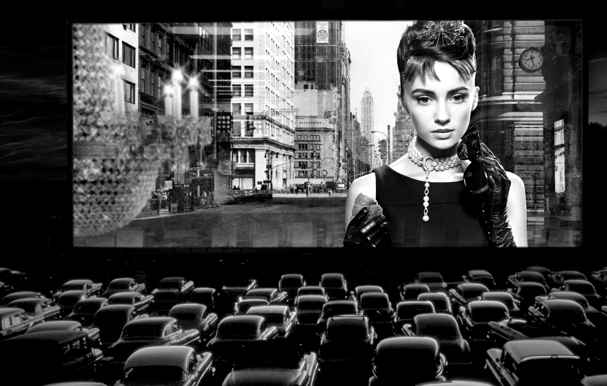
Spent my evenings down at the drive-in
And that's when I met you

Slide 11
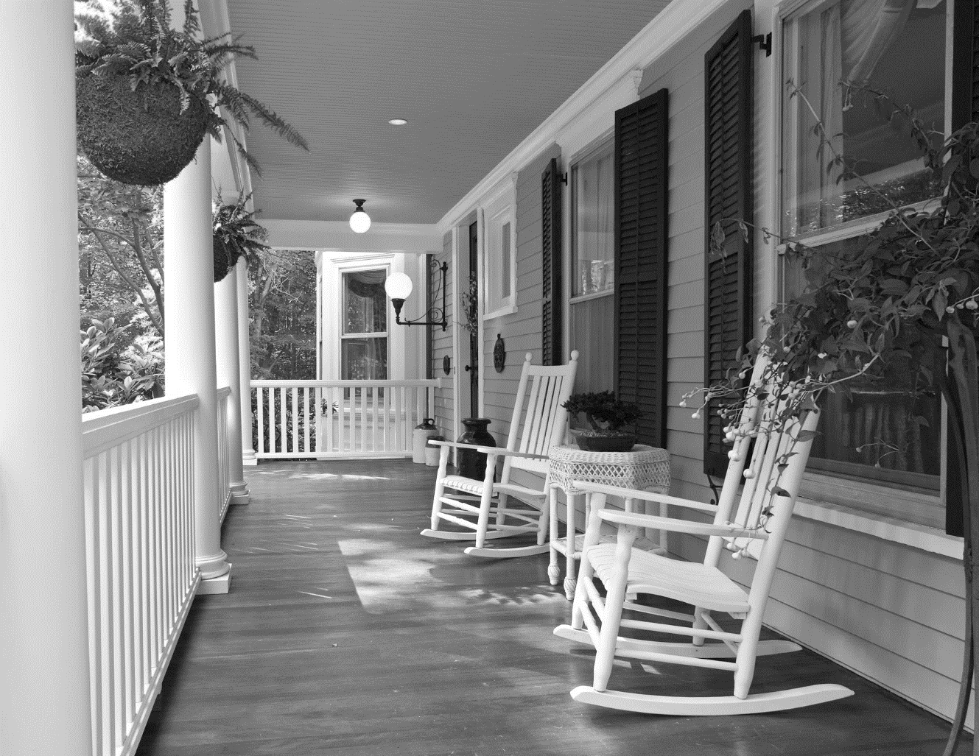
Standing on your mama's porch

Slide 12
You told me that you'd wait forever

Slide 13
Oh and when you held my hand
I knew that it was now or never

Slide 14
Those were the best days of my life. Oh yeah!
Back in the summer of '69. Oh!

Slide 15
Man we were killing time

Slide 16
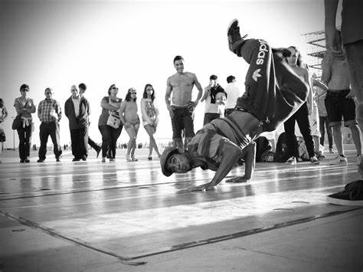
We were young and restless
We needed to unwind

Slide 17
I guess nothing can last forever-forever, no

Slide 18
Look at everything that's come and gone
And now the times are changing

Slide 19
Sometimes when I play that old six-string
I think about you wonder what went wrong

Slide 20
Standing on your mama's porch

Slide 21
You told me that you'd last forever

Slide 22
Oh and when you held my hand
I knew that it was now or never

Slide 23
Those were the best days of my life
Back in the summer of '69

Slide 24
It was the summer of ‘69
Baby baby of ‘69
It was 7 7 7
‘69

Slide 25
Thank you !

