Slide 1
一般将来时: will
I will be
设计制作：华南师范大学 黄铭华
广东省河源市紫金中学 肖其妙
指导老师：刘晓斌 肖其妙

Slide 2
There's nothing I could say to you
Nothing I could ever do to make you see

Slide 3
Still you never said goodbye
and now I know
What you mean to me
All the pain, the tears I cried

Slide 4
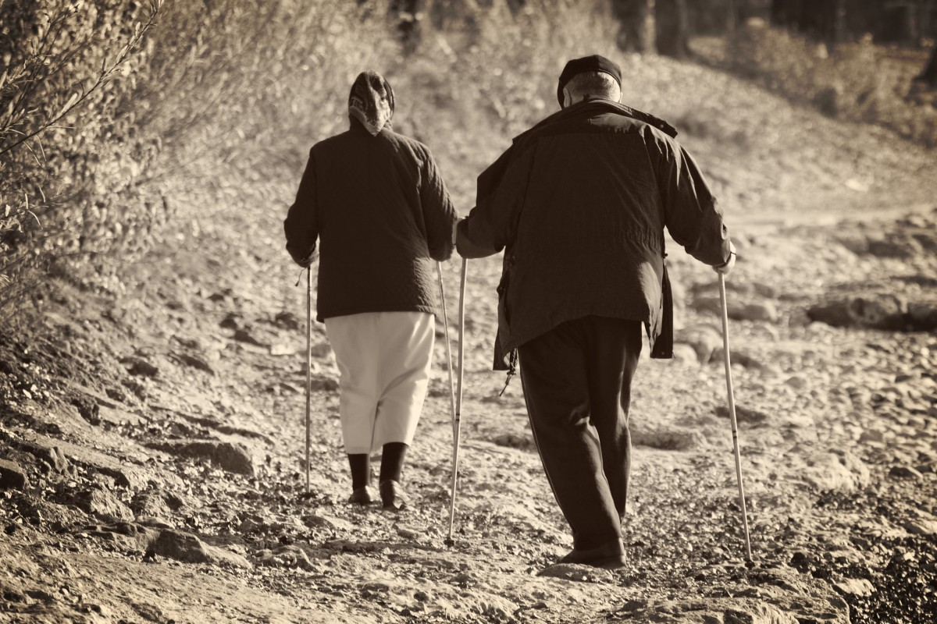
How far you'd go

Slide 5
I know I let you down
But it's not like that now

Slide 6
This time I'll never let you go
I will be, all that you want

Slide 7
And get myself together
Cause you keep me from falling apart

Slide 8
All my life, I'll be with you forever

Slide 9
To get you through the day
And make everything okay

Slide 10
I thought that I had everything
I didn't know what life could bring
But now I see, honestly

Slide 11
You're the one thing I got right
The only one I let inside
Now I can breathe, cause you're here with me

Slide 12
And if I let you down
I'll turn it all around
Cause I will never let you go

Slide 13
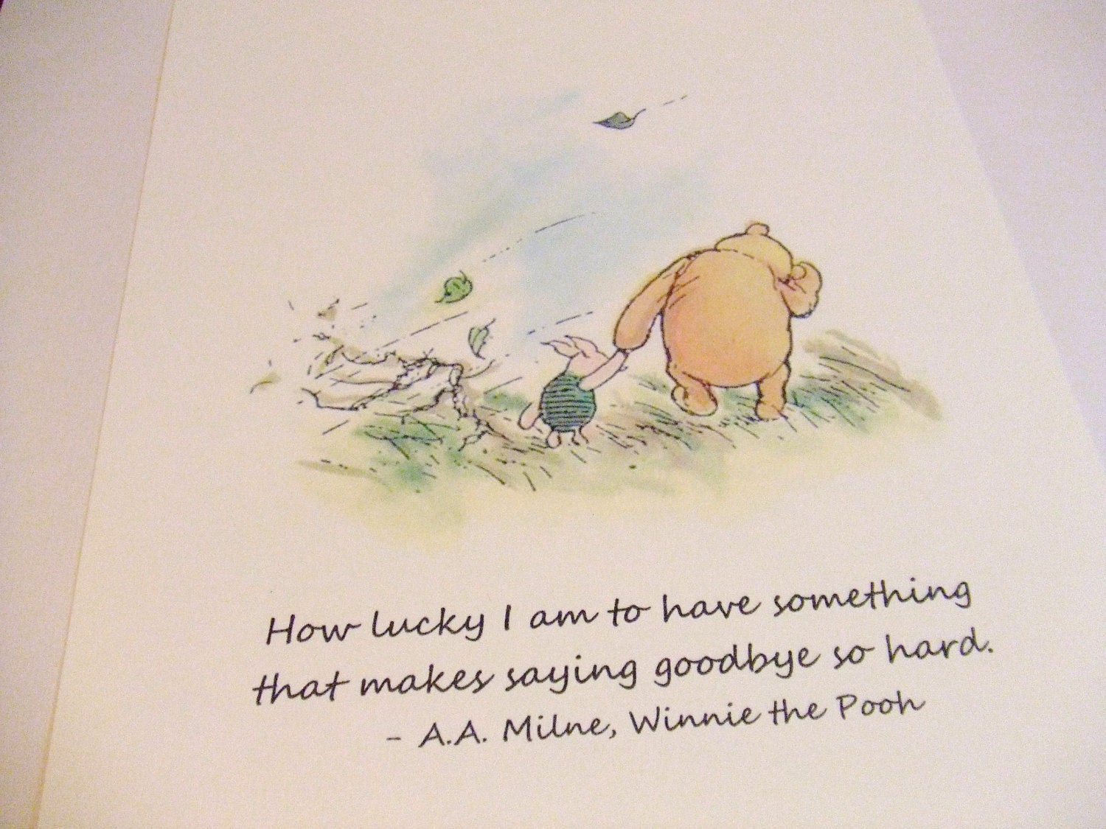
I will be, all that you want
And get myself together

Slide 14
Cause you keep me from falling apart
All my life, I'll be with you forever

Slide 15
To get you through the day
And make everything okay

Slide 16
Cause without you I can't sleep
I'm not gonna ever, ever let you leave

Slide 17
You're all I've got, you're all I want
And without you I don't know what I'll do
I can never, ever live a day without you

Slide 18
Here with me, did you see
You're all I need

Slide 19
I will be, all that you want
And get myself together

Slide 20
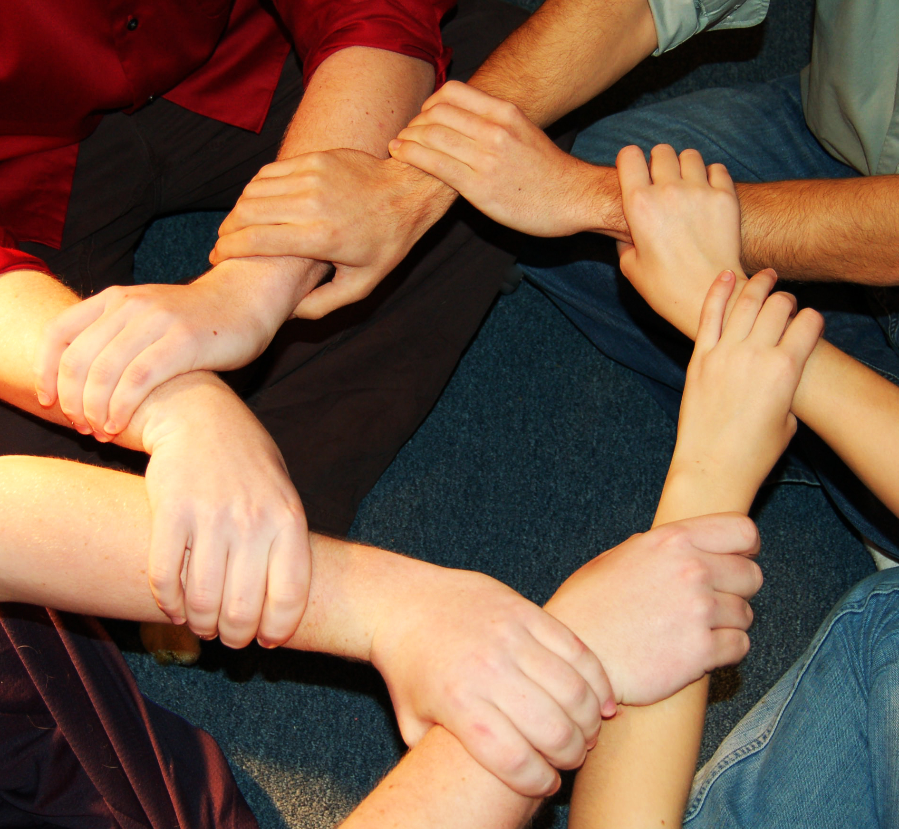
Cause you keep me from falling apart
All my life, I'll be with you forever

Slide 21
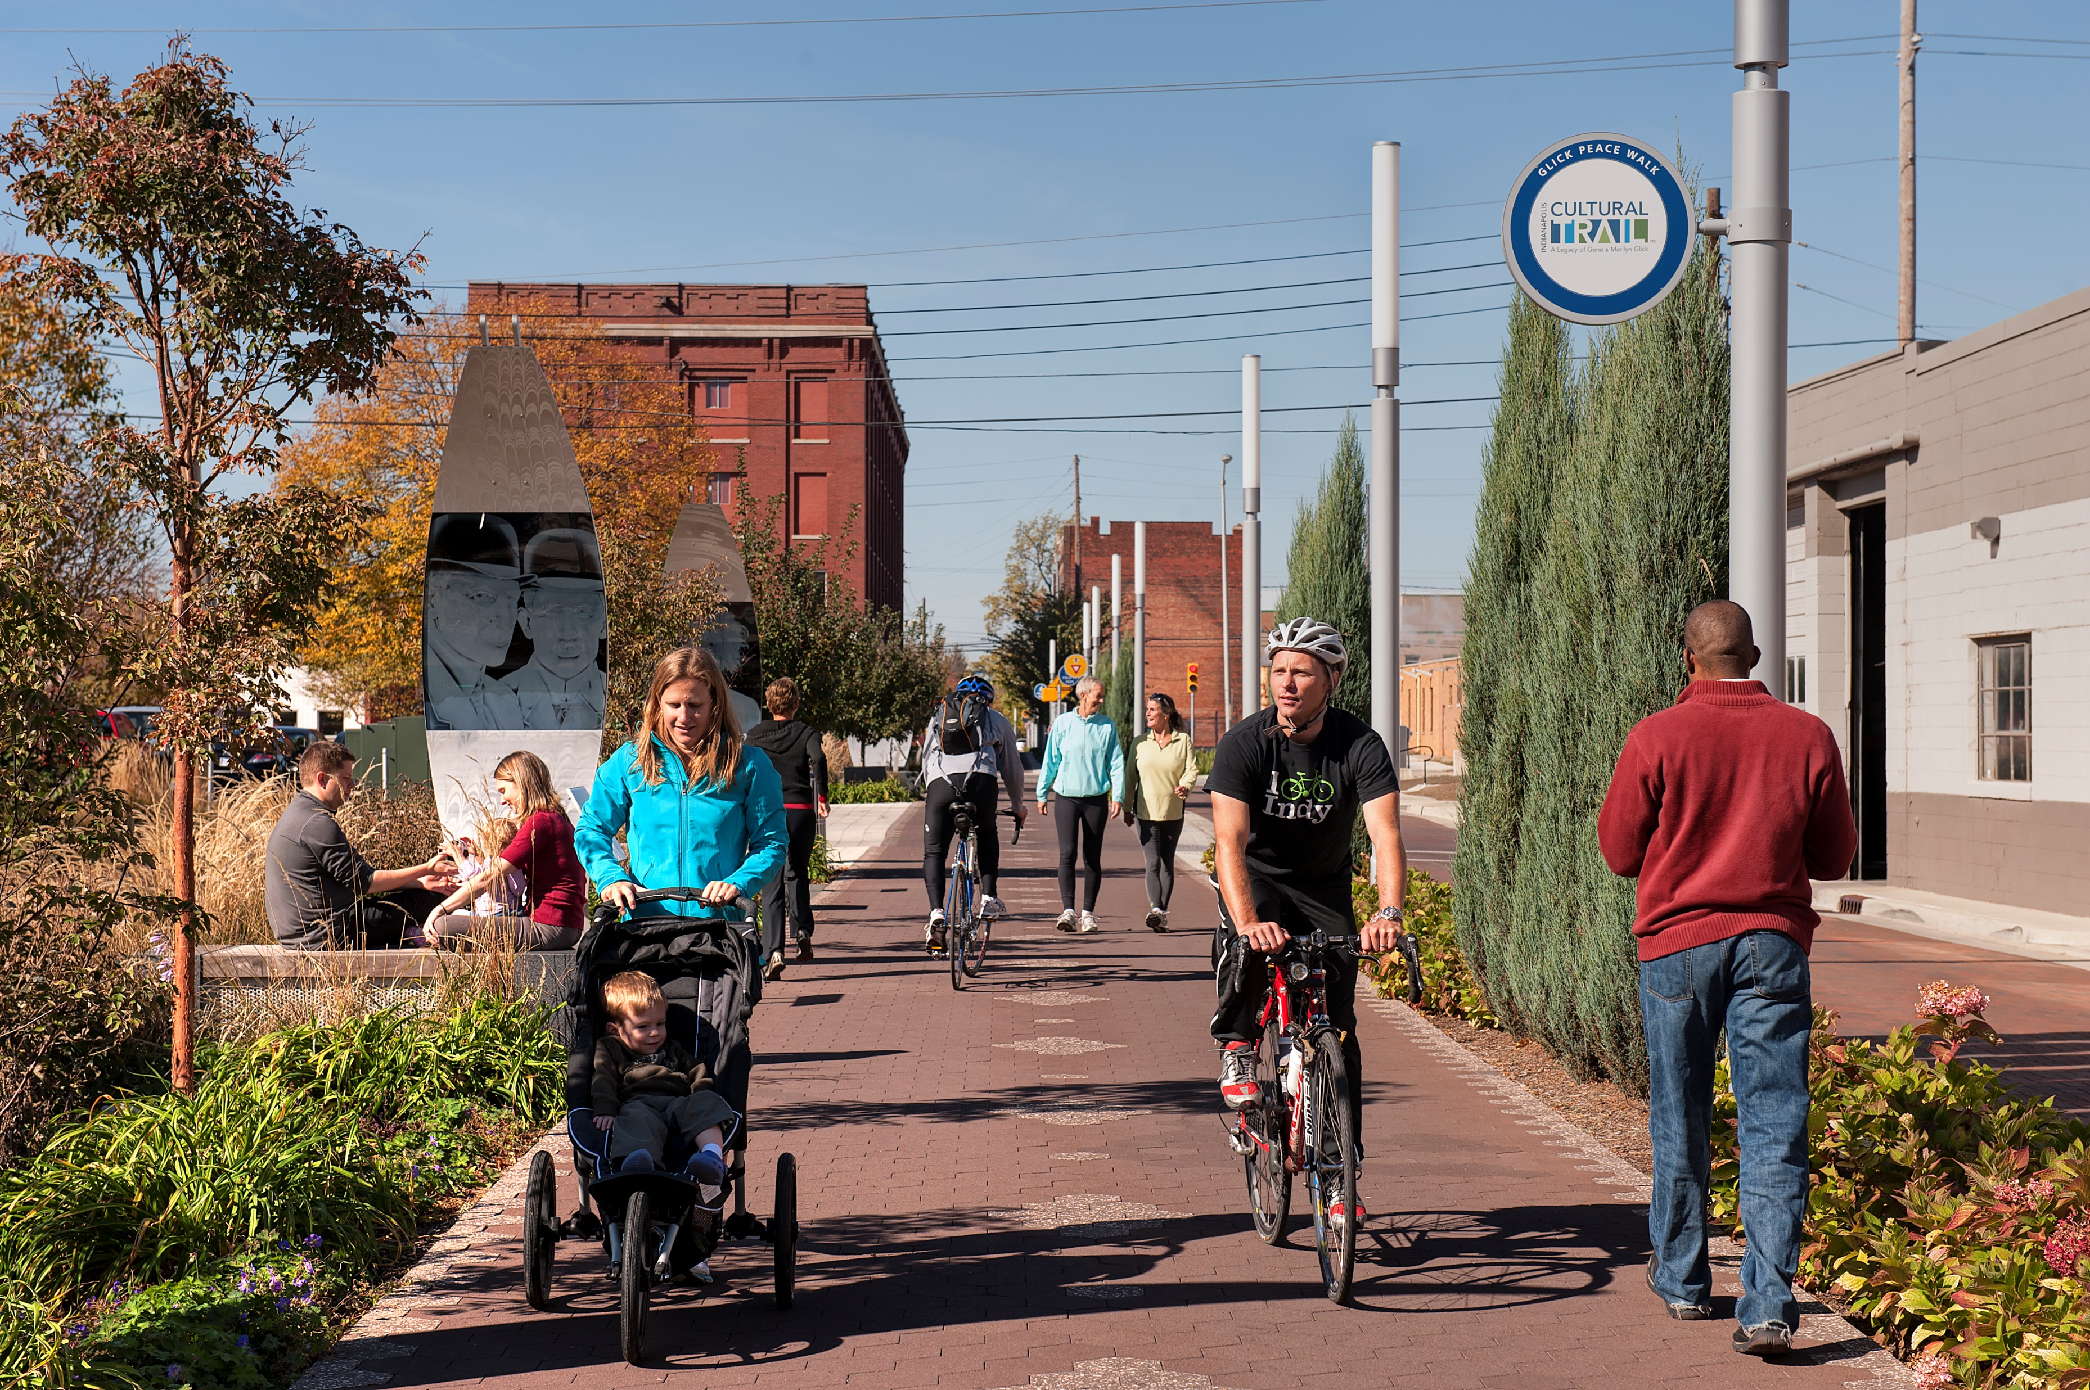
To get you through the day

Slide 22
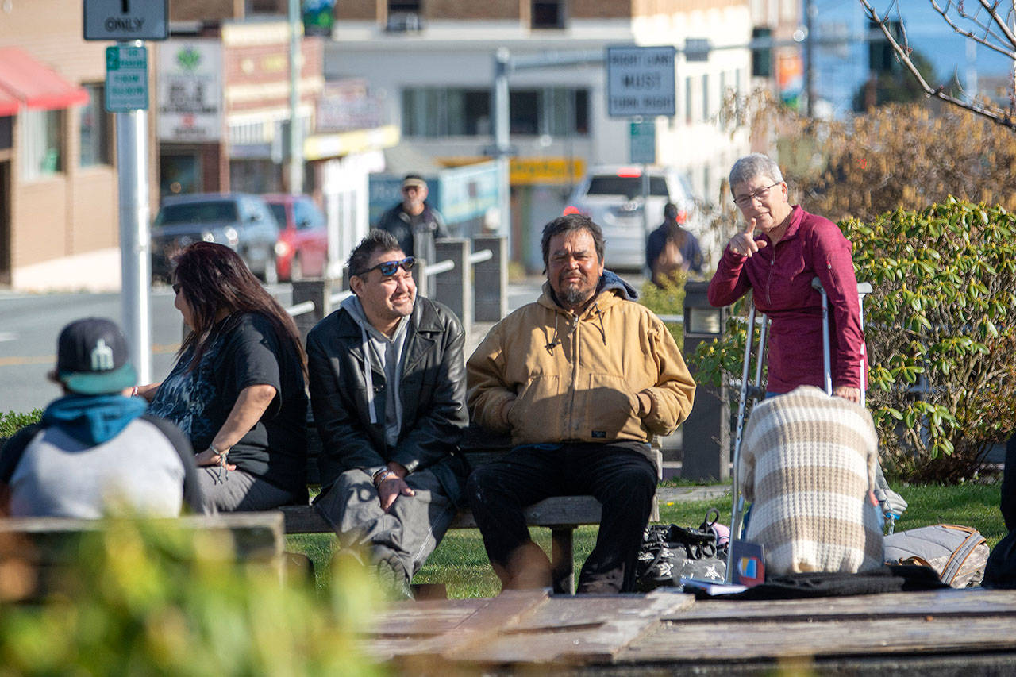
And make everything okay

Slide 23
I will be, all that you want
And get myself together

Slide 24
Cause you keep me from falling apart

Slide 25
All my life, I'll be with you forever

Slide 26
To get you through the day

Slide 27
And make everything okay

