Slide 1
Traveling Light 副词
华南师范大学外国语言文化学院 徐慧清
广东省河源市紫金县尔崧中学 廖利苹

Slide 2
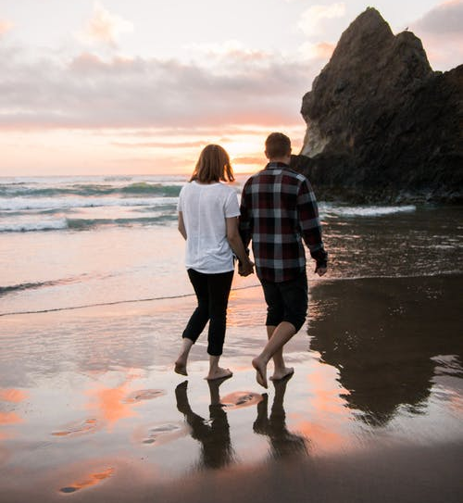
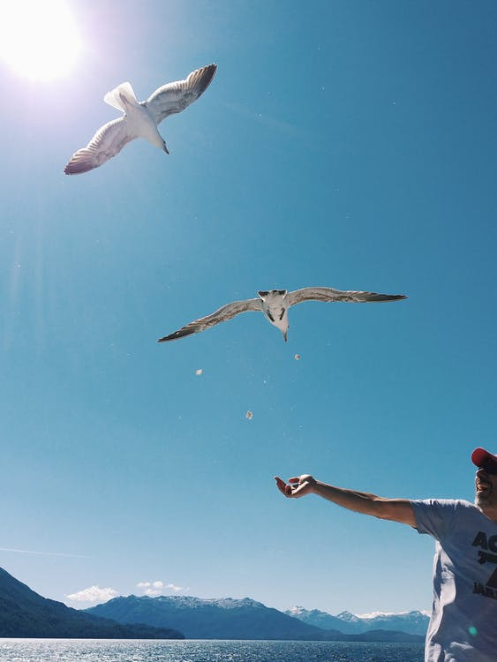
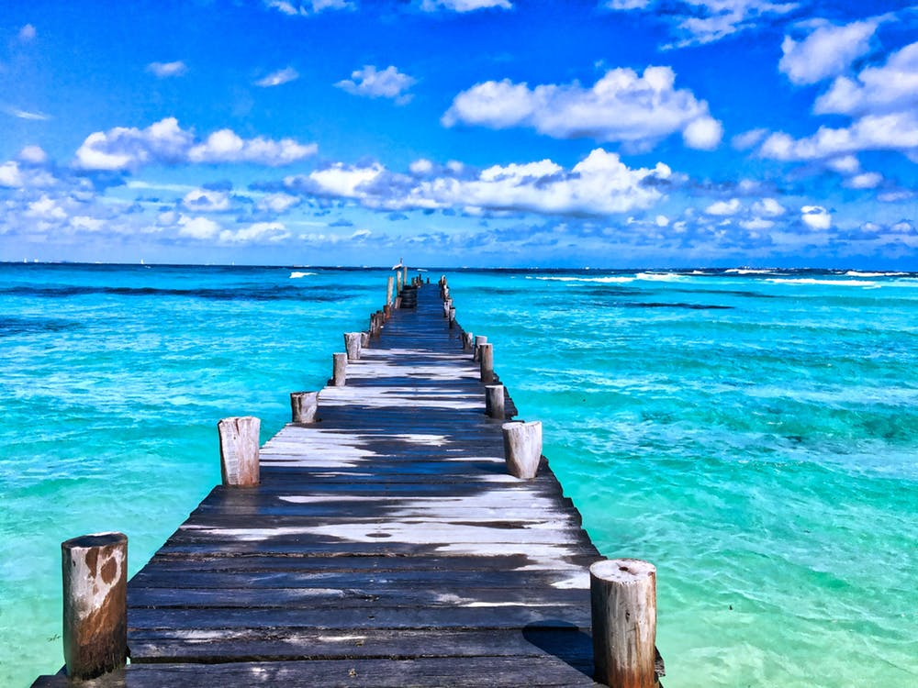
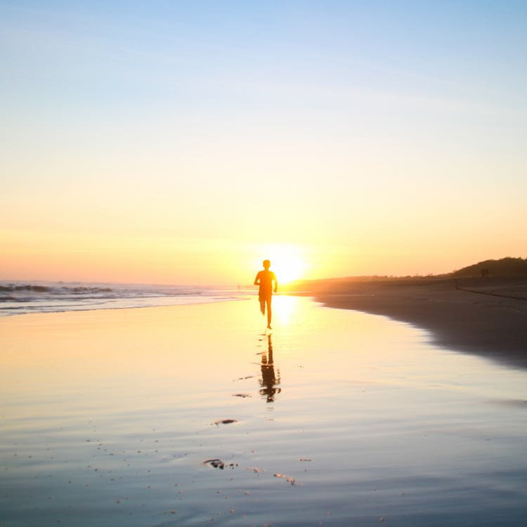
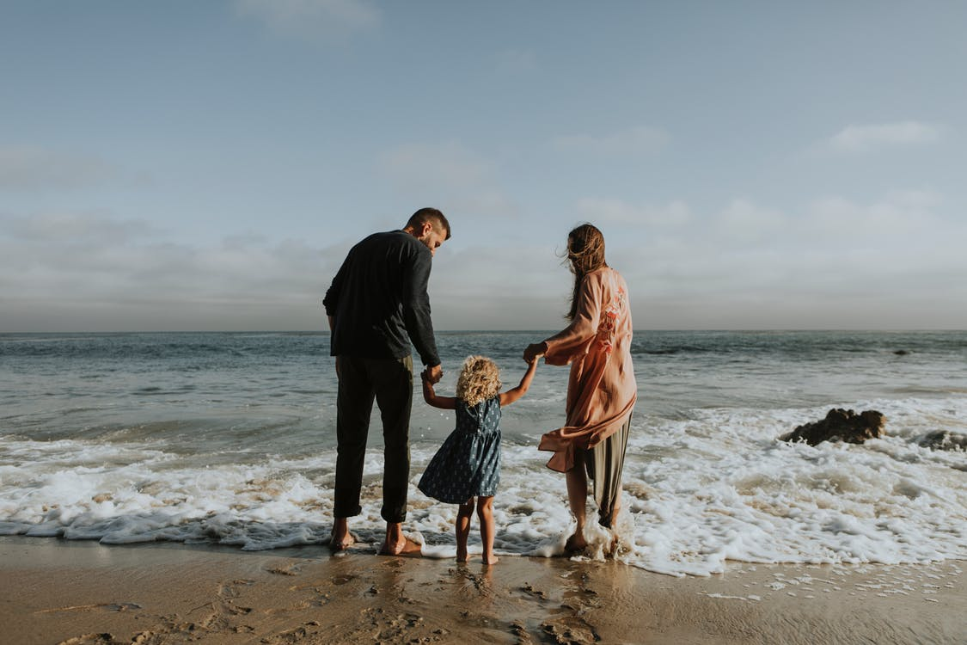
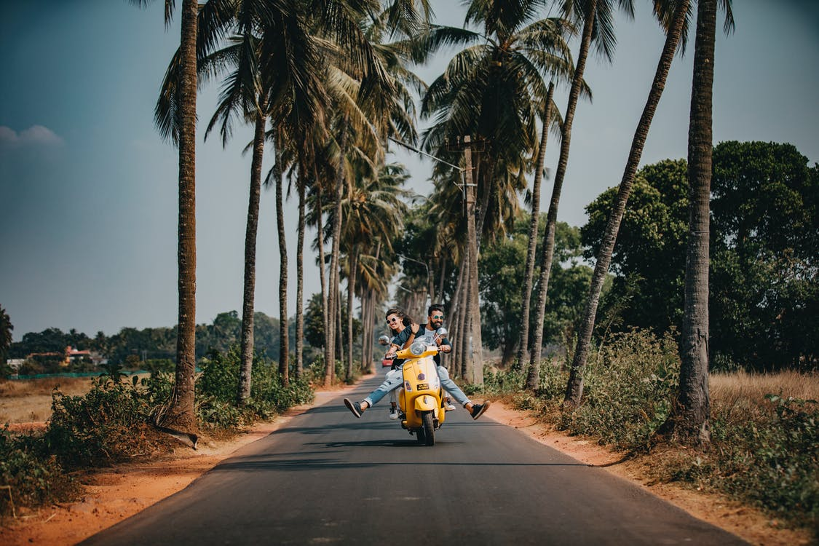
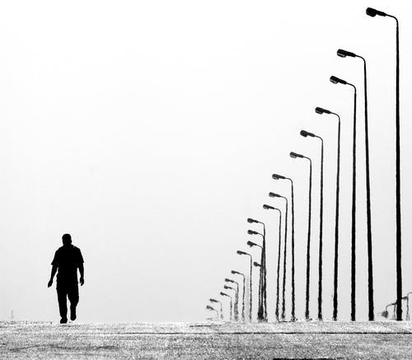
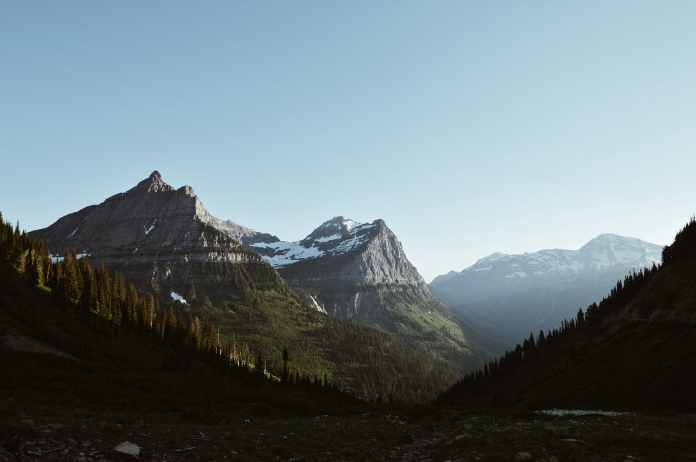
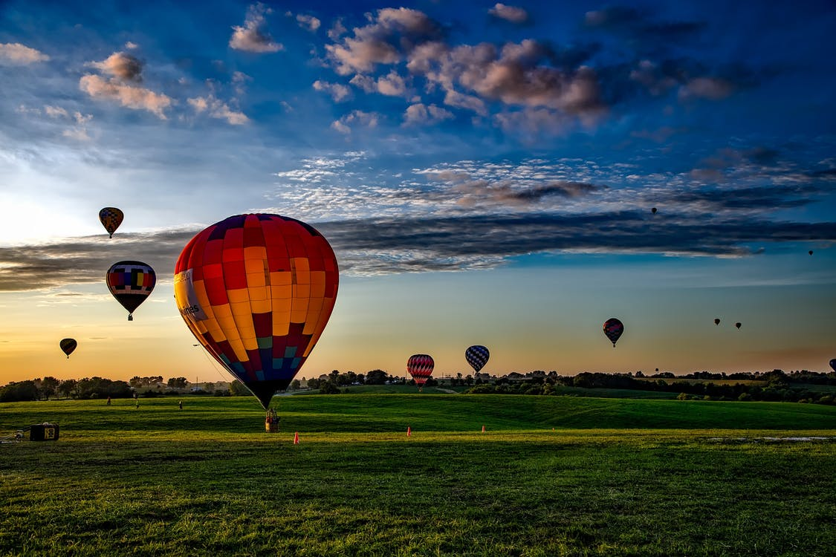
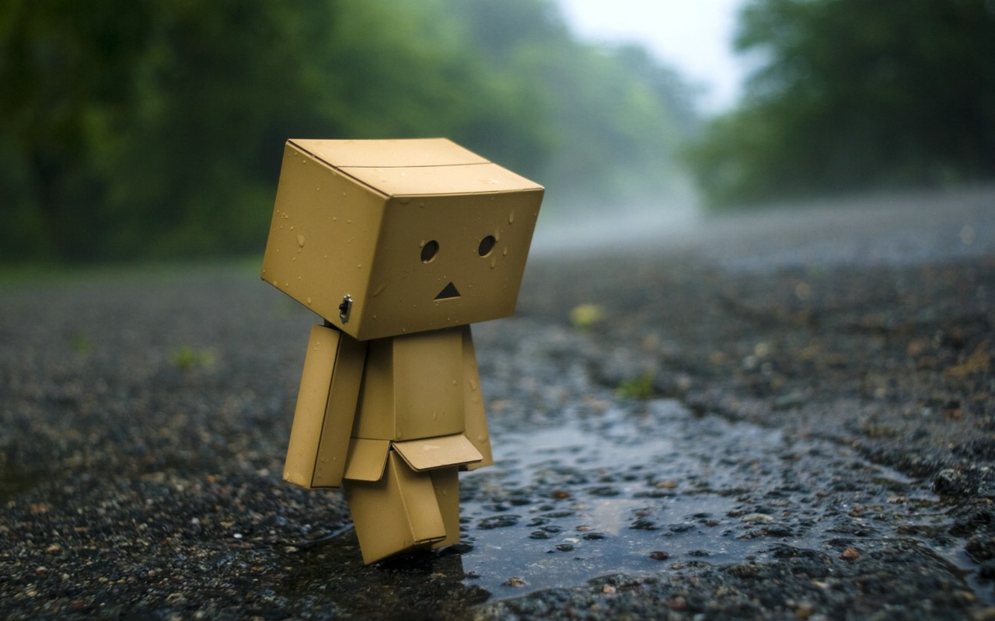
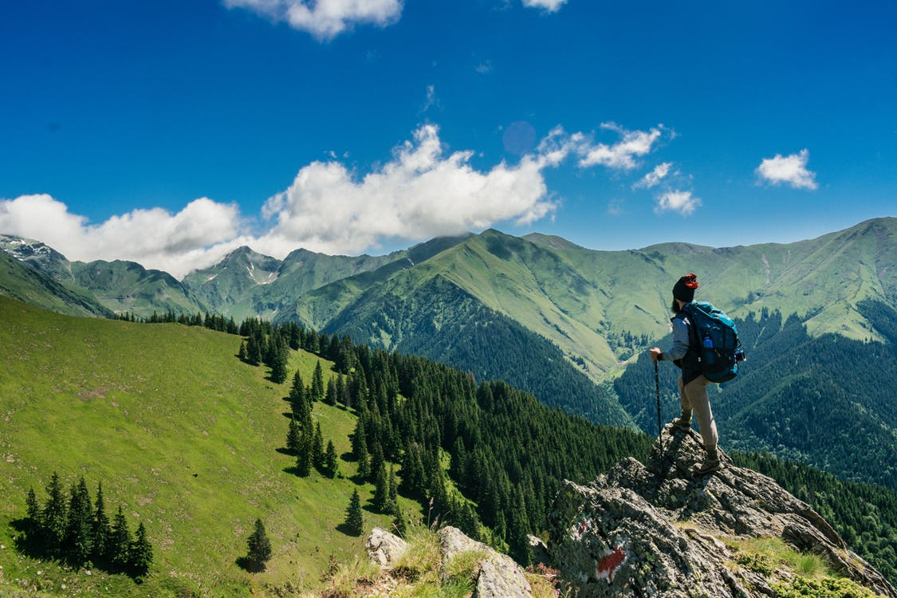
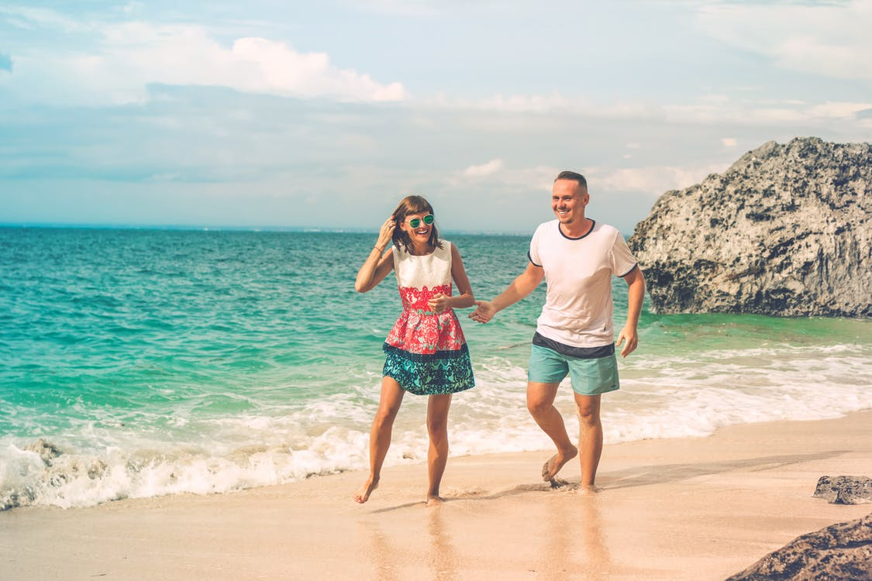
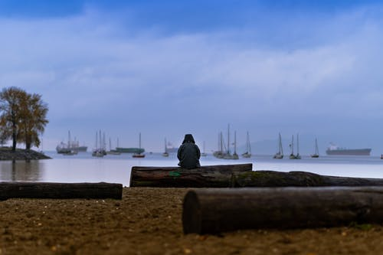
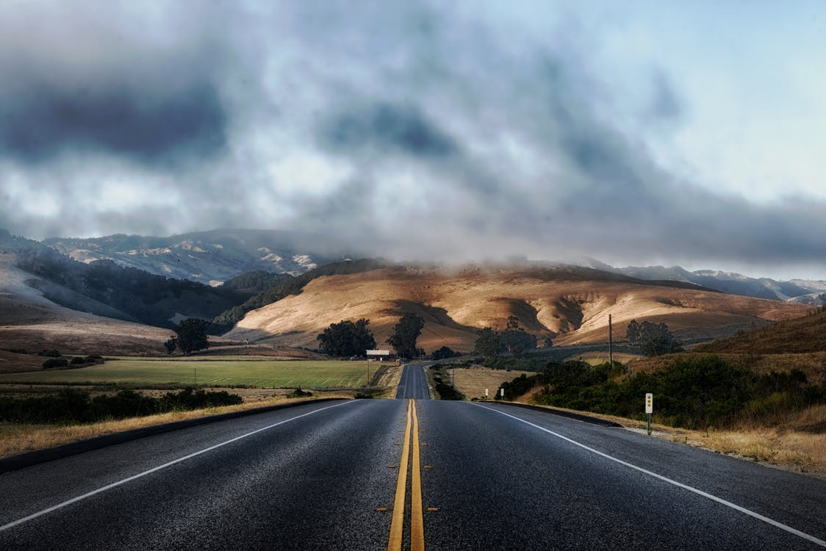
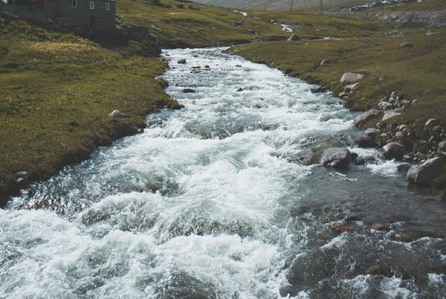
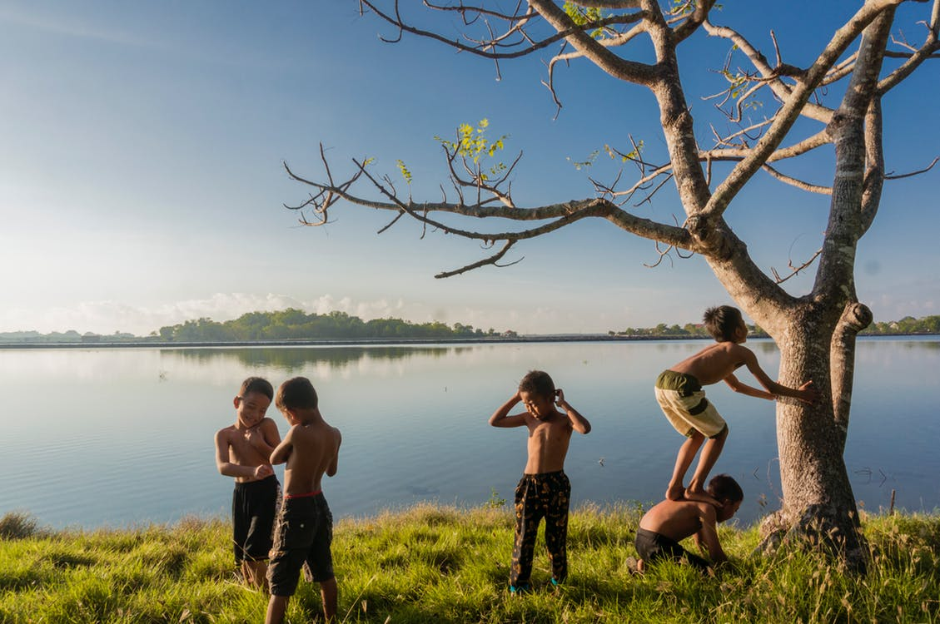
And with each step taken my back was breaking
Well I was doubling over the load on my shoulders
I was dragging those heavy chains of doubt and fear
Til I found the One who took it all from me
I was hauling those souvenirs of misery
Crossing miles of frustrations and rivers a raging
Then with the one word spoken the locks were broken
Was a weight I carried with me everyday
Picking up stones I found along the way
Now He's leading me to places where there are no tears
Through the darkest alleys and loneliest valleys
Now I'm traveling light
Now I'm traveling light
Now I'm traveling light
Now I'm traveling light
Now I'm traveling light
Traveling Light
I
found
my
freedom
now
Down
by
the
riverside
I
found
my
freedom
now
I
found
my
freedom
now
I
found
my
freedom
now
Down
by
the
riverside
I
found
my
freedom
now
Down
by
the
riverside
Down
by
the
riverside
I
found
my
freedom
now
Down
by
the
riverside
My spirit lifted high
My spirit lifted high
And I'm traveling light
My spirit lifted high
My spirit lifted high
And I'm traveling light
My spirit lifted high
And I'm traveling light
I
laid
my
burdens
down
Traveling Light
And I'm traveling light
I
laid
my
burdens
down
I
laid
my
burdens
down
And I'm traveling light
I
laid
my
burdens
down
I
laid
my
burdens
down
I staggered and I stumbled down
Pathways of trouble

